Slide 1
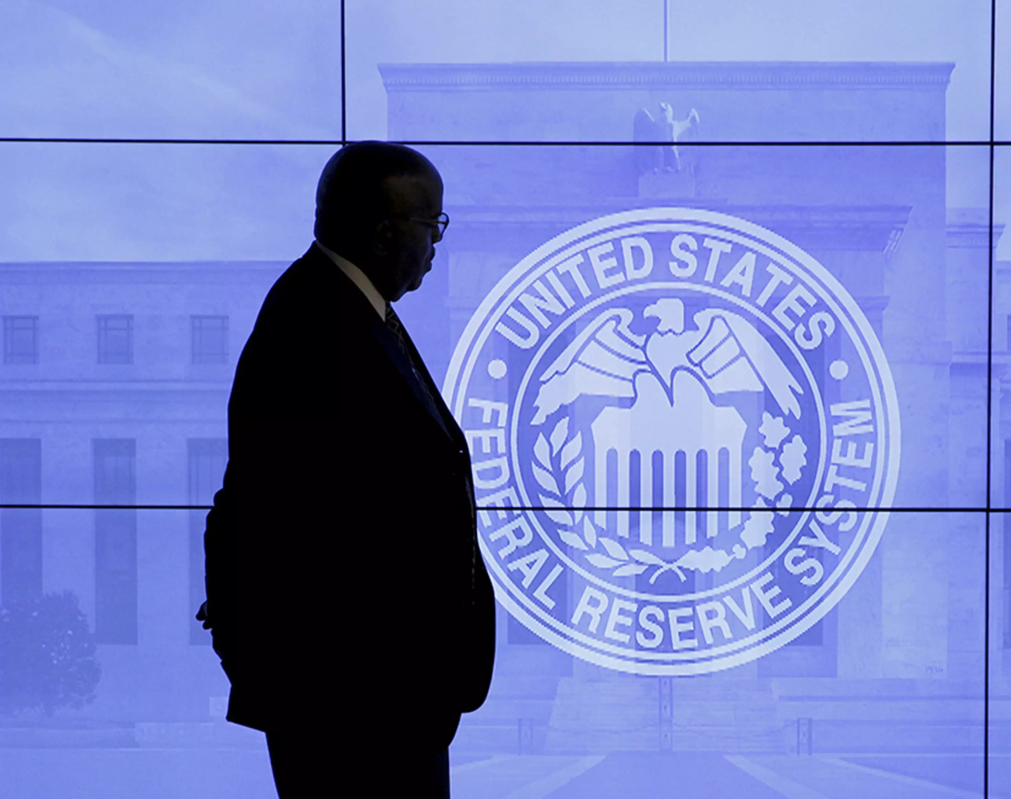
Role of the Federal Reserve & Central Bank

Slide 2
HEADLINE NEWS:
Over the past decade, the Fed kept interest rates low while it deployed trillions of dollars in stimulus and expanded its regulatory oversight. Now, the central bank is back in the spotlight for its battle against inflation.
The COVID-19 pandemic and repercussions from the Russian invasion of Ukraine have spurred alarming inflation, pushing the Fed to sharply raise rates in 2022.

Slide 3

The Federal Reserve is the most powerful economic institution in the United States. It is responsible for managing monetary policy and regulating the financial system.
  It does this by setting interest rates, influencing the supply of money in the economy, and, in recent years, making trillions of dollars in asset purchases to boost financial markets.

Slide 4
The Fed – An Overview
The Federal Reserve, also known as the "Fed", is the central bank of the United States. Its primary roles and responsibilities include:
  Conducting monetary policy: The Fed's main objective is to promote maximum employment, stable prices, and moderate long-term interest rates. It does this by adjusting the money supply and interest rates through a variety of tools, such as open market operations, reserve requirements, and discount rates.
  Supervising and regulating banks: The Fed is responsible for supervising and regulating banks and other financial institutions to ensure the safety and soundness of the financial system. It also regulates consumer protection laws and enforces anti-discrimination laws.
  Maintaining financial stability: The Fed works to maintain financial stability by monitoring and addressing systemic risks and disruptions to the financial system. It also provides emergency lending facilities to banks and other financial institutions in times of crisis.
  Providing payment services: The Fed provides payment services to banks and other financial institutions, including check clearing, wire transfers, and automated clearinghouse services.
Overall, the Federal Reserve plays a critical role in the U.S. economy by promoting economic growth, maintaining financial stability, and ensuring the safety and soundness of the financial system.

Slide 5
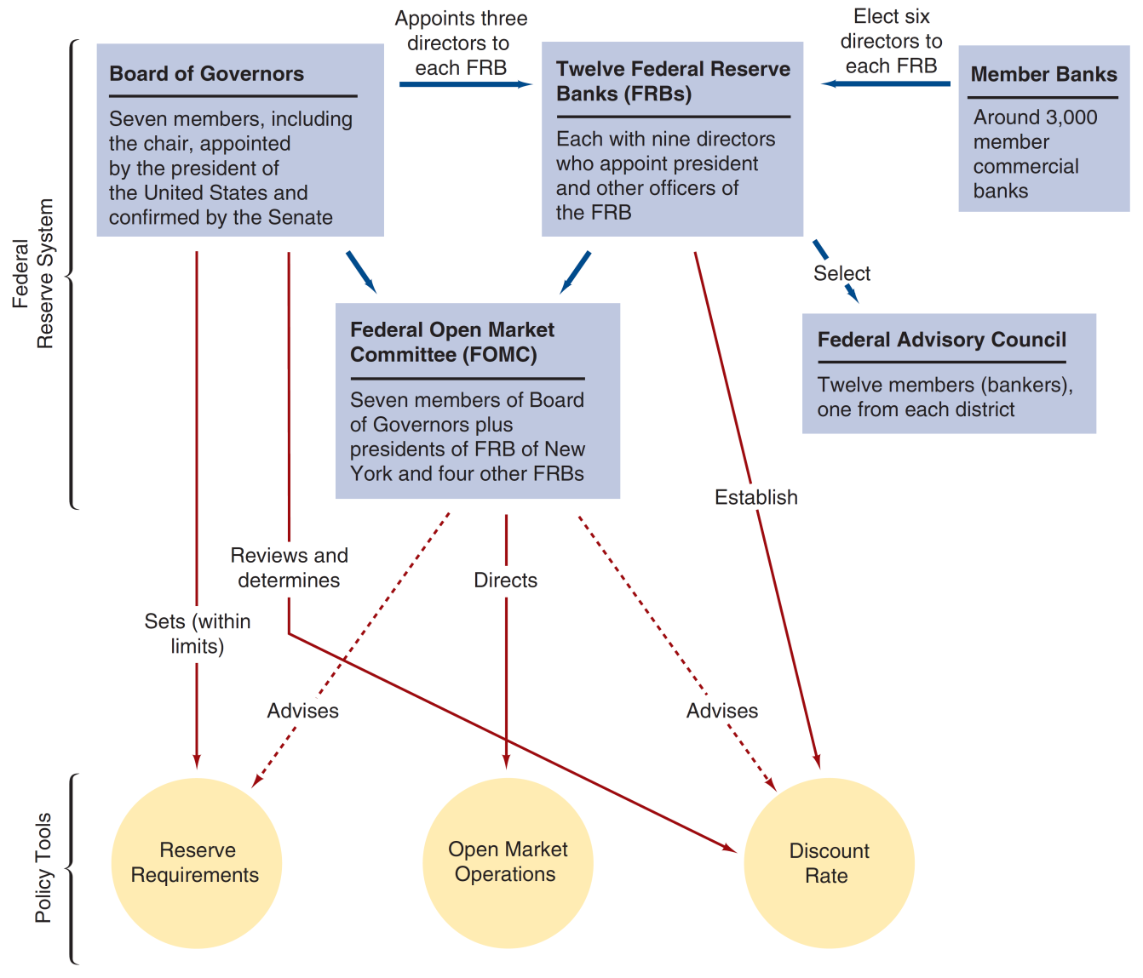
Figure 9.1 Structure and Responsibility for Policy Tools in the Federal Reserve System
Notes:
The slide outlines the relationships of these entities to one another and to the three policy tools of the Fed:
Open market operations
Discount rate
Reserve requirements

Slide 6
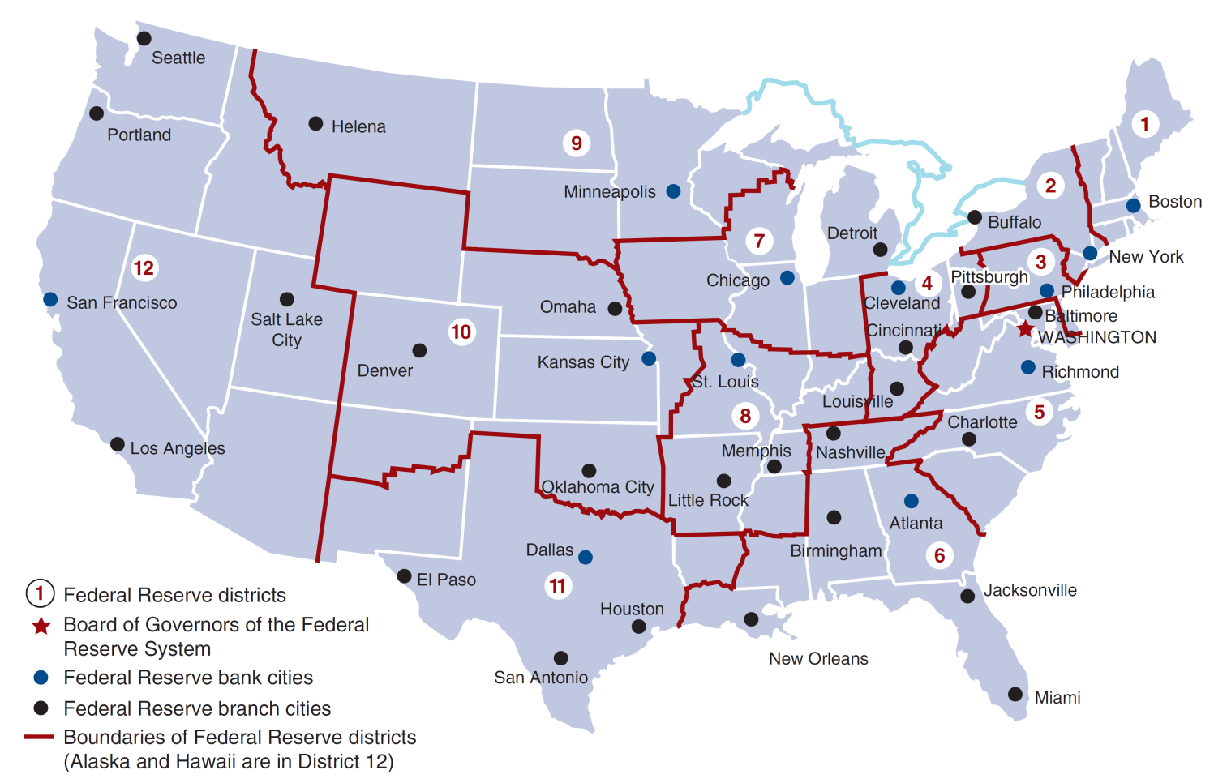
Figure 9.2 Federal Reserve System
Notes:
The next slide shows the location of the 12 main Federal Reserve Banks, and other prominent cities in the Federal Reserve System.
You are going to groups. Each group can act on behalf of one Federal Reserve Bank.

Slide 7
Chairman of the Federal Reserve System
Spokesperson for the entire Federal Reserve System, and supervises the Board’s staff
Negotiates, as needed, with Congress and the President of the United States
With these, the chairman has effective control over the system, even though he doesn’t have legal authority to exercise control over the system and its member banks.
Notes:
The second most powerful figure, next to the President. Sometimes even more important in terms of economic policy.

Slide 8
Board of Governors (1 of 2)
The seven governors are appointed by the President, and confirmed by the Senate, for 14-year terms on a rotating schedule.
All Board members are members of the FOMC.
Sets reserve requirements and effectively set the discount rate.

Slide 9
Board of Governors (2 of 2)
Serve in an advisory capacity to the President of the United States, and represent the U.S. in foreign economic matters.
Other duties as established by legislation (e.g., Regulation Q, Credit Control Act of 1969).
Set margin requirements for stock purchases.
Sets the salary of the president and all officers of each Federal Reserve bank and reviews each bank’s budget.

Slide 10
Federal Open Market Committee
Make decisions regarding open market operations, to influence the monetary base.
The chairman of the BOG is also the chair of this committee
Open market operations are the most important tool that the Fed has for controlling the money supply (along with reserve requirements and the discount rate)
Decisions about tightening (contractionary) of monetary policy (a rise in the federal funds rate) or an easing (expansionary) of monetary policy (a lowering of the federal funds rate) or neutral.
All actions are directed the Federal Reserve Bank of New York, where securities are bough / sold as required.
Notes:
Now let’s talk about the most important function of Federal Reserve System.

Slide 11
Twelve Federal Reserve Banks
Each of the twelve districts has a main Federal Reserve Bank and at least one branch office
The banks are “quasi-public”
  Owned by member commercial banks in the district
  Member banks elect six directors, while three directors are appointed by the Board of Governors
  Directors represent professional bankers, prominent business leaders, and public interests (three from
  each group)

Slide 12
What is Monetary Policy
Monetary Policy is a set of decisions that the central bank (sometimes called the Federal Reserve) makes about how much money should be in circulation and what interest rates should be.
The goal of monetary policy is to help the economy grow while keeping inflation stable. There are many different tools at the central bank’s disposal to achieve these goals, but they all have consequences. This blog post will explore some of these tools, as well as their impacts on different parts of the economy and people.

Slide 13
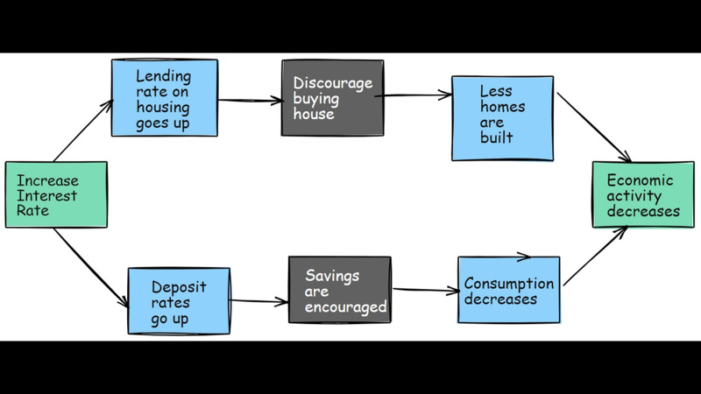
How Monitory Policy Works

Slide 14
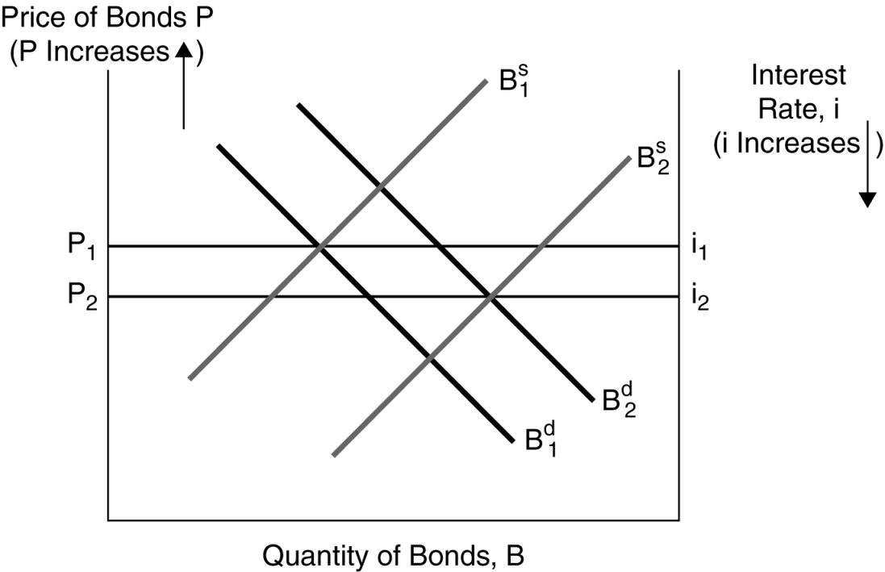
The Goal of the Fed to Increase Economic Growth
In the figure, the most likely cause of the equilibrium interest rate from i1 to i2 is an increase in economic growth

Slide 15
How Does Monetary Policy Work - Review
Central banks, such as the Federal Reserve, control monetary policy.
They use a variety of tools to maintain economic stability and ensure that inflation stays low (around 2%).
Tools include adjusting interest rates, changing the amount of money in circulation, and buying or selling bonds.
For instance, if there is very high inflation, they may raise interest rates which discourage people from borrowing and encourages them to save.
If there is too little inflation, they may lower interest rates which encourage people to borrow and spend.
By lowering rates, they make it cheaper for businesses to borrow money and invest.
As the demand for goods goes up, so does inflation.
By raising rates, the central bank reduces inflation by making it more expensive for consumers to buy things because prices go up when borrowing costs rise. In the US, the Federal Reserve Board sets interest rates by voting at its regular meetings.

Slide 16
Federal Reserve Bank Functions: General
Clear checks
Issue new currency and remove damaged currency
Administer and make discount loans to banks in their districts
Evaluate bank mergers and expansions
Liaison between local community and the Federal Reserve System
Perform bank examinations
Collect and examine data on local business conditions
Conduct research related to monetary policy

Slide 17
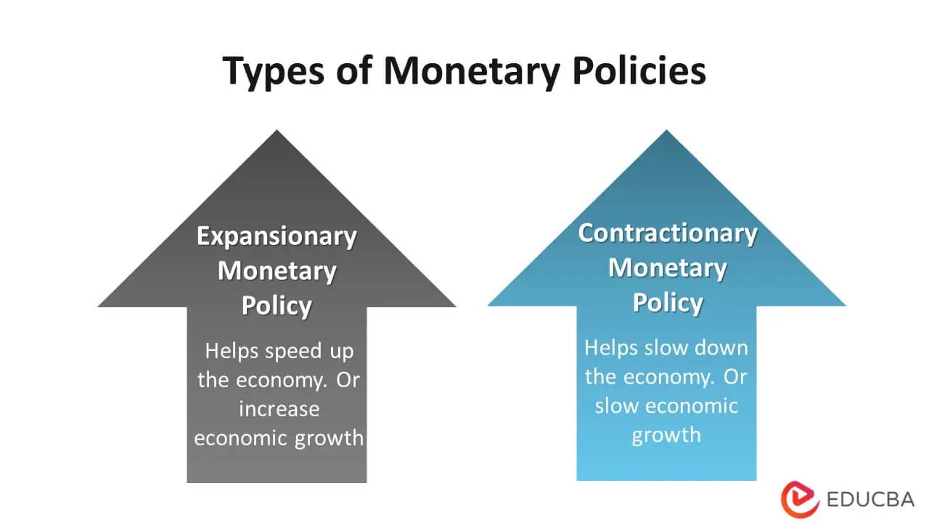
Types of Monetary Policy
There are two main tools of monetary policies:

Slide 18
There are two main tools of monetary policies:
Open market operations
Discount rate

Slide 19
Open market operations
With open market operations, a central bank buys or sells securities in order to change the money supply. A central bank can also adjust its target interest rates, which influences short-term and long-term interest rates.
An open market purchase shifts the supply curve for reserves to the right and may cause the federal funds rate to fall.
The Federal Reserve has control over open market operations as they affect changes in both short-term and long-term interest rates; the Fed doesn’t have direct control over the discount rate, so that tool has an indirect effect on those other rates.
If the Federal Reserve wants to lower the monetary base and the money supply, it will sell government securities.
For example, if unemployment remains high, then the Feds might try lowering the target rate while simultaneously buying up bonds from investors to increase liquidity and reduce their interest rates.

Slide 20
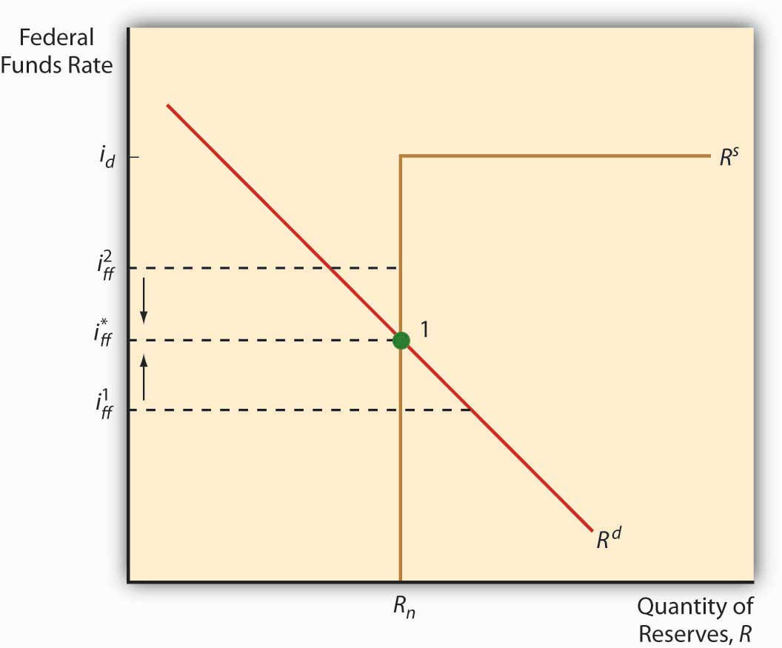
Open market operations
Reserve assets are assets that are readily available to and controlled by monetary authorities for direct financing of payment imbalances.

Slide 21
Discount rate
The discount rate is the interest rate charged by a central bank on loans to commercial banks.
Lowering this rate will encourage banks to borrow more from the central bank rather than borrowing elsewhere at higher rates, which increases the money supply.
The demand curve for reserves shifts to the right and the federal funds rate rises when the Fed increases reserves requirements.
Raising it makes borrowing more expensive and discourages banks from seeking loans.
The central bank can influence short-term interest rates by changing the discount rate.
The discount rate is how much the central bank charges commercial banks for loans, and it’s a key determinant of short-term interest rates because when commercial banks borrow from the central bank, they charge higher rates to their customers.
The idea is that if you change the rate at which a bank can borrow from the central bank, then you affect the cost of money for all other borrowers in that market.

Slide 22
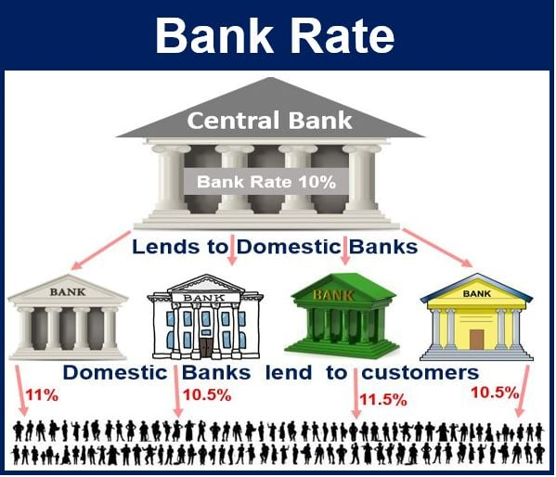
Discount rate
The term discount rate refers to the interest rate charged to commercial banks and other financial institutions for short-term loans they take from the Federal Reserve Bank. The discount rate is applied at the Fed's lending facility, which is called the discount window

Slide 23
Money Supply & Monetary Base
Money Supply:
Monetary policy impacts the value of your money by changing the amount of money in circulation and how quickly it circulates through the economy. This can influence prices, interest rates, and employment levels, which can affect your personal finances.
Monetary Base:
The central bank, such as the Federal Reserve, has the ability to control the money supply by adjusting the monetary base through various monetary policy tools, such as open market operations, reserve requirements, and discount rates.
By controlling the money supply, the central bank can influence interest rates, inflation rates, and economic growth.

Slide 24
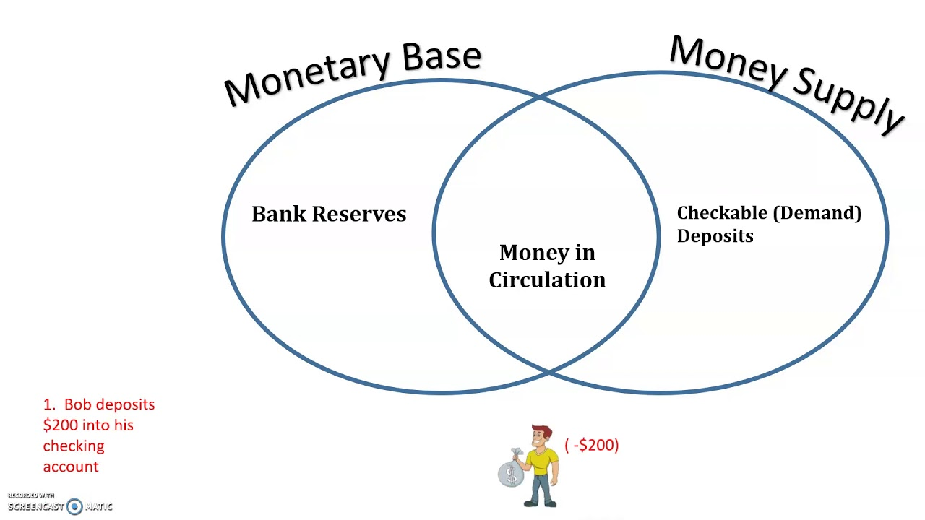
Money Supply & Monetary Base
Money Supply. In comparison to the money supply, the monetary base only includes currency in circulation and cash reserves at a bank. In contrast, the money supply is a broad term that encompasses the entire supply of money in a country

