Slide 1
PORTFOLIO RETURN ANALYSIS
Professor Droussiotis

Slide 2
Portfolio Project
An Asset Management Firm raised a new $200 million fund called Zeus Fund I.
The funds will be used to buy stock and corporate bonds.
The fund is leveraged at 50% - in other words, the $200 million fund is financed by $100 million of a loan and $100 million of newly raised equity.

Slide 3
FUND TRANSACTION SOOURCES & USES
Figure below shows the transaction sources and uses of the fund. The loan is structured as a 5-year $100 million with 5% fixed interest rate. At closing (June 1, 20x1), the $200 million fund is used for purchasing $82.6 million of stocks and $96.65 million of bonds. The manager has kept about $20mm or 10% in cash for liquidity earning 1.5% of annual interest income. The balance is used to pay accrued interest on the bonds

Slide 5
Stock Portfolio

Slide 12
Bond Portfolio

Slide 16
Combined Portfolio Analysis

Slide 18
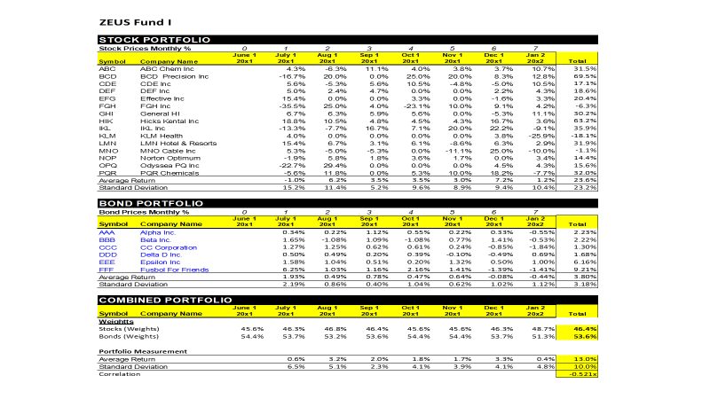

Slide 22
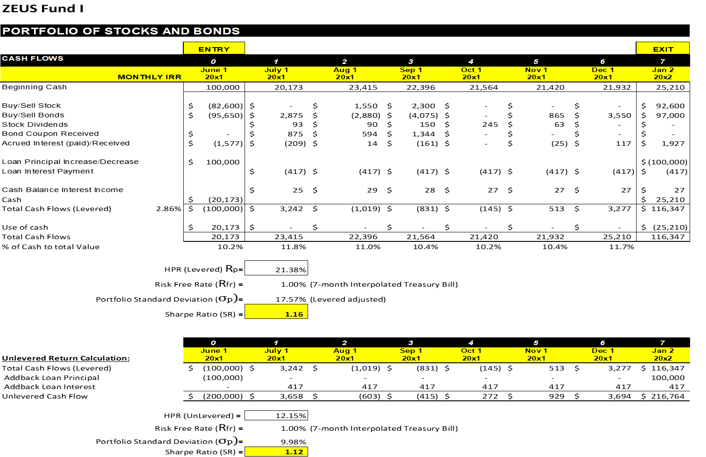

Slide 23




