Slide 1
Cross-border
Mergers & acquisitions
Professor Chris Droussiotis
Summer 2019

Slide 2

AGENDA
Managerial Strategies and the Need to Grow Globally via acquisitions
Mergers & Acquisition Overview
Cross-Border Merger & Acquisitions: Opportunities and Challenges
Mergers & Acquisition process
Analytical Approach to M&A, valuations and structures
Mergers & acquisitions – process (first round & second)
Accretion ABD dilution analysis

Slide 3
Managerial Strategies
Operational Strategy
  Revenue Growth (organic)
  Expense Management
  Hiring Talent
  Marketing the Product
Financial Strategy
  Raising Equity
  Raising Debt
Social Responsibility
  Governance
  Shareholders/ Employees / Government / Community
Transactional Strategy
  Merger
  Acquisitions
  Joint Ventures
  Strategic Alliances
  Greenfield Investment

Slide 4
Drivers of Cross Border M&A
Globalization and openness of financial markets
Geographical diversification
Deregulation of markets
Company efficiency
Hedging on Trade and Tariffs
Increase production
Technology and Innovation boom across cultures

Slide 5
Natural progression for A growth company
1
Companies started a domestic production
2
Companies started to export to the foreign markets
3
Companies established a subsidiary in overseas market
4
Companies started strategic alliances – customer acquisition
5
Companies started a Greenfield project – build manufacturing facility
6
Companies started to acquire other companies in foreign markets

Slide 6
Benefits of cross boarder M&A
Acceleration of business
Accessing capital
Synergies
Technology
Tax planning
Mitigation of trade and foreign exchange costs

Slide 7
Challenges of cross boarder M&A
Legal
Accounting
Strategic
Technology
Integration
Human Resources
Cultural

Slide 8
Challenges of cross boarder M&A
Legal Issues
  Acquirer need to understand all the legal provisions of the foreign country
  After understanding the local laws, the acquirer many find that these provisions are incompatible, resulting to lengthy process and company policy changes
  Ex-pat and HR laws / Visa issues
  Labor laws
  Sarbanes & Oxley – Laws on publicly traded companies

Slide 9
Challenges of cross boarder M&A
Accounting Issues
  Merging entities have different internal controls
  Absence of uniformity of internal controls could lead to mismanagement
  Accounting Standards (International Vs US GAAP)
  Merger accounting – adjustments to the Balance Sheet could result to overvalue or undervalue

Slide 10
Challenges of cross boarder M&A
Technological Differences
  Integration challenges due to different technology platforms
Strategic Issues
  Achieving synergies can be challenging including
    cost savings
    plant rationalization
    Labor issues
    IT integration
    marketing integration
    management changes

Slide 11
Challenges of cross boarder M&A
Cultural Differences
  Corporate Governance
  Job Security
  Regular and external environments
  Customer Expectations
  Operating styles due to different backgrounds
  Country culture and different values

Slide 12
Challenges of cross boarder M&A
Human Resources Issues
  Motivation & Morale
  Layoffs and voluntary leave
  Employee stress due to uncertainty
  Career paths of each employee could be ultered
  Organizational changes

Slide 13
PROCESS OF ACQUIRING the target company
Stage 1
Identification & Valuation
Stage 2
The Tender offer and Settlement
Stage 3
Post –Acquisition Management

Slide 14
PROCESS OF ACQUIRING the target company
Stage 1
Identification & Valuation
Well Define Corporate Strategy
Public vs Private Company
Quantify the Return (ROI) and Risk
Valuation Methodologies
Accretion vs Dilution Analysis

Slide 15
PROCESS OF ACQUIRING the target company
Stage 2
Identification & Valuation
Well Define Corporate Strategy
Public vs Private Company
Quantify the Return (ROI) and Risk
Valuation Methodologies

Slide 16
PROCESS OF ACQUIRING the target company
Stage 2
Tender Offer & Settlement
(after the Target has been identified)
Securing the approval of the management and ownership of the target company to government and regular bodies (friendly vs hostile takeover)
Settlement compensation – payment to the shareholders of target company
  Cash or Common stock
  Accretion vs Dilution Analysis
  Various factors for determining the methods used for settlement availability of cash, sixe of target firm
  Access to Capital

Slide 17
PROCESS OF ACQUIRING the target company
Stage 3
Post-Acquisition Management
This is very important stage because it ill determine is relatively quick order the success or failure of the acquisition
The objective is to create shareholder value
Problems identified earlier including the failure of meeting synergies, high cost of integration and difficult corporate culture

Slide 18
Modes of Mergers & Acquisitions
M&A
Amalgamation
Merger
De-Merger
Acquisition
Asset Purchase
Stock Purchase

Slide 19
U.S. Regulations on Public Targets
Proxy Statements
Schedule TO/Schedule 14D-9
Registration Statement/Prospectus (S04. 424B)
Schedule 13E-3
8K / 10K / 10Q

Slide 20
U.S. Regulations on private Targets
Not required to public filing of documents
When a public company buys a private company (or a division/subsidiary of a public company) it may require to file certain disclosure documents
Issuing shares in excess of 20%
LBOs – accessing public bonds – file with the SEC (S-4)

Slide 21
Primary sec filings in m&a transactions
SEC Proxy Statements | Description
Prem 14A /Defm 14A | Preliminary/definitive proxy statement relating to an M&A transaction
Prem 14C / Defm 14C | Preliminary / definitive information statement relating to an M&A transaction
Schedule 13E-3 | Filed to report going private transactions initiated by certain issuers or their affiliates
SEC Tender Offer | Description
Schedule TO | Filed by an acquirer upon commencement of a tender offer
Schedule 14D-9 | Recommended from the target’s board of directors on how shareholders should respond to a tender offer
SEC Registration Statement Prospectus | Description
S-4 | Registration statement for securities issued in connection with a business combination with a business combination or exchange offer. May include proxy statement of acquirer and/or public target
424B | Prospectus

Slide 22
Identifying the candidate
DEFINE THE STRATEGY
  State the Objective: i.e. Revenue Growth / Trade Barriers / Cost Efficiencies
  Identify the Business Model & Markets: i.e. Technology / Product
  Price Range Expectation and accessing capital (Debt/Equity balance)
  Zero in on few target candidates
  Begin the preliminary analysis – Valuation, Accretion and Return analysis

Slide 23
Screening Basic information
Company: AK Steel Holding Co.
Products: Flat-rolled carbon, stainless, and electrical steels, flat-rolled carbon steel products, including coated, cold-rolled, and hot-rolled carbon steel products; grain-oriented specialty stainless and electrical steels; and carbon and stainless steel tubing products.
Customers: Automotive manufacturers; customers in the infrastructure and manufacturing markets, including the manufacturers of power transmission and distribution transformers, who produce equipment for the electrical grid.
Other: AK Steel Holding Corporation was founded in 1993 and is headquartered in West Chester, Ohio.
SOURCE: https://finance.yahoo.com/quote/AKS?p=AKS

Slide 24
Analytical Approach to M&A
VALUATION METHODS:
  Method 1: Using the current stock price as a basis of valuation
  Method 2: Comparable method using Trading EBITDA Multiples
  Method 3: Comparable method using Acquisition EBITDA Multiples
  Method 4: Discount Cash Flow Method (DCF)
  Method 5: Leveraged Buyout Private Equity Expectation Model (LBO)

Slide 25
Method 1:
Using the Stock Price as the basis of valuation
The stock price represents the value of the company.
The company issues financial statements every three months and other non-financial information as they come up, so how does the stock price behave like this?
It is said that the stock price moves based on technical, fundamental and behavioral reasons and there are plenty of analytical approaches that back each of these three reasons.
      EV = MVE + D – C and MVE = (SP + SO)
                where EV is Enterprise Value, MVE is the Market Value of the Equity, D is the total Debt Outstanding and C is the Cash and cash equivalents of the company. where MVE is the Market Value of the Equity, SP is the Stock Price and SO is the Shares Outstanding.

Slide 26
Method #1
ENTERPISE VALUE: $2.96 Billion

Slide 27
Method 2
Using Comparable Trading EBITDA Multiples
The most commonly used method by mergers & acquisitions professional
Looks at the ratio of the Enterprise Value to Earnings Before Interest, Taxes, Depreciation and Amortization (EV /EBITDA) for each of the pier companies and applies the average to measure the company’s value.
The average multiple provides a benchmark which the analyst can establish as the basis for valuating publicly traded companies
The basic idea is that as the company increases its earnings based on either favorable economic conditions or management decisions from year to year, then the value should also follow at a relatively consistent way.
In general, industries with higher growth characteristics enjoy higher multiples of earnings. Similar companies that compete with the company that is being valued given the similar business and financial characteristics.

Slide 28
Method #2
ENTERPISE VALUE: $2.49 Billion

Slide 29
Method 3
Using Comparable Acquisition EBITDA Multiples
This method establishes a similar bench mark to what the companies in the same industry are being bought based on multiples of their EBITDA.
Corporate values using this method are determined based on other companies in the same business that are recently sold to either strategic investors or private equity firms.
The mergers & acquisition professional search for other companies in the same business that were sold to either strategic investors or private equity firms and establishes a bench mark based on average multiples over time.
That average acquisition multiple of the purchase price to EBITDA is then used as a measurement to value the company in question.

Slide 30
Method #3
ENTERPISE VALUE: $2.94 Billion

Slide 31
Method 4
Using discount cash flow method
This method is the most fundamental method that is used to value many types of companies, especially companies that are tough to find any trading and acquisition multiple comparables.
This method called the DCF method that is broadly used by many investors, advisors, banks and academics is premised on the principal that the value of a company can be derived by the present value of its projected free cash flow (FCF).
We will learn later that this FCF is derived from various assumptions, starting from Revenue and subtracting operating and capital costs.
To value the company using the DCF method the analyst needs to derive the following four items:
    Setting up a stream of cash flows
    Identifying an exit year.
    Calculating the value at exit year (Terminal Value)
    Using the appropriate discount rate to value the present value of the firm.

Slide 32
Method #4
ENTERPISE VALUE: $3.6 Billion

Slide 33
Method 5
Using Leveraged buyout (lbo) or non-recourse method
This method is very similar to method 4 (DCF method) which is based on future free cash flows except the projected debt, WACC and expected return.
While the DCF analysis is used for determining today’s value of the company based on future cash flows, the value of the company using this LBO method is determined based on investor expectation which is return determines the acquisition price of the firm.
The equity investment amount is determined after assuming that most of the financing will be via debt. This method is unique because it uses the capital markets to engineer the financing of the buyout, so the equity return expectation is met via the use of leverage.
This method starts step by step starting first with the maximum debt the private equity can raise based on the target’s cash flow..

Slide 34
Method #5
Setting up the financial structure

Slide 35
Method #5
Enterprise Value = $3.3

Slide 36
Summary valuation

Slide 37
Merging with a publicly traded company first round process (SEC driven)
Contact Prospective Buyers
Negotiate and Execute Confidentiality Agreements with Interested Parties
Distribute Confidential Information Memorandum and Initial Bid Procedures Letter
Prepare Management Presentation
Set up Data Room
Prepare Stapled Financing Package (if applicable)
Receive Initial Bids and Select Buyers to Proceed to Second Round

Slide 38
Merging with a publicly traded company second round process (SEC driven)
Contact Management Presentations
Facilitate Site Visits
Provide Data Room Access
Distribute Final Bid Procedures Letter and Draft Definitive Agreement
Receive Final Bids

Slide 39
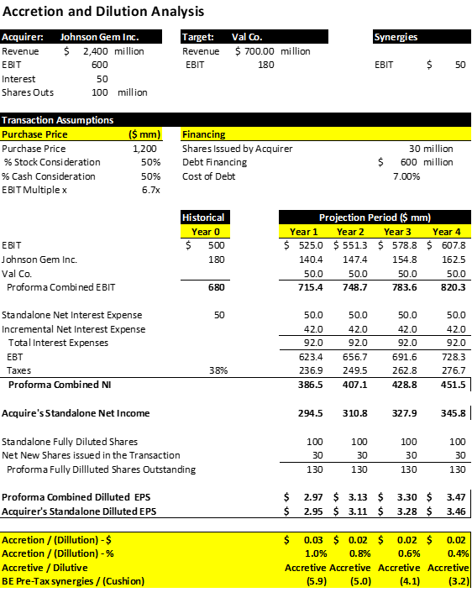
Merging
with a publicly traded company
Accretion & Dilution Analysis

Slide 40
WORKSHOP (MEET AT THE COMPUTER LAB)
THE INSTRUCTOR WILL PROVIDE CASE STUDIES FOR VALUATION AND DUE DILLIGENCE REVIEW
THE STUDENTS WILL HAVE A CHANCE TO REVIEW THE COMPANY AND PERFORM VALUATIONS

