Slide 1
Distressed Debt Markets: Investors & Analytical Frameworks
Understanding Opportunities in Financial Distress
Professor Chris Droussiotis

Slide 2

What is Distressed Debt?
- Debt trading at a significant discount (typically <70 cents on the dollar)
- Issuer is facing bankruptcy, default, or severe financial stress
- Common in leveraged loans, bonds, and trade claims

Slide 3
Key Participants in Distressed Debt Markets
- Hedge Funds (e.g., Elliott, Oaktree)
- Private Equity Firms (KPS)
- Distressed Debt Funds
- Credit Trading Desks (Investment Banks)
- Special Situations Investors

Slide 4

Reasons to Invest in Distressed Debt
- Potential for high returns (20%+ IRR)
- Control of reorganized equity (loan-to-own)
- Legal leverage in restructuring
- Inefficiencies in pricing due to complexity

Slide 5
Typical Investment Process
1. Screening for price anomalies
2. Initial Due Diligence – business fundamentals
3. Legal Review – covenant analysis
4. Valuation Modeling – recovery estimates
5. Restructuring Strategy – negotiation or litigation path

Slide 6

Types of Analysis Performed
- Financial Analysis (cash flow, liquidity, leverage)
- Valuation Analysis (enterprise value vs. claims)
- Legal Analysis (debt ranking, covenants, lien structure)
- Recovery Scenarios (liquidation vs. reorganization)

Slide 7

Tools Used in Distressed Analysis
- 13-week cash flow models
- DIP (Debtor-in-Possession) financing waterfall
- Recovery models for each debt tranche
- Bankruptcy case tracking
- Credit default swap (CDS) spreads

Slide 8
Legal Considerations
- Priority of Claims – senior vs. subordinated
- Automatic Stay & Bankruptcy Code
- Intercreditor Agreements
- Rights in Restructuring or Liquidation

Slide 9

Case Study Example: XYZ Retail Corp
- Debt Traded At: 40 cents on the dollar
- Recovery Estimate: 60–75% through reorg
- Investor Strategy: Buy debt → influence restructuring → convert to equity

Slide 10
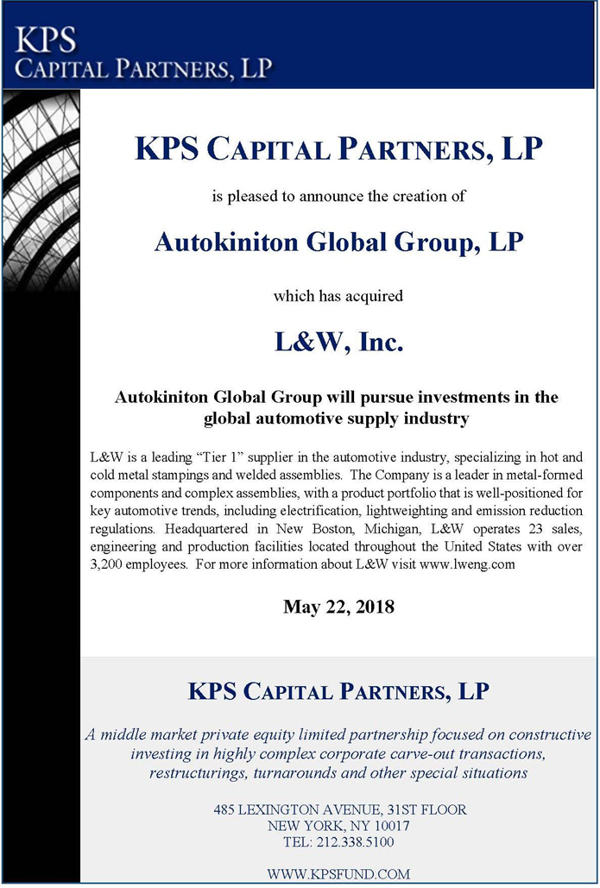
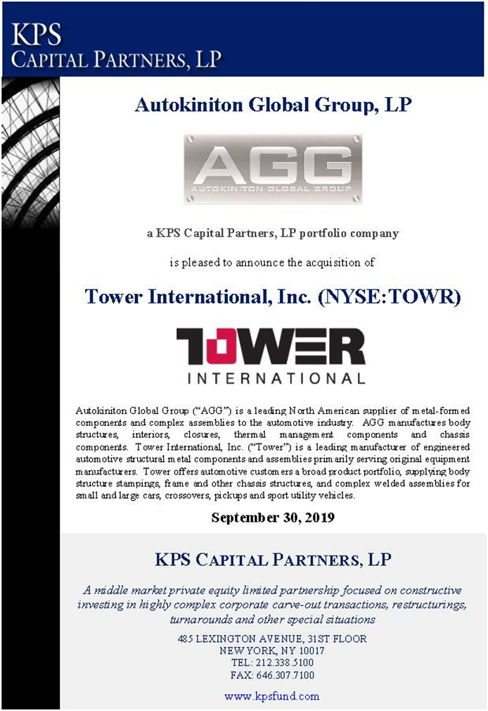
Transaction:
In 2019, Autokiniton Global Group (AGG), a North American automotive supplier backed by KPS Capital Partners, acquired Tower International, a manufacturer of automotive structural metal components, in a deal valued at approximately $900 million. The acquisition price was $31 per share in cash, representing a 70% premium over Tower's closing stock price on July 11, 2019 .

Slide 11
Background and Strategic Rationale
Tower International, headquartered in Livonia, Michigan, had faced financial challenges over the years, including a Chapter 11 bankruptcy filing in 2005. Despite emerging from bankruptcy in 2007 under Cerberus Capital Management's ownership, Tower continued to struggle with consistent cash flow generation. In early 2019, Tower sold its European operations to focus on its North American business, signaling a strategic shift .​Crain's Detroit Business
AGG, established in 2018 through the acquisition of L&W Engineering, aimed to consolidate the automotive metal components sector. The acquisition of Tower significantly expanded AGG's scale, product offerings, and customer base, positioning it as a leading supplier in North America

Slide 12
Transaction Details
Announcement Date: July 12, 2019
Acquisition Price: $31 per share in cash
Total Transaction Value: Approximately $900 million, including debt and pension liabilities
Completion Date: September 30, 2019
Structure: Tender offer followed by a merger, resulting in Tower becoming a wholly owned subsidiary of AGG ​Smart Business Dealmakers+8Autokiniton - Homepage+8SEC+8SEC+7PR Newswire+7Autokiniton - Homepage+7Lowenstein Sandler+1PR Newswire+1
The acquisition allowed AGG to enhance its manufacturing footprint and technological capabilities, particularly in lightweighting technologies, aligning with industry trends toward vehicle electrification and efficiency. Post-acquisition, AGG maintained a conservative capital structure to support ongoing research and development, technology investments, and organic growth initiatives .​Paul, Weiss+3PR Newswire+3Autokiniton - Homepage+3Smart Business Dealmakers+1PR Newswire+1
This strategic acquisition underscored AGG's commitment to becoming a dominant player in the automotive components industry by leveraging synergies and expanding its market presence.

Slide 13
Conclusion & Key Takeaways
- Combines financial, legal, and strategic analysis
- Capital structure understanding is essential
- High risk, high reward with proper diligence
- Legal positioning is as important as valuation

Slide 14
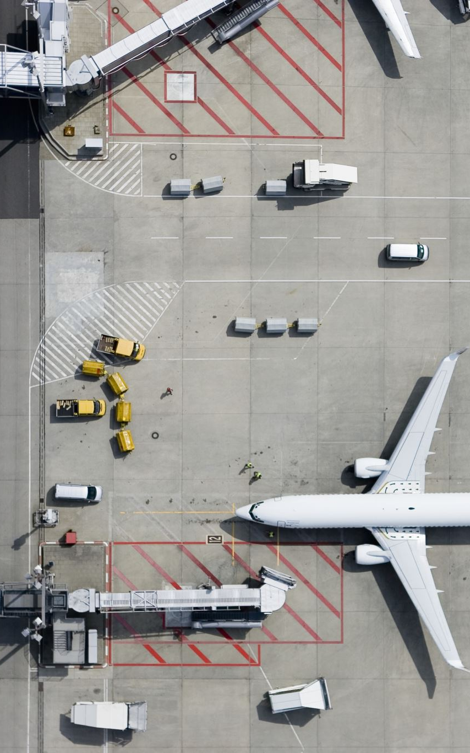
Case Study: Spirit Airlines
Spirit Airlines Files for Chapter 11 Bankruptcy Restructuring
MT Newswires
Mon, November 18, 2024, at 12:02 PM EST 1 min read
In This Article:
Spirit Airlines (SAVE) said Monday it has entered Chapter 11 bankruptcy restructuring with the support of a supermajority of its debtors.
The bankruptcy, filed with the US Bankruptcy Court for the Southern District of New York, will result in the likely delisting of the company from the New York Stock Exchange and the cancellation of its shares, the company said.
The discount airline said it has received commitments for $350 million in equity investments and $300 million in financing from existing debtors. The company will also equitize $795 million in debt.
The company said flights, ticket sales, and reservations as well as payments to employees, vendors, and secured debtors are to continue as normal during the bankruptcy proceedings. The airline's Free Spirit loyalty program and Saver$ Club perks and credit card terms for its customers will also continue, it added.
The restructuring of finances is meant to reduce debt, provide financial flexibility, and provide for investments in passenger services, the company said.
The company said it expects to complete the financial restructuring process in Q1 of 2025.
Company Description
Spirit Airlines, Inc. provides airline services. The company also offers hotels and rental cars services. It serves 93 destinations in 15 countries in the United States, Latin America, and the Caribbean. As of December 31, 2023, the company operated a fleet of 205 Airbus single-aisle aircraft. The company was formerly known as Clippert Trucking Company and changed its name to Spirit Airlines, Inc. in 1992. Spirit Airlines, Inc. was incorporated in 1964 and is headquartered in Miramar, Florida.

Slide 15
Case Study: Spirit Airlines

