Slide 1

Mergers & Acquisitions
Professor Chris Droussiotis
Lecture 5: CORPORATE VALUATIONS
CASE STUDY 1: HYATT CORPORATION (PUBLIC TRADED COMPANY)
CASE STUDY 2: Celerity technology company (private)
Case study 3: ABC Air (Distress company)

Slide 2
Valuation Analysis Overview
METHOD | DESCRIPTION | TYPE | TECHNICAL/ FUNDAMENTAL
1 | Using the current stock price as a basis of valuation | Market | Technical
2 | Intrinsic value and Capital Asset Pricing Model (CAPM) | Market | Technical
3 | Dividend Discount Model (DDM) | Market | Technical
4 | Comparable method using trading EBITDA multiples | Market | Fundamental
5 | Comparable method using acquisition EBITDA multiples | Market | Fundamental
6 | Discount cash flow method (DCF) | Income | Fundamental
7 | Leveraged buyout private equity expectation model (LBO) | Income | Fundamental
8 | Black-Scholes option pricing model | Options | Fundamental

Slide 3
Valuation of Publicly Traded Companies.
Testing the current Stock Price

Slide 4
Methods 1-7: Valuation of Public Traded Companies
Method 1: Using the Stock Price as the Basis of Valuation
  The formula to value the firm or the enterprise value (EV) is as follows:
EV = MVE + D – C
where EV is enterprise value, MVE is the market value of the equity, D is the total debt outstanding, and C is the cash and cash equivalents of the company.
  The stock price that represents the market value of each share when multiplied by the shares outstanding will give us the market value of the equity.
  MVE = (SP . SO)
where MVE is the market value of the equity, SP is the stock price and SO is the shares outstanding.
Bonds/Loans
Mezzanine / Loans
Series A, B, C

Slide 5
Methods 1-7: Valuation of Public Traded Companies
Method 1: Using the Stock Price as the Basis of Valuation
Series A, B, C

Slide 6
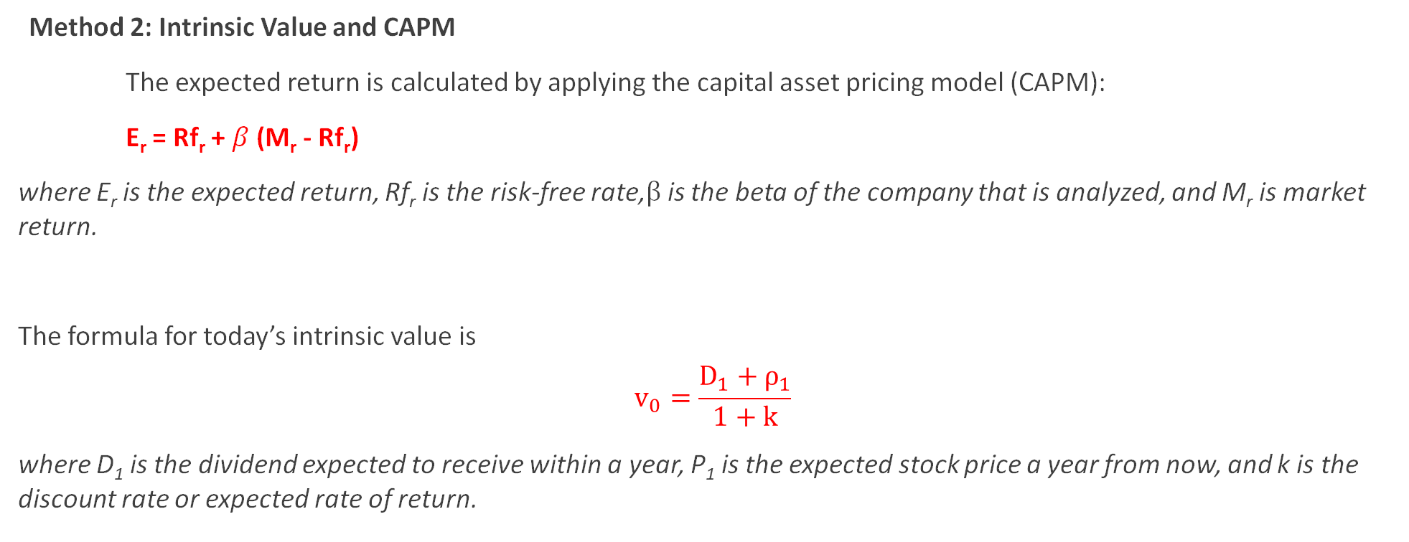
Methods 1-7: Valuation of Public Traded Companies
Method 2: Intrinsic Value and CAPM
The expected return is calculated by applying the capital asset pricing model (CAPM):
E_{r} = Rf_{r} + $β$ (M_{r} - Rf_{r})
where E_{r} is the expected return, Rf_{r} is the risk-free rate,$β$is the beta of the company that is analyzed, and M_{r} is market return.
The formula for today’s intrinsic value is
$$v_{0}=\frac{D_{1}+ρ_{1}}{1+k}$$
where D₁ is the dividend expected to receive within a year, P₁ is the expected stock price a year from now, and k is the discount rate or expected rate of return.

Slide 7
Methods 1-7: Valuation of Public Traded Companies
Method 2: Intrinsic Value and CAPM

Slide 8
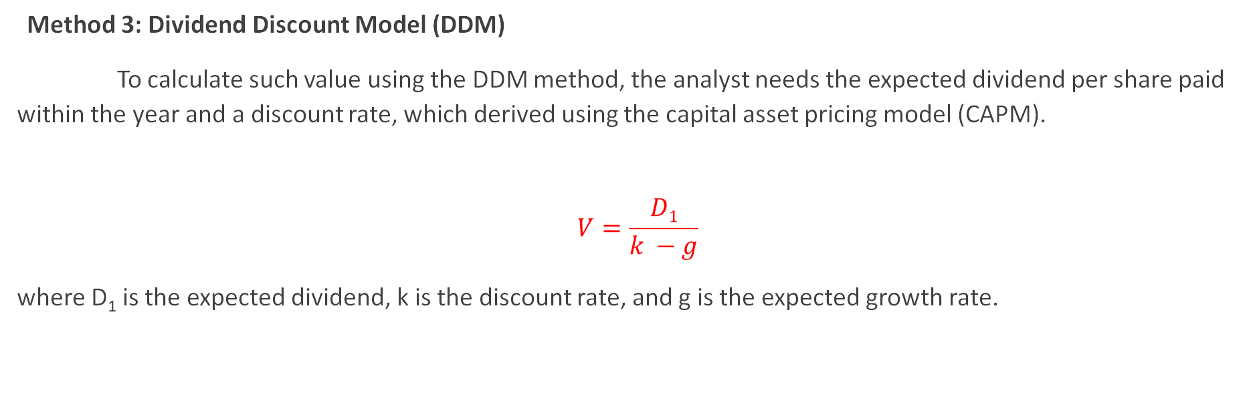
Methods 1-7: Valuation of Public Traded Companies
Method 3: Dividend Discount Model (DDM)
To calculate such value using the DDM method, the analyst needs the expected dividend per share paid within the year and a discount rate, which derived using the capital asset pricing model (CAPM).
$$V=\frac{D1}{k −g}$$
where D₁ is the expected dividend, k is the discount rate, and g is the expected growth rate.

Slide 9
Methods 1-7: Valuation of Public Traded Companies
Method 3: Dividend Discount Model (DDM)

Slide 10
Methods 1-7: Valuation of Public Traded Companies
Method 4: Using Comparable Trading EBITDA Multiples

Slide 11
Methods 1-7: Valuation of Public Traded Companies
Method 5: Using Comparable Acquisition EBITDA Multiples

Slide 12
Methods 1-7: Valuation of Public Traded Companies
Method 6: Discount Cash Flow (DCF)
To value the company using the DCF method the analyst needs to derive the following four items:
    Setting up a stream of cash flows
    Identifying an exit year
    Calculating the value at exit year (terminal value)
    Using the appropriate discount rate to value the present value of the firm

Slide 13
Methods 1-7: Valuation of Public Traded Companies
Method 6: Discount Cash Flow (DCF)
To value the company using the DCF method the analyst needs to derive the following four items:
    Using the appropriate discount rate to value the present value of the firm
      WACC for Firm Value
      CAPM for Equity Value

Slide 14
Method 6: Discount Cash Flow (DCF)
Methods 1-7: Valuation of Public Traded Companies

Slide 15
Methods 1-7: Valuation of Public Traded Companies
Method 6: Discount Cash Flow (DCF)
While the DCF analysis is used for determining today’s value of the company based on future cash flows, the value of the company using this LBO method is determined based on investor expectation, which means return determines the acquisition price of the firm.
  Building the Transactions Sources and Uses
  Setting up the Debt Schedules
  Calculating the Expected Equity Return
  Running Projections
  Determining the Terminal Value
  Determining the Value of the Firm

Slide 16
Method 7: Using the Leveraged Buyout Model (LBO) Method
Methods 1-7: Valuation of Public Traded Companies

Slide 17
Method 7: Using the Leveraged Buyout Model (LBO) Method
Methods 1-7: Valuation of Public Traded Companies

Slide 18
Method 7: Using the Leveraged Buyout Model (LBO) Method

Slide 19
Methods 1-7 - Summary:
  Putting All the Values Together

Slide 20
Valuation of Private Companies
Applying methods 6-8

Slide 21
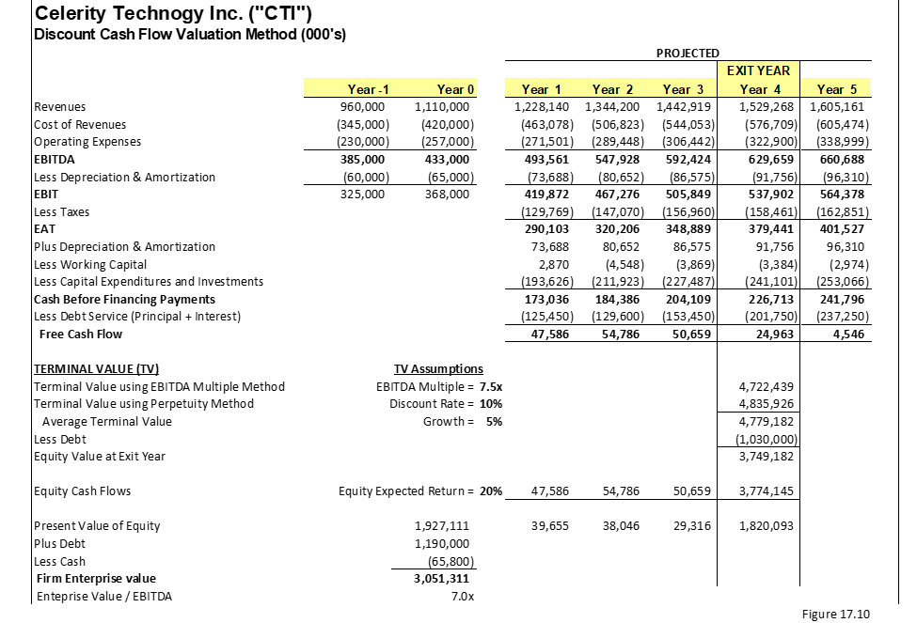
Valuation Analysis – Celerity Technology Inc

Slide 22
Method 6: Discount Cash Flow Method (DCF)
One of the most effective ways to value a private company is to dive into the company’s projections and change the assumptions based on the investor’s view of how the revenue will grow and at what cost.
Since there is no stock price that trades, which gives the investor a direct indication of what the company is worth (market value), an important method used by professionals is the discount cash flow (DCF) method, which measures the company’s intrinsic value.
The conduction of this method is to calculate the first the equity cash flows, identify the exit year, estimate the terminal value in the exit year, and use the expected equity return as the discount rate.

Slide 23
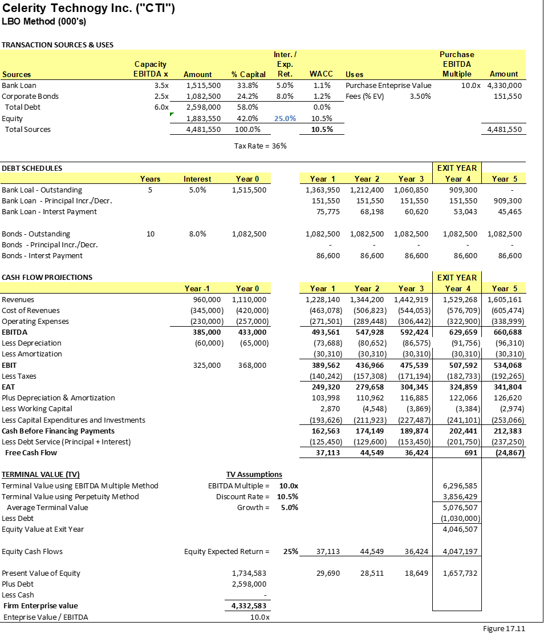
Method 7: Leveraged Buyout (LBO) Method for Private Companies

Slide 24
Method 8: Valuation of Distress Firms
Option Pricing Model Framework
  In option pricing and specifically in call options the payoff formula or intrinsic value of the option is
Option payoff = Max (0, S – X)
where S is the stock price and X is the exercise price.
  To calculate the enterprise value
EV = E + D – C or EV = E + net D
where EV is the enterprise value of the firm, E is the equity value, D is the debt and C is cash. The net D is referred to as debt minus cash implied that the current debt could be paid with cash on hand.
  Solving for equity:
E = EV – net D
where E is the equity, EV is the enterprise value and net D is the net debt.

Slide 25
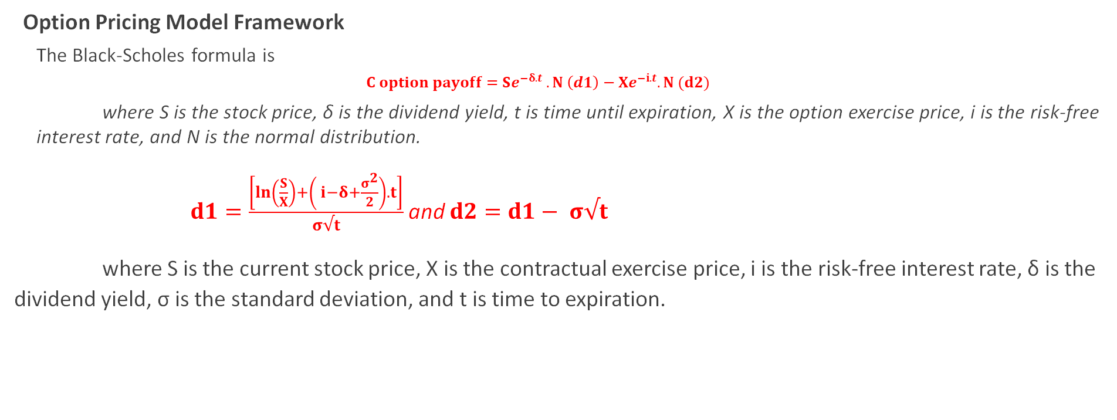
Method 8: Valuation of Distress Firms
Option Pricing Model Framework
  The Black-Scholes formula is
    $$C option payoff=Se^{−δ.t} .N \left(d1\right)−Xe^{−i.t}.N (d2)$$
  where S is the stock price, δ is the dividend yield, t is time until expiration, X is the option exercise price, i is the risk-free interest rate, and N is the normal distribution.
$d1=\frac{\left[\ln\left(\frac{S}{X}\right)+\left( i−δ+\frac{σ^{2}}{2}\right).t\right]}{σ√t}$ and $d2=d1− σ√t$
where S is the current stock price, X is the contractual exercise price, i is the risk-free interest rate, δ is the dividend yield, σ is the standard deviation, and t is time to expiration.

Slide 26
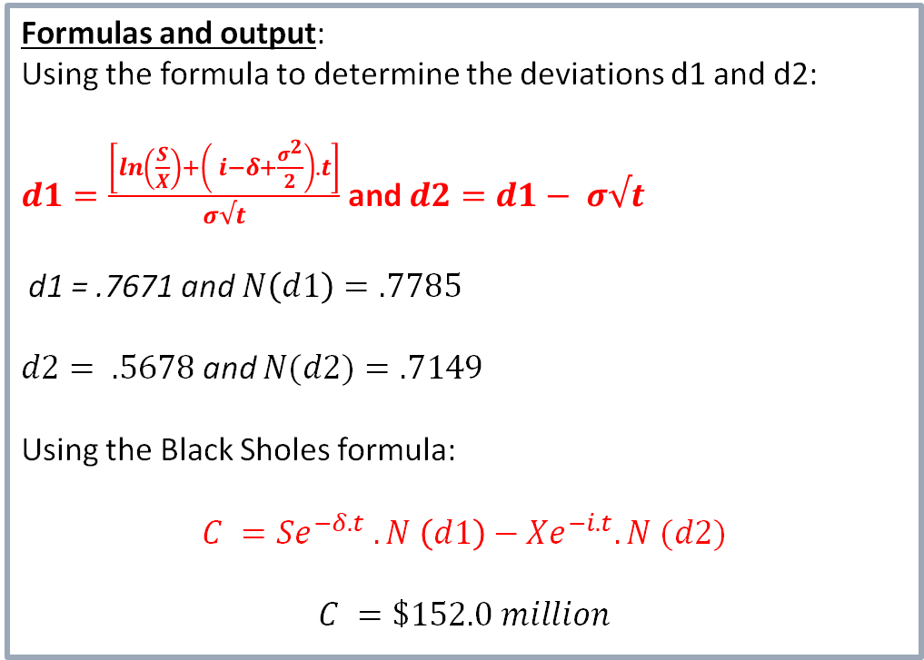
Method 8: Valuation of Distress Firms
  Input:
    S = Value of the firm = $1 billion
    X = Exercise price = debt value = $1,200 million
    σ = Standard deviation of the asset = 20%
    t = Time = term of the bond = 5 years
    i = Risk-free rate = 3%
    δ = Dividends = cash flow paying the equity = $0
    C = Equity value = E =?
Formulas and output:
Using the formula to determine the deviations d1 and d2:
$d1=\frac{\left[\ln\left(\frac{S}{X}\right)+\left( i−δ+\frac{σ^{2}}{2}\right).t\right]}{σ√t}$ and $d2=d1− σ√t$
d1 = .7671 and $N\left(d1\right)=.7785$
$d2= .5678$ and $N(d2)=.7149$
Using the Black Sholes formula:
$$C =Se^{−δ.t} .N \left(d1\right)−Xe^{−i.t}.N (d2)$$
$$C =\$152.0 million$$

Slide 27
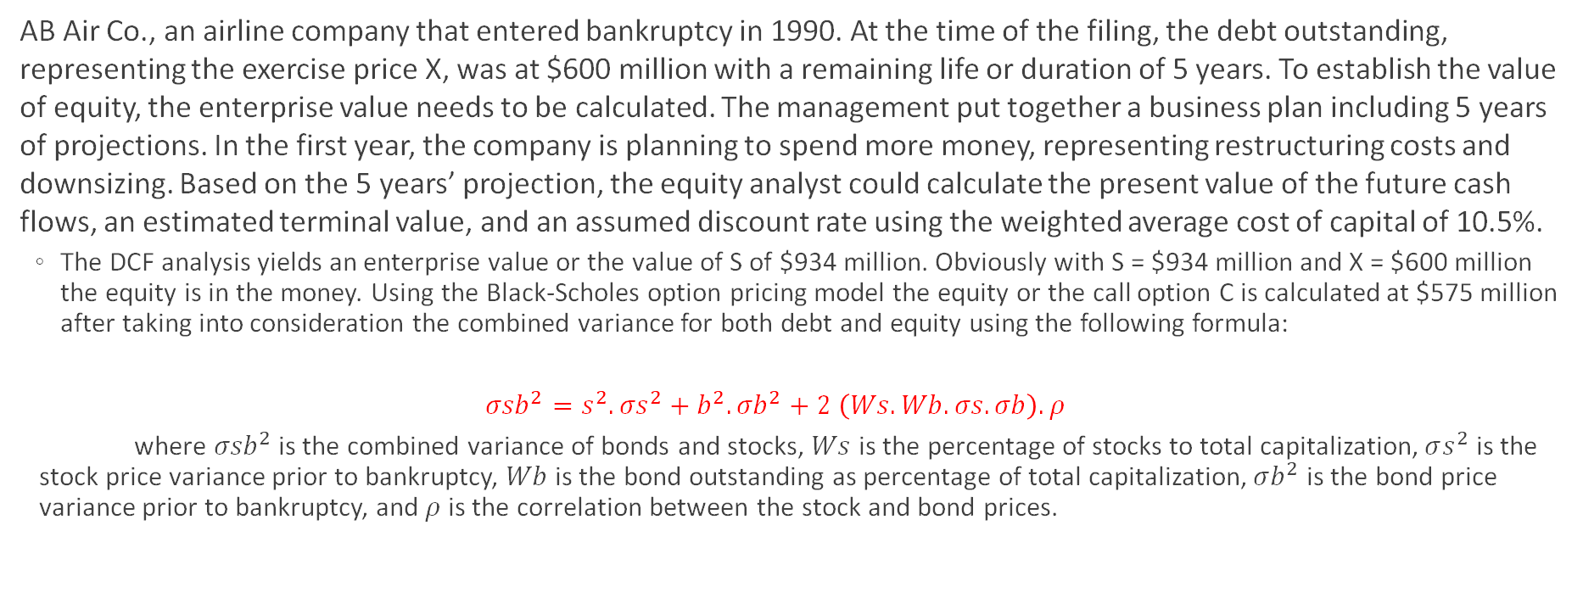
Valuation Analysis of Distress Company – AB Air Co.
AB Air Co., an airline company that entered bankruptcy in 1990. At the time of the filing, the debt outstanding, representing the exercise price X, was at $600 million with a remaining life or duration of 5 years. To establish the value of equity, the enterprise value needs to be calculated. The management put together a business plan including 5 years of projections. In the first year, the company is planning to spend more money, representing restructuring costs and downsizing. Based on the 5 years’ projection, the equity analyst could calculate the present value of the future cash flows, an estimated terminal value, and an assumed discount rate using the weighted average cost of capital of 10.5%.
  The DCF analysis yields an enterprise value or the value of S of $934 million. Obviously with S = $934 million and X = $600 million the equity is in the money. Using the Black-Scholes option pricing model the equity or the call option C is calculated at $575 million after taking into consideration the combined variance for both debt and equity using the following formula:
  $${σsb}^{2}=s^{2}.{σs}^{2}+b^{2}. {σb}^{2}+2 \left(Ws.Wb.σs.σb\right).ρ$$
  where ${σsb}^{2}$ is the combined variance of bonds and stocks, $Ws$ is the percentage of stocks to total capitalization, $σs^{2}$ is the stock price variance prior to bankruptcy, $Wb$ is the bond outstanding as percentage of total capitalization, $σb^{2}$ is the bond price variance prior to bankruptcy, and $ρ$ is the correlation between the stock and bond prices.

Slide 28
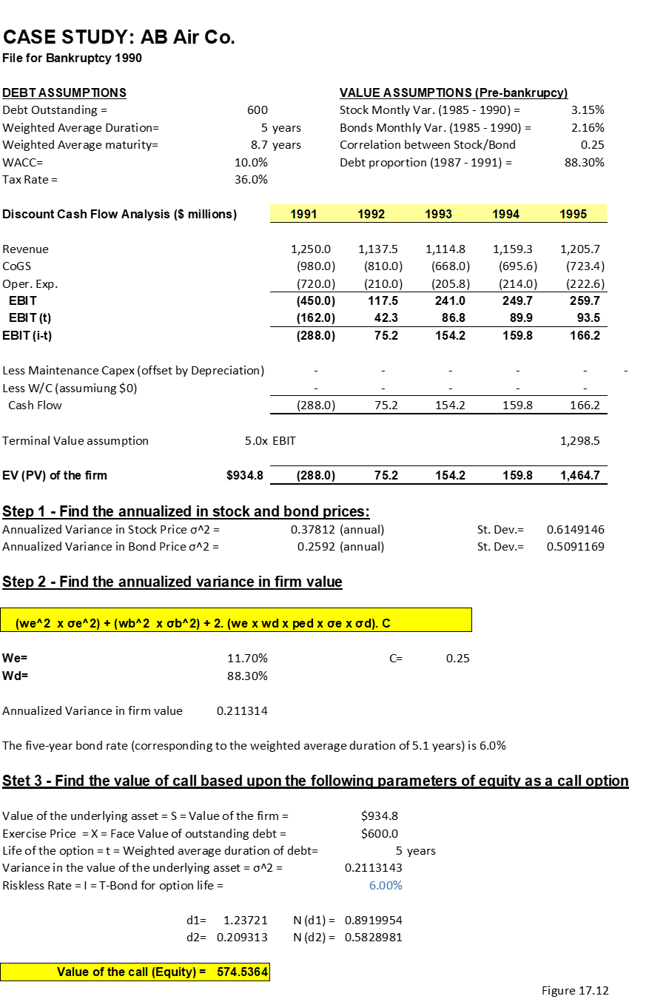
Valuation Analysis of Distress Company – AB Air Co.

