Slide 1

Private Equity & Venture Capital
Introductory Lecture 3
Raising Equity for Private Companis

Slide 2
Equity Markets: Raising Equity for Private Companies
Chapter 5
“An Analytical Approach to Investments, Finance and Credit”

Slide 3
Raising Equity: An Overview
A well-established private company that has been in the business for years and early founders that have just established their new company both have the same objective: raising capital, and specifically raising equity to develop and grow their business.
Early-stage companies are more likely to approach private equity than well-established larger companies that have more choices, including going public or IPO.
The investor, private or public, representing the equity contribution or buy-in will do their own valuation analysis based on their return expectation, adjusted for risk and probability of success.

Slide 4
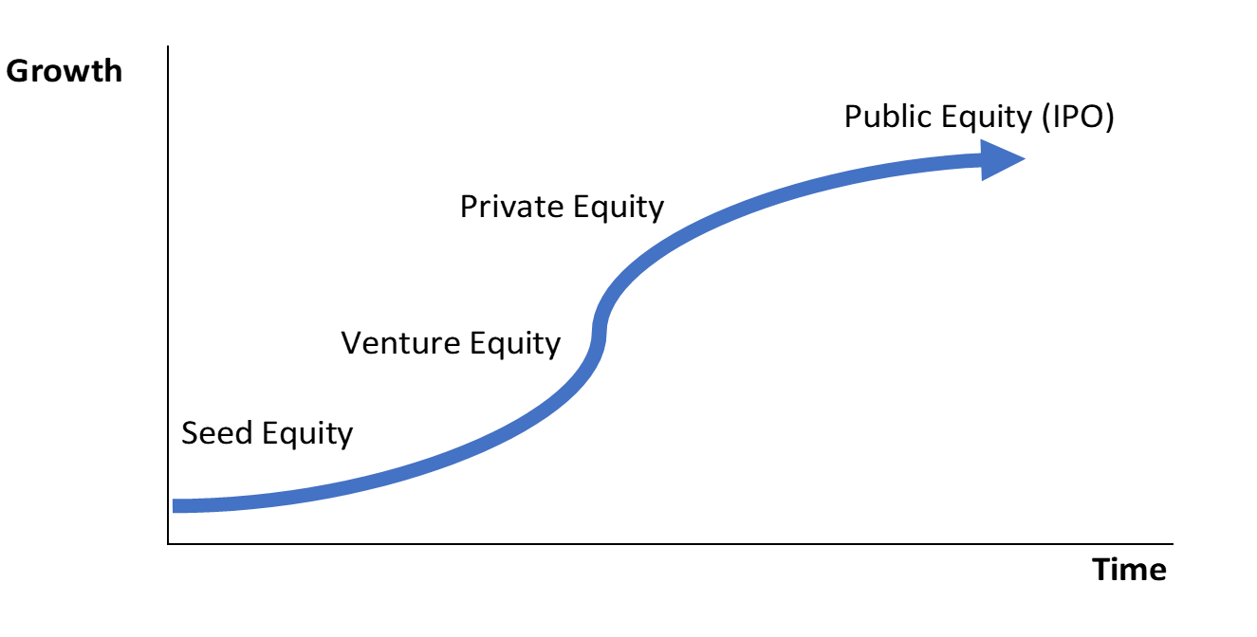



The Life Cycle of the Public Company and its ability to raise capital though the cycle
Bonds/Loans
Mezzanine / Loans
Series A, B, C

Slide 5
Raising Equity: Seed Capital
Valuations for early-stage investments are some of the most challenging since there is no history of revenue or cash flow.
  Figure 5.2 summarizes who these seed investors are, the purpose of their investment, and what you need to obtain such investment:

Slide 6
Raising Equity: Seed Capital
  The basis for this type of valuation method is very similar to valuing an out-of-money call option using the Black-Scholes pricing model described in chapter 13. The model is basically based on the probability of success, valuing the cash needs during the initial stage (referred to as “Death Valley”) and the velocity or acceleration of the profit in later years, as demonstrated in figure 5.3.
Angel investors are expected to be taken out by venture capitalists or private equity firms. Occasionally if the acceleration of the business happens much faster and the stock markets are very attractive, the angel investor might take the company public via an IPO to get the most value.

Slide 7
Raising Equity: Venture Capital
Venture capital is provided by private investment funds such as hedge funds, institutional investors, or industry-specific ventures that are specialized in start-up companies during their early stages of development.
  Figure 5.4 summarizes who these venture capital investors are, the purpose of their investment, and what the owners need in order to obtain such investment.

Slide 8
Raising Equity: Venture Capital
Prior to a venture capital transaction, the founders will need to prepare a business plan while the investors will typically run a basic discount cash flow (DCF) method analysis. This analysis includes the future stream of cash flows from running the company, an estimated terminal value at an assumed exit year (typically 3–5 years) while using an expected rate of return as a discount rate for the cash flows.
As the company grows and matures, the venture capital investors are expected to be taken out by other venture capital and private equity firms, as well as the larger IPO market if the stock markets are attractive to get the best value possible.

Slide 9
Raising Equity: Pivate Equity Capital
These investors are typically institutional investors with capital behind them from pension funds, banks, insurance companies, and high net-worth individuals.
  Figure 5.5 summarizes who these private equity investors are, the purpose of their investment, and what you need to obtain such an investment.

Slide 10
Raising Equity: Private Equity Capital
Typical PE transactions include buyouts of public companies (public to private) or buyouts of private companies (private to private or secondary LBO). In some cases, the acquiring firm could have one of its existing portfolio companies buy or merge with the target company to achieve synergies.
PE firms look to hold investments in their portfolio for 3 to 5 years. The investments in these companies are typically replaced by larger sums from other PE firms or via the IPO market. IPOs are especially considered if the stock markets are very attractive in order to get the best value possible.

Slide 11
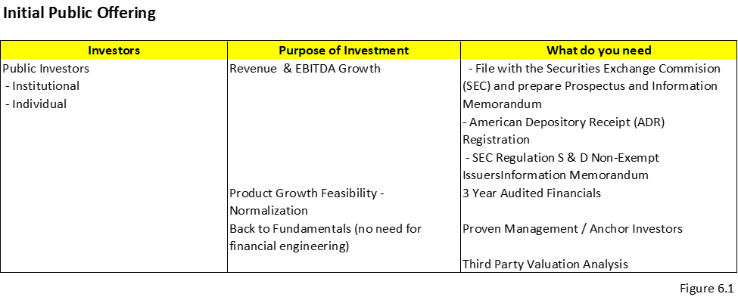
Initial Public Offering (Described more in detail next chapter)
Purpose of the Investors to Invest in IPOs
The institutional and public investors investing in a new company during and post IPO are looking to enhance their returns through earnings growth and multiple expansion. If this becomes a reality, the broader market will gain confidence and drive the stock price up. It will also continue to increase in the future if expectations for these higher multiples of earnings (PE or EBITDA) are realized. Dividends can also be a source of income for these investors, though typically new IPO companies are still in a growth stage of their development and do not pay dividends.

Slide 12
Raising Equity: Getting Ready to Go to Market
The preliminary investor presentation, which will at some point become the information memorandum to attract investors, needs to answer the following questions:
Who are we? The answer must include a description of the company, its management, and its stage of growth and development.
Why invest in us? The answer should be the company’s investment thesis including its target markets, product uniqueness, and the validation of its proposed technology.
What is our strategy? A full-scope strategic plan identifies the problem, the need for a solution, why there’s a substantial enough opportunity for profit, and how this can become a business opportunity that sustains itself into the future, all of which encompass the characteristics that need to be considered in the final go-to-market strategy.
How do we get there? The investors run a financial model that shows the expected revenue growth, the cash flow needs to support it, and a basic valuation of the company’s enterprise value.
What do we need to make that happen? Management must consider how much capital funding is reasonably attainable and sustainable. A capacity analysis will help curb and measure expectations of ongoing funding needs and capabilities.
How much time will it take? The strategy needs to establish a set timeline that is in line with the company’s growth and is attractive enough to investors that they anticipate receiving their intended return.

Slide 13
Raising Equity: Getting Ready to Go to Market
Step I: Generating Interest
Step II: Writing the Information Memorandum
Step III: Staple Financing
Step IV: Equity Financing and Return Analysis
Step V: Bidding Process
Step VI: Filing Requirements if necessary

Slide 14
Raising Equity: Step I: Generating Interest
Typically, more mature companies in their development stage hire a financial advisor or an investment banker to assist the company with raising capital.
The owners of these companies will call a few of these advisors and ask them to present their pitch on how they can assist the company with a successful fundraising execution.
The importance of hiring an advisor is that they have the “rolodex” of contacts and can advise the company on who is the best fit as a source of capital.
After the company chooses its advisor, they work together on creating an information memorandum or business plan.

Slide 15
Raising Equity:
Step II: Writing the Information Memorandum
The information memorandum (IM) is a document created by the business owners, assisted by the advisor, for prospective investors or buyers.
The primary purpose of the IM is to motivate potential investment into the business.
The IM is the most effective way to summarize all the information about a company to give to investors.
When preparing the IM, it is beneficial to look at it from the prospective of the buyer. This will help the company reflect on how to structure the IM. Sometimes, especially if the company is for sale, the advisor or bank will implement a staple financing package to attract investors.
Because access to capital funding is already in place, investors are enticed to bid due to a smoother and quicker execution.
Staple financing will include the potential selling price, any additional expenses, and how much equity the investor needs in conjunction with the debt financing.

Slide 16
Raising Equity:
Step II: Writing the Information Memorandum
Figure 5.6 is an example checklist for an information memorandum.

Slide 17
Raising Equity: Step III: Staple Financing
The advisor will call few banks to secure staple financing commitments.
Staple financing is a financing package arranged by a company for potential purchasers as part of an auction process.
The staple financing package includes the amount of the loan, the maturity date, pricing such as interest and fees, and other terms such as loan covenants.
The term staple comes from the fact that the bank commitment letter and term sheets are stapled to the back of the acquisition term sheet provided by the company that is interested in selling.
The purpose of staple financing is for quickening the bidding process

Slide 18
Raising Equity:
Step IV: Equity Financing and Return Analysis
Once the buyer receives the information on the company and the staple financing offer package, he or she runs his or her own analysis to derive a bidding price.
The analysis of a private equity firm is based primarily on return expectation.
Assuming the return expectation is 25%, the analysis will suggest a price that the buyer is willing to pay based on the financing available and using the same projected cash flows provided by management

Slide 19
Raising Equity: Step V: Bidding Process
The buyers or investors who are planning to buy the whole company or partially invest in the company are asked to put in a bid at a set date that includes the financing structure.
Sometimes they are also asked to present their strategy with the operations and management.
Throughout the process of choosing the right investors, there are several bidding sessions that take place.

Slide 20
Raising Equity:
Step VI: Filing Requirements if necessary
The private target company is not required to publicly file documents with the SEC.
When a public acquirer buys a private target, it may require filing certain disclosure documents, especially if they need to issue shares in excess of 20% of the pre-deal shares.
For leveraged buyouts (LBOs) that use high-yield bonds to finance private targets, purchasers need to file an S-4 with the SEC. The S-4 typically contains data on the purchase price and financial information on the target.

