Slide 1

Private Equity & Venture Capital
Introductory Lecture 3
Raising Equity for Private Companis

Slide 2
Equity Markets: Raising Equity for Private Companies
Chapter 5
“An Analytical Approach to Investments, Finance and Credit”

Slide 3
Raising Equity: An Overview
A well-established private company that has been in the business for years and early founders that have just established their new company both have the same objective: raising capital, and specifically raising equity to develop and grow their business.
Early-stage companies are more likely to approach private equity than well-established larger companies that have more choices, including going public or IPO.
The investor, private or public, representing the equity contribution or buy-in will do their own valuation analysis based on their return expectation, adjusted for risk and probability of success.

Slide 4
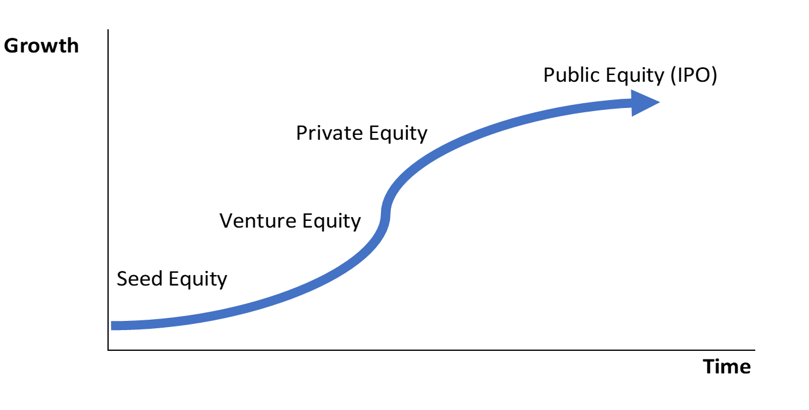



The Life Cycle of the Public Company and its ability to raise capital though the cycle
Bonds/Loans
Mezzanine / Loans
Series A, B, C

Slide 5
Raising Equity: Seed Capital
Valuations for early-stage investments are some of the most challenging since there is no history of revenue or cash flow.
Figure 5.2 summarizes who these seed investors are, the purpose of their investment, and what you need to obtain such investment:

Slide 6
Raising Equity: Seed Capital
The basis for this type of valuation method is very similar to valuing an out-of-money call option using the Black-Scholes pricing model described in chapter 13. The model is basically based on the probability of success, valuing the cash needs during the initial stage (referred to as “Death Valley”) and the velocity or acceleration of the profit in later years, as demonstrated in figure 5.3.
Angel investors are expected to be taken out by venture capitalists or private equity firms. Occasionally if the acceleration of the business happens much faster and the stock markets are very attractive, the angel investor might take the company public via an IPO to get the most value.

Slide 7
Raising Equity: Venture Capital
Venture capital is provided by private investment funds such as hedge funds, institutional investors, or industry-specific ventures that are specialized in start-up companies during their early stages of development.
Figure 5.4 summarizes who these venture capital investors are, the purpose of their investment, and what the owners need in order to obtain such investment.

Slide 8
Raising Equity: Venture Capital
Prior to a venture capital transaction, the founders will need to prepare a business plan while the investors will typically run a basic discount cash flow (DCF) method analysis. This analysis includes the future stream of cash flows from running the company, an estimated terminal value at an assumed exit year (typically 3–5 years) while using an expected rate of return as a discount rate for the cash flows.
As the company grows and matures, the venture capital investors are expected to be taken out by other venture capital and private equity firms, as well as the larger IPO market if the stock markets are attractive to get the best value possible.

Slide 9
Raising Equity: Private Equity Capital
These investors are typically institutional investors with capital behind them from pension funds, banks, insurance companies, and high net-worth individuals.
Figure 5.5 summarizes who these private equity investors are, the purpose of their investment, and what you need to obtain such an investment.

Slide 10
Raising Equity: Private Equity Capital
Typical PE transactions include buyouts of public companies (public to private) or buyouts of private companies (private to private or secondary LBO). In some cases, the acquiring firm could have one of its existing portfolio companies buy or merge with the target company to achieve synergies.
PE firms look to hold investments in their portfolio for 3 to 5 years. The investments in these companies are typically replaced by larger sums from other PE firms or via the IPO market. IPOs are especially considered if the stock markets are very attractive in order to get the best value possible.

Slide 11
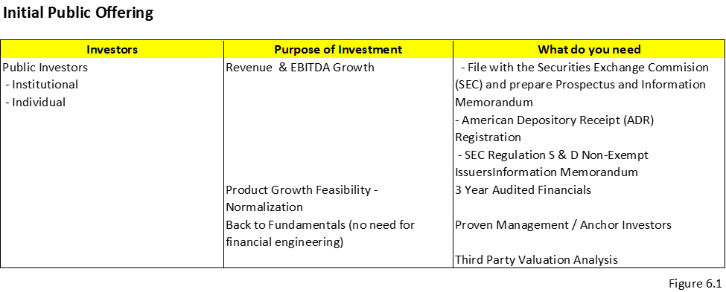
Initial Public Offering (Described more in detail next chapter) Purpose of the Investors to Invest in IPOs
The institutional and public investors investing in a new company during and post IPO are looking to enhance their returns through earnings growth and multiple expansion. If this becomes a reality, the broader market will gain confidence and drive the stock price up. It will also continue to increase in the future if expectations for these higher multiples of earnings (PE or EBITDA) are realized. Dividends can also be a source of income for these investors, though typically new IPO companies are still in a growth stage of their development and do not pay dividends.

Slide 12
Raising Equity: Getting Ready to Go to Market
The preliminary investor presentation, which will at some point become the information memorandum to attract investors, needs to answer the following questions:
Who are we? The answer must include a description of the company, its management, and its stage of growth and development.
Why invest in us? The answer should be the company’s investment thesis including its target markets, product uniqueness, and the validation of its proposed technology.
What is our strategy? A full-scope strategic plan identifies the problem, the need for a solution, why there’s a substantial enough opportunity for profit, and how this can become a business opportunity that sustains itself into the future, all of which encompass the characteristics that need to be considered in the final go-to-market strategy.
How do we get there? The investors run a financial model that shows the expected revenue growth, the cash flow needs to support it, and a basic valuation of the company’s enterprise value.
What do we need to make that happen? Management must consider how much capital funding is reasonably attainable and sustainable. A capacity analysis will help curb and measure expectations of ongoing funding needs and capabilities.
How much time will it take? The strategy needs to establish a set timeline that is in line with the company’s growth and is attractive enough to investors that they anticipate receiving their intended return.

Slide 13
Raising Equity: Getting Ready to Go to Market
Step I: Generating Interest
Step II: Writing the Information Memorandum
Step III: Staple Financing
Step IV: Equity Financing and Return Analysis
Step V: Bidding Process
Step VI: Filing Requirements if necessary

Slide 14
Raising Equity: Step I: Generating Interest
Typically, more mature companies in their development stage hire a financial advisor or an investment banker to assist the company with raising capital.
The owners of these companies will call a few of these advisors and ask them to present their pitch on how they can assist the company with a successful fundraising execution.
The importance of hiring an advisor is that they have the “rolodex” of contacts and can advise the company on who is the best fit as a source of capital.
After the company chooses its advisor, they work together on creating an information memorandum or business plan.

Slide 15
Raising Equity: Step II: Writing the Information Memorandum
The information memorandum (IM) is a document created by the business owners, assisted by the advisor, for prospective investors or buyers.
The primary purpose of the IM is to motivate potential investment into the business.
The IM is the most effective way to summarize all the information about a company to give to investors.
When preparing the IM, it is beneficial to look at it from the prospective of the buyer. This will help the company reflect on how to structure the IM. Sometimes, especially if the company is for sale, the advisor or bank will implement a staple financing package to attract investors.
Because access to capital funding is already in place, investors are enticed to bid due to a smoother and quicker execution.
Staple financing will include the potential selling price, any additional expenses, and how much equity the investor needs in conjunction with the debt financing.

Slide 16
Raising Equity: Step II: Writing the Information Memorandum
Figure 5.6 is an example checklist for an information memorandum.

Slide 17
Raising Equity: Step III: Staple Financing
The advisor will call few banks to secure staple financing commitments.
Staple financing is a financing package arranged by a company for potential purchasers as part of an auction process.
The staple financing package includes the amount of the loan, the maturity date, pricing such as interest and fees, and other terms such as loan covenants.
The term staple comes from the fact that the bank commitment letter and term sheets are stapled to the back of the acquisition term sheet provided by the company that is interested in selling.
The purpose of staple financing is for quickening the bidding process

Slide 18
Raising Equity: Step IV: Equity Financing and Return Analysis
Once the buyer receives the information on the company and the staple financing offer package, he or she runs his or her own analysis to derive a bidding price.
The analysis of a private equity firm is based primarily on return expectation.
Assuming the return expectation is 25%, the analysis will suggest a price that the buyer is willing to pay based on the financing available and using the same projected cash flows provided by management

Slide 19
Raising Equity: Step V: Bidding Process
The buyers or investors who are planning to buy the whole company or partially invest in the company are asked to put in a bid at a set date that includes the financing structure.
Sometimes they are also asked to present their strategy with the operations and management.
Throughout the process of choosing the right investors, there are several bidding sessions that take place.

Slide 20
Raising Equity: Step VI: Filing Requirements if necessary
The private target company is not required to publicly file documents with the SEC.
When a public acquirer buys a private target, it may require filing certain disclosure documents, especially if they need to issue shares in excess of 20% of the pre-deal shares.
For leveraged buyouts (LBOs) that use high-yield bonds to finance private targets, purchasers need to file an S-4 with the SEC. The S-4 typically contains data on the purchase price and financial information on the target.

Slide 21
Private Equity & Venture Capital
Case Study:
Investing Across the
Company Life Cycle

Slide 22
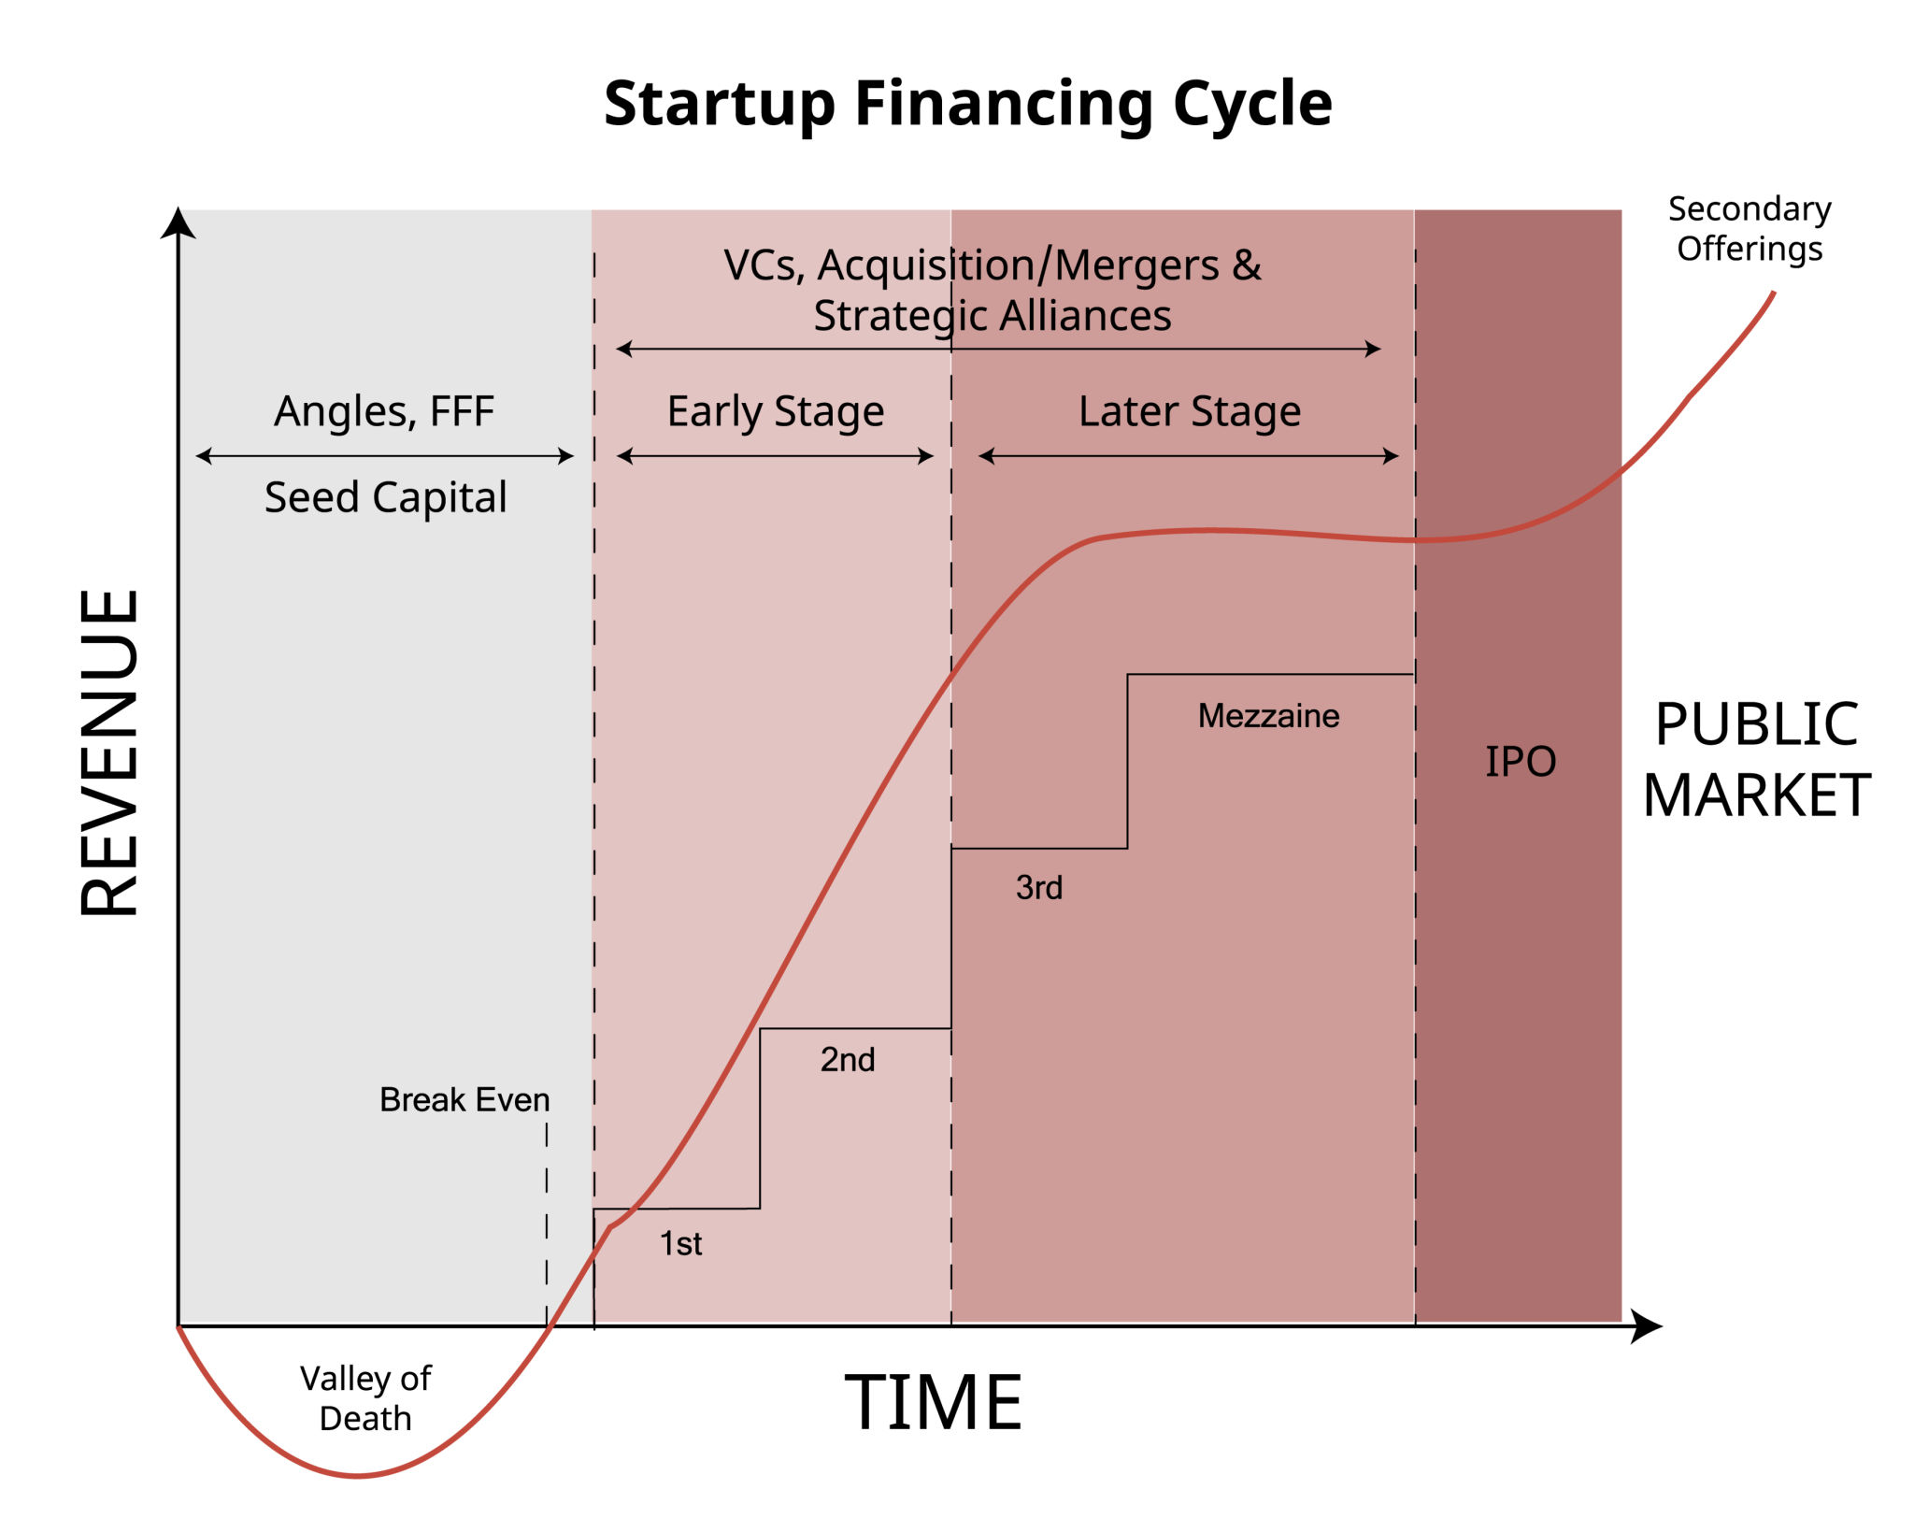

Slide 23

Company Background: NovaGen HealthTech
NovaGen HealthTech (“NovaGen”) is a healthcare technology company focused on AI-driven diagnostics for early detection of cardiovascular disease. The company was founded by two biomedical engineers and one software developer who met during a university research program.
The technology originated as a research prototype, later validated in pilot hospital studies, and eventually scaled into a commercial SaaS platform sold to hospitals and clinics.

Slide 24
Company Background: NovaGen HealthTech
NovaGen’s journey spans four major capital-raising stages:
Seed Stage
Venture Capital (VC) Stage
Private Equity (PE) Stage
Initial Public Offering (IPO)

Slide 25
Stage 1: Seed Investment (Year 0–2)
Situation
NovaGen is pre-revenue. The product exists only as a working prototype.
There is:
No commercial traction
No regulatory approval
Significant technical and execution risk
The founders seek $1.5 million to fund:
Product development
Initial regulatory pathway work
Small pilot programs

Slide 26
NovaGen HealthTech

Slide 27
Stage 1: Seed Investment (Year 0–2)
Valuation & Structure
Pre-money valuation: $4 million
Post-money valuation: $5.5 million
Instruments: Convertible notes or SAFEs*
Minimal governance right
Investors
Angel investors
Early-stage seed funds
Founder’s personal network
*Simple Agreement for Future Equity

Slide 28
Stage 1: Seed Investment (Year 0–2)
Key Risks
Technology may not work as intended
Regulatory approval may fail
Founders may lack operational experience
Seed Investor Mindset
Seed investors are underwriting people and vision, not cash flows. Failure rates are high, but winners can deliver 20–50x returns.

Slide 29
Stage 1: Seed Investment (Year 0–2)
Discussion Questions (Seed)
Why is DCF inappropriate at this stage?
What qualities matter most in founders at the seed stage?
Why do seed investors accept limited control?

Slide 30
Why is DCF inappropriate at this stage?
Discounted Cash Flow (DCF) analysis relies on predictable, estimable future cash flows and a meaningful terminal value. At the seed stage:
No reliable cash flows exist (often zero or negative revenue).
Forecasts are speculative guesses, not informed estimates.
Small changes in assumptions (growth, margins, discount rate) create massive swings in valuation, making outputs meaningless.
The risk profile is binary (success or failure), which DCF is not designed to capture well.
At the seed stage, valuation is driven by narrative, milestones, comparable seed rounds, and optionality, not intrinsic value models.

Slide 31
2. What qualities matter most in founders at the seed stage?
Since the business model is still evolving, investors are effectively betting on the founders, not the company. The most critical qualities include:
Vision & clarity of purpose – ability to articulate a compelling problem and solution.
Execution capability – evidence the founders can build, test, and iterate quickly.
Coachability – openness to feedback and willingness to adapt.
Resilience & grit – ability to operate under uncertainty, rejection, and limited resources.
Integrity & trustworthiness – essential given minimal formal controls.
👉 Early investors back people who can pivot intelligently, not those who cling rigidly to an initial plan.

Slide 32
3. Why do seed investors accept limited control?
Seed investors typically accept limited control because:
The investment checks are small relative to future rounds, making heavy governance inefficient.
Excessive control early can slow innovation and decision-making.
Founders need speed and flexibility, not bureaucracy.
Control is often deferred via convertible notes or SAFEs, with protections activating in later rounds.
Additionally:
Seed investors rely on portfolio diversification, knowing most investments will fail. The upside comes from owning a small piece of a potential breakout winner, not operational control.
👉 At the seed stage, alignment and trust matter more than control rights.

Slide 33
Stage 2: Venture Capital Investment (Year 3–6)
Situation
NovaGen has:
Completed successful pilot programs
Secured FDA clearance
Generated $6 million in annual recurring revenue (ARR)
120% net revenue retention
The company seeks $25 million in Series B funding to scale sales and expand internationally.

Slide 34
Stage 2: Venture Capital Investment (Year 3–6)
Investors
Institutional venture capital firms
Growth-stage healthcare-focused funds
Valuation & Structure
Pre-money valuation: $120 million
Post-money valuation: $145 million
Preferred equity with:
Board seats
Anti-dilution protection
Liquidation preferences

Slide 35
Stage 2: Venture Capital Investment (Year 3–6)
Key Risks
Scaling sales efficiently
Competitive pressure from incumbents
Path to profitability
VC Investor Mindset
VC investors focus on scalability and market dominance. Losses are acceptable if growth is rapid and defensible.

Slide 36
Stage 2: Venture Capital Investment (Year 3–6)
Discussion Questions (VC)
Why does governance increase at the VC stage?
How do VCs think about exit timing?
What metrics matter most at this stage (ARR, CAC, LTV, churn)?

Slide 37
Why does governance increase at the VC stage?
Governance increases at the VC stage because capital at risk is larger, uncertainty has narrowed, and investor actions can now meaningfully influence outcomes.
Specifically:
Investments are material in size (tens of millions, not hundreds of thousands).
The company has moved beyond vision into execution and scaling, where strategic mistakes are costly.
VCs are accountable to LPs and must actively manage downside risk.
Decision-making (hiring executives, pricing, expansion, M&A) now benefits from experienced oversight.
This is why VC rounds introduce: Board seats, Protective provisions, Preferred equity rights

Slide 38
How do VCs think about exit timing?
VCs think about exits through the lens of fund economics, not just company performance.
Key considerations include:
Fund life cycle: Most VC funds have a 10-year life, with exits typically targeted in years 5–10.
Value inflection points: VCs aim to exit after major de-risking events (market leadership, profitability, or IPO readiness).
IRR vs. MOIC trade-off:
A faster 3x exit may beat a slower 6x exit on an IRR basis.
Market windows: IPO and M&A markets are cyclical—timing matters.
👉 VCs don’t exit when the company is “perfect”; they exit when risk-adjusted returns peak.

Slide 39
3. What metrics matter most at this stage (ARR, CAC, LTV, churn)?
At the VC stage, metrics shift from storytelling to evidence of scalability and efficiency.
The most critical metrics include:
ARR (Annual Recurring Revenue) Indicates scale, momentum, and predictability.
CAC (Customer Acquisition Cost) Measures how efficiently growth is being purchased.
LTV (Lifetime Value) Shows the long-term economic value of customers.
Churn (Logo & Revenue Churn) Reveals product stickiness and competitive pressure.
Key relationships matter more than individual numbers:
LTV / CAC > 3x (rule of thumb)
Low churn + high expansion = valuation leverage
ARR growth with improving unit economics is the gold standard

Slide 40
Stage 3: Private Equity Investment (Year 7–10)
Situation
NovaGen now generates:
$110 million in revenue
$32 million in EBITDA
Strong recurring contracts
Growth has slowed, but cash flows are predictable. The founders want partial liquidity, and early VCs are ready to exit.

Slide 41
Stage 3: Private Equity Investment (Year 7–10)
Transaction
A Private Equity firm acquires 70% of NovaGen in a leveraged buyout.
Enterprise Value: $480 million
EV / EBITDA multiple: 15x
Capital structure includes significant debt
PE Value Creation Plan
Operational efficiency
Margin expansion
Add-on acquisitions
Professionalized management

Slide 42
Stage 3: Private Equity Investment (Year 7–10)
Key Risks
Leverage increases financial risk
Growth may stagnate
Integration risk from acquisitions
PE Investor Mindset
PE investors focus on cash flow, downside protection, and multiple expansion, targeting 2–3x equity returns.

Slide 43
Stage 3: Private Equity Investment (Year 7–10)
Discussion Questions (PE)
Why is leverage appropriate now but not earlier?
How does PE value creation differ from VC value creation?
What happens to founder control post-buyout?

Slide 44
Discussion Questions (PE)
Why is leverage appropriate now but not earlier?
How does PE value creation differ from VC value creation?
What happens to founder control post-buyout?

Slide 45
Why is leverage appropriate now but not earlier?
Leverage becomes appropriate at the PE stage because the company has stable, predictable cash flows that can reliably service debt.
Key reasons leverage works now:
Recurring revenues and contracted cash flows
Positive, consistent EBITDA
Lower business volatility
Established market position
Why leverage did not work earlier:
Early-stage firms have negative or volatile cash flows
Debt would constrain growth and raise bankruptcy risk
Lenders require predictability, not potential
👉 Leverage is a cash-flow tool, not a growth tool. It only works once growth uncertainty has largely been resolved.

Slide 46
2. How does PE value creation differ from VC value creation?
VC and PE create value in fundamentally different ways.
VC Value Creation
Focuses on:
Market expansion
Revenue growth
Product innovation
Accepts:
Losses and inefficiency in pursuit of scale
Value is created primarily through multiple expansion and growth
PE Value Creation
Focuses on:
Operational efficiency
Margin expansion
Cash flow optimization

Slide 47
3. What happens to founder control post-buyout?
Post-buyout, founder control is significantly reduced or eliminated, depending on the deal structure.
Typical outcomes:
PE firm gains:
Majority ownership
Board control
Strategic decision authority
Founders may:
Exit entirely
Retain a minority equity stake
Stay on as managers under performance-based incentives
Founder incentives shift from vision-driven leadership to financial performance targets tied to equity rollover or earn-outs.
👉 Post-buyout, founders become operators or partners—not ultimate decision-makers.

Slide 48
Stage 4: Initial Public Offering (Year 11+)
Situation
After operational improvements, NovaGen prepares for an IPO.
Revenue: $180 million
EBITDA: $55 million
Market leadership position
The company files for an IPO to:
Provide liquidity to PE investors
Raise capital for acquisitions
Enhance brand credibility

Slide 49
Stage 4: Initial Public Offering (Year 11+)
IPO Characteristics
Public market valuation based on:
Comparable multiples
Growth expectations
Market sentiment
Ongoing disclosure and regulatory oversight
Investor Profile
Institutional asset managers
Mutual funds
Retail investors
IPO Investor Mindset
Public investors expect predictability, transparency, and steady returns, not radical experimentation.

Slide 50
Stage 4: Initial Public Offering (Year 11+)
Discussion Questions (IPO)
How does investor expectation change post-IPO?
Why might PE prefer IPO over a strategic sale?
What are the trade-offs of being public?

Slide 51
1. How does investor expectation change post-IPO?
Post-IPO, investor expectations shift from growth potential to predictability and accountability.
Key changes include:
From vision to execution: Public investors expect companies to meet guidance, not just tell a compelling story.
From optionality to earnings quality: Emphasis moves toward revenue visibility, margins, and cash generation.
From long-term patience to short-term scrutiny: Quarterly performance matters.
From concentrated owners to diversified shareholders: Management must balance many stakeholders.
👉 Public investors reward consistency, not experimentation.

Slide 52
2. Why might PE prefer an IPO over a strategic sale?
Private Equity may prefer an IPO because it can maximize value and preserve optionality.
Key reasons:
Higher valuation multiples: Public markets may assign premium multiples versus strategic buyers.
Partial liquidity: PE can sell shares over time rather than exit all at once.
Retention of upside: Continued participation in post-IPO stock appreciation.
Broader buyer universe: IPO accesses global institutional capital, not just one acquirer.
Cleaner exit: Avoids integration risk and negotiation complexity of a strategic sale.
👉 An IPO allows PE to exit gradually while letting the market price the asset.

Slide 53
3. What are the trade-offs of being public?
Going public brings both benefits and constraints.
Benefits
Access to deep, permanent capital
Liquidity for shareholders
Enhanced brand credibility
Acquisition currency (stock)
Costs & Constraints
Regulatory burden and compliance costs
Loss of strategic privacy
Short-term earnings pressure
Market volatility beyond management’s control
Increased exposure to activist investors
👉 Being public trades strategic freedom for capital access and liquidity.

Slide 54
Final Integrative Question
If NovaGen faced a major industry disruption at each stage, which investors would be most exposed—and which would be best positioned to adapt? Why?

Slide 55
Comparative Summary Table
Stage | Risk | Valuation Method | Control | Return Target
Seed | Extremely High | Narrative / Comparable | Minimal | 20–50x
VC | High | Revenue multiples | Moderate | 5–10x
PE | Moderate | DCF / EBITDA | High | 2–3x
IPO | Lower | Market multiples | Market-driven | Market returns

