Slide 1

Private Equity & Venture Capital
Introductory Lecture 2
Venture Capital Overview

Slide 2
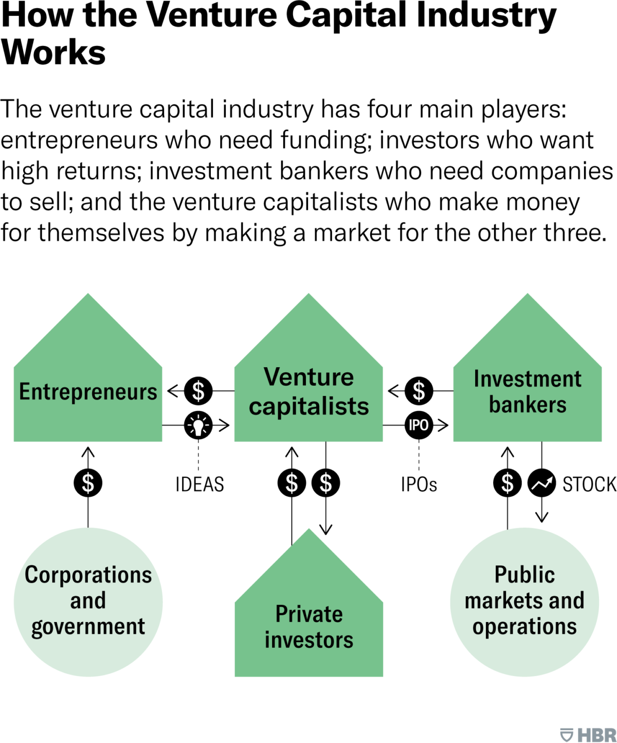
What is Venture Capital
Venture capital (VC) is a form of private equity and a type of financing for startup companies and small businesses with long-term growth potential.
Venture capitalists provide backing through financing, technological expertise, or managerial experience.
VC firms raise money from limited partners (LPs) to invest in promising startups or even larger venture funds.

Slide 3
Understanding Venture Capital (VC)
VC provides financing to startups and small companies that investors believe have great growth potential. Financing typically comes in the form of private equity (PE). Ownership positions are sold to a few investors through independent limited partnerships (LPs).
Venture capital tends to focus on emerging companies, while PE tends to fund established companies seeking an equity infusion. VC is an essential source for raising money, especially if start-ups lack access to capital markets, bank loans, or other debt instruments.
The corporation's first investment was in a company that had ambitions to use X-ray technology for cancer treatment. The $200,000 that Doriot invested turned into $1.8 million when the company went public in 1955.
VC became synonymous with the growth of technology companies in Silicon Valley on the West Coast. By 1992, 48% of all investment dollars went into West Coast companies; Northeast Coast industries accounted for just 20%. Today, a lot of states around the country established VC hubs incentivized by the state governments

Slide 4
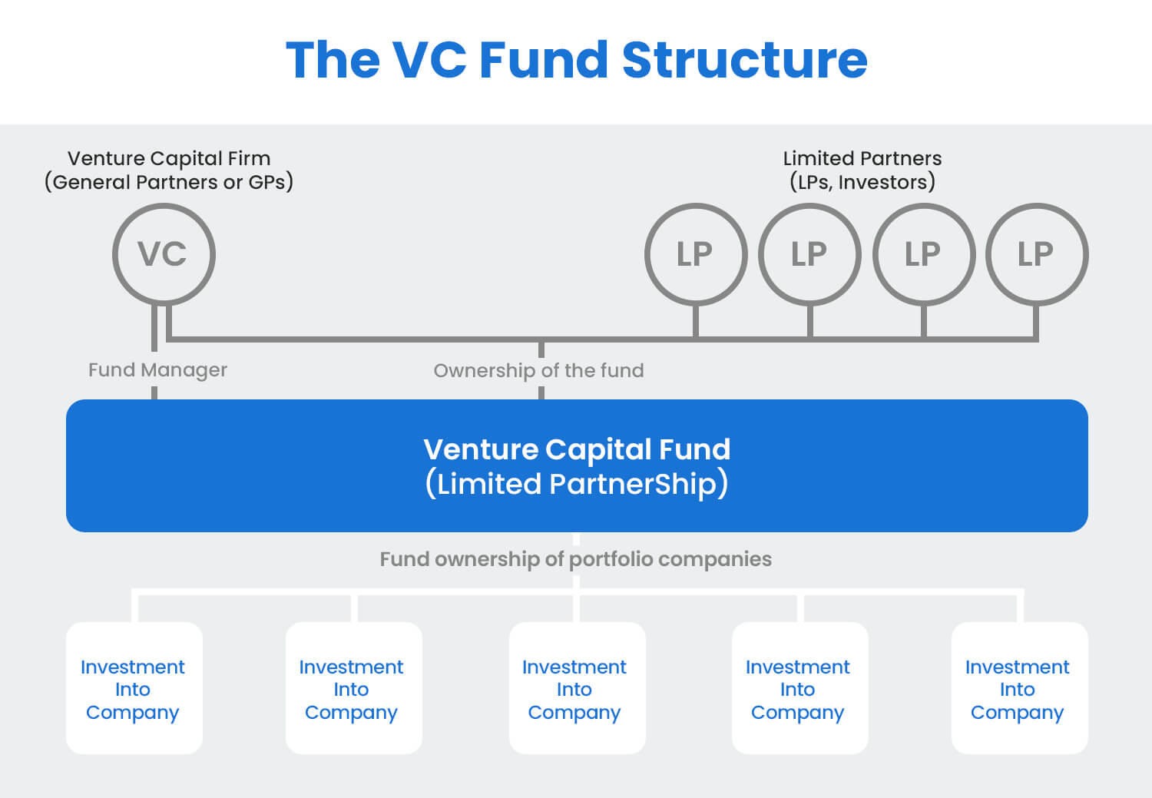
The VC Fund Structure

Slide 5
Types of Venture Capital
Pre-Seed: This is the earliest stage of business development when the startup founders try to turn an idea into a concrete business plan. They may enroll in a business accelerator to secure early funding and mentorship.
Seed Funding: This is the point where a new business seeks to launch its first product. Since there are no revenue streams yet, the company will need VCs to fund all of its operations.
Early-Stage Funding: Once a business has developed a product, it will need additional capital to ramp up production and sales before it can become self-funding. The business will then need one or more funding rounds, typically denoted incrementally as Series A, Series B, etc.

Slide 6
How to Secure VC Funding
Submit a Business Plan: Any business looking for venture capital must submit a business plan to a venture capital firm or an angel investor. The firm or the investor will perform due diligence, which includes a thorough investigation of the company's business model, products, management team, and operating history.
Investment Pledge: Once due diligence has been completed, the firm or the investor will pledge an investment of capital in exchange for equity in the company. These funds may be provided all at once, but more typically the capital is provided in rounds. The firm or investor then takes an active role in the funded company, advising and monitoring its progress before releasing additional funds.
Exit: The investor exits the company after some time, typically four to six years after the initial investment, by initiating a merger, acquisition, or initial public offering (IPO).

Slide 7
Advantages and Disadvantages of Venture Capital
Venture capital provides funding to new businesses that do not have enough cash flow to take on debts. This arrangement can be mutually beneficial because businesses get the capital, they need to bootstrap their operations, and investors gain equity in promising companies. VCs often provide mentoring and networking services to help them find talent and advisors. A strong VC backing can be leveraged into further investments.
Pros
Provides early-stage companies with capital to bootstrap operations
Companies don't need cash flow or assets to secure VC funding
VC-backed mentoring and networking services help new companies secure talent and growth
Cons
Demand a large share of company equity
Companies may find themselves losing creative control as investors demand immediate returns
VCs may pressure companies to exit investments rather than pursue long-term growth

Slide 8

Angel Investors
Venture capital can be provided by high net-worth individuals (HNWIs), also often known as angel investors, or venture capital firms. The National Venture Capital Association is an organization composed of venture capital firms that fund innovative enterprises.
Angel investors are typically a diverse group of individuals who have amassed their wealth through a variety of sources. However, they tend to be entrepreneurs themselves, or recently retired executives from business empires. The majority look to invest in well-managed companies, that have a fully-developed business plan and are poised for substantial growth.
These investors are also likely to offer to fund ventures that are involved in the same or similar industries or business sectors with which they are familiar. Another common occurrence among angel investors is co-investing, in which one angel investor funds a venture alongside a trusted friend or associate, often another angel investor.

Slide 9
Venture Capital Success
Due to the industry's proximity to Silicon Valley, most deals financed by venture capitalists occurred in the technology industry—the internet, healthcare, computer hardware and services, and mobile and telecommunications.
While technology dominates VC funding, other industries have also benefited from VC funding. VC has matured over time and the industry comprises an assortment of players and investor types who invest in different stages of a startup's evolution.
Regarding VC success rates, it's important to note that venture capital is a high-risk, high-reward investment strategy. According to research more than 75% of venture-backed startups fail to return investors' capital, and less than 75% of startup founders receive anything at all upon exit.
Indeed, most VC-backed firms fail, with only 5-7% of all investments accounting for high returns.
Indeed, VC firms generate most of their returns from only a small number of successful "home runs" that produce excess returns. While the average VC fund returns can be upwards of 15% annually, the median VC-backed startup fails to return investor capital.

Slide 10
Examples of Venture Capital Investments
Apple: In 1978, Apple received $250,000 in VC funding from Sequoia Capital and Arthur Rock. This early investment helped Apple develop its first mass-market personal computer, the Apple II.
Google: In 1998, Google received $100,000 from angel investor Andy Bechtolsheim. Shortly after, Sequoia Capital and Kleiner Perkins invested a combined $25 million, which helped Google develop its search engine technology.
Meta: In 2005, Accel Partners invested $12.7 million in Facebook at a roughly $100 million valuation. This investment helped Facebook expand beyond college campuses and become a global social network.
Amazon: In 1995, Amazon received $8 million in Series A funding from Kleiner Perkins. This early investment helped Amazon build its initial infrastructure and expand its product offerings beyond books.
Uber: In 2011, Uber raised $11 million in Series A funding led by Benchmark Capital. This investment helped Uber expand its ride-hailing service to new cities and develop its technology platform.
Coinbase: In 2013, Andreessen Horowitz led Coinbase's $25 million Series B funding round, which helped the company become one of the largest cryptocurrency exchanges globally.

Slide 11
Alternatives to VC Funding
Bootstrapping: Founders use their own savings and revenue from the business to fund growth. Bootstrapping allows entrepreneurs to maintain full control but may limit growth speed.
Angel investors: These investors are high-net-worth individuals who invest their own money in early-stage startups, often in exchange for equity. Angel investments are typically smaller than VC rounds and will often precede venture funding at later stages.
Crowdfunding: Platforms like Kickstarter or Indiegogo allow companies to raise small amounts of money from a large number of people. Crowdfunding can be particularly effective for consumer products.
Bank loans: Traditional bank loans or Small Business Administration (SBA) loans can provide capital without giving up equity, but they usually require collateral and a proven track record.

Slide 12
Alternatives to VC Funding
Revenue-based financing: For companies that are already producing sales, investors may provide capital in exchange for a percentage of ongoing gross revenues. This option is becoming increasingly popular for companies with recurring revenue.
Initial coin offerings (ICOs): Used primarily by blockchain-based startups, ICOs allow companies to raise funds by selling cryptocurrency tokens.
Grants: Government agencies, foundations, universities, and corporations offer grants for specific types of research or development, particularly in science and technology fields.
Peer-to-peer lending: Online platforms connect companies with individuals or institutions willing to lend money, often at competitive rates.

Slide 13

Why Is Venture Capital Important?
New businesses are often highly risky and cost-intensive ventures. As a result, external capital is often sought to spread the risk of failure. In return for taking on this risk through investment, investors in new companies can obtain equity and voting rights for cents on the potential dollar. Venture capital, therefore, allows startups to get off the ground and founders to fulfill their vision.

Slide 14
What Is a Portfolio Company?
A portfolio company refers to a company that a VC or private equity firm has invested in. Typically, a venture capital firm will have investments in multiple portfolio companies at various stages of development. This not only diversifies the investors' exposure to different segments or industries, but also allows for the fact that most startup companies will fail. By spreading their investments across multiple companies, VC firms can mitigate the risk of total loss and increase their chances of finding one or more highly successful ventures (i.e., "unicorns") that will provide outsized returns.

Slide 15
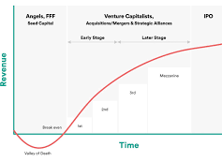
What Is Late-Stage Investing?
Late-stage financing has become more popular because institutional investors prefer to invest in less-risky ventures, as opposed to early-stage companies where the risk of failure is higher.

Slide 16
What Is Preferred Stock in VC Funding?
Preferred stock is a class of ownership in a corporation that has a higher claim on assets and earnings than common stock. In the context of venture capital, preferred stock plays a crucial role in investment negotiations. Preferred stock typically comes with special rights and features that make it more attractive to investors, particularly venture capitalists. For example, if the company goes bust, preferred stockholders are paid before common stockholders. This provides a level of downside protection for VCs. Preferred stock will also typically pay a higher fixed dividend, while common stock issued by startups might not pay a dividend at all. By negotiating for preferred stock, venture capitalists aim to balance the high risks associated with startup investments with potential rewards and protections.

Slide 17
How Have Regulatory Changes Boosted VC?
1958
The Small Business Investment Act (SBIC) in 1958 boosted the VC industry by providing tax breaks to investors. In 1978, the Revenue Act was amended to reduce the capital gains tax from 49% to 28%.
1979
In 1979, a change in the Employee Retirement Income Security Act (ERISA) allowed pension funds to invest up to 10% of their assets in small or new businesses.
1981
The capital gains tax was reduced to 20% in 1981.
1980s
These developments catalyzed growth in VC and the 1980s turned into a boom period for venture capital, with funding levels reaching $4.9 billion in 1987.

