Slide 1
International finance
Lecture 1: risk & return overview

Slide 2
What’s This?

Slide 3
EXIT
Expected Value Line Growth (Return)
Risk-Free Rate
ENTRY
Initial
Investment

Slide 4
Expected Value Line Growth (Return)
EXIT
Risk Premium
Risk-Free Rate
ENTRY
Initial
Investment

Slide 5
Expected Value Line Growth (Return)
EXIT
Risk (Volatility)
Risk Premium
Risk-Free Rate
ENTRY
Initial
Investment

Slide 6
The Study of Finance
Buying Stocks / Buying Bonds
Buying Assets / Equipment
Starting a New Project
Buying a Company
Starting a new Company
3 FACTORS BEFORE YOU INVEST
  Measure Expected Return
  Quantify Risk
  Set Time (Exit)

Slide 7


The Study of Finance
3 FACTORS BEFORE YOU INVEST
  Measure Expected Return
  Quantify Risk
  Set Time (Exit)
Game: Tossing a Coin to win $6 (Payoff):
Measure Expected Return: $6
Quantify Risk: 50/50 win/loss
Time: in 2 seconds
How much to Invest?
  $3 - mathematically using probability theory is (50% x $6) + (50% x $0) = $3 + 0 = $3
Game: Tossing one dice to win $6 (Payoff):
Measure Expected Return: $6
Quantify Risk: 1/6 to win, 5/6 to lose
Time: in 2 seconds
How much to Invest?
  $1 - mathematically using probability theory is (1/6 x $6) + (5/6 x $0) =
  $1 + 0 = $1

Slide 8
The Study of Finance
Risks that are pushing the Value Line down
FIELDS OF FINACE
Corporate Finance
Investment Analysis
Credit Analysis
EXIT
Risk (Volatility)
Expected Value Line Growth (Return)
Finance Strategies to Keep the Value Line Up
Initial
Investment
ENTRY
3 FACTORS BEFORE YOU INVEST
  Measure Expected Return
  Quantify Risk
  Set Time (Exit)

Slide 9
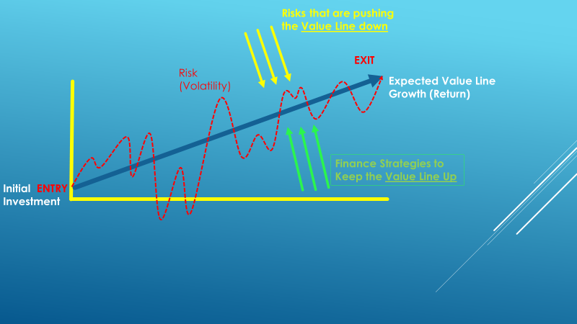
The Study of Finance
Corporate Finance
  Risks that are pushing the Value Line Down:
    Economy
    Competition
    Government
    Disasters
    Other Systemic/Firm Specific Risks
  Strategies to Keep the Value Line Up
    Operating Strategies
    Transactional Strategies
    Financing Strategies
    Social Responsibility

Slide 10
The Study of Finance
Investments
  Risks that is pushing the Value Line Down:
    Economy and Markets
    Government & Regulation
    Liquidity
    Other Systemic/Firm and Asset Class Specific Risks
  Strategies to Keep the Value Line Up
    Allocation/Diversification Strategies
    Hedging Strategies (Using Derivatives)

Slide 11
The Study of Finance
Credit Analysis
  Risks that is pushing the Value Line Down:
    Economy
    Government
    Other Systemic/Firm and Asset Class Specific Risks
  Strategies to Keep the Value Line Up
    Loan / Bond Structure
    Debt Capacity Analysis

Slide 12
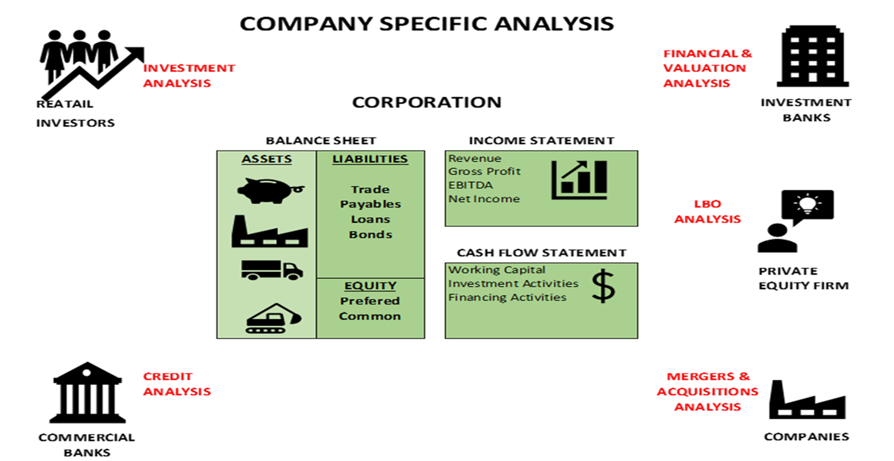
The Study of Finance
Finance, Investments and Credit
  Fundamental Analysis :
    Understanding Financial Statements
    Build Projections
    Corporate Valuations
    Transaction / Debt Capacity Analysis
  Technical Analysis
    Stock movements, Standard Deviation
    Comparative Analysis/ Regression Analysis and Correlation
    Portfolio Analysis measurements CAPM, Sharpe Ratio, Beta, Alpha,
  Behavioral Analysis
ASSET CLASS:
EQUITY
BONDS
DERIVATIVES

Slide 13
Corporate finance
Learning Objectives (LO)
Identify the basic types of financial management decisions and the role of the financial manager.
Describe the principal characteristics of the different forms of business organization.
Classify the core components of the three (3) principal financial statements: the balance sheet, the income statement, and the statement of cash flows.
Identify commonly-used financial ratios to measure a firm’s financial performance.
Accessing Capital Markets (Primary Markets) – raising capital including equity and debt (Transaction Analysis)
Corporate Valuation Methods

Slide 14
Investment analysis
Learning Objectives (LO)
Apply the principal time value of money (TVM) concepts used in financial analysis and valuation.
Determine the value of debt and equity securities using discounted cash flow methods (DCFs) and alternative valuation techniques.
Apply the Net Present Value (NPV) method and alternative decision rules such as the Internal Rate of Return (IRR) and the Payback Method to evaluate investment projects.
Analyze the tradeoffs between risk and return in capital markets.
Estimate the risk-return tradeoff for diversified investment portfolios by applying the fundamental principles of portfolio theory.

