Slide 1

Private Equity & Venture Capital
Introductory Lecture 1
Private Equity Overview

Slide 2
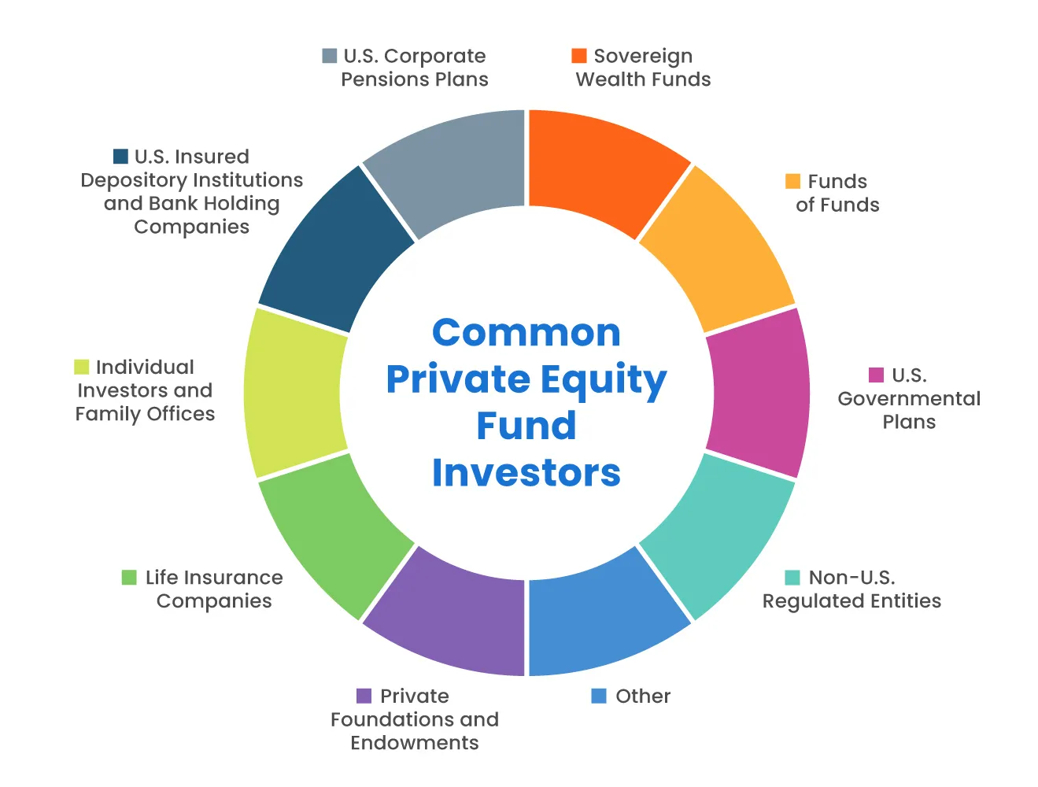
What is Private Equity
Private equity describes investment partnerships that buy and manage companies before selling them. Private equity firms operate these investment funds on behalf of institutional and accredited investors.
Private equity funds may acquire private companies or public ones in their entirety or invest in such buyouts as part of a consortium. They typically do not hold stakes in companies that remain listed on a stock exchange.
Private equity is often grouped with venture capital and hedge funds as an alternative investment. Investors in this asset class are usually required to commit significant capital for years, which is why access to such investments is limited to institutions and individuals with high net worth
Notes:
BUY – MANAGE – SELL
BUY PRIVATE AND PUBLIC COMPANIES - ALONE OR WITH A CONSORTIUM
PE IS PART OF THE ALTERNATIVE INVESTMENTS (LIMITED TO ACCRETED INVESTORS / INSTITUTIONS)

Slide 3
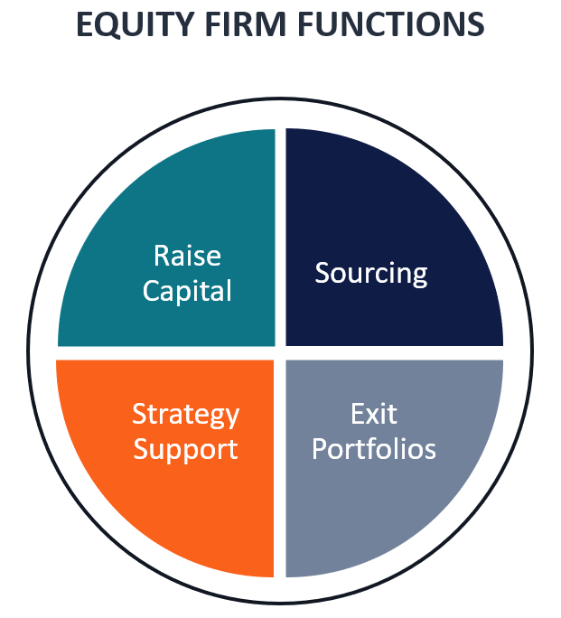
Understanding Private Equity
In contrast with venture capital, most private equity firms and funds invest in mature companies rather than startups. They manage their portfolio companies to increase their worth or to extract value before exiting the investment years later.
The private equity industry has grown rapidly amid increased allocations to alternative investments and following private equity funds' relatively strong returns the last 15 years.
Private equity firms raise client capital to launch private equity funds, and operate them as general partners, managing fund investments in exchange for fees and a share of profits above a preset minimum known as the hurdle rate.
Notes:
MATURE COMPANIES

Slide 4
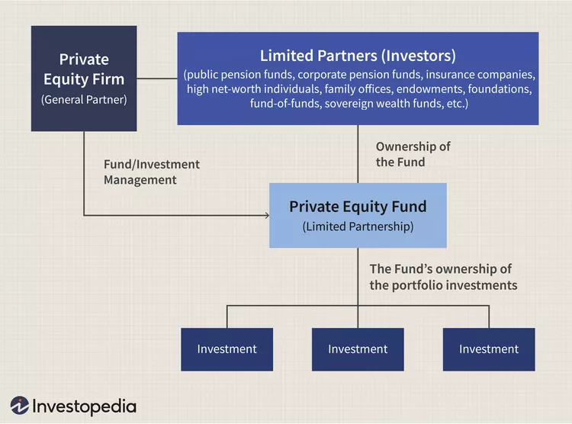
GP/LP Structure of Private Equity

Slide 5
GP/LP Structure of Private Equity
Example of a PE Fund

Slide 6
Summary Terms of Private Equity Fund Structure
Private equity funds have a finite term of 10 to 12 years, and the money invested in them isn't available for subsequent withdrawals. The funds do typically start to distribute profits to their investors after several years.
The average holding period for a private equity portfolio company was about 5.6 years in 2024.
Several of the largest private equity firms are now publicly listed companies in the wake of the landmark initial public offering (IPO) by Blackstone Group Inc. (BX) in 2007.
In addition to Blackstone, KKR & Co. Inc. (KKR), Carlyle Group Inc. (CG), and Apollo Global Management Inc. (APO) all have shares traded on U.S. exchanges. (https://finance.yahoo.com/compare/BX?comps=KKR,CG,APO

Slide 7
Private Equity Specialties
Some private equity firms and funds specialize in a particular category of private-equity deals. While venture capital is often listed as a subset of private equity, its distinct function and skillset set it apart and have given rise to dedicated venture capital firms that dominate their sector. Other private equity specialties include:
  Distressed investing, specializing in struggling companies with critical financing needs
  Growth equity, funding expanding companies beyond their startup phase
  Sector specialists, with some private equity firms focusing solely on technology or energy deals, for example
  Secondary buyouts, involving the sale of a company owned by one private-equity firm to another such firm
  Carve-outs involving the purchase of corporate subsidiaries or units.

Slide 8
Private Equity Deal Types
Traditional LBO (Public-to-Private): The buyout remains the focus a staple of private equity deals, involving the acquisition of an entire company whether Public-to-private or closely held. Private equity investors acquiring an underperforming public company will often seek to cut costs and may restructure its operations.
Carve-Outs: The private equity investors buy a division of a larger company, typically a non-core business put up for sale by its parent corporation. Carve-outs tend to fetch lower valuation multiples than other private equity acquisitions but can be more complex and riskier.
Secondary Buyouts (Private-to-Private): This is when a Private equity firm buys a company from another private equity group rather than a listed company. Such deals were assumed to constitute a distress sale but have become more common amid increased specialization by private equity firms.

Slide 9
How Private Equity Creates Value
By the time a private equity firm acquires a company, it will already have a plan in place to increase the investment's worth. That could include dramatic cost cuts or a restructuring, steps the company's incumbent management may have been reluctant to take. Private equity owners with a limited time to add value before exiting an investment have more of an incentive to make major changes.
The private equity firm may also have special expertise the company's prior management lacked. It may help the company develop an e-commerce strategy, adopt new technology, or enter additional markets. A private-equity firm acquiring a company may bring in its own management team to pursue such initiatives or retain prior managers to execute an agreed-upon plan.
The acquired company can make operational and financial changes without the pressure of having to meet analysts' earnings estimates or to please its public shareholders every quarter. Ownership by private equity may allow management to take a longer-term view, unless that conflicts with the new owners' goal of making the biggest possible return on investment.

Slide 10
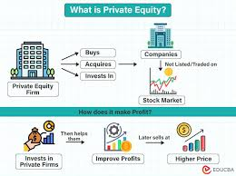
How Private Equity Creates Value

Slide 11
Making Money the Old-Fashioned Way With Debt
Industry surveys suggest operational improvements have become private equity managers' focus and source of added value.
Debt remains an important contributor to private equity returns, even as the increase in fundraising has made leverage less essential. Debt used to finance an acquisition reduces the size of the equity commitment and increases the potential return on that investment accordingly, albeit with increased risk.
Private equity managers can also cause the acquired company to take on more debt to accelerate their returns through a dividend recapitalization, which funds a dividend distribution to the private equity owners with borrowed money.
Dividend recaps are controversial because they allow a private equity firm to extract value quickly while saddling the portfolio company with extra debt.

Slide 12



Leveraged Buyouts Enhancing Private Equity Returns
Your Business
Income Statement
Balance Sheet
EBIT : $1.5 million
Interest Exp.: $ 0 million
Pretax Income: $1.5 million
Taxes (33%): $0.5 million
Net Income: $1.0 million
ASSETS:
$10 million
LIABILITIES:
$0 (No Debt)
EQUITY:
$10 million
ROA = 10%
ROE = 10%
The offer: $10mm (10 x Net Income) borrowed $9 million (90%) at 10%
LBO: NewCo
Income Statement
Balance Sheet
EBIT: $1.5 million
Interest Exp.: $ 0.9 million
Pretax Income: $ 0.6 million
Taxes (33%): $ 0.2 million
Net Income: $ 0.4 million
ASSETS:
$10 million
LIABILITIES:
$9 million
EQUITY:
$1 million
ROA = 10%
ROE = 40%

Slide 13
Leveraged Buyouts Enhancing Private Equity Returns
Your Business
Income Statement
Balance Sheet
EBIT : $1.5 million
Interest Exp.: $ 0 million
Pretax Income: $1.5 million
Taxes (33%): $0.5 million
Net Income: $1.0 million
ASSETS:
$10 million
LIABILITIES:
$0 (No Debt)
EQUITY:
$10 million
ROA = 10%
ROE = 10%
20% Premium
The offer: $12 mm (12 x Net Income) borrowed $10.8 million (90%) at 10%
LBO: NewCo
Income Statement
Balance Sheet
EBIT: $1.50 million
Interest Exp.: $1.08 million
Pretax Income: $ 0.42 million
Taxes (33%): $ 0.14 million
Net Income: $ 0.28 million
ASSETS:
Purchase: $10 million
Goodwill: $ 2 million
Total: $12 million
LIABILITIES:
$10.8 million
EQUITY:
$ 1.2 million
ROA = 10% (tang)
ROE = 23%
6

Slide 14
Why Private Equity Draws Criticism
Private equity firms have pushed back against the stereotype depicting them as strip miners of corporate assets, stressing their management expertise and examples of successful transformations of portfolio companies.
Many are touting their commitment to environmental, social, and governance (ESG) standards directing companies to mind the interests of stakeholders other than their owners.
Still, rapid changes that often follow a private equity buyout can often be difficult for a company's employees and the communities where it has operations.
Another frequent focus of controversy is the carried interest provision allowing private equity managers to be taxed at the lower capital gains tax rate on the bulk of their compensation. Legislative attempts to tax that compensation as income have met with repeated defeat, notably when this change was dropped from the Inflation Reduction Act of 2022.

Slide 15
How Are Private Equity Funds Managed?
A private equity fund is managed by a general partner (GP), typically the private equity firm that established the fund.
The GP makes assets and the fund's management decisions. It also contributes 1% to 3% of the fund's capital to ensure it has skin in the game.
In return, the GP earns a management fee often set at 2% of fund assets and may be entitled to 20% of fund profits above a preset minimum as incentive compensation, known in private equity jargon as carried interest.
Limited partners are clients of the private equity firm that invest in its fund; they have limited liability.

Slide 16

Are Private Equity Firms Regulated?
While private equity funds are exempt from regulation by the Securities and Exchange Commission (SEC) under the Investment Company Act of 1940 or the Securities Act of 1933, their managers remain subject to the Investment Advisers Act of 1940 as well as the anti-fraud provisions of federal securities laws.
In February 2022, the SEC proposed extensive new reporting and client disclosure requirements for private fund advisers including private equity fund managers.
U.S. Securities and Exchange Commission. "Proposed Rule: Private Fund Advisers; Documentation of Registered Investment Adviser Compliance Reviews."
The new rules would require private fund advisers registered with the SEC to provide clients with quarterly statements detailing fund performance, fees, and expenses, and to obtain annual fund audits. All fund advisors would be barred from providing preferential terms for one client in an investment vehicle without disclosing this to the other investors in the same fund

Slide 17

What Is the History of Private Equity Investments?
In 1901, J.P. Morgan bought Carnegie Steel Corp. for $480 million and merged it with Federal Steel Company and National Tube to create U.S. Steel in one of the earliest corporate buyouts and one of the largest relative to the size of the market and the economy.
In 1919, Henry Ford used mostly borrowed money to buy out his partners, who had sued when he slashed dividends to build a new auto plant.
In 1989, KKR engineered what is still the largest leveraged buyout in history after adjusting for inflation, buying RJR Nabisco for $31 billion.
The largest LBO ever was the acquisition of TXU by KKR and TPG in 2007 for $44.3 billion. https://bsic.it/vintage-private-equity-deals-txu-learnings-from-the-largest-lbo-bust-in-history/
https://www.youtube.com/watch?v=29Cv3-dGzJs&t=75s

Slide 19

https://www.youtube.com/watch?v=29Cv3-dGzJs&t=75s
Initial Bids for RJR Nabisco
KKR $90 per share
Forsman Little try to get in as a White Knight
Second Round
Management (CEO –Johnson) backed by Shearson/American Express $100 per share ($23 Billion)
KKR $94 ($21.6 Billion) work with Drexel Behrman (High Yield Bonds) – Michael Milken
First Boston $105-118 (up to $26 billion)
Forsman Little still at the $90 – no bid from them
Third Round
Management (MBO) up from $100 to $101 then to $112 per share
KKR up from $94 to $109 ($25.7 billion)

