Slide 1

Mergers & Acquisitions
Professor Chris Droussiotis
Lecture 1: introduction

Slide 2
The Study of Finance
FIELDS OF FINACE
Corporate Finance
Investment Analysis
Credit Analysis
Expected Value Line Growth (Return)
Risks that are pushing the Value Line down
Finance Strategies to Keep the Value Line Up

Slide 3
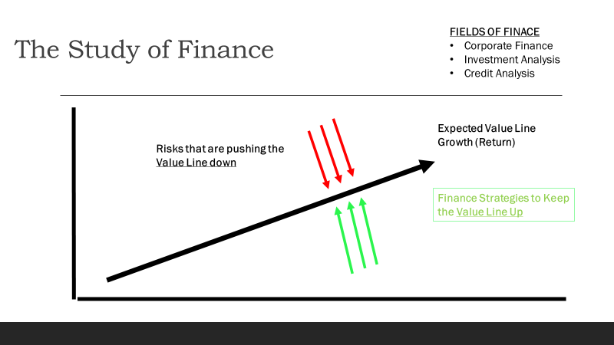
The Study of Finance
Corporate Finance
  Risks that are pushing the Value Line Down:
    Economy
    Competition
    Government
    Disasters
    Other Systemic/Firm Specific Risks
  Strategies to Keep the Value Line Up
    Operating Strategies
    Transactional Strategies
    Financing Strategies
    Social Responsibility

Slide 4
Managerial Strategies
Operational Strategy
  Revenue Growth (organic)
  Expense Management
  Hiring Talent
  Marketing the Product
Financial Strategy
  Raising Equity
  Raising Debt
Social Responsibility
  Governance
  Shareholders/ Employees / Government / Community
Transactional Strategy
  Merger
  Acquisitions
  Joint Ventures
  Strategic Alliances
  Greenfield Investment

Slide 5
M&A Ecosystem
THREE MAIN PARTIES:
SELLER
BUYER
THIRD PARTY

Slide 6
Why do M&A Happen?
Using Numbers – No words:
1 + 1 = 3
1 + 1 + 1 + 1 + 1 + 1 + 1 = 7
2 (0.20) + 2 (0.80) = 0.4 + 1.6 = 2

Slide 7
Why do M&A Happen?
Using Numbers – No words:
1 + 1 = 3 SYNERGY
1 + 1 + 1 + 1 + 1 + 1 + 1 = 7 DIVERSIFICATION
2 (0.20) + 2 (0.80) = 0.4 + 1.6 = 2
STRATEGIC REALIGNMENT / EFFICIENCY

Slide 8
Why do M&A Happen?
Using Words – No numbers:
Synergy
  Operating Synergy
  Financial Strategy
Diversification
Strategic Realignment
  Market Power
  Cross-Border
  Tax Considerations
  Defensive Strategy

Slide 9
PROCESS OF ACQUIRING the target company
Stage 1
Identification & Valuation
Stage 2
The Tender offer and Settlement
Stage 3
Post –Acquisition Management

Slide 10
PROCESS OF ACQUIRING the target company
Stage 1
Identification & Valuation
Well Define Corporate Strategy
Public vs Private Company
Quantify the Return (ROI) and Risk
Valuation Methodologies
Accretion vs Dilution Analysis

Slide 11
PROCESS OF ACQUIRING the target company
Stage 1
Identification & Valuation
Well Define Corporate Strategy
Public vs Private Company
Quantify the Return (ROI) and Risk
Valuation Methodologies

Slide 12
PROCESS OF ACQUIRING the target company
Stage 2
Tender Offer & Settlement
(after the Target has been identified)
Securing the approval of the management and ownership of the target company to government and regular bodies (friendly vs hostile takeover)
Settlement compensation – payment to the shareholders of target company
  Cash or Common stock
  Accretion vs Dilution Analysis
  Various factors for determining the methods used for settlement availability of cash, size of target firm
  Access to Capital

Slide 13
PROCESS OF ACQUIRING the target company
Stage 3
Post-Acquisition Management
This is very important stage because it will determine in relatively quick order the success or failure of the acquisition
The objective is to create shareholder value
Problems identified earlier including the failure of meeting synergies, high cost of integration and difficult corporate culture

Slide 14
Modes of Mergers & Acquisitions
M&A
Amalgamation
Merger
De-Merger
Acquisition
Asset Purchase
Stock Purchase

Slide 15
U.S. Regulations on Public Targets
Proxy Statements → Voting materials.
Schedule TO/14D-9 → Tender offer disclosure & target’s response.
Registration/Prospectus (S-4, 424B) → Securities issued in M&A or public offerings.
Schedule 13E-3 → “Going private” disclosures.
8-K / 10-K / 10-Q → Continuous financial & event reporting.

Slide 16
Proxy Statements
Definition: Documents filed with the SEC when shareholders are asked to vote on corporate matters.
Purpose: Provide information so investors can make informed voting decisions.
Examples of Use: Mergers & acquisitions, board elections, executive compensation, shareholder proposals.

Slide 17
Schedule TO / Schedule 14D-9
Schedule TO (Tender Offer):
  Filed by any party making a tender offer (an offer to purchase shares directly from shareholders, usually at a premium).
  Discloses terms, source of funds, and purpose of the transaction.
Schedule 14D-9:
  Filed by the target company in response to a tender offer.
  States whether the board recommends accepting, rejecting, or taking no position.
Together, these filings protect investors in takeover or buyout scenarios.

Slide 18
Registration Statement / Prospectus (S-4, 424B)
Schedule TO (Tender Offer):
  Filed by any party making a tender offer (an offer to purchase shares directly from shareholders, usually at a premium).
  Discloses terms, source of funds, and purpose of the transaction.
Schedule 14D-9:
  Filed by the target company in response to a tender offer.
  States whether the board recommends accepting, rejecting, or taking no position.
Together, these filings protect investors in takeover or buyout scenarios.

Slide 19
Schedule 13E-3
Definition: Filed when a company or affiliates engage in a “going private” transaction.
Purpose: Protect minority shareholders by requiring disclosure of the fairness of the transaction, valuation methods, and conflicts of interest.
Example: When management or a private equity firm buys out the public float to take the company private.

Slide 20
8-K / 10-K / 10-Q
8-K (Current Report): Filed to announce major unscheduled events (merger, bankruptcy, CEO resignation, etc.).
10-K (Annual Report): Comprehensive yearly report with audited financials, risks, management discussion, and business overview.
10-Q (Quarterly Report): Unaudited quarterly updates on financial performance and operations.
These are the backbone of ongoing public company reporting obligations.

Slide 21
U.S. Regulations on private Targets
Not required to public filing of documents
When a public company buys a private company (or a division/subsidiary of a public company) it may require to file certain disclosure documents
Issuing shares in excess of 20%
LBOs – accessing public bonds – file with the SEC (S-4)

Slide 22
Primary SEC filings in M&A transactions
SEC Proxy Statements | Description
Prem 14A /Defm 14A | Preliminary/definitive proxy statement relating to an M&A transaction
Prem 14C / Defm 14C | Preliminary / definitive information statement relating to an M&A transaction
Schedule 13E-3 | Filed to report going private transactions initiated by certain issuers or their affiliates
SEC Tender Offer | Description
Schedule TO | Filed by an acquirer upon commencement of a tender offer
Schedule 14D-9 | Recommended from the target’s board of directors on how shareholders should respond to a tender offer
SEC Registration Statement Prospectus | Description
S-4 | Registration statement for securities issued in connection with a business combination with a business combination or exchange offer. May include proxy statement of acquirer and/or public target
424B | Prospectus

Slide 23

M&A
USE
CASE:
DRIVERS
NATURAL PROGRESSION
BENEFITS
CHALLENGES

Slide 24
Drivers of Cross Border M&A
Globalization and openness of financial markets
Geographical diversification
Deregulation of markets
Company efficiency
Hedging on Trade and Tariffs
Increase production
Technology and Innovation boom across cultures

Slide 25
Natural progression for a growth company
1
Companies started a domestic production
2
Companies started to export to the foreign markets
3
Companies established a subsidiary in overseas market
4
Companies started strategic alliances – customer acquisition
5
Companies started a Greenfield project – build manufacturing facility
6
Companies started to acquire other companies in foreign markets

Slide 26
Benefits of cross border M&A
Acceleration of business
Accessing capital
Synergies
Technology
Tax planning
Mitigation of trade and foreign exchange costs

Slide 27
Challenges of cross border M&A
Legal
Accounting
Strategic
Technology
Integration
Human Resources
Cultural

Slide 28
Challenges of cross border M&A
Legal Issues
  Acquirer need to understand all the legal provisions of the foreign country
  After understanding the local laws, the acquirer many find that these provisions are incompatible, resulting to lengthy process and company policy changes
  Ex-pat and HR laws / Visa issues
  Labor laws
  Sarbanes & Oxley – Laws on publicly traded companies

Slide 29
Challenges of cross border M&A
Accounting Issues
  Merging entities have different internal controls
  Absence of uniformity of internal controls could lead to mismanagement
  Accounting Standards (International Vs US GAAP)
  Merger accounting – adjustments to the Balance Sheet could result to overvalue or undervalue

Slide 30
Challenges of cross border M&A
Technological Differences
  Integration challenges due to different technology platforms
Strategic Issues
  Achieving synergies can be challenging including
    cost savings
    plant rationalization
    Labor issues
    IT integration
    marketing integration
    management changes

Slide 31
Challenges of cross border M&A
Cultural Differences
  Corporate Governance
  Job Security
  Regular and external environments
  Customer Expectations
  Operating styles due to different backgrounds
  Country culture and different values

Slide 32
Challenges of cross border M&A
Human Resources Issues
  Motivation & Morale
  Layoffs and voluntary leave
  Employee stress due to uncertainty
  Career paths of each employee could be altered
  Organizational changes

