Slide 1
INTRODUCTION TO DERIVATIVES
Professor chris droussiotis

Slide 2
What’s This?

Slide 3
EXIT
Expected Value Line Growth (Return)
Risk-Free Rate
ENTRY
Initial
Investment

Slide 4
Expected Value Line Growth (Return)
EXIT
Risk Premium
Risk-Free Rate
ENTRY
Initial
Investment

Slide 5
Expected Value Line Growth (Return)
EXIT
Risk (Volatility)
Risk Premium
Risk-Free Rate
ENTRY
Initial
Investment

Slide 6

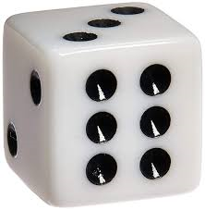
A LITTLE PROBABILITY TO SET THE MOOD
3 FACTORS BEFORE YOU INVEST
  Measure Expected Return
  Quantify Risk
  Set Time (Exit)
Game: Tossing a Coin to win $6 (Payoff):
Measure Expected Return: $6
Quantify Risk: 50/50 win/loss
Time: in 2 seconds
How much to Invest?
  $3 - mathematically using probability theory is (50% x $6) + (50% x $0) = $3 + 0 = $3
Game: Tossing one dice to win $6 (Payoff):
Measure Expected Return: $6
Quantify Risk: 1/6 to win, 5/6 to lose
Time: in 2 seconds
How much to Invest?
  $1 - mathematically using probability theory is (1/6 x $6) + (5/6 x $0) =
  $1 + 0 = $1

Slide 7
The Study of Finance
Risks that are pushing the Value Line down
FIELDS OF FINACE
Corporate Finance
Investment Analysis
Credit Analysis
EXIT
Risk (Volatility)
Expected Value Line Growth (Return)
Finance Strategies to Keep the Value Line Up
Initial
Investment
ENTRY
3 FACTORS BEFORE YOU INVEST
  Measure Expected Return
  Quantify Risk
  Set Time (Exit)

Slide 8
The Study of Finance
3 FACTORS BEFORE YOU INVEST
  Measure Expected Return
  Quantify Risk
  Set Time (Exit)
Game: Tossing a Coin to win $6 (Payoff):
Measure Expected Return: $6
Quantify Risk: 50/50 win/loss
Time: in 2 seconds
How much to Invest?
  $3 - mathematically using probability theory is (50% x $6) + (50% x $0) = $3 + 0 = $3
Game: Tossing one dice to win $6 (Payoff):
Measure Expected Return: $6
Quantify Risk: 1/6 to win, 5/6 to lose
Time: in 2 seconds
How much to Invest?
  $1 - mathematically using probability theory is (1/6 x $6) + (5/6 x $0) =
  $1 + 0 = $1

Slide 9
Math & Statistics 101

Slide 10
Derivatives in Math (Calculus)
A derivative is a measure of how a function changes as its input changes.
Δy = m.Δx
I (y being the independent variable, x the independent variable and m the rate of change or the slope)

Slide 11
Derivatives - overview
A VIEW (EXPECTATION) AND A BET (PREMIUM)
  Mechanics for Options and Futures
  Variables (S, X, Premium)
  Pricing the Bet (Based on Intrinsic Value)
  Action (Sell or Short and Buy or Long)
  Strategies (Covered and Uncovered)
TYPES
  Options
  Futures & Forwards
  Swaps and CDS

Slide 12
Why use/invest in Derivatives:
  Speculate and to make a profit if the value of the underlying asset moves the way they expect (e.g., moves in a given direction, stays in or out of a specified range, reaches a certain level)
  Hedge or mitigate risk in the underlying, by entering a derivative contract whose value moves in the opposite direction to their underlying position and cancels part or all of it out
  Obtain exposure to underlying where it is not possible to trade in the underlying (e.g., weather derivatives)
  Create option ability where the value of the derivative is linked to a specific condition or event (e.g., the underlying reaching a specific price level)

Slide 13
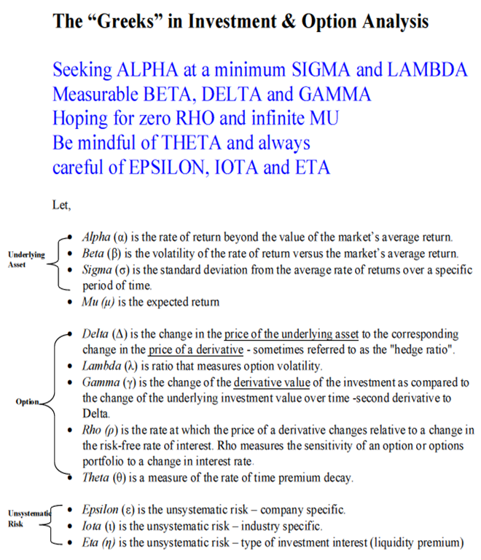

Slide 14

Options
OTHER TERMS:
Expiration Date (3rd Friday of the month)
American / European Options
Action: Buy/Sell Options
Speculation/Hedging
100 shares per option contract
Three Variables:
  S = Stock (underlying assets)
  X = Future Price (Exercise Price)
  Pr = Premium (“the bet”)
BUYING CALL OPTIONS The right to buy the Stock (S) at X price
BUYING PUT OPTIONS The right to sell the Stock (S) at X price
SELLING CALL OPTIONS The obligation to sell the Stock (S) at X price
SELLING PUT OPTIONS The obligation to buy the Stock (S) at X price

Slide 15
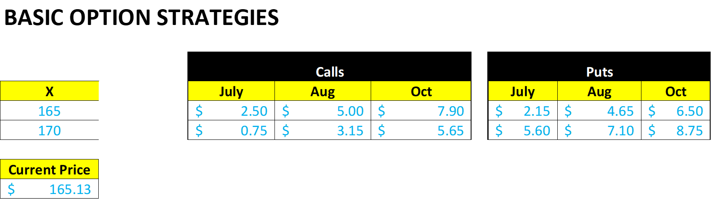
CALL PRICE
CONCEPTS
VIEW ON THE STOCK: STOCK WILL GO UP BY EXPIRATION TIME
RIGHT TO BUY THE STOCK AT A SET PRICE X NO MATTER WHAT THE STOCK DOES
TO GET THAT RIGHT, YOU PAY A PREMIUM
PAYOFF = Max (0, S – X )
PROFIT = PAYOFF – PEMIUM
BE = EXERCISE PRICE + PREMIUM

Slide 16




ACTION | X | Prem | S
BUY | 170 | (3.15) | 180
BUY Aug | 165 | (5.00) | 166
PAYOFF | PROFIT | HPR% | BE
10 | 6.85 | 6.85/3.15 | 173.15
1 | (4.00) | (4.0)/5= -0.80 | 170
June

Slide 17
CALLS

Slide 18

PUT PRICE
CONCEPTS
VIEW ON THE STOCK: STOCK WILL GO DOWN BY EXPIRATION TIME
RIGHT TO SELL THE STOCK AT A SET PRICE X NO MATTER WHAT THE STOCK DOES
TO GET THAT RIGHT, YOU PAY A PREMIUM
PAYOFF = Max (0, X – S)
PROFIT = PAYOFF – PEMIUM
BE = EXERCISE PRICE – PREMIUM

Slide 19








ACTION | X | Prem | S
PAYOFF | PROFIT | HPR% | BE
June

Slide 20
PUTS

Slide 21
Futures & Forwards
Options = 3 Variables (X, S, Premium)
Where,
X = Future Price or Exercise Price, S = Stock Price (Underlying Asset), Premium = Pay today to have the option
Futures & Forwards = 2 Variables (K, S)
Where,
K = Future Price, S = Spot Price (Underlying Asset)

Slide 22
Futures & Forwards
Concepts
Futures & Forwards
Delivery Price
Delivery Date
Delivery Volume
Long Position (purchasing the commodity on delivery date)
Short position (commits to delivery of the contract maturity)
Existing Contracts
Agriculture Futures
Metals and Minerals
Foreign Currencies
Financial Futures (fixed Income and Equity indices)

Slide 23
FORWARDS:
Starting with an Example
Example 1 To see how futures and forwards work and how they might be useful, consider the portfolio diversification problems facing a farmer growing a single crop, let us say wheat. The entire planting season’s revenue depends critically on the highly volatile crop price. The farmer can’t easily diversify his position because virtually his entire wealth is tied in the crop. The miller who must purchase wheat for processing faces a portfolio problem that is the mirror image of the farmer’s. He is subject to profit uncertainty because of unpredictable future cost of the wheat.
Both parties can reduce this source of risk if they enter a forward contract calling for the farmer to deliver the wheat when harvested at a price agreed upon now, regardless of the market price at harvest time. No money needs to change hands currently. The forward contract is simply a deferred delivery sale of some asset with the sales price to be paid or received for delivery of the commodity. The forward contract protects each party from future price fluctuations.

Slide 24
SWAPS - Introduction
SWAPS
  Interest Rate Swaps
  Currency Swaps
  Credit Default Swaps (CDS)

Slide 25
Interest Rate Swaps
  It’s a derivative in which one party exchange a stream of interest payments for another party’s stream of cash flows.
  Interest rate swaps can be used by hedgers to manage their fixed or floating assets and liabilities
  They could also for speculation – speculators replicate unfunded bond exposures to profit from changes in interest rates.
  Each counterparty agrees to pay either a fixed a floating rate – multiplied by a notional principal amount

Slide 26
Interest Rate Swaps
Example of Simple Interest Rate Swap:
Suppose that XYZ Corp. has $100 million of floating-rate debt at LIBOR – meaning that every year XYZ pay current six months LIBOR + 3.0% – but would prefer to have fixed-rate debt with 3 years maturity. There are several ways XYZ could effect this change:
XYZ could change their interest rate exposure by retiring the floating-rate debt and issuing fixed-rate debt in its place. However, an actual purchase and sale of debt has transaction coats.
They could enter into a strip of forward rata agreements (FRAs) in order to guarantee the borrowing rate for remaining life of the debt. Since the FRA for each year will typically carry a different interest rate, the company will lock in a different rate each year and hence, the company’s borrowing cost will vary over time, even though it wil be fixed in advance (it could be expensive depending of the steepness of the yield curve).
Obtain interest rate exposure equivalent to that of fixed rate debt by entering into a swap. XYZ is already paying floating interest rate. They therefore want to enter a swap in which they receive a floating rate and pay the fixed rate – assuming is 2.0%:
  Current Payment: - (LIBOR + 3.0%) = - LIBOR – 3.0%.
  Swap Rate is 2.0% which needs to pay 2.% more and receives the LIBOR rate so the following formula shoes the net pay
XYZ net payment = – LIBOR - 3.0% + LIBOR – 2.0% = – 5.0% Payment
The Notional principal of the swap is $100 million: It is the amount on which the interest payments – and hence, the swap payment – is based. The life of the swap is the swap term or swap tenor. The annual fixed payment for XYZ is always going to be 5.0% x $100mm = $5 million no matter what happens to LIBOR rates.
The counterparty (party A) who takes a interest rate risk is betting that the LIBOR rate will not increase over the course of 3 years contract. An assume payment exchange is illustrated below:

Slide 27
Currency Rate Swaps
Interest Rate Swaps
  It’s a derivative in which one party exchange a stream of payments in one currency for another party’s stream of cash flows of another currency.
  currency rate swaps can be used by hedgers to manage their foreign exchange exposure for assets and liabilities
  They could also for speculation – speculators replicate unfunded bond exposures to profit from changes in currency rates between two currencies.
  Each counterparty agrees to pay/receive certain currency and use the currency swap market to hedge the position against currency swings that can affect their revenue or cost

Slide 28
Currency Swap - Example
Suppose the effective annual euro-denominated interest rate is 6% and dollar-denominated rate is 7.0%.
The spot exchange rate is $1.30 / 1 €. A dollar-based firm has a 3-year 6% euro-denominated bond with a €100 par value and price of €100.
The firm wishes to guarantee the dollar value of the payments.
Since the firm will make debt payments in euros, it buys the euro forward to eliminate currency exposure.
The table below summarizes the transaction and reports the currency forward curve and the unhedged and hedged cash flows. The value of the hedge cash flow is:

Slide 29
Credit Default Swap
Is a swap contract in which the protection buyer of CDS makes a series of payments to the protection seller and, in exchange, receives a payoff if a credit instrument (typically a loan or a bond) goes into default – like an insurance
The payments (like premiums) are called “spread” - if the security defaults the seller pays the buyer the par value of the bond or loan in exchange of physical delivery of the bond or loan (though it could be cash too) – CREDIT EVENT
Naked CDS (not owning the bonds) are done for speculation – side bet – synthetic long and short positions
CDS can also be used in capital structure arbitrage.
BDS (basket default swaps)
Index CDS
LCDS

