Slide 1





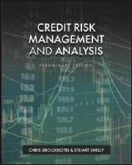

Introducing Credit Basics

Slide 2
CREDIT RISK MANAGEMENT AND RISK ANALYSIS
1 Credit Basics, History and Role
2 Credit Markets and Macroeconomics
3 Credit Risk Analysis
4 Credit Risk Management
5 Company Specific and Industry Risk
6 Financial Credit and Structure of the Loan
7 Market Risk and Loan Syndication
8 External Credit and Other Credit Analysis
9 Corporate Loans
10 Leveraged Loans, Private Credit and Collateralized Loan Obligations (CLOs)
11 Structured Finance, Off-Balance-Sheet Credit Structures and Instruments
12 Project Finance
13 Lease Finance
14 Structured Operating Contracts (SOCs)
15 Alternative Specialty Credit
16 Financial Statement Analysis
17 Projection Analysis and Financial Modeling
18 Valuation Analysis
19 Debt-Capacity Analysis

Slide 3
Credit Basics
What’s This?

Slide 4
Credit Basics
Company’s Top Line, bottom line and Cash Flow Expectation

Slide 5
Credit Basics
Company’s Top Line, bottom line and Cash Flow Expectation
New Debt Service
Debt Service

Slide 6
Credit Basics
Company’s Top Line, bottom line and Cash Flow Expectation
Cyclical Vs Steady
New Debt Service
Debt Service

Slide 7
Risks that are pushing the Value Line down
FIELDS OF FINACE
Corporate Finance / Investment
Credit Risk Management Analysis
EXIT
Risk (Volatility)
Expected Value Line Growth (Return)
Finance Strategies to Keep the Value Line Up
Initial
Investment
ENTRY
3 FACTORS BEFORE YOU INVEST
  Measure Expected Return
  Quantify Risk
  Set Time (Exit)

Slide 8
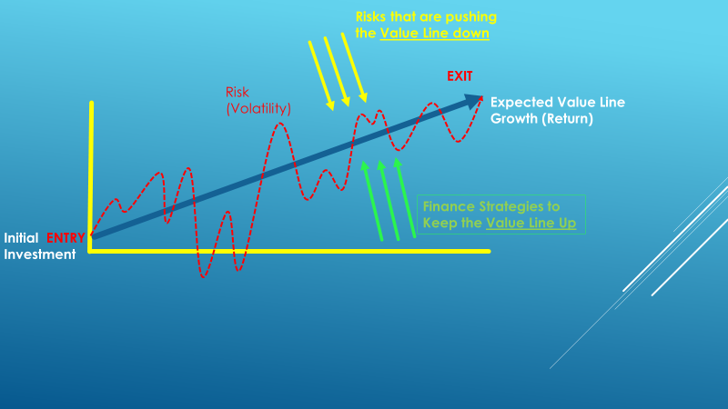
From the Prospective of Mgmt/Equity/Borrower
Corporate Finance
  Risks that are pushing the Value Line Down:
    Economy
    Competition
    Government
    Disasters
    Other Systemic/Firm Specific Risks
  Strategies to Keep the Value Line Up
    Operating Strategies
    Transactional Strategies
    Financing Strategies
    Social Responsibility

Slide 9
From the Prospective of Lenders
Credit Analysis
  Risks that is pushing the Value Line Down:
    Economy
    Government
    Other Systemic/Firm and Asset Class Specific Risks
  Strategies to Keep the Value Line Up
    Loan / Bond Structure
    Debt Capacity Analysis
    Sound Credit Analysis – CAMEL Approach

Slide 10
Commercial Credit Concepts and Definitions

Slide 11
Corporate Banking – Quantitative Approach
Bank Asset Rating Categories
All commercial banks, credit agencies, and institutions that lend money to corporations, focus on the following five areas of analysis when rating the Borrower and the loan based on the probability of default.
  Loan-to-value (LTV) or debt capitalization ratio: This ratio, expressed as a percentage, compares the enterprise debt to its’ total capital, or total value of the asset or business. It is important to look at each tier of credit in the capital structure to examine priorities and collateral interests.
  Leverage ratio of debt to EBITDA or EBIT: This leverage ratio, or debt to cash flow ratio, is one of the most popular ratios to used analyze the solvency and credit quality of a company.
  Coverage ratios describing the Borrower’s ability to service either Interest alone or the combination of Interest and Principal, include EBITDA / interest and cash flow (EBITDA) to debt service (Principal and Interest):
  Cash flow forecasts, typically using a 30% haircut to base projections:
  Customized operating ratios based on the company’s business that which can be cyclical or seasonal or depend on commodity pricing

Slide 12
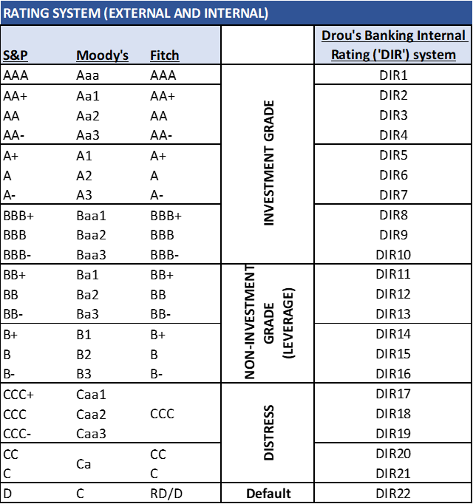
Bank Asset Rating Categories
Based on how each borrower and loan is assessed against the ratios and measures, most banks use a rating scale for their internal portfolio risk management. An example of which is below:

Slide 13
Corporate Banking – Qualitative Approach
Credit risk analysis involves the analysis of an obligor to determine their credit worthinesscreditworthiness regarding their ability to repay and service (payment of periodic interest payments) a debt.
The foremost consideration for repayment of a debt, is the obligor's “Willingness and Preparedness” to repay the debt – do they have any intention of repaying the debt, and do they have the capacity to do so?
5 C’s of Credit:
Character – see discussion of the Client Acceptance Memorandum (CAM)
Collateral – as a second source of repayment in the event of default and the needs of the lender to satisfy the obligation through liquidation of collateral.
Capital – adequacy of amount of funding for a business to execute its plan and sufficient investment at risk on the part of the enterprise and principals representing the borrower.
Capacity – as determined by the collateral and debt service capability as forecast in projections and based on historical proven experience of the borrower. The Capacity “C” incorporates the notion of Cash, Cash Flow and Coverage Ratios (debt Service and leverage, as discussed in Chapter 1.)
Conditions – the structure of the loan and the documentation stipulations
Credit Risk/Default and Loss in Event of Default – The purpose of Credit Analysis is to mitigate Credit Risk

Slide 14
Client Qualification & Credit Process
Review of Templates
Client Acceptance Memo (CAM) – INITIAL SCREENING
  Assess client attributes and character as well as willingness and capacity to repay a loan
Business plan Evaluation and Assessment Memo (BEAM)
  Financial analysis
    Historical financial statements
    Business plan modeling and forecasting
      Capital structure and Debt capitalization
      Cash flow forecasting
      Ratio analysis
Investment Committee Memo (ICM)
  Comprehensive written memo of borrower and their business and the proposed financing, including assessment of their ability and willingness to repay the loan

Slide 15
Management Discussion & Analysis (MD&A)
“Em DNA” - phonetic
  Quarterly and Annual (Qs and Ks)
  The Credit analyst must review what is written and also interpret that which is NOT written
The MD&A provide:
  Insight on direction and sentiment of the company
  Detailed analysis for prior unusual non-recurring events and forecasting
  Structural changes in their business economics useful for interpreting historical financial statements and developing better forecasts
Credit Analysts Discussion and Analysis - CAD&A – “Cadennay - phometic
  The Credit analyst will interpret the information available through all company sources as well as that available external to the company (often from industry experts on staff or other similar companies in the same industry, suppliers or customers
  This is particularly important in developing costs structure, unit economics and forecasting
  Comprises bulk of basis for assumptions and BEAM and ISM narrative accompanying the models

Slide 16
Historical Financial Statement Analysis
Income statement
  Stability and trajectory of revenues and EBITDA
  Cost structure (Fixed v variable)
  Commodity or other exogenous variable exposure
  Unit Economics
Balance sheet
  Working Capital Analysis
  Fixed Assets Analysis - CapEx
Cash flow statements
  Converting Income to Cash
  Cash & Commitments, Debt Service, Other Obligations

Slide 17
Cash Flow Analysis - Available
EBITDA
  Earnings Before Interest, Taxes, Depreciation and Amortization
    Intended to represent the operating cash for of the enterprise
EBITDA less Change in Working Capital (Timing Difference) and CapEx
  Intent to Operating cash flow available for debt service
Debt Service Requirements
  Interest Expense
    Senior (revolver and term, tranche A, B, etc.)
    subordinated
  Amortization Schedule – constant v sculpted
  Liquidity available from working capital revolver

Slide 18
Financial Performance Analysis
Answering the 3 questions
How well the Company performed as compared to other years – TREND ANALYIS
How well the Company performed as compared to their peer, competition, industry – COMPARATIVE OR PEER ANALYSIS
How well the Company performed as compared to Expectation – EXPECTATION ANALYSIS

Slide 19
Cash Flow Analysis
Coverage & Ratios
Debt Service Capacity
  Primary:
    EBITDA / Interest – (Total Interest & Senior Only)
    EBITDA / Cash Interest
    EBITDA / P&I (Total P&I and Senior Only)
  Secondary – operating cash flow available
    (EBITDA - ΔWC – CapEx) / Interest – (Total Interest & Senior Only)
    (EBITDA - ΔWC – CapEx) / Cash Interest
    (EBITDA - ΔWC – CapEx) / P&I – (Total Interest & Senior Only)
Leverage Multiples – Debt / EBITDA
  Debt – WC, WC & term
  Senior Leverage

Slide 20
Structuring and Risk Mitigation
Structuring the Financing is the Second most important element of Risk Mitigation
  After Risk-based Due Diligence
  Followed by Asset Management, Monitoring & Reporting (AMMR)
    “Inspect what you Expect”
Leverage multiple – maximum indebtedness tests using a range of leverage multples
DSCR
Collateral
Working Capital and Liquidity
Term Loan Debt Capacity

Slide 21
Corporate Banking:
Loan Covenants
To establish early warning signs
To ensure cash flow performance and repayments are made according to the borrower and lender agreed undertakings.
Typical Performance Covenants include the following:
  Minimum EBITDA
  Minimum Equity
  Minimum EBITDA to Interest of
  Minimum EBITDA to Principal and Interest (“Debt Service”) – called a Debt Service Coverage Ratio (DSCR)
Various reporting and governance covenants as well as maxmimum indebtedness and minimum cash and equity are also common
Investment Grade loans often have no collateral and no covenants
  Global Crossing
  Enron
  LBO Structures

Slide 22
Pricing of Risk
The Fees on a credit instrument include:
  Fees paid to a funding source or lender – “Funding Fees.”
  Fees paid to intermediaries for arranging a loan, or security. Only the security is regulated by SEC rules, and anyone can assist a borrower in the arrangement of a loan, if they have appropriate jurisdictional licensing or approvals or are doing so as a consultant or advisor to the borrower. – “Arrangement Fees”
  Fees paid to various parties for their ongoing roles in administering or managing a credit facility - Administrative Fees:
    Asset management, monitoring and reporting - AMMR
    ABL audit and Monitoring Fees
    Documentation Agent Fees – paid to a Lender, which has the responsibility of managing Loan documentation compliance on behalf of all Lenders in a syndication.

Slide 23
Corporate Banking:
Bank’s Strength and Loan Products

Slide 24
Corporate Banking:
CAMELS Bank Ratings
The OCC regulates banks and performs regular reviews of banks, with the largest banks under constant regulatory review, due mainly to their massive size and risk in the event of a negative outcome. Bank regulators have developed a rating scale from 1 to 5, where 1 is the highest and 5 being the lowest, wherein the regulators measure banks against various operational, qualitative, and quantitative attributes. The rating systems is an acronym called CAMELS, which stands for:
  Capital Adequacy.
  Asset Quality.
  Management
  Earnings and Cash Flow
  Liquidity – interest rate sensitivity and ability to convert assets to cash.
  Sensitivity – to certain risk exposures
Any bank with a rating below 2 is considered troubled
Notes:
Capital: Tier 1 Capital ratio of 6.0%
Asset: Substantial Assets/Doubtful Assets (highly questionable)
Liquidity: Sufficient funds to cover borrowers
Sensitivity: Stress Case
Earnings: Cash burn

Slide 25
Corporate Banking:
Banking Units
Origination and Relationship Management
  Industry Groups
  Geographic Groups
  Wholesale Banking
  Middle Market Banking
Product Specialists: LBO, Leasing, ABL, Project Finance, Venture Credit, Commercial Paper, etc.
Credit & Underwriting – approves the loans and manages the potfolio, including CECL and ACL
Operations - Asset Management, Monitoring, and Reporting (AMMR) – manages the book of loans
Finance & Treasury – funds the banks balance sheet
Audit & Review
Syndications and Asset Sales
Capital Markets
Investment Banking
Wealth Management

Slide 26
Corporate Banking: Corporate Loans
Bank commercial lending products may be categorized in one of two types primarily constructed around the nature of the assets they are collateralized with:
  Short-term working capital revolving credit facilities
  Equipment, real estate, or corporate term loans (based on enterprise values)
Working Capital Facilities
  Revolving credit facilities: because they are self-liquidating, are paid down through cash collections and reborrowed constantly
    Often structured with a Lockbox _ account control agreement – requiring collections o be controlled and “swept” agsint the loan outstandings
      Orange County Lamborghini example
    Secured by Inventory and Receivables
  ABL – Business Credit Structures
    Rigorous asset level monitoring and auditing, and strict controls over cash, lockbox and sweeps
  Receivables Factoring: discussed in Chapter 15
  Merchant Cash Advances: discussed in Chapter 15

Slide 27
Corporate Banking: Corporate Loans
Term Loan Facilities:
  Corporate Term Credit Facilities: typical bank duration is 3-7 years
  Equipment Term Loans:
    Specialized equipment lending against fungible equipment assets such as medical equipment or trucks (often in the case of sole proprietorships using SBA (Small Business Administration) loans
  Mortgage Term Loans:
    Term loans secured by real property, unless fungible such as office buildings, will likely be shorter term loans -5-7 years, and lower advance LTVs
  Corporate Term Loans:
    Most corporate term loans fall into this category, low LTV secured by all fixed assets and often all assets in a single collateral pool along with the working capital revolving credit facility (revolver)

Slide 28
Corporate Banking: Corporate Loans
Term Loan A, B, C:
  The differentiation of tranches of senior term loans may simply designate the maturity spectrum each tranche covers but may also represent different loan agreements and different types of holders or lenders.
Second Lien Term Loan:
  A second lien loan is one that may or may not have a primary perfected lien on assets uniquely to that loan, but rather has a second lien security interest in collateral which other lenders may have a primary security interest.
Subordinated Term Loan:
  While a second lien or springing lien term loan has a subordinated interest and claim against collateral ahead of trade creditors and other constituents such as employees or customers, a Subordinated Lender has specifically relegated themselves by their credit agreements to a subordinated position, which may be secured, but most often is not, to ensure the trade creditor positions are not impaired. Subordinated debt may be a structural requirement of the borrowers’ trade creditors and have nothing to do with the leverage or other indebtedness of the company.

Slide 29
Corporate Banking:
Commercial Finance – Equipment Finance
Appropriate for Asset Intensive Borrowers – Initial loans against Original equipment Costs (OEC), High LTV, 3-7 years
Equipment loans are often provided by the Commercial Finance or Leasing units within banks or non-bank Commercial Finance companies such as Stonebriar Commercial Finance or Encina Commercial Finance. Leasing as a product is discussed in Chapter 13 later in this book.
Rigorous monitoring and establishment of procedures to ensure the equipment is adequately maintained by the borrower to protect the value of the collateral. In many cases equipment lenders will install remote tracking devices on equipment and may also install controlled “shut-off” switches to enable the lender to control a borrower’s use and access to equipment.
Commercial equipment finance requires specialized monitoring and unique asset valuation skills, and the lenders often have substantial secondary sales marketing activities supporting the end-of-life monetization of equipment as collateral.
End-of-life (EOL) analysis is important to lending against equipment assets, and constantly reviewing the collateral condition and value against current market replacement costs and the decay curve of the collateral – the declining value of a new piece of equipment over its useful life.
Commercial Finance lenders are concerned about replacement cost of equipment as a protection of their collateral value – decay curve of its depreciating market value is important
Best performing asset class in the global financial crisis (GFC)

