Slide 1

VALUATION
INTELLECTUAL PROPERTY, PATENTS AND START-UPS
IIP
V
Cash
Flow
BV
G
L
P
Professor Chris Droussiotis
July 2019

Slide 2
Agenda
Basic Valuation Methods and Concepts of Enterprise Values
Valuing Patents
Valuing Intellectual Property – Option Pricing and DCF Analysis Overview
Case I (IP) – BioTech (Option Pricing Method)
Case II (IP) – EduTech (DCF Method)

Slide 3
TREND:
OLD ECONOMY TO THE NEW ECONOMY
Recent Emphasis on Intellectual Property (IP) given the highest growth comes from new technological platforms such as FinTech, CleanTech, HealthTech, EduTech.
The largest companies by market cap are technology companies such as Apple, Amazon, Google & Microsoft that attributed to intangibles as evidenced from Market/Book ratios.

Slide 4
GENERAL ACCOUNTING CONCEPTS REVISITED
Tangible vs. Intangibles Assets
Finite vs. Infinite Intangibles
Identifiable vs. Non-Identifiable
Amortized vs. Impairment Assets
Book Value vs. Market Value

Slide 5
INTANGIBLE ASSET VALUATION METHODS
Income Approach based on cash flows from intangible assets
  Segregating the cash flow from operation vs. cash from the intangibles
  What Discount Rate to use? = Using Cost of Equity (Ke) vs. Cost of Debt (Kd), WACC, IRR, WARA
Cost or Replacement Approach
Market Approach
Option Pricing-Based Approach

Slide 6
INTANGIBLE ASSET VALUATION METHODS
METHOD | DESCRIPTION | PROS | CONS | WHEN USED
Market | Based on comparable market transactions of intangibles | Market driven – based on what someone is willing to pay (reflecting market prices based on demand and supply equilibrium) | Comparable transactions are sometimes not available | Most desirable but rarely used since a lot of the intangible products (IP) are new and unique
Income | Based on future cash flows (Royalties, Licensing or other Incremental profits) | Top-down approach, based on expected economic returns on initial cost | Input information can be very challenging since the info deals with future projections | Most commonly used – building future benefits helps pricing the royalties, licensing fees based on return expectation
Cost/Replacement | Based on estimated cost of replacing or reproducing the intangible | Easier to calculate – calculate labor, materials and overhead (LMO) | The cost representing the book value does not always represent the market value | Not very common. Used as the basis before spending the money for the specific intangible.
Option Pricing | Based on option pricing models such as Black-Scholes measuring the current “out-of-money” to future “in-the-money” values | Using probability of success and sensitize to get a range. | Input variables to determine future value can be very challenging | Used when there is an obvious cash outflow before the cash inflow kicks in to value the specific intangible asset

Slide 7

Enterprise Value - Overview
METHODS & EXAMPLES

Slide 8
Enterprise Valuation Concepts
METHODS & EXAMPLES
Corporate Enterprise Value methods – Back to Basics:
  Method 1: Using the current stock price as a basis of valuation
  Method 2: Comparable method using Trading EBITDA Multiples
  Method 3: Comparable method using Acquisition EBITDA Multiples
  Method 4: Discount Cash Flow Method (DCF)
  Method 5: Leveraged Buyout Private Equity Expectation Model (LBO)

Slide 9
Method 1:
Using the Stock Price as the Basis of Valuation – Publicly Traded Companies
The stock price represents the value of the company.
The company issues financial statements every three months and other non-financial information as they come up, so how does the stock price behave like this?
It is said that the stock price moves based on technical, fundamental and behavioral reasons and there are plenty of analytical approaches that back each of these three reasons.
      EV = MVE + D – C and MVE = (SP + SO)
                where EV is Enterprise Value, MVE is the Market Value of the Equity, D is the total Debt Outstanding and C is the Cash and cash equivalents of the company. where MVE is the Market Value of the Equity, SP is the Stock Price and SO is the Shares Outstanding.

Slide 10
Method 1:
Using the Stock Price as the Basis of Valuation
ENTERPISE VALUE: $2.72 Billion

Slide 11
Method 2
Using Comparable Trading EBITDA Multiples
The most commonly used method by mergers & acquisitions professional
Looks at the ratio of the Enterprise Value to Earnings Before Interest, Taxes, Depreciation and Amortization (EV /EBITDA) for each of the pier companies and applies the average to measure the company’s value.
The average multiple provides a benchmark which the analyst can establish as the basis for valuating publicly traded companies
The basic idea is that as the company increases its earnings based on either favorable economic conditions or management decisions from year to year, then the value should also follow at a relatively consistent way.
In general, industries with higher growth characteristics enjoy higher multiples of earnings. Similar companies that compete with the company that is being valued given the similar business and financial characteristics.

Slide 12
Method 2
Using Comparable Trading EBITDA Multiples
ENTERPISE VALUE: $3.04 Billion

Slide 13
Method 3
Using Comparable Acquisition EBITDA Multiples
This method establishes a similar benchmark to what the companies in the same industry are being bought based on multiples of their EBITDA.
Corporate values using this method are determined based on other companies in the same business that are recently sold to either strategic investors or private equity firms.
The mergers & acquisition professional search for other companies in the same business that were sold to either strategic investors or private equity firms and establishes a bench mark based on average multiples over time.
That average acquisition multiple of the purchase price to EBITDA is then used as a measurement to value the company in question.

Slide 14
Method 3
Using Comparable Acquisition EBITDA Multiples
ENTERPISE VALUE: $3.86 Billion

Slide 15
Method 4
Using Discount Cash Flow Method
This method is the most fundamental method that is used to value many types of companies, especially companies that are tough to find any trading and acquisition multiple comparables.
This method called the DCF method that is broadly used by many investors, advisors, banks and academics is premised on the principal that the value of a company can be derived by the present value of its projected free cash flow (FCF).
We will learn later that this FCF is derived from various assumptions, starting from Revenue and subtracting operating and capital costs.
To value the company using the DCF method the analyst needs to derive the following four items:
    Setting up a stream of cash flows
    Identifying an exit year
    Calculating the value at exit year (Terminal Value)
    Using the appropriate discount rate to value the present value of the firm

Slide 16
Method 4
Using Discount Cash Flow Method
ENTERPISE VALUE: $3.28 Billion

Slide 17
Method 5
Using Leveraged Buyout (LBO) or Non-Recourse Method
This method is very similar to method 4 (DCF method) which is based on future free cash flows except the projected debt, WACC and expected return.
While the DCF analysis is used for determining today’s value of the company based on future cash flows, the value of the company using this LBO method is determined based on investor expectation which is return determines the acquisition price of the firm.
The equity investment amount is determined after assuming that most of the financing will be via debt. This method is unique because it uses the capital markets to engineer the financing of the buyout, so the equity return expectation is met via the use of leverage.
This step by step method starts first with the maximum debt and then how much private equity can be raised based on the target’s cash flow.

Slide 18
Method #5
Setting up the Financial Structure

Slide 19
Method #5
Enterprise Value = $2.91Billion

Slide 20
Summary Valuation

Slide 21
Patents & New Technology
METHODS & EXAMPLES

Slide 22
Valuing Patents and New Technology
The Questions a Buyer will ask for valuing IP – Patents, Trademarks
    What’s the market size?
    What are the competitive advantages?
    How much will it cost to implement?
    How long before competitors crowd in?
Factoring the Risks:
    How much would it cost to develop this idea yourself
    How long might it take to get off the ground
    Any unexpected challenges or problems that may arise

Slide 23

Valuing Patent
Using
Option
Pricing

Slide 24

Intellectual Property
METHODS & EXAMPLES

Slide 25

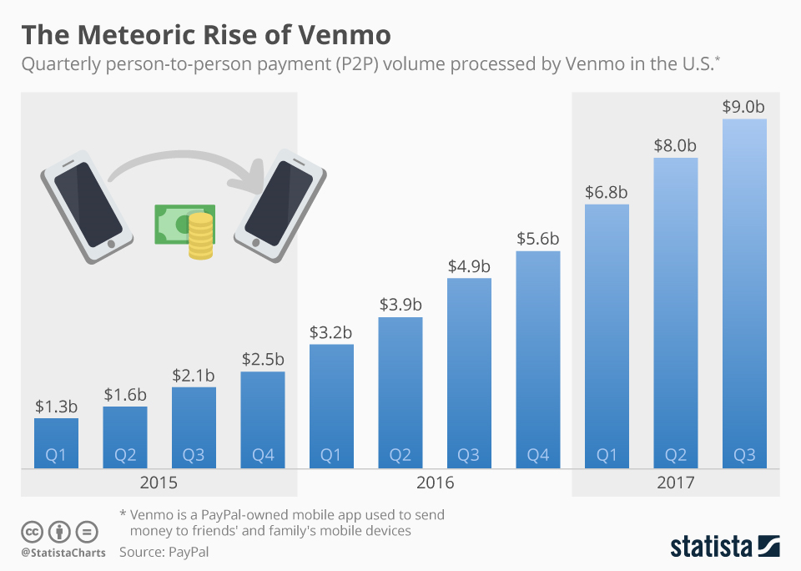
FINTECH: The Venmo Case
Mobile Peer-to-Peer Payments
Venmo is a mobile payment service owned by PayPal. Venmo account holders can transfer funds to others via a mobile phone app; both the sender and receiver have to live in the U.S. Venmo is a type of payment rail. It handled $12 billion in transactions in the first quarter of 2018.
Venmo includes social networking interaction; it was created so friends could quickly split bills, whether that is for movies, dinner, rent, tickets, etc. When a user makes a transaction, the transaction details (stripped of the payment amount) are shared on the user's "news feed" and to the user's network of friends.
History:
  2009: Founded
  2010: $1.2 million Seed money raised – RRE Ventures
  2012: Sold to Braintree for $26.2 million
  2013: Braintree was bought by PayPal for $800 million

Slide 26
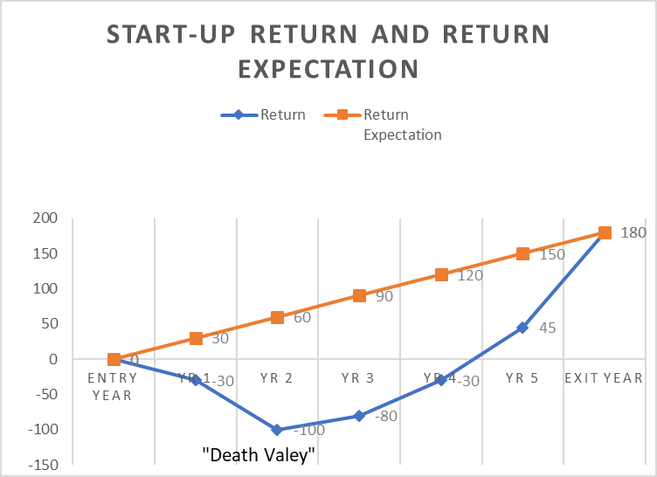
Basic Concepts of Valuing a Start-up
FINANCIAL MODELLING
Determining Cash Needs during “Death Valley”
Sensitizing the Velocity and adjusting re-investment continuous pivoting the product concept
Calculating the Value based on investor expectation which is based on risk (probability of success)

Slide 27
Using Call Options as a Measurement of a Start-up – Need 3 numbers
S (Stock Price)
X (Exercise Price)
P (Premium)

Slide 28
Using Call Options as a Measurement of a Start-up – Need 3 numbers to determine the Expected Return and then the Value
S (Value at Exit)
X (Cost of Start-Up)
P (Initial Investment)
S – X (Intrinsic Value = PAYOFF
PAYOFF – P = $ Return
P = PAYOFF - $ Return

Slide 29
Probability Concepts – the basis of return expectation

Slide 30
Using Options as a Measurement of IP Valuation - 3 Questions
Is there a real option embedded in a decision or an asset? YES
  Call price as the investment (Premium), Strike Price (X) as the Cost and Value of the firm as the underline Asset (S)
Does that real option have significant economic value? YES
  No restriction on competition / exclusivity and the time until no value added
Can that value be estimated using option pricing model? YES
  Leading to S – X > Minimum Return Expectation
  Point worth noting why Options vs DCF:
Delay/ Negative NPV constant pivoting

Slide 31
Lesson on Options – Call option

Slide 32
Lesson of Option Pricing – Introducing Binomial Option Pricing Model

Slide 33
Lesson of Option Pricing – Introducing 2-Step Binomial Option Pricing Model

Slide 34
Introducing Standard Deviation Concepts and Black-Scholes

Slide 35
Lessons on Black-Scholes Option Pricing

Slide 36
Case Study I – Pharma Inc.
Using Options to build financial model for valuating IP
Pharma Inc, a biotech firm, has a patent on a drug to treat multiple sclerosis, for the next 17 years, and it plans to produce and sell the drug by itself.
The drug will be priced at $46.50 per patient per day taking it for an average of 2 years
After an extensive market research, it was determined that 100,000 patients will be buying this drug immediately
The total cost of development for commercial use is estimated at $2.75 billion
Patent life is 17 years
The 17-year treasury bond rate is 3.50%
Variance in Expected Present Values = 0.224 based on industry average firm variance for bio-tech firms

Slide 37
Case Study
Using Options to build financial model for valuating IP with patent
INPUT | PROCESS
Value of the Underlined Asset (S) | PV of Cash Flows expected from the commercialization of the IP
Exercise Price on Option (X) | Cost of Development of the IP
Variance in Value of Underlined Asset (σ²) | Variance in Cash Flows of similar assets on firm (i.e. the stock price of other companies with similar applications) or Variance in present value from capital budgeting simulation
Expiration of the Option (t) | Life of the IP patent
Dividend Yield (δ) | Cost of Delay- each year of delay translates to one less year of value-creating cash flows 1/t

Slide 38
Case Study I
Using options to build financial model for valuating IP

Slide 39
Case Study II
Using Income Method (DCF Analysis) for valuating IP
The Value of a firm’s new innovative products that will be put to commercialization can be derived using the option pricing model
Value of the Firm = Value of products after it is commercialized or licensed (DCF Analysis)
Measuring the efficiency of the firm for converting its Development Cost into a commercial product.

Slide 40
Case Study II
Using Income Method (DCF Analysis) for Valuating IP
The Company: EduTech Company developed a SaaS training platform that allows trainees to get trained in investments, finance and credit analysis. The company identified that they are similar training platforms primarily in trading areas but not in other areas of corporate finance including financial analysis and valuation. In this area between the academic and business application and this simulation game should bridge the gap. Junior and senior-year graduates will have a chance to apply the academic concepts, such portfolio management, valuation of stock and bond or using options for hedging to enhancing real-life experience. It will also enhance the student or trainee’s ability to negotiate a specific transaction such as buying a company or raising capital.
The Market: Business Schools / Investment Banks that offer training in the US 2018: 9,000 Colleges/Universities, 150 Banks with training programs - $3 billion

Slide 41
Case Study II
Using Income Method (DCF Analysis) for valuating IP

Slide 42


Slide 43
Biography

