Slide 1
Topic 9: The Mortgage Market
Main Reading (Sources): Chap 14 Mishkin & Eakins, 8th

Slide 2
Chapter Preview
Topics include:
  What Are Mortgages?
  Characteristics of Residential Mortgages
  Types of Mortgage Loans
  Mortgage-Lending Institutions
  Loan Servicing
  Secondary Mortgage Market
  Securitization of Mortgages

Slide 3
What are Mortgages?
A long-term loan secured by real estate
An amortized loan whereby a fixed payment pays both principal and interest each month

Slide 4
Table 14.1 Mortgage Loan Borrowing
Type of Property | Mortgage Loans Issued ($ billions) | Proportion of Total (%)
One- to four-family dwelling | 9,986 | 72.38
Multifamily dwelling | 1,099 | 7.97
Commercial building | 2,506 | 18.16
Farm | 205 | 1.49

Slide 5
What Are Mortgages? History
Mortgages were used in the 1880s, but massive defaults in the agricultural recession of 1890 made long-term mortgages difficult to attain.
Until post-WWII, most mortgage loans were short-term balloon loans with maturities of five years or less.
Balloon loans, however, caused problems during the depression. Typically, the lender renews the loan. But, with so many Americans out of work, lenders could not continue to extend credit.
As a part of the depression recovery program, the federal government assisted in creating the standard 30-year mortgage we know today.

Slide 6
Characteristics of the Residential Mortgage
Mortgages can be roughly classified along the following three dimensions:
  Mortgage Interest Rates
    The actual rate that banks charge customers is based on the following:
      Market Rates (based on risk free rates premium)
      Term (years)
      Discount Points (upfront fees)
  Loan Terms
    Collateral or lien
    Down Payment (based on LTV)
    Private Mortgage Insurance (PMI) Insurance for event of default (diff. between Loan and Value)
  Mortgage Loan Amortization
    Even amortization (Excel based =pmt(rate/frequency, term x frequency, PV)

Slide 7
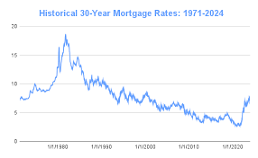
Figure 14.1 Mortgage Rates 1971-2024
Source: http://www.federalreserve.gov/releases/h15/data.htm.

Slide 8

Characteristics of the Residential Mortgage: Mortgage Interest Rates & Points
Suppose you had to choose between a 12% 30-year mortgage or an 11.5% mortgage with 2 discount points. Which should you choose? Assume you wished to borrow $100,000.
First, examine the 12% mortgage.
Using the formula Mortgage Payment:
$FP=$LV*$\frac{i}{1−{(1+i)}^{−n}}$
the required payments is:
n = 360, i = 0.01, LV = 100,000,
Calculate the PMT. PMT = ?

Slide 9

Characteristics of the Residential Mortgage: Mortgage Interest Rates & Points
Now, examine the 11.5% mortgage.
Using Mortgage Payment
$FP=$LV*$\frac{i}{1−{(1+i)}^{−n}}$
, the required payments is:
n = 360, i = 0.115/12=0.0096, LV = 100,000,
Calculate the PMT. PMT = ?
So, paying the points will save you $38.32 each month. However, you have to pay $2,000 upfront.
You can see that the decision depends on how long you want to live in the house, keeping the same mortgage.
If you only want to live there 12 months, clearly the $2,000 upfront cost is not worth the monthly savings.

Slide 10
Characteristics of the Residential Mortgage

Slide 11
Table 14.2 Effective Rate of Interest on a Loan at 12% with 2 Discount Points
Year of Payment | Effective Rate of Interest (%) | Year of Prepayment | Effective Rate of Interest (%)
1 | 14.54 | 6 | 12.65
2 | 13.40 | 7 | 12.60
3 | 13.02 | 10 | 12.52
4 | 12.84 | 15 | 12.45
5 | 12.73 | 30 | 12.42

Slide 12
Characteristics of the Residential Mortgage: Mortgage Interest Rates & Points
Many mortgage lenders will point to the
30-year effective rate of interest, and argue that the points are a good deal (and it is here, compared to the 12.68% effective rate on a 12% nominal rate mortgage).
Although the calculation is correct, the information is not what you need.
You need to determine when the present value of the savings ($38.32) equals the $2,000 upfront. Using a financial calculator, this is:
i = 1, PV = −2,000, PMT = 38.32
Calculate n. n = 74 months, or about 6.2 years.
So, if you think you will stay in the house and not refinance for at least 6.2 years, paying the $2,000 for the lower payment is a sound financial decision.
Otherwise, you should accept the 12% loan.

Slide 13
Characteristics of the Residential Mortgage: Loan Terms (1 of 3)
Mortgage loan contracts contain many legal terms that need to be understood. Most protect the lender from financial loss.
Collateral: usually the real estate being financed, pledged as security
  Lien: a public record that attached to the title of the property. It gives the lender the right to sell the property if default.
Down payment: a portion of the purchase price paid by the borrower
  Reduce moral hazard problem

Slide 14
Characteristics of the Residential Mortgage: Loan Terms (2 of 3)
Mortgage loan contracts contain many legal terms that need to be understood. Most protect the lender from financial loss.
Primary Mortgage Insurance (PMI): insurance against default by the borrower
Qualifications: includes credit history, employment history, etc., to determine the borrowers ability to repay the mortgage as specified in the contact

Slide 15
Characteristics of the Residential Mortgage: Loan Terms (3 of 3)
Lenders will also order a credit report from one of the credit reporting agencies.
The score reported is called the FICO.
The range is 300 to 850, with 660 to 720 being average.
Payment history, debt, and even credit card applications can affect your credit score.

Slide 16
Characteristics of the Residential Mortgage: Loan Amortization
Mortgage loans are amortized loans:
fixed, level payment
pays interest due plus some principal
balance on the mortgage will be zero when the last payment is made

Slide 17
Table 14.3 Amortization of a 30-Year, $130,000 Loan at 8.5%
Payment Number | Beginning Balance of Loan | Monthly Payment | Amount Applied to Interest | Amount Applied to Principal | Ending Balance of Loan
1 | 130,000.00 | 999.59 | 920.83 | 78.76 | 129,921.24
24 | 128,040.58 | 999.59 | 906.95 | 92.64 | 127,947.95
60 | 124,257.09 | 999.59 | 880.15 | 119.44 | 124,137.65
120 | 115,366.01 | 999.59 | 817.18 | 182.41 | 115,183.60
180 | 101,786.66 | 999.59 | 720.99 | 278.60 | 101,508.06
240 | 81,046.91 | 999.59 | 574.08 | 425.51 | 80,621.40
360 | 992.56 | 999.59 | 7.03 | 992.56 | 0.00

Slide 18
Types of Mortgage Loans (1 of 2)
Insured vs. Conventional Mortgages: if the down payment is less than 20%, insurance is usually required
Fixed-Rate Mortgages: the interest rate is fixed for the life of the mortgage
Adjustable-Rate Mortgages: the interest rate can fluctuate within certain parameters

Slide 19
Types of Mortgage Loans (2 of 2)
Other Types
  Graduated-Payment Mortgages (GPMs) for home buyers their income will rise
  Growing Equity Mortgages (GEMs) for home buyers that want to pay faster
  Second Mortgages secured by the same assets than the first mortgage
  Reverse Annuity Mortgages (RAMs) for retired people that want to live off the equity built on their home
  Option ARMs Option to Adjustable-Rate Mortgages
The following table lists additional characteristics on all the loans.

Slide 20
Table 14.4 Summary of Mortgage Types (1 of 2)
Conventional mortgage | Loan is not guaranteed; usually requires private mortgage insurance; 5% to 20% down payment
Insured mortgage | Loan is guaranteed by FHA or VA; low or zero down payment
Adjustable-rate mortgage (ARM) | Interest rate is tied to some other security and is adjusted periodically; size of adjustment is subject to annual limits
Graduated-payment mortgage (GPM) | Initial low payment increases each year; loan amortizes in 30 years

Slide 21
Table 14.4 Summary of Mortgage Types (2 of 2)
Growing-equity mortgage (GEM) | Initial payment increases each year; loan amortizes in less than 30 years
Second mortgage | Loan is secured by a second lien against the real estate; often used for lines of credit or home improvement loans
Reverse annuity mortgage | Lender disburses a monthly payment to the borrower on an increasing-balance loan; loan comes due when the real estate is sold

Slide 22
Mortgage-Lending Institutions
Originally, thrift institutions were the primary originator of mortgages in the U.S. and, therefore, the primary holder of mortgage loans.
As the next figure illustrates, this is not the case anymore.

Slide 23
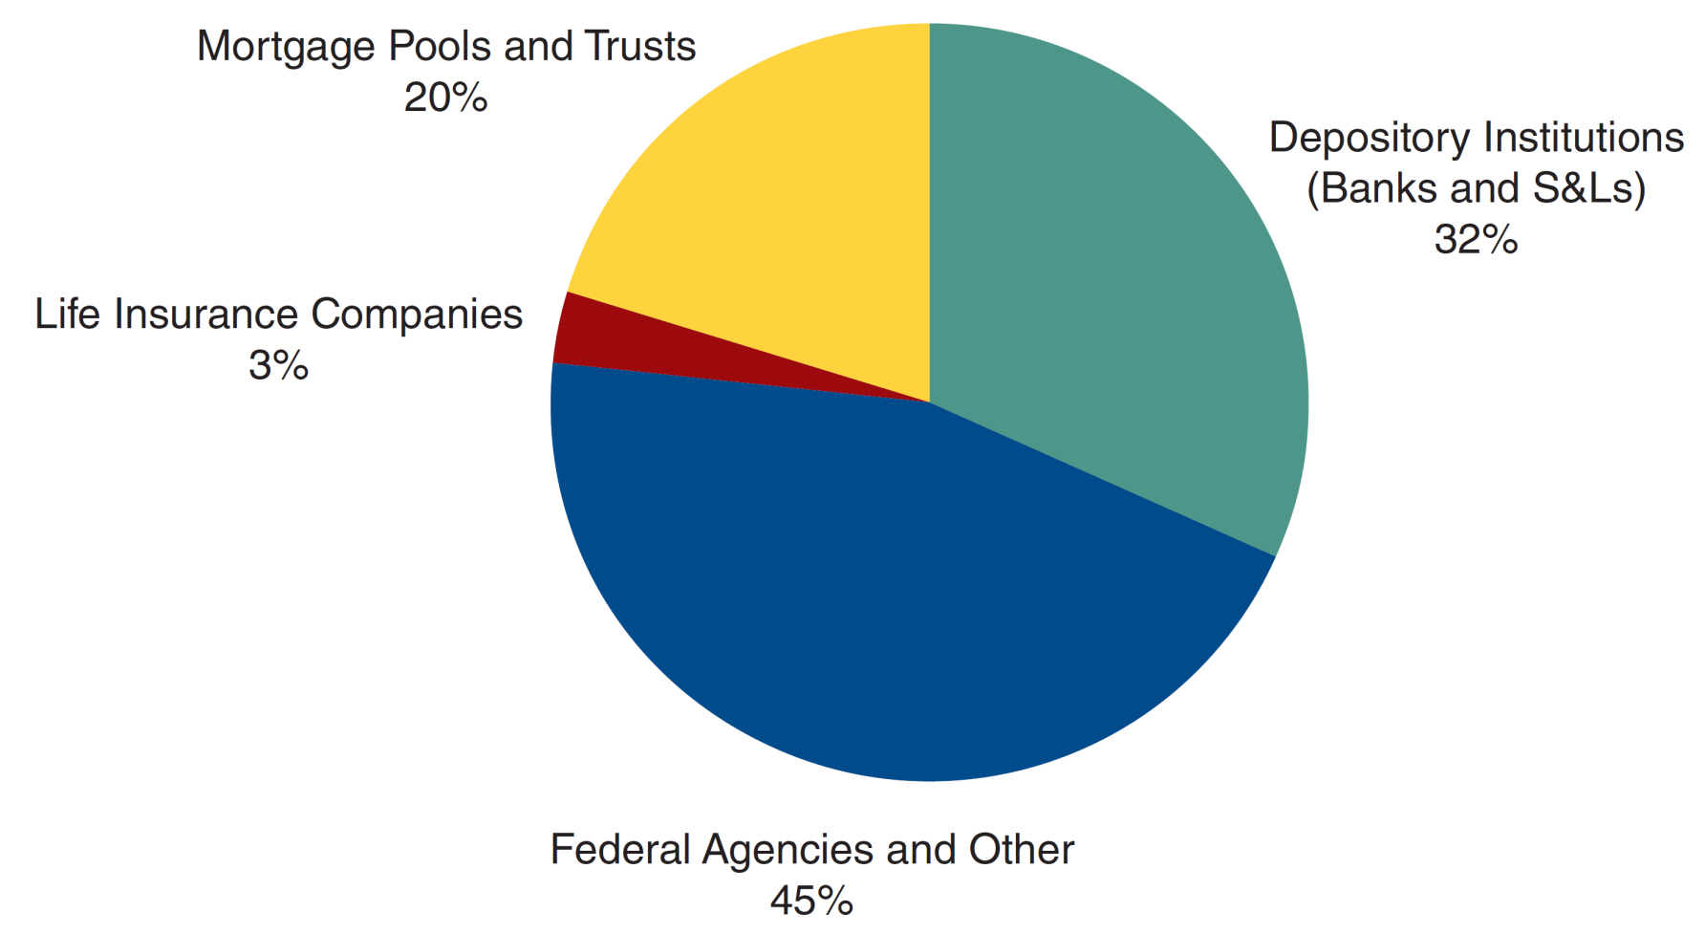
Figure 14.2 Share of the Mortgage Market Held by Major Mortgage-Lending Institutions
Source: http://www.federalreserve.gov/econresdata/releases/mortoutstand/current.htm.

Slide 24
Loan Servicing
Most mortgages are immediately sold - frees cash to originate another loan.
Loan servicers collect monthly payments, usually keeping a portion of the payments received.
In all, there are three distinct elements in mortgage loans:
The originator packages the loan for an investor
The investor holds the loan
The servicing agent handles the paperwork

Slide 25
E-Finance: Borrowers Shop the Web for Mortgages
Mortgages used to originate from a local bank. But the web is well-suited to handle online mortgage origination:
This is a financial product—nothing really needs to be delivered
Mortgages are fairly standardized. There is no product differentiation to consider.
Little bank loyalty for borrowers
Online lenders have low overhead, and so lower fees.

Slide 26
Secondary Mortgage Market
The secondary mortgage market was originally established by the federal government after WWII when it created Fannie Mae to buy mortgages from thrifts.
The market experienced tremendous growth in the early to mid-1980, and has continued to remain a strong market in
the U.S.

Slide 27
Securitization of Mortgages
The securitization of mortgages developed because of the risk of default and costs of prepayment / servicing.
A pool of mortgages reduces this problem through diversification.
The mortgage-backed security (MBS) is created.
Pools including hundreds of mortgages.
Rights to the cash flows sold as separate securities.
At first, simple pass-through securities were designed.

Slide 28
Securitization of Mortgages: The Mortgage Pass-Through
Definition: A security that has the borrower’s mortgage payments pass through the trustee before being disbursed to the investors
This design did eliminate idiosyncratic risk, but investors still faced prepayment risk.
The value of mortgages held in pools is reaching nearly $8.0 trillion near the end of 2009.
Fell dramatically
The securities compete for funds along with all other bond market participants.

Slide 29
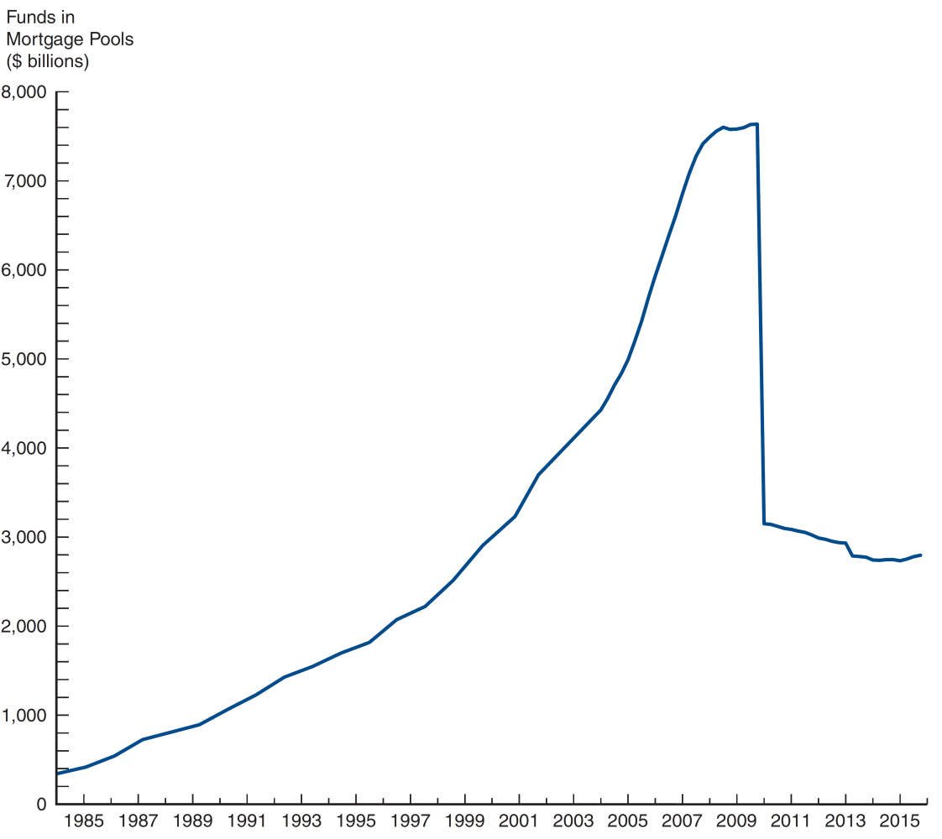
Figure 14.3 Value of Mortgage Principal Held in Mortgage Pools, 1984–2016
Source: http://www.federalreserve.gov/econresdata/releases/mortoutstand/current.htm.

Slide 30
Securitization of Mortgages: Types of Passthroughs
There are a variety of different types of pass-through securities. We will briefly look at three:
GNMA Pass-Throughs Government National Mortgage Assoc.
FHLMC Pass-Throughs Federal Home Mortgage Corporation
Private Pass-Throughs Collateralized Mortgage Obligations (CMO)

Slide 31
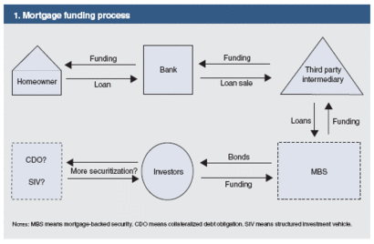
Secondary Mortgage Market

Slide 32
Securitization of Mortgages: GNMA Passthroughs
Ginnie Mae began guaranteeing passthroughs in 1968.
GNMA mortgages can be originated by many different financial institutions.
GNMA aggregates the mortgages and issues passthroughs with rights to interest and principle.
GNMA also offers default insurance on the mortgages in the pools.

Slide 33
Securitization of Mortgages: FHLMC Passthroughs (1 of 2)
Freddie Mac buys mortgages and packages them for resale in MBSs.
FHLMC pools contain mortgages that are not guaranteed, and may have different rates, etc.
Pass-through securities issued by Freddie are called participation certificates.

Slide 34
Securitization of Mortgages: FHLMC Passthroughs (2 of 2)
Definition: A CMO is a structured MBS where investor “tranches” have different rights to different sets of cash flows.
This design structured the prepayment risk. Some tranches had little prepayment risk, while other had a lot.
Freddie Mac helped originate these structures, and continues to innovate new tranche designs.

Slide 35
Securitization of Mortgages: Private Passthroughs
BankAmerica offered the first private pass-through in 1977.
Non-agency issuers are free to incorporate any type of mortgages into their MBSs, including jumbo loans, Alt-A loans, and other non-traditional mortgages.

Slide 36
Subprime Mortgages and CDOs (CMOs) (1 of 2)
Subprime loans are loans to borrowers who have poor credit ratings or other issues with collateral, etc.
In 2000, only 2% of mortgages were subprime. This climbed to 17% by 2006.
The average FICO score was 624 for subprime borrowers. Prime mortgage borrowers were 742.
However, these mortgages were hailed by politicians and bankers alike. They helped less-then-perfect borrowers secure the “American Dream” of owning a home. And since real estate prices can’t fall , there is little risk involved.

Slide 37
Subprime Mortgages and CDOs (CMOs) (1 of 2)

Slide 38
Subprime Mortgages and CDOs (CMOs) (2 of 2)
Several factors lead to this dramatic increase in subprime lending:
New mortgage products (2/28 ARMS, Option ARMS, NoDoc loans) made expensive houses “affordable” (sort-of).
The creation of CDOs helped create deal flow to continue lending in subprime markets. The credit derivative of mortgage security that has several tranches is the collateralized mortgage obligations (CMO)
When house prices were increasing, subprime borrowers had an out if problems arose.

Slide 39
The Real Estate Bubble (1 of 2)
Between 2000 and 2005 home prices increased an average of 8% per year. The run up in prices was cause by two factors:
The increase in subprime loans created new demand for housing
Real estate speculators

Slide 40
The Real Estate Bubble (2 of 2)
In the aftermath of the financial meltdown, lending policies have largely returned to selecting capable borrowers:
CDO issuance peaked in 2006 at $520b, but in 2009 fell to $4.2b. Up to $58b in 2012.
New legislation, such a Frank-Dodd, may require mortgage originators to hold a part of the mortgages they create.

Slide 41
Chapter Summary (1 of 2)
What Are Mortgages? Loans made for the purchase on real property, and usually collateralized by the purchased property.
Characteristics of Residential Mortgages: includes the length of the mortgage, the terms, and the rate charges for the loan
Types of Mortgage Loans: includes conventional, insured, fixed and variable rate, and a variety of other designs.
Mortgage-Lending Institutions: the primarily originator and holder of mortgages is no longer thrift institutions as other attempt to generate fees

Slide 42
Chapter Summary (2 of 2)
Loan Servicing: the fees generated by collecting, distributing, and recording payments
Secondary Mortgage Market: the active market for mortgages after the mortgage has been originated
Securitization of Mortgages: growing in popularity, causing mortgages to complete with both Treasury and corporate debt. But also clearly a part of the problem in the Housing Bubble and Financial Crisis of 2007–2009.

