Slide 1
Topic 8b: The Mutual Fund Industry
Main Reading (Sources): Chap 20 Mishkin & Eakins, 8th

Slide 2
Chapter Preview
Topics include:
The Growth of Mutual Funds
Mutual Fund Structure
Investment Objective Classes
Fee Structure of Investment Funds
Exchange Traded Funds and Hedge Funds

Slide 3
The Growth of Mutual Funds
Mutual funds pool the resources of many small investors by selling them shares and using the proceeds to buy securities.
At the beginning of 2013, 57% of retirement assets were held by mutual funds.
28% of the U.S. stock market and almost 44% of all U.S. households hold stock via mutual funds.
Assets held by mutual funds have grown by about 17% per year for the last 25 years, reaching over $14 trillion. The first mutual fund similar to the funds of today was introduced in Boston in 1824.
The stock market crash of 1929 set the mutual fund industry back because small investors avoid stocks and distrusted mutual funds.
The Investment Company Act of 1940 reinvigorated the industry by requiring better disclosure of fees, etc.
Ownership in mutual funds has changed dramatically over the last 20 years
In 1980, only 5.7% of households held mutual fund shares
In the beginning of 2013, that number was 75%
Mutual funds account for $5.3 trillion of the retirement market (estimated at $19.5 trillion)

Slide 4
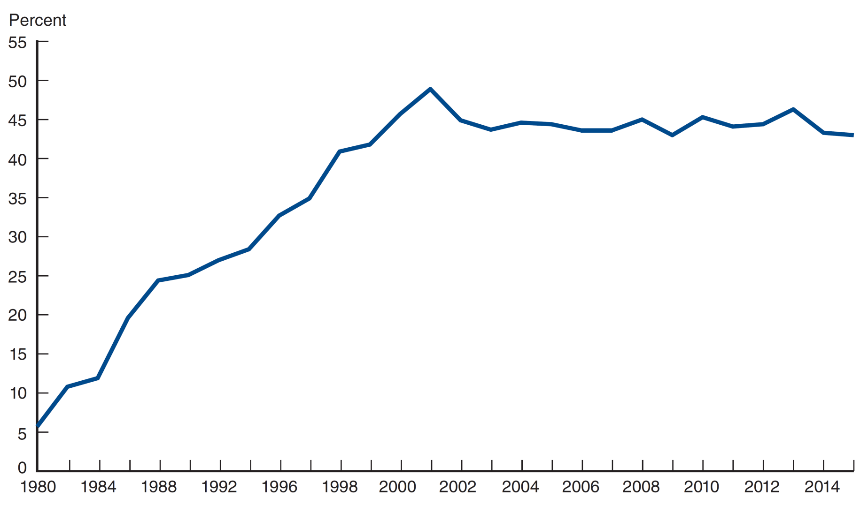
Figure 20.1 Household Ownership of Mutual Funds
Data Source: Investment Company Institute, 2016 Investment Company Fact Book (Washington, DC: ICI), https://www.ici.org/pdf/2016_factbook.pdf.

Slide 5
The Growth of Mutual Funds
There are five principal benefits of mutual funds:
Liquidity intermediation: investors can quickly convert investments into cash.
Denomination intermediation: investors can participate in equity and debt offerings that, individually, require more capital than they possess.
Diversification: investors immediately realize the benefits of diversification even for small investments.
Cost advantages: the mutual fund can negotiate lower transaction fees than would be available to the individual investor.
Managerial expertise: many investors prefer to rely on professional money managers to select their investments
Notes:
At the start of 2014, one share of Berkshire Hathaway's A-shares was trading at over $150,000. Denomination intermediation in an mutual fund gives a small investor access to these shares.

Slide 6
Mutual Fund Structure
Closed-End Fund: a fixed number of nonredeemable shares are sold through an initial offering and are then traded in the OTC market. Price for the shares is determined by supply and demand forces.
Open-End Fund: investors may buy or redeem shares at any point, where the price is determined by the net asset value of the fund.
Net Asset Value (NAV)
Definition: Total value of the mutual fund’s stocks, bonds, cash, and other assets minus any liabilities such as accrued fees, divided by the number of shares outstanding

Slide 7
Mutual Fund Structure
Closed-End Fund: a fixed number of nonredeemable shares are sold through an initial offering and are then traded in the OTC market. Price for the shares is determined by supply and demand forces.
Open-End Fund: investors may buy or redeem shares at any point, where the price is determined by the net asset value of the fund.
Net Asset Value (NAV)
Definition: Total value of the mutual fund’s stocks, bonds, cash, and other assets minus any liabilities such as accrued fees, divided by the number of shares outstanding

Slide 8
Mutual Funds: Open-End Funds
Managed investment company
Investors can invest/divest in the fund by cashing in/out at NAV (at the day’s closing prices)
Market price = NAV: sold at par
Dominant type of investment: over 90%
Assets under management: more than $9 trillion by 2009
Assets
Individual
investors
Fund’s board
of directors
Management
company
Assets
Redeemable shares
Liabilities

Slide 9
Basics
Net Asset Value (NAV)
A basis for valuation of shares in investment companies
Assets
Individual
investors
Investment
company
Assets
Liabilities
Shares

Slide 10
Basics
An Example
A mutual fund manages a portfolio of securities worth $120 million. It owes $4 million to its investment advisors and another $1 million to various suppliers of office products. The fund has 5 million shares. What is the Net Asset Value?
Answer

Slide 11
Investment Objective Classes
There are four primary classes of mutual funds available to investors:
Stock (equity) funds
Bond funds
Hybrid funds
Money market funds
The next slide shows the distribution of assets among these different classes.

Slide 12
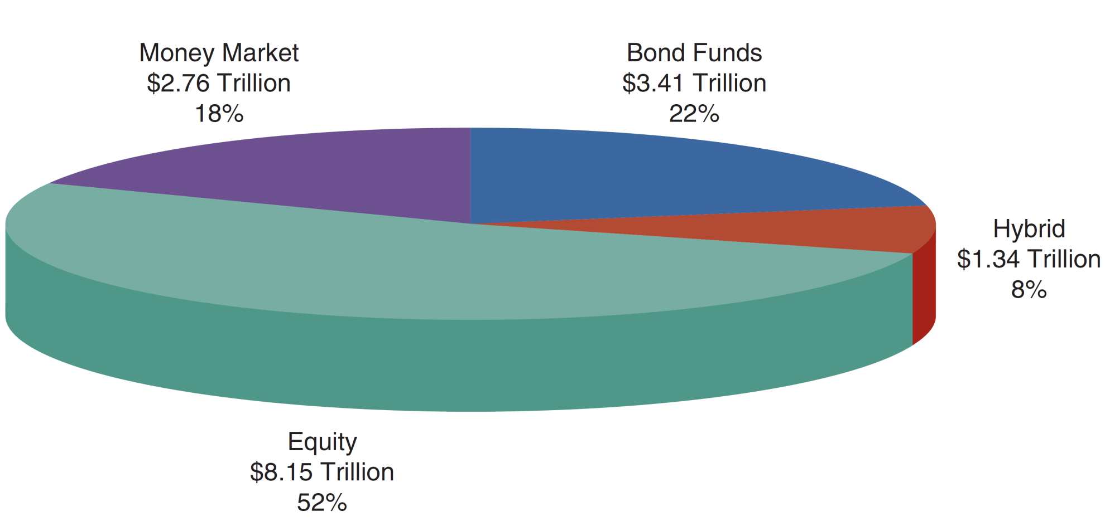
Figure 20.4 Distribution of Assets Among Types of Mutual Funds
Source: Investment Company Institute, 2016 Investment Company Fact Book (Washington, DC: ICI), https://www.ici.org/pdf/2016_factbook.pdf.

Slide 13
Investment Objective Classes
Index Funds
A special class of mutual funds that do fit into any of the categories discussed so far.
The fund contains the stock of the index it is mimicking. For example, an S&P 500 index fund would hold the equities comprising the S&P 500.
Offers benefits of traditional mutual funds without the fees of the professional money manager. Lower fee is a feature of index funds.

Slide 14
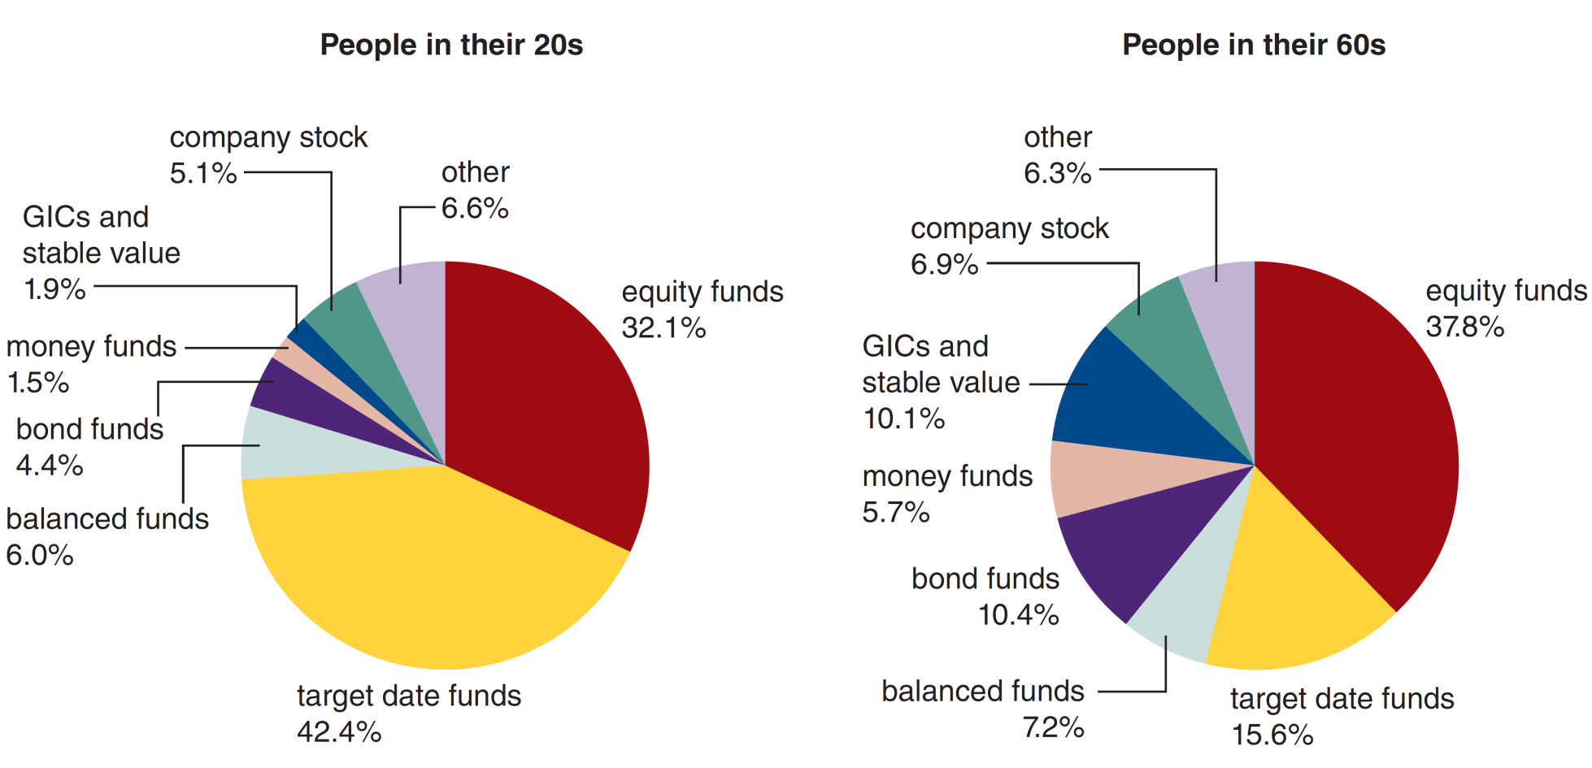
Figure 20.2 Average Asset Allocation for All 401(k) Plan Balances
Source: Investment Company Institute, 2016 Investment Company Fact Book, (Washington, DC: ICI), https://www.ici.org/pdf/2016_factbook.pdf. Reprinted with permission.
Notes:
A target-date fund is a fund offered by an investment company that seeks to grow assets over a specified period of time for a targeted goal. Target-date funds are usually named by the year in which the investor plans to begin utilizing the assets. The funds are structured to address a capital need at some date in the future, such as retirement. The asset allocation of a target-date fund is therefore a function of the specified timeframe available to meet the targeted investment objective. A target-date fund’s risk tolerance become more conservative as it approaches its objective target date. Target-date funds are managed with a specific utilization date. They are typically used for retirement but essentially they can be used by an investor for any type of need requiring a specific utilization date.
Target-date funds are managed to a specified target date and therefore are considered to be long-term investments. As a long-term investment, portfolio managers have a predetermined time horizon for which they base their investment strategy on. Portfolio managers use traditional asset allocation theory guided by risk tolerance and liquidity. In July 2017, Vanguard launched its Target Retirement 2065 products. Given that the funds have a targeted utilization date of 2065, that gives them a time horizon of 48 years.
Target-date fund managers use the remaining investment horizon to determine a fund’s risk tolerance. Following the initial launch, a target-date fund has a high tolerance for risk and therefore is more heavily weighted toward high performing riskier assets. Target-date portfolio managers typically reconstitute portfolio risk levels annually. At the annual reconstitution, portfolio managers will reset the allocation of investment categories. Higher risk portfolio investments typically include domestic and global equities. Lower risk portions of a target-date portfolio typically include fixed income investments such as bonds and cash equivalents.
Target-date funds will also manage funds to a specified asset allocation through the target date. Most fund marketing materials show the glide path of allocation across the entire investment time horizon and through the specified target date. In the years beyond the target date, allocations are more heavily weighted towards low risk fixed income investments.
Investing in Target-Date Funds
Target-date funds are popular with 401(k) plan investors. Instead of having to choose a number of investments to create a portfolio that will help them reach their retirement goals, investors simply choose a single fund designed to help them reach that goal. For example, a younger worker hoping to retire in 2065 would choose a target-date 2065 fund, while an older worker hoping to retire in 2025 would choose a target-date 2025 fund.
Vanguard is one investment manager offering a comprehensive series of target-date funds. Below we compare the characteristics of the Vanguard 2065 fund to the characteristics of the Vanguard 2025 fund.
Vanguard Target Retirement 2065 Fund (VLXVX)
The Vanguard Target Retirement 2065 Fund has an expense ratio of 0.16%. As of October 31, 2017, the portfolio allocation was 89.86% stocks, 9.95% bonds and 0.19% short-term reserves. The Fund uses index funds as the underlying securities for investment. As of October 2017, the Fund had 53.90% of its assets invested in the Vanguard Total Stock Market Index Fund Investor Shares, 36.10% invested in the Vanguard Total International Stock Index Fund Investor Shares, 7.00% invested in the Vanguard Total Bond Market II Index Fund Investor Shares, and 3.00% invested in the Vanguard Total International Bond Index Fund Investor Shares.
Vanguard Target Retirement 2025 Fund (VTTVX)
The Vanguard Target Retirement 2025 Fund has an expense ratio of 0.14%. As of October 31, 2017, the portfolio allocation was 63.92% in stocks, 36.07% in bonds and 0.01% in short-term reserves. As of October 2017, the Fund had 38.40% invested in the Vanguard Total Stock Market Index Fund Investor Shares, 25.50% invested in the Vanguard Total International Stock Index Fund Investor Shares, 25.50% invested in the Vanguard Total Bond Market II Index Fund Investor Shares, and 10.60% invested in the Vanguard Total International Bond Index Fund Investor Shares.
The 2065 Fund is more heavily weighted toward stocks, with a relatively smaller percentage of bonds and cash equivalents. The 2025 Fund has greater weight in fixed income and fewer stocks so it is less volatile and more likely to contain the assets the investor needs to begin making withdrawals in 2025. In the years beyond the target date, both Vanguard target-date funds report an asset allocation mix of approximately 20% in U.S. equities, 10% in international equities, 40% in U.S. bonds, 10% in international bonds, and approximately 20% in short-term TIPS.
Proponents of target-date funds cite the convenience to investors of putting their investing activities on autopilot in one fund. However, with multiple target-date funds in the market, investors should be aware of their options. Investment companies and managers offer a variety of target-date funds with varying asset allocation strategies and underlying investments. With the variety of options, investors have an array of choices available to fit their risk and management preferences.
Read more: Target-Date Fund | Investopedia https://www.investopedia.com/terms/t/target-date_fund.asp#ixzz5U6loiGHb Follow us: Investopedia on Facebook

Slide 15
Fee Structure of Investment Funds
Load funds (class A shares) charge an upfront fee for buying the shares. No-load funds do not charge this fee.
Front-end load (“entrance fee”)
A commission or sales charge
Not to exceed 8.5%
Low load funds: 1-3%
Deferred load (class B shares) funds charge a fee when the shares are redeemed.
If the particular fund charges no front or back end fees, it is referred to as class C shares.
Back-end load (“exit fee”)
A redemption fee
Contingent deferred sales charges
5-6% with 1% sliding down per year

Slide 16
Costs: Operating Expenses
Administrative expenses
Investment advisory fees
Range from 0.2% to 2% of asset value
12b-1 charges
Commissions to brokers, distribution costs (fee to pay marketing, advertising)
Up to 1%
contingent deferred sales charge: a back end fee that may disappear altogether after a specific period.
redemption fee: another name for a back end load
exchange fee: a fee (usually low) for transferring money between funds in the same family.
account maintenance fee: charges if the account balance is too low.
Payment of expenses
No explicit bill for operating expenses
Automatic deduction from fund assets

Slide 17
Costs: Example
$10,000 each invested in fund A, B, C. Each fund has 12% before-tax return out of which 5% is dividend yield. How much money you have in each fund after a year?
Results
A: $10,000×[1+(.12–.005)] = $11,150
B: $10,000×[1+(.12–.01–.005)]= $11,050
C:(10,000–800)×[1+(.12–.005–.05×.08)]=$10,221
Dividend reinvestment subject to front-end load
All else being equal, you want to own funds that have the lowest possible cost.

Slide 18
Performance
Historical comparison (1980 - 2005)*
S&P 500 – 12.3% average yearly return
Average Mutual Fund - 10% average yearly return
Historical comparison (1971 - 2008)**
Wilshire 5000 – 11.4 % average yearly return
Average Mutual Fund return was more than 1% lower than Wilshire 5000
Consensus: index funds outperform active managed funds
The past performance of a mutual fund is not an indicator of future outcomes
* The Economist, Feb 28, 2008 ** BKM 8th ed

Slide 19
Other Investment Companies: Closed-End Funds
Managed investment company
Investors invest/divest in the fund by buying/selling the company shares and the fund itself is not involved.
Assets
Individual
investors
Fund’s board
of directors
Management
company
Assets
Non-redeemable
shares
Liabilities
Exchange listed

Slide 20
Exchange Traded Funds (ETFs)
ETFs are investment funds that allow investors to trade index portfolios like shares of stock.
An ETF combines the valuation feature of a mutual fund or unit investment trust , which can be bought or sold at the end of each trading day for its net asset value, with the tradability feature of a closed-end fund , which trades throughout the trading day at prices that may be more or less than its net asset value.
Examples:
Spiders (State Street) : Standard & Poor Depository Receipts
The first index ETF (trust) started in 1993
HOLDRS (Merrill Lynch): Holding Company Depositary Receipts
iShares (BlackRock)

Slide 21
Hedge Funds
A special type of mutual fund that received considerable attention following the collapse of Long Term Capital Management.
Different from typical mutual funds, as follows:
High minimum investment, averaging around $1 million
Long-term commitment of funds is required
High fees: typically 1% of assets plus 20% of profits
Highly levered
Little current regulation

Slide 22
Chapter Summary
The Growth of Mutual Funds: mutual funds growth has been dramatic, increasing from under $300 billion in 1980 to over $14 trillion in 2012.
Mutual Fund Structure: the organization structure, including ownership, the board, and operations of the fund were reviewed.
Investment Objective Classes: along with delineating equity and debt funds, we also reviewed classes on funds within each major category.
Fee Structure of Investment Funds: the various fees charged by funds were defined and reviewed.

