Slide 1
Topic 8: The Stock Market
Main Reading (Sources): Chap 13 Mishkin & Eakins, 8th

Slide 2
Chapter Preview
Topics Addressed
Stock Market Indexes
Buying Foreign Stocks
Regulation of the Stock Market
Investing in Stocks
Computing the Price of Common Stock
How the Market Sets Security Prices
Errors in Valuation

Slide 3
Investing in Stocks
Represents ownership in a firm
Earn a return in two ways
Price of the stock rises over time
Dividends are paid to the stockholder
Stockholders have claim on all assets
Right to vote for directors and on certain issues
Two types
Common stock
Right to vote
Receive dividends
Preferred stock
Receive a fixed dividend
Do not usually vote

Slide 4
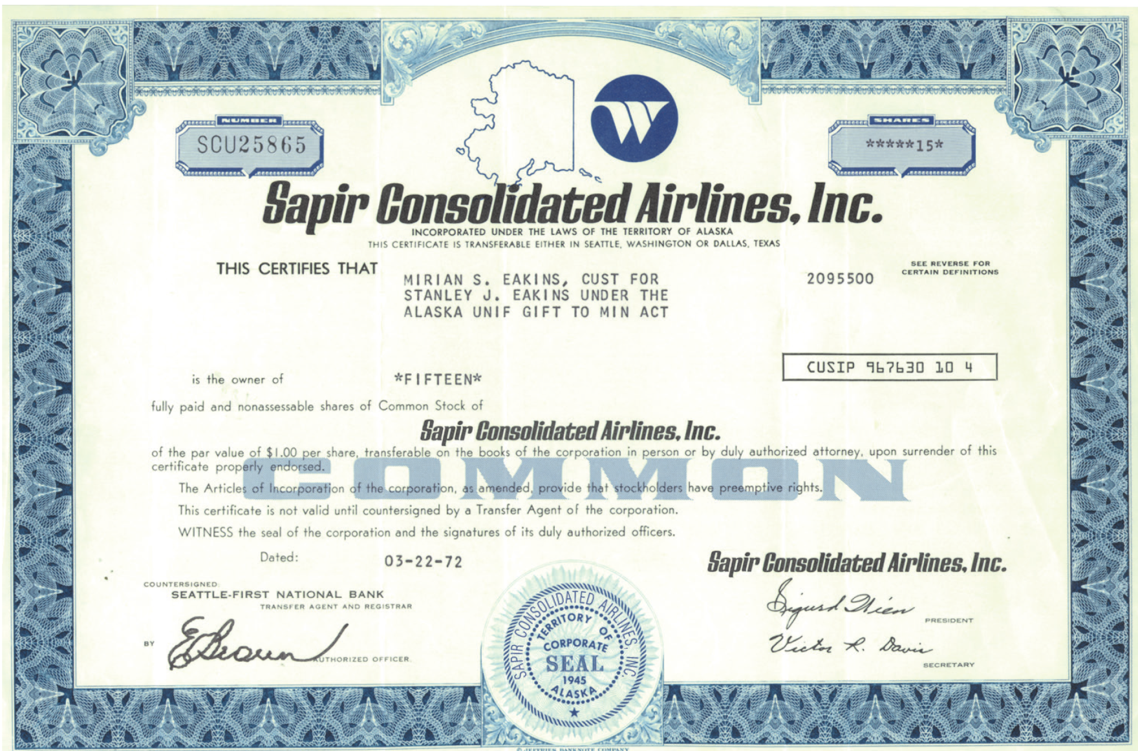
Figure 13.1 Sapir Consolidated Airlines Stock

Slide 5
Investing in Stocks: How Stocks are Sold (1 of 2)
Organized exchanges
NYSE is best known, with daily volume around 4 billion shares, with peaks at 10 billion.
“Organized” used to imply a specific trading location. But computer systems (ECNs) have replaced this idea.
Others include the ASE (US), and Nikkei, LSE, DAX (international)
Listing requirements exclude small firms

Slide 6
Investing in Stocks: How Stocks are Sold (2 of 2)
Over-the-counter markets
Best example is NASDAQ
Dealers stand ready to make a market
Today, about 3,000 different securities are listed on NASDAQ.
Important market for thinly-traded securities—securities that don’t trade very often. Without a dealer ready to make a market, the equity would be difficult to trade.

Slide 7
Investing in Stocks: Organized vs. OTC
Organized exchanges (e.g., NYSE)
Auction markets with floor specialists
25% of trades are filled directly by specialist
Remaining trades are filled through SuperDOT
Over-the-counter markets (e.g., NASDAQ)
Multiple market makers set bid and ask prices
Multiple dealers for any given security

Slide 8
Investing in Stocks: ECNs (1 of 2)
ATSs (alternative trading systems) and MTFs (multilateral trading facilities) allow buyers and sellers of securities to dead directly with each other.
ECNs (electronic communication networks) are a subset of ATSs/MTFs that allow brokers and traders to trade without the need of the middleman. They provide:
Transparency: everyone can see unfilled orders
Cost reduction: smaller spreads
Faster execution
After-hours trading

Slide 9
Investing in Stocks: ECNs (2 of 2)
However, ECNs are not without their drawbacks:
Don’t work as well with thinly-traded stocks
Many ECNs competing for volume, which can be confusing
Major exchanges are fighting ECNs, with an uncertain outcome

Slide 10
Investing in Stocks: ETFs
Exchange Traded Funds are a recent innovation to help keep transaction costs down while offering diversification.
Represent a basket of securities
Traded on a major exchange
Index to a specific portfolio (e.g., the S&P 500), so management fees are low (although commissions still apply) compared with stock index mutual fund.
Exact content of basket is known, so valuation is certain
Disadvantage: Investors have to pay a broker commission each time they buy or sell shares. (trade like stock)

Slide 11
Computing the Price of Common Stock
Valuing common stock is, in theory, no different from valuing debt securities:
determine the cash flows
discount them to the present
We will review four different methods for valuing stock, each with its advantages and drawbacks.

Slide 12
Computing the Price of Common Stock: The One-Period Valuation Model
Simplest model, just taking using the expected dividend and price over the next year.
$Price=\frac{{Div}_{1}}{1+k_{e}}+\frac{P_{1}}{\left(1+k_{e}\right)}$
Example: what is the price for a stock with an expected dividend and price next year of $0.16 and $60, respectively? Use a 12% discount rate
Answer: ???

Slide 13
Computing the Price of Common Stock: The Generalized Dividend Valuation Model (1 of 2)
Most general model, but the infinite sum may not converge.
Price = Sum of the present value of all dividends.
Rather than worry about computational problems, we use a simpler version, known as the Gordon growth model.

Slide 14
Computing the Price of Common Stock: The Gordon Growth Model (1 of 2)
Same as the previous model, but it assumes that dividend grow at a constant rate, g. That is,
With that, the price is simply:
The model is useful, with the following assumptions:
Dividends do, indeed, grow at a constant rate forever
The growth rate of dividends, g, is less than the required return on the equity, k_{e}.

Slide 15
Computing the Price of Common Stock: The Gordon Growth Model (2 of 2)
Example: Find the current market price of Coca-Cola stock assuming dividends grow at a constant rate of 10.95%, D₀=$1.00, and the required return is 13%.
Answer: P₀=???

Slide 16
Computing the Price of Common Stock: The Price Earnings Ratio Model (2 of 2)
The price earnings ratio (PE) is a widely watched measure of how much the market is willing to pay for $1.00 of earnings from the firms.
Price = P/E × Earnings
Example: if the industry PE ratio for a firm is 16, what is the current stock price for a firm with earnings for $1.13 / share?
Answer: Price = ???

Slide 17
How the Market Sets Security Prices (1 of 2)
Generally speaking, prices are set in competitive markets as the price set by the buyer willing to pay the most for an item.
The buyer willing to pay the most for an asset is usually the buyer who can make the best use of the asset.
Superior information can play an important role.

Slide 18
How the Market Sets Security Prices (2 of 2)
Consider the following three valuations for a stock with certain dividends but different perceived risk:
Bud, who perceives the lowest risk, is willing to pay the most and will determine the “market” price.
Investor | Discount Rate | Stock Price
You | 15% | $16.67
Jennifer | 12% | $22.22
Bud | 7% | $50.00

Slide 19
Errors in Valuation (1 of 2)
Although the pricing models are useful, market participants frequently encounter problems in using them. Any of these can have a significant impact on price in the Gordon model.
Problems with Estimating Growth
Problems with Estimating Risk
Problems with Forecasting Dividends

Slide 20
Table 13.1 Stock Prices for a Security with D₀ = $2.00, k_{e} = 15%, and Constant Growth Rates as Listed
Growth (%) | Price ($)
1 | 14.43
3 | 17.17
5 | 21.00
10 | 44.00
11 | 55.50
12 | 74.67
13 | 113.00
14 | 228.00

Slide 21
Table 13.2 Stock Prices for a Security with D₀ = $2.00, g = 5%, and Required Returns as Listed
Required Return (%) | Price ($)
10 | 42.00
11 | 35.00
12 | 30.00
13 | 26.25
14 | 23.33
15 | 21.00

Slide 22
Errors in Valuation (2 of 2)
Security valuation is not an exact science!
Considering different growth rates, required rates, etc., is important in determining if a stock is a good value as an investment.

Slide 23
Case: The 2007–2009 Financial Crisis and the Stock Market
The financial crisis, which started in August 2007, was the start of one of the worst bear markets.
The crisis lowered “g” in the Gordon Growth model - driving down prices.
Also impacts k_{e} - higher uncertainty increases this value, again lowering prices.
The expectations were still optimistic at the start of the crisis. But, as the reality of the severity of the crisis was understood, prices plummeted.

Slide 24
Case: 9/11, Enron and the Market
Both 9/11 and the Enron scandal were events in 2001.
Both should lower “g” in the Gordon Growth model - driving down prices.
Also impacts k_{e} - higher uncertainty increases this value, again lowering prices.
We did observe in both cases that prices in the market fell. And subsequently rebounded as confidence in US markets returned.

Slide 25
Stock Market Indexes
Stock market indexes are frequently used to monitor the behavior of a groups of stocks.
Major indexes include the Dow Jones Industrial Average, the S&P 500, and the NASDAQ composite.
The securities that make up the (current) DJIA are included on the next several slides.

Slide 26
Table 13.3 The Thirty Companies That Make Up the Dow Jones Industrial Average (1 of 3)
Company | Stock Symbol
3M Co. | MMM
Apple Inc. | AAPL
American Express Co. | AXP
Boeing Co. | BA
Caterpillar Inc. | CAT
Chevron | CVX
Cisco Systems | CSCO
Coca-Cola Co. | KO
E.I. DuPont de Nemours | DD
Exxon Mobil Corp. | XOM

Slide 27
Table 13.3 The Thirty Companies That Make Up the Dow Jones Industrial Average (2 of 3)
Company | Stock Symbol
General Electric Co. | GE
Goldman Sachs | GS
Home Depot Inc. | HD
International Business Machines | IBM
Intel Corp. | INTC
Johnson & Johnson | JNJ
JP Morgan Chase & Co. | JPM
McDonald’s Corp. | MCD
Merck & Co. Inc. | MRK
Microsoft Corp. | MSFT

Slide 28
Table 13.3 The Thirty Companies That Make Up the Dow Jones Industrial Average (3 of 3)
Company | Stock Symbol
Nike | NKE
Pfizer Inc. | PFE
Procter & Gamble Co. | PG
Travelers Corp. | TRV
United Technologies Corp. | UTX
United Health Group | UNH
Verizon Communications Inc. | VZ
Visa International | V
Wal-Mart Stores Inc. | WMT
Walt Disney Co. | DIS

Slide 29
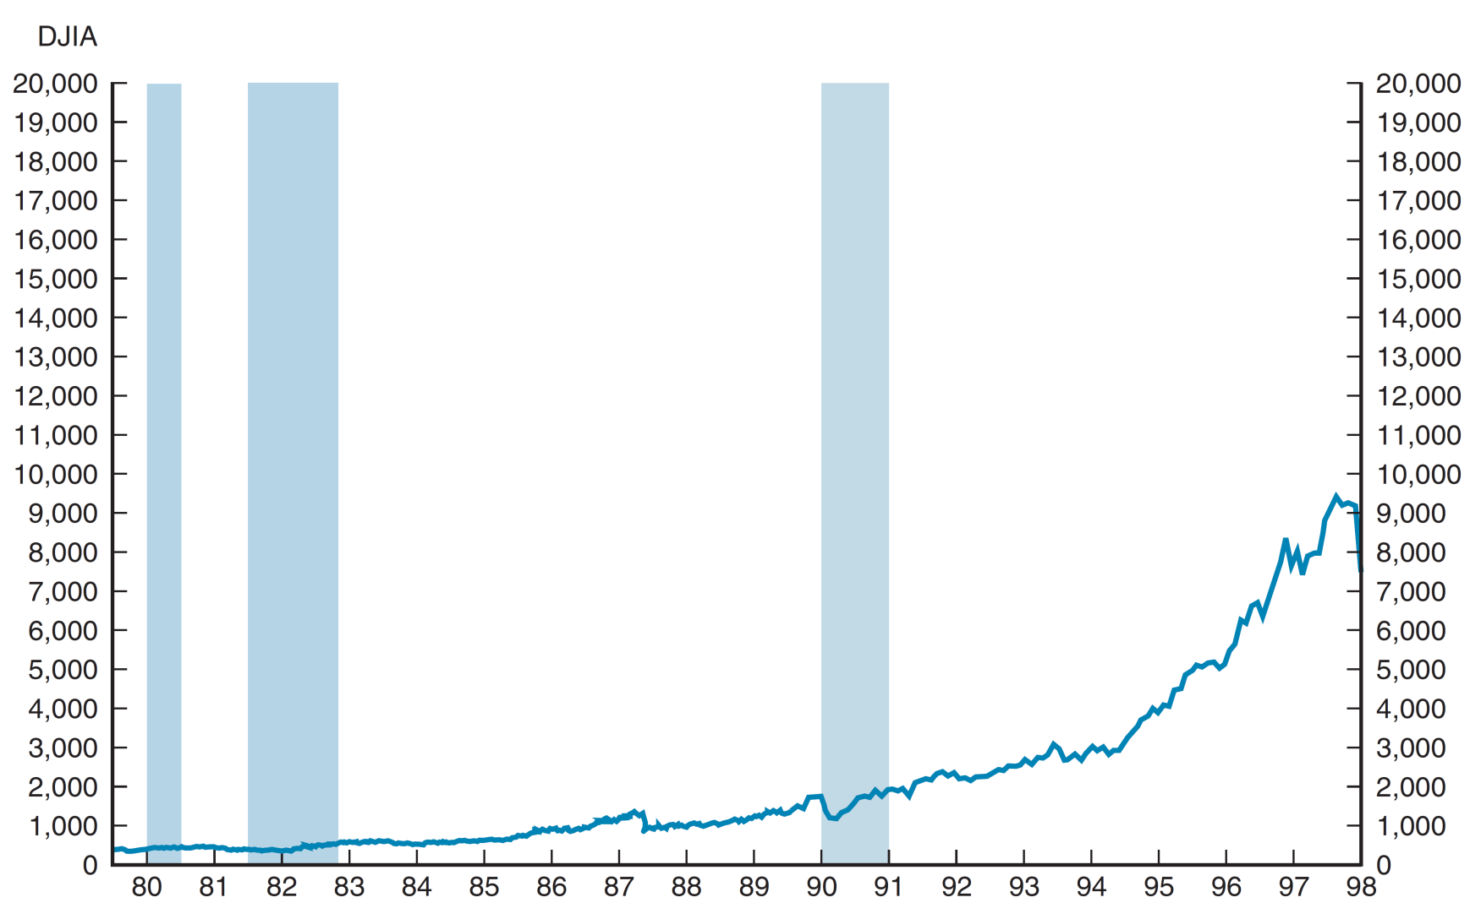
Figure 13.2 Dow Jones Industrial Averages, 1980–2016 (1 of 2)

Slide 30
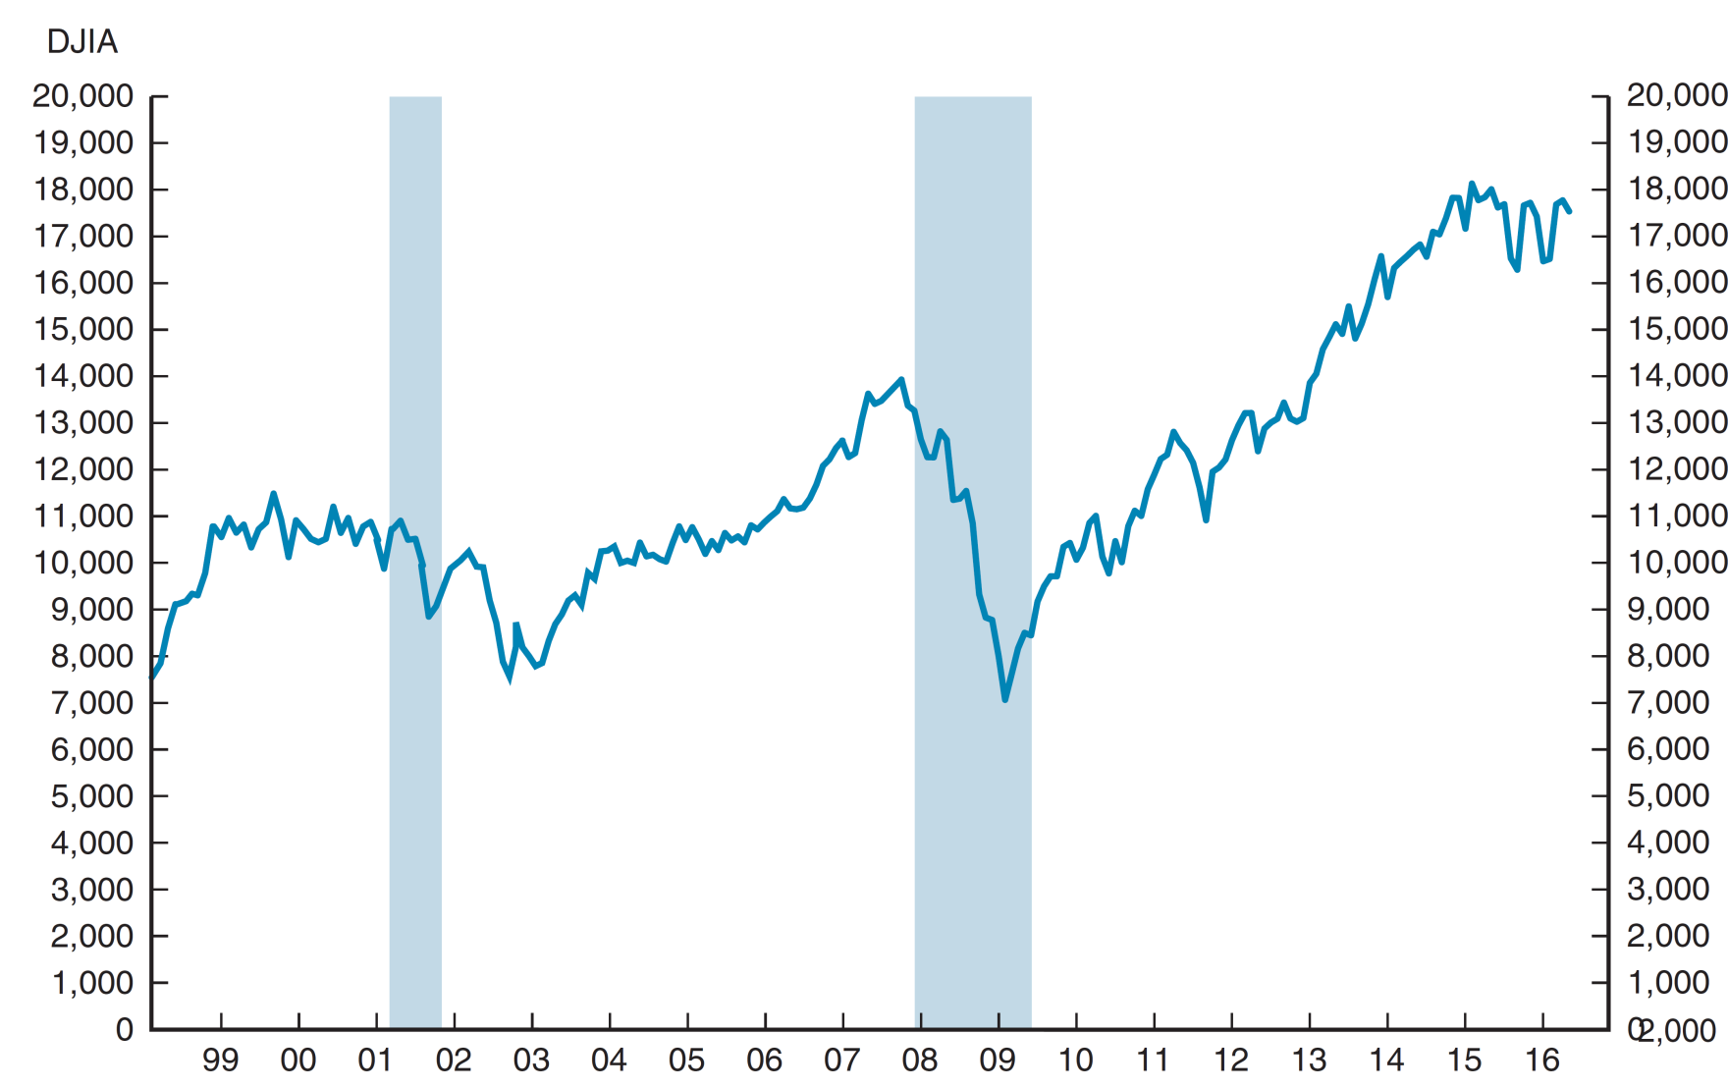
Figure 13.2 Dow Jones Industrial Averages, 1980–2016 (2 of 2)

Slide 31
Buying Foreign Stocks
Buying foreign stocks is useful from a diversification perspective. However, the purchase may be complicated if the shares are not traded in the U.S.
American depository receipts (ADRs) allow foreign firms to trade on U.S. exchanges, facilitating their purchase. U.S. banks buy foreign shares and issue receipts against the shares in U.S. markets.

Slide 32
Regulation of the Stock Market
The primary mission of the SEC is “…to protect investors and maintain the integrity of the securities markets.”
The SEC brings around 500 actions against individuals and firms each year toward this effort. This is accomplished through the joint efforts of four divisions.

Slide 33
Regulation of the Stock Market: Divisions of the SEC
Division of Corporate Finance: responsible for collecting, reviewing, and making available all of the documents corporations and individuals are required to file
Division of Market Regulation: establishes and maintains rules for orderly and efficient markets.
Division of Investment Management: oversees and regulates the investment management industry
Division of Enforcement: investigates violations of the rules and regulations established by the other divisions.

Slide 34
Chapter Summary
Investing in Stocks: we developed an understanding the structure of the various trading systems, including exchanges and OTC markets
Computing the Price of Common Stock: various techniques for valuing dividends and earnings were presented
How the Market Sets Security Prices: the basic idea that prices are set by the “highest bidder” was reviewed
Errors in Valuation: difficulties in determining dividends, growth rates, and/or required returns can have a significant impact in the pricing models
Stock Market Indexes: a way to track changes in valuation for a broad group of stocks
Buying Foreign Stocks: potential benefits for diversifications, simplified by the use of ADRs.
Regulation of the Stock Market: the primary function of the Securities and Exchange Commission

