Slide 1
Topic 7: The Bond Market
Main Reading (Sources): Chap 12 Mishkin & Eakins, 8th

Slide 2
Chapter Preview
Purpose of the Capital Market
Capital Market Participants
Capital Market Trading
Types of Bonds
Treasury Notes and Bonds
Municipal Bonds
Corporate Bonds
Financial Guarantees for Bonds
Oversight of the Bond Markets
Current Yield Calculation
Finding the Value of Coupon Bonds
Investing in Bonds

Slide 3
Purpose of the Capital Market
Original maturity is greater than one year, typically for long-term financing or investments
Best known capital market securities:
Stocks and bonds

Slide 4
Capital Market Participants
Primary issuers of securities:
Federal and local governments: debt issuers
Corporations: equity and debt issuers
Largest purchasers of securities:
You and me

Slide 5
Capital Market Trading
Primary market for initial sale (IPO)
Secondary market
Over-the-counter
Organized exchanges (i.e., NYSE)

Slide 6
Types of Bonds
Bonds are securities that represent debt owed by the issuer to the investor, and typically have specified payments on specific dates.
Types of bonds we will examine include long-term government bonds (T-bonds), municipal bonds, and corporate bonds.

Slide 7
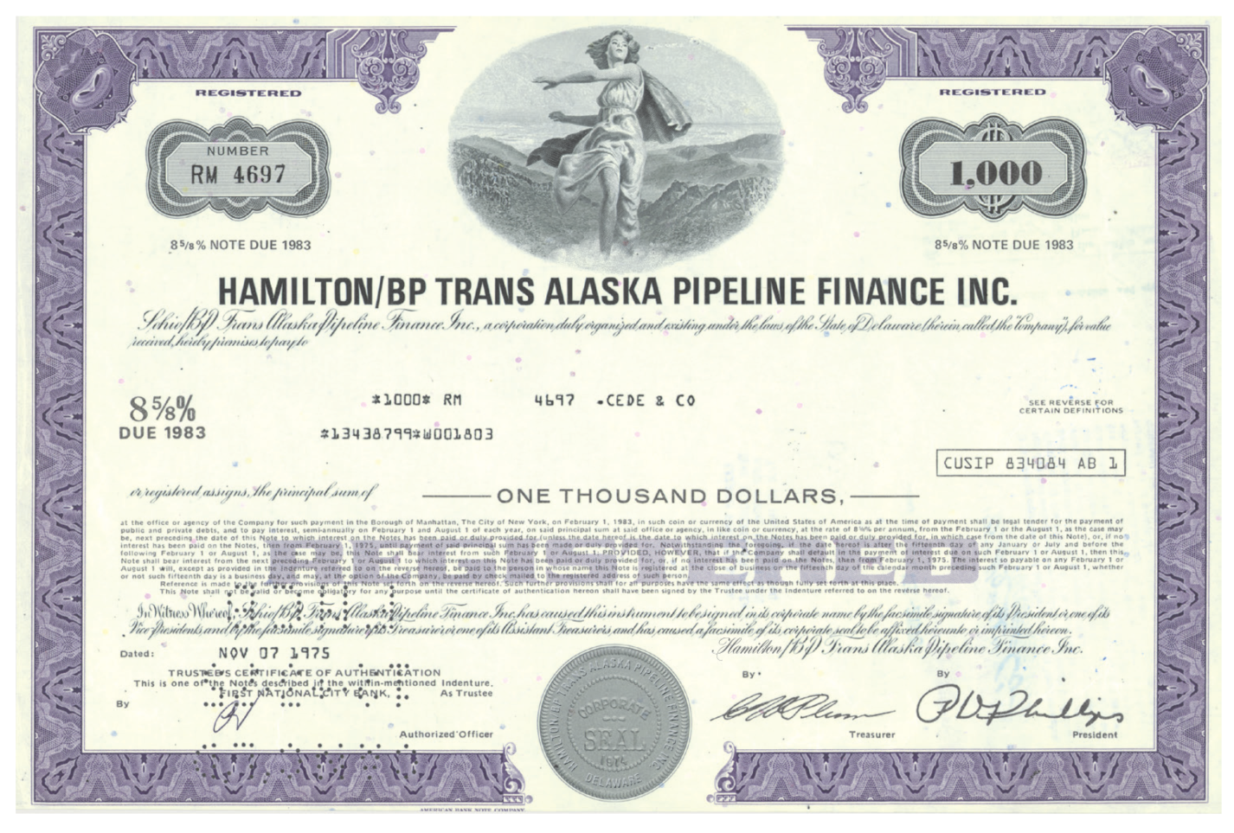
Figure 12.1 Hamilton/BP Corporate Bond

Slide 8
Treasury Notes and Bonds
The U.S. Treasury issues notes and bonds to finance its operations.
The table (12.1) summarizes the maturity differences among the various Treasury securities.

Slide 9
Treasury Bond Interest Rates
No default risk since the Treasury can print money to payoff the debt
Very low interest rates, often considered the risk-free rate (although inflation risk is still present)

Slide 10
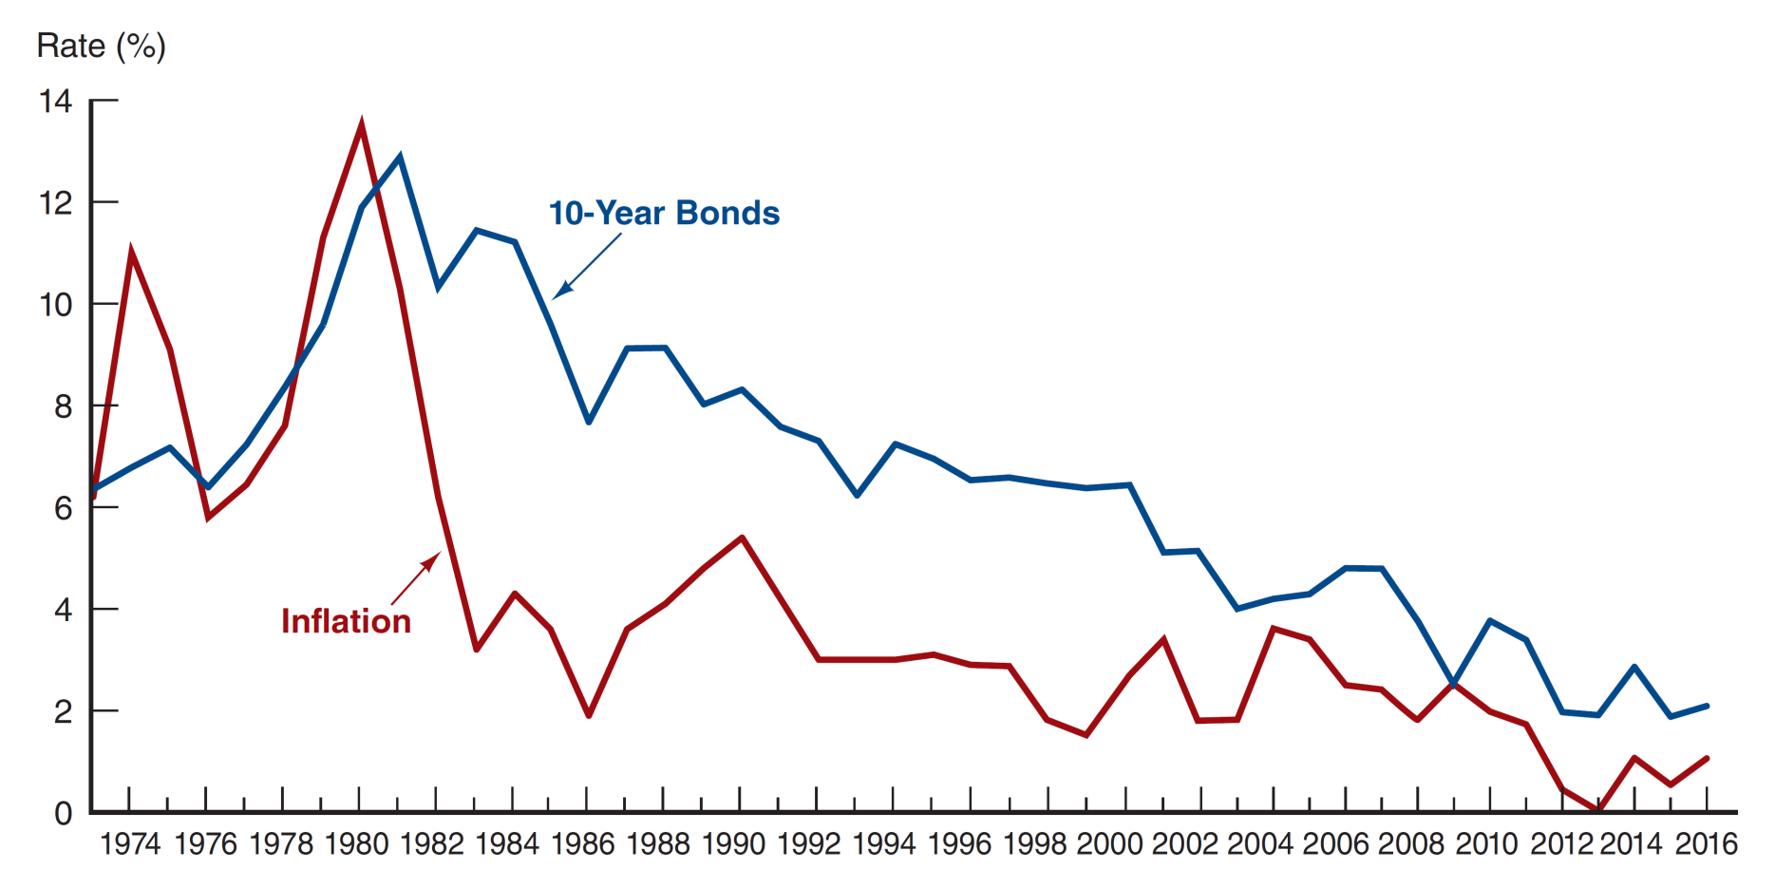
Figure 12.2 Interest Rate on Treasury Bonds and the Inflation Rate, 1973–2016 (January of each year)
Source: http://www.federalreserve.gov/releases and https://www.treasury.gov/resource-center/data-chart-center/interest-rates/Pages/TextView.aspx?data=reallongtermrate.

Slide 11
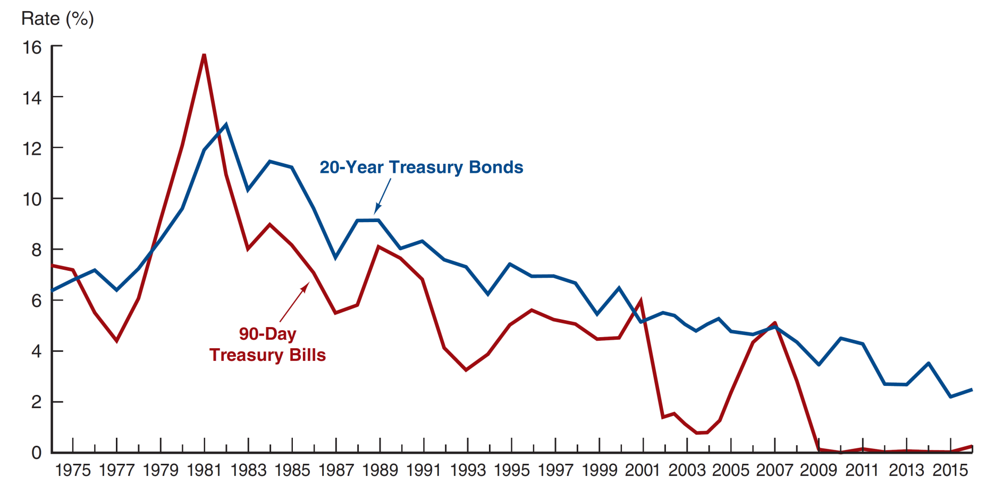
Figure 12.3 Interest Rate on Treasury Bills and Treasury Bonds, 1974–2016 (January of each year)
Source: http://www.federalreserve.gov/releases/h15/data.htm.

Slide 12
Treasury Bonds: Recent Innovation
Treasury Inflation-Indexed Securities: the principal amount is tied to the current rate of inflation to protect investor purchasing power
Treasury STRIPS: the coupon and principal payments are “stripped” from a T-Bond and sold as individual zero-coupon bonds.

Slide 13
Treasury Bonds: Agency Debt
Although not technically Treasury securities, agency bonds are issued by government-sponsored entities, such as GNMA, FNMA, and FHLMC.
The debt has an “implicit” guarantee that the U.S. government will not let the debt default. This “guarantee” was clear during the 2008 bailout…

Slide 14
The 2007–2009 Financial Crisis: Bailout of Fannie and Freddie
Both Fannie and Freddie managed their political situation effectively, allowing them to engage in risky activities, despite concerns raised.
By 2008, the two had purchased or guaranteed over $5 trillion in mortgages or mortgage-backed securities.
Part of this growth was driven by their Congressional mission to support affordable housing. They did this by purchasing subprime and Alt-A mortgages.
As these mortgages defaults, large losses mounted for both agencies.
By October of 2016, the two agencies had paid $250 billion in dividends to the treasury.

Slide 15
Municipal Bonds
Issued by local, county, and state governments
Used to finance public interest projects
Tax-free municipal interest rate = taxable interest rate × (1 − marginal tax rate)
Two types
General obligation bonds
Revenue bonds
NOT default-free (e.g., Orange County California)
Defaults in 1990 amounted to $1.4 billion in this market

Slide 16
Municipal Bonds: Example
Suppose the rate on a corporate bond is 5% and the rate on a municipal bond is 3.5%. Which should you choose? Your marginal tax rate is 28%.
Find the equivalent tax-free rate (ETFR):
ETFR = 5% × (1 − MTR) = 5% × (1 − 0.28)
The ETFR = 3.6%. If the actual muni-rate is above this , choose the muni. If the actual muni-rate is below this, choose the corporate bond. In this case, we choose corporate bond.

Slide 17
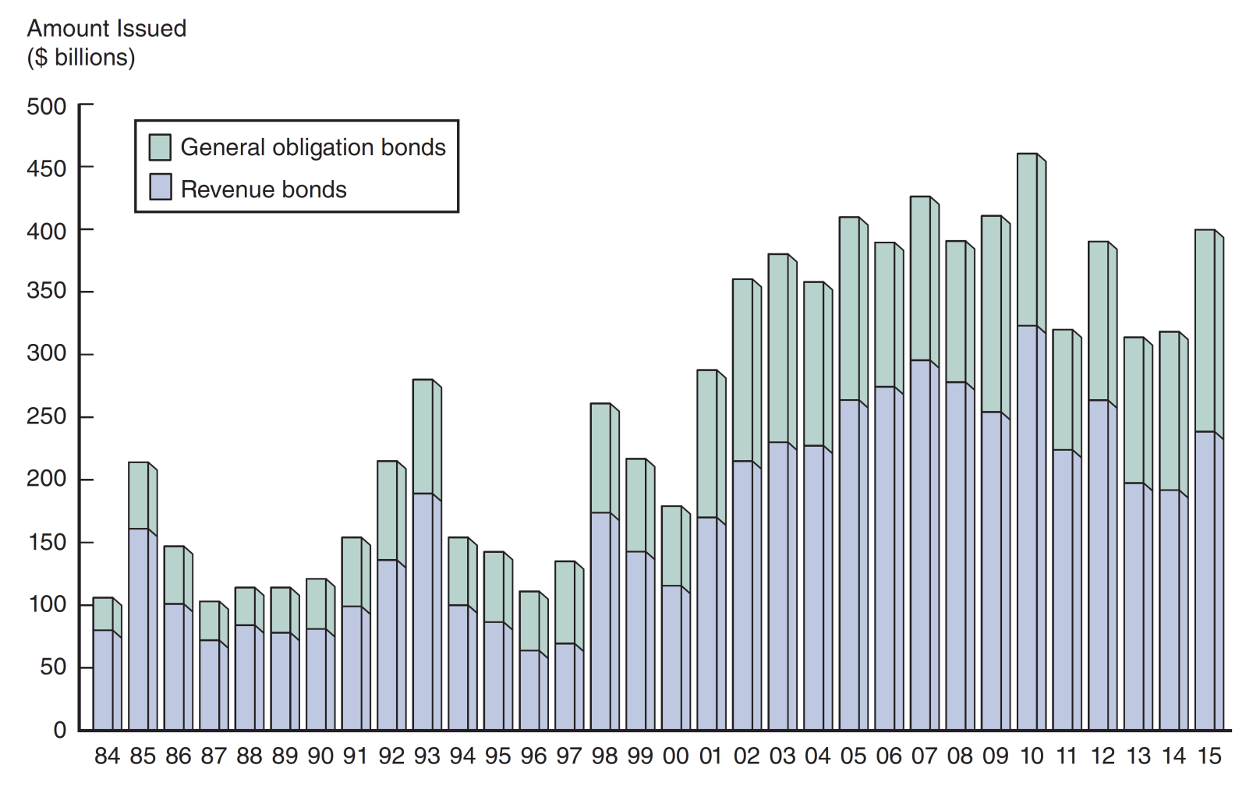
Figure 12.4 Issuance of Revenue and General Obligation Bonds, 1984–2015 (End of year)
Source: http://www.federalreserve.gov/econresdata/releases/govsecure/current.htm.

Slide 18
Corporate Bonds
Typically have a face value of $1,000, although some have a face value of $5,000 or $10,000
Pay interest semi-annually
Cannot be redeemed anytime the issuer wishes, unless a specific clause states this (call option).
Degree of risk varies with each bond, even from the same issuer. Following suite, the required interest rate varies with level of risk.
The degree of risk ranges from low-risk (AAA) to higher risk (BBB). Any bonds rated below BBB are considered sub-investment grade debt.

Slide 19
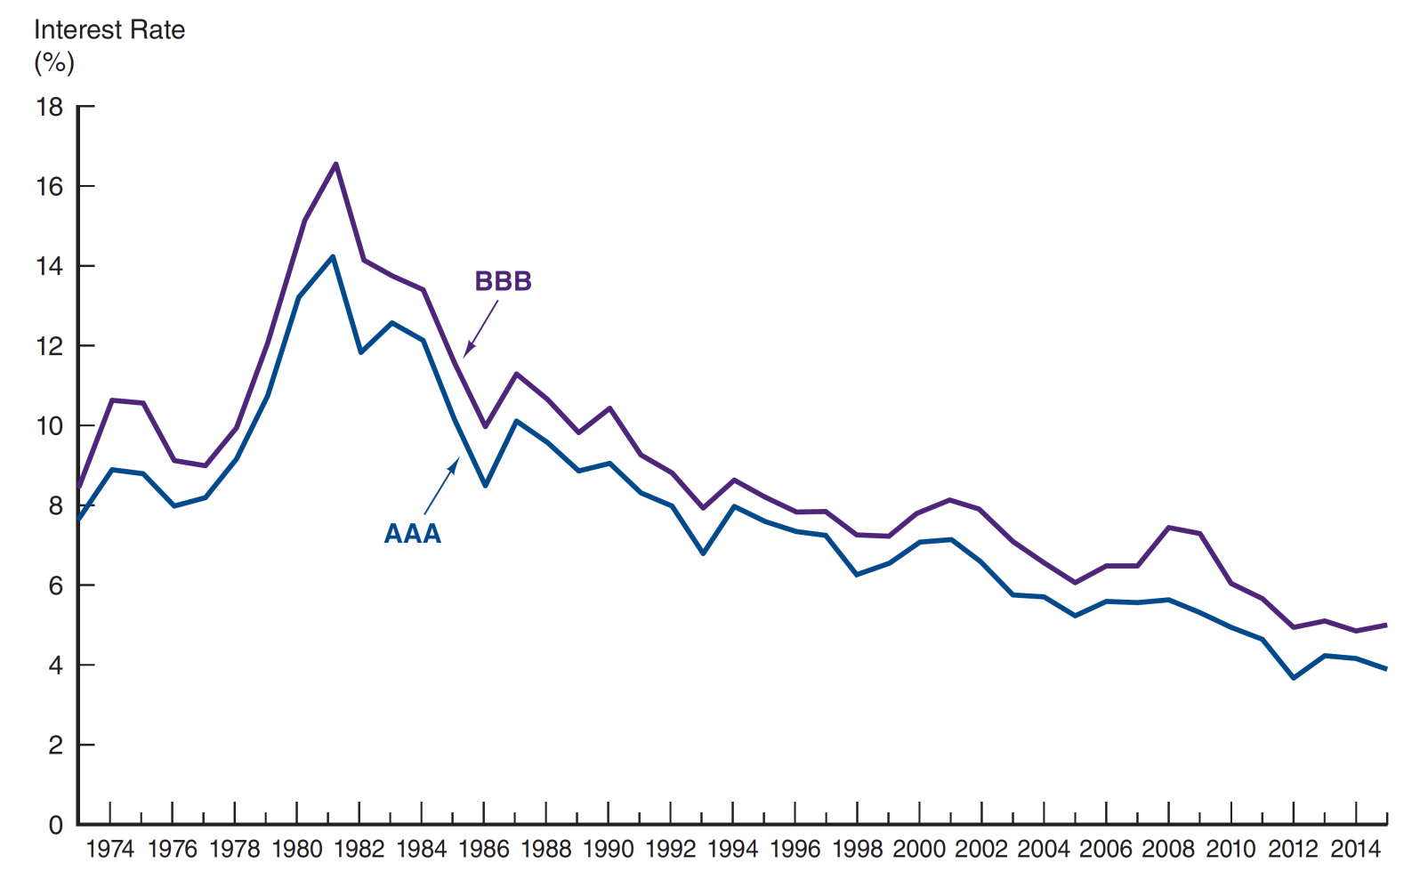
Figure 12.5 Corporate Bond Interest Rates, 1973–2015 (End of year)
Source: http://www.federalreserve.gov/releases/h15/data.htm.

Slide 20
Characteristics of Corporate Bonds
Registered Bonds
Replaced “bearer” bonds
IRS can track interest income this way
Restrictive Covenants
Mitigates conflicts with shareholder interests
May limit dividends, mergers, new debt, ratios, etc.
Usually includes a cross-default clause

Slide 21
Characteristics of Corporate Bonds
Call Provisions
Higher required yield
Mechanism to adhere to a sinking fund provision
Interest of the stockholders
Alternative opportunities
Conversion (Convertible bond)
Some debt may be converted to equity
Similar to a stock option, but usually more limited
Lower required yield, sell at higher price than comparable nonconvertible bonds.

Slide 22
Characteristics of Corporate Bonds
Secured Bonds
Mortgage bonds
Equipment trust certificates
Unsecured Bonds
Debentures
Subordinated debentures
Variable-rate bonds

Slide 23
Characteristics of Corporate Bonds
Junk Bonds
Debt that is rated below BBB
Often, trusts and insurance companies are not permitted to invest in junk debt
Michael Milken developed this market in the mid-1980s, although he was subsequently convicted of insider trading

Slide 24
Table 12.2 Debt Rating Descriptions (1 of 4)
Standard & Poor’s | Moody’s | Definition
AAA | Aaa | Best quality and highest rating. Capacity to pay interest and repay principal is extremely strong. Smallest degree of investment risk.
AA | Aa | High quality. Very strong capacity to pay interest and repay principal and differs from AAA/Aaa in a small degree.
A | A | Strong capacity to pay interest and repay principal. Possess many favorable investment attributes and are considered upper-medium-grade obligations. Somewhat more susceptible to the adverse effects of changes in circumstances and economic conditions.

Slide 25
Table 12.2 Debt Rating Descriptions (2 of 4)
Standard & Poor’s | Moody’s | Definition
BBB | Baa | Medium-grade obligations. Neither highly protected nor poorly secured. Adequate capacity to pay interest and repay principal. May lack long-term reliability and protective elements to secure interest and principal payments.
BB | Ba | Moderate ability to pay interest and repay principal. Have speculative elements and future cannot be considered well assured. Adverse business, economic, and financial conditions could lead to inability to meet financial obligations.
B | B | Lack characteristics of desirable investment. Assurance of interest and principal payments over long period of time may be small. Adverse conditions likely to impair ability to meet financial obligations.

Slide 26
Table 12.2 Debt Rating Descriptions (3 of 4)
Standard & Poor’s | Moody’s | Definition
CCC | Caa | Poor standing. Identifiable vulnerability to default and dependent on favorable business, economic, and financial conditions to meet timely payment of interest and repayment of principal.
CC | Ca | Represent obligations that are speculative to a high degree. Issues often default and have other marked shortcomings.
C | C | Lowest-rated class of bonds. Have extremely poor prospects of attaining any real investment standard. May be used to cover a situation where bankruptcy petition has been filed, but debt service payments are continued.

Slide 27
Table 12.2 Debt Rating Descriptions (4 of 4)
Standard & Poor’s | Moody’s | Definition
CI | Caa | Reserved for income bonds on which no interest is being paid.
D | Ca | Payment default.
NR |  | No public rating has been requested.
(+) or (−) | C | Ratings from AA to CCC may be modified by the addition of a plus or minus sign to show relative standing within the major rating categories.

Slide 28
Financial Guarantees for Bonds (1 of 2)
Some debt issuers purchase financial guarantees to lower the risk of their debt.
The guarantee provides for timely payment of interest and principal, and are usually backed by large insurance companies.

Slide 29
Financial Guarantees for Bonds (2 of 2)
As it turns out, not all guarantees actually make sense!
In 1995, JPMorgan created the credit default swap (CDS), a type of insurance on bonds.
In 2000, Congress removed CDSs from any oversight.
By 2008, the CDS market was over $62 trillion!
2008 losses on mortgages lead to huge payouts on this insurance.

Slide 30
Oversight of the Bond Markets
Bond trades are not available to the public, making trading less transparent.
TRACE, under FINRA, was developed to:
Make some bond transactions reported to the public
Develop a trading platform to make transaction data available to the public

Slide 31
Table 12.3 Sample Violations in the Bond Market
Violation | Fine
Excessive trading | $5,000 to $110,000
Excessive markups | $5,000 to $146,000
Failure to supervise | $5,000 to $73,000
Fraud/Misrepresentation | $2,500 to $146,000
Late reporting | $5,000 to $146,000
Net capital deficiencies | $1,000 to $73,000
Outside business activities | $2,500 to $73,000
Recordkeeping violations | $1,000 to $146,000
Sale of unregistered securities | $2,500 to $73,000
Unsuitable recommendations | $2,500 to $110,000

Slide 32
Bond Current Yield Calculation
Bond yields are quoted using a variety of conventions, depending on both the type of issue and the market.
We will examine the current yield calculation that is commonly used for long-term debt.
Example:
What is the current yield for a bond with a face value of $1,000, a current price of $921.01, and a coupon rate of 10.95%?
Answer:
i_{c} = C / P = $109.50 / $921.01 = 11.89%
Note: C (coupon) = 10.95% × $1,000
= $109.50

Slide 33
Finding the Value of Coupon Bonds
Bond pricing is, in theory, no different than pricing any set of known cash flows.
Once the cash flows have been identified, they should be discounted to time zero at an appropriate discount rate.

Slide 34
Table 12.3 Bond Terminology (1 of 3)
Term | Definition
Coupon interest rate | The stated annual interest rate on the bond. It is usually fixed for the life of the bond.
Current yield | The coupon interest payment divided by the current market price of the bond.
Face amount | The maturity value of the bond. The holder of the bond will receive the face amount from the issuer when the bond matures. Face amount is synonymous with par value.

Slide 35
Table 12.3 Bond Terminology (2 of 3)
Term | Definition
Indenture | The contract that accompanies a bond and specifies the terms of the loan agreement. It includes management restrictions, called covenants.
Market rate | The interest rate currently in effect in the market for securities of similar risk and maturity. The market rate is used to value bonds.

Slide 36
Table 12.3 Bond Terminology (3 of 3)
Term | Definition
Maturity | The number of years or periods until the bond matures and the holder is paid the face amount.
Par value | The same as face amount, the maturity value of the bond.
Yield to maturity | The yield an investor will earn if the bond is purchased at the current market price and held until maturity.

Slide 37
Finding the Value of Coupon Bonds (1 of 2)
Let’s use a simple example to illustrate the bond pricing idea.
What is the price of two-year, 10% coupon bond (semi-annual coupon payments) with a face value of $1,000 and a required rate of 12%?

Slide 38
Finding the Value of Coupon Bonds (2 of 2)
Solution:
Identify the cash flows:
$50 is received every six months in interest
$1000 is received in two years as principal repayment
Find the present value of the cash flows:
N = 4, FV = 1000, Coupon Payment every six month = 50, i for six month = 6%
PV =50/1.06+50/1.06^2+50/1.05 ^3+50/1.06 ^4 +1000/1.06 ^4
PV= 50*(1-1.06^(-4))/0.06+1000/1.06^4=173.2553+792.0937
PV = 965.35

Slide 39
Investing in Bonds
Bonds are the most popular alternative to stocks for long-term investing.
Even though the bonds of a corporation are less risky than its equity, investors still have risk: interest rate risk, which was covered in chapter 3

Slide 40
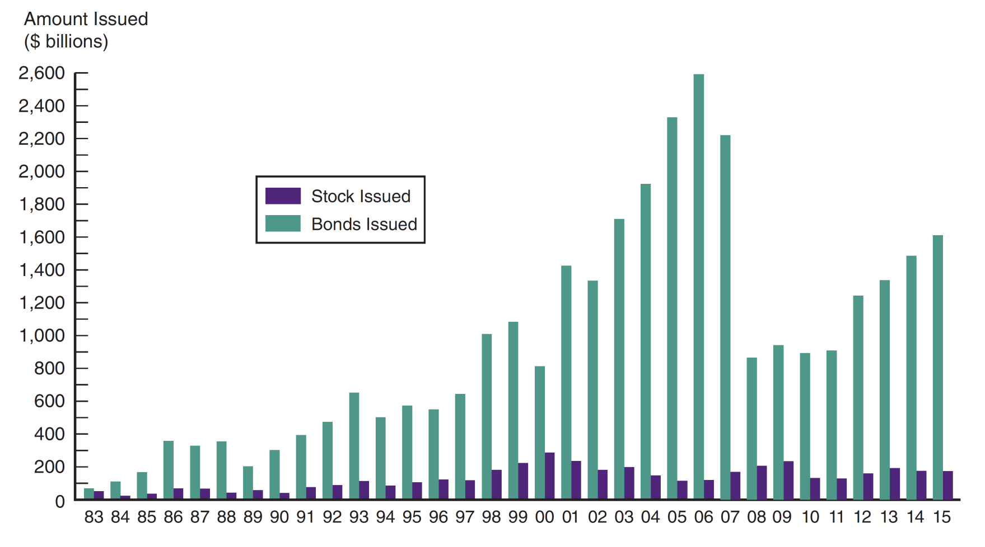
Figure 12.6 Bonds and Stocks Issued, 1983–2015
Source: http://www.federalreserve.gov/econresdata/releases/corpsecure/current.htm.

Slide 41
Chapter Summary (1 of 2)
Purpose of the Capital Market: provide financing for long-term capital assets
Capital Market Participants: governments and corporations issue bond, and we buy them
Capital Market Trading: primary and secondary markets exist for most securities of governments and corporations
Types of Bonds: includes Treasury, municipal, and corporate bonds
Treasury Notes and Bonds: issued and backed by the full faith and credit of the U.S. Federal government
Municipal Bonds: issued by state and local governments, tax-exempt, defaultable.

Slide 42
Chapter Summary (2 of 2)
Corporate Bonds: issued by corporations and have a wide range of features and risk
Financial Guarantees for Bonds: bond “insurance” should the issuer default
Oversight of the Bond Markets: TRACE developed to add transparency to bond markets
Bond Current Yield Calculation: how to calculation the current yield for a bond
Finding the Value of Coupon Bonds: determining the cash flows and discounting back to the present at an appropriate discount rate
Investing in Bonds: most popular alternative to investing in the stock market for long-term investments

