Slide 1
Topic 6: The Money Market
Main Reading (Sources): Chap 11 Mishkin & Eakins, 8th

Slide 2
Chapter Preview
We review the money markets and the securities that are traded there. In addition, we discuss why the money markets are important in our financial system. Topics include:
  The Money Markets Defined
  The Purpose of Money Markets
  Who Participates in Money Markets?
  Money Market Instruments
  Comparing Money Market Securities

Slide 3
The Money Markets Defined
Money Markets Defined
  Usually sold in large denominations ($1,000,000 or more)
  Low default risk
  Mature in one year or less from their issue date, although most mature in less than 120 days

Slide 4
The Money Markets Defined:
Why Do We Need Money Markets?
The banking industry should handle the needs for short-term.
Banks have an information advantage.
Banks, however, are heavily regulated.
Creates a distinct cost advantage for money markets over banks.

Slide 5
The Money Markets Defined: Cost Advantages
Reserve requirements create additional expense for banks that money markets do not have
Regulations on the level of interest banks could offer depositors lead to a significant growth in money markets, especially in the 1970s and 1980s.
When interest rates rose, depositors moved their money from banks to money markets.
The cost structure of banks limits their competitiveness to situations where their informational advantages outweighs their regulatory costs.
Limits on interest banks could offer was not relevant until the 1950s. In the decades that followed, the problem became apparent.

Slide 6
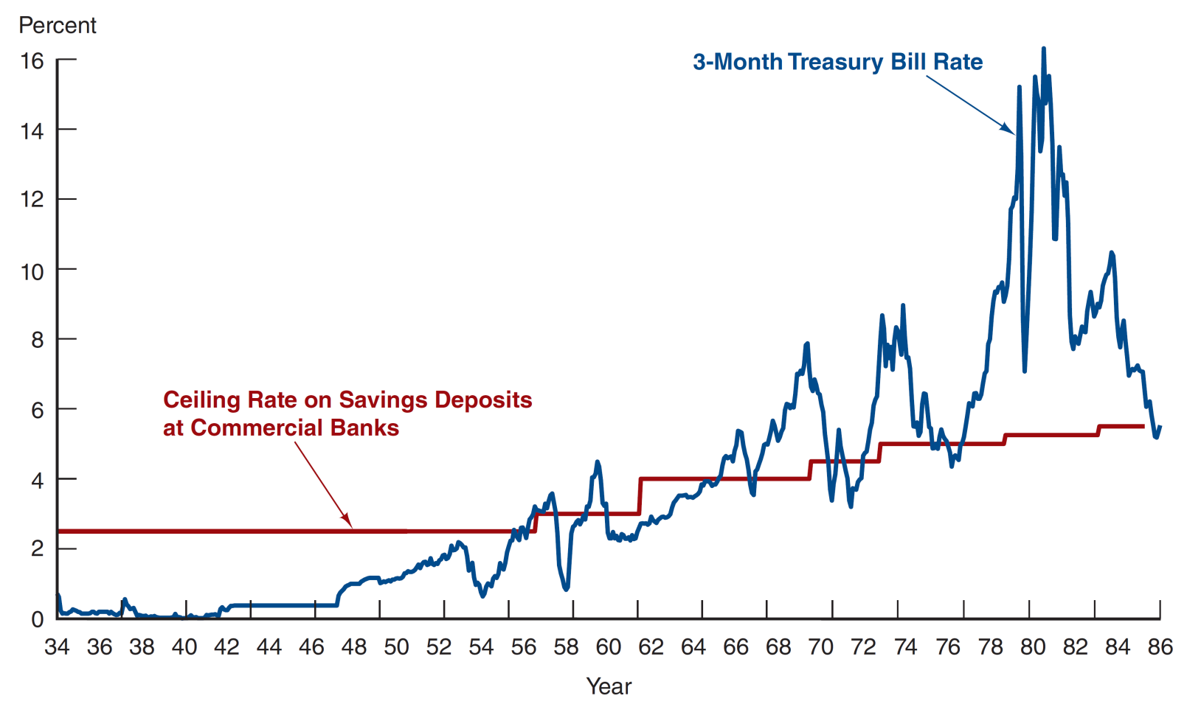
Figure 11.1 Three-Month Treasury Bill Rate and Ceiling Rate on Savings Deposits at Commercial Banks, 1933 to 1986
Source: http://www.stlouisfed.org/default.cfm.

Slide 7
The Purpose of Money Markets
Investors in Money Market: Provides a place for warehousing surplus funds for short periods of time
Borrowers from money market provide low-cost source of temporary funds
Corporations and U.S. government use these markets because the timing of cash inflows and outflows are not well synchronized.
Money markets provide a way to solve these cash-timing problems.

Slide 8
Table 11.1 Sample Money Market Rates, Feb 22, 2024
Instrument | Interest Rate (%)
Prime rate | 8.50
Federal funds | 5.25-5.50
Commercial Paper | 5.24
SOFR | 5.30
Eurodollar | 5.48
Treasury bills (4 week) | 5.41

Slide 9
Table 11.2 Money Market Participants (1 of 3)
Participant | Role
U.S. Treasury Department | Sells U.S. Treasury securities to fund the national debt
Federal Reserve System | Buys and sells U.S. Treasury securities as its primary method of controlling interest rates
Commercial banks | Buy U.S. Treasury securities; sell certificates of deposit and make short-term loans; offer individual investors accounts that invest in money market securities

Slide 10
Table 11.2 Money Market Participants (2 of 3)
Participant | Role
Businesses | Buy and sell various short-term securities as a regular part of their cash management
Investment companies (brokerage firms) | Trade on behalf of commercial accounts
Finance companies (commercial leasing companies) | Lend funds to individuals
Insurance companies (property and casualty insurance companies) | Maintain liquidity needed to meet unexpected demands

Slide 11
Table 11.2 Money Market Participants (3 of 3)
Participant | Role
Pension funds | Maintain funds in money market instruments in readiness for investment in stocks and bonds
Individuals | Buy money market mutual funds
Money market mutual funds | Allow small investors to participate in the money market by aggregating their funds to invest in large-denomination money market securities

Slide 12
Money Market Instruments
Money market instruments include:
  Treasury Bills
  Federal Funds
  Repurchase Agreements
  Negotiable Certificates of Deposit
  Commercial Paper
  Banker’s Acceptance
  Eurodollars

Slide 13
Money Market Instruments: Treasury Bills
T-bills have 28-day maturities through 12- month maturities.
Discounting: When an investor pays less for the security than it will be worth when it matures, and the increase in price provides a return. This is common to short-term securities because they often mature before the issuer can mail out interest checks.

Slide 14
Money Market Instruments: Treasury Bills Discounting Example
You pay $996.73 for a 28-day T-bill. It is worth $1,000 at maturity. What is its discount rate? What is its yield to maturity(i.e. investment return)?
i_{discount} = ?
i_{yt} =?

Slide 15
Money Market Instruments: Treasury Bill Auctions
T-bills are auctioned to the dealers every Thursday.
The Treasury may accept both competitive and noncompetitive bids, and the price everyone pays is the highest yield paid to any accepted bid.

Slide 16
Money Market Instruments: Treasury Bill Auctions Example (1 of 2)
The Treasury auctioned $2.5 billion par value
91-day T-bills, the following bids were received:
Bidder | Bid Amount | Bid Price
1 | $500 million | $0.9940
2 | $750 million | $0.9901
3 | $1.5 billion | $0.9925
4 | $1 billion | $0.9936
5 | $600 million | $0.9939
The Treasury also received $750 million in noncompetitive bids. Who will receive T-bills, what quantity, and at what price?

Slide 17
Money Market Instruments: Treasury Bill Auctions Example (2 of 2)
The Treasury accepts the following bids:
Bidder | Bid Amount | Bid Price
1 | $500 million | $0.9940
5 | $600 million | $0.9939
4 | $650 million | $0.9936
Both the competitive and noncompetitive bidders are paid at the highest yield—based on the price of 0.9936.

Slide 18
Table 11.3 Recent Bill Auction Results
Security Term | Issue Date | Maturity Date | Discount Rate | Investment Rate | Price per $100 | CUSIP
28 day | 5/19/2016 | 6/16/2016 | 0.240 | 0.243 | 99.981333 | 912796HX0
91 day | 5/19/2016 | 8/18/2016 | 0.275 | 0.279 | 99.930486 | 912796HA0
182 day | 5/19/2016 | 11/17/2016 | 0.370 | 0.376 | 99.812944 | 912796JU4
28 day | 5/19/2016 | 6/9/2016 | 0.245 | 0.248 | 99.980944 | 912796HW2
91 day | 5/19/2016 | 8/11/2016 | 0.240 | 0.243 | 99.939333 | 912796JF7

Slide 19
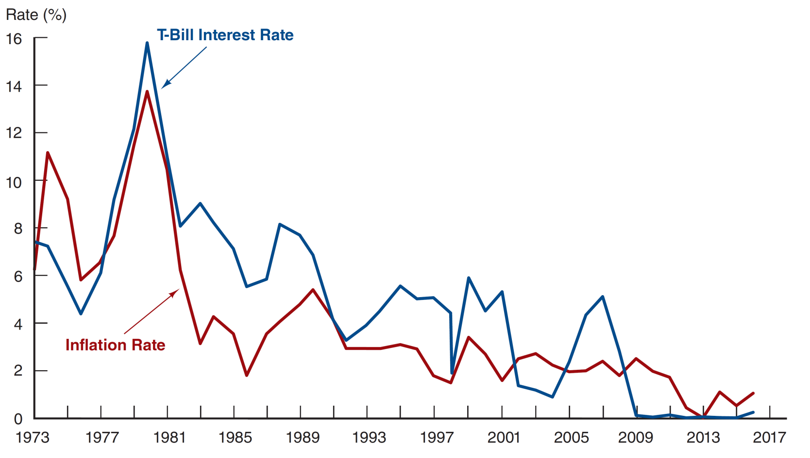
Figure 11.2 Treasury Bill Interest Rate and the Inflation Rate, January 1973–January 2016
Source: http://www.federalreserve.gov/releases and CPI: ftp://ftp.bls.gov/pub/special.requests/cpi/cpiai.txt.

Slide 20
Mini-Case: Treasury Bill Auctions Go Haywire
In 1991, Salomon Smith Barney violated Treasury auction rules to corner the auction on an $11 billion issue.
Several top Salomon officials were forced to retire (or fired) as a result of the incident.
The Treasury also changed the auction rules to ensure a competitive auction.

Slide 21
Money Market Instruments: Federal Funds
Short-term funds transferred (loaned or borrowed) between financial institutions, usually for a period of one day (overnight). They are lent by banks that have an excess of reserves and borrowed by banks that have a deficit of reserves.
Used by banks to meet short-term needs to meet reserve requirements.

Slide 22
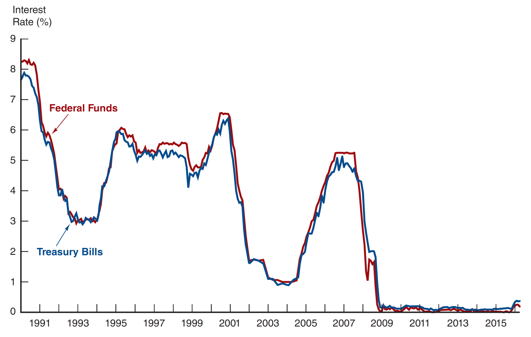
Figure 11.3 Federal Funds and Treasury Bill Interest Rates, January 1990–April 2016
Source: http://www.federalreserve.gov/releases/h15/data.htm.

Slide 23
Money Market Instruments: Repurchase Agreements
These work similar to the market for fed funds, but nonbanks can participate.
A firm sells Treasury securities, but agrees to buy them back at a certain date (usually 3–14 days later) for a certain price.
This set-up makes a repo agreements essentially a short-term collateralized loan.
This is one market the Fed may use to conduct its monetary policy, whereby the Fed purchases/sells Treasury securities in the repo market.

Slide 24
Money Market Instruments: Negotiable Certificates of Deposit
A bank-issued security that documents a deposit and specifies the interest rate and the maturity date
Denominations range from $100,000 to $10 million

Slide 25
Money Market Instruments: Commercial Paper (1 of 2)
Unsecured promissory notes, issued by corporations, that mature in no more than 270 days.
The use of commercial paper increased significantly in the early 1980s because of the rising cost of bank loans.
Commercial paper volume:
fell significantly during the recent economic recession
annual market is still large, at well over $0.85 trillion outstanding

Slide 26
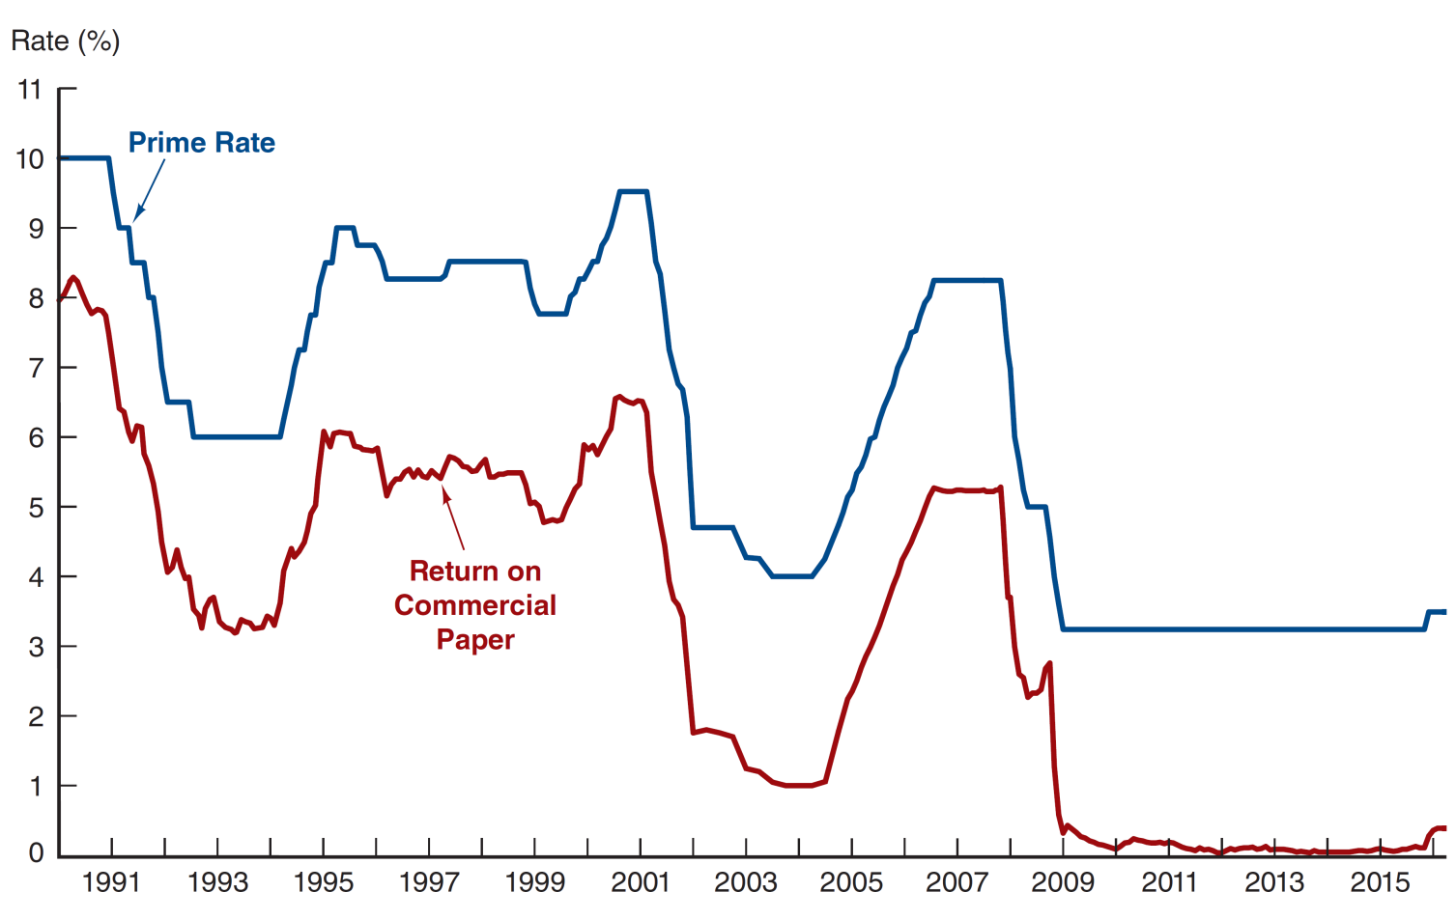
Figure 11.4 Return on Commercial Paper and the Prime Rate, 1990–April 2016
Source: http://www.federalreserve.gov/releases/h15/data/Monthly/H15_PRIME_NA.txt.

Slide 27
Money Market Instruments: Commercial Paper (2 of 2)
A special type of commercial paper, known as asset-backed commercial paper (ABCP)
played a key role in the financial crisis in 2008 backed by securitized mortgages
often difficult to understand
accounted for about $1 trillion
When the poor quality of the underlying assets was exposed, a run on ABCP began. Because ABCP was held by many money market mutual funds (MMMFs), these funds also experienced a run. The government eventually had to step in to prevent the collapse of the MMMF market.

Slide 28
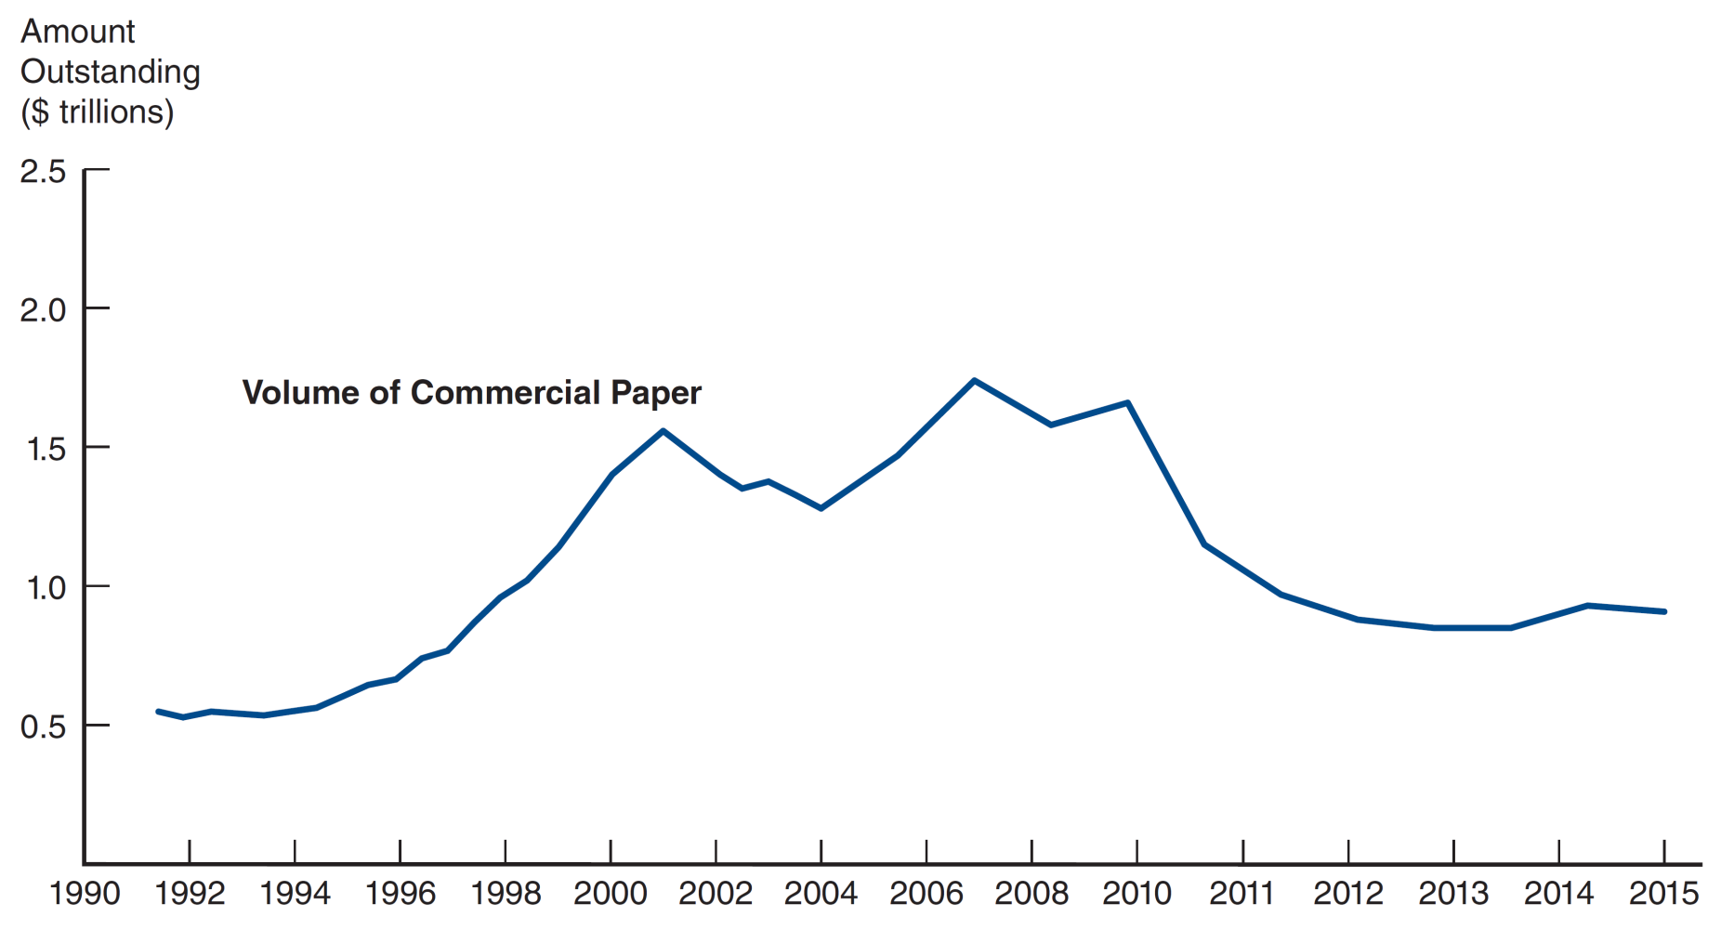
Figure 11.5 Volume of Commercial Paper Outstanding
Source: http://www.federalreserve.gov/releases/cp/yrend.htm.

Slide 29
Money Market Instruments: Banker’ s Acceptances
An order to pay a specified amount to the bearer on a given date if specified conditions have been met, usually delivery of promised goods.
These are often used when buyers / sellers of expensive goods live in different countries.
Banker’s acceptances avoid the need to establish the credit-worthiness of a customer living abroad.
There is also an active secondary market for banker’s acceptances until they mature. The terms of note indicate that the bearer, whoever that is, will be paid upon maturity.

Slide 30
Money Market Instruments: Banker’ s Acceptances Advantages
Exporter paid immediately
Exporter shielded from foreign exchange risk
Exporter does not have to assess the financial security of the importer
Importer’s bank guarantees payment
Crucial to international trade

Slide 31
Money Market Instruments: Eurodollars
Eurodollars represent Dollar denominated deposits held in foreign banks.
The market is essential since many foreign contracts call for payment is U.S. dollars due to the stability of the dollar, relative to other currencies.
The Eurodollar market has continued to grow rapidly because depositors receive a higher rate of return on a dollar deposit in the Eurodollar market than in the domestic market.
Multinational banks are not subject to the same regulations restricting U.S. banks and because they are willing to accept narrower spreads between the interest paid on deposits and the interest earned on loans.

Slide 32
Money Market Instruments: Eurodollars Rates
London interbank bid rate (LIBID)
  The rate paid by banks buying funds
London interbank offer rate (LIBOR) switching to Secured Overnight Financing Rate (SOFR)
  The rate offered for sale of the funds
Time deposits with fixed maturities
  Largest short term security in the world

Slide 33
Global: Birth of the Eurodollar
The Eurodollar market is one of the most important financial markets, but oddly enough, it was fathered by the Soviet Union.
In the 1950s, the USSR had accumulated large dollar deposits, but all were in US banks. They feared the US might seize them, but still wanted dollars. So, the USSR transferred the dollars to European banks, creating the Eurodollar market.

Slide 34
Comparing Money Market Securities:
Table 11.4 Money Market Securities and Their Markets
Money Market Security | Issuer | Buyer | Usual Maturity | Secondary Market
Treasury bills | U.S. government | Consumers and companies | 4, 13, 26, and 52 weeks | Excellent
Federal funds | Banks | Banks | 1 to 7 days | None
Repurchase agreements | Businesses and banks | Businesses and banks | 1 to 15 days | Good
Negotiable CDs | Large money center banks | Businesses | 14 to 120 days | Good
Commercial paper | Finance companies and businesses | Businesses | 1 to 270 days | Poor
Banker’s acceptances | Banks | Businesses | 30 to 180 days | Good
Eurodollar deposits | Non-U.S. banks | Businesses, governments, and banks | 1 day to 1 year | Poor

Slide 35
Chapter Summary
The Money Markets Defined
  Short-term instruments
  Most have a low default probability
The Purpose of Money Markets
  Used to “warehouse” funds
  Returns are low because of low risk and high liquidity
Who Participates in Money Markets?
  U.S. Treasury
  Commercial banks
  Businesses
  Individuals (through mutual funds)
Money Market Instruments
  Include T-bills, fed funds, etc.
Comparing Money Market Securities
  Issuers range from the US government to banks to large corporations
  Mature in as little as 1 day to as long as 1 year
  The secondary market liquidity varies substantially

