Slide 1
Determinants of Interest Rate
CHAPTER 4 REVIEW

Slide 2
INVESTMENTS, FINANCE AND CREDIT OVERVIEW
Expected Value Line Growth (Return)
EXIT
Risk Premium
Risk-Free Rate
ENTRY
Initial
Investment

Slide 3
INVESTMENTS, FINANCE AND CREDIT OVERVIEW
Expected Value Line Growth (Return)
EXIT
Risk (Volatility)
Risk Premium
Risk-Free Rate
ENTRY
Initial
Investment

Slide 4
The Study of Finance
Buying Stocks / Buying Bonds
Buying Assets / Equipment
Starting a New Project
Buying a Company
Starting a new Company
3 FACTORS BEFORE YOU INVEST
  Measure Expected Return
  Quantify Risk
  Set Time (Exit)
  1 more FACTOR BEFORE YOU INVEST (discuss in detail later)
  Allocation / Diversifiaction

Slide 5

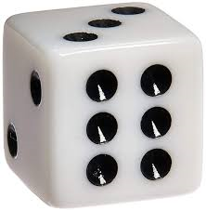
The Study of Finance
3 FACTORS BEFORE YOU INVEST
  Measure Expected Return
  Quantify Risk
  Set Time (Exit)
Game: Tossing a Coin to win $6 (Payoff):
Measure Expected Return: $6
Quantify Risk: 50/50 win/loss
Time: in 2 seconds
How much to Invest?
  $3 - mathematically using probability theory is (50% x $6) + (50% x $0) = $3 + 0 = $3
Game: Tossing one dice to win $6 (Payoff):
Measure Expected Return: $6
Quantify Risk: 1/6 to win, 5/6 to lose
Time: in 2 seconds
How much to Invest?
  $1 - mathematically using probability theory is (1/6 x $6) + (5/6 x $0) =
  $1 + 0 = $1

Slide 6
Time Value of Money Concepts - REVIEW
One-Time Investment
Annuities or Even Annual Cash flows
Uneven Annual Cash Flows

Slide 7

One-Time Investment
FUTURE VALUE
FV = PV ${\left(1+i\right)}^{t}$
  where FV is the future value of the investment, PV is the present value of the investment or the initial investment, i is the expected interest rate or rate of return of the investment, and t is time to realize such investment.
  PRESENT VALUE
FV = PV ${\left(1+i\right)}^{t}$, then $PV=\frac{FV}{{\left(1+i\right)}^{t}}$
As an example, assuming the investor targets an investment that is expected to receive $133.10 in 3 years, representing a 10% interest or expected return (sometimes referred to as the discount rate), the investment required today will be calculated as follows:
$PV=\frac{FV}{{\left(1+i\right)}^{t}} = \frac{133.10}{{\left(1+.10\right)}^{3}} = \frac{133.10}{1.331}=100$

Slide 8

One-Time Investment
INTEREST RATES
If the investor knows the amount they are planning to invest today, and targets a specific investment payoff at a set time in the future, then the investor can rearrange the formula to calculate the interest (i) or discount rate that he or she will earn, as follows:
Starting at FV = PV ${\left(1+i\right)}^{t}$, then ${\left(1+i\right)}^{t}=\frac{FV}{PV}$ , and
$i$ = $({\frac{FV}{PV})}^{\frac{1}{t}}$ – 1
As an example, let’s assume the investor invests $100 today and targets an investment that expects to receive $133.10 in 3 years. What will the annual rate of return be on such an investment?
$i$ = $({\frac{FV}{PV})}^{\frac{1}{t}}$ – 1 $=({\frac{133.10}{100})}^{\frac{1}{3}}$ – 1 $=({1.331)}^{\frac{1}{3}}$ – 1 = 1.10 – 1 = 0.10 = 10%

Slide 9

One-Time Investment
TIME
If the investor knows the amount that they are planning to invest today, then sets a target payoff amount in the future and assumes a given rate of return, then he or she can calculate how long it will take to achieve the target. The time (t) to realize the targeted return is calculated by rearranging the formula as follows:
Starting at FV = PV ${\left(1+i\right)}^{t}$, then ${\left(1+i\right)}^{t}=\frac{FV}{PV}$, then adding ln on both sides, you get ${ln \left(1+i\right)}^{t}=ln(\frac{FV}{PV})$ , $t [\ln\left(1+i\right)]=ln(\frac{FV}{PV})$ , and
$t$ = $\frac{ln (\frac{FV}{PV})}{ln⁡(1+i)}$
As an example, assume the investor invests $100 today and wants to find out how long it will take for the investment to reach $133.10 if invested at an annual rate of return of 10%. The time to reach the targeted future value of such investment is calculated as follows:
$t$ = $\frac{ln (\frac{FV}{PV})}{ln⁡(1+i)}= \frac{ln (\frac{133.10}{100})}{ln⁡(1+0.10)}=\frac{ln (\frac{133.10}{100})}{ln⁡(1+0.10)}= \frac{ln (1.331)}{ln⁡(1.100)}= \frac{0.2859}{0.0953}=3 years$

Slide 10

Annuities or Even Annual Cash flows
FUTURE VALUE
FVA = CF + CF (1 + i) + CF (1 + i) (1 + i), or FVA = CF ( $\frac{{(1+i)}^{t}−1}{i} )$
For example, if an investor invests $100 per year for 3 years and expects a 10% rate of return, then the value of such investment when it is cashed out in 3 years will be calculated as follows:
FVA = CF ( $\frac{{(1+i)}^{t}−1}{i} )=100 \left(\frac{{\left(1+0.10\right)}^{3}−1}{.10} \right)=100 \left(\frac{{\left(1.10\right)}^{3}−1}{.10} \right)= 100 \left(\frac{1.331−1}{.10} \right)= 331.00$

Slide 11

Annuities or Even Annual Cash flows
PRESENT VALUE
The present value of an annuity (PVA) can be calculated as follows:
PVA = $\frac{CF}{{(1+i)}^{1}}+ \frac{CF}{{(1+i)}^{2}}$ + $\frac{CF}{{(1+i)}^{3}}$ +…..+ $\frac{CF}{{(1+i)}^{n}}$, or PVA = CF $[\frac{1−\frac{1}{{\left(1+i\right)}^{t}}}{i}]$
For example, if an investor expects to receive $100 per year for 3 years, then what is the present value for an investment if the investor expects to receive a 10% annual rate of return? The calculation of the present value of such an investment is as follows:
  PVA = CF $[\frac{1−\frac{1}{{\left(1+i\right)}^{t}}}{i}]=$ 100 $[\frac{1−\frac{1}{{\left(1+.10\right)}^{3}}}{.10}]=100 [\frac{1−\frac{1}{1.331}}{.10}] = 248.69$

Slide 12

Uneven Annual Cash Flows
If the investment expected to produce uneven annual cash flows to the investor, called payments, for a set time, using the same expected rate of return, then the investment is calculated differently. The present value of such cash flows is the sum of all the future cash flows discounted back at a given expected rate of return, as follows:
PV = $\frac{{CF}_{1}}{{(1+i)}^{1}}+ \frac{{CF}_{2}}{{(1+i)}^{2}}+\frac{{CF}_{3}}{{(1+i)}^{3}}+…\frac{{CF}_{t}}{{\left(1+i\right)}^{t}} …. PV= \sum{\frac{{CF}_{t}}{{(1+i)}^{t}}}$
For example, if an investor expects to receive $95 the first year, $92 the second year, and $105 the third year, what is the present value for such an investment if the investor expects a 10% annual rate of return? The calculation of the present value of such investment is as follows:
PV = $\frac{{CF}_{1}}{{(1+i)}^{1}}+ \frac{{CF}_{2}}{{(1+i)}^{2}}+\frac{{CF}_{3}}{{(1+i)}^{3}}= \frac{95}{{(1+0.10)}^{1}}+ \frac{92}{{(1+1.10)}^{2}}+\frac{105}{{(1+1.10)}^{3}}=$
$86.36+76.03+78.89=241.28$

Slide 13
Excel based formulas:
Excel formulas for calculating all five variables including the present value, future value, rate of return, time and cash flows or payments (represent set additional payments received during the investment):
= PV (rate, years, payment, future value) or =pv(rate,nper,pmt,fv)
=FV (rate, years, payment, -present value) or =fv(rate,nper,pmt,pv)
=Rate (years, payment, - present value, future value) or =rate(nper,pmt,pv,fv)
=Nper (rate, payment, - present value, future value) or =nper(rate,pmt,pv,fv)
= Pmt (rate, years, -present value, future value) or =pmt(rate,nper,pv,fv)

Slide 14
Chapter Preview
In this chapter, we examine the forces the move interest rates and the theories behind those movements. Topics include:
Determining Asset Demand
Supply and Demand in the Bond Market
Changes in Equilibrium Interest Rates

Slide 15
Determinants of Asset Demand (1 of 2)
An asset is a piece of property that is a store of value. Facing the question of whether to buy and hold an asset or whether to buy one asset rather than another, an individual must consider the following factors:
  Wealth, the total resources owned by the individual, including all assets
    Wealth increases = more resources = more purchases
  Expected return (the return expected over the next period) on one asset relative to alternative assets
    Gain for holding an asset (base on interest)
  Risk (the degree of uncertainty associated with the return) on one asset relative to alternative assets
    High Standard Deviation = High Risk
  Liquidity (the ease and speed with which an asset can be turned into cash) relative to alternative assets
    Converting asset to cash

Slide 16

Rates of Return: Holding Period Return (HPR)
HPR = $\frac{CF}{I}$
where CF is the cash flow (inflow and outflow) during the investment period and I is the initial investment.
For example, if an investor buys the stock for $100 and sells it for $120 and during the investment he or she received $2 in dividends, then the cash flow on the numerator is $120 of proceeds for selling the stock plus $2 of cash dividends received (cash inflow) minus the initial investment of $100 (cash outflow), and the net cash flow is $22 = ($120 + $2 - $100). The HPR will be then be calculated by dividing the net cash flow of $22 by the initial investment of $100 resulting in a 22% return:
$$\frac{\left(120−100+2\right)}{100}=\frac{22}{100}=0.22=22\%$$

Slide 17
Measuring Return and Quantifying Risk
Rate of Return: Average Annual Rate of Return
  The average annual rate of return can be calculated by looking at 5 to 10 years of historical returns and averaging them to represent the annual return. It gives the investor an indication what to expect on an average. This method is used for comparing to other investments that were calculated the same way and by taking this number to the next level of assessment of volatility in the return as compared to the average on a given year.
Rate of Risk: Standard Deviation of Periodic Returns
  The expected return on a risky asset such stocks and bonds depend on systematic risk, such as the overall market movements, and unsystematic risk or portfolio-specific risk. We will examine later in detail how the unsystematic or idiosyncratic risk can be minimized or eliminated through diversification. First, it’s important to examine the relationship between the rate of return and risk such as volatility, or the standard deviation of these returns. There are two methods of calculating the risk-return: historical analysis and scenario analysis.

Slide 18
Measuring Return and Quantifying Risk
Historical Analysis Method

Slide 19

Expected Return (weighted)
$\text{R}\text{e}\text{ = }\text{p}\text{1}\text{R}\text{1}\text{+}\text{p}\text{2}\text{R}\text{2}\text{+}…+\text{p}\text{n}\text{R}n$ (1)
Example 4.1 : What is the expected return to Exxon-Mobil if the return is 12% two-thirds of the time, and 8% one-third of the time?
R^{e} = ?
R = (2/3) 12% + (1/3) 8% = 8 + 2.67 =10.67%

Slide 20

Risk: Standard Deviation (1 of 4 )
$σ=\sqrt{\text{p}\text{1}\text{(}\text{R}\text{1}\text{−}\text{R}\text{e}\text{)}\text{2}\text{+}\text{p}\text{2}\text{(}\text{R}\text{2}\text{−}\text{R}\text{e}\text{)}\text{2}\text{+}…+\text{p}\text{n}\text{(}\text{R}\text{n}\text{−}\text{R}\text{e}\text{)}\text{2} }$ (2)
Example 4. 2: Consider the following two companies and their forecasted returns for the upcoming year:
What is the standard deviation of the returns on the Fly-by-Night Airlines and Feet-on-the-Ground Bus Company? Of these two stocks, which is riskier?
Blank | Blank | Fly-by-Night | Feet-on-the-Ground
Outcome 1 | Probability | 50% | 100%
Blank | Return | 15% | 10%
Outcome 2 | Probability | 50% | 0%
Blank | Return | 5% | n/a

Slide 21

Risk: Standard Deviation (2 of 4)
Fly-by-Night Airlines:
$$\text{R}\text{e}\text{ = }\text{p}\text{1}\text{R}\text{1}\text{+}\text{p}\text{2}\text{R}\text{2}$$
where
p₁ = probability of occurrence of return 1 = $\frac{1}{2}$ = 0.50
R₁ = return in state 1 = 15% = 0.15
p₂ = probability of occurrence of return 2 = $\frac{1}{2}$ = 0.50
R₂ = return in state 2 = 5% = 0.05
R^{e} = expected return = ? = (.50)(15%) + (0.50)(5.0%) = 10%
Thus,
$σ \text{=}\sqrt{\text{p}\text{1}\text{(}\text{R}\text{1}\text{−}\text{R}\text{e}\text{)}\text{2}\text{+}\text{p}\text{2}\text{(}\text{R}\text{2}\text{−}\text{R}\text{e}\text{)}\text{2} }=$?
σ= √((0.5)(0.15-.10) $\text{2}$ + (0.5) (0.05-.10) $\text{2}$ = 5%

Slide 22
Risk: Standard Deviation (4 of 4)
Fly-by-Night Airlines has a standard deviation of returns of 5%; Feet-on-the-Ground Bus Company has a standard deviation of returns of 0%.
Clearly, Fly-by-Night Airlines is a riskier stock because its standard deviation of returns of 5% is higher than the zero standard deviation of returns for Feet-on-the-Ground Bus Company, which has a certain return.
A risk-averse person prefers stock in the Feet-on-the-Ground (the sure thing) to Fly-by-Night stock (the riskier asset), even though the stocks have the same expected return, 10%. By contrast, a person who prefers risk is a risk preferrer or risk lover. We assume people are risk-averse, especially in their financial decisions.

Slide 23
Measuring Return and Quantifying Risk
Scenario Analysis Method
STOCKS
BONDS

Slide 24
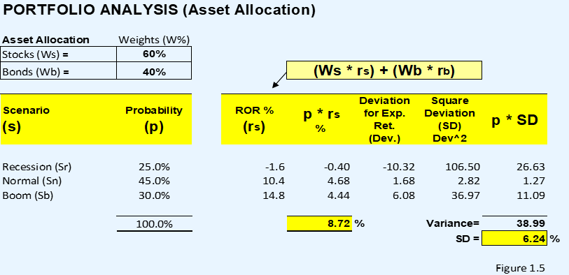
Measuring Return and Quantifying Risk
Scenario Analysis Method

Slide 25

Return, Return Expectation, Risk and Allocation
CHAPTER 1 REVIEW:
Measuring Return and Return Expectation
Return:
Then the combined portfolio shown in figure 1.5 consisting of 60% stock and 40% bonds shows an expected combined return, variance, and standard deviation of 8.72%, 38.99% or .39x, and 6.24%, respectively. As expected, as we moved from the stock portfolio of 100% to a portfolio of 60% stock and 40% bonds, the return is calculated at 8.72% measured as
(Ws . Rs) + (Wb . Rb) = = (.60) (11.70%) + (.40) (4.25%) = 7.02% + 1.7% = 8.72%
Risk:
The Risk is measured by the amount of volatility needed to achieve the expected returns. The volatility is basically the variance and standard deviation of the historical rate change of the stocks during the 3 scenarios. The formulas areas follows:
Variance = $σ_{P}^{2}=w_{s}^{2}σ_{s}^{2}+w_{b}^{2}σ_{b}^{2}+2w_{s}^{ }σ_{s}^{ }w_{b}^{ }σ_{b}^{ }ρ$
Standard Deviation = $σ_{P}^{ }=\sqrt{(}w_{s}^{2}σ_{s}^{2}+w_{b}^{2}σ_{b}^{2}+2w_{s}^{ }σ_{s}^{ }w_{b}^{ }σ_{b }^{}ρ)$

Slide 26
CHPATER 1 REVIEW:
Measuring Return and Return Expectation
Scenario Analysis Method

Slide 27
Table 4.1 Summary Response of the Quantity of an Asset Demanded to Changes in Wealth, Expected Returns, Risk, and Liquidity
Variable | Change in Variable | Change in Quantity Demanded
Wealth | Increase | ?
Expected Return relative to other assets | Increase | ?
Risk relative to other assets | Increase | ?
Liquidity relative to other assets | Increase | ?

Slide 28
Table 4.1 Summary Response of the Quantity of an Asset Demanded to Changes in Wealth, Expected Returns, Risk, and Liquidity
Variable | Change in Variable | Change in Quantity Demanded
Wealth | Increase | Increase
Expected Return relative to other assets | Increase | Increase
Risk relative to other assets | Increase | Decrease
Liquidity relative to other assets | Increase | Increase

Slide 29
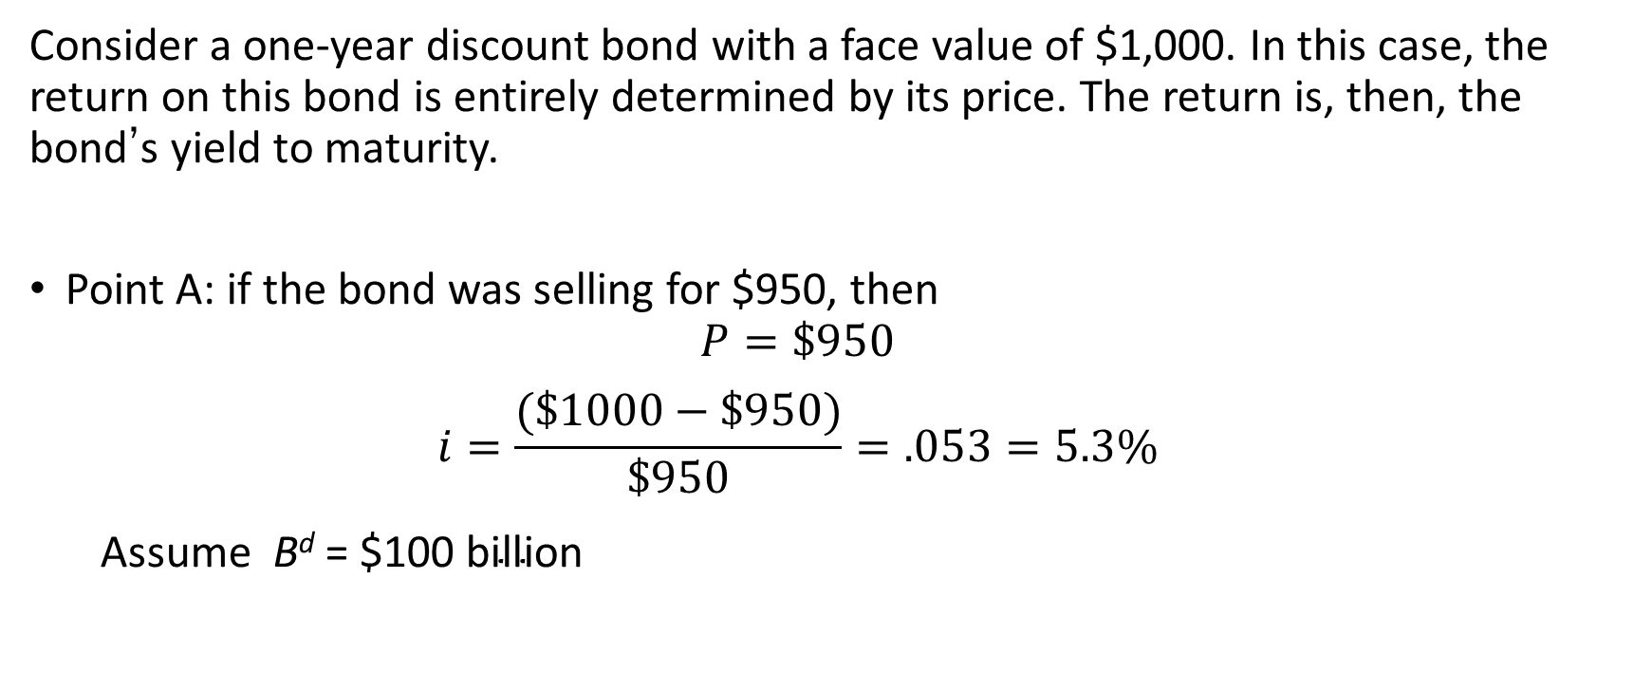
Supply & Demand in the Bond Market:
Derivation of Demand Curve (1 of 3)
Consider a one-year discount bond with a face value of $1,000. In this case, the return on this bond is entirely determined by its price. The return is, then, the bond’s yield to maturity.
Point A: if the bond was selling for $950, then
  $$P=\$950$$
  $$i=\frac{(\$1000−\$950)}{\$950}=.053=5.3\%$$
  Assume $\text{B}\text{d}\text{ = }\text{\$}\text{100} \text{billion}$

Slide 30

Derivation of Demand Curve (2 of 3)
Point B: if the bond was selling for $900.
$$P=\$900$$
$$i=\frac{(\$1000−\$900)}{\$900}=.111=11.1\%$$
Assuming $Bd=\$200 billion$
Here we are applying basic economics—more people will want (demand) the bonds if the expected return is higher.

Slide 31
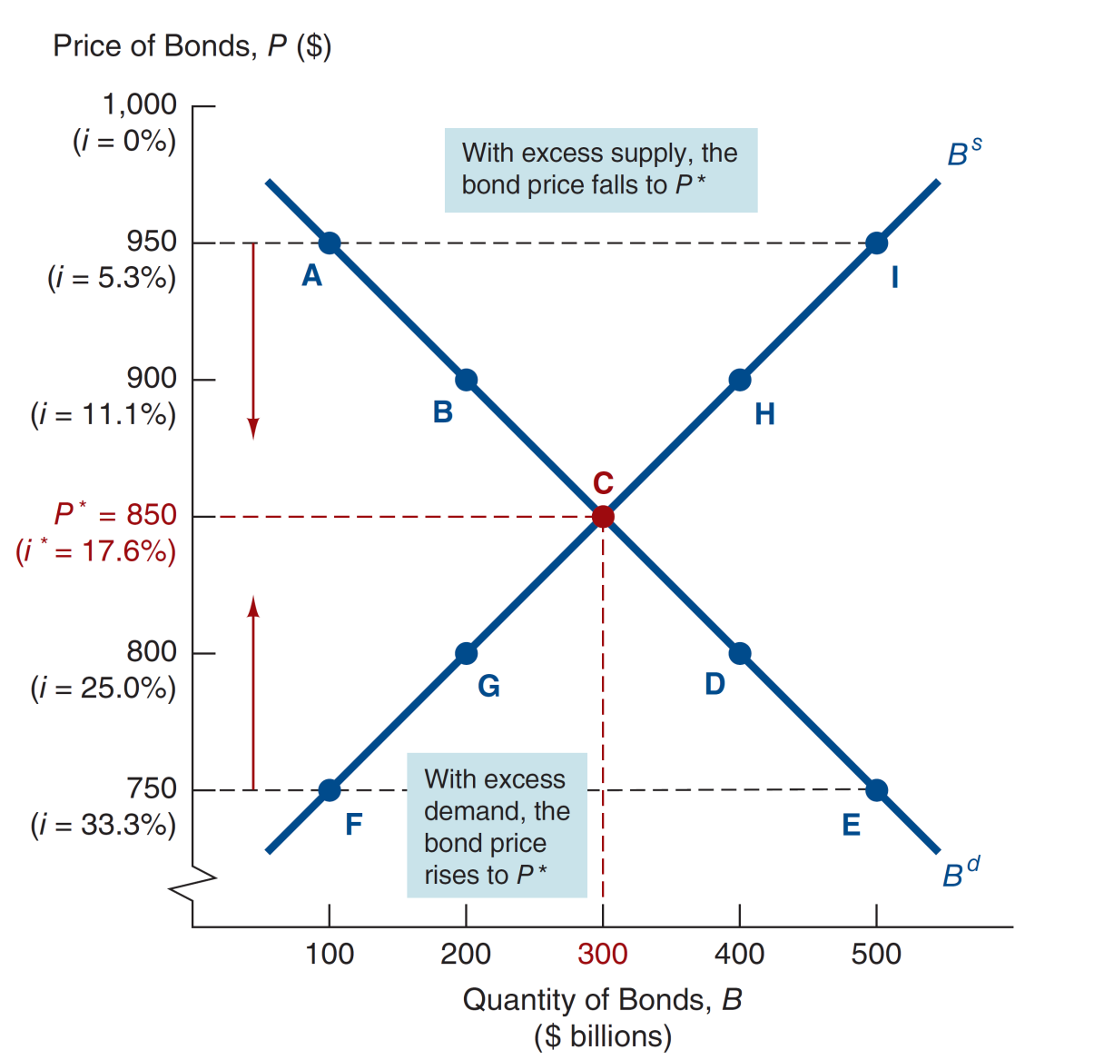
Figure 4.1 Supply and Demand for Bonds

Slide 32
Derivation of Supply Curve
In the last figure, we snuck the supply curve in—the line connecting points F, G, C, H, and I. The derivation follows the same idea as the demand curve.
Point F: P = $750 i = 33.0% B^{s} = 100
Point G: P = $800 i = 25.0% B^{s} = 200
Point C: P = $850 i = 17.6% B^{s} = 300
Point H: P = $900 i = 11.1% B^{s} = 400
Point I: P = $950 i = 5.3% B^{s} = 500
Supply Curve is B^{s} that connects points F, G, C, H, I, and has an upward slope
Again we are applying basic economics—more people will offer (supply) the bonds if the expected return (cost) is lower.

Slide 33
Market Equilibrium
The equilibrium follows what we know from supply-demand analysis:
Occurs when B^{d} = B^{s}, at P* = 850, i* = 17.6%
When P = $950, i = 5.3%, B^{s} > B^{d}
(excess supply): P ↓ to P*, i ↑ to i*
When P = $750, i = 33.0, B^{d} > B^{s}
(excess demand): P ↑ to P*, i ↓ to i*

Slide 34
Market Conditions
Market equilibrium occurs when the amount that people are willing to buy (demand) equals the amount that people are willing to sell (supply) at a given price
Trading level
Excess supply occurs when the amount that people are willing to sell (supply) is greater than the amount people are willing to buy (demand) at a given price
sell more than willing to buy
Excess demand occurs when the amount that people are willing to buy (demand) is greater than the amount that people are willing to sell (supply) at a given price
Buy more than willing to sell

Slide 35
Changes in Equilibrium Interest Rates: How Factors Shift the Demand Curve
(1 of 5)
Remember: movements along the curve will be due to price changes alone.
Wealth/saving
  Economy up, wealth up
  B^{d} higher, B^{d} shifts out to right
  OR
  Economy down, wealth down
  B^{d} lower, B^{d} shifts out to left

Slide 36
How Factors Shift the Demand Curve
(2 of 5)
Expected Returns on bonds
  i ↓ in future, R^{e} for long-term bonds ↑
  B^{d} shifts out to right
  OR
  π^{e} ↓, relative R^{e} ↑
  B^{d} shifts out to right

Slide 37
How Factors Shift the Demand Curve
(3 of 5)
…and Expected Returns on other assets
  ER on other asset (stock) ↑
  R^{e} for long-term bonds ↓
  B^{d} shifts out to left
These are closely tied to expected interest rate and expected inflation from Table 4.2

Slide 38
How Factors Shift the Demand Curve
(4 of 5)
Risk
  Risk of bonds ↓, B^{d} ↑
  B^{d} shifts out to right
  OR
  Risk of other assets ↑, B^{d} ↑
  B^{d} shifts out to right

Slide 39
How Factors Shift the Demand Curve
(5 of 5)
Liquidity
  Liquidity of bonds ↑, B^{d} ↑
  B^{d} shifts out to right
  OR
  Liquidity of other assets ↓, B^{d} ↑
  B^{d} shifts out to right

Slide 40
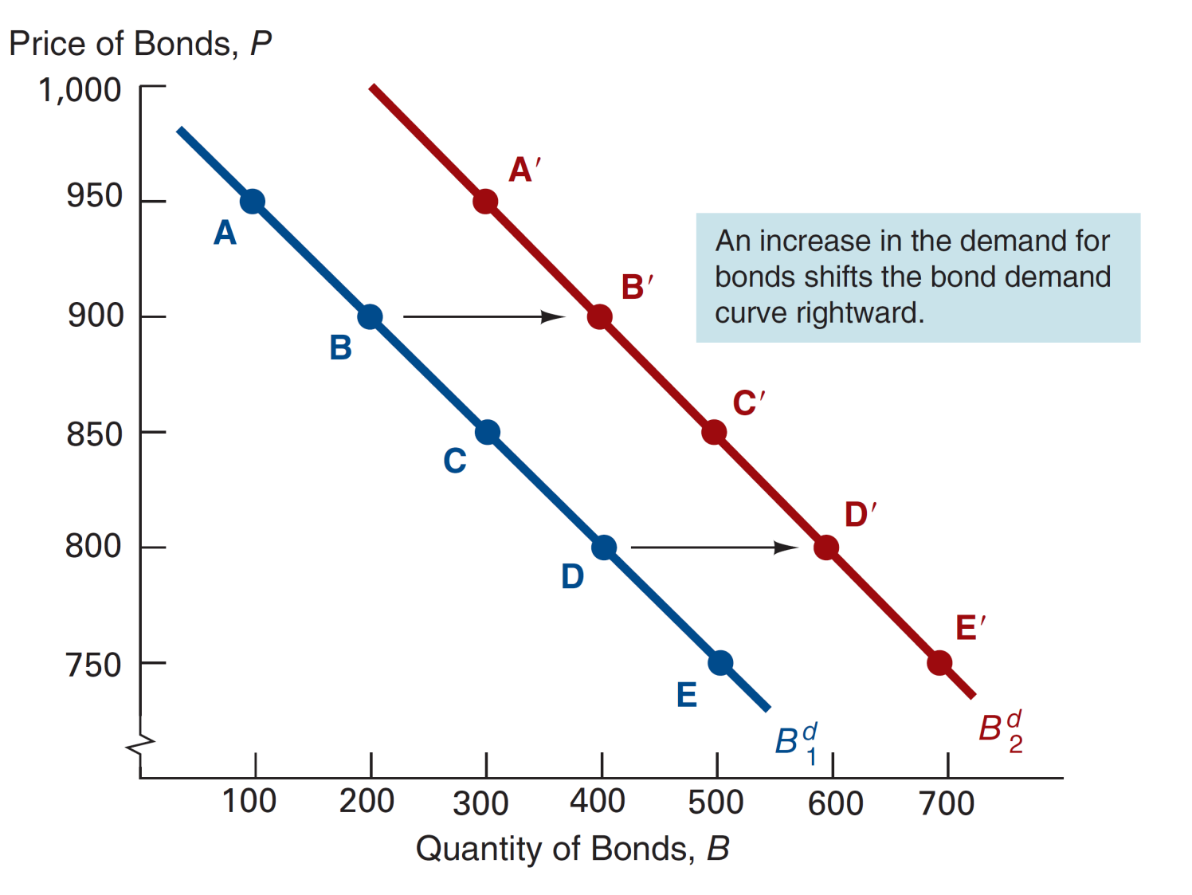
Figure 4.2 Shift in the Demand Curve for Bonds

Slide 41
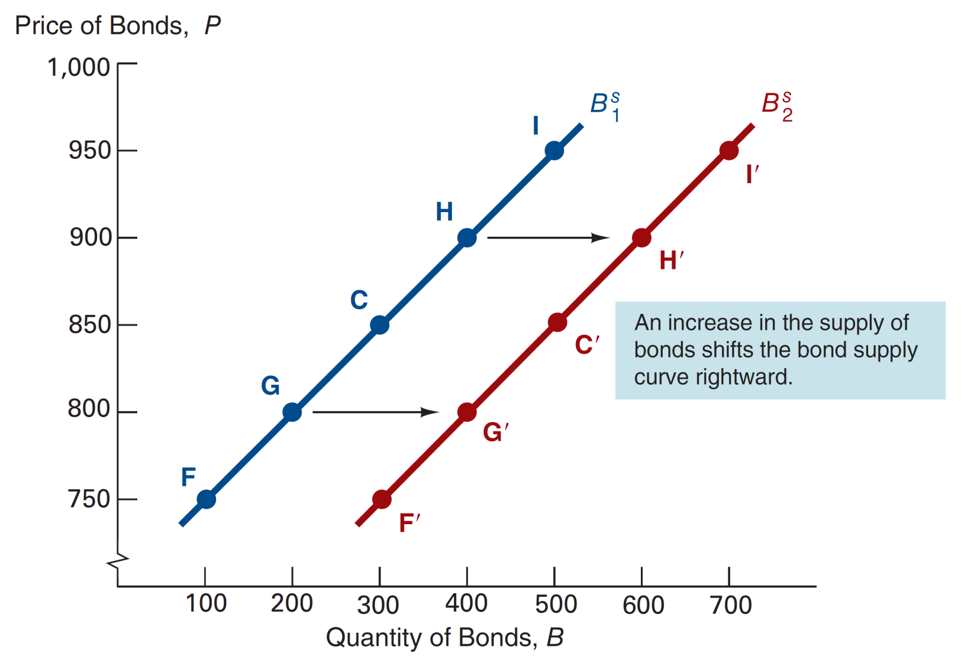
Figure 4.3 Shift in the Supply Curve for Bonds

Slide 42
Chapter Summary
Determining Asset Demand: We examined the forces that affect the demand and supply of assets.
Supply and Demand in the Bond Market: We examine those forces in the context of bonds, and examined the impact on interest rates.
Changes in Equilibrium Interest Rates: We further examined the dynamics of changes in supply and demand in the bond market, and the corresponding effect on bond prices and interest rates.

