Slide 1


Overview of the Financial System
Main Reading (Sources): Chap 2 Mishkin & Eakins, 8th

Slide 2
Chapter Preview
In this chapter, we examine the role of the financial system in an advanced economy. We study the effects of financial markets and institutions on the economy, and look at their general structure and operations. Topics include:
  Function of Financial Markets
  Structure of Financial Markets
  Internationalization of Financial Markets
  Function of Financial Intermediaries: Indirect Finance
  Types of Financial Intermediaries
  Regulation of the Financial System

Slide 3
Function of Financial Markets
Channels funds from person or business without investment opportunities (i.e., “Lender-Savers”) to one who has them (i.e., “Borrower-Spenders”)
  This process - financial intermediation, involves the movement of funds from individuals or businesses that have surplus funds but lack investment opportunities (such as lenders or savers) to those who have investment opportunities but lack funds (such as borrowers or spenders).
  Financial intermediaries play a crucial role in this process by acting as intermediaries between the two parties, facilitating the flow of funds and enabling economic growth.
  These intermediaries can include banks, credit unions, mutual funds, and other financial institutions that bring together savers and borrowers, thereby allocating capital efficiently and promoting economic activity.
  By channeling funds from surplus units to deficit units, financial intermediation helps to bridge the gap between those who have excess funds and those who need them for productive purposes, fostering economic development and wealth creation.

Slide 4
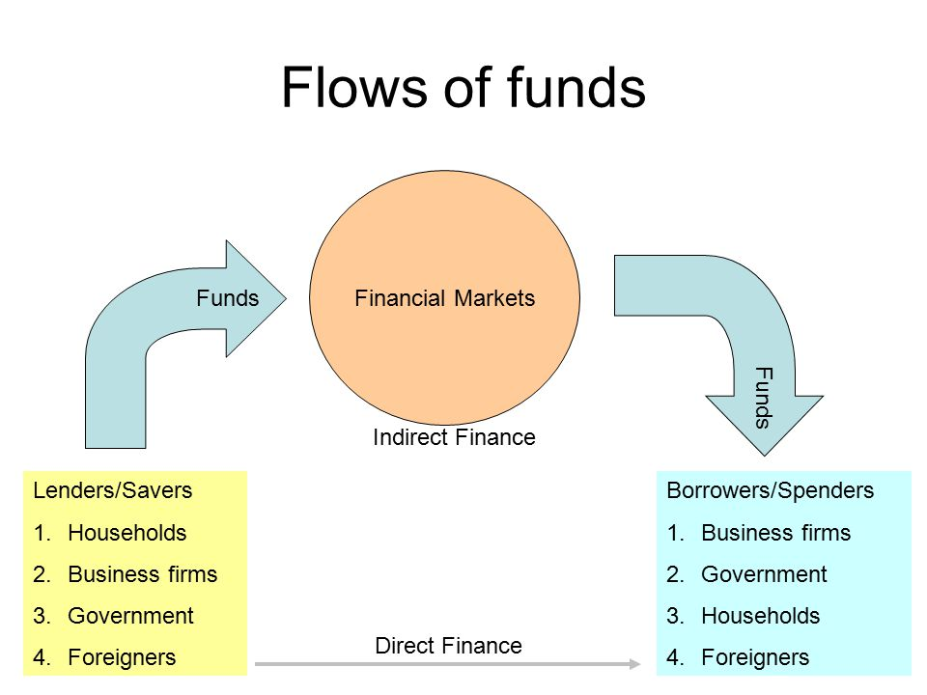
Financial Markets Funds Transferees

Slide 5
Segments of Financial Markets
Direct Finance
  Borrowers borrow directly from lenders in financial markets by selling financial instruments which are claims on the borrower’s future income or assets
Indirect Finance
  Borrowers borrow indirectly from lenders via financial intermediaries (established to source both loanable funds and loan opportunities) by issuing financial instruments which are claims on the borrower’s future income or assets

Slide 6
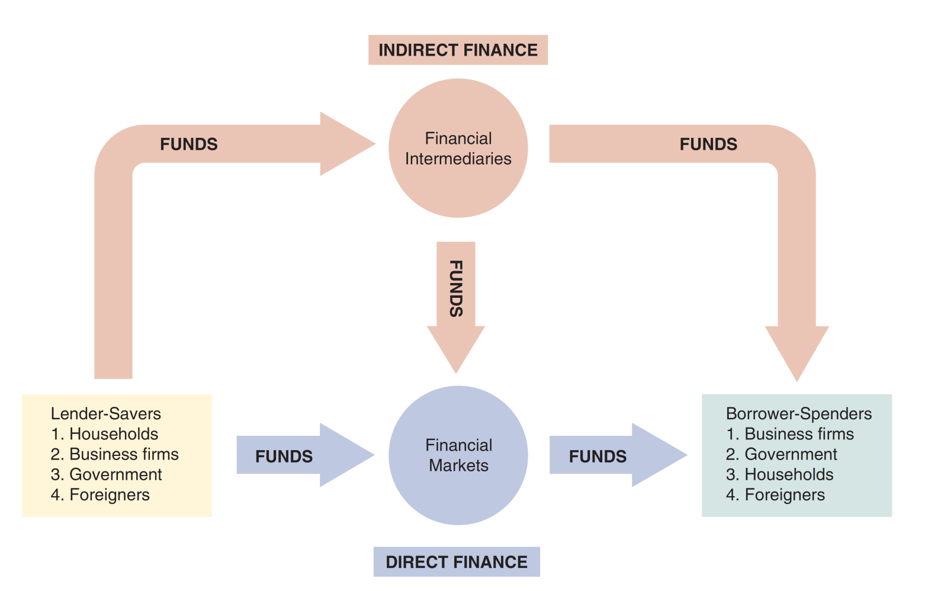
Figure 2.1 Flows of Funds Through the Financial System

Slide 7
Importance of Financial Markets
This is important. For example, if you save $1,000, but there are no financial markets, then you can earn no return on this - might as well put the money under your mattress.
However, if a carpenter could use that money to buy a new saw (increasing her productivity), then she is willing to pay you some interest for the use of the funds.
Financial markets are critical for producing an efficient allocation of capital, allowing funds to move from people who lack productive investment opportunities to people who have them.
Financial markets also improve the well-being of consumers, allowing them to time their purchases better.

Slide 8
Structure of Financial Markets
Debt Markets
  Short-Term (maturity < 1 year)
  Long-Term (maturity > 10 year)
  Intermediate term (maturity in-between)
Equity Markets
  Pay dividends, in theory forever
  Represents an ownership claim in the firm

Slide 9
Structure of Financial Markets
Primary Market
  New security issues sold to initial buyers
  Typically involves an investment bank who underwrites the offering
Secondary Market
  Securities previously issued are bought and sold
  Examples include the NYSE and Nasdaq
  Involves both brokers and dealers (do you know the difference?)
We can further classify secondary markets as follows:
Exchanges
  Trades conducted in central locations (e.g., New York Stock Exchange, CBT)
Over-the-Counter Markets
  Dealers at different locations buy and sell
  Best example is the market for Treasury Securities

Slide 10
Classifications of Financial Markets
We can also classify markets by the maturity of the securities:
Money Market: Short-Term
(maturity < 1 year)
Capital Market: Long-Term
(maturity > 1 year) plus equities (no maturity)

Slide 11
Internationalization of Financial Markets
The internationalization of markets is an important trend. The U.S. no longer dominates the world stage.
International Bond Market & Eurobonds
  Foreign bonds
  Eurobonds
    Denominated in one currency, but sold in a different market
    Now larger than U.S. corporate bond market
    Over 80% of new bonds are Eurobonds
Eurocurrency Market
  Foreign currency deposited outside of home country
  Eurodollars are U.S. dollars deposited, say, London.
  Gives U.S. borrows an alternative source for dollars.
World Stock Markets
  U.S. stock markets are no longer always the largest—at one point, Japan’s was larger

Slide 12
Internationalization of Financial Markets
> FOLLOWING THE FINANCIAL NEWS
Foreign Stock Market Indexes
Foreign stock market indexes are published daily in newspapers and Internet sites such as www.finance.yahoo.com. The most important of these stock market indices are: Dow Jones Industrial Average (DJIA) An index of the 30 largest publicly traded corporations in the United States maintained by the Dow Jones Corporation. S&P 500 An index of 500 of the largest companies traded in the United States maintained by Standard & Poor’s. Nasdaq Composite An index for all the stocks that trade on the Nasdaq stock market, where most of the technology stocks in the United States are traded. | FTSE 100 An index of the 100 most highly capitalized UK companies listed on the London Stock Exchange. DAX An index of the 30 largest German companies trading on the Frankfurt Stock Exchange. CAC 40 An index of the largest 40 French companies traded on Euronext Paris. Hang Seng An index of the largest companies traded on the Hong Kong stock markets. Strait Times An index of the largest 30 companies traded on the Singapore Exchange.

Slide 13

Indices and Tracking Market Performance
Indices and tracking market performance: A stock market index is a method of measuring the performance of a specific segment of the stock market or economy
  Price weighted - Dow Jones Industrial Average (DJIA)
  $DJIA_{t}=\sum_{i=1}^{30}{\frac{P_{it}}{D}}$
  Capitalization weighted - Standard & Poor’s 500 (S&P 500)
  $Index=\frac{ΣPt.Qt}{D}$

Slide 14
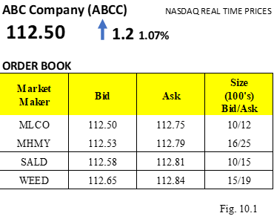
How to Trade Stocks
Types of Orders
  Market Orders: Market orders are BUY or SELL orders that need to be executed immediately at the current market price.
  Limit Orders: Investors may place an order with an instruction to buy or sell at a specific price regardless what the market prices are.
  Stop Order (Stop-Loss Orders or Stop-Buy Orders): A stop order is like a limit order with a condition to buy or sell at a certain price but differing on the mechanics

Slide 15
Global Perspective: Relative Decline of U.S. Capital Markets
The U.S. has lost its dominance in many industries: automobiles and consumer electronics, to name a few.
A similar trend appears at work for U.S. financial markets, as London and Hong Kong compete. Indeed, many U.S. firms use these markets over the U.S.
Why?
New technology in foreign exchanges
9–11 made U.S. regulations tighter
Greater risk of lawsuit in the U.S.
Sarbanes-Oxley has increased the cost of being a U.S.-listed public company

Slide 16
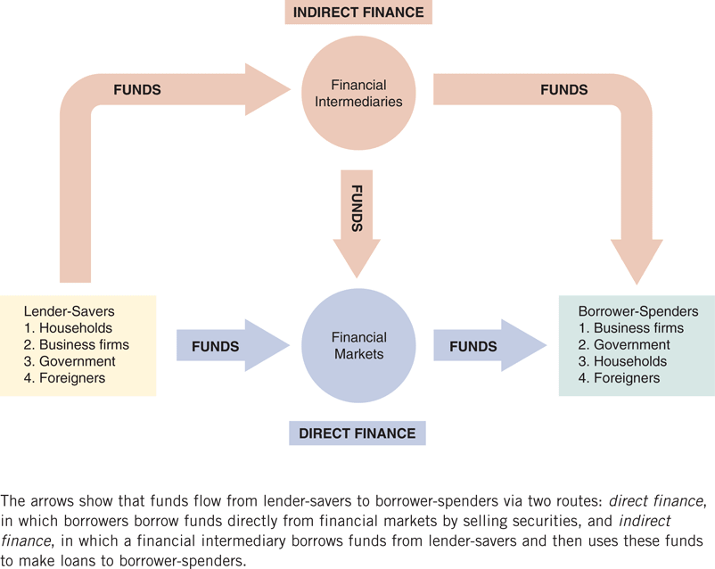
The top part of Figure —indirect finance.

Slide 17
Function of Financial
Intermediaries: Indirect Finance
Instead of savers lending/investing directly with borrowers, a financial intermediary (such as a bank) plays as the middleman:
  the intermediary obtains funds from savers
  the intermediary then makes loans/investments with borrowers
This process, called financial intermediation, is actually the primary means of moving funds from lenders to borrowers.
More important source of finance than securities markets (such as stocks)
Needed because of transactions costs, risk sharing, and asymmetric information

Slide 18
Function of Financial
Intermediaries: Indirect Finance
Transactions Costs
  Financial intermediaries make profits by reducing transactions costs
  Reduce transactions costs by developing expertise and taking advantage of economies of scale
A financial intermediary’s low transaction costs mean that it can provide its customers with liquidity services, services that make it easier for customers to conduct transactions
  Banks provide depositors with checking accounts that enable them to pay their bills easily
  Depositors can earn interest on checking and savings accounts and yet still convert them into goods and services whenever necessary

Slide 19
Function of Financial
Intermediaries: Indirect Finance
Another benefit made possible by the FI’s low transaction costs is that they can help reduce the exposure of investors to risk, through a process known as risk sharing
  FIs create and sell assets with lesser risk to one
  party in order to buy assets with greater risk from another party
  This process is referred to as asset transformation, because in a sense risky assets are turned into safer assets for investors
Financial intermediaries also help by providing the means for individuals and businesses to diversify their asset holdings.
Low transaction costs allow them to buy a range of assets, pool them, and then sell rights to the diversified pool to individuals.

Slide 20
Function of Financial
Intermediaries: Indirect Finance
Another reason FIs exist is to reduce the impact of asymmetric information.
One party lacks crucial information about another party, impacting decision-making.
We usually discuss this problem along two fronts: adverse selection and moral hazard.
Adverse Selection
  Before transaction occurs
  Potential borrowers most likely to produce adverse outcome are ones most likely to seek a loan
  Similar problems occur with insurance where unhealthy people want their known medical problems covered

Slide 21
Asymmetric Information: Adverse Selection and Moral Hazard
Moral Hazard
  After transaction occurs
  Hazard that borrower has incentives to engage in undesirable (immoral) activities making it more likely that won’t pay loan back
  Again, with insurance, people may engage in risky activities only after being insured
  Another view is a conflict of interest
  Financial intermediaries reduce adverse selection and moral hazard problems, enabling them to make profits. How they accomplish this is covered in many of the chapters to come.

Slide 22
Economies of Scope and Conflicts of Interest
FIs are able to lower the production cost of information by using the information for multiple services: bank accounts, loans, auto insurance, retirement savings, etc. This is called economies of scope.
But, providing multiple services may lead to conflicts of interest, perhaps causing one area of the FI to hide or conceal information from another area (or the economy as a whole). This may actually make financial markets less efficient!

Slide 23
Types of Financial Intermediaries: Depository Institutions
Depository Institutions (Banks): accept deposits and make loans. These include commercial banks and thrifts.
Commercial banks (about 5,000 at end of 2015)
  Raise funds primarily by issuing checkable, savings, and time deposits which are used to make commercial, consumer and mortgage loans
  Collectively, these banks comprise the largest financial intermediary and have the most diversified asset portfolios
Thrifts: S&Ls & Mutual Savings Banks and Credit Unions (around 900 of each)

Slide 24
Types of Financial Intermediaries: Contractual Savings Institutions (CSIs)
All CSIs acquire funds from clients at periodic intervals on a contractual basis and have fairly predictable future payout requirements.
  Life Insurance Companies
  Fire and Casualty Insurance Companies
  Pension and Government Retirement Funds

Slide 25
Types of Financial Intermediaries: Investment Intermediaries
Finance Companies
Mutual Funds
Money Market Mutual Funds
Hedge Funds
Investment Banks

Slide 26
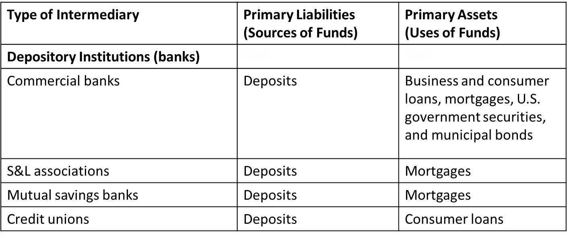
Table 2.1 Primary Assets and Liabilities of Financial Intermediaries (1 of 3)

Slide 27
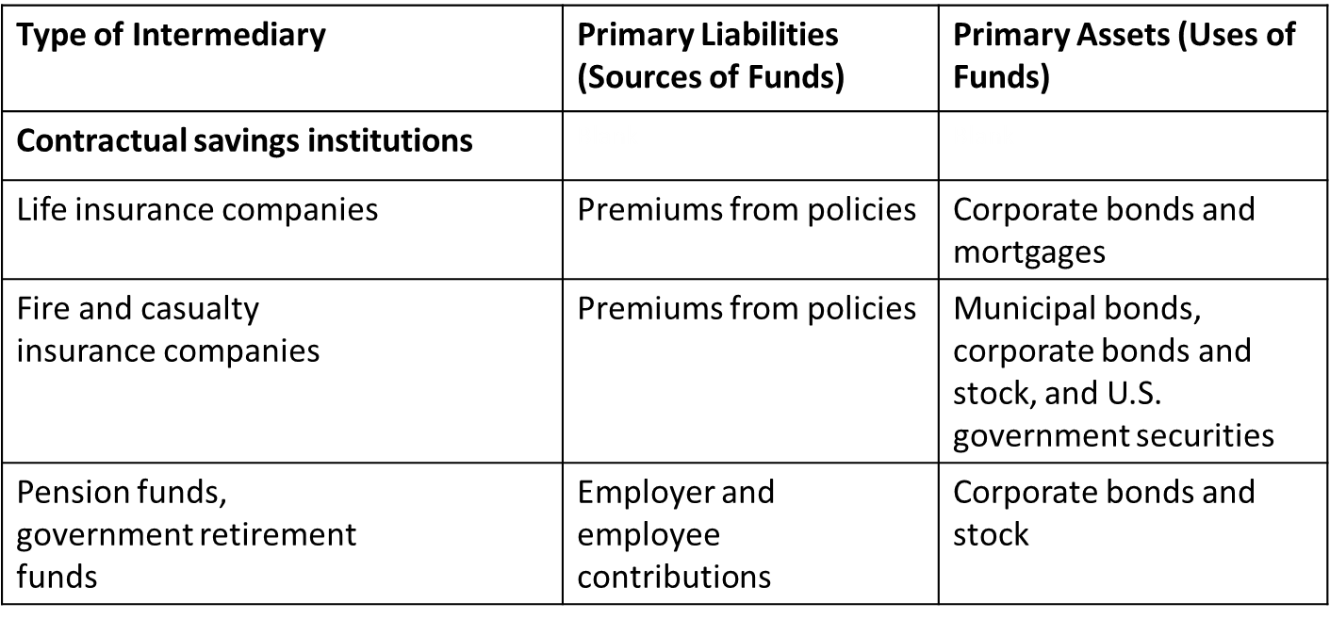
Table 2.1 Primary Assets and Liabilities of Financial Intermediaries (1 of 3)

Slide 28
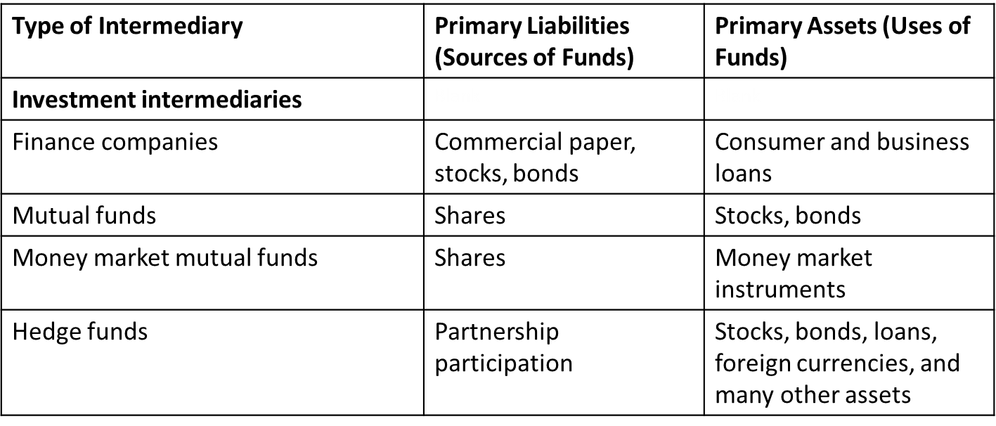
Table 2.1 Primary Assets and Liabilities of Financial Intermediaries (1 of 3)

Slide 29
Table 2.3 Principal Regulatory Agencies of the U.S. Financial System (1 of 3)
Regulatory Agency | Subject of Regulation | Nature of Regulations
Securities and Exchange Commission (SEC) | Organized exchanges and financial markets | Requires disclosure of information; restricts insider trading
Commodities Futures Trading Commission (CFTC) | Futures market exchanges | Regulates procedures for trading in futures markets
Office of the Comptroller of the Currency | Federally chartered commercial banks and thrift institutions | Charters and examines the books of federally chartered commercial banks and thrift institutions; imposes restrictions on assets they can hold

Slide 30
Table 2.3 Principal Regulatory Agencies of the U.S. Financial System (2 of 3)
Regulatory Agency | Subject of Regulation | Nature of Regulations
National Credit Union Administration (NCUA) | Federally chartered credit unions | Charters and examines the books of federally chartered credit unions and imposes restrictions on assets they can hold
State banking and insurance commissions | State-chartered depository institutions | Charter and examine the books of state-chartered banks and insurance companies; impose restrictions on assets they can hold; and impose restrictions on branching

Slide 31
Table 2.3 Principal Regulatory Agencies of the U.S. Financial System (3 of 3)
Regulatory Agency | Subject of Regulation | Nature of Regulations
Federal Deposit Insurance Corporation (FDIC) | Commercial banks, mutual savings banks, savings and loan associations | Provides insurance of up to $250,000 for each depositor at a bank; examines the books of insured banks; and imposes restrictions on assets they can hold
Federal Reserve System | All depository institutions | Examines the books of commercial banks that are members of the system; sets reserve requirements for all banks

Slide 32
Regulation of Financial Markets
Main Reasons for Regulation
Increase Information to Investors
Ensure the Soundness of Financial Intermediaries

Slide 33
Regulation Reason: Increase Investor Information
Asymmetric information in financial markets means that investors may be subject to adverse selection and moral hazard problems that may hinder the efficient operation of financial markets and may also keep investors away from financial markets.
The Securities and Exchange Commission (SEC) requires corporations issuing securities to disclose certain information about their sales, assets, and earnings to the public and restricts trading by the largest stockholders (known as insiders) in the corporation.
Such government regulation can reduce adverse selection and moral hazard problems in financial markets and increase their efficiency by increasing the amount of information available to investors. Indeed, the SEC has been particularly active recently in pursuing illegal insider trading.

Slide 34
Regulation Reason: Ensure Soundness of Financial Intermediaries (1 of 2)
Providers of funds (depositors, like you) to financial intermediaries may not be able to assess whether the institutions holding their funds are sound or not.
If they have doubts about the overall health of financial intermediaries, they may want to pull their funds out of both sound and unsound institutions, which can lead to a financial panic.
Such panics produces large losses for the public and causes serious damage to the economy.

Slide 35
Regulation Reason: Ensure Soundness of Financial Intermediaries (2 of 2)
To protect the public and the economy from financial panics, the government has implemented six types of regulations:
  Restrictions on Entry
  Disclosure
  Restrictions on Assets and Activities
  Deposit Insurance
  Limits on Competition
  Restrictions on Interest Rates

Slide 36
Chapter Summary
Function of Financial Markets: We examined the flow of funds through the financial system and the role of intermediaries in this process.
Structure of Financial Markets: We examined market structure from several perspectives, including types of instruments, purpose, organization, and time horizon.
Internationalization of Financial Markets: We briefly examined how debt and equity markets have expanded in the international setting.
Function of Financial Intermediaries: We examined the roles of intermediaries in reducing transaction costs, sharing risk, and reducing information problems.
Types of Financial Intermediaries: We outlined the numerous types of financial intermediaries to be further examined in later chapters.
Regulation of the Financial System: We outlined some of the agencies charged with the oversight of various institutions and markets.

