Slide 1
Topic #1: Introduction
ECON 2408
Money and Banking

Slide 2
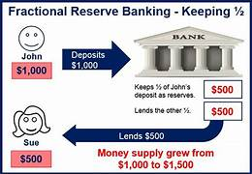
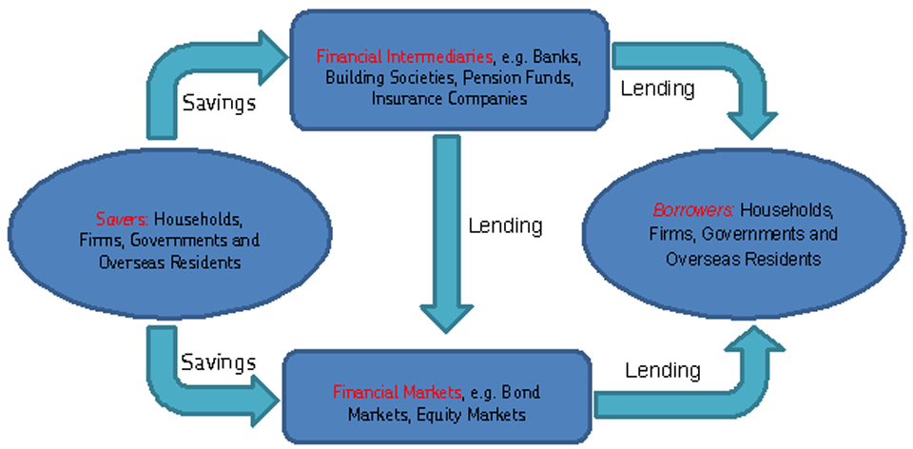
Topic 1: Introduction
Why Study Money and Banking? Financial Markets and Institutions in Particular?
Main Reading (Sources): chap 1 of Mishkin and Eakins, 8th Ed.

Slide 3
Why Study Financial Markets?
Financial markets are crucial in our economy.
Channel funds from savers to investors, promoting economic efficiency
Intermediation promote economic efficiency by facilitating the efficiency via allocation of resources, diversifying risk, gathering and analyzing information and facilitating financial transactions.
Market activity affects personal wealth, business firms, and economy
Buying and selling goods, services and financial assets (investments in new tech, infrastructure)
Well functioning financial markets are key factors in producing high economic growth.
Access to capital from individuals, companies, government
Notes:
We will briefly examine each of these markets, key statistics, and how we will examine them throughout this course.

Slide 4
Why Study Financial Markets? Debt Markets & Interest Rates (1 of 4)
Debt markets allow governments, corporations, and individuals to borrow.
Growth of Money
Arbitrage (Borrow versus Lending)
Borrowers issue a security, called a bond, offering interest and principal over time.
The interest rate is the cost of borrowing.
Housing – government support – encourage mortgages – try keep low rates

Slide 5
Why Study Financial Markets? Debt Markets & Interest Rates (2 of 4)
Many types of market interest rates: mortgage rates, car loan rates, credit card rates, etc.
Risk adjusted
Includes – pricing the loss
The level of these rates are important. For example, mortgage rates in the early part of 1983 exceeded 13%.

Slide 6
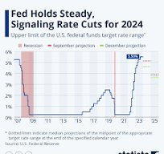
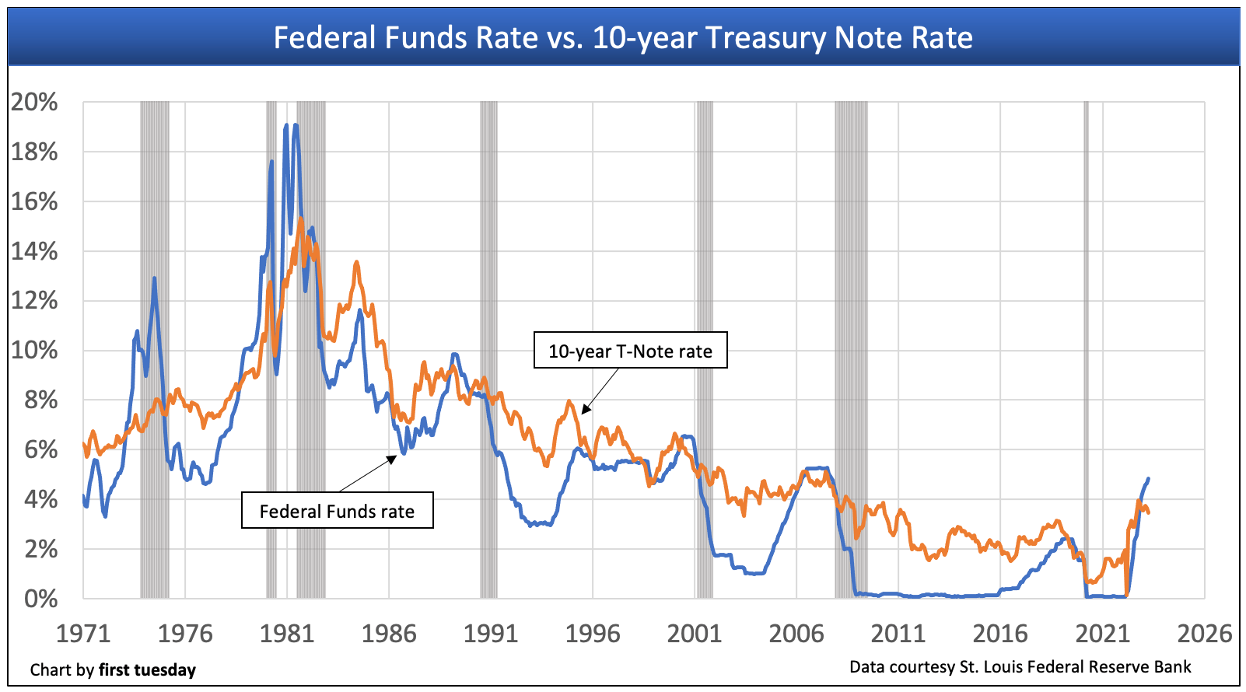
Why Study Financial Markets? Debt Markets & Interest Rates (3 of 4)
Understanding the history of interest rates is beneficial.
We will study these further in the course: types and characteristics of bonds; theories on how rates are determined.

Slide 7
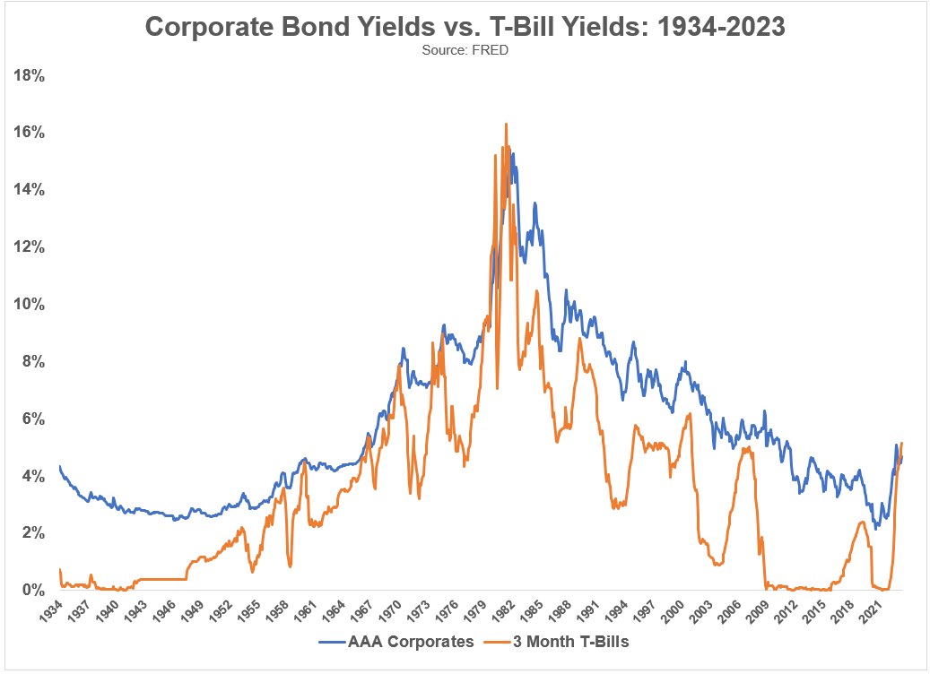
Figure 1.1 Interest Rates on Selected Bonds, 1950–2016
Source: Federal Reserve Bank of St. Louis, FRED database: https://fred.stlouisfed.org/series/TB3MS; https://fred.stlouisfed.org/series/GS10; https://fred.stlouisfed.org/series/BAA.

Slide 8
Why Study Financial Markets? Debt Markets & Interest Rates (4 of 4)
For the moment, we will turn to other topics, but revisit these topics.
In chapters 2, 11, 12, and 14, we will examine the role of debt markets in the economy.
In chapters 3 through 5, we will examine the characteristics of interest rates.

Slide 9
Why Study Financial Markets? The Stock Market (1 of 3)
The stock market is the market where common stock (or just stock) are traded.
Companies initially sell stock (in the primary market) to raise money. After that, the stock is traded among investors.
Primary vs Secondary Market or Direct and Indirect Finance
The stock market receives the most attention from the media.

Slide 10
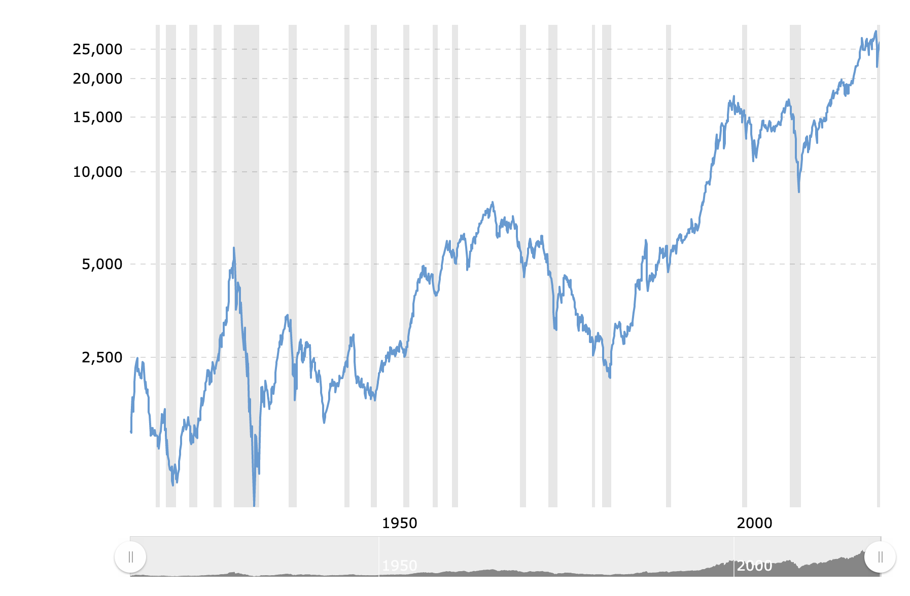
Figure 1.2 Stock Prices as Measured by the Dow Jones Industrial Average
Source: Federal Reserve Bank of St. Louis, FRED database: https://fred.stlouisfed.org/series/DJIA.

Slide 11
Why Study Financial Markets? The Stock Market (2 of 3)
Companies, not just individuals, also watch the market.
Often seeking additional funding
The success of SEOs is dependent on the company’s stock
Fundamental – Profit translates to Firm Value to higher stock

Slide 12
Why Study Financial Markets? The Stock Market (3 of 3)
In chapter 2, we will examine the role of the stock market in the financial system.
In 13, we will further look at how stock prices behave to information in the marketplace.
Fundamental
Technical
Behavioral

Slide 13
Why Study Financial Markets? The Foreign Exchange Market (1 of 2)
The foreign exchange market is where international currencies trade and exchange rates are set.
Although most people know little about this market, it has a daily volume around $5 trillion!

Slide 14
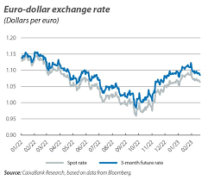
Figure 1.3 Exchange Rate of the U.S. Dollar
Source: Federal Reserve Bank of St. Louis, FRED database: https://fred.stlouisfed.org/series/TWEXMMTH.

Slide 15
Why Study Financial Markets? The Foreign Exchange Market (2 of 2)
These fluctuations matter!
This past year, consumers have found that vacationing in Europe is cheap, due to a strong dollar relative to the Euro – That’s Good
When the dollar strengthens, foreign purchase of domestic goods falls. – That’s bad
In chapter 15, we will examine how exchange rates are determined in both the short- and long-run.

Slide 16
Why Study Financial Institutions? (1 of 3)
We will also spend considerable time discussing financial institutions - the corporations, organizations, and networks that operate the so-called “marketplaces.” We will look at:
Structure of the Financial System
Helps funds move from savers to investors, typically through financial intermediaries
Financial Crises
The “Great Recession” of 2007–2009 was the worst financial crisis since the Great Depression. Why did it happen?

Slide 17
Why Study Financial Institutions? (2 of 3)
Central Banks and the Conduit of Monetary Policy
The role of the Fed, and foreign counterparts, in the management of interest rates and the money supply
Monetary Vs Fiscal Policy
4. Management and Trend in Banking Industry
How Banks Manage their assets and liabilities
Focusing on improvements in technology and the impact on financial product delivery

Slide 18
Applied Managerial Perspective
Financial institutions are among the largest employers in the U.S. and often pay high salaries.
Knowing how financial institutions are managed may help you better deal with them.

Slide 19
Exploring the Web (1 of 2)
Web Exercise
The World Wide Web is an enormous resource for present and historical information. We will periodically present web exercises to introduce some of the important locations for information, and how to use it.
Alpha Vantage: https://lnkd.in/g7wv6F9K Barchart: https://www.barchart.com/ CNBC: https://lnkd.in/g8ThTi3a
EOD Historical Data: https://lnkd.in/gP9FEXzX
ETF Database: https://etfdb.com/ FinViz: https://finviz.com/ FRED (Federal Reserve Economic Data): https://lnkd.in/g8dKMMN2 Google Finance: https://lnkd.in/gWHw9Fhg Investing: https://www.investing.com/ Macromicro: https://en.macromicro.me/ MarketWatch: https://lnkd.in/gcWCY34e Morningstar: https://lnkd.in/giKy_WHw Quandl or Nasdaq Data Link: https://lnkd.in/gRCA676Q Seeking Alpha: https://seekingalpha.com/ StockCharts: https://lnkd.in/gQEjzWzW Tiingo: https://www.tiingo.com/ TradingView: https://lnkd.in/gDcDb6dy Yahoo Finance: https://finance.yahoo.com/

Slide 20
Exploring the Web (2 of 2)
Web Exercise
The next three slides (starting on page 11 in the text) show you how to (1) find historical interest rates from the Fed and save the information, (2) how to import the data into Excel, and (3) how to examine the information using an Excel chart.

Slide 21
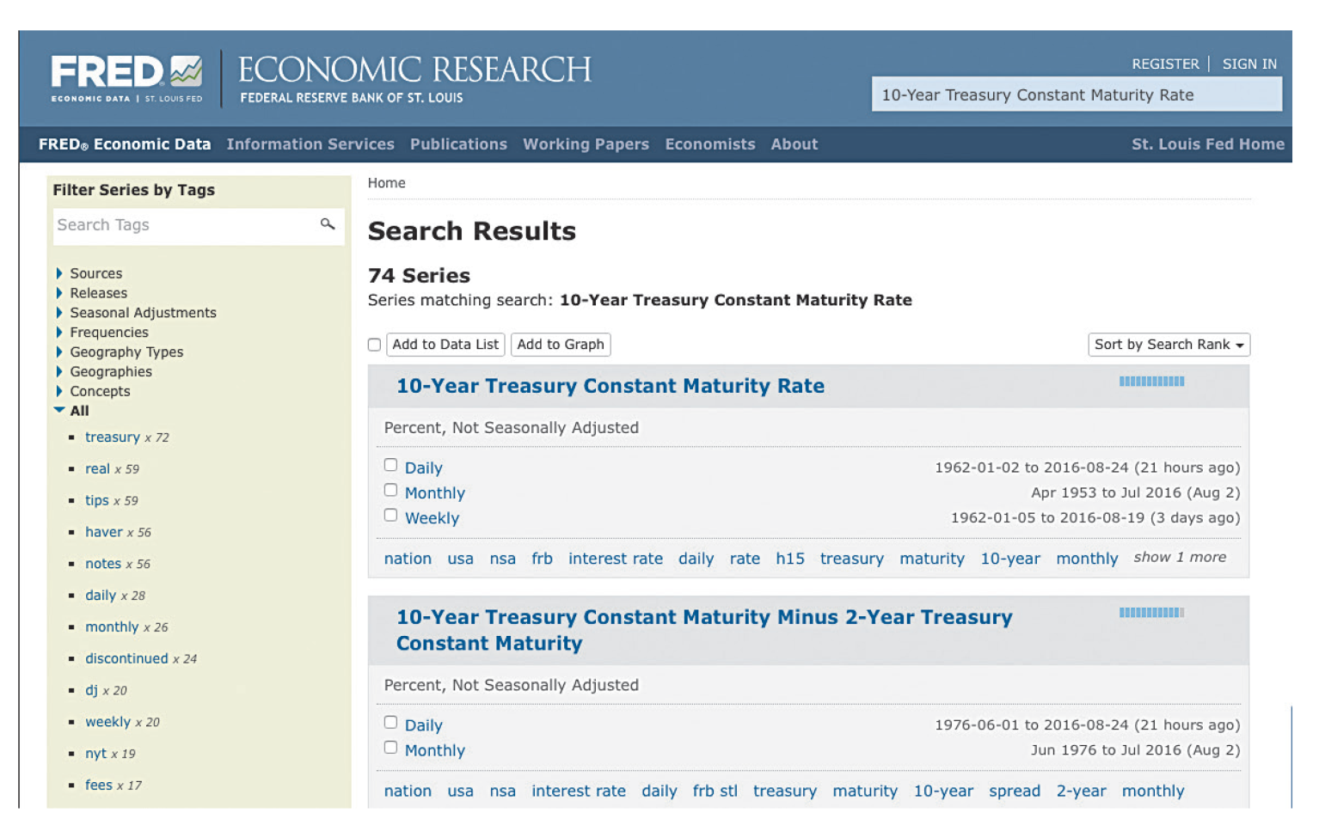
Figure 1.4 Federal Reserve Bank of St. Louis, FRED Database
Source: https://fred.stlouisfed.org/series/GS10.

Slide 22
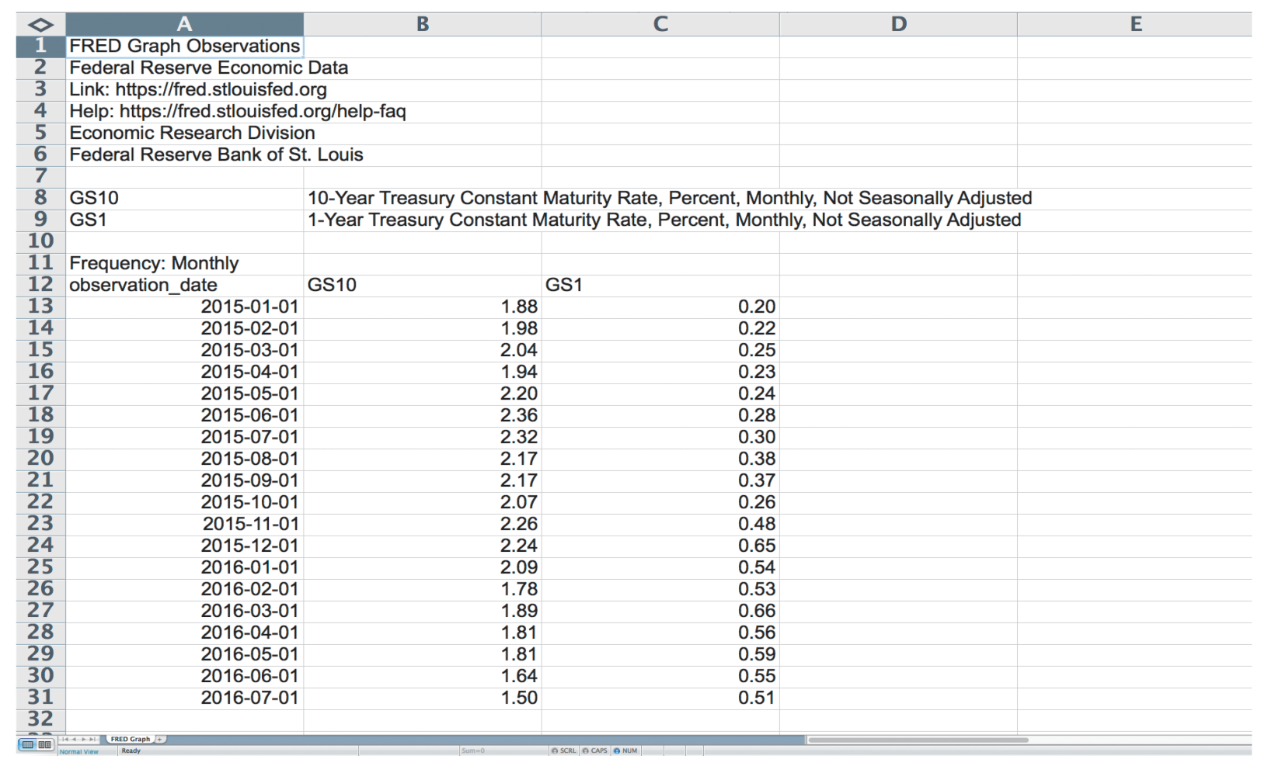
Figure 1.5 Excel Spreadsheet with Interest-Rate Data
Source: Used with permission from Microsoft Corporation; https://fred.stlouisfed.org/series/GS1; https://fred.stlouisfed.org/series/GS10.

Slide 23
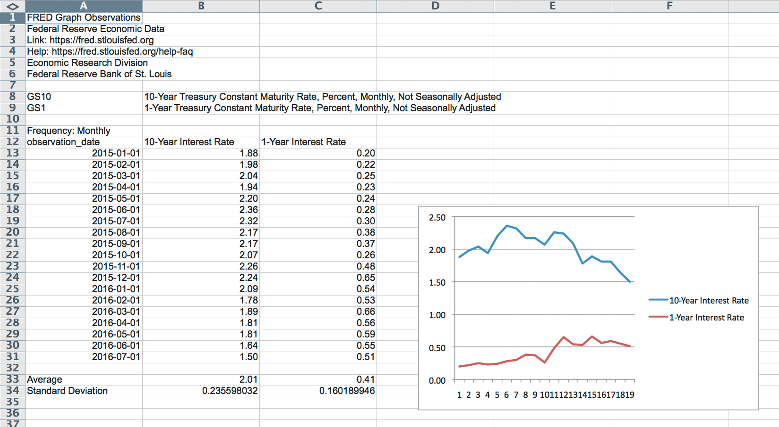
Figure 1.6 Excel Graph of Interest-Data
Source: Used with permission from Microsoft Corporation.

Slide 24
Chapter Summary
Why Study Financial Markets?: the three primary markets (bond, stock, and foreign exchange) were briefly introduced.
Why Study Financial Institutions?: the market, institutions, and key changes affecting these were outlined.
Applied Managerial Perspective: the course will often present material to better understand how actual managers use the information in daily operations.
How We Will Study Financial Markets and Institutions: we outlines the three key components: analytical framework, features, and web exercises.
Notes:
Concluding Remarks:This field is an exciting one, and this course will help you develop skills to further your career and your understanding of financial events.
You will also have a better understanding of the controversies to hotly debated in the political arena.

