Slide 1
Topic 12: Why Do Financial Crises Occur and Why Are They So Damaging to the Economy?
Main Reading (Sources): Chap 8 Mishkin & Eakins, 8th

Slide 2
Chapter Preview
In this chapter, we develop a framework to understand the dynamics of financial crises. Topics include:
What Is a Financial Crises
Dynamics of Financial Crises in Advanced Economies

Slide 3
What Is a Financial Crisis?
Financial crises are major disruptions in financial markets characterized by sharp declines in asset prices and firm failures.
Asymmetric information creates barriers between savers and firms with productive investment opportunities. Both moral hazard and adverse selection are still present in our financial system.
A financial crisis occurs when information flows in financial markets experience a particularly large disruption. Financial markets may stop functioning completely.
The study of these problems (agency theory) is the basis for understanding and defining a financial crisis.

Slide 4
Dynamics of Financial Crises in Advanced Economies
Financial crises hit countries like United States every so often, and each event helps economists gain insights into present-day turmoil.
These crises usually proceed in 2 or 3 stages, as the next two slides outline:

Slide 5
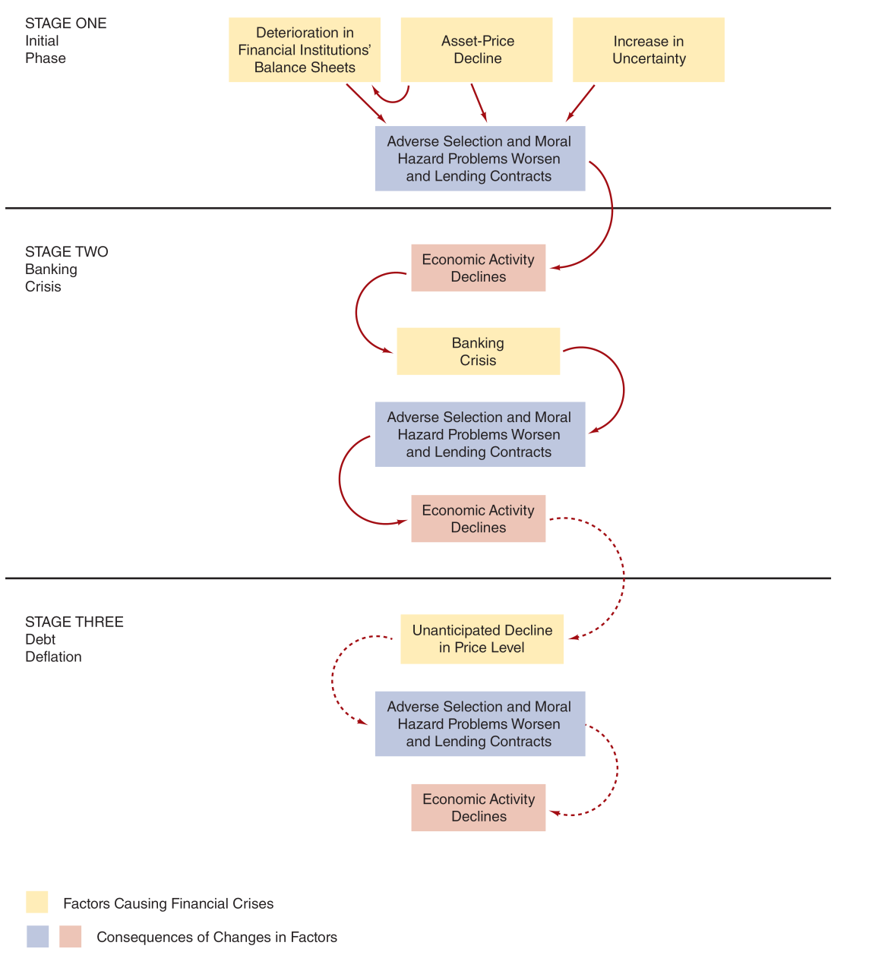
Figure 8.1 Sequence of Events in Financial Crises in Advanced Economies

Slide 6
Stage One: Initial Phase (1 of 4)
Financial crisis can begin in several ways:
Credit Boom and Bust
Asset-Price Boom and bust
Increase in Uncertainty

Slide 7
Stage One: Initial Phase (2 of 4)
The seeds of a financial crisis can begin with mismanagement of financial liberalization or innovation:
elimination of restrictions
introduction of new types of loans or other financial products
Either can lead to a credit boom, where risk management is lacking.
Government safety nets weaken incentives for risk management. Depositors ignore bank risk-taking.
Eventually, loan losses accrue, and asset values fall, leading to a reduction in capital.
Financial institutions cut back in lending and borrowing, a process called deleveraging. Banking funding falls as well. (the process or practice of reducing the level of one's debt by rapidly selling one's assets)
As FIs cut back on lending, no one is left to evaluate firms. The financial system losses its primary institution to address adverse selection and moral hazard.
Economic spending contracts as loans become scarce.

Slide 8
Stage One: Initial Phase (3 of 4)
A financial crisis can also begin with an asset- price boom and bust:
A pricing bubble starts, where asset values exceed their fundamental values.
When the bubble bursts and prices fall, corporate net worth falls as well. Moral hazard increases as firms have little to lose.
FIs also see a fall in their assets, leading again to deleveraging.

Slide 9
Stage One: Initial Phase (4 of 4)
Finally, a financial crisis can begin with an increase in uncertainty:
Periods of high uncertainty can lead to crises, such as stock market crashes or the failure of a major financial institution. Examples include:
1857, when the Ohio Life Insurance & Trust Company failed
2008, when AIG, Bear Sterns, and Lehman Bros. failed
With information hard to come by, moral hazard and adverse selection problems increase, reducing lending and economic activity

Slide 10
Stage Two: Banking Crisis
Deteriorating balance sheets lead financial institutions into insolvency. If severe enough, these factors can lead to a bank panic.
Panics occur when depositors are unsure which banks are insolvent, causing all depositors to withdraw all funds immediately
As cash balances fall, FIs must sell assets quickly, further deteriorating their balance sheet
Adverse selection and moral hazard become severe – it takes years for a full recovery

Slide 11
Stage Three: Debt Deflation (1 of 2)
Consider a firm in 2015 with assets of $100 million (in 2015 dollars), $90 million of long-term liabilities, and so $10 million in net worth.
Price levels fall by 10% in 2016. Real value of assets (in 2015 dollars) remains the same.
Real value of liabilities rise to $99 million (in 2015 dollars), and so net worth falls to just $1 million!

Slide 12
Stage Three: Debt Deflation (2 of 2)
If the crisis also leads to a sharp decline in prices, debt deflation can occur, where asset prices fall, but debt levels do not adjust, increasing debt burdens.
This leads to an increase in adverse selection and moral hazard, which is followed by decreased lending
Economic activity remains depressed for a long time

Slide 13
Case: The Great Depression (1 of 3)
In 1928 and 1929, stock prices doubled in the U.S. The Fed tried to curb this period of excessive speculation with a tight monetary policy. But this lead to a stock market collapse of more than 20% in October of 1929, and losing an additional 20% by the end of 1929.
The decline continued for several years.
What might have been a normal recession turned into something far worse, when severe droughts in 1930 in the Midwest led to a sharp decline in agricultural production.
Between 1930 and 1933, one-third of U.S. banks went out of business as these agricultural shocks led to bank failures.
For more than two years, the Fed sat idly by through one bank panic after another.

Slide 14
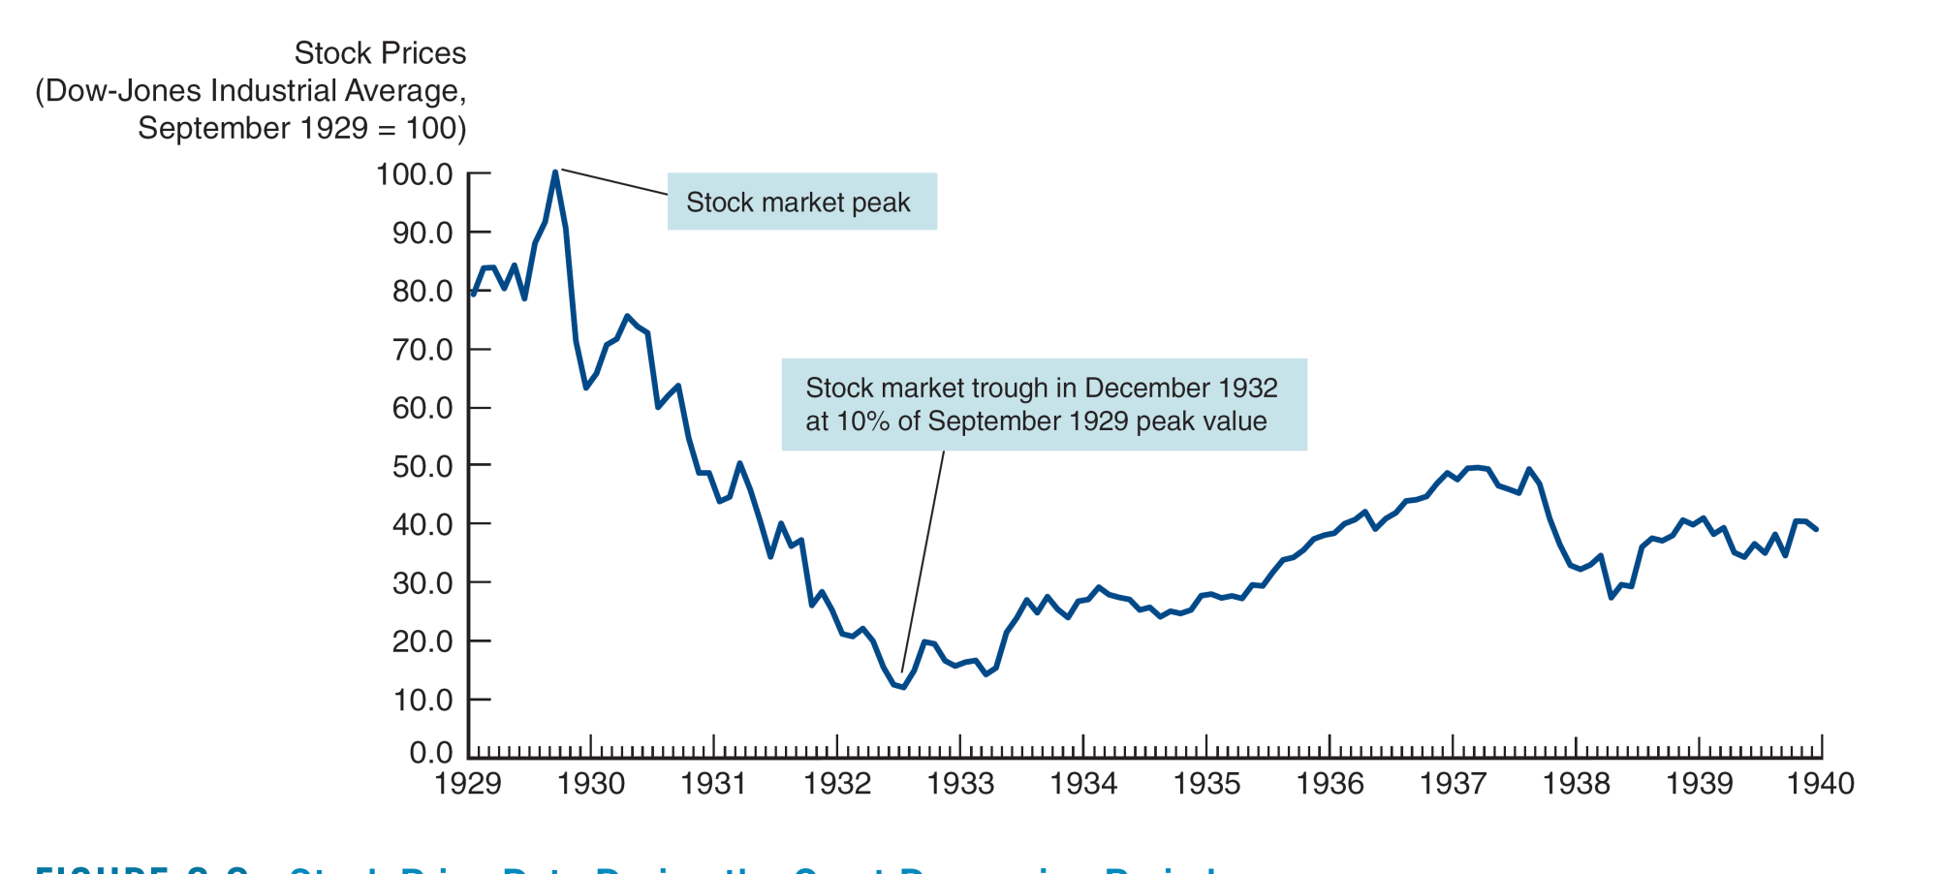
Figure 8.2 Stock Price Data During the Great Depression Period

Slide 15
Case: The Great Depression (2 of 3)
Adverse selection and moral hazard in credit markets became severe. Firms with productive uses of funds were unable to get financing. Credit spreads increased from 2% to nearly 8% during the height of the Depression in 1932.

Slide 16
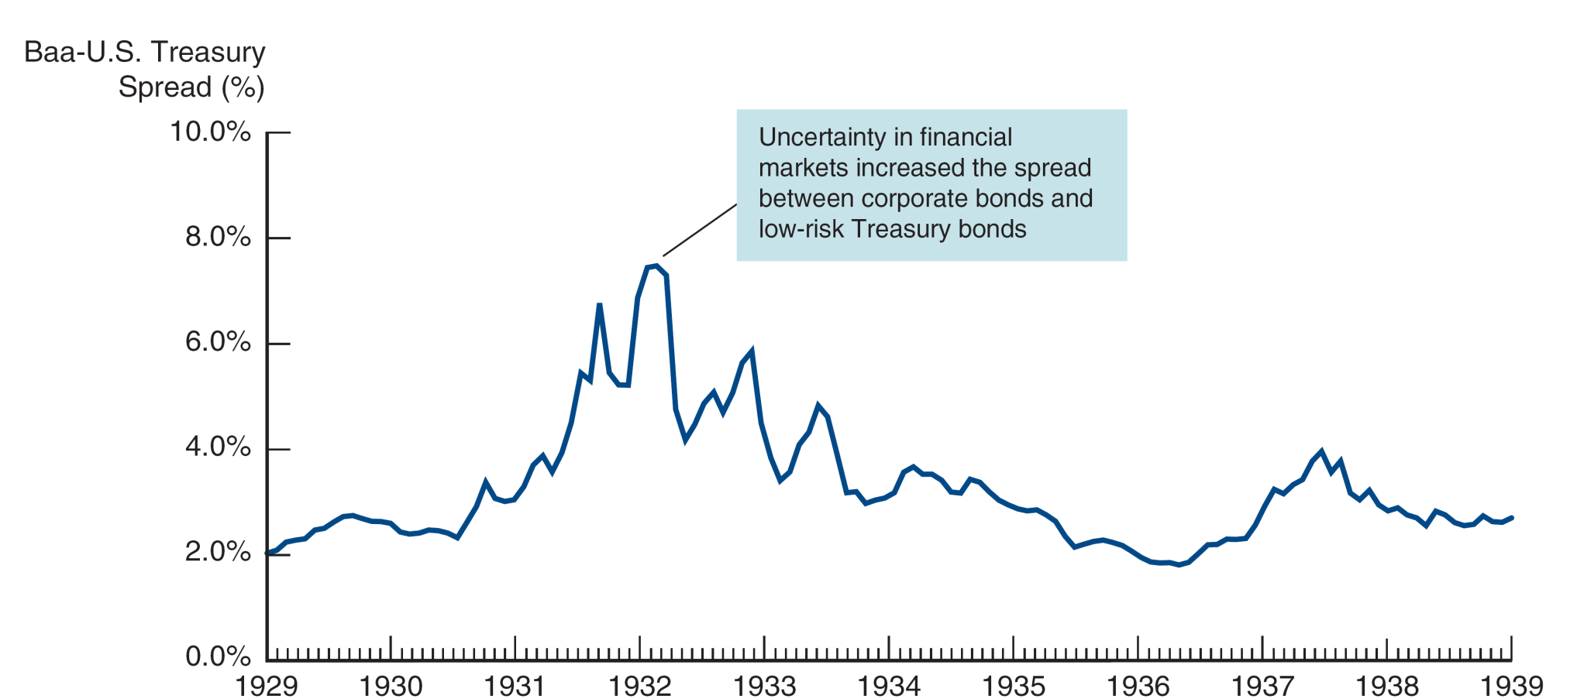
Figure 8.3 Credit Spreads During the Great Depression
Source: Federal Reserve Bank of St. Louis, FRED database: https://fred.stlouisfed.org/series/M13036USM193NNBR, https://fred.stlouisfed.org/series/LTGOVTBD.

Slide 17
Case: The Great Depression (3 of 3)
The deflation during the period lead to a 25% decline in price levels.
The prolonged economic contraction lead to an unemployment rate around 25%.
The Depression was the worst financial crisis ever in the U.S. It explains why the economic contraction was also the most severe ever experienced by the nation.
Bank panics in the U.S. spread to the rest of the world, and the contraction of the U.S. economy decreased demand for foreign goods.
The worldwide depression caused great hardship, and the resulting discontent led to the rise of fascism and WWII.

Slide 18
Case: The Global Financial Crisis of 2007–2009 Causes of the 2007-2009 Global Financial Crisis (1 of 4)
We begin our look at the 2007–2009 financial crisis by examining three central factors:
financial innovation in mortgage markets
agency problems in mortgage markets
the role of asymmetric information in the credit rating process

Slide 19
Causes of the 2007-2009 Global Financial Crisis(2 of 4)
Financial innovation in mortgage markets developed along a few lines:
Less-than-credit worthy borrowers found the ability to purchase homes through subprime lending, a practice almost nonexistent until the 2000s
Financial engineering developed new financial products to further enhance and distribute risk from mortgage lending

Slide 20
Causes of the 2007-2009 Global Financial Crisis(3 of 4)
Agency problems in mortgage markets also reached new levels:
Mortgage originators did not hold the actual mortgage, but sold the note in the secondary market
Mortgage originators earned fees from the volume of the loans produced, not the quality
In the extreme, unqualified borrowers bought houses they could not afford through either creative mortgage products or outright fraud (such as inflated income)

Slide 21
Causes of the 2007-2009 Global Financial Crisis (4 of 4)
Finally, the rating agencies didn’t help:
Agencies consulted with firms on structuring products to achieve the highest rating, creating a clear conflict
Further, the rating system was hardly designed to address the complex nature of the structured debt designs
The result was meaningless ratings that investors had relied on to assess the quality of their investments

Slide 22
Mini-Case: CDOs (1 of 3)
Before continuing with the crisis, let’s take a detour and see how Collateralized Debt Obligations (CDOs) played a role in the crisis.
A special purpose vehicle (SPV) is created to buy assets, create securities from those assets, and then sell those securities to investors.
In a CDO, the securities (or tranches) are created based on default priorities. The first defaults go to the lowest rated tranches. The highest rated tranches suffer defaults if most of the assets default.

Slide 23
Mini-Case: CDOs (2 of 3)
There are many, many tranches in a CDO, each with different exposure to defaults:
The highest rated tranches are called super senior tranches
The next bucket is known as the senior tranche – it has a little more risk and pays a higher interest rate
The next tranche is the mezzanine tranche - it bears more risk and has an even higher interest
The lowest tranche is the equity tranche - this is the first tranche that suffers losses from defaults

Slide 24
Mini-Case: CDOs (3 of 3)
If this sounds complicated, you are right. It can be difficult to determine exactly what they are worth and who has the rights to what cash flows.
In a speech in the middle of the crisis, Ben Bernanke, the chairman of the Federal Reserve, joked that he “would like to know what those damn things are worth.”
Bottom line - increased complexity of structured products can actually reduce the amount of information in financial markets. Makes you wonder who is willing to buy these in the first place!

Slide 25
Effects of The Global Financial Crisis of 2007-2009
Many suffered as a result of the 2007–2009 financial crisis. We will look at five areas:
U.S. residential housing
FIs balance sheets
The “shadow” banking system
Global financial markets
The failure of major financial firms

Slide 26
Effects of The Global Financial Crisis of 2007-2009
1. Impact on Residential Housing
Initially, the housing boom was lauded by economics and politicians. The housing boom helped stimulate growth in the subprime market as well.
However, underwriting standard fell. People were clearly buying houses they could not afford, except for the ability to sell the house for a higher price.
Lending standards also allowed for near 100% financing, so owners had little to lose by defaulting when the housing bubble burst.
The next slide shows the rise and fall of housing prices in the U.S. The number of defaults continues to plague the U.S. banking system.

Slide 27
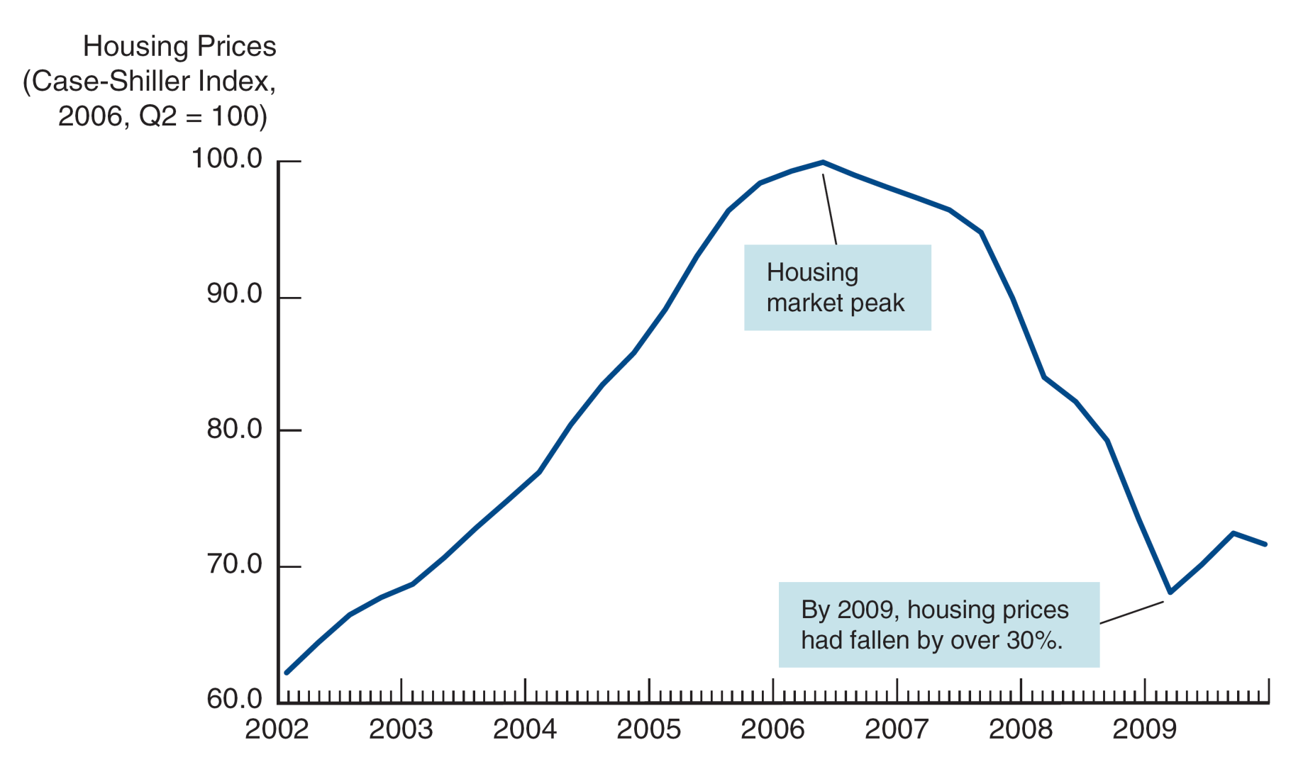
Figure 8.4 Housing Prices and the Financial Crisis of 2007–2009
Source: Case-Shiller 20-City Composite Home Price Index in Federal Reserve Bank of St. Louis, FRED database: https://fred.stlouisfed.org/series/SPCS20RSA.

Slide 28
Was the Fed to Blame for the Housing Price Bubble?
Some argue that low interest rates from 2003 to 2006 fueled the housing bubble (the Taylor rule).
In early 2010, Mr. Bernanke rebutted this argument. He argued rates were appropriate.
He also pointed to new mortgage products, relaxed lending standards, and capital inflows as more likely causes.
Bernanke’s speech was very controversial, and the debate over whether monetary policy was to blame for the housing price bubble continues to this day.

Slide 29
Effects of The Global Financial Crisis of 2007-2009
2. Impact on Financial Institutions’ Balance Sheet
As mortgage defaults rose, banks and other FIs saw the value of their assets fall. This was further complicated by the complexity of mortgages, CDOs, defaults swaps, and other difficult-to-value assets.
Banks began the deleveraging process, selling assets and restricting credit, further depressing the struggling economy.

Slide 30
Effects of The Global Financial Crisis of 2007-2009
3. Run on the shadow banking system
These are the hedge funds, investment banks, and other liquidity providers in our financial system. They used their funds to support the issuance of low interest-rate mortgages and auto loans.
They use repurchase agreements (repos) short term borrowing to fund their investment. The Repos require collateral and they use assets like mortgage-back securities.
When the short-term debt markets seized, so did the availability of credit to this system. This lead to further “fire” sales of assets to meet higher credit standards.

Slide 31
Effects of The Global Financial Crisis of 2007-2009
The fall in the stock market and the rise in credit spreads further weakened both firm and household balance sheets.
Both consumption and real investment fell, causing a sharp contraction in the economy.

Slide 32
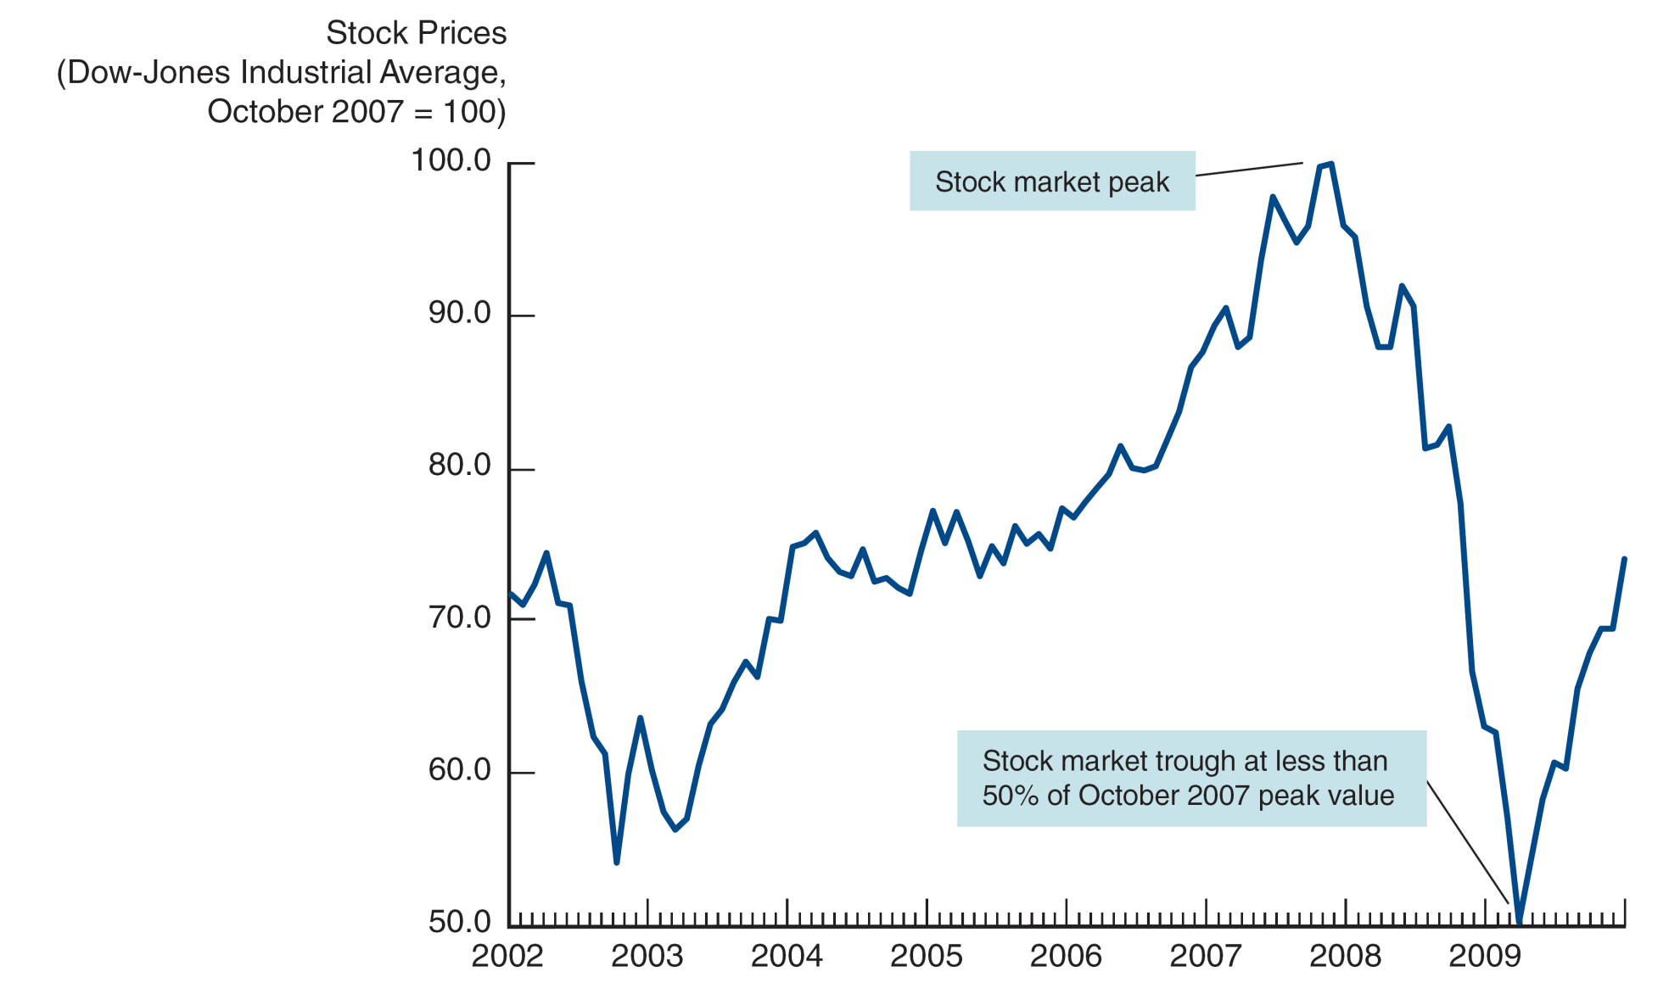
Figure 8.5 Stock Prices and the Financial Crisis of 2007–2009

Slide 33
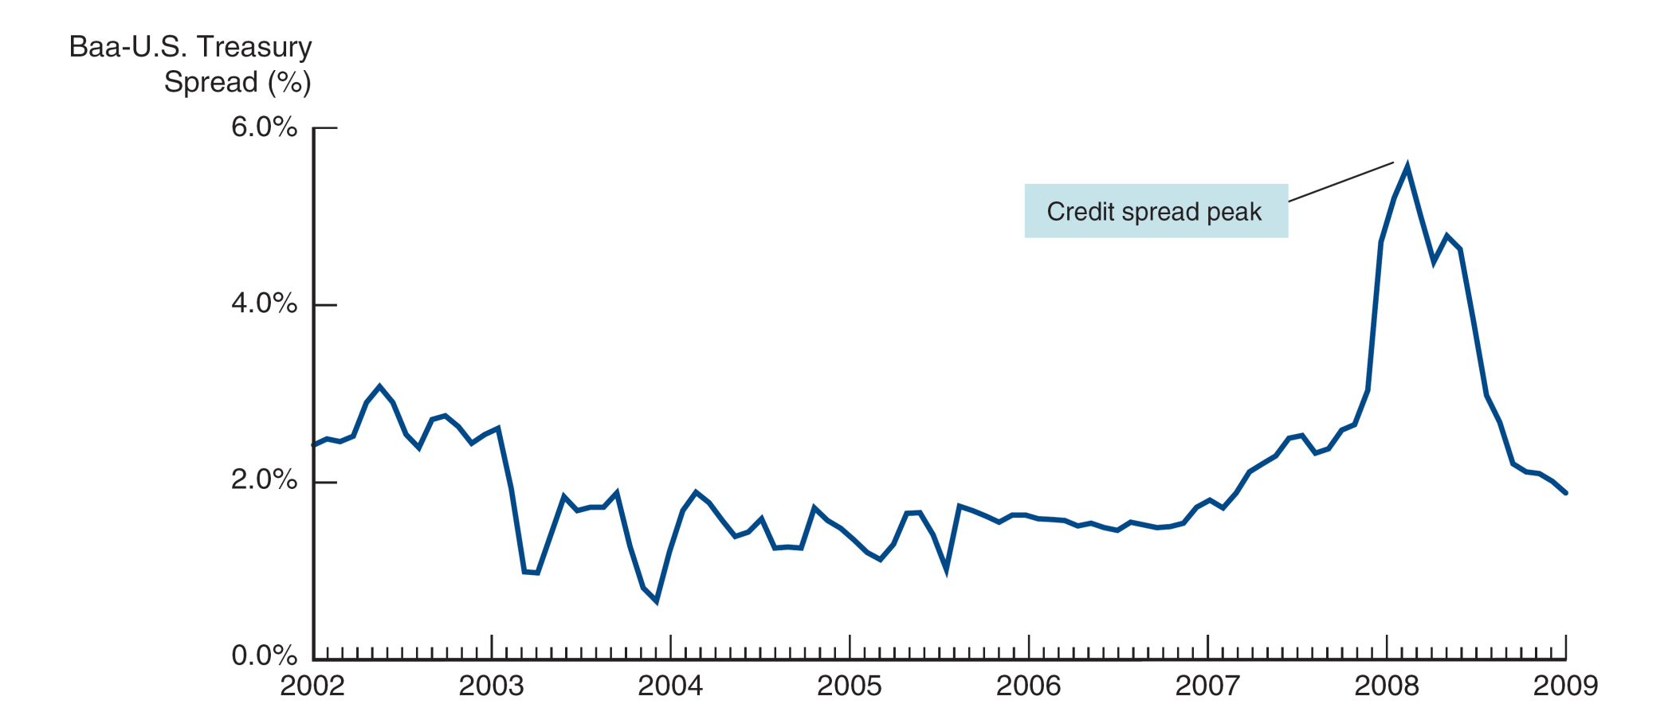
Figure 8.6 Credit Spreads and the 2007–2009 Financial Crisis

Slide 34
Effects of The Global Financial Crisis of 2007-2009
4. Impact on global financial markets.
Europe was actually first to raise the alarm in the crisis. With the downgrade of $10 billion in mortgage related products, short term money markets froze, and in August 2007, a French investment house suspended redemption of some of its money market funds. Banks and firms began to horde cash.
The end of credit lead to several bank failures.
Northern Rock was one of the first, relying on short–term credit markets for funding. Others soon followed.
By most standards, Europe experienced a more severe downturn that the U.S.

Slide 35
Effects of The Global Financial Crisis of 2007-2009
5. Failure of high-profile firms
Finally, the collapse of several high-profile U.S. investment firms only further deteriorated confidence in the U.S.
March 2008: Bear Sterns fails and is sold to JP Morgan for 5% of its value only 1 year ago
September 2008: both Freddie and Fannie put into conservatorship after heaving subprime losses.

Slide 36
Height of the 2007-2009 Financial Crisis
The crisis and impaired credit markets have caused the worst economic contraction since World War II.
The crisis peaked in September of 2008.
Congress passed a bailout package, but the stock market continued to decline, and credit spreads reached over 500 bps.

Slide 37
Height of the 2007-2009 Financial Crisis
The fall in real GDP and increase in unemployment to over 10% in 2009 impacted almost everyone.
The recession that started in December 2007 became the worst economic contraction in the United States since World War II, and is now called the “Great Recession.”
Starting in March 2009, a bull market in stocks got under way and credit spreads began to fall.
Unfortunately, the pace of the recovery has been slow.
Global: The European Sovereign Debt Crisis
Up until 2007, all the countries that had adopted the euro found their interest rates converging to very low levels.
At the same time, several of these countries were hit very hard:
Lower tax revenue from economic contraction
High outlays for FI bailouts
Fear of gov’t default cause rates to surge

Slide 38
Global: The European Sovereign Debt Crisis (1 of 2)
Greece was the first domino to fall
In September 2008, gov’t projected a 6% deficit and debt-to-GDP of 100%
In October, with newly elected officials, numbers were shown to be far worse
Fear of default caused rates on Greek debt to peak near 40%
Debt-to-GDP rose to 160% in 2012
Greece was forced to write-down its debt (partial default)
Civil unrest broke out as unemployment rates climbed
The prime minister was eventually forced to resign

Slide 39
Global: The European Sovereign Debt Crisis (1 of 2)
Ireland, Portugal, Spain, and Italy followed
Governments forced to embrace austerity measures to shore up their public finances
Interest rates climbed to double-digit levels
Severe recessions resulted, despite assurances from the ECB to help
Unemployment rates rose to double-digits (25% in Spain)
Will the euro survive?

Slide 40
Chapter Summary
What Is a Financial Crises: we revisited the ideas of embodied in agency theory as a framework to examine what a financial crisis is.
Dynamics of Financial Crises in Advanced Economies: We examined the stages of a crisis in an advanced economy. We further examined the 2007–2009 U.S. Financial Crisis.

