Slide 1
Topic 11: Why Do Financial Institutions Exist?
Main Reading (Sources): Chap 7 Mishkin & Eakins, 8th

Slide 2
Chapter Preview
In this chapter, we take a closer look at why financial institutions exist and how they promote economic efficiency. Topics include:
Basic Facts About Financial Structure Throughout the World
Transaction Costs
Asymmetric Information: Adverse Selection and Moral Hazard
The Lemons Problem: How Adverse Selection Influences Financial Structure
How Moral Hazard Affects the Choice Between Debt and Equity Contracts
How Moral Hazard Influences Financial Structure in Debt Markets
Conflicts of Interest

Slide 3
Basic Facts About Financial Structure Throughout the World
The financial system is a complex structure including many different financial institutions: banks, insurance companies, mutual funds, stock and bonds markets, etc.
The chart on the next slide shows how nonfinancial business attain external funding in the U.S., Germany, Japan, and Canada. Notice that, although many aspects of these countries are quite different, the sources of financing are somewhat consistent, with the U.S. being different in its focus on debt.

Slide 4
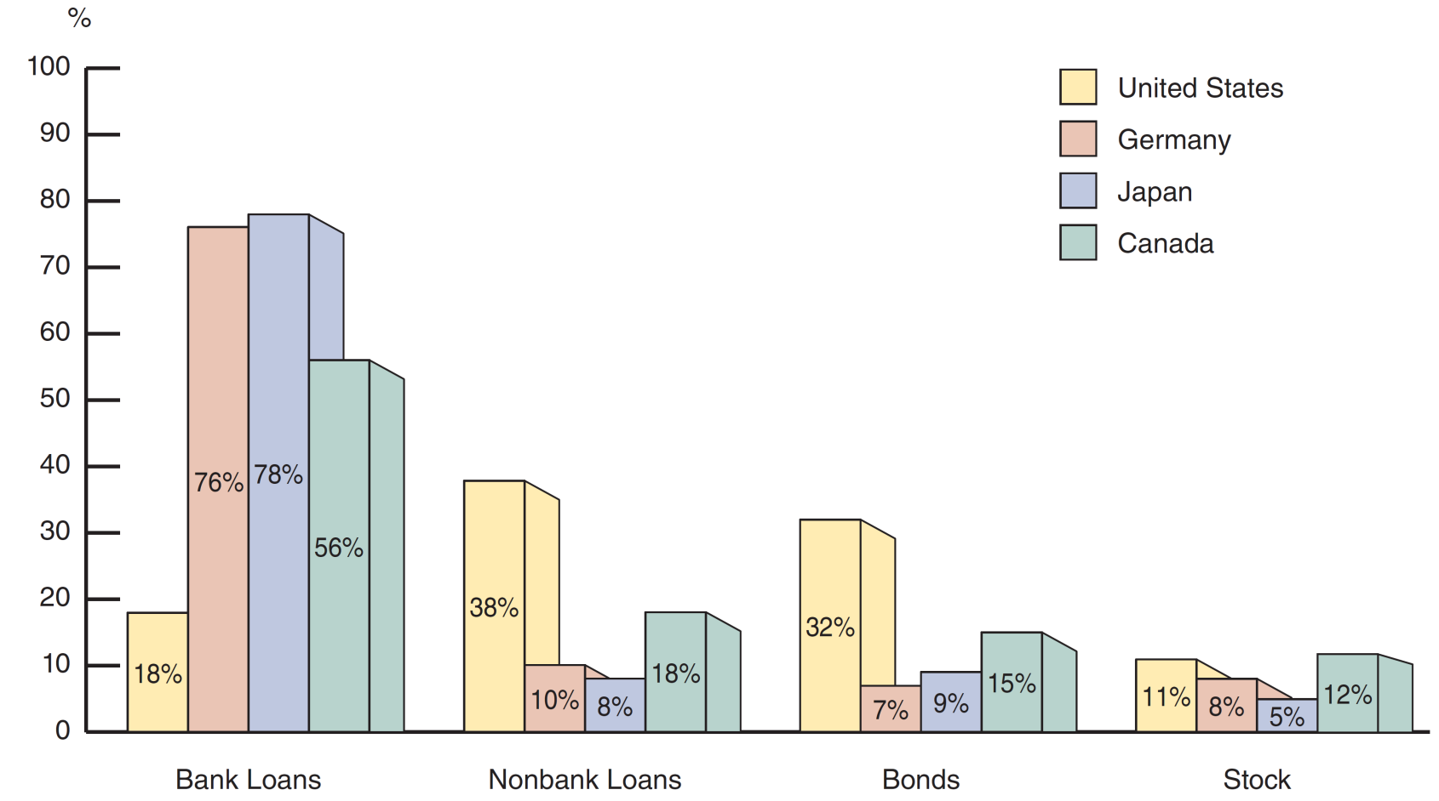
Figure 7.1 Sources of External Funds for Nonfinancial Businesses: A Comparison of the United States with Germany, Japan, and Canada

Slide 5
Facts of Financial Structure (1 of 2)
Stocks are not the most important source of external financing for businesses.
Issuing marketable debt and equity securities is not the primary way in which businesses finance their operations.
Indirect finance, which involves the activities of financial intermediaries, is many times more important than direct finance, in which businesses raise funds directly from lenders in financial markets.
Financial intermediaries, particularly banks, are the most important source of external funds used to finance businesses.

Slide 6
Facts of Financial Structure (2 of 2)
The financial system is among the most heavily regulated sectors of economy.
Only large, well-established corporations have easy access to securities markets to finance their activities.
Collateral is a prevalent feature of debt contracts for both households and businesses.
Debt contracts are typically extremely complicated legal documents that place substantial restrictions on the behavior of the borrowers.

Slide 7
Transaction Costs
Transactions costs influence financial structure
  E.g., a $5,000 investment only allows you to purchase 100 shares @ $50 / share (equity)
  No diversification
  Bonds even worse—most have a $1,000 size
In sum, transactions costs can hinder flow of funds to people with productive investment opportunities
Financial intermediaries make profits by reducing transactions costs
  Take advantage of economies of scale (example: mutual funds)
  Develop expertise to lower transactions costs
    Also provides investors with liquidity, which explains Fact # 3

Slide 8
Asymmetric Information: Adverse Selection and Moral Hazard
Adverse Selection
  Occurs when one party in a transaction has better information than the other party
  Before transaction occurs
  Potential borrowers most likely to produce adverse outcome are ones most likely to seek loan and be selected
Moral Hazard
  Occurs when one party has an incentive to behave differently once an agreement is made between parties
  After transaction occurs
  Hazard that borrower has incentives to engage in undesirable (immoral) activities making it more likely that won't pay loan back
The analysis of how asymmetric information problems affect behavior is known as agency theory.

Slide 9
The Lemons Problem: How Adverse Selection Influences Financial Structure
(1 of 2)
Lemons Problem in Used Cars
  If we can't distinguish between “good” and “bad” (lemons) used cars, we are willing pay only an average of good and bad car values
  Result: Good cars won’t be sold, and the used car market will function inefficiently.
What helps us avoid this problem with used cars?

Slide 10
The Lemons Problem: How Adverse Selection Influences Financial Structure
(2 of 2)
Lemons Problem in Securities Markets
  If we can't distinguish between good and bad securities, willing to pay only average of good and bad securities’ value
  Result: Good securities undervalued and firms won't issue them; bad securities overvalued so too many issued
  Investors don't want buy bad securities, so market don't function well
    Explains Fact # 1 and # 2
    Also explains Fact # 6 : Less asymmetric info for well known firms, so smaller lemons problem

Slide 11
Tools to Help Solve Adverse Selection (Lemons) Problems
Private Production and Sale of Information
  Free-rider problem interferes with this solution
Government Regulation to Increase Information (explains Fact # 5)
  For example, annual audits of public corporations (Enron case)
Financial Intermediation
  Analogy to solution to lemons problem provided by used car dealers
  Avoid free-rider problem by making private loans (explains Fact # 3 and # 4)
  Also explains fact #6—large firms are more likely to use direct instead of indirect financing
Collateral and Net Worth
  Explains Fact # 7

Slide 12
The Enron Implosion
Up to 2001, Enron appeared to be a very successful firm engaged in energy trading.
However, that the firm had severe financial problems, and hid many of its problems in complex financial structures that allowed Enron to not report them.
Even though Enron regularly filed records with the SEC, the problem was not prevented.
Even worse, its auditor Arthur Andersen eventually plead guilty to obstruction of justice charges. With that plea, one the largest and trusted auditors closed its doors forever.

Slide 13
How Moral Hazard Affects the Choice Between Debt and Equity Contracts (1 of 3)
Moral Hazard in Equity Contracts: the Principal-Agent Problem
  Result of separation of ownership by stockholders (principals) from control by managers (agents)
  Managers act in own rather than stockholders' interest

Slide 14
How Moral Hazard Affects the Choice Between Debt and Equity Contracts (2 of 3)
Suppose you become a silent partner in an ice cream store, providing 90% of the equity capital ($9,000). The other owner, Steve, provides the remaining $1,000 and will act as the manager. If Steve works hard, the store will make $50,000 after expenses, and you are entitled to $45,000 of it.
However, Steve doesn’t really value the $5,000 (his part), so he goes to the beach, relaxes, and even spends some of the “profit” on art for his office. How do you, as a 90% owner, give Steve the proper incentives to work hard?

Slide 15
How Moral Hazard Affects the Choice Between Debt and Equity Contracts (3 of 3)
Tools to Help Solve the Principal-Agent Problem
  Production of Information: Monitoring
  Government Regulation to Increase Information
  Financial Intermediation (e.g, venture capital)
  Debt Contracts
Explains Fact # 1 : Why debt is used more than equity

Slide 16
How Moral Hazard Influences Financial Structure in Debt Markets (1 of 2)
Even with the advantages just described, debt is still subject to moral hazard. In fact, debt may create an incentive to take on very risky projects. This is important to understand. Let’s looks at a simple example.
Most debt contracts require the borrower to pay a fixed amount (interest) and keep any cash flow above this amount.
For example, what if a firm owes $100 in interest, but only has $90? It is essentially bankrupt. The firm “has nothing to lose” by looking for “risky” projects to raise the needed cash.

Slide 17
How Moral Hazard Influences Financial Structure in Debt Markets (2 of 2)
Tools to Help Solve Moral Hazard in Debt Contracts
  Net Worth and Collateral
  Monitoring and Enforcement of Restrictive Covenants. Examples are covenants that …
    discourage undesirable behavior
    encourage desirable behavior
    keep collateral valuable
    provide information
  Financial Intermediation—banks and other intermediaries have special advantages in monitoring
Explains Facts # 1–4

Slide 18
Table 7.1 Summary of Asymmetric Information Problems and Tools to Solve Them (1 of 3)
Asymmetric Information Problem | Tools to Solve It | Explains Fact Number
Adverse Selection | Private production and sale of information | 1,2
Blank | Government regulation to increase information | 5
Blank | Financial intermediation | 3,4,6
Blank | Collateral and net worth | 7

Slide 19
Table 7.1 Summary of Asymmetric Information Problems and Tools to Solve Them (2 of 3)
Asymmetric Information Problem | Tools to Solve It | Explains Fact Number
Moral hazard in equity contracts (principal-agent problem) | Production of information monitoring | 1
Blank | Government regulation to increase information | 5
Blank | Financial intermediation | 3
Blank | Debt contracts | 6,7

Slide 20
Table 7.1 Summary of Asymmetric Information Problems and Tools to Solve Them (3 of 3)
Asymmetric Information Problem | Tools to Solve It | Explains Fact Number
Moral hazard in debt contracts | Collateral and net worth | 6,7
Blank | Monitoring and enforcement of restrictive covenants | 8
Blank | Financial intermediation | 3,4

Slide 21
Case: Financial Development and Economic Growth
Financial repression leads to low growth
Why?
  Poor legal system
  Weak accounting standards
  Government directs credit (state-owned banks)
  Financial institutions nationalized
  Inadequate government regulation
Financial Crises

Slide 22
Mini-Case: The Tyranny of Collateral
Legal title to land in foreign countries is much more complicated than in the U.S.
  Legal title to a dwelling land in the Philippines involves 168 bureaucratic steps
  In Haiti? 176 steps over nineteen years
Article argues that trillions is held in land not legally titled. And in that case, land cannot be used as collateral for loans.
Adverse selection problem becomes worse.
Contributes to the problem of the poor.

Slide 23
Financial Crises and Aggregate Economic Activity
Our analysis of the effects of adverse selection and moral hazard can also assist us in understanding financial crises, major disruptions in financial markets. The end result of most financial crises in the inability of markets to channel funds from savers to productive investment opportunities.

Slide 24
Is China a Counter-example?
Even with its booming economy, China’s financial development is still in an early stage.
Per capital income is around $10,000, but savings are around 40%, allowing China to build up capital stock as labor moves out of subsistence agriculture.
However, this is unlikely to work for long.
Russia in the 1950s had a similar economy, and few would argue that modern Russia is a success story.
To continue its growth, China needs to allocate capital more efficiently. Many of the financial repression problems we outlined are being addressed by Chinese authorities today.

Slide 25
Conflicts of Interest
Conflicts of interest are a type of moral hazard that occurs when a person or institution has multiple interests, and serving one interest is detrimental to the other.
Three classic conflicts developed in financial institutions. Looking at these closely offers insight in avoiding these conflicts in the future.

Slide 26
Conflicts of Interest: Underwriting and Research in Investment Banking
Investment banks may both research companies with public securities, as well as underwrite securities for companies for sale to the public.
Research is expected to be unbiased and accurate, reflecting the facts about the firm. It is used by the public to form investment choices.
Underwriters will have an easier time if research is positive. Underwriters can better serve the firm going public if the firm’s outlook is optimistic.
An investment bank acting as both a researcher and underwriter of securities for companies clearly has a conflict—serve the interest of the issuing firm or the public?
During the tech boom, research reports were clearly distorted to please issuers. Firms with no hope of ever earning a profit received favorable research.
This also lead to spinning, where underpriced equity was allocated to executives who would promise future business to the investment bank.

Slide 27
Conflicts of Interest: Auditing and Consulting in Accounting Firms
Auditors check the assets and books of a firm for the quality and accuracy of the information. The objective in an unbiased opinion of the firm’s financial health.
Consultants, for a fee, help firms with variety of managerial, strategic, and operational projects.
An auditor acting as both an auditor and consultant for a firm clearly is not objective, especially if the consulting fees exceed the auditing fees.
The Mini-case of Arthur Andersen, of course, epitomizes this conflict. A myriad of conflicts with its client Enron resulted in the eventual demise of Arthur Andersen when Enron collapsed.

Slide 28
Conflicts of Interest: Credit Assessment and Consulting in Rating Agencies
Rating agencies assign a credit rating to a security issuance of a firm based on projected cash flow, assets pledged, etc. The rating helps determine the riskiness of a security.
Consultants, for a fee, help firms with variety of managerial, strategic, and operational projects.
An rating agency acting as both a rater and consultant for a firm clearly is not objective, especially if the consulting fees exceed the rating fees.
Rating agencies, such as Moody’s and Standard and Poor, were caught in this game during the housing bubble. Firms asked the rater to help structure debt offerings to attain the highest rating possible. When the debt subsequently defaulted, it was difficult for the agency to justify the original high rating. Perhaps it was just error. But few believe that—most see the rating agencies as being blinded by high consulting fees.

Slide 29
Remedies? (1 of 3)
Sarbanes-Oxley Act of 2002
  Established an oversight board to supervise accounting firms
  Increased the SEC’s budget for supervisory activities
  Limited consulting relationships between auditors and firms
  Enhanced criminal charges for obstruction
  Improved the quality of the financial statements and board

Slide 30
Remedies? (2 of 3)
Global Legal Settlement of 2002
  Required investment banks to sever links between research and underwriting
  Spinning is explicitly banned
  Imposed a $1.4 billion fine on accused investment banks
  Added additional requirements to ensure independence and objectivity of research reports

Slide 31
Remedies? (3 of 3)
However, there is much criticism over the cost involved with these separations. In other words, financial institutions can no longer take advantage of the economies of scope gained from relationships.
Some have argued that Sarbanes-Oxley has negatively impacted the value of U.S. Capital Markets. The details of that follow:
The cost of implementing Sarbanes-Oxley is not trivial. For companies with less than $100 million in sales, it’s estimated to be around 1% of sales.
During the same period, European countries have made it easier for firms to go public.
Both equity issuances and bond issuances are growing faster now in Europe than in the U.S. Is it time to revisit this bill to determine if the benefits outweigh the costs?

Slide 32
Chapter Summary
We reviewed eight basic facts concerning the structure of the financial system
We examined how transaction costs can hinder capital flow and the role financial institutions play in reducing transaction costs
We defined asymmetric information along with two categories of asymmetric information—adverse selection and moral hazard
We discussed how adverse selection effects the flow of capital and tools to reduce this problem.
We reviewed the principal-agent problem and how moral hazard influences the use of more debt than equity
We discussed how moral hazard and debt may lead to increased risk-taking, and tools to reduce this problem
We reviewed several examples of conflicts in our economy, many of which ended badly. Can we address these in the future before they lead to severe problems?

