Slide 1

FUTURES & FORWARDS
Professor Droussiotis

Slide 2
Futures & Forwards
Concepts
Options = 3 Variables (X, S, Premium)
Where,
X = Future Price or Exercise Price, S = Stock Price (Underlying Asset), Premium = Pay today to have the option
Futures & Forwards = 2 Variables (K, S)
Where,
K = Future Price, S = Spot Price (Underlying Asset)

Slide 3
Futures & Forwards
Concepts
Futures & Forwards
Delivery Price
Delivery Date
Delivery Volume
Long Position (purchasing the commodity on delivery date)
Short position (commits to delivery of the contract maturity)
Existing Contracts
Agriculture Futures
Metals and Minerals
Foreign Currencies
Financial Futures (fixed Income and Equity indices)

Slide 4


FORWARDS:
Starting with an Example
Example 1 To see how futures and forwards work and how they might be useful, consider the portfolio diversification problems facing a farmer growing a single crop, let us say wheat. The entire planting season’s revenue depends critically on the highly volatile crop price. The farmer can’t easily diversify his position because virtually his entire wealth is tied in the crop. The miller who must purchase wheat for processing faces a portfolio problem that is the mirror image of the farmer’s. He is subject to profit uncertainty because of unpredictable future cost of the wheat.
Both parties can reduce this source of risk if they enter a forward contract calling for the farmer to deliver the wheat when harvested at a price agreed upon now, regardless of the market price at harvest time. No money needs to change hands currently. The forward contract is simply a deferred delivery sale of some asset with the sales price to be paid or received for delivery of the commodity. The forward contract protects each party from future price fluctuations.

Slide 5
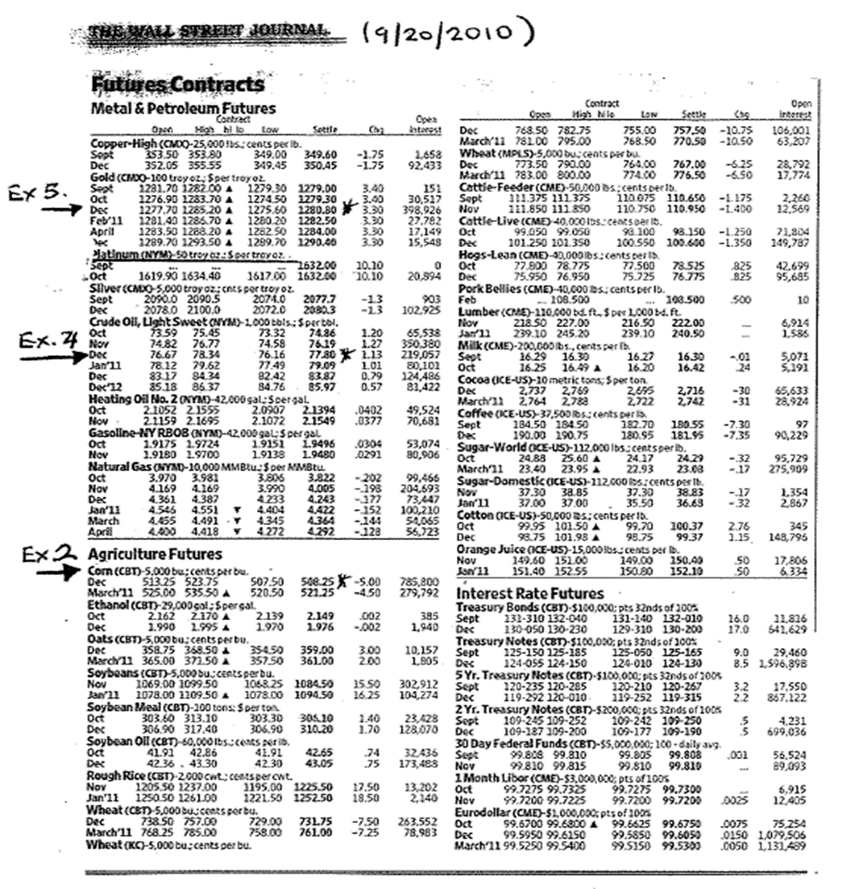







Wall Street Page on Futures

Slide 6

Futures & Forwards
Concepts
Marking to Market (Daily Settlement)
Original Margin: Each trader establishes a margin account (both Long and short trader) – backed by treasury bills/cash to make sure the cash is there. i.e. if the initial margin for corn is 10%, the trader must post (looking at the WSJ March 2020 prices) at 10% of 651.00 cents or 65.10 cents x 5,000 = $3,255 per contract on the margin account.
Maintenance margin / maintenance Margin: Daily, they debit/credit the account to maintain 5% cushion (this margin could be different than the original margin).
Convergence property: The convergence of futures prices and spot prices at the maturity of the futures contract – As a maturity contract calls for immediately delivery, the futures price on that day must equal the spot price.

Slide 7
Futures
Example 2
Corn – 5,000 bushels Price: cents per bushel Expiration dates April 2020
The April 2020 maturity corn contract opened during the day at a future price of 355.50 cents ($3.55) per bushel. The highest during the day was 356.00 cents ($3.56) and lowest 351.00 cents ($3.51) and the settlement price was 354.00cents ($3.54) or 1.50 cents lower than the opening price. The open interest or the number of outstanding contracts was 301,794.
The trader holding the long position, that is, the person who will purchase the good, profits from price increases at maturity. Suppose that when the contract matures in April, the price of corn (spot price) turns out to be $3.64 per bushel. The long position trader who entered the contract at the futures price of $3.64 cents – earns a profit of 10 cents per bushel. The eventual price is 10 cents higher than the originally agreed-upon futures price. As each contract calls for delivery of 5,000 bushels – the profit to the long position equals 5,000 bushels x $0.10 = $500 per contract. The short position loses 10 cents per bushel. The short position’s loss equals the long position’s gain.
Corn (cents per Bushel, 5,000 bushels) | Open | High | Low | Close | Interest
April ‘20 | 355.00 | 356.00 | 351.00 | 354.00 | 301,794

Slide 8
Futures
Example 3
Silver - 5,000 Ounces
Marking to Market and Future Contract Profits): Assume the current futures price for silver for delivery five days from today is (March 2020- $17.20 per ounce). Suppose that over the next five days, the futures price evolves as follows:

Slide 9
Future Market Strategies
Hedging – Example 4
Consider an oil distribution planning to sell 100,000 barrels of oil in June 2020 that wishes to hedge against a possible decline in oil prices. Because each contract calls of 1,000 barrels, it would sell 100 contracts. Any decrease in prices would then generate a profit on the contracts that would offset the lower sales revenue from the oil.
Using the WSJ prices, suppose that the only three possible prices for oil December (stay at $57.35 and up/down $4 from there).

Slide 10




Futures Market Strategies
Speculation – Basis Risk
The basis is the difference between the futures price and spot price. The convergence property implies that
Sr – K = basis or K – Sr = 0
Basis Risk is the risk associated with imperfect hedging using futures. It could arise because of the difference between the asset whose price is to be hedged and the asset underlying the derivative, or because of a mismatch between the expiration date of the futures and the actual selling date of the asset.
Under these conditions, the spot price of the asset, and the futures price, do not converge on the expiration date of the future. The amount by which the two quantities differ measures the value of the basis risk. That is,

Slide 11
Speculation on the Basis
Example 5
Investor holding 100 ounces of gold, who is short of one gold futures contract. Suppose gold sells for $1,266.80 an ounce, and the futures price for May 2020 $1,236.80 an ounce (WSJ). Therefore, the basis is currently $30 ($1,266.80 - $1,236.80). Tomorrow, the spot price might increase to $1,276.80, while the futures price increases to $1,241.80, so the basis increases to $35 ($1,276.80 - $1,241.80). The investor’s gains and losses are as follows:
Gain on holdings of gold (per ounce): $1,276.80 – 1266.80 = $10 Loss on gold futures position (per ounce): $1,241.80 – 1,236.80 = $ 5
An investor gains $10 per ounce on the gold holdings but loses $5 an ounce on the short futures position. The net gain is the decrease in the basis, or $5 an ounce.

Slide 12


Example 6
Using the Hedge Ratio
h = ρ. (σS / σK)
A company knows that it will buy 1 million gallons of jet fuel in three months. The standard deviation of the change in the price per gallon of jet fuel over a 2-month period (σs) is calculated 0.032 (3.2%). The company chooses to hedge by buying futures contracts on heating oil. The standard deviation of the change in the futures price over 2-month period (σk) is 0.040 (4.0%) and the coefficient of correlation (ρ) between the 3-month change in the price of jet fuel and 2-month change in the futures price is 0.8. The optimal hedge ratio is here fore:
0.8 x (0.032 / 0.040) = 0.64.
One heating oil futures contract is on 42,000 gallons. The company should therefore buy
0.64 x (1,000,000 / 42,000) = 15.2 or Contracts (~15 contracts)

