Slide 1
U.S. Debt Markets
Professor Chris Droussiotis

Slide 2
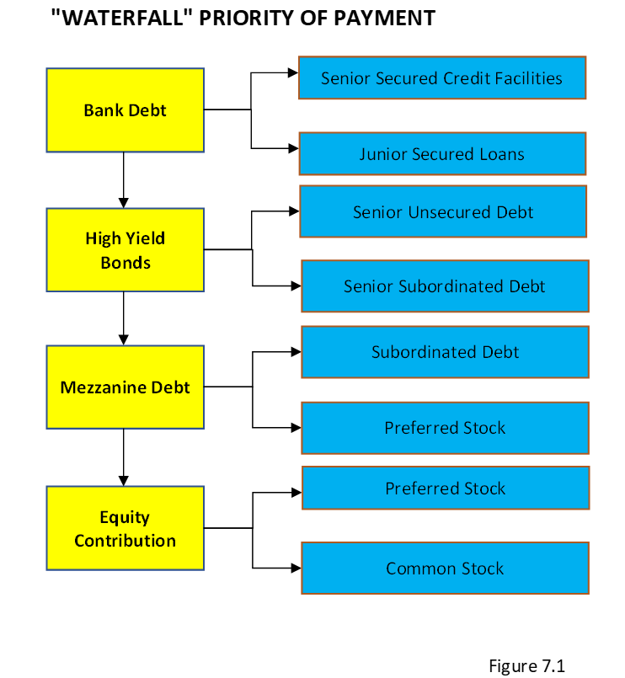
Corporate Debt: An Overview

Slide 3
Corporate Debt: TYPES
Unsecured Bonds
Unsecured bonds have a higher interest rate than secured ones given the risk of recovery in the case of bankruptcy.
Some unsecured facilities are further broken down by senior unsecured and subordinated facilities. The holders of subordinated facilities, sometimes referred to as high-yield or junk bonds, have a lower priority claim in the case of bankruptcy.
These bonds are typically used for leveraged buyout (LBO) transactions where the target companies have very aggressive capital structures.
The typical grading by S&P and/or Moody’s is below B and B1, respectively. Some high-yield or junk bond issues could be graded CCC and Caa1 by S&P and Moody’s, respectively.

Slide 4
Corporate Debt: TYPES
Secured Bonds
Mortgage bonds are corporate bonds backed by real estate assets
Collateral trust bonds are corporate bonds that are secured by financial assets or investments owned by the company such as stocks, bonds, or other investments.
Equipment trust obligations are debt obligations that are secured by equipment or physical assets.
Guarantee bonds are bonds where the interest and principal payments are guaranteed by a company other than the direct borrower of these bonds.

Slide 5
Corporate Debt: TYPES
Convertible Bonds
This type of bond is structured so that the holders of these bonds have the option to convert their bonds (debt) to stock (equity).
The methodology for converting bonds to stock is based on a ratio between stocks and bonds called the convertible ratio.
The formula to calculate the conversion ratio is as follows:
$$Conversion ratio=\frac{Par value}{Conversion price}$$

Slide 6
Corporate Debt: TYPES
Convertible Bonds
No matter what the bond price is when traded in the secondary market (market price), the numerator is at par value or $1,000. The conversion price is stated in the convertible bond indenture. For example, let’s assume the conversion price is $20 per share. Basically, the conversion ratio is calculated to be at 50 shares per one bond as follows:
$$Conversion ratio=\frac{\$1,000}{\$20}=50 shares:1 bond$$
Using the example, if the stock is trading at $25, the convertible bond holder will most likely convert from bonds to stock since the value of holding 50 shares (50 x $25 = $1,250) is higher than holding one bond valued at $1,000 par. The conversion parity is the point where the bond value is equal to the market value of the stock. Using the example, if the stock is traded at $25, the market value of the bond will be trading at premium of 125% of par to be in parity as follows:
$$Parity price of the stock=\frac{Market value of the bond}{Conversion ratio}= \frac{\$1,250 }{50 shares}=\$25$$

Slide 7
Corporate Debt: TYPES
Zero Coupon Bonds
Does not have to pay any cash interest during the life of the bond. Instead, the interest on these bonds is added to the principal amount and gets paid at maturity.
These bonds are issued at a deep discount from par value.
Companies that issue zero bonds are companies that might have initial negative or light cash flow,
Paid-In-Kind (PIK) Bonds
Paid-in-kind (PIK) bonds are structured as such that the interest payment is deferred for a certain number of years (PIKs are typically 3 years) and then the interest payment starts to be paid in cash.
PIKs allow a company to borrow more money without having immediate concerns about cash flow.
PIKs are considered high yield or speculative debt securities.

Slide 8
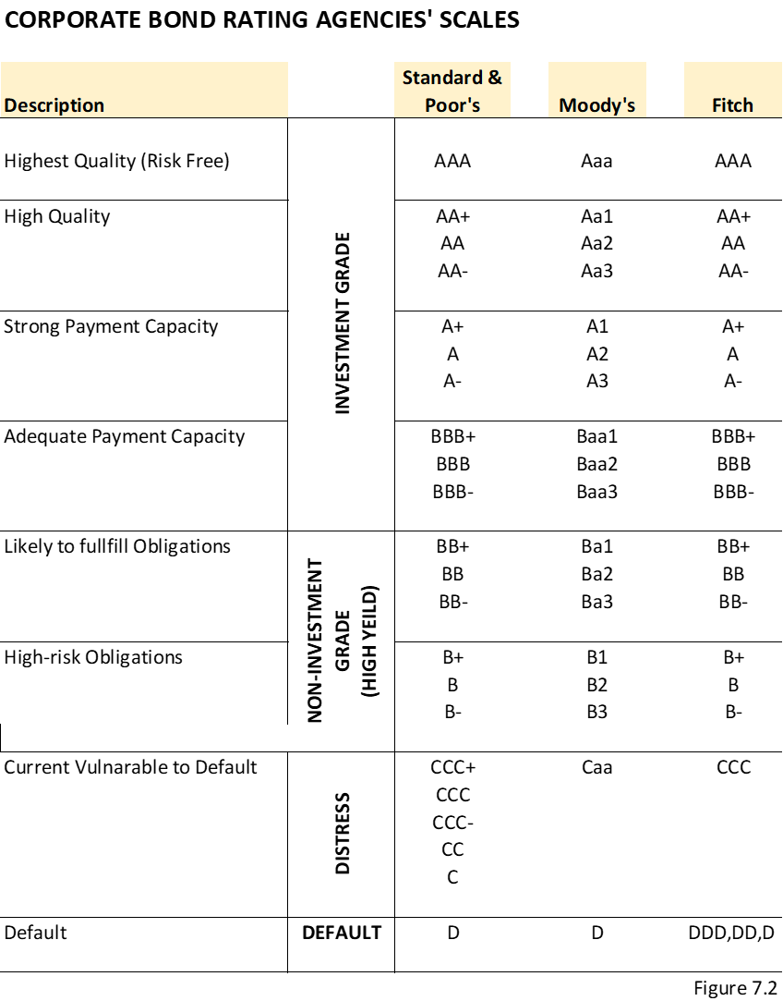
Rating Corporate Bonds
The companies issuing bonds in the public markets are required by the Securities and Exchange Commission (SEC) to be independently rated by at least two rating agencies before they are issued

Slide 9
Rating Agency Methodology
Industry Risk
Company-Specific Business Risks
Management Factor
Financial Risk Analysis
Cash Flow Forecasting and Modeling

Slide 10
Terms and Conditions of Corporate Bonds
Money Terms
Amount
Interest/price
Maturity
Payment
Non-Money Terms
Non-money terms are terms in the indenture that are not related to the amount, price, and maturity of the bond. However, terms such as optional redemptions, for example, entail that the price of the bonds will be paid if the issuer exercises the option to repay the bond value earlier than maturity (call price at certain call dates). Other non-money terms include covenants, permissions, and restrictions of the issuer while the bonds are outstanding.

Slide 11
Going to Market to Raise Corporate Bonds
Step I: Select the Investment Company/Underwriter
Step II: Preparing the Documents for the Bond Offering
Step III: SEC Registration and Approval
Step IV: Marketing the Bond Offering
Step V: Indication of Interest
Step VI: Closing, Funding, and Free to Trade

Slide 12
Bond Investment Concepts
Yield to maturity (YTM)
Yield to call (YTC)
Yield to worst (YTW)
Current yield (CY)
Duration (D)
Convexity (C)

