Slide 1

Credit and Banking
Professor Chris Droussiotis
Summer 2019

Slide 2
Banking - Overview
Commercial Banking / Retail Banking
  Intermediary between customers who save money and customers who borrow money
  Taking Deposits
Investment Banking
  Broker/Dealer
    Underwrite Initial Securities – Raising Capital
    Sales and Trade (Stock, Bonds and Derivatives)
  Advice
    Mergers & Acquisitions – Valuation
    Raising Capital
    Research / Recommnedations

Slide 3
Banking Overview
FRONT OFFICE
  Customer facing services
    Corporate Finance: Underwrite, Lending / Investing (Primary Market)
    Sales & Trade – (Secondary Market)
    Advisory and Research
MIDDLE OFFICE
  Risk Management
    Market Risk
    Credit Risk
    Operating Risk
    Liquidity Risk
BACK OFFICE
  Operations / IT (Technology) & Compliance

Slide 4
Corporate Banking & Credit Overview
    Corporate Banking
      Underwrite & Lending (Primary or Capital Market)
        Equity Markets (IPO) and Follow-on offering
        Debt Markets
          Corporate Bond Markets
          Private Placement Markets
          Loan (Credit) Markets

Slide 5
Credit Markets
Investment Grade Loan Market
Rated BBB- and Higher (Corporate)
Arrangers hold Higher Exposure ($200 million +)
The majority of the Syndicate are traditional banks
Leveraged Loan Market
Rated BB+ and Lower (Corporate)
Arrangers hold Lower Exposure – thus the need to syndicate
The majority of the Syndicate are non-banks (Financial institutions)
Leverage Loan Market purpose:
Leverage Buyouts (LBO)
Acquisitions using substantial debt
Refinancing
4

Slide 6
Credit Markets
Typical Internal Analysis Process by Credit Analyst
  Internal Application sent to their respected investment/credit committees. This application includes the following:
    Requested amount that is within the rating parameters for each bank
    Recommended amounts by Tranche (Revolving Credit / Term Loans)
    Term and Conditions of the Loans (includes pricing, structure and covenants)
    Profitability (RORA and RAROC)
    Syndication strategy
    Transaction discussion including Source and Uses and Capital Structure
    Company discussion including historical performance and outlook
    Corporate Structure
    Management Biographies / Equity Sponsor Profile
    Collateral Analysis
    Industry Analysis
    Financial Analysis (Projections’ Model)
    Internal Rating Analysis
  Internal Legal Review
  KYC (know-your-customer) and Compliance Review
18

Slide 7
Credit Analysis Overview
Typical Internal Rating Analysis
  Most banks’ internal ratings are in line with the Agencies’ external ratings, though the analysis is done independently. This analysis is based on two approaches:
      Quantitative Analysis
      Qualitative Analysis
The Typical Scale is 1-10, 1 being with very limited risk to default and 10 the issuer being in bankruptcy with no chance of recovery
  The Quantitative Analysis for establishing the Internal rating which measures the probability of default is based on the following parameters (each component is weighted at a specific level of importance):
      Leverage Ratio - the relationship between debt and earnings (i.e. DEBT / EBITDA)
      Capitalization Ratio – the relationship between the bank debt and the rest of the capital (Capital Leases, Bonds, Equity)
      Coverage Ratio - Issuer’s Cash Flow covering it’s debt obligations (interest and principal payments)
      Variance of Projections – based on the projections, the model typically assumes a certain haircut (10-30%) to the management’s projections and it tests it’s ability to pay its debt obligations.
      The Quantitative approach adjusts up or down based on industry characteristics (Recession resistance, cyclical, or event driven).
  The Qualitative Analysis is subjective based on each bank’s internal policy. The Analysis would include strength of management, support from the equity sponsor, recovery analysis (asset collateral) and outlook.
19

Slide 8
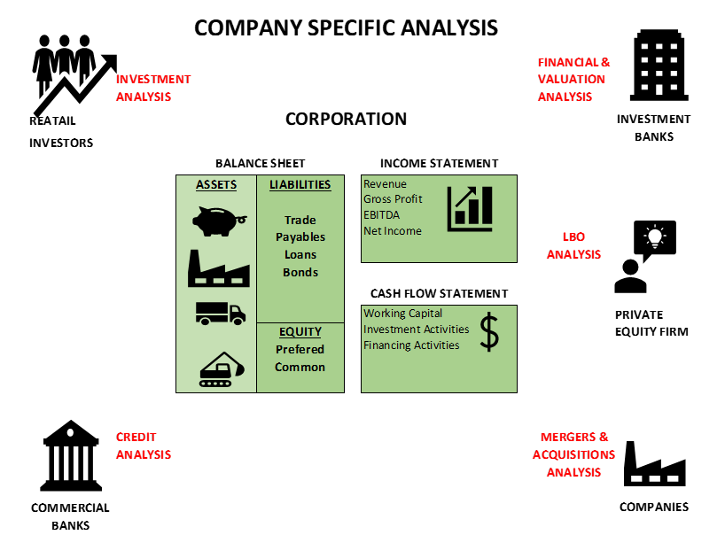
The Three Main Areas of Credit Analysis:
Review of financial statements and apply credit related ratios
Debt Capacity Analysis
Risk and Credit Restructure Analysis

Slide 9
Review of financial statements and apply credit related ratios

Slide 10
Understanding Financial Statements
There are three primary financial statements:
Income Statement
Balance Sheet
Cash Flow Statement.

Slide 11
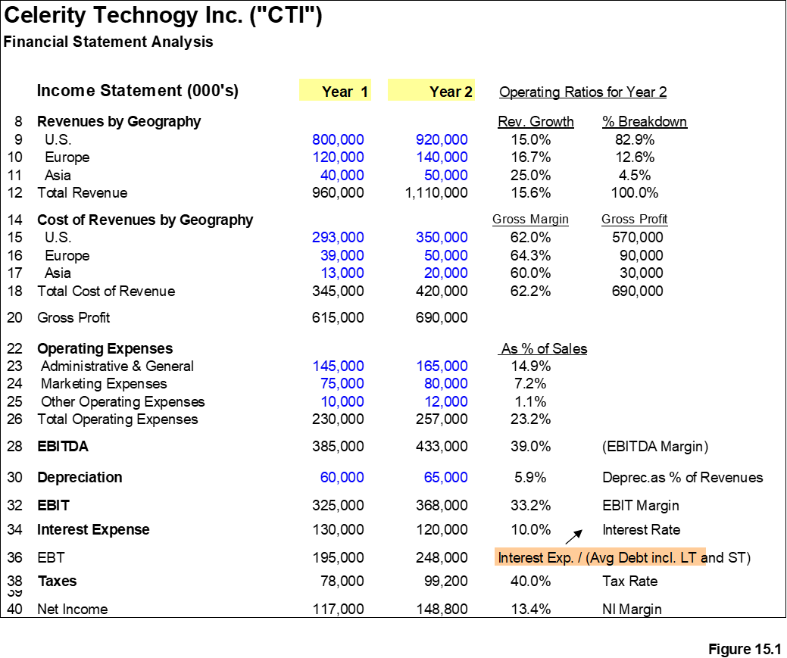
The Income Statement
Is a summary of the company’s profit or loss over a period. It reports the revenues, expenses and net profit or net loss over a quarter or a full year

Slide 12
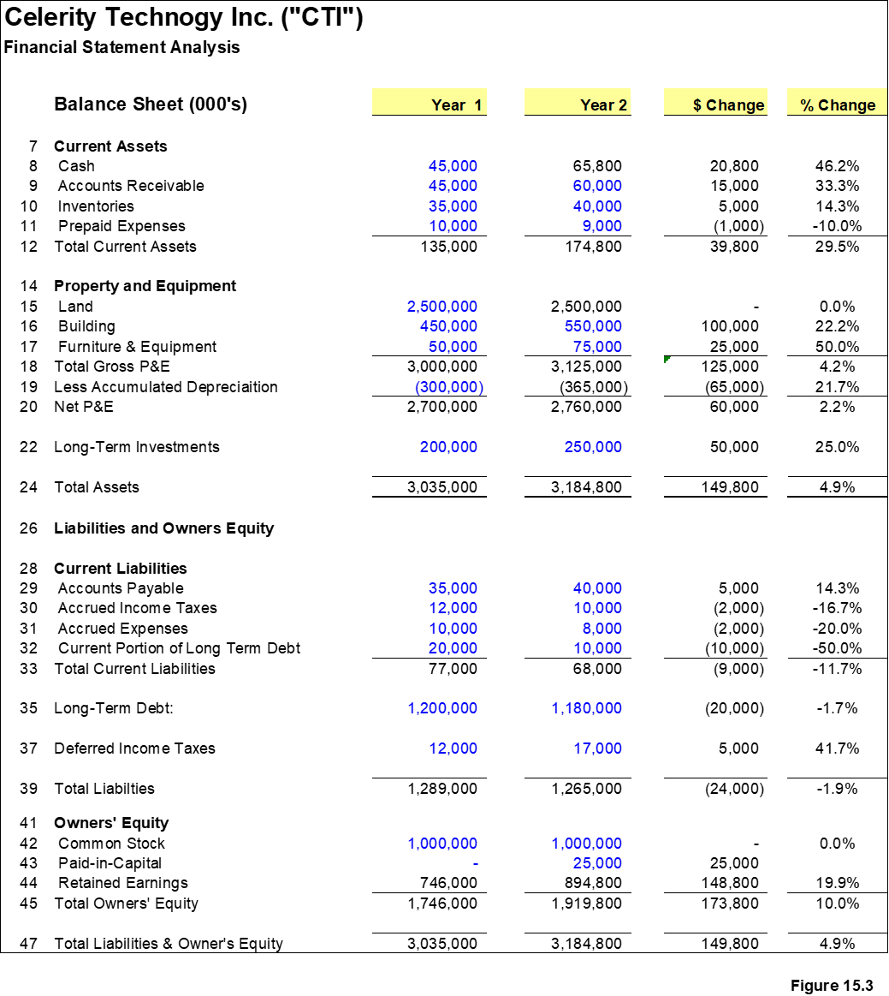
The Balance Sheet
It represents the wealth or the financial condition of the company

Slide 13
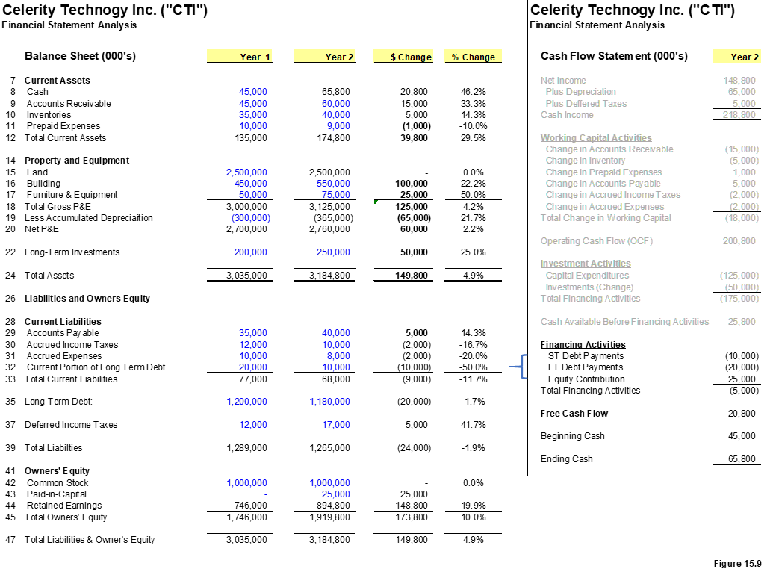
The Cash Flow Statement
It represents the cash inflow and outflow of the company

Slide 14
Objective of Ratio Analysis and Credit Parameters
Use the various ratio analysis methods to measure how well the company manages their debt (solvency ratios), how well they manage their cash (liquidity ratios) and how profitable they are and how will they fair in economic turmoil (profitability ratios) once we run various stress case scenarios.
Use the specific ratio analysis methods to capture asset efficiency, and collateral coverage
Use the ratio analysis to structure the debt capacity of any company including the appropriate starting leverage and ongoing coverage of the company’s contractual debt obligations.
Build-in warning signal ratios of deterioration such as the Altman Z-score credit parameter.
Use customized ratios based on industry drivers to measure revenue growth and cost structures and change those to sensitize the company’s performance during economic cycles or commodity price fluctuations.

Slide 15
Usefulness of Ratio Analysis
To complete the full credit risk assessment of a company, the analyst should compare ratio results:
With past results to establish how well they are trending;
With the company’s peers to establish how well they are performing versus the bench mark;
With the company’s budget to establish management credibility of meeting its business plan.

Slide 16
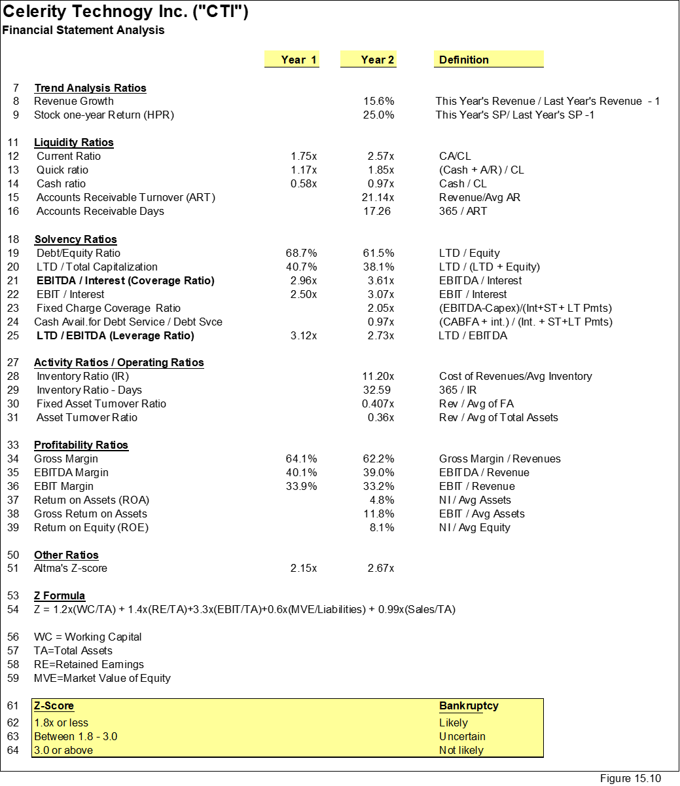
Financial Ratios
Understanding how to interpret financial statements does not purely involves looking at the trends between years such as revenue growth to determine how the company is performing

Slide 17
Five areas that the Risk Credit Analysis should focus:
A lot of the commercial banks and institutions that lend money to corporations, as well as credit agencies focus on the following five areas of analysis:
Loan to Value or Debt Capitalization ratio.
Leverage Ratio of Debt to EBITDA: This solvency type ratio, well know as the Leverage Ratio, is one of the most popular ratios to analyze the credit of a company
Coverage Ratios including EBITDA / Interest and Cash Flow to Debt Service
Run a 30% haircut across operating assumptions to test profitability and cash flow
Adjust and customize operating ratios based on the company’s business that can be cyclical, seasonal or depend on commodity pricing

Slide 18
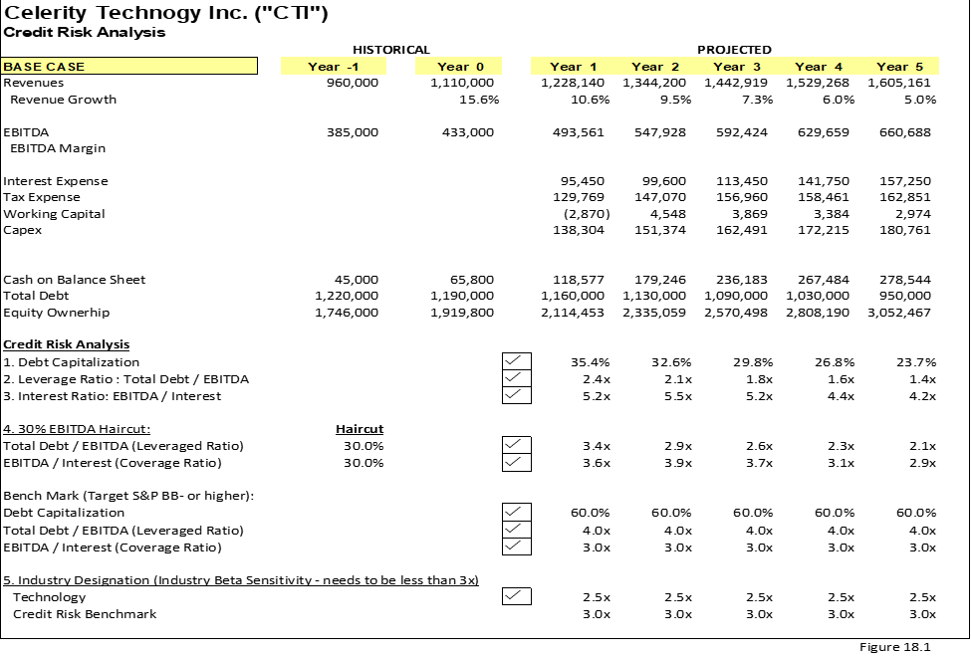
Credit Risk Analysis

Slide 19
Debt Capacity Analysis

Slide 20
Objective of Debt Capacity Analysis
This ratio which has been one of the most controversial ratios used to measure debt capacity has been changing every year based on risk appetite of the banks.
Pre-financial crisis of 2008, leveraged buyout transactions were structured on average of 7.0 times leverage. During the financial crisis any deal that got done was done less than 5.0x and post financial crisis, the leverage ratio climbed up to 6.0x, so on a $100 mm acquisition of a Company with a $10 million EBITDA, the $40mm needs to be paid with Equity (40%) because the market capacity is 6x$10 = $60 million of Debt – the extra multiple (4x on a 10x acquisition multiple) needs to come from Equity.

Slide 21
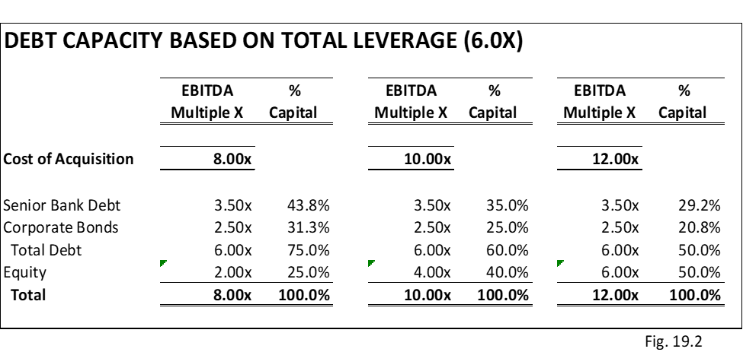
Debt Capacity based on Total Leverage
  For example, the negotiation turns out that the price is raised to $120mm, the equity needs to make up the difference since the debt level has met its maximum capacity.

Slide 22
Debt Capacity Based on Loan to Value (Total Debt /Total Assets or Total Debt / Enterprise Value)
Many commercial banks have developed the asset-based loan business (ABL) where the debt capacity is based on the book value of the company’s assets by multiplying the latest reported assets by an assigned advance rate or loan to value rate.

Slide 23
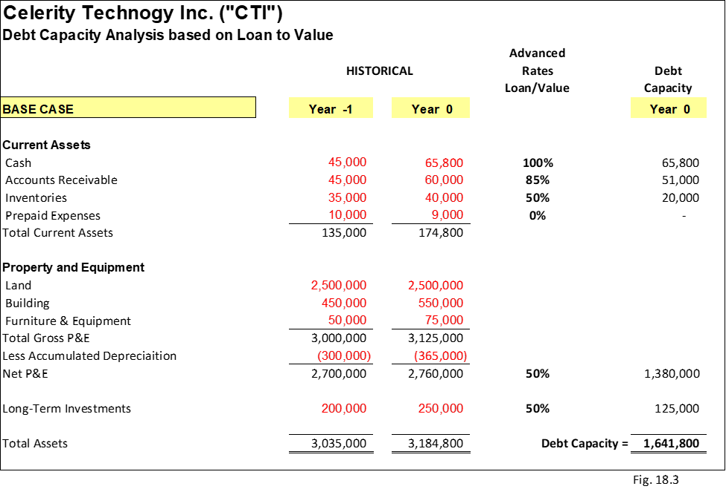
Debt Capacity Based on Loan to Value (Total Debt /Total Assets or Total Debt / Enterprise Value)
The advanced rate is determined at the time based on the company’s strength of assets. For example, cash has the strongest coverage with 100% advance rate and inventory is analyzed closely before applying an advanced rate. Raw materials could be viewed that has higher value than work-in-process inventory or lower than finished good inventory. These categories of inventory are based on comfort level for each bank. The banks developed a list of these assets to loan against, sometimes, referred to eligible assets.

Slide 24
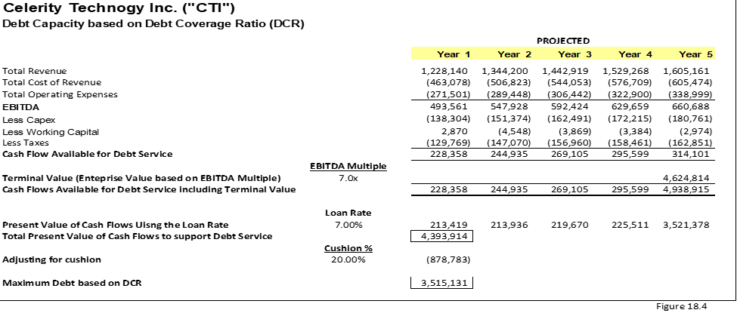
Debt Capacity Based on Debt Coverage Ratio (DCR)
The Debt Coverage Ratio (DCR) method of calculating debt capacity is similar a Discount Cash Flow (DCF) method of calculating the firm and equity values. The difference is that the stream of cash flows is before debt service and the discount rate used to calculate the present value of these cash flows is the loan rate that the bank will charge the customer based on their risk rating.

Slide 25
Risk and Credit Restructure Analysis

Slide 26
Objective of Risk and Credit Structure Analysis
These analytical methods are designed to focus primarily on the ability of the company to pay back its debt obligations in a timely fashion and are used by the bank to obtain an approval before the loan was funded
Calculate the losses if they decide to sell off their debt investment to other lenders for the best possible price – possibly selling at a discount; or
Calculate the losses if they decide to stay in the credit and work with the company through their tough times and hopefully they will have a better outcome.

Slide 27
Recovery Analysis
The basic assumption of any recovery analysis is to assume that if the company files for bankruptcy the debt obligations will be considered as claims.
Valuing the enterprise in a distressed scenario:
Collateral Analysis:

Slide 28
Cost of Capital Analysis
The credit analyst needs to review whether the business can be restructured or whether it will be sold or liquidated and closed.
Restructuring Option
Business Sale Option
Liquidation Option

