Slide 1







Chapter 9: Corporate Loans
Chapter 9
“Credit Risk Management & Analysis”

Slide 2
Corporate Loans: An Overview
Unlike corporate bonds, corporate loans are issued by companies that need flexibility during the repayment process.
These corporate loans are provided by banks and structured as floating rate loans based on an index, such as the London Inter Banking Offering Rate (LIBOR), plus a negotiated spread determined by the issuer’s credit quality.
These loans may be backed by collateral or be unsecured and backed by the “good faith” of the corporation.
In a bankruptcy, corporate loans have the highest priority of payment.

Slide 3
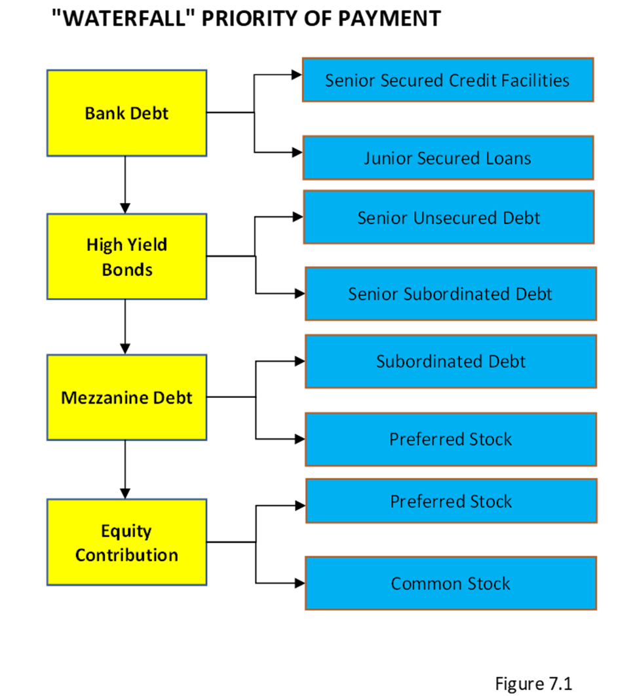
Corporate Loans: An Overview
“The Waterfall” or priority of payment, in a bankruptcy, bonds are viewed higher in the capital structure than stock

Slide 4
Corporate Loans
Revolving Loan Facility (Revolver)
Asset-Based Lending Facility (ABL)Mortgage bonds
Term Loans
Second-Lien Term Loans
Mezzanine Loans and Notes
Unitranche Term Loans
Other Types of Bank Loans
Debt-In-Possession Loan (DIP)
Bridge Loans
Swing Loans
Project Finance Loans

Slide 5
Revolving Loan Facility (Revolver)
The revolving loan facility or revolver provided by a traditional commercial bank is a variable line of credit used by companies to primarily fund working capital needs.
This revolver is one of the most flexible debt facilities that a company obtains from a bank. It can borrow and be repaid at any time and typically for any reason.
It provides short-term liquidity and in many cases the company uses the revolver as a guarantee letter of credit for ordering their raw materials and supplies.
The pricing is made up of two rates: an unfunded rate called a commitment fee, plus a funded interest rate based on the LIBOR, plus a negotiated spread based on the quality of the borrower. Commitment fees are calculated as a percentage of the unfunded portion of the facility, typically 0.35–0.50%.
The amount determined by the bank is based on the company’s working capital needs and expected cash flow. This amount is often highly negotiated as the company is trying to obtain the best possible flexibility to fund its short-term cash flow setbacks.
Seasonal companies, such as retailers that build up their inventory before the holidays in November and December, are heavy users of revolver credit. The rule of thumb for a traditional user of a revolver is for the amount to be set at 1.0x EBITDA.

Slide 6
Asset-Based Lending Facility (ABL)
This type of revolver is structured based on the company’s current assets such as accounts receivable and inventory.
The lender has a priority of payment over the borrower’s current assets.
The term loans provided, also by the banks, have a second priority claim on these assets.
The amount that can be drawn under this facility is based on a set advance rate against the pledged assets.
Typically, accounts receivable, which has the highest liquidity after cash, draws advanced rates of 85%. Inventory typically carries 50% advance rates, but they can be dependent on the individual business and current situation.
Since ABLs are directly secured by the most liquid collateral, the interest rate charged is significantly lower than bank revolvers and term loans (1–2% lower), which rely on the company’s future cash flows for debt repayment.

Slide 7
Term Loans
Unlike the revolver, term loans are one-time loans provided by a traditional bank and are typically used for acquisitions, purchasing equipment, and real estate.
A term loan typically carries a floating interest rate based on a benchmark like the U.S. prime rate or LIBOR plus a negotiated spread based on the quality of the borrower.
The interest and principal payments for such loans are typically paid on a quarterly basis for 5–7 years. Throughout the years, terms loans have developed to be marketable in the secondary markets.
This led to ratings being assigned to these loans, similar to bonds, by the rating agencies.
Also, these term loans are sometimes structured in various tranches like term loan A and term loan B, or even term loan C or term loan D.
Each tranche can be priced differently based on maturity and scheduled payments. Term loan B is one of the most marketable debt facilities that represents the loan secondary market, often called Term loan B markets.
Most collateral loan obligations (CLOs) use term loan Bs in their portfolio and trade these securities frequently in the secondary market.
The scheduled principal repayment for these term loan Bs are structured similar to that of bonds with most of the repayment being made at maturity (bullet payment).
Typically, a 7-year term loan will have a scheduled amortization payment of 1–2% per year for the first 6 years with the balance (other 94%) being paid in the seventh year.

Slide 8
Term Loans (Continued)
Pricing
The LIBOR
The spread
Original issuance discount (OID)
To calculate the loan-yield the analyst needs all the sections of pricing, as described. The formula is as follows:
Annual loan yield = LIBOR or LIBOR floor + spread + (100 – OID) / 4 years
For example, a term loan B is priced at LIBOR or LIBOR floor of 1% plus 4% spread and OID of 98. Assuming current LIBOR is 1.5%, the original issued yield is calculated as follows:
First, since LIBOR is higher than LIBOR floor (1.5% versus 1.0%), the LIBOR is used as the benchmark to calculate yield:
Annual loan yield (%) = 1.5 + 4.0 + (100-98)/4 = 5.5 + 2/4 = 5.5 + .5 = 6.0

Slide 9
Term Loans
Example:
Figure 9.1 shows Colorado Dental’s scheduled principal and interest payments for both term loan A and term loan B based on an assumed increased LIBOR.

Slide 10
Second-Lien Term Loans
Second-lien term loans are more popular in mid-cap LBO transactions.
In the last few years there has been a shift in replacing unsecured bonds with second-lien term loans to provide the company and the private equity buying or owning the company with the flexibility of restructuring the debt in the future
A second-lien term loan is a secured loan that has a subordinated or second lien claim to collateral pledged as a means of securing the term loan and revolver.
In a bankruptcy that results in a forced liquidation, the second-lien term loan may receive proceeds from the sale of assets pledged to secure the loan, but only after senior term loan holders have been paid.
Due to the second-lien nature of this loan, second liens carry more risk for lenders than senior-term loans. As a result, these loans usually have higher borrowing rates, typically 1–2% higher than term loans.
Analysts that attempt to weigh the default risk before approving a second-lien loan usually assess many of the same factors as first-lien lenders. This includes borrowers’ leverage ratios such as total debt to EBITDA, total debt to total capitalization (total debt/ (total debt + equity), and credit ratings.

Slide 11
Mezzanine Loans and Notes
Mezzanine financing is placed between senior loans and equity, hence the name “mezzanine.”
A typical structure would be a hybrid of debt and equity financing that gives the lender the right to convert to an equity interest in the company in case of default on the loan.
Given the financial risk, pricing is set much higher than on senior loans (12% to 20%). Mezzanine financing is structured to replace part of the capital equity investors would otherwise have to provide the company.
For example, a company would seek financing for $20 million and put in $30 million of its own funds for the buyout (the purchased company’s assets are generally placed as collateral for the loan).
The mezzanine lenders will look to gain equity in the business through structured warrants allowing the purchase of equity later, sometimes at an agreed-on rate. Basically, mezzanines are structured originally as debt that entitles the issuer to receive interest payments with the upside of equity returns if the company succeeds.

Slide 12
Mezzanine Loans and Notes (Continued)
Mezzanine financing is placed between senior loans and equity, hence the name “mezzanine.”
A typical structure would be a hybrid of debt and equity financing that gives the lender the right to convert to an equity interest in the company in case of default on the loan.
Given the financial risk, pricing is set much higher than on senior loans (12% to 20%). Mezzanine financing is structured to replace part of the capital equity investors would otherwise have to provide the company.
For example, a company would seek financing for $20 million and put in $30 million of its own funds for the buyout (the purchased company’s assets are generally placed as collateral for the loan).
The mezzanine lenders will look to gain equity in the business through structured warrants allowing the purchase of equity later, sometimes at an agreed-on rate. Basically, mezzanines are structured originally as debt that entitles the issuer to receive interest payments with the upside of equity returns if the company succeeds.
The borrowers could prefer mezzanine debt instead of equity if there is enough support because the interest is tax deductible. Also, since the mezzanine investor has the best interest of the company in mind (potential equity ownership), he or she might be willing to amend certain terms to help the company through tough times.

Slide 13
Mezzanine Loans and Notes (Continued)
Figure 9.2 shows an example of Colorado Dental LBO structure purchased by a private equity firm for $1.08 billion that includes bank loans, mezzanine notes, and equity.

Slide 14
Unitranche Term Loans
Unitranche debt is a type of structured debt that combines senior and junior loans into one debt vehicle.
These senior and junior loans are awarded different priority of payment or pricing in one loan agreement during the structuring of the security.
This type of loan is obtained from one or multiple participants that are interested in the combination of the different term structures.
It is typically arranged by financial institutions and not your traditional bank and allows the borrower to raise funds with a one-stop-shop arrangement that only requires one approval process.
Combining different debt structures from different investors that have their own risk assessment and purposes allows the total debt package to be more comprehensive, tailored, and marketable in the secondary market.
The borrower in this case will make one interest payment to one lender with the cost of the loan (interest rate) being a blend between a traditional bank-secured loan and a subordinated loan such as a second-lien and/or mezzanine loan.

Slide 15
Unitranche Term Loans (Continued)
Unitranche loans serving middle-market companies are typically structured as non-amortizing loans. In many cases, these are made to riskier borrowers with the structure possibly utilizing a PIK-interest toggle as well as equity kickers. A PIK or paid-in-kind interest toggle is a mechanism that allows the interest payment to be converted to a form of cash paid subsequently to finance-deferred payments. Equity kickers are mechanisms that allow investors to obtain equity at different points during the loan term.
There are two types of unitranche loans:
  Straight unitranche are loans that are provided by one lender or a syndicate of lenders. A straight unitranche loan represents a senior stretch loan. The name “stretch loan” comes from the idea that the lender stretches the seniority to leverage ratios of total debt to EBITDA of five to six times instead of breaking up the facilities into senior and junior loans.
  Bifurcated unitranche are structures that separate the principal into first-out and last-out tranches, as discussed.

Slide 16
Other Types of Bank Loans
Debt-In-Possession Loan (DIP)
Debtor-in-possession financing (DIP financing) is a special type of financing that aids and gears companies for the process of either filing for bankruptcy or a reorganization.
Those companies that are considered financially distressed will generally seek additional financing to cover short-term liquidity while the rest of the debt is restructured post-bankruptcy.
The facility is therefore a bridge to facilitate the short-term needs of the company until post- reorganization and bankruptcy. DIP financing has immediate priority of payment over existing debt, equity, and other claims.
Bridge Loans
Bridge loans are short-term loans that are used for cash until the company can secure more permanent financing.
Bridge loans are designed so that the company is able to close on a specific transaction that requires quick funding and execution, such as an acquisition or leveraged buyout (LBO).
Bridge loan participants charge high fees and interest rates once funded and could insist on interest rate escalation if the bridge objective is not accomplished within the expected time frame. Bridge loans are very popular when the company is in the process of raising public debt or equity for a specific transaction.

Slide 17
Other Types of Bank Loans (Continued)
Swing Loans
This is a loan that is offered by the lead syndication arranger that includes all the terms of the loan in the credit agreement.
The swing loan, which has a maximum cap, is used as a quick liquidity loan for the company to manage same day working capital needs.
In a large syndication with multiple lending banks, implementing a revolver could be a bureaucratic nightmare. It is tedious to have all the banks fund their share of a revolver.
Therefore, as compensation, the administrative bank is asked to fund the working capital on behalf of the other lenders.
The swing facility is usually repaid shortly thereafter (within a few days), so there is no real incentive to having additional banks involved in the financing.

Slide 18
Other Types of Bank Loans (Continued)
Project Finance Loans
Project loans are used to finance infrastructure and industrial projects.
A project loan is structured to include the interest payment during construction and is repaid with a more permanent loan after the project is completed or rolled over into a permanent-term debt facility.
The facility is then paid back with the cash flow generated by the project. Project financing is a loan structure that relies primarily on the project's cash flow as repayment and is secured by the project’s assets.
A project loan is a non-recourse loan and is structured to finance three distinct phases of a project’s initiation process; the three phases draw the connotation BOT standing for build, operate, and transfer.
Project loans finance the BOT projects via a special purpose vehicle (SPV).
The riskiest period of the loan for both the borrower and the lender is during the construction phase.
The expected repayment in this phase relies on an off-take contract or a power purchase agreement in the case of an energy project.

Slide 19
Raising / Issuing Corporate Loans
In a larger syndicated transaction involving a facility known as a broadly syndicated loan (BSL), typically raised in tandem with the bond issue, the agencies rate the bonds, and the underwriter will also ask for ratings to be assigned to the associated loans

Slide 20
Types of Loan Syndication
Fully Underwritten
This is where the loan underwriters or arrangers of the loans guarantee the entire commitment, then syndicate the loan to reduce their exposure.
Similar to a bond underwriting, if the arrangers cannot fully subscribe the loan, they are forced to absorb the difference and take full market risk.
The incentive for the arrangers to take such market risk is embedded in the transaction. A fully underwritten loan can be a very competitive tool for arrangers to win a mandate.
Also, the arranger requires higher fees and can profit off the spread it charges over its associated cost.
Best-Efforts Syndication
This is where the underwriter or arranger commits to underwriting less than the entire amount of the loan. If the loan is undersubscribed, the deal may not close unless the terms/pricing/structure are changed (revisiting the terms).
Best-efforts syndications are used for risky borrowers or for complex transactions.
Club Deal
This arrangement is a very typical financing arrangement for smaller and middle-market transactions and involves a pre-marketed offering to a group of issuers or equity sponsors called relationship lenders. T
The arranger is generally a first among equals, and each lender gets a full cut of the fees.

Slide 21
The Loan Syndication Process
The loan syndication process starts from a handful of arrangers who solicit bids to win the mandate of a specific deal.
These arrangers provide the company or the sponsor with information including an outline of their syndication strategy and their view on the way the loan will be priced in market.
After all the solicitation processes are completed by the potential arrangers, the following process is executed:
The issuer gives the mandate to one or more arrangers (co-arrangers).
The arranger will prepare an information memo (IM) describing the terms of the transactions.
A bank meeting is scheduled at which potential lenders hear from the management and the investor group.
A deadline is given for the banks to send their commitment levels that are subject to final documentation.
Each bank analyzes the deal’s credit and assesses the pricing (RORA). Each issuer is assigned an internal rating.
The arranger collects all commitments, different amounts from each bank.
Allocations are given and legal documentation is sent for final review.
After review and signatures of legal documents by each lender, the deal closes and is funded.

Slide 22
The Loan Syndication Process

Slide 23
Terms and Conditions of
Corporate Loans
Money Terms
Amount
Interest
Maturity/Term
Principal Payment
Non-Money
Financial Covenants
Negative Covenants
Affirmative Covenants

