Slide 1





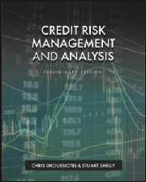

Chapter 8: External Credit and Other Credit Analysis
Chapter 8
“Credit Risk Management & Analysis”

Slide 2
External Credit and Other Credit Analysis - Overview
In a larger syndicated transaction involving a facility known as a broadly syndicated loan (BSL), typically raised in tandem with the bond issue, the agencies rate the bonds, and the underwriter may also ask for ratings to be assigned to the bank loans.
The ratings for loans are desired to make these loans more marketable to funds like CLOs and BDCs who will purchase and trade these securities in the leveraged loan market.
Many CLOs, discussed earlier and again in later chapters, are limited to buying securities, and loans, rated by recognized rating agencies such as S&P and Moody’s.
As in the case of bonds, the ratings assigned to loans, primarily term loan B, are measuring the likelihood or probability of default.
The rating is usually one or two credit levels higher than the public bonds given the seniority in the structure.

Slide 3
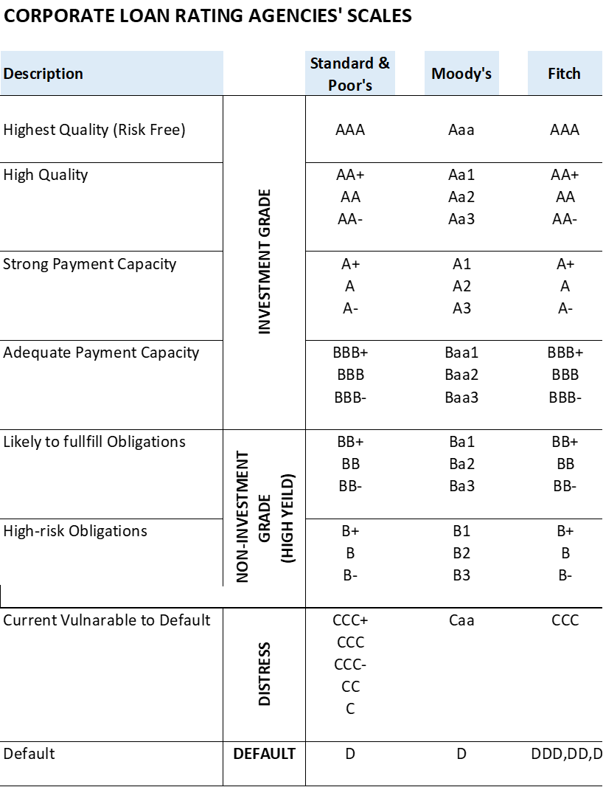
Corporate Loan Rating Agencies’ Scales

Slide 4
Rating Corporate Bonds & Loans
The companies issuing bonds in the public markets are required by the Securities and Exchange Commission (SEC) to be independently rated by at least two rating agencies before they are issued. I
n conjunction with rating the bonds, the rating agencies are asked to rate the loans that are part of the same transaction.
Conceptually, the rating that is assigned to the firm issuing the bonds and loans represent the proxy for the probability of default, based on the predictability of its’ cash flows and ability to service the levels of debt it has.
The rating agencies’ sole objective when measuring the risk of default for bonds is to protect the public investor who is not sophisticated enough to analyze the risk of the company, nor the specifics of a particular bond issue, and measure the probability of default.
The purpose of rating of the loans has a different objective since these loans are sold to sophisticated institutions that have their own inhouse credit assessment and review process.
The objective is to make these loans more marketable to those CLOs, which are set-up to only include third-party rated loans to indirectly protect their investors.

Slide 5
Rating Corporate Bonds & Loans
The rating agencies such as Standard & Poor’s (S&P), Moody’s, and Fitch assign two to three separate ratings:
The company that is specifically issuing the bonds and loans (sometimes an SPV or parent or operating subsidiary of a public company).
The bonds themselves, and in many cases
Large, syndicated bank loans, which are being bought by an array of CLO and BDC funds.
All three rating measurements focus on the credit strength of the company and the likelihood that debts are paid. They are essentially woven into the ratings themselves and can affect the borrowers’ access to corporate bond and bank loan opportunities.

Slide 6
Rating Corporate Bonds & Loans
Risk Free (AAA) and Investment Grade Loans/Bonds (AA+ to BBB-)
  Highest Quality Rating (Risk-Free) (AAA)
  The highest ratings possible.
  Only a handful of companies have a “Triple A”, or “A Double A” rating, and it is not an active market for corporate entities since there is always some embedded risk of running a company.
  The AAA rating is assigned primarily to specific portfolio funds such as collateralized loan obligations (CLOs) that are protected by a well-structured portfolio of loans and ample cushion of equity capital below the rated CLO securities (discussed in detail in later chapters).
  Typical AAA issuers are wealthy countries who issue short and long-term securities, like U.S. Treasury Notes and Bonds that are considered, at least from likelihood of default, risk-free investments.
  Investment Grade Bonds (BBB- to AA)
  A bond is considered investment grade (IG) if the rating is BBB-, or Baa3 and higher, by S&P and Moody’s, respectively.
  Not only can the issuer’s interest rate or coupon rate be substantially lower with a non-investment grade rating, but also certain capital structures could be more flexible as well as they may obtain less restrictive terms and conditions of the bond indenture.

Slide 7
Rating Corporate Bonds & Loans
Non- Investment Grade Loans/Bonds (BB+ to B-)
  Non-investment grade, high-yield bonds, and leveraged loans are debt securities issued by corporations with ratings of BB+ and Ba1 or lower by S&P and Moody’s, respectively.
  High-yield bonds are for companies that are seeking growth, or acquisition capital (i.e., M&A or LBO), working capital, recapitalization, refinancing existing debt, or other cash flow purposes.
  Since these issuers are riskier given the lower ratings, they must offer a higher interest rate and, in most cases, have additional investor-friendly structural features, such as security and restrictive covenants.
  The high-yield bond was originally developed in the late 80s by Michael Milken, also referred to as the “junk bond king,” while he was at Drexel Lambert, an investment bank. This type of corporate bond was developed to finance the mega leveraged buyout (LBO) deals in the 80s such as the KKR buyout of RJR Nabisco, illustrated in the satiric book and movie Barbarians at the Gate (Burrough & Helyar, 1990).
  Though these bonds are sometimes called junk bonds (typical B, B-, and CCC+ rated bonds) and have given the asset class some negative connotation over the years, this asset class has matured into a solid 25% of the overall corporate bond market, according to Bond Market Association estimates.

Slide 8
Rating Corporate Bonds & Loans
Distress Loans/Bonds (CCC+ to C)
  These bonds are securities that a company will issue when experiencing financial and operational difficulties and is near or under bankruptcy.
  Many investors, primarily hedge funds or “vulture funds,” buy these bonds because they believe their market value is lower than the ultimate price recovery after a restructuring.
  Distressed bonds may be issued in conjunction with a corporate restructuring in conjunction with, or to avoid, bankruptcy.
  The investment thesis of a distressed bond buyer is that when the company enters a period of financial distress, the original investors often sell automatically at any price as part of their investment policy.
  Insurance companies, for instance are restricted on how much of their investment portfolio can be allocated to NAIC 3, 4 or 5 (below IG NAIC ratings – the NAIC is the National Association of Insurance Commissioners).
  Many funds such as collateralized debt obligations (CDOs) are structured to maintain consistent average credit for their portfolio, meaning when one of their portfolio holdings gets downgraded to CCC+, for example, the asset manager needs to sell immediately without necessarily analyzing the recovery values of these bonds.
  The company, “fighting for its life,” will prefer bond holders that have the best interest of the company’s future in mind post-bankruptcy. Therefore, the exchange of normal investors to distress buyers might impact their value expectation.

Slide 9
Rating Corporate Bonds & Loans
Defaulted Bonds (D) and Selective Default Bonds/Loans (SD)
  These are bonds where the issuer has failed to meet the debt obligation.
  Once the company fails to pay interest or principal payment of any debt, the rating agencies automatically downgrade the issuer and bonds.
  Sometimes the rating agencies, such as S&P, will give an “SD” or select default rating. This rating is assigned when the rating agency believes that the issuer has selectively defaulted on a specific debt facility but that it will continue to make payments on the other debt facilities. T
  hese bonds could be very interesting investment opportunities, as they may represent a pending restructuring which could improve the bonds credit ratings immediately, while the default may represent a small pause in their debt service, recovered with penalties and fees upon the restructuring.

Slide 10
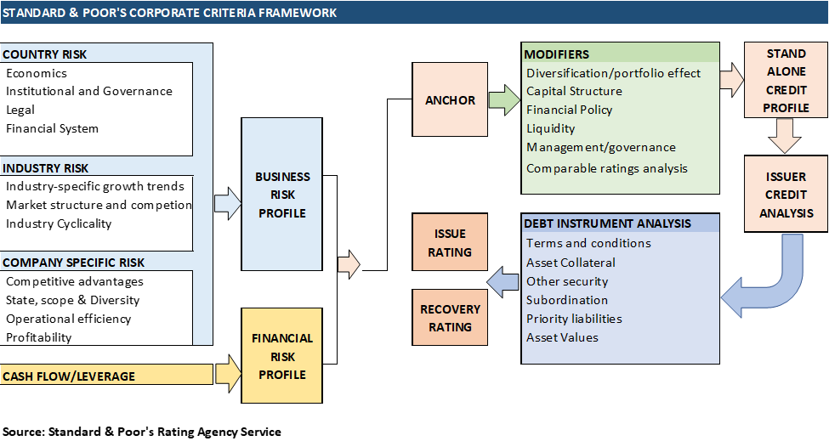
Rating Agency Methodology

Slide 11
Country Risk
All rating agencies factor in their credit rating assessment the location of the company’s operations as it views that the bonds or loans placed in that company could be affected from external factors such as the local economy, the government regulation and political risk. Standard & Poor’s defines "country risk" as the “broad range of economic, institutional, financial market, and legal risks that arise from doing business with or in a specific country and can affect a non-sovereign entity's credit quality”.
Standard & Poor’s rating agency’s rating levels and description is as follows:
  • AAA: The best quality countries, reliable and stable such as Germany*
  • AA: Quality countries, a bit higher risk than AAA such as the UK* and USA*
  • A: Economic situation can affect finance such as Japan* (A+)
  • BBB: Medium class countries, which are satisfactory now such as Italy* and Mexico*.
  • BB: More prone to changes in the economy such as Greece*
  • B: Financial situation varies noticeably such as Turkey* (B+)
  • CCC: An obligor rated currently vulnerable, and is dependent upon favorable business, financial, and economic conditions to meet its financial commitments. Few countries with CCC or below ratings are Sri-Lanka* and Laos*.

Slide 12
Industry Risk
Rating agencies such as S&P recognize that every industry is different and as compensation focus on how each industry has credit risk built into the company’s business plan going forward.
The industry drivers of revenue and cost are the focus points for calculating risk. Some companies are cyclical, some are seasonal, and others are stable. Some industries develop barriers to entry and others have fragmented.
Rating agencies characterize industries in five ways regarding the company’s revenue drivers.
The industry that the company competes in could be in a growth industry, a mature industry, a niche sector, a global business, or in a highly cyclical industry. Each characterization will have an impact on the way the rating agency interprets the credit quality of the industry and the companies that are part of it.
Industries that are highly affected by economic changes include chemical companies, paper and packaging, large-scale manufacturing such as auto and appliances, airlines, shipping, trucking, homebuilding and building materials, hotels, restaurants, and retail.
Industries that are moderately affected by economic changes include telecommunications, technology, broadcasting, and publishing. Industries slightly affected by economic changes include regulated utilities, government contracts, non-discretional consumer products, health care, and pharmaceuticals.

Slide 13
Company-Specific Business Risks
The rating agency spends most of its analytical work assessing the company’s business.
The analysis focuses on the company’s market position in the industry, sales growth potential, strength and stability of cash flow, and how management’s strategy will impact the company’s credit strength.
The rating agencies start their analysis of what drives the revenues of the company and the likelihood of it getting affected by competition or new product innovation.
A strong market share is an attractive consideration when the company is rated.
he reality is that not every company can be the industry leader and the industry leader is not always guaranteed to be the most profitable. In many cases, the number two or number three company in an industry can be more successful than number one.
Many companies that have the highest market share in terms of volume and sales can have lower income and cash flow than the ones with less market share.
Another focus is the actual product and service and its differentiation from its competitors. Consistency in sales versus the economy is one measurement that the credit analyst must pay attention to.
Consistent sales growth and pricing power are two of the areas of good credit, as well as strong liquidity.

Slide 14
Management Factor
The analyst of a rating agency assesses how management strategies affect the operational and financial success of the company. The assessment, which is more of a quality approach after all the quantitative factors are measured, is based on historical record and how management was able to manage the business through economic cycles.
Also considered will be managements experience in running a company with high leverage while at the same time being able to successfully reduce that leverage. During the presentations between the management and the rating agencies, the analyst spends a lot of time assessing the management’s confidence, company knowledge, and vision.
The integrity of management is most important. Management should be accessible to answer questions and answer these without deception. Being transparent and discussing their strategy and other activities openly builds necessary credibility with the rating agencies.

Slide 15
Financial Risk Analysis
After the analyst spends most of the time assessing the company’s business, the revenue and profit drivers, its position in the marketplace, and how management can positively or negatively affect the company’s direction, then the analysis is concentrated on debt capacity and financial engineering.
The amount of debt or equity support is very important when rating a company.
Even if the company is successful with growing the sales and profit consistently over the years, the wrong amount of debt that requires heavy debt service could significantly impact the company’s credit performance.
A company with cyclical revenues is not ideal for making fixed debt obligations.
The rating agency focuses on all three financial statements including the balance sheet and income and cash flow statements and then applies various ratios to measure the solvency, profitability, liquidity, and operational performance.

Slide 16
Financial Risk Analysis
The three solvency ratios that the agencies focus on are provided with explanations:
  Loan-to-value or debt capitalization ratio: One of the areas of credit analysis that establishes the position of debt in relationship to other capital raised, such as preferred and common equity.
  Leverage ratio of debt to EBITDA: This solvency-type ratio, well known as the leverage ratio, is one of the most popular ratios to analyze the credit of a company. Generally, a leverage level after planned asset sales (that is, the amount of debt that must be serviced from operating cash flow) more than 6X Total Debt/EBITDA raises concerns for most industries.” This ratio is also used by analysts to derive debt capacity and is incorporated in a lot of the credit agreements as a covenant ratio to measure ongoing performance of the borrower versus his or her projections.
  Coverage ratios, including EBITDA/interest and cash flow to debt service: While the two previous ratios focus on the debt as in relationship to value or other source of capital by setting up the initial debt as compared to current EBITDA and cash flow, the coverage ratios address the ongoing ability of the company to meet its annual debt obligations. These ratios, such as EBITDA to interest or EBITDA minus Capex-to-debt payments, are usually found in credit agreements as a covenant ratio. These ratios are very effective when running various sensitivity cases to test the ability of the company to pay its debt obligations.

Slide 17
Cash Flow Forecasting and Modeling
The rating agency will run various financial projection scenarios to measure the strength of the company’s cash flows and its ability to pay its debt obligations.
The company will give the rating agency the business plan, which will include financial projections before obtaining a bond and/or a loan.
The analyst working for the rating agency that is in the process of rating the issuer and the bond will run various stress cases, including a case that adjusts down the top-line and bottom-line income and cash flow by 20–30% to test how the company can meet its debt obligations.
The strength and stability of the cash flows based on the drivers are then compared with a benchmark of other issuers in the industry.

Slide 18
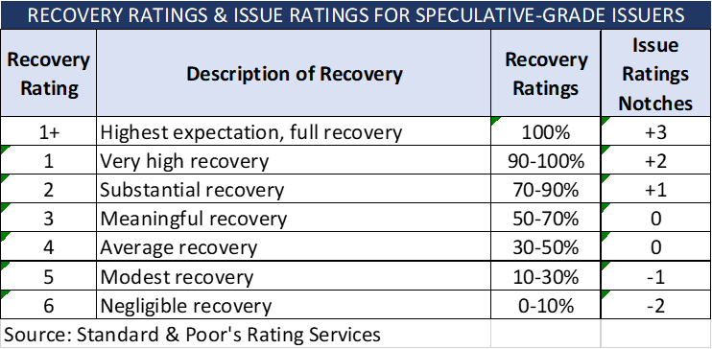
Recovery Rates
In addition to issuing specific ratings for the issuer of debt and/or the debt facilities such loans or bonds, S&P rating agency will run “recovery” assessment analysis. The recovery rates (1-6) designated by S&P are derived based the following review structure:
  Review transaction structure
  Review borrower’s projections
  Establish simulated path to default.
  Forecast borrower’s free cash flow at default based on our simulated default scenario and default proxy.
  Determine valuation.
  Identify priority debt claims and value.
  Determine collateral value available to lenders.
  Assign recovery rating.
  Convey the recovery analytics to the issuer and investment community.

Slide 19
Other Credit Review and Analysis
Other third-party areas, internally or externally, that are part of the review includes Know-You-Customer (KYC) review and compliance, the legal review of the closing documents by internal and/or external counsel.
Other departments within the bank or financial institution that is the lender have a role in reviewing certain areas of the loan before the loan is funded.
The portfolio management department reviews the price of loans to make sure it meets the bank’s return targets.

Slide 20
Know Your Customer (KYC) Review
A KYC (Know Your Customer) review is one of the most important internal reviews that bank is required to do before granting an approval and fund the loan. A KYC form needs to be competed in parallel with the loan application. This from filed by an individual and/or the company that is applying to become a customer of the bank or financial institution. The form usually includes verification data not only of the company but its directors including personal information of the CEO and CFO of the company applying for loan.
KYC forms are then used as a part of the identification and verification processes. The objective is to assist banks and the government, if requested, to track and prevent suspicious activities such as fraud, money laundering, bribery, and corruption.
Below, you will find the list of supporting documents to be submitted alongside the KYC application form.
  • Certificate of Registration and Incorporation
  • Articles of the Corporation
  • Resolution of the Board of Directors
  • A list of authorized signatures
  • Company’s Directors’ Proof of identity (passport, driving license, residency, address, phone number)
  • Proof of address (utility bill, a copy of the employer’s address, bank account statement received by mail

Slide 21
Loan Portfolio Risk vs Pricing Review
Each bank that manages its loan portfolio has set up a department that reviews all the loans that are seeking approval. This department’s focus is to make sure the proposed pricing (spread and fees) meets the banks’ pricing hurtles as compared to the internal raring that measures risk. A few formulas that the bank is setting up as their hurtle rate:
Risk-Adjusted Return on Capital (RAROC)
  Risk-adjusted return on capital (RAROC) is similar to return on investment (ROI) adjusted for risk. Every loan given has its own risk and must be evaluated differently. RAROC therefore accounts for changes in the borrower’s profile by discounting risky cash flows against less-risky cash flows of the bank.
  The formula is as follows:
  RAROC= (r – e – el + ifc) / c
  where:
    RAROC is the Risk-adjusted return on capital, r is the interest income from the loan, e is expenses per borrower, el is the expected loss which equals average loss for equivalent loan over a specified period, ifc is the Income from capital which equals the capital charges times the risk-free rate and c is the capital,
  RAROC is also known as a profitability-measurement formula, based on risk, that allows the bank to use their internal rating to quantify the risk and use it to adjust the overall expected return. The RAROC metric was developed in the late 1970s by Bankers Trust and has spread in popularity to other commercial banks that have developed their own RAROC systems.

Slide 22

Loan Portfolio Risk vs Pricing Review
Example:
Target RAROC = 10% (minimum expectation for the portfolio manager to approve the loan)
Loan Amount: $10,000,000
  r = 4.5% Spread over LIBOR plus 2.0% of upfront fees amortized over 4 years or 0.5% for a total of 5.0%
  e = Variable of 0.50% + $80,000
  el = 1.5% (based on B equivalent rating
  i = 1.0% risk free rate
  cc = $300,000/10,000,000 = 0.3% capital charges
  ifc = i x cc = 0.03%
  c= 20%
    $RAROC= \frac{r−e−el+ifc}{c}$ = $\frac{5.0\%−(0.5\%+(\frac{20,000}{10,000,000})−1.5\% +3 (0.03\%)}{20\%}=\frac{5.0\%−(0.5\%+(\frac{20,000}{10,000,000})−1.5\% +3 (0.03\%)}{20\%}=\frac{4.11\%}{20\%}$
  RAROC=21.0%
  Meeting the 10% target rate

