Slide 1
Debt Markets: issuing Corporate Bonds 144As Private Placements
Chapter 7
“An Analytical Approach to Investments, Finance and Credit”
Professor C. droussiotis

Slide 2
Corporate Debt: An Overview
Corporate debt is by far one of the most prefer
Raising debt ,in general, do not need to give up ownership and instead they signed a contract.
The contract, called bond indenture or loan agreement, requires the company to pay back such debt in the future plus pre-determined interest payment which represents the cost of borrowing.
Though debt is the preferred source of capital, is not always available.
Debt holders are betting that the company has relatively strong income and cash flows to meet their debt obligations which include both interest and principal payments.
In a bankruptcy, debt is viewed higher in the capital structure than stock

Slide 3
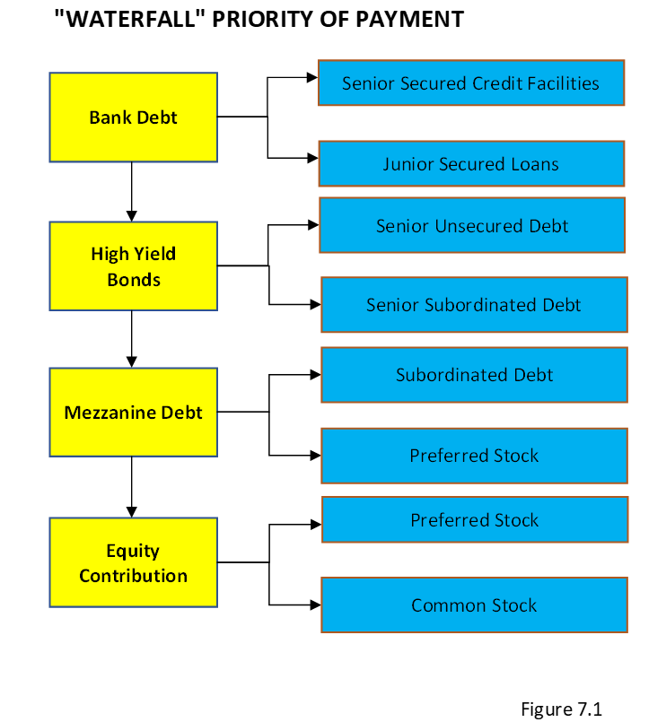
Corporate Debt: An Overview
“The Waterfall” or priority of payment, in a bankruptcy, bonds are viewed higher in the capital structure than stock.

Slide 4
Types of Corporate Debt
Unsecured Bonds
Secured Bonds
Mortgage bonds
Collateral trust bonds
Equipment trust obligations
Guarantee bonds
Convertible Bonds
$Conversion ratio=\frac{Par value}{Conversion price}$,
Zero Coupon Bonds
Paid-In-Kind (PIK) Bonds

Slide 5
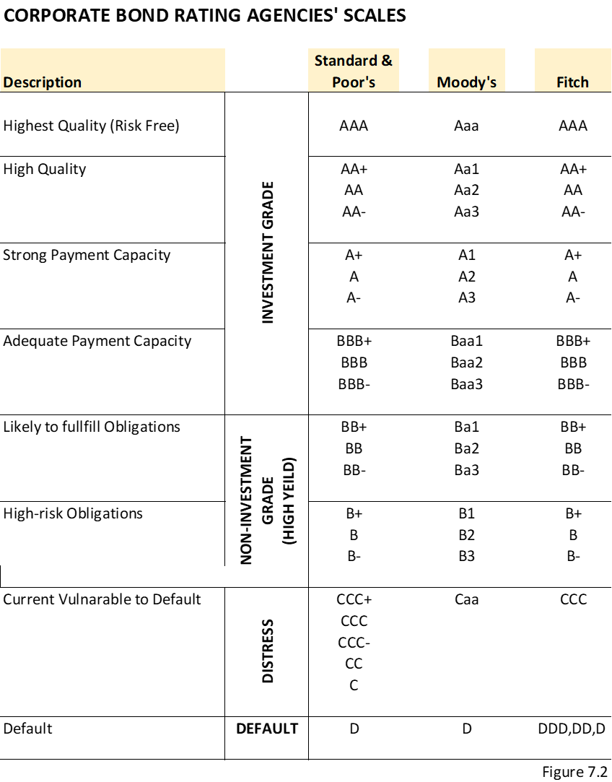
Raising / Issuing Corporate Bonds
The companies issuing bonds in the public markets are required by the Securities and Exchange Commission (SEC) to be independently rated by at least two rating agencies before they are issued Secured Bonds

Slide 6
Rating Agency Methodology
Industry Risk
Company-Specific Business Risks
Management Factor
Financial Risk Analysis
Loan-to-value or debt capitalization ratio
Leverage ratio of debt to EBITDA
Coverage ratios, including EBITDA/interest and cash flow to debt service
Cash Flow Forecasting and Modeling

Slide 7
Going to Market to Raise Corporate Bonds
Step I: Select the Investment Company/Underwriter
Firm Commitment
Best-Effort Commitment
Step II: Preparing the Documents for the Bond Offering
Step III: SEC Registration and ApprovalThough debt is the preferred source of capital, is not always available.
Step IV: Marketing the Bond Offering
.Step V: Indication of Interest
Step VI: Closing, Funding, and Free to Trade

Slide 8
Terms of the Bonds
Money Terms
Amount
Interest
Maturity/Term
Principal Payment
Non-Money
Financial Covenants
Negative Covenants
Afifrmative Covenants

Slide 9
Money Terms - Primary
Amount Concepts
Face Value (Book Value) $1,000 per Bond – PAR AMOUNT 100
Redemption
Maturity 100
Earlier than Maturity (Call/Non-Call) at different prices
Interest Rate / Coupon Rate
Fixed or Floating
Semi-Annual Payment (i.e. 8.0% Coupon pay $80 per year or $40 every six months)
Maturity (anniversary of issuance)
Principal Payments
Term Bond (0,0,0,0,100)
Serial Bond (20,20,20,20,20)
Balloon Bond (10,10,10,10, 60)

Slide 10
Pricing Bonds
The initial pricing of bonds is guided primarily by demand and supply based on the rating. In setting up the coupon rate, which is the interest rate of cost of borrowing for the issuer, the investment advisor considers the following factors:
Risk Free Rate or AAA rated bonds which are used as the base
Inflation Price
Maturity Rate Price
Default Rate based on rating
Liquidity
$$Coupon Rate= Rfr+IP+MRP+DRP+LP$$

Slide 11
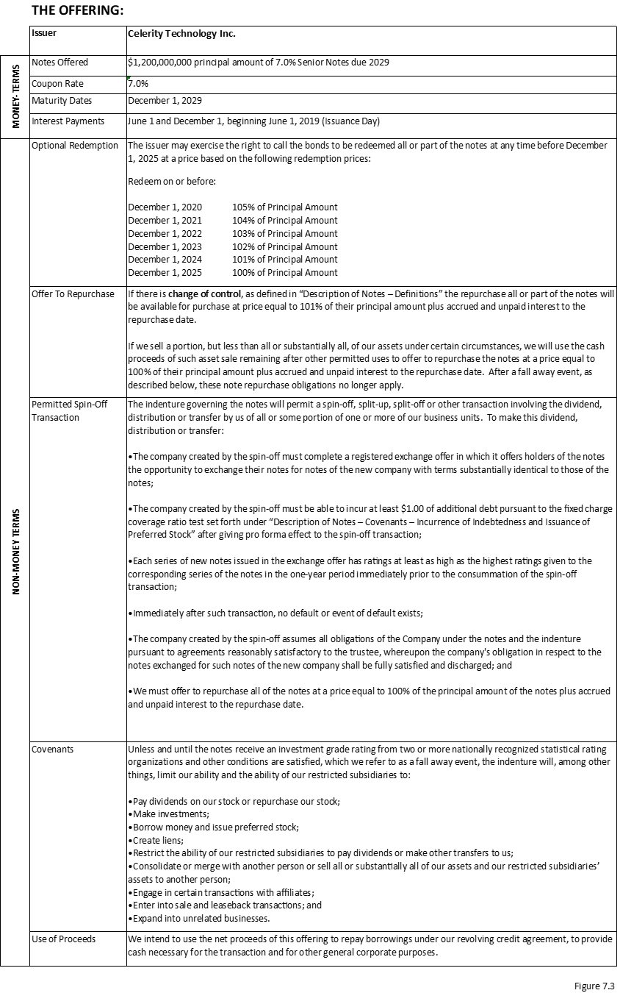
Term Sheet

Slide 12
Example of High-Yield Issuance and Explanation of the “Bond Talk”
X Health this afternoon completed its $1.5 billion note offer in two parts, pricing $500 million of senior secured notes due 2027 at 5.75%, the tight end of initial guidance, and $1 billion of add-on 8.5% senior notes due 2027 at 103.25, also the tight end of early guidance, according to sources. The add-on portion was upsized from $750 million. The offering via lead book-runner KP Investment Bank will fund tender offer and consent solicitation for the company’s existing 5.625% senior notes due 2021, 5.5% senior notes due 2023, and 5.875% senior notes due 2023. The original offering of 8.5% senior notes due 2027 priced at par in May 2018; they were trading between 104.375 and 104.625 yesterday, yielding as much as 7.5%. The pharmaceutical concerns trades on the New York Stock Exchange with an $8.31 billion market capitalization.

Slide 13
Example of High-Yield Issuance and Explanation of the “Bond Talk”
Issuer: | X Heath
Notes | $500 million
Coupon Rate | 5.75% (T+314 bps) yield 5.75% senior notes
Maturity | August 15, 2027
Price | 100
Ratings | Ba2/BB-
Call Provision | NC 3.5 @par +50% coupon
Notes (Type) | 144A-life; 40% equity clawback option; talk 5.875% area
Settlement | 03/08/19 (T+10)
Book-runners | KP/DDD/ABC/BCC/LLP
Issuer: | X Heath
Notes | $1 billion
Coupon rate | 8.75% (T+516 bps) yield 7.75% senior notes
Maturity | January 31, 2027
Price | 103.25
Ratings | B3/B-
Call provision | NC 3.5 @par +50% coupon
Notes (type) | 144A-life; 40% equity clawback option; talk 103-103.25 area total deal size now $1.75B
Settlement | 03/08/19 (T+10)
Book-runners | KP/DDD/ABC/BCC/LLP

Slide 14
Explanation of the “Bond Talk”
X Health has priced two different notes for total proceeds of $1.5 billion: $500mm and $1 billion.
Proceeds were used to repay the existing notes that are due in 2 years.
The coupons were circled at 5.75% and 8.75% fixed, respectively
The coupons were set at approximately 10-year treasuries (T) of 2.61%, plus a premium (risk premium over risk free) of 315 and 516 basis points, respectively.
The pricing (original issuance discount) is 100 (par) for the first note and the 103.25 (premium), calculating 5.75% yield and 7.75% yield (it makes sense that the yield is lower than the 8.75% coupon rate priced at premium), respectively
The ratings were Ba2/BB- and B3/B-, respectively; the 8.75% notes are rated much lower than the 5.75% notes (S&P three notches lower from BB- to B- and Moody’s four notches lower from Ba2 to B3).
Both have no call for 3.5 years and a make-whole (if the company refinance early) of par + 50% of the coupon.
These notes have approximately 8- and 8.5-year terms (August 15, 2017 and January 31, 2027, respectively).
The notes were not registered with the SEC since they were raised in 144A private market.
The 144A-life means that the issuance will stay private, it does not have registration rights to convert to public bond.
The settlement is T+10, which means the investors will own the bonds 10 business days since the trade (T) day.
The book-runners of all these banks listed (KP/DDD/ABC/BCC/LLP) are the initial underwriters before the retail syndication.

