Slide 1
Equity Markets: Raising Equity in the Public Markets (IPO)
Chapter 6
“An Analytical Approach to Investments, Finance and Credit”
Professor C. droussiotis

Slide 2
Initial Public Offering: An Overview
Everyone knows what an IPO is. It is one on the most exciting milestones of the company. It validates that the company is already successful of what they are doing, and they are ready for the big league.
A company that has successfully raise money via IPO has reached that last chapter of their early development and have proven that their selling product is in demand.
Not all IPOs had successful outcomes after the IPO but given the rigorous process in order to go public it feels that the company is already successful. It feels like graduation. Its one of the best feelings of any student has after achieving such milestone but graduation is also a beginning of many more successes.
Companies that achieve that milestone of becoming public are also in their beginning stage of many successfully years to come.
Accessing capital in the public markets gives the company more options to continue their growth by accessing more ongoing capital from equity investors and other types of investors such bondholders.

Slide 3
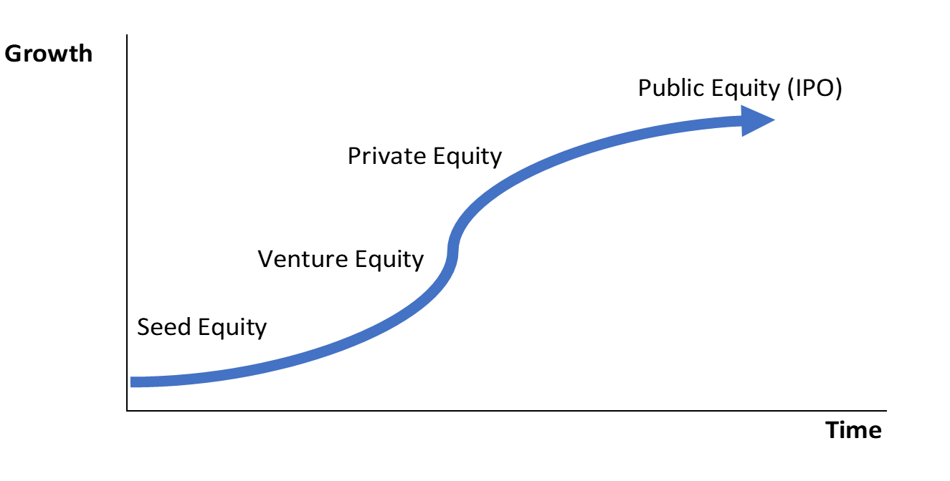



The Life Cycle of the Public Company and its ability to raise capital though the cycle
Bonds/Loans
Mezzanine / Loans
Series A, B, C

Slide 4

Venture Capital
Investors
  Series A ($2 mm - $10 million)
  Hedge Funds
  Institutional Investors (GP/LP structures)
  Industry Specific Venture Funds
Purpose of Venture Equity:
  Revenue Growth (no necessarily initial income growth)
  Market Share / Penetration
  Continue to develop the product
What do you need:
  Exit Strategy
  Business Plan
  DCF Valuation

Slide 5
Private Equity Capital
Investors:
  Large and Middle Market PE firms (Higher than $10 million)
  Institutional Investors (GP/LP structures)
  Industry specific PE firms
Purpose of Private Equity:
  Revenue & EBITDA Growth
  Cost Efficiency and Plant implementation
  Financial Engineering (using leverage)
  Focus on Core Business
What do you need:
  2-3 Year Financial Statements
  Operational Data (supporting Revenue, Income and Cash Flow)
  Industry Consulting Reports
  DCF Valuation and other Valuation Methods (Comparables)
  Exit Strategy and Estimated Terminal Values

Slide 6
Public Equity (IPO)
Investors:
  SEC Registration / ADR
  ADR (Level 1)
  Regulation S & D Non-Exempt Issuers
Purpose of Public Equity:
  Revenue, EBITDA and Net Income Growth
  Product Growth Feasibility - Normalization
  Back to Fundamentals (no need to financial engineering)
What do you need:
  File for SEC or Private Memorandum
  3 Year Audited Financials
  Proven Management / Anchor Investors
  Third Party Valuation Analysis

Slide 7
Initial Public Offering
Objectives of the Owners to Go Public
A company will seek equity financing from the public markets through a process called an initial public offering (IPO). When the company is IPO ready (discussed next), it will choose to offer its equity to a large market of investors to meet the existing owner’s following objectives:
  To provide liquidity for the founders and early private investors to sell their holdings to the public markets
  To establish a broad-based valuation of the company by offering the stock to a large group of investors, hence increasing the existing value to the current owners who stay post-IPO
  To fund the company’s ongoing needs and access follow-on financings
  To create stock that can be used to offer executives and employees retirement plans

Slide 8
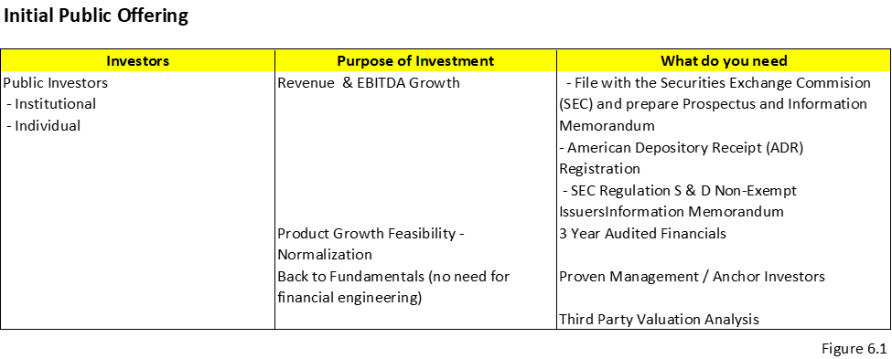
Initial Public Offering
Purpose of the Investors to Invest in IPOs
The institutional and public investors investing in a new company during and post IPO are looking to enhance their returns through earnings growth and multiple expansion. If this becomes a reality, the broader market will gain confidence and drive the stock price up. It will also continue to increase in the future if expectations for these higher multiples of earnings (PE or EBITDA) are realized. Dividends can also be a source of income for these investors, though typically new IPO companies are still in a growth stage of their development and do not pay dividends.

Slide 9
The Shareholder’s rights
Voting rights:
  Holders of common stock exercise control by electing the board of directors that vote on corporate policy
  Each share gives the shareholder a share of the vote that represents their percentage of ownership as a percentage of total shares outstanding
  The voting can be carried out by either a statutory voting method or cumulative voting method.
    The statutory voting method is based on the stocks that the shareholders owns: one share = one vote.
    The cumulative voting method is based on allocating the shares that the shareholder owns to each candidate.
Financial reporting and company information
Dividends
Preemptive Rights

Slide 10
Dividend Payment Process
Declaration date: This is the date by which the board of directors declares dividends. In their announcement they mention two other dates including the record date and the payable date.
Record date: This is the date the shareholder must register on or before to receive the dividend.
Payable date: This is the date that the dividend is paid to the shareholder on record.
Ex-dividend date: This is the date 2 business days prior to the record date. Any regular way trades of the stock take 3 days to settle (T+3), which will give the official title of the stock

Slide 11
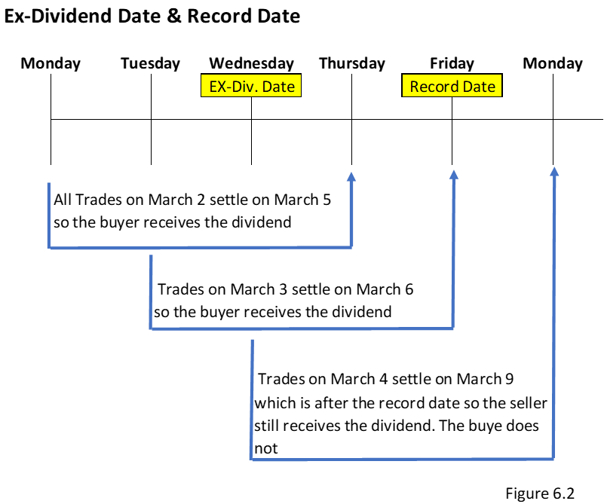
Dividend Payment Process

Slide 12
Other Stock Concepts
Stock Splits and Reverse Splits
  A stock split occurs when a company believes the price per share is too high to keep buyers interested in purchasing shares. This of course is due to the perception that the market of buyers shrinks once the stock price is too high, as the common unsophisticated investor looks for other cheaper stocks to purchase instead.
    For example, a two-for-one split of a stock that is trading at $50 will result in the stock trading at $25 ($50/2). Note that holders of the stock will double their shares at the time of the split, preventing dilution of current investors.
  A reverse split is when the stock price is too low, and the company decides to reduce the number of overall shares to increase the per unit price. For this to occur it usually indicates that current perception of the stock is weak and growing weaker, and the low per share price is contributing to that perception.
    For example, in a one-for-five reverse split, five $5 shares become one $25 share (5 x $5).

Slide 13

Other Stock Concepts
Classifying Common Stock
  Income stocks: These are stocks of companies that consistently pay dividends. When an investor purchases income stock he or she expects to receive dividends. Most of the return for such an investment is based on consistent dividends. Companies that are classified as having income stock are more mature companies with limited research and development and stable cash flows. There are two methods of calculating the dividend payout ratio:
$Dividend payout ratio = \frac{Annual dividend}{Net income}$ and per share,
$$Dividend payout ratio = \frac{Annual dividend per share}{Earnings per share (EPS)}$$
The dividend yield (δ) % per share is calculated as follows:
$$Dividend yield \left(δ\right)\% = \frac{Annual dividend per share}{Stock price}$$
  Growth stocks: These are stocks of companies that reinvest most of their income into their business. Investors buying these stocks expect a higher capital gain from growth in share price due to expanding earnings/revenue multiples.

Slide 14
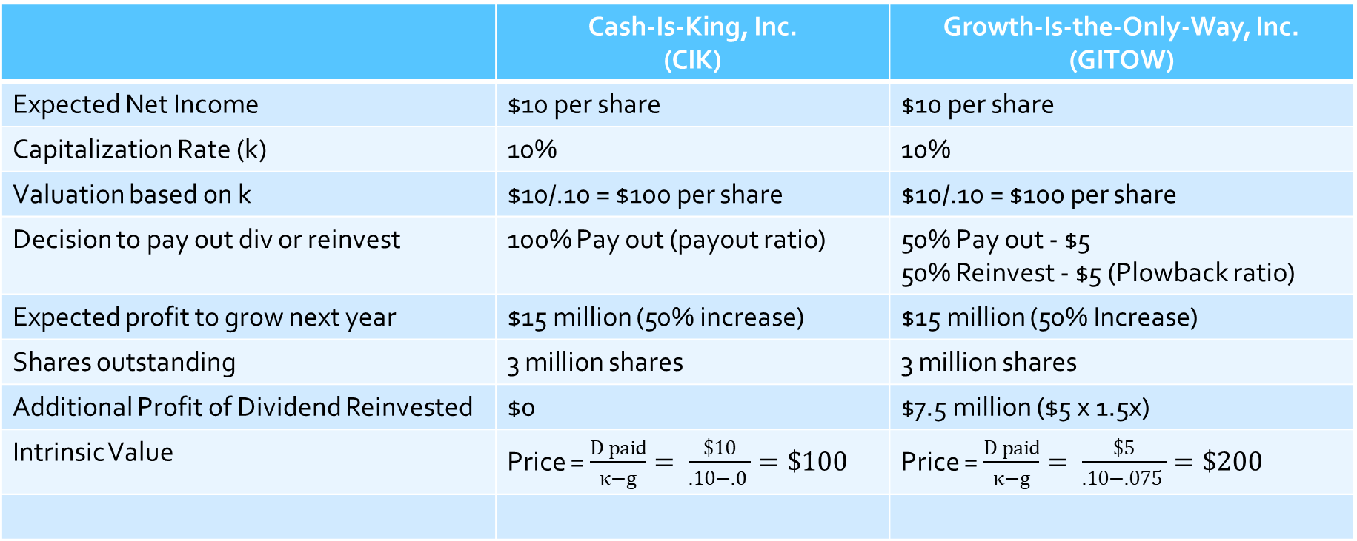
Stock Prices and Investment Opportunities: Growth Stock Versus Dividend Stock – An Example
 | Cash-Is-King, Inc. (CIK) | Growth-Is-the-Only-Way, Inc. (GITOW)
Expected Net Income | $10 per share | $10 per share
Capitalization Rate (k) | 10% | 10%
Valuation based on k | $10/.10 = $100 per share | $10/.10 = $100 per share
Decision to pay out div or reinvest | 100% Pay out (payout ratio) | 50% Pay out - $5 50% Reinvest - $5 (Plowback ratio)
Expected profit to grow next year | $15 million (50% increase) | $15 million (50% Increase)
Shares outstanding | 3 million shares | 3 million shares
Additional Profit of Dividend Reinvested | $0 | $7.5 million ($5 x 1.5x)
Intrinsic Value | Price = $\frac{D paid}{κ−g}= \frac{\$10}{.10−.0 }=\$100$ | Price = $\frac{D paid}{κ−g}= \frac{\$5}{.10−.075 }=\$200$

Slide 15
Syndication of Securities Offerings for IPO
  Step 1: Selecting the Investment Company/Underwriter
  Step 2: Preparing the Documents for the IPO
  Step 3: SEC Registration and Approval
  Step 4: Marketing the IPO
  Step 5: Indication of Interest
  Step 6: Closing, Funding, and Free to Trade

Slide 16
Types of Underwriting Commitments for IPO
Firm Commitment
    A firm commitment is a commitment from the underwriters that enables them to purchase all the shares that are offered in an IPO
Best-Effort Commitment
  A best effort’s underwriting agreement is an agreement in which the underwriters seek to sell all the shares to the interested investors but have no obligation to purchase any unsold shares

Slide 17
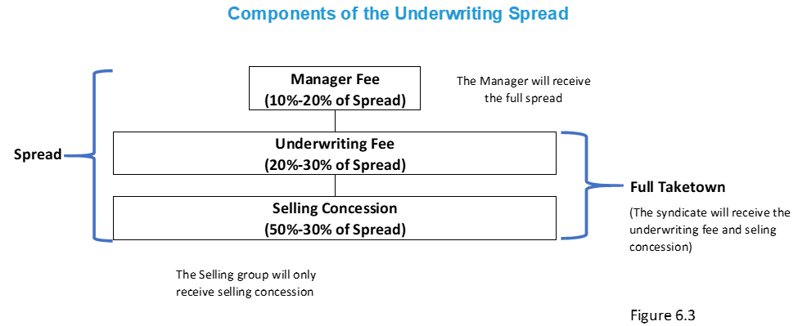
Underwriting Fees and Compensation
Underwriting Spread (fees)
    Manager’s Fee
    Unwriting Fees
    Selling Concession Fees

Slide 18
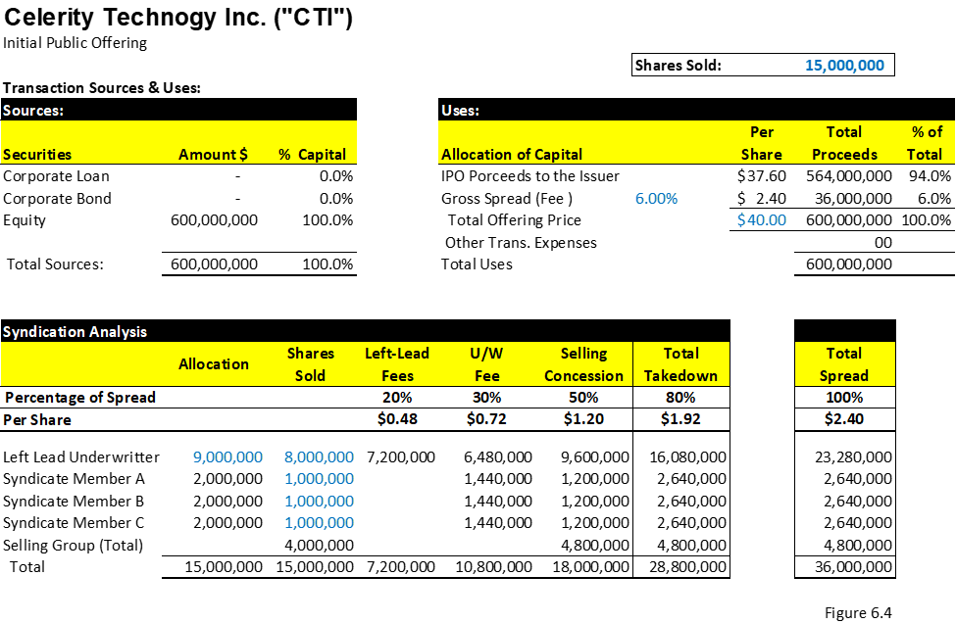
Underwriting Fees and Compensation
Breaking down underwriting compensation
  For small companies, a typical underwriting spread fee is around 12%, or a discount rate of 88% of the IPO proceeds raised from the offering. Figure 6.4 shows an example of a Celerity Technology Inc. IPO and the allocation of the spread compensation to the manager, the syndicate, and the selling groups.
The Celerity Technology IPO example (Figure 6.4) shows that the company or the issuer is planning to issue 15 million shares. The left lead manager keeps 9 million of the shares and the remaining 6 million are allocated pro-rata (equally) among the three underwriters.

Slide 19
Building the Book
The first responsibility of the left lead manager is to pre-market the offering to institutional investors (qualified investors).
The other underwriters in the syndicate also start pre-marketing to their own investors.
Before they start this process, called building the book, each underwriter of the syndicate is allocated shares by the left lead manager.
These institutional investors who are interested in purchasing the stock will give an indication of interest (IOI). These IOIs will become orders on the effective day, though they are not obliged at this point to commit and are able to cancel any time before purchase.
The building-the-book stage is probably one of the most important stages during the offering as the manager, syndicate, and selling group receive a lot of market feedback and evaluate the demand, which can be used as the basis to start the discussion on the offering price (i.e. Celerity Technology IPO to be priced $38-40)

Slide 20
Building the Book
Setting Up the Investor List by Underwriter (Allotment):
  Before the building-the-book stage, which involves the pre-marketing of the offering, the list of investors could be allocated among the underwriters.
  This process, which is the preferred process in the United States, is called a fixed-pot arrangement. This arrangement is sometimes cleaner to execute since each underwriter focuses on his or her allocated list of investors and fees are shared across all, despite one underwriter doing better than the other.
  The jump-ball arrangement is basically an arrangement that the credit of circling investors is on a first-come-first-serve basis and the underwriters are paid based on how big a book they are building with IOIs.
Pricing:
  The left lead manager is untimely responsible for letting the issuer know about the success or failure of the book-building effort and the state of the market, including records of other IPOs that have already been priced.
  The manager also confirms the final pricing and scheduling. After looking at the final book with all the orders at different prices within the range, the manager sets the price and communicates it to the company.
  Example: In the Celerity Technology IPO example, (Figure 6.4) the final price is $40:
    15 million shares issuance x $40 = $600 million
    Less 6% gross fees or $36 million ($6 million x 6.0% )
    Net proceeds to the company are estimated to be $564 million before any other transaction expenses.

Slide 21
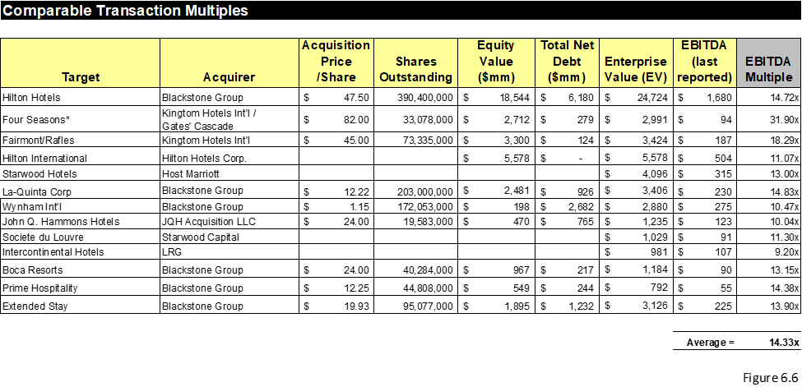
Mergers and Acquisition Transaction
Accessing Capital
  Steps for the Transaction Analysis
  Step 1: Select Comparable Acquisitions
  Step 2: Find the Necessary Financial Information Related to the Transaction

Slide 22
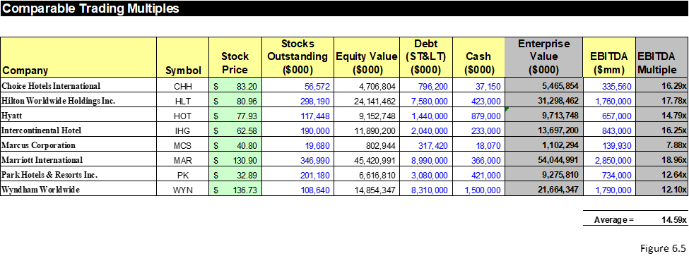
Mergers and Acquisition Transaction
Accessing Capital
  Steps for the Transaction Analysis
  Step 3: Review Key Multiples for Trading Multiples

Slide 23
Mergers and Acquisition Transaction
Accessing Capital
  Steps for the Transaction Analysis
  Step 4: Comparable and Benchmark Analysis
    After the trading and acquisition comparable analytical methods are done and justified as truly comparable, the banker sets the average or the range of multiples that are used to value the target company. The average or range of multiples are used as an industry benchmark and the basis for analyzing the target company
  Step 5: Determine Valuation
    The mean (averages) and median multiples for both analytical approaches are used to value the relevant target company. Figures 6.5 and 6.6 show that the averages of the hotels sector for trading comparable and acquisition comparable are 14.6x and 14.3x EBITDA multiples, respectively. These multiples ranging from 14–15x EBITDA will then be used to calculate the relevant hotel company that is either an IPO or M&A candidate

Slide 24
Mergers and Acquisition Transaction
Round of Bids
First Round
  Reaching out to prospective buyers
  Execute the confidentiality agreement (CA)
  Distribution of CIM and initial bid procedures letter
Initial Bid
  Bid Procedure Letter also outlines the information that the buyers need to submit with their bid including their initial purchase price and the composition of payment such as all cash, stock, or a combination of the two.
  Preparation of management presentation
  Setting up the data room
  Receive initial bids

Slide 25
Mergers and Acquisition Transaction
Round of Bids
Second Round
  Management presentations and site
  Data Room
  Final bid procedure letter
  Definitive agreement
  Final bid
Negotiations
  Evaluating final bids:
  Negotiate with the selected buyer:
  Select winning bidder:
  Board of directors’ approval:
Closing
  Shareholders Approve the Transaction

