Slide 1





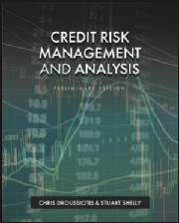

Chapter 2: Credit Markets and Macroeconomics
Chapter 2
“Credit Risk Management & Analysis”

Slide 2
Credit Markets & Macroeconomics Overview
Historically credit markets eclipsed equity markets as of August 2024:
  Residential mortgage ~ $14.1 Trillion,
  Commercial bank loans ~ $2.8 Trillion,
  Consumer credit (credit cards and auto finance primarily) ~ $17.4 Trillion.
  Commercial mortgages ~ $3 Trillion,
The US Equities markets have grown enormously in the last decade (as of July 2024): ~ $55 Trillion
  Apple ($3.3 Trillion),
  Microsoft ($3.2 Trillion),
  NVidia($2.9 Trillion), and
  Amazon and Alphabet (Google parent) each > $1.9 Trillion
The US Treasury Market is currently $27.6 Trillion as of August 2024.

Slide 3
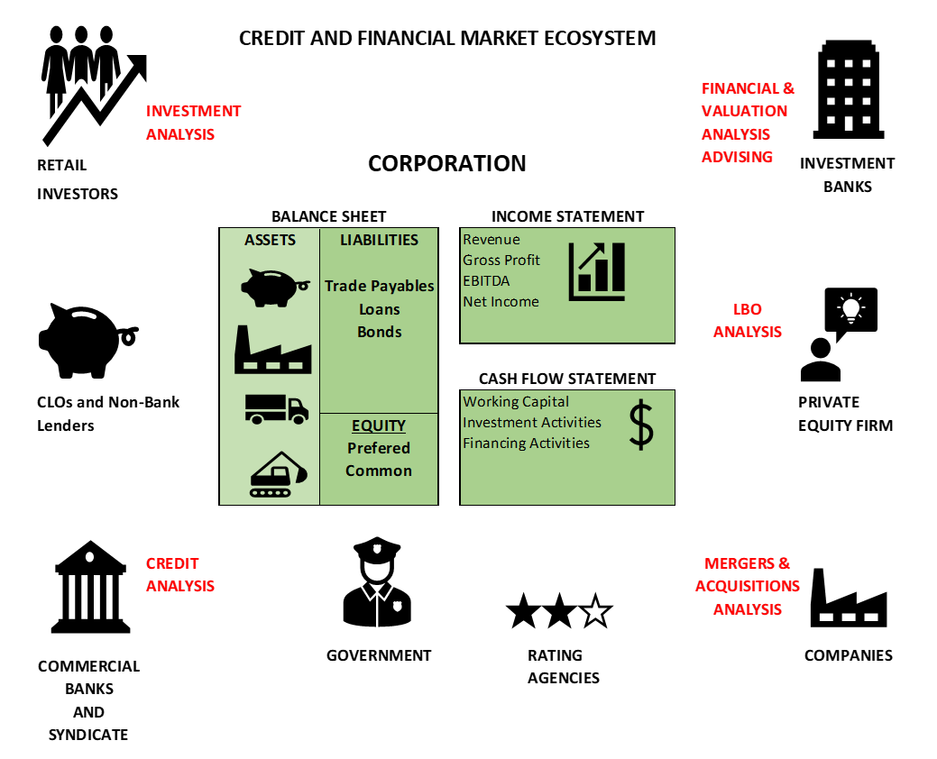
Credit Markets & Macroeconomics Overview

Slide 4
Credit Markets Intermediation Role
Credit Markets Inter-mediate Capital
  Capital for borrowers
  Assets for banks, insurance and pension investors
CUSIP (Committee for Uniform Securities identification procedures) – 9 digit number
  Securities (Bonds), evidenced by a Promissory Note – a promise to pay,
  Indenture (like loan agreement), all terms and conditions
  Enables insurance companies and other investors to buy
  Notes (less than 10 years) or Bonds (> 10 years)
Loans
  Bank and non-bank advance of credit / capital
  Loan Agreement & Security Agreement
Leases – not a Loan
Factoring, Merchant Cash Advance
Securitization – CUSIP, bundling process, trust formation, enables credit assets to become securities

Slide 5
Bank Loans
Bank Market defined by two main categories, based on size of borrowers:
  Middle Market Loans
  Broadly Syndicated Loans – “Wholesale” Loans
  Middle Market Loans (defined by each bank)
  Secured term loans – primarily in the form of mortgages and equipment loans
  Working capital loans
    borrowing base formula
    ABL structure

Slide 6
History of LBOs and Secondary Loan Market
1980s Large LBOs – need for large bank syndications (multiple lenders party to credit agreements):
  Previously only in country credits, very little secondary market sales and trading activity
  Club, Syndicate, Participants – Secondary
  KKR, Bain, Morgan Stanley, Merril, TH Lee, Carlyle, Bass Bros, TPG, Apollo, Blackstone
  Drexel Junk Bonds – Mike Milken
  RJR Nabisco ($31.1B) – BofA alone was asked to commit $1B in Equity and $5B in Debt
1996 – CLOs, LMFs & BDCs
  Loan Mutual Funds, or Prime Rate Funds, Non-bank lenders, securitizations of bank loans
  BMo / Goldman $800mm, over subscribed in < 30 days to $1.2B in 1996
  First BDC – Allied Capital (closed) – permanent capital, trade at below NAV (like REITS)
2000s - Mature Secondary Trading
Two Markets
  Investment Grade
  Non- Investment grade

Slide 7
Secondary Loan Market Asset Class
Eligible investment for restricted investors (insurance and pensions):
  CUSIPs
  Strips – maturities, collateral pools, etc
Insulation from Interest rate Risk
  Floating rate loans (Libor now SOFR – Secured Overnight Financing Rate)
  Credit Spread adjustment risk remains
Low price volatility
  Low covariance with other investment asset classes
Defensive Strategy
  High Risk-Adjusted returns relative to other asset classes
Liquidity and Ratings
  CLOs and individual loans often rated, enhancing liquidity and expanding investor eligibility

Slide 8
Secondary Loan Pricing
Loan Syndication and Trading Association (LSTA):
  Improve liquidity and transparency in secondary loan market
  Syndicate establishes “Flex” pricing range:
  Establishes standard pricing formula:
  Annual Loan Yield = SOFR + spread + (100-OID/Loan term)/100
Example: SOFR = 2.50%, Credit Spread = 4.50%, OID = 99 (99% of par, representing a 1% fee to bank syndicate), Term = 4 years
  Annual Loan Yield = .025 + .045 + ((100-99)/4)/100 = .07 + .0025 = .0725
  Floating rate loans may also be swapped into a fixed rate at an additional swap spread (.05% - .15%)
LTSA and Standard & Poors (S&P) Leveraged Commentary & Data (LCD) issue a LevFin benchmark of 100 largest currently traded leveraged finance loans.

Slide 9
Secondary Loan Pricing
CY% = SOFR % + Spread % + [ (100%-SBP)/RAL ]
Axell Corp’s CY% = 2.25% + 4.0% + [(100% - 97.5%)/3.5] = 6.964%
OIDY% = SOFR % + Spread % + [ (100%-OID)/ 4 yrs ]
Buzz Corp’s OCY% = 2.25% + 4.75% + [(100% - 99.0%)/4] = 7.250%

Slide 10
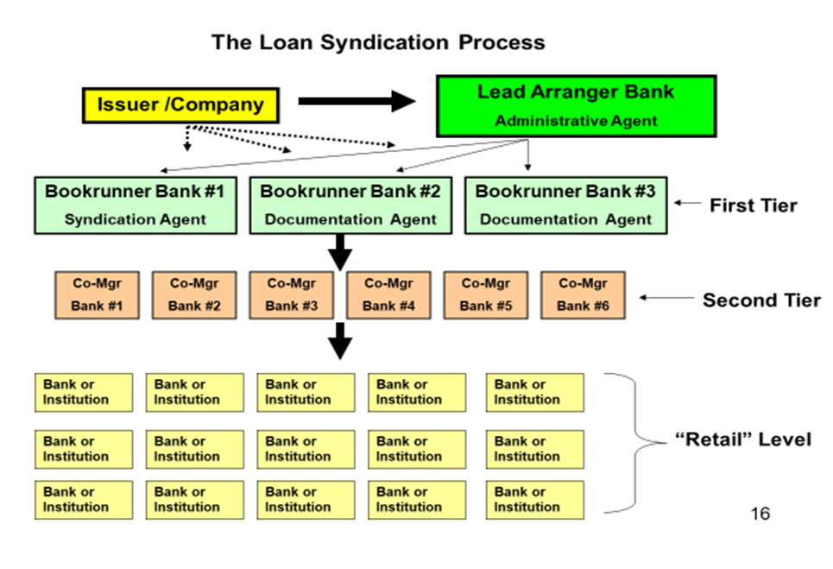
The Syndication Process of Loan Market

Slide 11
Secondary Market Loan Terms
Loan Participation and Silent Participation:
  Signatory v non-signatory to Loan Documents (Loan Docs)
Loan Assignment:
  A lender may assign rights and obligations to an assignee (obligations to fund can be tricky)
Most-favored Nation:
  Protects participants and assignees from new loan issues to borrower at higher rates
  Participants and assignees will get a step-up
Sunset Provisions:
  Expiration of MFN up to 90 or 180 days from original loan date

Slide 12
Credit Ratings & Risk Management
IG = Better than BBB-:
  “Make-whole” v Call Premium
  Prepayment penalty to compensate lender /investor if rates have moved
  Non-IG will have a 5% call premium – 5% prepayment fee in the event of refinancing as the borrower's credit improves, they will want to refi, this compensates the lender
Non-Investment-Grade Bonds / High Yield Bonds (CCC to BB+):
  Market developed in 1980s by Drexel Burnham Lambert – Mike Milken – at one point prior to its closure controlled over 50% of the high yield market
  Last Drexel deal was Kaiser Aluminum, Dec 26, 1989
Credit Derivatives:
  Interest Rate Swaps – World Bank
  Credit Default Swaps (CDs) – Exxon Valdez
  Banks use to manage credit risk on a loan and portfolio basis

Slide 13
Leveraged Lending credit Analysis
March 2013 Supervisory Guidance on Leveraged Lending to Board of Governors:
  Federal Reserve, OCC (Office of the Comptroller of the Currency), FDIC (Federal depository insurance Corporation)
    Cash Flow analysis – forecasts and integration assumptions
    Cash flow forecasting needs, estimations of debts service and working capital
    Merger integration costs
    Stress tests, downsides and various covenant breaches (defaults)
    Quarterly assessment post closing of plan v actual
    Third party collateral and enterprise valuations
    Current market estimates updated on collateral liquidation values
    Assessment of FX and interest rate risk of borrower

Slide 14
COVID19 & Global Financial Crisis (GFC)
COVID19:
  Federal Government passed two stimulus spending packages (2020 & 2021):
    $1.9 T - Coronavirus Aid, relief and economic security ActCARES Act
    $2.3T – Consolidated Appropriations Act (CAA)
  Banks flush with deposits at low cost of borrowings, generated huge profits
Global Financial Crisis – GFC
  TARP (Troubled Assets Relief Program) designed to help shore up banks exposed to defaulted loans: BAML, WaMu / Wells Fargo and Morgan Stanley and Goldman Sachs allowed deposits
  Mortgage defaults – CLOs and other securitizations collapsed
  Dodd-Frank - Dodd-Frank Wall Street Reform and Consumer Protection Act – requires mortgage originators to retain 5% of residential mortgage securitizations
C&I loans less affected
Explosion of CLOs and non-bank C&I lenders using bank leverage of their portfolios
Financial Stabiity & Oversight Council (FSOC) – C&I and bank systemic risks to commerce

Slide 15
CLOs, BDCs and Non-bank Lenders
Collateralized Loan Obligations
  Securitization of pools of C&I loans, often LBOs
  1996 – Goldman Sachs and Bank of Montreal, KMV CLO - $800 million oversubscribed in 30 days to $1.2B
    Trusted conservative bank, trusted risk rating tools, pedigree of Goldman Sachs
    Recipe replicated by others
Business Development Corporations (BDCs)
  BDC’s are a lending equivalent of the REIT (Real Estate Investment Trust)
    LP Tax Pass through structure
    Trade at NAV
    First was Allied capital – no longer in business
    KKR, THL Credit, many others
Special Situations Groups (SSGs):
  Cerberus, Fortress (Drawbridge) Goldamn Sachs, TPG (Sixth Street), Morgan Stanley (Tactical opportunities)
  Leveraged and unlevered – e.g. $300mm Michael Jackson deal
Leasing, ABL and other

Slide 16
Structuring the Tranches of CLOs

