Slide 1
Covariance, Correlation and Efficient Frontiers
Chapter 2
“An Analytical Approach to Investments, Finance and Credit”
CHAPTER 1 REVIEW
RISK, RETURN, TIME AND ALLOCATION

Slide 2
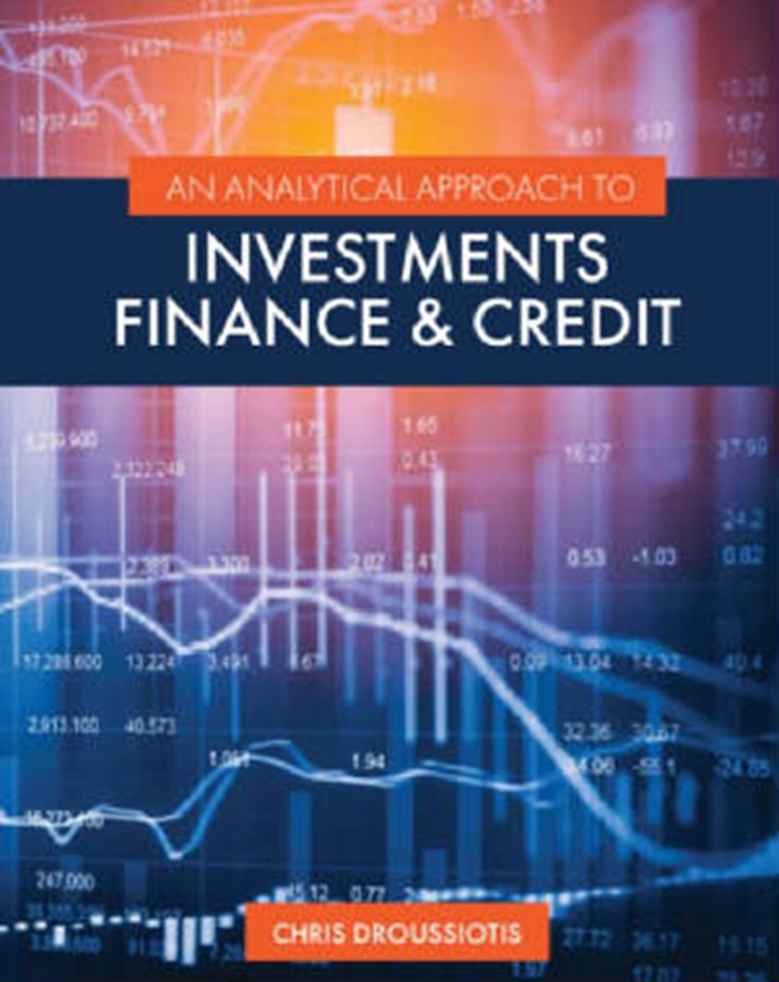
Overview
Part I. Investment & Portfolio Return Analysis
Chapter 1: Risk-and-Return Analysis
Chapter 2: Covariance, Correlation, and Efficient Frontiers
Chapter 3: Beta Coefficient, R-Squared, and Regression Analysis
Chapter 4: Sharpe Ratio, CAPM, Jensen’s Alpha, Treynor Measure, and M-Square

Slide 3
CHAPTER 1 REVIEW:
Measuring Return and Return Expectation
Before you invest your money in any securities or any businesses, it’s extremely important to consider and must measure the following four factors:
  Return expectation
  Risk
  Allocation
  Time

Slide 4
INVESTMENTS, FINANCE AND CREDIT OVERVIEW
What’s This?

Slide 5
INVESTMENTS, FINANCE AND CREDIT OVERVIEW
What’s This? Everyone’s Expectation
EXPECTED VALUE LINE OF ANY INVESTMENT

Slide 6
INVESTMENTS, FINANCE AND CREDIT OVERVIEW
What’s This? EXPECTED VALUE LINE OF ANY INVESTMENT
EXIT
Expected Value Line Growth (Return)
Risk-Free Rate – Expected Investment with no risk
ENTRY
Initial
Investment

Slide 7
INVESTMENTS, FINANCE AND CREDIT OVERVIEW
Expected Value Line Growth (Return)
EXIT
Risk Premium
Risk-Free Rate
ENTRY
Initial
Investment

Slide 8
INVESTMENTS, FINANCE AND CREDIT OVERVIEW
Expected Value Line Growth (Return)
EXIT
Risk (Volatility)
Risk Premium
Risk-Free Rate
ENTRY
Initial
Investment

Slide 9
The Study of Finance
Buying Stocks / Buying Bonds
Buying Assets / Equipment
Starting a New Project
Buying a Company
Starting a new Company
3 FACTORS BEFORE YOU INVEST
  Measure Expected Return
  Quantify Risk
  Set Time (Exit)
  1 more FACTOR BEFORE YOU INVEST (discuss in detail later)
  Allocation / Diversifiaction

Slide 10

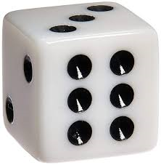
The Study of Finance
3 FACTORS BEFORE YOU INVEST
  Measure Expected Return
  Quantify Risk
  Set Time (Exit)
Game: Tossing a Coin to win $6 (Payoff):
Measure Expected Return: $6
Quantify Risk: 50/50 win/loss
Time: in 2 seconds
How much to Invest?
  $3 - mathematically using probability theory is (50% x $6) + (50% x $0) = $3 + 0 = $3
Game: Tossing one dice to win $6 (Payoff):
Measure Expected Return: $6
Quantify Risk: 1/6 to win, 5/6 to lose
Time: in 2 seconds
How much to Invest?
  $1 - mathematically using probability theory is (1/6 x $6) + (5/6 x $0) =
  $1 + 0 = $1

Slide 11
The Study of Finance
Risks that are pushing the Value Line down
FIELDS OF FINACE
Corporate Finance
Investment Analysis
Credit Analysis
EXIT
Risk (Volatility)
Expected Value Line Growth (Return)
Finance Strategies to Keep the Value Line Up
Initial
Investment
ENTRY
3 FACTORS BEFORE YOU INVEST
  Measure Expected Return
  Quantify Risk
  Set Time (Exit)

Slide 12
Risk & Return Analysis
Before investing, the investor needs to consider the following four factors:
  Measurement of the expected return (Er)
  Quantification of the risk (σ)
  How to allocate the investments to achieve efficiency and optimization (A for Allocation)
  Time to determine the exit strategy or realization of the investment (t)

Slide 13
Time Value of Money Concepts
One-Time Investment
Annuities or Even Annual Cash flows
Uneven Annual Cash Flows

Slide 14

One-Time Investment
FUTURE VALUE
FV = PV ${\left(1+i\right)}^{t}$
  where FV is the future value of the investment, PV is the present value of the investment or the initial investment, i is the expected interest rate or rate of return of the investment, and t is time to realize such investment.
  PRESENT VALUE
FV = PV ${\left(1+i\right)}^{t}$, then $PV=\frac{FV}{{\left(1+i\right)}^{t}}$
As an example, assuming the investor targets an investment that is expected to receive $133.10 in 3 years, representing a 10% interest or expected return (sometimes referred to as the discount rate), the investment required today will be calculated as follows:
$PV=\frac{FV}{{\left(1+i\right)}^{t}} = \frac{133.10}{{\left(1+.10\right)}^{3}} = \frac{133.10}{1.331}=100$

Slide 15

One-Time Investment
INTEREST RATES
If the investor knows the amount they are planning to invest today, and targets a specific investment payoff at a set time in the future, then the investor can rearrange the formula to calculate the interest (i) or discount rate that he or she will earn, as follows:
Starting at FV = PV ${\left(1+i\right)}^{t}$, then ${\left(1+i\right)}^{t}=\frac{FV}{PV}$ , and
$i$ = $({\frac{FV}{PV})}^{\frac{1}{t}}$ – 1
As an example, let’s assume the investor invests $100 today and targets an investment that expects to receive $133.10 in 3 years. What will the annual rate of return be on such an investment?
$i$ = $({\frac{FV}{PV})}^{\frac{1}{t}}$ – 1 $=({\frac{133.10}{100})}^{\frac{1}{3}}$ – 1 $=({1.331)}^{\frac{1}{3}}$ – 1 = 1.10 – 1 = 0.10 = 10%

Slide 16

One-Time Investment
TIME
If the investor knows the amount that they are planning to invest today, then sets a target payoff amount in the future and assumes a given rate of return, then he or she can calculate how long it will take to achieve the target. The time (t) to realize the targeted return is calculated by rearranging the formula as follows:
Starting at FV = PV ${\left(1+i\right)}^{t}$, then ${\left(1+i\right)}^{t}=\frac{FV}{PV}$, then adding ln on both sides, you get ${ln \left(1+i\right)}^{t}=ln(\frac{FV}{PV})$ , $t [\ln\left(1+i\right)]=ln(\frac{FV}{PV})$ , and
$t$ = $\frac{ln (\frac{FV}{PV})}{ln⁡(1+i)}$
As an example, assume the investor invests $100 today and wants to find out how long it will take for the investment to reach $133.10 if invested at an annual rate of return of 10%. The time to reach the targeted future value of such investment is calculated as follows:
$t$ = $\frac{ln (\frac{FV}{PV})}{ln⁡(1+i)}= \frac{ln (\frac{133.10}{100})}{ln⁡(1+0.10)}=\frac{ln (\frac{133.10}{100})}{ln⁡(1+0.10)}= \frac{ln (1.331)}{ln⁡(1.100)}= \frac{0.2859}{0.0953}=3 years$

Slide 17

Annuities or Even Annual Cash flows
FUTURE VALUE
FVA = CF + CF (1 + i) + CF (1 + i) (1 + i), or FVA = CF ( $\frac{{(1+i)}^{t}−1}{i} )$
For example, if an investor invests $100 per year for 3 years and expects a 10% rate of return, then the value of such investment when it is cashed out in 3 years will be calculated as follows:
FVA = CF ( $\frac{{(1+i)}^{t}−1}{i} )=100 \left(\frac{{\left(1+0.10\right)}^{3}−1}{.10} \right)=100 \left(\frac{{\left(1.10\right)}^{3}−1}{.10} \right)= 100 \left(\frac{1.331−1}{.10} \right)= 331.00$

Slide 18

Annuities or Even Annual Cash flows
PRESENT VALUE
The present value of an annuity (PVA) can be calculated as follows:
PVA = $\frac{CF}{{(1+i)}^{1}}+ \frac{CF}{{(1+i)}^{2}}$ + $\frac{CF}{{(1+i)}^{3}}$ +…..+ $\frac{CF}{{(1+i)}^{n}}$, or PVA = CF $[\frac{1−\frac{1}{{\left(1+i\right)}^{t}}}{i}]$
For example, if an investor expects to receive $100 per year for 3 years, then what is the present value for an investment if the investor expects to receive a 10% annual rate of return? The calculation of the present value of such an investment is as follows:
  PVA = CF $[\frac{1−\frac{1}{{\left(1+i\right)}^{t}}}{i}]=$ 100 $[\frac{1−\frac{1}{{\left(1+.10\right)}^{3}}}{.10}]=100 [\frac{1−\frac{1}{1.331}}{.10}] = 248.69$

Slide 19

Uneven Annual Cash Flows
If the investment expected to produce uneven annual cash flows to the investor, called payments, for a set time, using the same expected rate of return, then the investment is calculated differently. The present value of such cash flows is the sum of all the future cash flows discounted back at a given expected rate of return, as follows:
PV = $\frac{{CF}_{1}}{{(1+i)}^{1}}+ \frac{{CF}_{2}}{{(1+i)}^{2}}+\frac{{CF}_{3}}{{(1+i)}^{3}}+…\frac{{CF}_{t}}{{\left(1+i\right)}^{t}} …. PV= \sum{\frac{{CF}_{t}}{{(1+i)}^{t}}}$
For example, if an investor expects to receive $95 the first year, $92 the second year, and $105 the third year, what is the present value for such an investment if the investor expects a 10% annual rate of return? The calculation of the present value of such investment is as follows:
PV = $\frac{{CF}_{1}}{{(1+i)}^{1}}+ \frac{{CF}_{2}}{{(1+i)}^{2}}+\frac{{CF}_{3}}{{(1+i)}^{3}}= \frac{95}{{(1+0.10)}^{1}}+ \frac{92}{{(1+1.10)}^{2}}+\frac{105}{{(1+1.10)}^{3}}=$
$86.36+76.03+78.89=241.28$

Slide 20
Excel based formulas:
Excel formulas for calculating all five variables including the present value, future value, rate of return, time and cash flows or payments (represent set additional payments received during the investment):
= PV (rate, years, payment, future value) or =pv(rate,nper,pmt,fv)
=FV (rate, years, payment, -present value) or =fv(rate,nper,pmt,pv)
=Rate (years, payment, - present value, future value) or =rate(nper,pmt,pv,fv)
=Nper (rate, payment, - present value, future value) or =nper(rate,pmt,pv,fv)
= Pmt (rate, years, -present value, future value) or =pmt(rate,nper,pv,fv)

Slide 21

Rates of Return: Holding Period Return (HPR)
HPR = $\frac{CF}{I}$
where CF is the cash flow (inflow and outflow) during the investment period and I is the initial investment.
For example, if an investor buys the stock for $100 and sells it for $120 and during the investment he or she received $2 in dividends, then the cash flow on the numerator is $120 of proceeds for selling the stock plus $2 of cash dividends received (cash inflow) minus the initial investment of $100 (cash outflow), and the net cash flow is $22 = ($120 + $2 - $100). The HPR will be then be calculated by dividing the net cash flow of $22 by the initial investment of $100 resulting in a 22% return:
$$\frac{\left(120−100+2\right)}{100}=\frac{22}{100}=0.22=22\%$$

Slide 22
Rates of Return:
Annual Rate of Return (ROR) and Internal Rate of Return (IRR)
The more challenging calculation is if the payment is different every year, so the annual rate of return must be weighted based on size and the year paid sometime referred to as dollar weighted return. This type of rate return method is the internal rate of return. It’s challenging because each year the investment would have different payoffs and sometimes negative numbers. The best approach to calculate the IRR is using spreadsheet analysis. The formula on excel is as follows:
=IRR(CF₀, CF₁, CF₂, CF₃ . . . CF_{t}).

Slide 23
Rates of Return:
Annual Rate of Return (ROR) and Internal Rate of Return (IRR)

Slide 24
Measuring Return and Quantifying Risk
Rate of Return: Average Annual Rate of Return
  The average annual rate of return can be calculated by looking at 5 to 10 years of historical returns and averaging them to represent the annual return. It gives the investor an indication what to expect on an average. This method is used for comparing to other investments that were calculated the same way and by taking this number to the next level of assessment of volatility in the return as compared to the average on a given year.
Rate of Risk: Standard Deviation of Periodic Returns
  The expected return on a risky asset such stocks and bonds depend on systematic risk, such as the overall market movements, and unsystematic risk or portfolio-specific risk. We will examine later in detail how the unsystematic or idiosyncratic risk can be minimized or eliminated through diversification. First, it’s important to examine the relationship between the rate of return and risk such as volatility, or the standard deviation of these returns. There are two methods of calculating the risk-return: historical analysis and scenario analysis.

Slide 25
Measuring Return and Quantifying Risk
Historical Analysis Method

Slide 26
Measuring Return and Quantifying Risk
Scenario Analysis Method
STOCKS
BONDS

Slide 27

Return, Return Expectation, Risk and Allocation
Return:
Then the combined portfolio shown in figure 1.5 consisting of 60% stock and 40% bonds shows an expected combined return, variance, and standard deviation of 8.72%, 38.99% or .39x, and 6.24%, respectively. As expected, as we moved from the stock portfolio of 100% to a portfolio of 60% stock and 40% bonds, the return is calculated at 8.72% measured as
(Ws . Rs) + (Wb . Rb) = = (.60) (11.70%) + (.40) (4.25%) = 7.02% + 1.7% = 8.72%
Risk:
The Risk is measured by the amount of volatility needed to achieve the expected returns. The volatility is basically the variance and standard deviation of the historical rate change of the stocks during the 3 scenarios. The formulas areas follows:
Variance = $σ_{P}^{2}=w_{s}^{2}σ_{s}^{2}+w_{b}^{2}σ_{b}^{2}+2w_{s}^{ }σ_{s}^{ }w_{b}^{ }σ_{b}^{ }ρ$
Standard Deviation = $σ_{P}^{ }=\sqrt{(}w_{s}^{2}σ_{s}^{2}+w_{b}^{2}σ_{b}^{2}+2w_{s}^{ }σ_{s}^{ }w_{b}^{ }σ_{b }^{}ρ)$

Slide 28
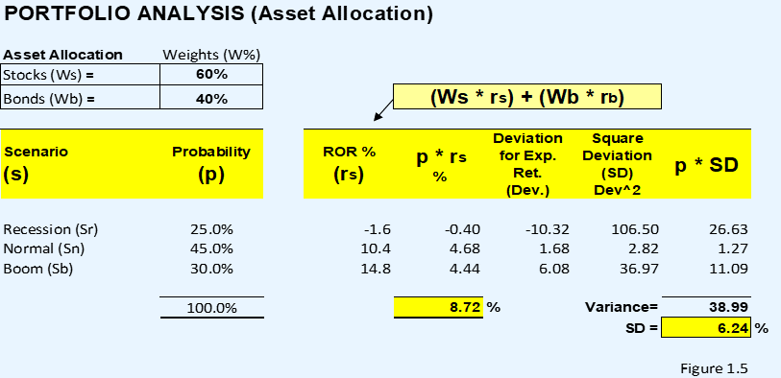
Measuring Return and Quantifying Risk
Scenario Analysis Method

Slide 29
REVIEW:
Measuring Return and Return Expectation
Scenario Analysis Method
STOCKS
BONDS

Slide 30
Return, Return Expectation, Risk and Allocation
CHAPTER 1 REVIEW:
Measuring Return and Return Expectation
Return:
Then the combined portfolio shown in figure 1.5 consisting of 60% stock and 40% bonds shows an expected combined return, variance, and standard deviation of 8.72%, 38.99% or .39x, and 6.24%, respectively. As expected, as we moved from the stock portfolio of 100% to a portfolio of 60% stock and 40% bonds, the return is calculated at 8.72% measured as
(Ws . Rs) + (Wb . Rb) = = (.60) (11.70%) + (.40) (4.25%) = 7.02% + 1.7% = 8.72%
Risk:
The Risk is measured by the amount of volatility needed to achieve the expected returns. The volatility is basically the variance and standard deviation of the historical rate change of the stocks during the 3 scenarios. The formulas areas follows:
Variance = $σ_{P}^{2}=w_{s}^{2}σ_{s}^{2}+w_{b}^{2}σ_{b}^{2}+2w_{s}^{ }σ_{s}^{ }w_{b}^{ }σ_{b}^{ }ρ$
Standard Deviation = $σ_{P}^{ }=\sqrt{(}w_{s}^{2}σ_{s}^{2}+w_{b}^{2}σ_{b}^{2}+2w_{s}^{ }σ_{s}^{ }w_{b}^{ }σ_{b }^{}ρ)$

Slide 31
CHPATER 1 REVIEW:
Measuring Return and Return Expectation
Scenario Analysis Method

Slide 32
Chapter 2:
Covariance, Correlation and Efficient Frontiers

Slide 33
Covariance and Correlation Overview
After reviewing the risk and return independently for each asset, the next step for an investor is to analyze a potential portfolio that combines all asset classes and apply the same measurement of return and calculation of risk.
The risk and return of the combined portfolio can be significantly different when compared to each individual asset calculated separately.
The covariance and correlation calculation represent the relationship of the risk between two or more asset classes.
This an important step towards building a combined portfolio that achieves efficiency.

Slide 34

Investment Return and Risk Efficiency
The investment thesis is based on the idea that by diversifying or allocating your investments to various assets classes you can achieve higher efficiency
  Let’s compare two asset classes such as stocks and bonds, as illustrated in figure 2.1. After we calculate each deviation from their respective mean for each economic scenario and apply the probability, we will then calculate the covariance (Cov) (Rs, Rb) for stock and bonds, which is the sum of these deviations. The correlation is calculated as follows:
$ρ=\frac{\operatorname{cov}\left(R_{s}R_{b}\right)}{σs⋅σ_{b}}$
    where $cov$ is the covariance of the combined portfolio of returns over the standard deviation of each asset class

Slide 36

The Impact of Correlation to Portfolio Efficiency: Achieving Minimum Variance
When combining two asset classes in one portfolio, the combined return, variance, and standard deviation can be achieved as follows:
Mean return (average return): $R_{ρ}=\left(w_{s}⋅R_{s}\right)+\left(w_{b}⋅R_{b}\right)$
  where $R_{ρ}$is the return of the combined portfolio, $R_{s}$ is the return of the stock portfolio, $R_{b}$ is the return of the bond portfolio, and $w_{s}$ and $w_{b}$ are the percentage weights of stock and bonds, respectively.
Variance and standard deviation:
$$σ_{P}^{2}=w_{s}^{2}σ_{s}^{2}+w_{b}^{2}σ_{b}^{2}+2w_{s}^{ }σ_{s}^{ }w_{b}^{ }σ_{b}^{ }ρ$$
$$σ_{P}^{ }=\sqrt{(}w_{s}^{2}σ_{s}^{2}+w_{b}^{2}σ_{b}^{2}+2w_{s}^{ }σ_{s}^{ }w_{b}^{ }σ_{b }^{}ρ)$$
  where $σ_{P}^{2}$ is the variance of the combined portfolio, $w_{s}$ and $w_{b}$ are the percentage weights of stocks and bonds, respectively, $σ_{s}^{ }$ and $σ_{b}^{ }$are the standard deviation of the stocks and bonds, respectively, and $ρ$ is the correlation.

Slide 37
Efficient Frontier at Different Correlation Levels
The most northwestern point of the map just before the turn is the efficient frontier. This is the point with the highest possible return at the lowest possible risk, measured by the standard deviation. Figure 2.2 calculates that the lowest possible variance is estimated at 31.9% Stocks and 68.1% bonds achieving a minimum standard deviation of 1.12759 and weighted average return of 6.62655%.

Slide 38
Efficient Frontier at Different Correlation Levels
Correlations from -1 to +1

Slide 39
Efficient Frontier at Different Correlation Levels
Correlation = 0.0
Figure 2.4 shows that our portfolio (portfolio A) with an assumed zero correlation. The efficiency can be achieved around 10%–20% stock allocation, showing that the standard deviation at these levels is reduced from 7.05% (all bonds) to 6.52% at 10% stock and continues to reduce to 6.38% at 20% stock before the standard deviation increases again around 30%, showing a standard deviation of 6.66%. The lowest possible standard deviation representing the efficient frontier is calculated at 18.3% stocks and 81.7% bonds calculating a 6.637319% and 5.61335% standard deviation and combined portfolio return, respectively.

Slide 40
Efficient Frontier at Different Correlation Levels
Correlation = +1.0
Figure 2.5 shows our portfolio’s (portfolio A) risk-versus-return allocation line assuming a perfect positive +1 correlation. At a +1 correlation there is no efficiency. As the portfolio moves from all bonds to all stock, the line is at 45-degree angle, showing that the risk continues to increase at the same pace as the portfolio manager is seeking higher returns.

Slide 41
Efficient Frontier at Different Correlation Levels
Correlation = -1.0
The lowest possible standard deviation with negative -1 correlation representing the efficient frontier is calculated at 32.1% stocks and 67.9% bonds calculating a 0.00206% and 6.64145% standard deviation and combined portfolio return, respectively.

Slide 42
Efficient Frontier at Different Correlation Levels
Historical Analysis
Excel formulas for average, standard deviation, covariance, and correlation:
=Average(number1, number2, . . .): highlight information range
=Stdev.p(number1, number 2, . . .) for n observations, =stdev.s for n-1 observations
=Covar(aray1, array2): highlight each comparative range
=Correl(array1, array2): highlight each comparative range

Slide 43
Extension to the Three-Asset Case
The question is how the investor will could improve the trade-off between risk and return by adding a new asset class in the portfolio.

Slide 44
  Portfolio Efficiency to Optimization
  From the point of efficiency, the portfolio manager is seeking to achieve an even a higher return delta (rate of change), but as discussed, it will also come with higher risk. The optimization point is where the additional return, or the rate of change going from bonds to stocks, is lower than the rate of change of additional risk—basically, higher return delta at a lower risk delta. That achievement is called the optimum point and is the basis of the Sharpe ratio. Figure 4.3 shows a basic illustration of the optimization process.

