Slide 1





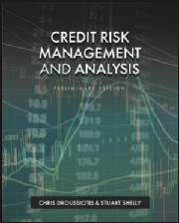

Chapter 1: Credit Basics, History and role
Chapter 1
“Credit Risk Management & Analysis”

Slide 2
MONEY BANKING,
THE FED, INVESTMENTS AND CREDIT

Slide 3
Segments of Financial Markets
Direct Finance
  Borrowers borrow directly from lenders in financial markets by selling financial instruments which are claims on the borrower’s future income or assets
Indirect Finance
  Borrowers borrow indirectly from lenders via financial intermediaries (established to source both loanable funds and loan opportunities) by issuing financial instruments which are claims on the borrower’s future income or assets

Slide 4
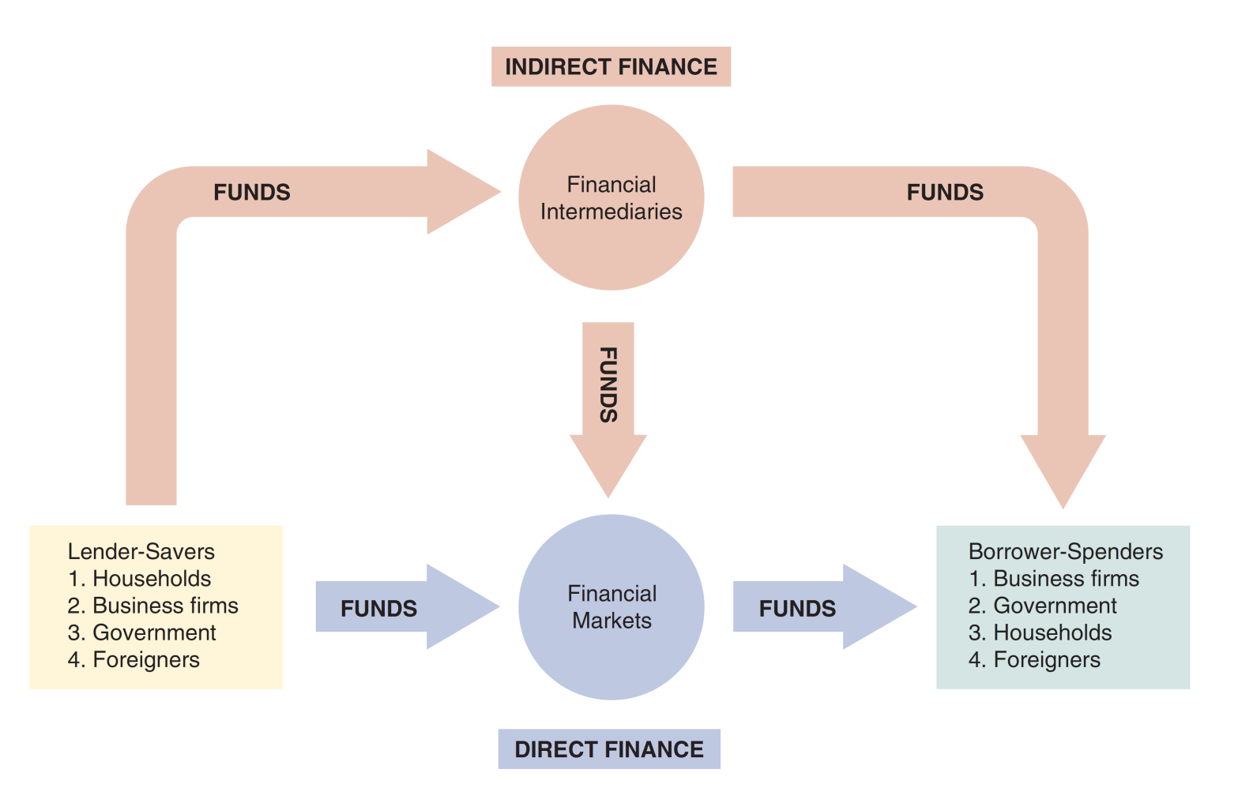
Flows of Funds Through the Financial System

Slide 5
Structure of Financial Markets
Debt Markets
  Short-Term (maturity < 1 year)
  Long-Term (maturity > 10 year)
  Intermediate term (maturity in-between)
  Represented $133 trillion at the end of Dec 2023.
Equity Markets
  Pay dividends, in theory forever
  Represents an ownership claim in the firm
  Total value of all U.S. equity was over $100 trillion at the end of August 2024.

Slide 6
Structure of Financial Markets
Primary Market
  New security issues sold to initial buyers
  Typically involves an investment bank who underwrites the offering
Secondary Market
  Securities previously issued are bought and sold
  Examples include the NYSE and Nasdaq
  Involves both brokers and dealers (do you know the difference?)
We can further classify secondary markets as follows:
Exchanges
  Trades conducted in central locations (e.g., New York Stock Exchange, CBT)
Over-the-Counter Markets
  Dealers at different locations buy and sell
  Best example is the market for Treasury Securities

Slide 7
Classifications of Financial Markets
We can also classify markets by the maturity of the securities:
Money Market: Short-Term
(maturity < 1 year)
Capital Market: Long-Term
(maturity > 1 year) plus equities (no maturity)

Slide 8
First Pre-Requisite:
Time Value of Money Concepts Overview

Slide 9
Time Value of Money Concepts
One-Time Investment
Annuities or Even Annual Cash flows
Uneven Annual Cash Flows

Slide 10
One-Time Investment
Four Variables:
Future Value (The expected money you will get in the future)
Present Value (money you invest today)
Interest Rate
  Growth of your money
  Discount Rate
  Cost of Capital
  Opportunity Cost
  Holding Period Return (HPR)
  Internal Rate of Return (IRR) or Rate of Return (ROR)
Time

Slide 11
Calculating Future Value
What is the future value of $1,000 after 3 years if the interest rate is 5% compounded annually?

Slide 12
FV: Formula Method
After 1 year:
  FV₁ = PV(1 + r) = $1,000(1.05) = $1,050.00
After 2 years:
  FV₂ = $1,050.00(1.05) = $1,102.50 or
  FV₂= PV(1 + r)² = $1,000(1.05)² = $1,102.50
After 3 years:
  FV₃ = 1,102.50(1.05) = $1,157.63 or
  FV₃ = PV(1 + r)³ = $1,000(1.05)³ = $1,157.63
After t years (general case):
  FV_{t} = PV(1 + r)^{t}

Slide 13
Future Values: General Formula
FV = PV(1 + r)^{t}
  FV = future value
  PV = present value
  r = period interest rate, expressed as a decimal
  t = number of periods (time)
Interest factor = (1 + r)^{t}
To find future values

Slide 14
FV: Using Excel’s Financial Technology
Type the formula
Use a dialogue box
  Click on Formulas > Financial > FV.
  Fill in the Rate, number of periods (Nper), periodic payments (Pmt), and present value (Pv). Click OK.
Type the function
  =FV(rate, nper, pmt, pv, type)

Slide 15
Compound Interest
What is the future value of $1,000 after 3 years if the interest rate is 5% compounded annually?

Slide 16
FV: Formula Methods
After 1 year:
  FV₁ = PV(1 + r) = $1,000(1.05) = $1,050.00
After 2 years:
  FV₂ = $1,050.00(1.05) = $1,102.50 or
  FV₂= PV(1 + r)² = $1,000(1.05)² = $1,102.50
After 3 years:
  FV₃ = 1,102.50(1.05) = $1,157.63 or
  FV₃ = PV(1 + r)³ = $1,000(1.05)³ = $1,157.63
After t years (general case):
  FV_{t} = PV(1 + r)^{t}

Slide 17
FV: Three Methods

Slide 18
Future Value – Example 3
Suppose a relative of yours deposited $10 at 5% interest into a savings account 200 years ago. How much would the investment be worth today with simple interest? With compound interest? What is the difference?

Slide 19
Future Value – Example 3
Suppose a relative of yours deposited $10 at 5% interest into a savings account 200 years ago. How much would the investment be worth today with simple interest? With compound interest? What is the difference?
Simple 10 + 10 (0.5) (200) = 110
Compound FV = 10 (1+1.05) ^ 200 = 172,925.81

Slide 20
Calculate Present Value
We can use the future value formula to find the present value.
  FV = PV(1 + r)^{t}
  Rearrange to solve for PV = FV / (1 + r)^{t}
To find present values

Slide 21
Present Values – Example 2
Suppose when you were born, your parents wanted to begin saving for your college education and they estimated that after 17 years you would need $150,000. If they felt confident that they could earn 8% per year, how much did they need to invest when you were born?

Slide 22
Present Values – Example 2
Suppose when you were born, your parents wanted to begin saving for your college education and they estimated that after 17 years you would need $150,000. If they felt confident that they could earn 8% per year, how much did they need to invest when you were born?
150,000 , 17 years 8.0% = 150,000 / (1.08)^17 = 40,540.34

Slide 23
PV: Using Excel’s Financial Technology
Type the formula
Use a dialogue box
  Click on Formulas > Financial > PV.
  Fill in the Rate, number of periods (Nper), periodic payments (Pmt), and future value (Fv). Click OK.
Type the function
  =PV (rate, nper, pmt, fv, type)

Slide 24
Calculating the Interest Rate
You are looking at an investment that will pay $1,200 in 5 years if you invest $1,000 today. How much interest does this investment earn?

Slide 25
Calculating the Interest Rate
You are looking at an investment that will pay $1,200 in 5 years if you invest $1,000 today. How much interest does this investment earn?
Starting with FV = PV (1+i)^t
1,200 = 1,000 (1+i)^5
1,200/1,000 = (1+i)^5
[(1,200/1,000)^1/5] – 1= i
[(1.2)^0.20] – 1 = 1.0371 – 1 = 0.0371
i = 3.71%

Slide 26
Interest Rate using Excel
Type the formula
Use a dialogue box
  Click on Formulas > Financial > RATE.
  Fill in the, number of periods (Nper), periodic payments (Pmt), present value (pv), and future value (Fv). Click OK.
Type the function
  = RATE(nper, pmt, pv, fv, type, guess)

Slide 27
Discount Rate – Example 2
Suppose you have a 1-year old son and you want to provide $75,000 in 17 years toward his college education. You currently have $5,000 to invest. What interest rate must you earn to have the $75,000 when you need it?

Slide 28
Discount Rate – Example 2
Suppose you have a 1-year old son and you want to provide $75,000 in 17 years toward his college education. You currently have $5,000 to invest. What interest rate must you earn to have the $75,000 when you need it?
R = (fv / pv ) ^ 1/t – 1 = 17.27%

Slide 29
Interest Rate
Suppose you buy a home for $300,000 and sell it 5 years later for $400,000. What yearly interest rate did you earn?

Slide 30
Interest Rate
Suppose you buy a home for $300,000 and sell it 5 years later for $400,000. What yearly interest rate did you earn?
PV = 300k, FV = 400k t = 5 I = (400/300) ^ 1/5 – 1 = 5.92%
Excel: Rate(time,pmt, PV,FV)

Slide 31
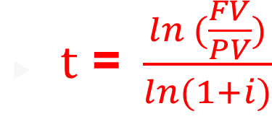
Calculate Time
You want to purchase a new car and you are willing to pay $20,000. If you can invest at 10% per year and you currently have $15,000, how long will it be before you have enough money to pay cash for the car?
FV = $20,000, r = 10%, PV=15,000 t=?
FV = PV (1+i) ^t
20/15 = 1.1^t
ln(20/15) = ln (1.1)^t) ln (20/15)/ ln (1.1) = ln (1.33 )/ ln (1.1) = 0.287/0.095 = 3.02
T = 3.02 years

Slide 32
Calculating Time using Excel
Type the formula
Use a dialogue box
  Click on Formulas > Financial > NPER.
  Fill in the Rate, periodic payments (Pmt), present value (pv), and future value (Fv). Click OK.
Type the function
  =NPER(rate, pmt, pv, fv, type)

Slide 33
Number of periods
You buy a stock for $25 which you expect to grow at a rate of 7% each year. How long will it be before the stock is worth $50?

Slide 34
Number of periods
You buy a stock for $25 which you expect to grow at a rate of 7% each year. How long will it be before the stock is worth $50?
PV = 25
FV = 50
I = 7.0%
T = ?
T = Ln (FV/PV) / ln (1+i) = ln (50/25) / ln (1.07) = 10.24 years

Slide 35

Reviewing One-Time Investment
Variable 1: FUTURE VALUE
FV = PV ${\left(1+i\right)}^{t}$
  where FV is the future value of the investment, PV is the present value of the investment or the initial investment, i is the expected interest rate or rate of return of the investment, and t is time to realize such investment.
  Variable 2: PRESENT VALUE
FV = PV ${\left(1+i\right)}^{t}$, then $PV=\frac{FV}{{\left(1+i\right)}^{t}}$
As an example, assuming the investor targets an investment that is expected to receive $133.10 in 3 years, representing a 10% interest or expected return (sometimes referred to as the discount rate), the investment required today will be calculated as follows:
$PV=\frac{FV}{{\left(1+i\right)}^{t}} = \frac{133.10}{{\left(1+.10\right)}^{3}} = \frac{133.10}{1.331}=100$

Slide 36

Reviewing One-Time Investment
Variable 3: INTEREST RATES
If the investor knows the amount they are planning to invest today, and targets a specific investment payoff at a set time in the future, then the investor can rearrange the formula to calculate the interest (i) or discount rate that he or she will earn, as follows:
Starting at FV = PV ${\left(1+i\right)}^{t}$, then ${\left(1+i\right)}^{t}=\frac{FV}{PV}$ , and
$i$ = $({\frac{FV}{PV})}^{\frac{1}{t}}$ – 1
As an example, let’s assume the investor invests $100 today and targets an investment that expects to receive $133.10 in 3 years. What will the annual rate of return be on such an investment?
$i$ = $({\frac{FV}{PV})}^{\frac{1}{t}}$ – 1 $=({\frac{133.10}{100})}^{\frac{1}{3}}$ – 1 $=({1.331)}^{\frac{1}{3}}$ – 1 = 1.10 – 1 = 0.10 = 10%

Slide 37

Reviewing One-Time Investment
Variable 4: TIME
If the investor knows the amount that they are planning to invest today, then sets a target payoff amount in the future and assumes a given rate of return, then he or she can calculate how long it will take to achieve the target. The time (t) to realize the targeted return is calculated by rearranging the formula as follows:
Starting at FV = PV ${\left(1+i\right)}^{t}$, then ${\left(1+i\right)}^{t}=\frac{FV}{PV}$, then adding ln on both sides, you get ${ln \left(1+i\right)}^{t}=ln(\frac{FV}{PV})$ , $t [\ln\left(1+i\right)]=ln(\frac{FV}{PV})$ , and
$t$ = $\frac{ln (\frac{FV}{PV})}{ln⁡(1+i)}$
As an example, assume the investor invests $100 today and wants to find out how long it will take for the investment to reach $133.10 if invested at an annual rate of return of 10%. The time to reach the targeted future value of such investment is calculated as follows:
$t$ = $\frac{ln (\frac{FV}{PV})}{ln⁡(1+i)}= \frac{ln (\frac{133.10}{100})}{ln⁡(1+0.10)}=\frac{ln (\frac{133.10}{100})}{ln⁡(1+0.10)}= \frac{ln (1.331)}{ln⁡(1.100)}= \frac{0.2859}{0.0953}=3 years$

Slide 38
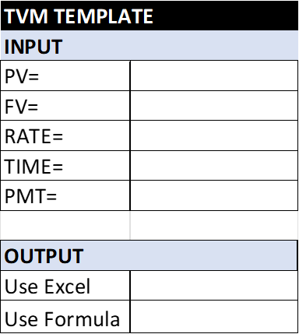
Annuity Investment
In Annuities we are adding the 5th variable (Annual Payment)
Here are the five Variables
Present Value (money you invest today)
Future Value (The expected money you will get in the future)
Interest Rate
  Growth of your money
  Discount Rate
  Holding Period Return (HPR)
  Internal Rate of Return (IRR) or Rate of Return (ROR)
Time
Payment (Even Monthly, Even Annual Payment)

Slide 39

Annuities or Even Annual Cash flows
Variable 1: FUTURE VALUE ANUITY (FVA)
FVA = CF + CF (1 + i) + CF (1 + i) (1 + i), or FVA = CF ( $\frac{{(1+i)}^{t}−1}{i} )$
For example, if an investor invests $100 per year for 3 years and expects a 10% rate of return, then the value of such investment when it is cashed out in 3 years will be calculated as follows:
FVA = CF ( $\frac{{(1+i)}^{t}−1}{i} )=100 \left(\frac{{\left(1+0.10\right)}^{3}−1}{.10} \right)=100 \left(\frac{{\left(1.10\right)}^{3}−1}{.10} \right)= 100 \left(\frac{1.331−1}{.10} \right)= 331.00$

Slide 40

Annuities or Even Annual Cash flows
Variable 2: PRESENT VALUE ANUITY (PVA)
The present value of an annuity (PVA) can be calculated as follows:
PVA = $\frac{CF}{{(1+i)}^{1}}+ \frac{CF}{{(1+i)}^{2}}$ + $\frac{CF}{{(1+i)}^{3}}$ +…..+ $\frac{CF}{{(1+i)}^{n}}$, or PVA = CF $[\frac{1−\frac{1}{{\left(1+i\right)}^{t}}}{i}]$
For example, if an investor expects to receive $100 per year for 3 years, then what is the present value for an investment if the investor expects to receive a 10% annual rate of return? The calculation of the present value of such an investment is as follows:
  PVA = CF $[\frac{1−\frac{1}{{\left(1+i\right)}^{t}}}{i}]=$ 100 $[\frac{1−\frac{1}{{\left(1+.10\right)}^{3}}}{.10}]=100 [\frac{1−\frac{1}{1.331}}{.10}] = 248.69$

Slide 41
Annuity (Real-world) Example
You decide that starting when you are 20 years old you will save $3 a day for retirement. Every day you put $3 in a drawer. At the end of the year, you invest the accumulated savings ($1,095) in a brokerage account with an expected annual return of 12%. If you continue the practice every year until you are 65, how much money will you have?

Slide 42
Annuity (Real-world) Example
You decide that starting when you are 20 years old you will save $3 a day for retirement. Every day you put $3 in a drawer. At the end of the year, you invest the accumulated savings ($1,095) in a brokerage account with an expected annual return of 12%. If you continue the practice every year until you are 65, how much money will you have?
CF = 10,095 , FV = ? , T= 45 years, PV = 0
FV = CF ((1+r)^t – 1) / r
FV = 1095 ((1+.12)^45 – 1 / .12
$1,487,261.89

Slide 43
Annuity - Cash Flow
If you would like to have $120,000 in your child’s college account in in 18 years and you can earn 6.5% per year, how much must you invest each year?

Slide 44
Annuity - Cash Flow
If you would like to have $120,000 in your child’s college account in in 18 years and you can earn 6.5% per year, how much must you invest each year?

Slide 45
Who wants to be a millionaire?
How much money do you need to save each year to be a millionaire by the time you are 65 if you can earn an interest rate of 8% and you start saving when you are
20 years old:
30 years old:
40 years old
When you are born

Slide 46
Who wants to be a millionaire?
How much money do you need to save each year to be a millionaire by the time you are 65 if you can earn an interest rate of 8% and you start saving when you are
  45? $21,852.21
  30? $5,803.26
  20? $2,587.28
  Born? $541.35
  FV=$1 mm
  PV = 0
  t =65-45 = 20 years
  R = 8.0%
  =pmt(

Slide 47
Annuity – Interest rate
What interest rate must you earn in order to have $500,000 in a savings account in 20 years in you contribute $2400 per year?

Slide 48
Annuity – Interest rate
What interest rate must you earn in order to have $500,000 in a savings account in 20 years in you contribute $2400 per year?

Slide 49
Excel based formulas for one-time and annuity investments:
For calculating all five variables for annuities including the present value, future value, rate of return, time and cash flows or payments (represent set additional payments received during the investment) use the following Excel formulas:
= PV (rate, years, payment, future value) or =pv(rate,nper,pmt,fv)
=FV (rate, years, payment, -present value) or =fv(rate,nper,pmt,pv)
=Rate (years, payment, - present value, future value) or =rate(nper,pmt,pv,fv)
=Nper (rate, payment, - present value, future value) or =nper(rate,pmt,pv,fv)
= Pmt (rate, years, -present value, future value) or =pmt(rate,nper,pv,fv)

Slide 50

Uneven Annual Cash Flows
If the investment expected to produce uneven annual cash flows to the investor, called payments, for a set time, using the same expected rate of return, then the investment is calculated differently. The present value of such cash flows is the sum of all the future cash flows discounted back at a given expected rate of return, as follows:
PV = $\frac{{CF}_{1}}{{(1+i)}^{1}}+ \frac{{CF}_{2}}{{(1+i)}^{2}}+\frac{{CF}_{3}}{{(1+i)}^{3}}+…\frac{{CF}_{t}}{{\left(1+i\right)}^{t}} …. PV= \sum{\frac{{CF}_{t}}{{(1+i)}^{t}}}$
For example, if an investor expects to receive $95 the first year, $92 the second year, and $105 the third year, what is the present value for such an investment if the investor expects a 10% annual rate of return? The calculation of the present value of such investment is as follows:
PV = $\frac{{CF}_{1}}{{(1+i)}^{1}}+ \frac{{CF}_{2}}{{(1+i)}^{2}}+\frac{{CF}_{3}}{{(1+i)}^{3}}= \frac{95}{{(1+0.10)}^{1}}+ \frac{92}{{(1+1.10)}^{2}}+\frac{105}{{(1+1.10)}^{3}}=$
$86.36+76.03+78.89=241.28$

Slide 51
Intro to Corporate Banking and
Credit Analysis

Slide 52



MONEY BANKING,
THE FED, INVESTMENTS AND CREDIT

Slide 53
Central Banks and Monetary Policy
Countries use a “Central Bank” to implement and administer their monetary policy – controlling interest rates and money supply
The US uses its Federal Reserve Banking System (the Fed) in conjunction with the US Treasury
  Money Supply refers to the amount of a country’s currency that is available for the payment of goods and services as well as for the repayment of debt.
  Most of the Money Supply is not actually in the form of physical notes but rather is recorded in the form of mortgages, US Treasuries, and Deposits and Loans.
  Monetary Policy, which refers to the governance of interest rates
  Money Supply, impacts liquidity (available funds), the flow of money, and the cost of borrowing, all of which has implications for inflation.
  Decreases Money Supply by issuing debt (Bills <=1 year, Notes between >1, <10 years, Bonds longer than 10 years, the most popular are 10 and 30) and Increases Money Supply by Buying Treasuries, which also lowers rates
  Inverse relationship between Price and Rate

Slide 54
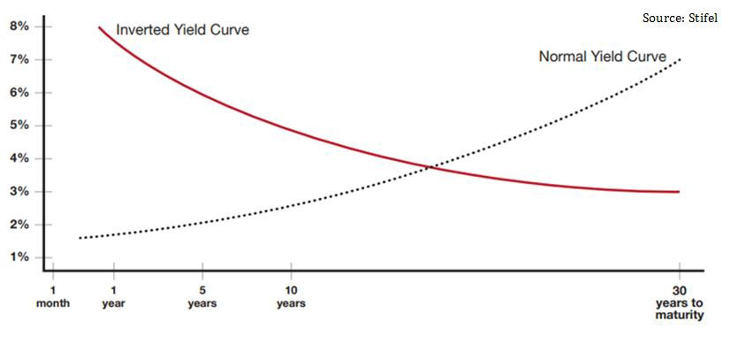
Normal vs Inverted Yield

Slide 55
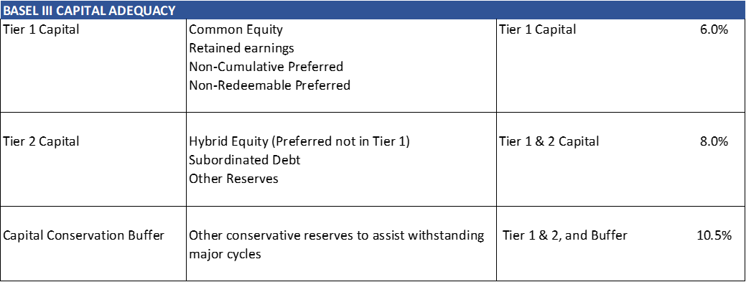
Role of Regulators, Bank Equity, and Capital Adequacy
Regulators ensure the Safety and Soundness of US banking institutions, primarily for the protection of the depositors
OCC – Office of the Comptroller of the Currency): primary regulator
FDIC – Federal Depository Insurance Corporation: Insures bank deposits up to $250,000 per account (not necessarily owner of account)
Bank Charters:
  OCC – Federal (Savings Associations) and National (National Banks)
  State Charter – State Comptrollers
The Capital Adequacy Ratio (CAR) of Risk Based Capital (Tier 1 Capital and Tier 2 Capital) to Risk Weighted Assets (RWA):

Slide 56
Role of Regulators, Bank Equity, and Capital Adequacy
Regulators ensure the Safety and Soundness of US banking institutions, primarily for the protection of the depositors
OCC – Office of the Comptroller of the Currency): primary regulator
FDIC – Federal Depository Insurance Corporation: Insures bank deposits up to $250,000 per account (not necessarily owner of account)
Bank Charters:
  OCC – Federal (Savings Associations) and National (National Banks)
  State Charter – State Comptrollers
The Capital Adequacy Ratio (CAR) of Risk Based Capital (Tier 1 Capital and Tier 2 Capital) to Risk Weighted Assets (RWA):

Slide 57
Corporate Banking:
CAMELS Bank Ratings
The OCC regulates banks and performs regular reviews of banks, with the largest banks under constant regulatory review, due mainly to their massive size and risk in the event of a negative outcome. Bank regulators have developed a rating scale from 1 to 5, where 1 is the highest and 5 being the lowest, wherein the regulators measure banks against various operational, qualitative, and quantitative attributes. The rating systems is an acronym called CAMELS, which stands for:
Capital Adequacy – discussed previously.
Asset Quality – discussed above – see ACL.
Management
Earnings
Liquidity – interest rate sensitivity and ability to convert assets to cash.
Sensitivity – to certain risk exposures
The regulators of banks provide lists of banks and their respective CAMELS ratings, however, will oddly not provide any insight into the basis for the ratings nor details behind how each bank ranked on each attribute.
Any bank with a rating below 2 is considered troubled

Slide 58
Corporate Banking:
Credit Analysis Overview
Credit vs Investment:
Credit comes from the Latin word meaning to “trust”, in that someone providing credit is trusting that the person borrowing the money will pay them back on the terms that have been established – the “Money terms”.
Investment refers to a participation in the risk and rewards of the venture or project. The original Latin root means to “clothe or provide substance to.” Investing involves a return based on the risk of the project.
Fixed Income involves the provision of credit and the levels of Trust being taken and given, and for what return or compensation for time and perceived risk associated with the granting of trust. Risk of the return of the credit advance pursuant to the money terms agreed to:
Money Terms: Amount, Compensation (Interest), Repayment Schedule, Maturity, (and Collateral)
Time Value of Money: Risk-free rate
Compensation for Risk: Credit Spread

Slide 59
Corporate Banking
Loan Money Terms
Amount:
The amount of money borrowed, which is typically the “Face” amount of the loan, note, or bond
Interest Rate:
The annual rate paid (accrued) each year to compensate for the time value of money and risk
Repayment Schedule: (Amortization Schedule)
Date certain, schedule of payments of interest and principal over the life of the loan
Maturity:
Date of final repayment in full of the loan plus accrued interest and penalties and any other fees
Collateral:
The security for the loan (house, car, equipment, intangible assets, etc.)

Slide 60
Corporate Banking:
TVM concepts can be used to calculate Loans as well
LOAN
Principal (Loan Amount) plus Risk-Free Interest for each period the Principal is outstanding until its return equals the Future Value of the initial principal Amount
P = Principal
i_{r} = risk-free interest rate per annum
n = number of periods
FV = Future Value of original Principal Amount
FV = P * (1 + i_{r})^{n} (1.1)
We then add a Risk Premium (i_{rp}), to compensate for the assessed credit risk: risk (probability) of default, and loss given the event of default – including all costs and net of recoveries
FV = P * (1 + (i_{r} + i_{rp})) ^{n} (1.2)
Most Bonds have semi-annual interest payments, having a payment frequency (f) of 2 per annum
FV = P * (1 + (i_{r} + i_{rp})/f) ^{n*f} (1.3)

Slide 61
Corporate Banking:
Repayment (Amortization) Schedule
Fixed Constant Principal Payments: Straight Line
Each repayment of principal reflects a given equal amount per period
      P = A / (Term * f): [P = Principal Payment Amount]
Fixed Sculpted, Balanced or Uneven Principal Payments:
The payments of principal are fixed and known, yet are different from period to period, presumably to accommodate for varying cash flows of the borrower
Balloon Payments:
A large fixed payment to be made some period in the future, after a grace period or a term of reduced payments. The Balloon payment may be the final maturity payment.
Fixed P&I (Principal & Interest):
Mortgage – payments in arrears, no payment at time zero
      P&I = A / ((1- (1 / (1+i)^{n})) / i) (1.4)
Lease Schedule – payments in advance – first payment made at time zero
      P&I = A / (((1- (1 / (1+i) ^{(n-1)})) / i) +1) (1.5)

Slide 62
Corporate Banking:
Typical Corporate Loan and Bond Debt Schedule

Slide 63
Corporate Banking:
Typical Mortgage Type Payment Schedule

Slide 64
Corporate Banking:
Reserves - Allowance for Credit Losses
Risk Weighted Assets (RWA - refers to the value of a bank’s assets as adjusted for reserves.
  “Reserves” refers to the concept of the bank making a reserve for potential future credit losses.
Allowance for Credit Losses (ACL) was developed after the Global Financial Crisis (GFC) of 2008.
  ACL is an accounting concept, providing for a “contra asset” account (credit balance), which reduces the gross value of balance sheet assets by a credit loss provision in much the same way accumulated depreciation estimates the declining value of property plant and equipment by creating a contra asset reducing the net carrying value of the fixed assets of an enterprise.
  ACL was developed to replace the old notion of Allowance for Loan and Lease Losses (ALLL)
  Current Estimate of Credit Losses (CECL) - current period accruals
    Developed from “bottoms up analysis at loan level” – NAAH, not really, but almost!

Slide 65
Corporate Banking:
Bank Asset Rating Categories
All commercial banks, credit agencies, and institutions that lend money to corporations, focus on the following five areas of analysis when rating the Borrower and the loan based on the probability of default.
Loan-to-value (LTV) or debt capitalization ratio: This ratio, expressed as a percentage, compares the enterprise debt to its’ total capital, or total value of the asset or business. It is important to look at each tier of credit in the capital structure to examine priorities and collateral interests.
Leverage ratio of debt to EBITDA or EBIT: This leverage ratio, or debt to cash flow ratio, is one of the most popular ratios to used analyze the solvency and credit quality of a company.
Coverage ratios describing the Borrower’s ability to service either Interest alone or the combination of Interest and Principal, include EBITDA / interest and cash flow (EBITDA) to debt service (Principal and Interest):
Cash flow forecasts, typically using a 30% haircut to base projections:
Customized operating ratios based on the company’s business that which can be cyclical or seasonal or depend on commodity pricing

Slide 66
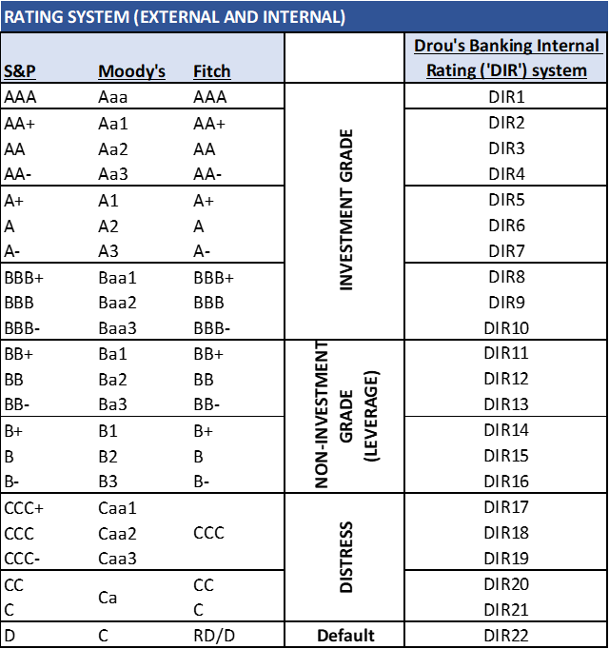
Bank Asset Rating Categories
Based on how each borrower and loan is assessed against the ratios and measures, most banks use a rating scale for their internal portfolio risk management. An example of which is below:

Slide 67
Corporate Banking:
Basic Bank Loan Products
Bank commercial lending products may be categorized in one of two types primarily constructed around the nature of the assets they are collateralized with:
  Short-term working capital revolving credit facilities
  Equipment, real estate, or corporate term loans (based on enterprise values)
Working Capital Facilities
  Revolving credit facilities: because they are self-liquidating, are paid down through cash collections and reborrowed constantly
    Often structured with a Lockbox _ account control agreement – requiring collections o be controlled and “swept” agsint the loan outstandings
      Orange County Lamborghini example
    Secured by Inventory and Receivables
  ABL – Business Credit Structures
    Rigorous asset level monitoring and auditing, and strict controls over cash, lockbox and sweeps
  Receivables Factoring: discussed in Chapter 15
  Merchant Cash Advances: discussed in Chapter 15

Slide 68
Corporate Banking:
Basic Bank Loan Products
Wholesale Banking and Syndicated Credit Facilities:
  Larger borrowers or those where an ABL structure isn’t required or suitable – see Tyson Foods Case Study
Term Credit Facilities: typical bank duration is 3-7 years, other than certain mortgages secured by generic real estate (office buildings, etc, not factories)
  Equipment Term Loans:
    Specialized equipment lending against fungible equipment assets such as medical equipment or trucks (often in the case of sole proprietorships using SBA (Small Business Administration) loans
  Mortgage Term Loans:
    Term loans secured by real property, unless fungible such as office buildings, will likely be shorter term loans -5-7 years, and lower advance LTVs
  Corporate Term Loans:
    Most corporate term loans fall into this category, low LTV secured by all fixed assets and often all assets in a single collateral pool along with the working capital revolving credit facility (revolver)

Slide 69
Basic Bank Loan Products
Stretch Senior term loan:
  Secured by all assets, LTVs possibly higher than typical, requiring extra risk premium
Term Loan A, B, C:
  The differentiation of tranches of senior term loans may simply designate the maturity spectrum each tranche covers but may also represent different loan agreements and different types of holders or lenders.
Second Lien Term Loan:
  A second lien loan is one that may or may not have a primary perfected lien on assets uniquely to that loan, but rather has a second lien security interest in collateral which other lenders may have a primary security interest.
Subordinated Term Loan:
  While a second lien or springing lien term loan has a subordinated interest and claim against collateral ahead of trade creditors and other constituents such as employees or customers, a Subordinated Lender has specifically relegated themselves by their credit agreements to a subordinated position, which may be secured, but most often is not, to ensure the trade creditor positions are not impaired. Subordinated debt may be a structural requirement of the borrowers’ trade creditors and have nothing to do with the leverage or other indebtedness of the company.

Slide 70
Corporate Banking:
Commercial Finance – Equipment Finance
Appropriate for Asset Intensive Borrowers – Initial loans against Original equipment Costs (OEC), High LTV, 3-7 years
Equipment loans are often provided by the Commercial Finance or Leasing units within banks or non-bank Commercial Finance companies such as Stonebriar Commercial Finance or Encina Commercial Finance. Leasing as a product is discussed in Chapter 13 later in this book.
Rigorous monitoring and establishment of procedures to ensure the equipment is adequately maintained by the borrower to protect the value of the collateral. In many cases equipment lenders will install remote tracking devices on equipment and may also install controlled “shut-off” switches to enable the lender to control a borrower’s use and access to equipment.
Commercial equipment finance requires specialized monitoring and unique asset valuation skills, and the lenders often have substantial secondary sales marketing activities supporting the end-of-life monetization of equipment as collateral.
End-of-life (EOL) analysis is important to lending against equipment assets, and constantly reviewing the collateral condition and value against current market replacement costs and the decay curve of the collateral – the declining value of a new piece of equipment over its useful life.
Commercial Finance lenders are concerned about replacement cost of equipment as a protection of their collateral value – decay curve of its depreciating market value is important
Best performing asset class in the global financial crisis (GFC)

Slide 71
Corporate Banking:
Parties to a Credit Agreement
Two primary parties to a credit agreement: (1) Borrower, and (2) Lender. There may be others such as documentation agent, collateral agent, trustee (in securitizations and syndications) and asset audit firm (in ABL and Commercial Finance).
Borrower: The Borrower is the commercial business or enterprise which is seeking to borrow debt capital to fund their operations, acquire a building, facilities, equipment, inventory, or another business, or simply to support their growth. The attributes of the Borrower are essential to the structure and nature of the credit Facility developed and underpin the rate the bank will charge for the risk they are taking.
Borrower Risk:
i) Collateral
ii) Creditworthiness of Borrower
    Investment grade v. non-investment grade
    Historical financial performance
    Revenues
    EBITDA – Earnings Before Interest Depreciation and Amortization
    DSCR – Debt Service Coverage ratio
iii) Management
iv) Competition
v) Customers

Slide 72
Corporate Banking:
Parties to a Credit Agreement
Lender: Banks private lenders and non-bank lenders, such as Commercial Finance companies or Business Credit providers
  skills in an industry or with managing and monitoring an asset class, such as rail cars or truck trailers, beer kegs or marine containers.
  Banks, as discussed previously are constrained by their regulatory construct

Slide 73
Corporate Banking:
Banking Units
Origination and Relationship Management
  Industry Groups
  Geographic Groups
  Wholesale Banking
  Middle Market Banking
Product Specialists: LBO, Leasing, ABL, Project Finance, Venture Credit, Commercial Paper, etc.
Credit & Underwriting – approves the loans and manages the potfolio, including CECL and ACL
Operations - Asset Management, Monitoring, and Reporting (AMMR) – manages the book of loans
Finance & Treasury – funds the banks balance sheet
Audit & Review
Syndications and Asset Sales
Capital Markets
Investment Banking
Wealth Management

Slide 74
Corporate Banking:
Credit Underwriting and Structuring
Complete various internal documentation of a credit review process
  Initial Client Evaluation Questionnaire – background on client
  Management Capability and Moral Standing Review: Client Acceptance Memo – CAM template – foundational critical gating preqialifcation of potential borrower, size, industry, location, business (years in business and business model), assets as collateral, and character of borrower
  Historical Financial Performance Review: Business Plan Evaluation and Assessment Memo – BEAM template – historical financial analysis and financial forecast with pro-forma financial statements and debt capital as contemplated
  Collateral Review: - BEAM
  Business Plan Review: - BEAM
  Credit Underwriting and Structuring Review: - BEAM
  Investment Screening Memo – ISM template – which ultimately becomes the Investment Committee Memo, when it is taken to committee for approval

Slide 75
Corporate Banking:
Credit Underwriting and Structuring
Debt Capacity Analysis
Revolving Credit Capacity:
  Inventory aging analysis by type – Raw Materials, WIP and finished Goods.
  Inventory Turns (COGS / Inventory)
  Seasonality – a review of the seasonality of sales demand cycles will enable the lender to establish the inventory variability throughout the year and the needs for having more inventory in one period than another to ensure adequate supplies to fulfil customer orders and the manufacture of finished goods to fulfill customer orders.
  Manufacturing cycle
  Raw materials commodity risk and exposure, and substitution availability and marketability (including access to remote locations)
  Freight into manufacturing or distribution warehouses
  Accounts Receivable
    Quality
    Aging – collectability
    Revenue and collections cycle
Maximum Debt Capacity Analysis: Establish the predictable recurring EBITDA levels to refine the determination of the maximum available indebtedness of the enterprise. The capacity may be dependent on the type of credit instruments and structure contemplated – see Tyson foods case study
Term Debt Capacity Analysis: Derived from the Maximum debt Capacity less the revolver – Note: the Revolver is both “self-liquidating” (best lenders assets) and does not require amortization – so maximize this first!

Slide 76
Corporate Banking:
Loan Covenants
To establish early warning signs
To ensure cash flow performance and repayments are made according to the borrower and lender agreed undertakings.
Typical Performance Covenants include the following:
  Minimum EBITDA
  Minimum Equity
  Minimum EBITDA to Interest of
  Minimum EBITDA to Principal and Interest (“Debt Service”) – called a Debt Service Coverage Ratio (DSCR)
Various reporting and governance covenants as well as maxmimum indebtedness and minimum cash and equity are also common
Investment Grade loans often have no collateral and no covenants
  Global Crossing
  Enron
  LBO Structures

Slide 77
Corporate Banking:
Asset Management, Monitoring & Reporting (AMMR)
“Inspect What You Expect”
The responsibility of the AMMR function is to monitor and report in each borrower’s performance on a regular basis, paying particular attention to and reporting on, their performance against their business plan as encapsulated in the BEAM and ISM and the Covenants stipulated and agreed to in the loan documents.
HBJ Case Study:
  In the 1980s, when the standards of LBOs and reporting functionality of AMMR was evolving, a large leveraged recapitalization of Harcourt Brace Jovanovich (HBJ) was completed and the AMMR function was not upheld until the last minute with dramatic and extreme results. HBJ had covenanted to sell its excess real estate surrounding its headquarters in Orlando, FL, as well as to undertake various other asset sales such as the sale of its “Farmer’s Almanac” and Insurance units. HBJ also owned SeaWorld at the time. About one year after the defensive recapitalization, led by JP Morgan (acquired by Chase and now, JP Morgan Chase), with Sub Debt placed by First Boston (now Credit Suisse First Boston), HBJ and JP Morgan informed the bank participants of a bank meeting at NYU in two weeks. After a flurry of activity reviewing the years performance belatedly, by the LBO group at Bank of America (BofA), the meeting was held with over 100 bankers present, including small contingent from BofA and their loan participation buyers (mostly international banks). HBJ had not complied with any of its asset sales covenants and yet was informing the large group of bankers, without any prior information, of dramatically lower EBTIDA levels, pending default and a request for a repayment restructuring! The BofA team immediately interrupted the meeting, alerting the attendees to the issues. The bank meeting was halted and within weeks HBJ had sold not only its excess real estate but also its insurance and magazine businesses and was proceeding to sell SeaWorld. All these actions resulted in massive corrective actions protecting the lenders.

