Slide 1





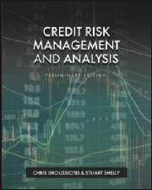

Chapter 18: Valuation Analysis
Chapter 18
“Credit Risk Management & Analysis”

Slide 2
Valuation Analysis Overview
The chapter will introduce the following eight methods of valuating the company’s enterprise value:
Method 1: Using the current stock price as a basis of valuation
Method 2: Intrinsic value and capital asset pricing model (CAPM)
Method 3: Dividend discount model (DDM)
Method 4: Comparable method using trading EBITDA multiples
Method 5: Comparable method using acquisition EBITDA multiples
Method 6: Discount cash flow method (DCF)
Method 7: Leveraged buyout private equity expectation model (LBO)
Method 8: Black-Scholes option pricing model

Slide 3
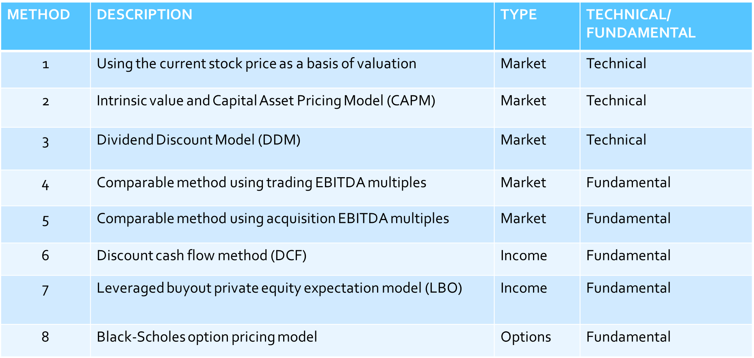
Valuation Analysis Overview

Slide 4
Valuation of Publicly Traded Companies.
Testing the current Stock Price

Slide 5
Methods 1-6: Valuation of Public Traded Companies
Method 1: Using the Stock Price as the Basis of Valuation
The formula to value the firm or the enterprise value (EV) is as follows:
EV = MVE + D – C
where EV is enterprise value, MVE is the market value of the equity, D is the total debt outstanding, and C is the cash and cash equivalents of the company.
The stock price that represents the market value of each share when multiplied by the shares outstanding will give us the market value of the equity.
MVE = (SP . SO)
where MVE is the market value of the equity, SP is the stock price and SO is the shares outstanding.

Slide 6
Methods 1-6: Valuation of Public Traded Companies
Method 1: Using the Stock Price as the Basis of Valuation – HYATT CORPORATION

Slide 7

Methods 1-6: Valuation of Public Traded Companies
Method 2: Intrinsic Value and CAPM
The expected return is calculated by applying the capital asset pricing model (CAPM):
Er = Rfr + 𝛽 (Mr - Rfr)
where Er is the expected return, Rfr is the risk-free rate, β is the beta of the company that is analyzed, and Mr is market return.
The formula for today’s intrinsic value is
$$v_{0}=\frac{D_{1}+ρ_{1}}{1+Er}$$
where D1 is the dividend expected to receive within a year, P1 is the expected stock price a year from now, and Er is the discount rate or expected rate of return.

Slide 8
Methods 1-6: Valuation of Public Traded Companies
Method 2: Intrinsic Value and CAPM – HYATT CORPORATION

Slide 9

Methods 1-6: Valuation of Public Traded Companies
Method 3: Dividend Discount Model (DDM)
To calculate such value using the DDM method, the analyst needs the expected price of the stock a year from the date of the analysis, the expected dividend per share paid within the year, and a discount rate, which derived using the capital asset pricing model (CAPM).
$$V=\frac{D1}{Er−g}$$
where D1 is the expected dividend, Er is the discount rate, and g is the expected growth rate.

Slide 10
Methods 1-6: Valuation of Public Traded Companies
Method 3: Dividend Discount Model (DDM) – HYATT CORPORATION

Slide 11
Methods 1-6: Valuation of Public Traded Companies
Method 4: Using Industry Trading EBITDA Multiples– HYATT CORPORATION

Slide 12
Methods 1-6: Valuation of Public Traded Companies
Method 5 Using Industry Acquisition EBITDA Multiples– HYATT CORPORATION

Slide 13
Methods 1-6: Valuation of Public Traded Companies
Method 6: Using the Discount Cash Flow Method (DCF)
To value the company using the DCF method the analyst needs to derive the following four items:
Setting up a stream of cash flows
Identifying an exit year
Calculating the value at exit year (terminal value)
Using the appropriate discount rate to value the present value of the firm

Slide 14
Methods 1-6: Valuation of Public Traded Companies
Method 6: Discount Cash Flow (DCF) –
HYATT CORPORATION

Slide 15
Method 7: Using the Leveraged Buyout Model (LBO) Method
While the DCF analysis is used for determining today’s value of the company based on future cash flows, the value of the company using this LBO method is determined based on investor expectation, which means return determines the acquisition price of the firm.
Building the Transactions Sources and Uses
Setting up the Debt Schedules
Calculating the Expected Equity Return
Running Projections
Determining the Terminal Value
Determining the Value of the Firm

Slide 16
Method 7: Using the Leveraged Buyout Model (LBO) Method

Slide 17
Methods 1-7 - Summary:
Putting All the Values Together

Slide 18
Valuation of Private Companies Applying Methods 6-8

Slide 19
Method 6: Discount Cash Flow Method (DCF)
One of the most effective ways to value a private company is to dive into the company’s projections and change the assumptions based on the investor’s view of how the revenue will grow and at what cost.
Since there is no stock price that trades, which gives the investor a direct indication of what the company is worth (market value), an important method used by professionals is the discount cash flow (DCF) method, which measures the company’s intrinsic value.
The conduction of this method is to calculate the first the equity cash flows, identify the exit year, estimate the terminal value in the exit year, and use the expected equity return as the discount rate.

Slide 20
Method 6: Discount Cash Flow Method (DCF)

Slide 21
Method 7: Leveraged Buyout (LBO) Method for Private Companies

Slide 22
Method 8: Valuation of Distress Firms
Option Pricing Model Framework
In option pricing and specifically in call options the payoff formula or intrinsic value of the option is
Option payoff = Max (0, S – X)
where S is the stock price and X is the exercise price.
To calculate the enterprise value
EV = E + D – C or EV = E + net D
where EV is the enterprise value of the firm, E is the equity value, D is the debt and C is cash. The net D is referred to as debt minus cash implied that the current debt could be paid with cash on hand.
Solving for equity:
E = EV – net D
where E is the equity, EV is the enterprise value and net D is the net debt.

Slide 23

Method 8: Valuation of Distress Firms
Option Pricing Model Framework
The Black-Scholes formula is
C option payoff=Se^(−δ.t) .N (d1)−Xe^(−i.t).N (d2)
where S is the stock price, δ is the dividend yield, t is time until expiration, X is the option exercise price, i is the risk-free interest rate, and N is the normal distribution.
$d1=\frac{\left[\ln\left(\frac{S}{X}\right)+\left( i−δ+\frac{σ^{2}}{2}\right).t\right]}{σ√t}$ and $d2=d1− σ√t$
where S is the current stock price, X is the contractual exercise price, i is the risk-free interest rate, δ is the dividend yield, σ is the standard deviation, and t is time to expiration.

Slide 24

Method 8: Valuation of Distress Firms
  Input:
    S = Value of the firm = $1 billion
    X = Exercise price = debt value = $1,200 million
    σ = Standard deviation of the asset = 20%
    t = Time = term of the bond = 5 years
    i = Risk-free rate = 3%
    δ = Dividends = cash flow paying the equity = $0
    C = Equity value = E =?
Formulas and output:
Using the formula to determine the deviations d1 and d2:
$d1=\frac{\left[\ln\left(\frac{S}{X}\right)+\left( i−δ+\frac{σ^{2}}{2}\right).t\right]}{σ√t}$ and $d2=d1− σ√t$
d1 = .7671 and $N\left(d1\right)=.7785$
$d2= .5678$ and $N(d2)=.7149$
Using the Black Sholes formula:
$$C =Se^{−δ.t} .N \left(d1\right)−Xe^{−i.t}.N (d2)$$
$$C =\$152.0 million$$

Slide 25
Valuation Analysis of Distress Company – AB Air Co.

Slide 26
Valuation Analysis of Start-up Business

