Slide 1


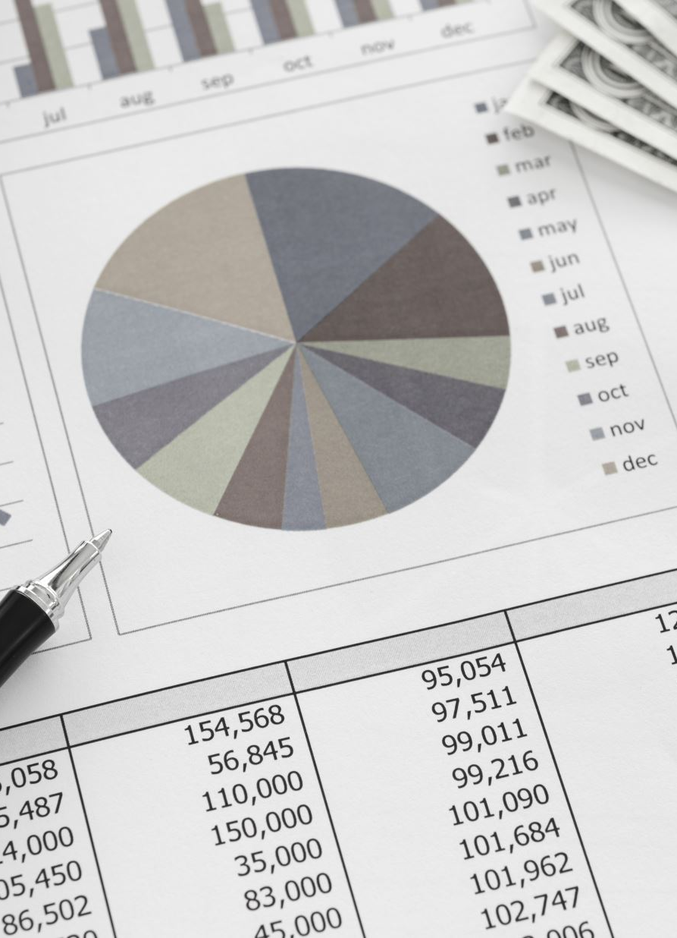




Chapter 17: Projections Analysis
Chapter 17
“Credit Risk Management & Analysis”

Slide 2
Projections Overview
The main role of both the financial analyst and credit analyst is to measure the future income and cash flow of the firm.
The financial analyst, representing the equity investors, is trying to determine the value the corporation based on the future cash flows.
The credit analyst, representing the debt holder, is trying to determine if the current debt is high or low based on the future cash flows.
Also, the credit analyst is measuring how much debt the company can handle for a given transaction.

Slide 3
Projections – Building the Financial Model
All analysts, including the credit analyst, equity financial analyst, or the company that is in the process of raising capital, start with the base case.
The base case is the first approach to building the financial model.
Since this model will be shared with all the stakeholders, including bankers, investors, and management, the case needs to be simple, reasonable, and basic before any adjustments that need to be made to run other scenarios, such as the upside case, downside case and breakeven case.

Slide 4
Projections – Building the Financial Model
Building the Base Case
The base case is the first projected scenario that the analyst sets up before making any of his or her own customized adjustments.
Depending on the circumstances, the assumptions to build this case are either given directly by management as part of the plan to raise capital or the analyst independently builds it to determine the value of the company, as later described in chapter 18.
When building this case, it is important for the analyst to arrange the revenue drivers or the cost assumptions so that are in line with industry standards and so the proper comparison can be made for follow-up adjustments.

Slide 5
Projections – Building the Financial Model
Revenue Drivers
The revenue drivers are customized based on the industry performance measurements that the company competes in.
This makes it easier to compare the results versus the industry operating benchmarks. For example, the assumptions used for a hotel company could be based on the average daily rate (ADR) representing what the customer will pay to rent the room for a night; the number of rooms available per property; and the occupancy rate (OR), which represents the rooms that are rented as a percentage of total available rooms.
A common benchmark that is used in the hotel business is revenue per available room (RevPAR), calculated by multiplying the ADR by OR.
For manufacturing companies, the revenues are typically driven by volume and price.
The analyst will assume a volume growth and price increase/decrease assumption to drive the future revenue.
The best starting approach of setting up these assumptions is to use historical growth rates and extend them going forward. Then the analyst can use discretion to adjust these numbers based on expectation.

Slide 6
Projections – Building the Financial Model
In figure 17.1, Celerity Technology Company shows a breakdown of revenues by geography.
Each region then is projected based on historical average unit volume growth and price increases per unit.
In this case, despite the 2-year historical assumptions that show high total revenue growth rates of 15.6%, the analyst is adjusting these numbers for the future to lower revenue growth rates to perhaps show a more moderate rate of growth (from 9.45% down to 4.96% in year 5).

Slide 7
Projections – Building the Financial Model
Revenue Drivers
In setting up the projected revenue drivers the following assumptions are typically needed to be considered:
Historical averages
Industry drivers–based demand and supply
Organic and inorganic volume growth
Price assumptions
Contractual revenues
Cyclical revenues
Newly Established Companies

Slide 8
Projections – Building the Financial Model

Slide 9
Projections – Building the Financial Model
Cost Assumptions
The analysts typically rely on historical cost amounts in relationship to revenues. The projected revenue is the basis for estimating the company’s total costs going forward.
The premise is that as the company grows, the cost will probably grow at the same pace as revenues.
Direct costs, such as cost of goods sold, which includes labor, materials, and overhead expenses, are expected to grow at the same percentage of revenues. Indirect costs though, such as selling, general, and administrative expenses, expect to grow from year to year at a higher or lower growth rate than revenues, depending on where the company stands in its promotional cycle.
New companies spend more on up-front SG&A as they are positioning the company to grow in the future. Mature companies’ SG&A typically grow at a slower pace than revenue, contributing to higher EBITDA margins from the year before.
For conservative purposes though, is not unusual to see that the analysts assume that these indirect operating expenses for a mature company grow at the same rate as revenues; therefore, they are running these costs as a percentage of revenues.

Slide 10
Projections – Building the Financial Model

Slide 11
Projections – Building the Financial Model
Cost of goods sold:
The cost of goods sold (COGS) includes the labor costs, material costs, and overhead costs.
A detailed analysis would include the number of workers per shift, number of shifts, number of shifts per day, and average wages per worker to determine the cost of labor.
A detailed analysis would also include the cost of inventory as a raw material and the energy costs that are spent to produce the manufacturing units (overhead expenses). Most of the analysts though don’t have such detailed information, so it is typical to use the historical COGS as percentage of revenue to run the projections.
Sometimes, the COGS are given by segment or by product, which will be helpful to project the cost going forward and being able to make different assumptions based on each segment dynamics.
In a typical transaction that the company is seeking financing, the management lays its cost strategy, which could include cost savings that need to be incorporated in the projections.
Other information that is useful for the analyst is the capacity utilization.
This is measured as a percentage of the actual volume output per year to the maximum yearly output, assuming 100% of the manufacturing facility is running at its peak.

Slide 12
Projections – Building the Financial Model
Operating expenses:
The operating expenses include the selling or the expenses to market the company’s products, administrative expenses for indirectly supporting the company’s business, and any other general expenses that are not directly expenses based on the company’s revenues.
Other expenses in this category could include research and development expenses very important expenses, especially for companies that spend a lot of money to support the growth of the company.
This segment could be looked at as separating the fixed costs and variable costs.
If the company is positively growing at a healthy pace, the fixed costs could contribute higher margins, but if the company shows revenue declines, the fixed cost has a reverse impact to operating margins.
The analyst needs to be aware of the sensitivity of the fixed expenses to revenue, especially the factors influencing the largest cost line items.
For conservative purposes, analysts typically run the operating assumptions as a percentage of revenue. The better approach for general and administrative expenses is to assume a growth rate, so if the revenues decline, these expenses continue to grow, causing a problem for the company that needs to manage these expenses during tough periods.
The selling or marketing expenses are typically run as percentages of revenues since these expenses directly support the revenue growth of the company

Slide 13
Projections – Building the Financial Model
Depreciation expenses:
Depreciation expense, which is a non-cash expense, is typically projected based on the company’s fixed assets using an average life.
A lot of the analysis, though, since depreciation is not significant, is done using the same approach as any other expense: by calculating the depreciation as percentage of revenue, as seen previously in figure 17.3.
It’s not perfectly correct, but the argument is that since revenue grows so does the need to invest in capital to sustain the growth, hence the growth of depreciation at the same rate.
t’s important to compare the depreciation to the capital expenditures (Capex) found in the cash flow statement, as it need to be in line.
Since depreciation expense is used primarily for tax benefits, it’s important to make sure the amount is not excessively high, especially as it relates to capital expenditures.
Typically for valuation purposes, depreciation is assumed to be equal with Capex, representing the minimum capital expenditures the company needs to spend to keep up with the devaluation of its assets or depreciation.

Slide 14
Balance Sheet Statement
Net Worth or Shareholder’s Equity
Shareholder’s equity measures the amount by which a company’s assets exceed its liabilities at snapshot in time; basically, if one sold all that the company owns after paying all the obligations against these assets, the balance left is what the ownership will keep (figure 15.2). Shareholder’s equity is also referred to as net worth or book value of equity. Included in this section are common stock, preferred stock, treasury stock, paid-in capital, and other equity and retained earnings.
Common stock: This represents the original issuance of equity by the owners, and it will go down when the company buys back shares.
Preferred stock: This could be an issuance by a third-party investor who expects the company to pay certain fixed dividends (like debt obligations).
Treasury stock: Recorded as a negative number on the balance sheet, treasury stock represents shares that have been issued in the past but were repurchased by the company. The amount repurchased will reduce both par value and capital surplus on the balance sheet if the company decides to permanently retire the stock that was repurchased. If the company decides to re-issue the stock sometime in the future, the treasury stock will be set up at a separate account, reducing common stock and shareholder’s equity.
Paid-in capital: This represents proceeds from any additional equity investments invested in the company.
Retained earnings: Retained earnings represent the cumulative income net of loses over time. The retained earnings could also be reducing if the company pays out dividends to shareholders or records loses.

Slide 15
Projections – Building the Financial Model
Working capital activities:
Working capital activity recorded in the cash flow statement is driven directly by year-to-year changes of the current assets minus current liability changes, as shown on the balance sheet statement. The current asset includes the accounts receivable, inventory, and other current assets such as prepaid expenses. The current liabilities include accounts payable and other current liabilities such as accrued income taxes and accrued expenses

Slide 16
Projections – Building the Financial Model
Working capital activities:
Accounts receivable: The accounts receivable (AR) on the balance sheet are based on accounts receivable days (ARD) and accounts receivable turnover (ART) calculations. In Figure 16.4 the projected ARD used for the projections is based on historical average of 17.26 days or the average length of time that the customers pay starting from the day they are charged to pay for the merchandise. The formula is
AR = [(ARD / 365) x revenues]
Inventory: The inventory (Inv) on the balance sheet is based on inventory turnover (ITO) and inventory days (ID) calculations. In figure 16.4 the projected ID used for the projections used is based on the historical average of 11.20 days or the average length of time that the raw material bought from the suppliers turns into a finished good and a cash sale. The formula is
Inv = [(ID / 365) x accounts payable]

Slide 17
Projections – Building the Financial Model
Working capital activities:
Other current assets: For projection purposes, other current assets are based as a percentage of revenue. In figure 17.4 the projected prepaid expenses are calculated based on last year’s percentage of revenues of 0.81%.
Accounts payable: The accounts payable (AP) on the balance sheet are based on accounts payable days (APD) and accounts payable turnover (APT) calculations. In figure 17.4, like inventory, the projected APD that is used to calculate the projections is based on the historical average of 11.20 days or the average length of time that the company pays its bills to the vendors or suppliers the inventory. The formula is
AP = [(APD /365) x accounts payable]
Other current liabilities: For simplistic purposes, all other current liabilities on the balance sheet are calculated based on percentage of revenue. In figure 17.4 both the accrued income taxes and accrued expenses are based on percentage of revenues at 0.90% and 0.72%, respectively.

Slide 18
Projections – Building the Financial Model
Investment Activities Assumptions
Capital Expenditures (CAPEX):
For simplistic purposes, unless there are specific plans to spend a major one-time manufacturing plant improvements or major purchases of the truck fleet.
One approach for the analyst is to run the Capex at the same percentage of Depreciation to Revenue representing low maintenance growth and any additional percentage of Capex to revenue should contribute directly to higher growth
Long-Term Investments (LTI)
These are projected to grow at the same level as the revenues calculated as percentage of revenues – this is sometimes called “Maintenance Capex”.

Slide 19
Projections – Building the Financial Model
Investment Activities Assumptions
Capital Expenditures (CAPEX):
For simplistic purposes, unless there are specific plans to spend a major one-time manufacturing plant improvements or major purchases of the truck fleet.
One approach for the analyst is to run the Capex at the same percentage of Depreciation to Revenue representing low maintenance growth and any additional percentage of Capex to revenue should contribute directly to higher growth
Long-Term Investments (LTI)
These are projected to grow at the same level as the revenues calculated as percentage of revenues – this is sometimes called “Maintenance Capex”.

Slide 20
Projections – Building the Financial Model
Financing activities assumptions:
The financing activities shown in the cash flow statement consists of debt activities of borrowing or paying down the debt as well any equity activities including any distributions or issuance of new equity.
The debt assumptions include the borrowing and repayment of debt, which are based on the contractual obligation between the company and its creditors.
The equity component of the cash flow statement is based on specific plans for the company to make equity distributions to the existing investors or to raise new equity via public issuance or private placement offering.
The repayment of debt shown on the cash flow statement is driven from the debt schedule table (figure 17.6) and described under the Debt Schedule Assumptions.

Slide 21
Projections – Building the Financial Model
Debt Schedule
The debt schedule is built based on the four basic input criteria, also called money terms, typically seen in the credit agreements and bond indentures: amount borrowed (outstanding); the cost of borrowing (interest payment); the principal payment (scheduled or amortized debt payments); and the term of the debt facility representing how many years it takes to pay the loan.
The debt outstanding drives the balance sheet, the interest payments drive the income statement, and the principal payment drives the cash flow statement.
The interest rate charged could be set as fixed or floating and the principal payments are based on a set scheduled payment found in the agreement.

Slide 22
Projections – Building the Financial Model
Debt Schedule
Figure 17.6 shows that the short-term and long-term debt interest payment is based on floating rate index London Inter Bank Offering Rate (LIBOR) starting at 2% plus a spread rate of 3%.
LIBOR is a rate that most banks use as an interest rate benchmark, which represents the cost of a bank’s borrowing from other banks.
In this example, the projections assume an increase in LIBOR by 0.5% per year for the next 3 years and another 1% increase in year 4 before it stabilizes at that level.
Please note that the interest payment is calculated based on last year’s outstanding, conservatively assuming that the principal payment is paid on the last day of each year.

Slide 23
Projections – Building the Financial Model

Slide 24
Projections – Building the Financial Model
Tax Schedule
The tax schedule is set up to estimate the yearly tax expenses going forward. These expenses are typically calculated by multiplying the tax rate to the earnings before taxes (EBT). A portion of this expense could be the actual taxes paid in cash and the remaining will be deferred. Figure 17.7 shows that 4% of the tax expenses are deferred (historical estimate) and the other 96% is paid in cash. The tax rate used in this case is 40%. The deferred tax is added to the net income in the cash flow statement, like the depreciation expense.

Slide 25
Projections – Building the Financial Model
Balance Sheet Assumptions
The balance sheet flows entirely as an output.
The income statement builds the retained earnings (RE) found in the bottom of the balance sheet by adding the net income to last year’s income, and the cash flow statement builds the cash (C) found on the top of the balance sheet by adding the free cash flow to last year’s cash.
All the balance sheet items in between the cash and retained earnings are driven primarily by the cash flow statement activities.
Other balance sheet items such as other intangible and tangible long-term assets, as well as other liabilities, are projected based on either set asset schedules or as percentage of revenues.
In later chapters we will discuss these assets such as goodwill that are generated based on new transactions involving the acquisition of the company or initial public offering.
The example used, Celerity Technology Inc. does not show any other assets or liabilities now. In later chapters, we will examine the generation of goodwill and other intangibles based on an assumed leveraged buyout (LBO) or an acquisition of the company by another strategic

Slide 26
The Finished Product: “Base Case” Spreadsheet: Balance Sheet, Income, and Cash Flow Statements

Slide 27
The Finished Product: “Base Case” Spreadsheet: Balance Sheet, Income, and Cash Flow Statements
The balance sheet (figure 17.9) shows the base case results assuming the company continues to grow on all fronts, generating higher cash balances every year as retained earnings continue to grow.

Slide 28
The Finished Product: “Base Case” Spreadsheet:
Balance Sheet, Income, and Cash Flow Statements
The income statement (figure 17.10) shows a normalized growth and flat costs as percentage of revenue.

Slide 29
The Finished Product: “Base Case” Spreadsheet:
Balance Sheet, Income, and Cash Flow Statements
The cash flow statement (figure 17.11) shows the buildup of free cash flow resulting from continuous growth of the income statement. The base case assumes working capital and investment activities are in line with the revenue growth. The financing activities are based on the debt schedule obligations including interest payments calculated on an assumed increase in floating rate (LIBOR) and set scheduled principal payments.

Slide 30
The Finished Product: “Base Case” Spreadsheet:
Balance Sheet, Income, and Cash Flow Statements
Financial Ratios

Slide 31
Building the What-if Scenario Cases
The what-if scenario analysis could include a downside case, an upside case, a break-even case, or any other sensitivity case customized for the analyst that challenges the base case.
The equity analyst could run the upside case including potential cost savings or enhanced revenue assumptions resulting from a new product launch or a significant price increase or an acquisition.
The debt analyst could run a downside case measuring how resistant the company is if revenue declines and/or cost increases.
The management could run a break-even case scenario to measure how low the revenue can go so a few of the obligations such as short-term and long-term debt services are not met.

Slide 32
Building the What-if Scenario Cases
Revenue drivers:
For example, the downside case (figure 17.13) for Celerity Technology Inc. shows lower revenue growth assumptions, perhaps to illustrate a potential recession that might occur in year 2, slower growth expectations in year 1, and very slow recovery post-recession years.
The lower revenue growth and declines are adjusted by region including volume and price.

Slide 33
Building the What-if Scenario Cases
Cost assumptions:
This case will also assume an increase in costs on both the direct and indirect expenses (figure 17.14) resulting in lower margins, profit, and cash flow.

Slide 34
Building the What-if Scenario Cases
Working capital assumptions:
The working capital assumptions (figure 17.15) were kept at the same levels as the base case though there could be an argument that the company manages the receivables and payables differently in recession years as it is trying to squeeze more cash given the income declines.

Slide 35
Building the What-if Scenario Cases
Investment activities:
The capital expenditures and annual investments are typically the first expenses that management is able to cut when facing recessionary pressures, lower revenues, and/or higher operating costs.
This downside case though (figure 16.16), takes a conservative approach by showing that capital expenditures and long-term investments as percentage of revenues remain the same as the base case.

Slide 36
Building the What-if Scenario Cases - Deliverable
The downside case results shown in each core statement (balance sheet in figure 17.17, income statement in figure 17.18, and cash flow statement figure 17.19, are better captured in the ratio analysis.

Slide 37
Building the What-if Scenario Cases - Deliverable

Slide 38
Building the What-if Scenario Cases - Deliverable

Slide 39
Building the What-if Scenario Cases - Deliverable

