Slide 1
Derivatives Investments: Option Strategies, Analysis and Valuations
Chapter 13
“An Analytical Approach to Investments, Finance and Credit”

Slide 2
Intro to Options
OTHER TERMS:
Expiration Date (3rd Friday of the month)
American / European Options
Action: Buy/Sell Options
Speculation/Hedging
100 shares per option contract
Three Variables:
  S = Stock (underlying assets)
  X = Future Price (Exercise Price)
  Pr = Premium (“the bet”)
BUYING CALL OPTIONS The right to buy the Stock (S) at X price
BUYING PUT OPTIONS The right to sell the Stock (S) at X price
SELLING CALL OPTIONS The obligation to sell the Stock (S) at X price
SELLING PUT OPTIONS The obligation to buy the Stock (S) at X price

Slide 3
CALL PRICE
CONCEPTS
VIEW ON THE STOCK: STOCK WILL GO UP BY EXPIRATION TIME
RIGHT TO BUY THE STOCK AT A SET PRICE X NO MATTER WHAT THE STOCK DOES
TO GET THAT RIGHT, YOU PAY A PREMIUM
PAYOFF = Max (0, S – X ), where S is the stock price and X is the future stock price locked in today
PROFIT = PAYOFF – PREMIUM
BE = EXERCISE PRICE + PREMIUM

Slide 4
ACTION | X | Prem | S
PAYOFF | PROFIT | HPR% | BE

Slide 5
PUT PRICE
CONCEPTS
VIEW ON THE STOCK: STOCK WILL GO DOWN BY EXPIRATION TIME
RIGHT TO SELL THE STOCK AT A SET PRICE X NO MATTER WHAT THE STOCK DOES
TO GET THAT RIGHT, YOU PAY A PREMIUM
PAYOFF = Max (0, X – S)
PROFIT = PAYOFF – PREMIUM
BE = EXERCISE PRICE – PREMIUM

Slide 6
ACTION | X | Prem | S
PAYOFF | PROFIT | HPR% | BE

Slide 7
STRADDLES
VIEW ON THE STOCK: THERE WILL BE VOLATILITY OF THE STOCK BY EXPIRATION TIME
STRATEGY: BUY THE CALL AND BUY THE PUT AT THE SAME X PRICE FOR THE SAME PERIOD
RIGHT TO BUY AND SELL THE STOCK AT A SET PRICE X NO MATTER WHAT THE STOCK DOES
TO GET THAT RIGHT, YOU PAY BOTH CALL AND PUT PREMIUMS
PAYOFF = Max (S – X , X – S )
PROFIT = PAYOFF – PREMIUM
BE1 = EXERCISE PRICE + PREMIUM and BE2 = EXERCISE PRICE - PREMIUM

Slide 8
ACTION | X | Prem | S
PAYOFF | PROFIT | HPR% | BE

Slide 9
STRADDLES

Slide 10
BASIC OPTIONS - PRACTICE PROBLEMS
PRACTICE EXAMPLES
Action | Type | X |  | Premium |  | Stock |  |  | Payoff | Profit | BE 1 | BE 2 | HPR %
BUY | CALL | 100 |  | 5 |  | 120
BUY | PUT | 68 |  | 3 |  | 62
BUY | CALL | 100 |  | 5 |  | 99
BUY | PUT | 68 |  | 3 |  | 70
BUY | CALL | 100 |  | 5 |  | 101
BUY | PUT | 68 |  | 3 |  | 67
SELL | CALL | 90 |  | 8 |  | 105
SELL | PUT | 75 |  | 5 |  | 68
SELL | CALL | 90 |  | 8 |  | 96
SELL | PUT | 75 |  | 5 |  | 73
SELL | CALL | 90 |  | 8 |  | 89
SELL | PUT | 75 |  | 5 |  | 76
BUY | STRADDLE | 100 |  | 17 |  | 120
SELL | STRADDLE | 70 |  | 12 |  | 65
BUY | STRADDLE | 100 |  | 17 |  | 100

Slide 11
BASIC OPTIONS - PRACTICE PROBLEMS

Slide 12
PROTECTIVE PUTS

Slide 13
COVERED CALLS

Slide 14
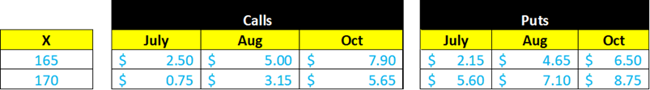
COLLARS

Slide 15
SPREADS
HORIZONTAL SPREADS (CALENDAR SPREADS)
  LONG (BUY) / SHORT (SELL) CALL AND PUTS SAME X DIFFERENT EXPIRATION DAYS
VERTICAL SPREADS (MONEY SPREADS)
  LONG (BUY) / SHORT (SELL) CALL AND PUTS SAME EXP. DAY DIFFERENT X
  BULL CALL SPREADS: BUY LOW CALL X /SELL HIGH CALL X
  BEAR PUT SPREADS: BUY HIGH PUT X / SELL LOW PUT X
  BULL PUT SPREADS: BUY LOW PUT X / SELL HIGH PUT X
  BEAR CALL SPREADS: BUY HIGH CALL X / SELL LOW CALL X
  LONG BUTTERFLY SPREADS: BUY HIGH, BUY LOW, SELL THE AVERAGE TWICE
  SHORT BUTTERFLY SPREADS: SELL HIGH, SELL LOW, BUY THE AVERAGE TWICE

Slide 16
SPREADS

Slide 17
BULL CALL SPREADS

Slide 18
WHITEBOARD

Slide 19
BULL CALL SPREADS

Slide 20
BEAR PUT SPREADS

Slide 21
WHITEBOARD

Slide 22
BEAR PUT SPREADS

Slide 23
BULL PUT SPREADS

Slide 24
WHITEBOARD

Slide 25
BULL PUT SPREADS

Slide 26
BEAR CALL SPREAD

Slide 27
WHITEBOARD

Slide 28
BEAR CALL SPREAD

Slide 29
LONG BUTTERFLY CALL SPREADS

Slide 30
WHITEBOARD

Slide 31
LONG BUTTERFLY CALL SPREADS

Slide 32
LONG BUTTERFLY PUT SPREADS

Slide 33
WHITEBOARD

Slide 34
LONG BUTTERFLY PUT SPREADS

Slide 35
SPREADS – PRACTICE PROBLEMS
SPREAD OPTIONS - PRACTICE PROBLEMS
Action | Type | X1 | X2 | Prem 1 | Prem 2 | Prem 3 (Avg) | Stock |  | Payoff | Profit | BE | Max Gain | Max Loss
BUY/LONG | BULL CALL SPREADS | 70 | 90 | 8 | 4 |  | 95
BUY/LONG | BEAR PUT SPREADS | 100 | 120 | 8 | 13 |  | 100
BUY/LONG | BULL PUT SPREADS | 65 | 85 | 5 | 8 |  | 50
BUY/LONG | BEAR CALL SPREADS | 35 | 45 | 4 | 2 |  | 40
BUY/LONG | BUTTERFLY CALL SPREADS | 70 | 90 | 11 | 8 | 9 | 100
SELL/SHORT | BUTTERFLY CALL SPREADS | 75 | 85 | 8 | 5 | 6 | 82

Slide 36
VALUING OPTIONS
APPLYING PROBABILITY THEORY

Slide 37
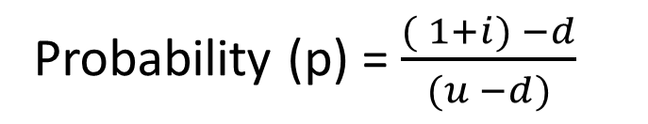
BIONOMIAL OPTION PRICING METHOD for valuing options (single period)
Probability (p) = $\frac{( 1+i) −d}{(u −d)}$

Slide 38


BIONOMIAL OPTION PRICING METHOD for valuing options (single period)
Probability (p) = $\frac{( 1+i) −d}{(u −d)}$

Slide 39
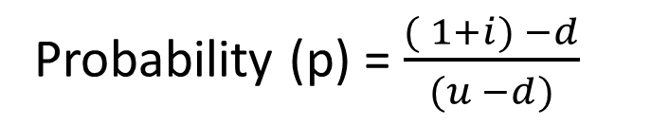
BIONOMIAL OPTION PRICING METHOD for valuing options (two-period)
Probability (p) = $\frac{( 1+i) −d}{(u −d)}$

Slide 40
BIONOMIAL OPTION PRICING METHOD for valuing options (two-period)
CALL OPTION

Slide 41
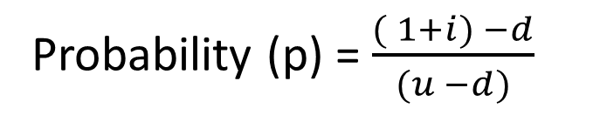
BIONOMIAL OPTION PRICING METHOD for valuing options (two-period)
Probability (p) = $\frac{( 1+i) −d}{(u −d)}$

Slide 42

BIONOMIAL OPTION PRICING METHOD
for valuing options (two-period)
Probability (p) = $\frac{( 1+i) −d}{(u −d)}$
PUT OPTION

Slide 43
BIONOMIAL OPTION PRICING METHOD for valuing options (two-period) with Dividends (yield and $)
Probability (p) = $\frac{( 1+i) −d}{(u −d)}$

Slide 44
BIONOMIAL OPTION PRICING METHOD for valuing options (two-period)
Probability (p) = $\frac{( 1+i) −d}{(u −d)}$
CALL OPTION

Slide 45
BIONOMIAL OPTION PRICING METHOD for valuing options (two-period)
CALL OPTION

Slide 46
BINOMIAL OPTION PRICING MODEL – LEVERAGE METHOD (6-Step Method)
S = $100
X = $110
Su= 1.20
Sd = .90
i = 5.0%
t = 1

Slide 47
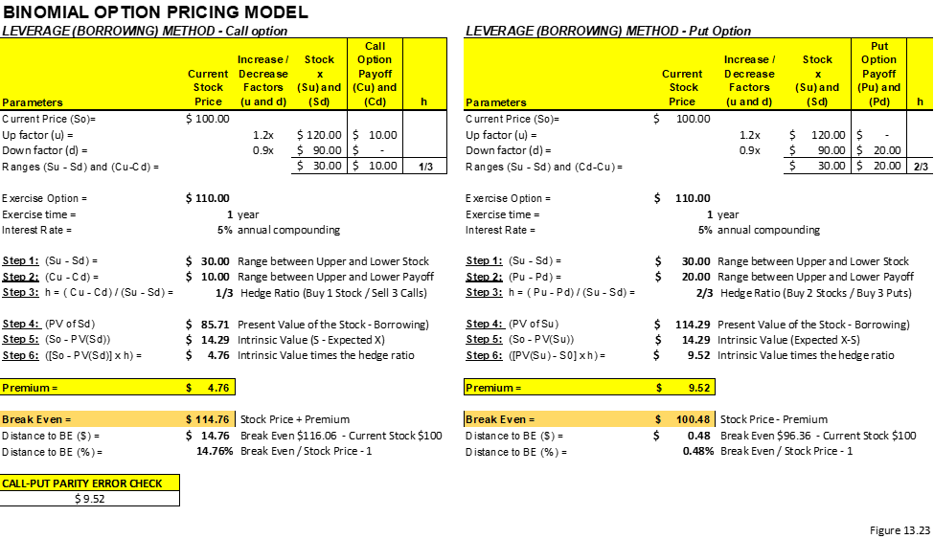
BINOMIAL OPTION PRICING MODEL – LEVERAGE METHOD

Slide 48
Math & Statistics 101

Slide 49
Math & Statistics 101

Slide 50
Black-Scholes Option Pricing Model

Slide 51




Black-Scholes Option Pricing Model
$$C=Se^{−δt}\left[N\left(d1\right)\right]−Xe^{−it}N\left(d1\right)$$
$$P= Xe^{−it}\left[1−N\left(d2\right)\right]− Se^{−δt}[1−N\left(d1\right)]$$
$$d1=\frac{ln⁡({\frac{S}{X}})+ \left(i−δ+\frac{{.σ}^{2}}{2}\right) t}{σ\sqrt{t}}$$
$$d2=d1 − σ\sqrt{t}$$

Slide 52
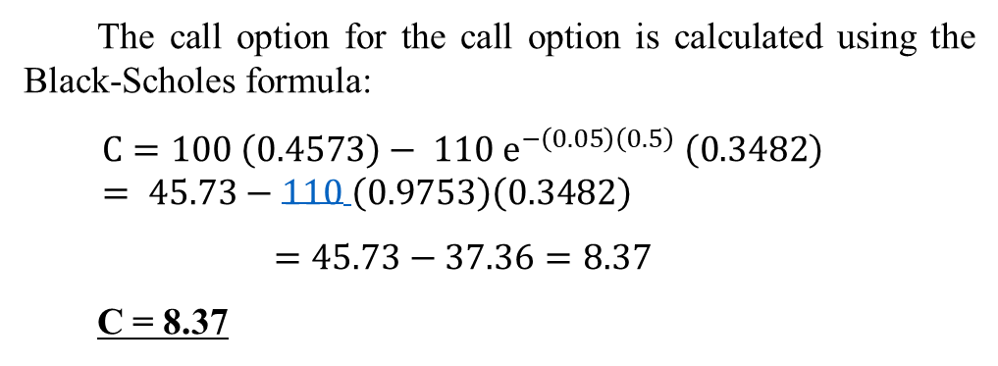
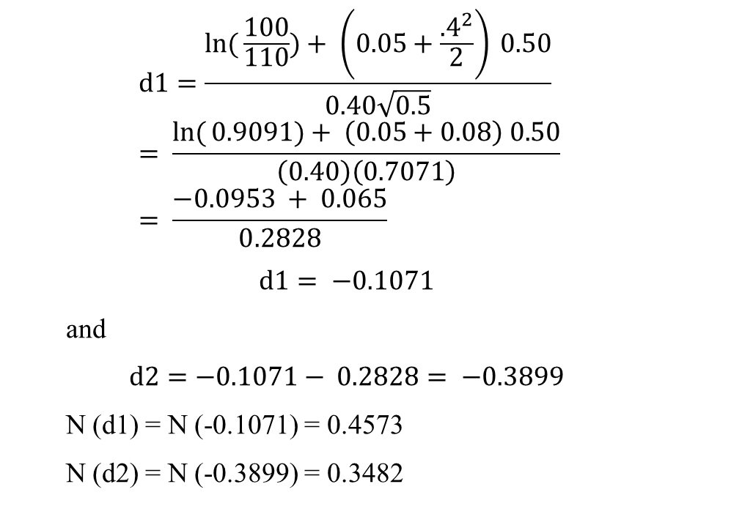
Black-Scholes
$$d1=\frac{ln⁡({\frac{100}{110}})+ \left(0.05+\frac{{.4}^{2}}{2}\right) 0.50}{0.40\sqrt{0.5}}= \frac{ln⁡({0.9091})+ \left(0.05+0.08\right) 0.50}{\left(0.40\right)\left(0.7071\right)}= \frac{−0.0953 + 0.065}{0.2828}$$
$$d1= −0.1071$$
and
$$d2=−0.1071− 0.2828= −0.3899$$
N (d1) = N (-0.1071) = 0.4573
N (d2) = N (-0.3899) = 0.3482
S = $100
X = $110
t = 0.50 (6 months)
i = 5.0%
σ = .40
CALL OPTION
The call option for the call option is calculated using the Black-Scholes formula:
$$C=100 \left(0.4573\right)− 110 e^{−\left(0.05\right)\left(0.5\right)} \left(0.3482\right)= 45.73−110 \left(0.9753\right)\left(0.3482\right)$$
$$=45.73−37.36=8.37$$
C = 8.37

Slide 53
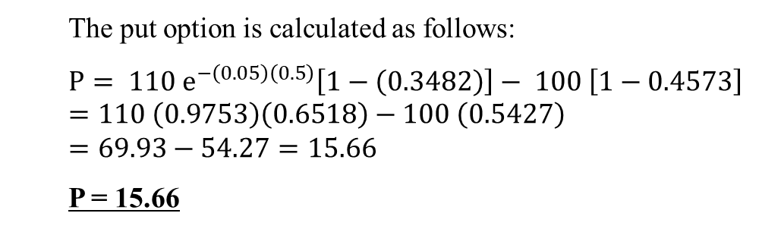
Black-Scholes
$$d1=\frac{ln⁡({\frac{100}{110}})+ \left(0.05+\frac{{.4}^{2}}{2}\right) 0.50}{0.40\sqrt{0.5}}= \frac{ln⁡({0.9091})+ \left(0.05+0.08\right) 0.50}{\left(0.40\right)\left(0.7071\right)}= \frac{−0.0953 + 0.065}{0.2828}$$
$$d1= −0.1071$$
and
$$d2=−0.1071− 0.2828= −0.3899$$
N (d1) = N (-0.1071) = 0.4573
N (d2) = N (-0.3899) = 0.3482
S = $100
X = $110
t = 0.50 (6 months)
i = 5.0%
σ = .40
PUT OPTION
The put option is calculated as follows:
$$P= 110 e^{−\left(0.05\right)\left(0.5\right)}\left[1−\left(0.3482\right)\right]− 100 \left[1−0.4573\right]=110 \left(0.9753\right)\left(0.6518\right)−100 \left(0.5427\right)=69.93−54.27=15.66$$
P = 15.66

Slide 54

Black-Scholes with Dividends
$$d1=\frac{ln⁡({\frac{100}{110}})+ \left(0.05−0.03+\frac{{.4}^{2}}{2}\right) 0.50}{0.40\sqrt{0.5}}= \frac{ln⁡({0.9091})+ \left(0.02+0.08\right) 0.50}{\left(0.40\right)\left(0.7071\right)}= \frac{−0.0953 + 0.050}{0.2828}$$
$$d1= −0.1602$$
and
$$d2=−0.1602− 0.2828= −0.4430$$
N (d1) = N ( -0.1602) = 0.4364
N (d2) = N (-0.4430) = 0.3289
Input
S = $100
X = $110
t = 0.50 (6 months)
i = 5.0%
σ = .40
δ = 3.0%

Slide 55


Black-Scholes with Dividends
The call option for the call option is calculated using the Black-Scholes formula:
$$C=100 e^{−\left(0.03\right)\left(0.5\right)}\left(0.4364\right)− 110 e^{−\left(0.05\right)\left(0.5\right)} \left(0.3289\right)= 100 (0.9851)(0.4364)−110 \left(0.9753\right)\left(0.3289\right)$$
$$=42.99−35.28=7.71$$
C = 7.71
The put option is calculated as follows:
$$P= 110 e^{−\left(0.05\right)\left(0.5\right)}\left[1−\left(0.3482\right)\right]− 100 e^{−\left(0.03\right)\left(0.5\right)} \left[1−0.4573\right]=110 \left(0.9753\right)\left(0.6518\right)−100 (0.9851)\left(0.5427\right)=69.93−53.46=16.47$$
P = 16.47
Input
S = $100
X = $110
t = 0.50 (6 months)
i = 5.0%
σ = .40
δ = 3.0%

Slide 56
Black-Scholes using Excel

Slide 57
Black-Scholes using Excel

Slide 58
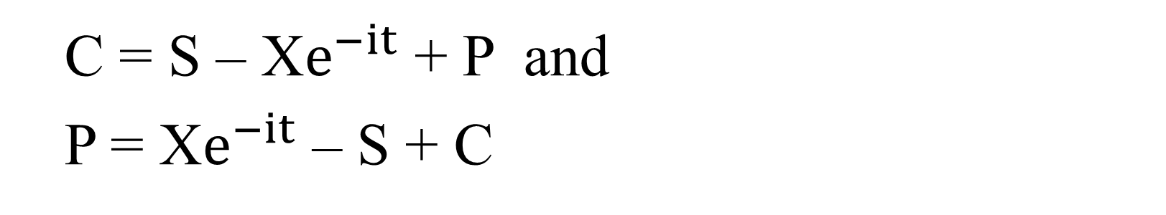

Put Call Parity
C – P = S – PV (X) or
C – P = S – X$e^{−it}$
C = S – X$e^{−it}$ + P and
P = X$e^{−it}$ – S + C

