Slide 1
Secondary Debt Markets:
Credit and Alternative Investments: Leveraged Loans, CLOs, and Structured Finance
Chapter 12
“An Analytical Approach to Investments, Finance and Credit”

Slide 2
Secondary Loan Markets – An Overview
The secondary loan market sprung up in the late 1990s and early 2000s with the creation of the institutional loan market, also referred to as term loan B market, since the traditional term loan (term loan A) was financed by commercial banks.
The growth came from the establishment of collateralized loan obligations (CLO) that became the majority of the syndication market.
These loans evolved into many types, depending on the purpose of the loan, the investor providing the loan, and the market demand supply dynamics.
Also, when Standard & Poor’s and Moody’s expanded their rating services to loans from bonds, the secondary market opened, and many funds were created that were designed to frequently trade these loans.

Slide 3
The Bank Loan or Credit Markets
The secondary loan market is divided into two distinct markets: investment-grade (IG) and non-investment-grade or leverage loan (LevFin) markets. T
he IG secondary market consists primarily of commercial banks trading with one another to reduce or increase exposure on certain borrowers.
In the case of non-investment-grade and leveraged transactions, the parties that trade these loans consist of financial companies and institutional investors such as collateralized loan obligations (CLOs), loan mutual funds (LMF), business development companies (BDCs) and other direct lenders and hedge funds.
Since the IG secondary market involves trading between commercial banks whose cost of capital is relatively low, the pricing is not as important as the LevFin secondary market. These commercial banks, often called relationship banks, are more interested in providing other banking products to the company.
Thus, they see the transaction as a source of increasing their exposure to obtain customers or up-tier their relationship with the company.
The participants in LevFin secondary market, on the other hand, care more about the loan’s price based on the credit quality of the issuer and their personal risk appetite.

Slide 4
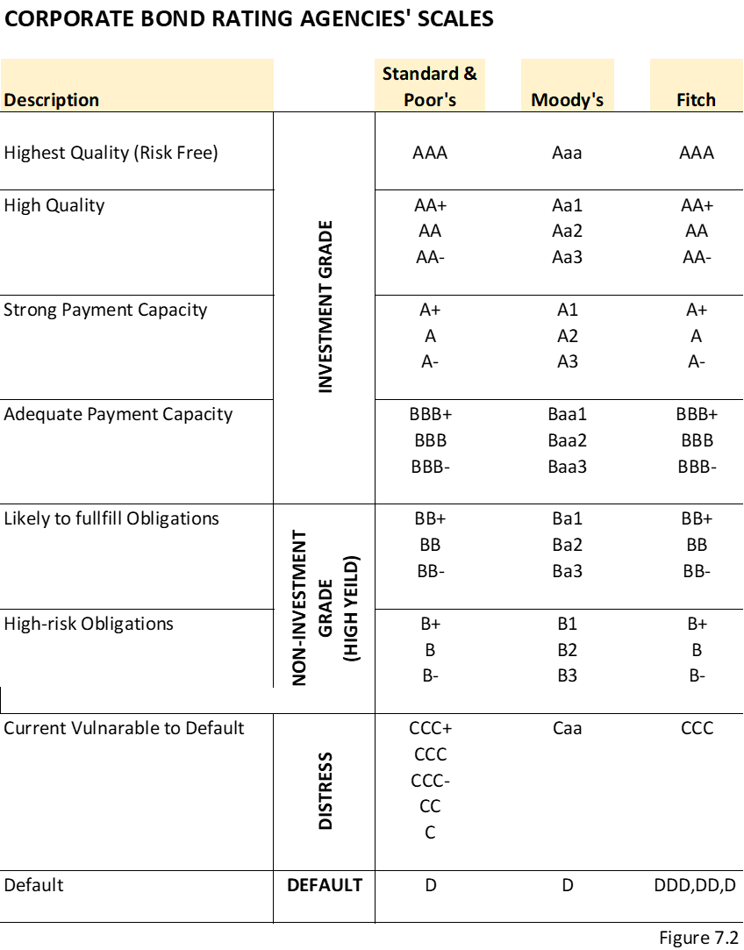
Bonds, Loans and CLOs Ratings

Slide 5
The Case of Loans
The leveraged loan asset class has been relatively attractive for many portfolio managers due to the following investment characteristics.
  Insulation from interest rate risk: Both the revenues and cost of the CLO is based on floating rate interest (LIBOR based) that is reset at least every 90 days, so even if the interest rate rises for the CLO’s loan obligations, the rates will also rise at the same level for the individual portfolio of companies, enabling natural arbitrage for the CLO manager.
  Low price volatility: In general, leverage loans experience reduced volatility resulting from a low correlation and covariance with other assets. The floating rate nature of leveraged loans contributes to its low correlation with other security types. Only short-term treasury bills (considered risk free) consistently exhibit lower volatility.
  Defensive strategy: Senior loan funds have historically provided consistent, higher risk–adjusted returns compared to other asset classes, which may make them attractive to investors during volatile markets.

Slide 6

Pricing and Loan Yields
  Then the pricing is set based on an initial spread over a base rate (usually LIBOR) at set original issuance discount (OID), which represents the additional “fee” the investor receives. The loan yield formula is as follows:
$$Annual loan yield=LIBOR+spread+\frac{\left(\frac{100−OID}{4 years}\right)}{100}$$
Please note that this conventional formula is based on 4 years’ average life of the loan.
A typical press announcement from the lead arranger bank will be as follows:
“The term loan B price is set at LIBOR + 4.5% at 99.0 OID and is now free to trade.”
Based on this example and assuming the starting LIBOR is 2.50%, the initial loan yield is then calculated as follows:
$Annual loan yield=2.5\%+4.5\%+\frac{\left(\frac{100−99}{4 years}\right)}{100}$ = 2.5% + 4.5% + 0.25% = 7.25%

Slide 7
Pricing and Loan Yields
  The Loan Syndication and Trading Association (LSTA) was established in the mid 1990s to develop liquidity and transparency in the secondary market for bank loans.
  LSTA provides dealer-secondary quotes based on market-to-market and other relevant information including the most volatile loans, the list of the biggest price movers, and the listing of the newest deals.
  The LSTA, in conjunction with Standard & Poor’s Leveraged Commentary & Data (LCD), has developed a LevFin index as a benchmark representing a weighted average of the 100 largest loan facilities.
  The index, S&P/LSTA Index is a total return index of the leverage loans. Loan portfolio managers use this as a benchmark to compare the portfolio performance and other asset class to the market.
  A list of loan secondary trading level examples is shown in figure 12.1.

Slide 8
Secondary Loan Terms - Concepts
Loan participation: A loan participation, sometimes called “silent participation,” is an agreement between two or more lenders in which a primary lender sells specific rights in a loan to other lenders (participants)
Loan assignments: Defined in the credit agreement, assignments are the sale or transfer of all or portion of the loan from one bank (assignor) to another bank (assignee). With the purchase, the assignee has the same rights and obligations as all the other banks listed in the agreement as a lender of record
Most-favored Nation: Most agreements for leverage loans include “most-favored nation” (MFN) pricing protection.
Sunset provision: A sunset provision is a clause in the loan agreement that would allow the MFN protection to expire after a set period, typically 90–180 days.

Slide 9
Collateralized Loan Obligations (CLOs)
Collateralized loan obligations (CLOs) are funds created with a pool of corporate loans.
Typically, these corporate loans are comprised of leveraged loans with lower credit ratings with higher expected returns. In exchange for taking on higher risk, the investor in a CLO is offered higher diversity and better-than-average returns.
A typical CLO fund will include a portfolio of 100 –250 first-lien bank loans that the manager of such funds is actively buying and selling in the secondary loan market.
To fund the initial purchase of these loans, the CLO raises funds from outside investors in structures called tranches.
Each tranche is ranked with a priority of payment when and if the CLO fund liquidates. The tranches are comprised of debt and equity investments

Slide 10
Collateralized Loan Obligations (CLOs)
The investments in the debt tranches are rated by Moody’s based on risk of default, where the equity investments in CLOs are not ranked and are the last to get paid in a liquidation.
Investors who are paid out first have lower overall risk, but they receive smaller interest payments as a result.
Investors who are in later tranches, referred to as equity tranches, are paid last, and thus expect higher interest payments.
The highest priority tranches, referred to as debt tranches, are treated just like bonds and have credit ratings as well as set coupon payments.
These debt tranches are structured and rated in a specific pecking order.

Slide 11
Structuring the Tranches of CLOs

Slide 12
Structuring the Tranches of CLOs
CLO funds are structured to meet certain criteria set by the credit agencies such as Moody’s including portfolio diversification factors by industry, company and credit ratings discussed further in this chapter.
These loans are primarily leveraged loans given the higher yield characteristics.
The CLO investment platforms are as follows:
  Intermediate Investing: Warehouse Financing
  Capital Raising
  Investing the Capital Raised

Slide 13
Structuring the Tranches of CLOs
Intermediate Investing: Warehouse Financing
Typically, before raising the capital, the CLO manager obtains a warehouse facility.
This is basically a credit facility obtained by a commercial bank (typically by the underwriter for the intended new-issue CLO).
This will serve as a short-term financing for the purchase (or warehousing) of leverage loans before the launch of the CLO. Especially with new issuance of CLOs, companies need to show their success of ramping up the portfolio before they obtain more permanent financing.
Also, since the permanent financing requires diversification, this arrangement is built toward securing that.
The terms and conditions of the warehouse facility are relatively straightforward.
Such facility, similar to revolving credit facility, could have several classes of loans with differing seniority levels, and the short-term equity during the ramp up is typically funded by the CLO manager or affiliates.
The borrower is often the special purpose vehicle or entity (e.g., Metanext CLO Fund IV Ltd.) that will raise the permanent financing shortly after a significant percentage of the ramp up has occurred.
This borrower will pledge the corporate loans purchased as security to the warehouse lenders.
This credit agreement (warehouse facility agreement) typically has specific criteria of what loan can be purchased.

Slide 14
Structuring the Tranches of CLOs
Intermediate Investing: Warehouse Financing
The most significant risk to a manager who provides the warehouse facility is market risk, a loss that various commercial banks experienced during the financial crisis of 2008/2009 when the secondary loan market plummeted due lack of liquidity.
Given the potential fluctuations of the secondary loan markets, these loans are vulnerable to price movements.
To mitigate this market risk, a typical warehouse lender requires that the manager who provides the short-term equity maintain a pre-negotiated level of loan-to-value ratio, so if the market value of loans decreases above the set loan-to-value ratio, the manager must provide additional funding to maintain the required level of loan-to-value ratio stated in the agreement (similar to a margin loan).
In recent years, a lot of seasoned CLO managers have successfully launched new-issue CLOs without relying on a warehouse facility, as it seems very costly for the equity investor in a ramp-up stage.
Banks have been very innovative in creating various structures that encourage the manager to use these warehouse facilities by using various cash flow techniques such as higher overcollateralization during the ramp up.
Overcollateralization ratio tests (OC tests) are used to maintain a par amount of the warehouse portfolio, in aggregate, instead secondary market value-based tests.

Slide 15
Structuring the Tranches of CLOs
Capital Raising
Once the ramp up is successful (typically 70% of the fund used), the manager moves to raise a more permanent finance for the CLO investments (typical 10–14 years).
The CLO manager will reach out to an advisor (typically the provider of the warehouse facility) to assist with capital raising for the next CLO portfolio.
The capital raising includes the debt and equity.
As mentioned, the debt is divided by tranche based on probability of default assigned by third-party rating agency for each tranche.
Typically, each tranche is raised by different investors based on their risk appetite. Historically, commercial banks invest in the AAA- and AA-rated tranches, and any tranches below that (BBB–BB) involve other institutional investors such as insurance companies, pension funds, and hedge funds.

Slide 16
Structuring the Tranches of CLOs
Investing the Capital Raised
Moody’s and Standard Poor’s set various parameters for CLO managers to follow when building a portfolio of investments including certain diversification levels across companies, industries, and ratings levels.
The typical investment is between $5–$15 for a $500-million loan.

Slide 17
CLO Investment Vehicles
Bank Loan Funds (BLF)
These are closed-end funds that trade leveraged loans.
BLFs are sometimes called floating rate funds because the loans in these funds are LIBOR or prime rate based on floating rate loans.
These funds trade based on the market value of the individual loans that create BLFs’ net asset value and are structured like CLOs except they provide daily information such as liquidity and diversification across borrowers and industries.
The market values in these funds may fluctuate based on individual loan and industry performance.
These loans are typically repaid without penalty at any time and cause the expected income stream to end before the stated maturity. Such prepayment is caused by an upgrade of the rating of the borrower, a declining interest rate environment, and favorable market conditions.

Slide 18
CLO Investment Vehicles
Business Development Company (BDC)
A business development company (BDC) is a firm that also invests in leveraged loans. To qualify as a business development company, a company must be registered in compliance with Section 54 of the Investment Company Act of 1940.
Many financial institutions are set up to have both CLOs and BDC structures. A major difference between a BDC and a CLO fund is that BDCs allow smaller, non-accredited investors to invest in these funds.
The other difference is that BDCs have a maximum leverage of 1:1 equity and debt.
Due to lower leverage than CLOs, many BDCs invest in junior debt that carries higher yields.
BDC funds are typically closed-end funds that make investments in middle-market companies. BDCs provide the investors with exposure to debt and equity investments in predominantly privately owned companies.
Because BDCs are regulated investment companies, they must distribute over 90% of their profits to shareholders, which results in above-average dividend yields.

