Slide 1
Secondary Debt Markets:
Corporate Bonds
Chapter 11
“An Analytical Approach to Investments, Finance and Credit”
Professor C. droussiotis

Slide 2
Corporate Bonds
In general, investing in bonds is safer than investing in stocks.
The return is expected to be fixed assuming the investor holds the bonds until the contractual maturity, thus the risk is estimated to be lower than the equity’s investment risk.
What gets a little complicated with holding corporate bonds is that the market value of these bonds could fluctuate due to many factors such as
  interest rates
  credit risk
  market liquidity
  refinancing

Slide 3
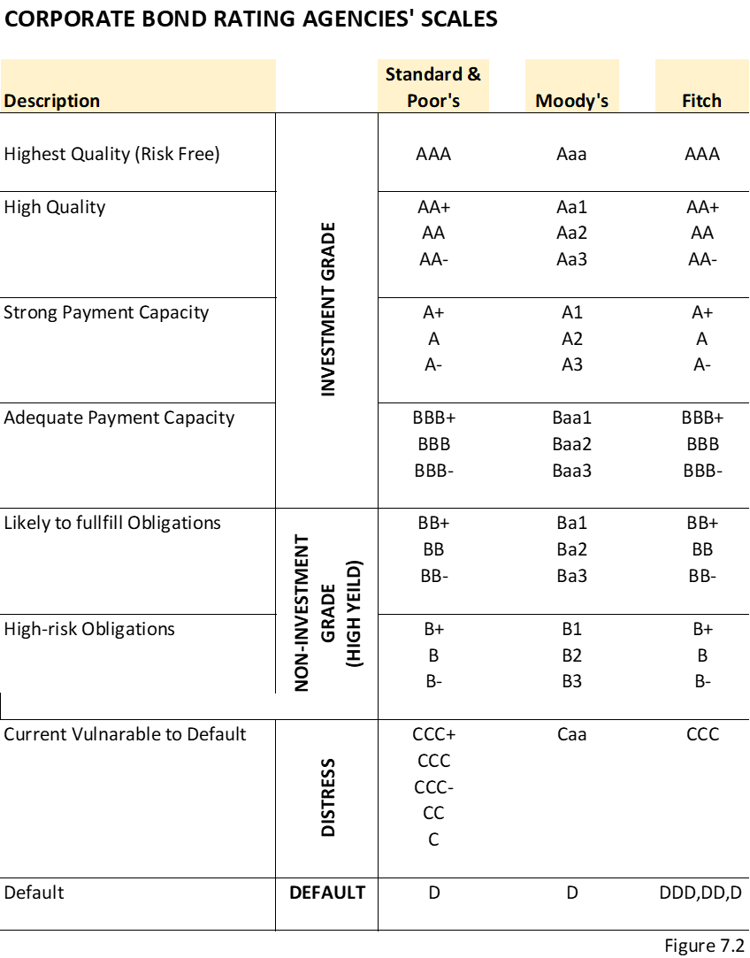
Raising / Issuing Corporate Bonds
The companies issuing bonds in the public markets are required by the Securities and Exchange Commission (SEC) to be independently rated by at least two rating agencies before they are issued Secured Bonds

Slide 4
Secondary Bond Markets: An Overview
The secondary market for publicly traded bonds takes place in over-the-counter transactions.
Bonds need to register with the SEC and report all secondary trading activities in a centralized reporting platform called TRACE (trade reporting and compliance engine).
The bonds are rated, as required by the SEC, by two independent rating agencies before they are issued. As a precaution, they continue to be monitored for upgrades or downgrades. The rating that is assigned to the bond security is an estimation on the probability of default.
Bonds are basically traded in two separate markets: investment grade and non-investment grade (high yield).

Slide 5
Corporate Bond Money Terms Revisited
Amount (Book Value Vs Market Value and other prices)
Interest Rate (Coupon Rate Vs Yield)
Maturity (Term of the bonds in years)
Payment (Coupon Payments and Redemption Price)

Slide 6
Bond Value / Prices Concepts
1. AMOUNT
Face value (par value) – $1,000 or 100% of $1,000
Market value/market price (clean price) – Trading at Discount, Premium, Par
Invoice Price (Dirty Price)
Redemption Price
Call Price
Original Issued Discount

Slide 7

Market Value
  Secondary pricing starts on the day of issuance until the bonds are refinanced. When they say that the market price of a bond is trading at either a discount, at par, or at a premium, it indicates the bond can be bought below a percentage of $1,000, at $1,000, or above $1,000 per bond, respectively.
  For example, a bond that is trading at 98 means that you can trade it in the secondary market at 98% of a $1,000 or $980. This bond is considered to be trading at a discount. If a bond is trading at 103, then the secondary market value is 103% of $1,000, or $1,030 market price – trading at a premium.
  FORMULA: $MV=\sum_{1}^{n}{\frac{CP}{{(1+YTM)}^{n}}}+\frac{\$1,000}{{(1+YTM)}^{n}}$
  MV/10 = MP
  EXAMPLE:
    A 5-year Corporate Bond with a 4.5% annual coupon paid every six months (semi-annual ) is yielding 4.74%. Find the Market Value of each bond. Also find the market price (% of Par) – 5 years with semi-annual payments=10 payments.
      $$MV=\sum_{1}^{10}{\frac{21.25}{{(1+0.0474/2)}^{10}}}+ \frac{\$1,000}{{(1+.0474/2)}^{10}}=170.42+807.99=978.41$$
      $$MP=\frac{978.41}{10}=97.841$$

Slide 8
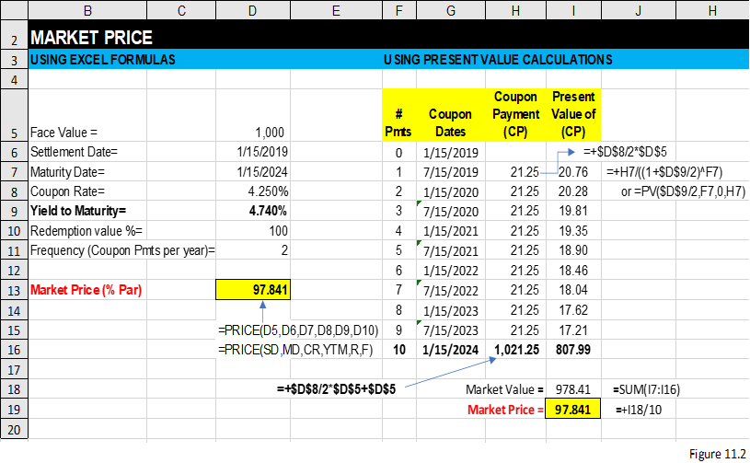
Market Value/Price
  EXAMPLE USING EXCEL:
    A 10-year Corporate Bond with a 4.5% annual coupon paid every six months (semi-annual ) is yielding 4.74%. Find the Market Value of each bond. Also find the market price (% of Par)

Slide 9
Reasons bond prices move up or down in the secondary market
Change of risk-free rate
Rating downgrade/upgrade
Refinancing

Slide 10
Invoice Price
The invoice price or “dirty price” is the total price of the bond including the market price and accrued interest.
This is the amount that you would pay or receive if you purchase or sell the bond.
Corporate bonds (and municipal bonds) are based on a 360-day year when calculating the accrued interest. In other words, every month has 30 days (day-count basis)—even February has 30 days when calculating the accrued interest
The “regular way trade” (per SEC definition) is T+3 business days (trade day + 3 days) to calculate the settlement day
The invoice price is
  IP = MV+ Accrued interest
  Where,
  Accrued Interest = Semiannual CP x Days since last CP / 180 days

Slide 11
Invoice Price Example
Market Price / Market value= 98.50 / $985.00.
Coupon Rate = 7.5% or $75 per year coupon ($37.50 semi-annual payment)
Coupon Dates = February 28, August 31
Trade Day = Thursday, January 17
Settlement Day (T+ 3 business Days): Tuesday, January 22
Days since the last coupon payment is calculated at 142 days
    30 days in September + 30 days is October +30 days in November +30 days in December +
    17 days in January through the trade days +5 days = 142 Days
142/180 x $37.50 = $29.50.
The invoice price is calculated $1,042.58, calculated as $985.00 + $29.50 = $1,014.58.

Slide 12
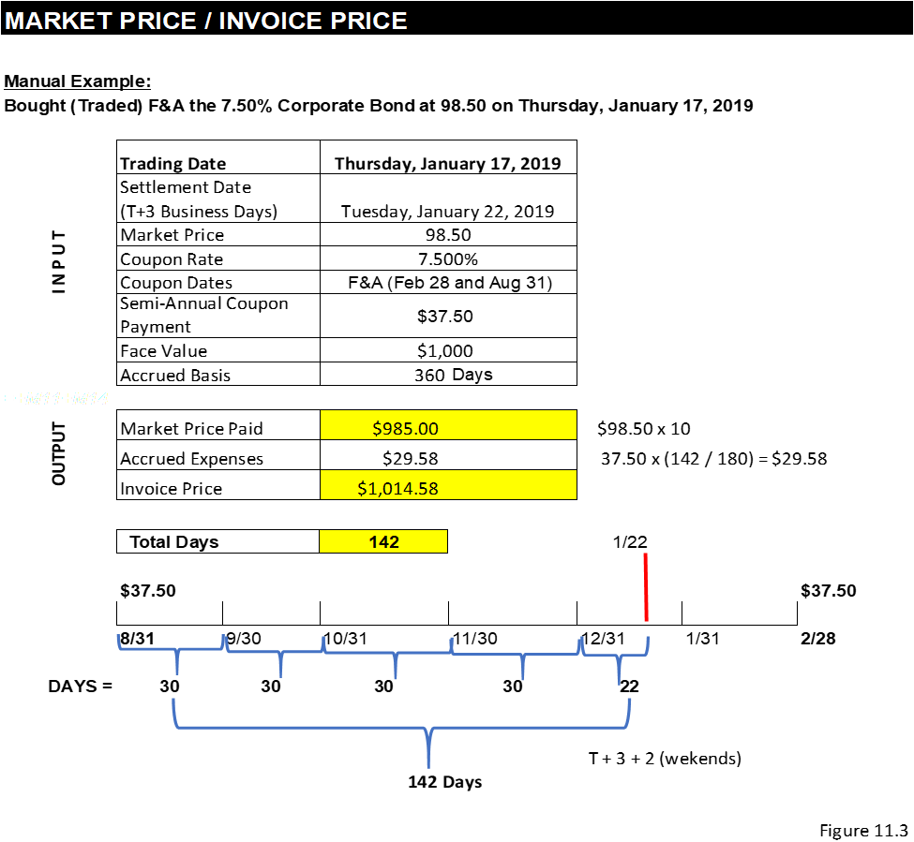
Invoice Price
Example

Slide 13
Example Practice – Calculating MV (Clean) and IP (Dirty)
Coupon Rate= 8.0%
Market Price = 96.50
Coupon Days = Mar 31, Sep 30
Trading Day = Tuesday, June 16
Accrued Basis = 360 days (Corp. Bond)
Market Value $ Per Bond =
Invoice Price $ =
First, need to find Settlement Day =
Second, need to find days since Last Coupon=
Third, need to calculate the accrued Interest=

Slide 14
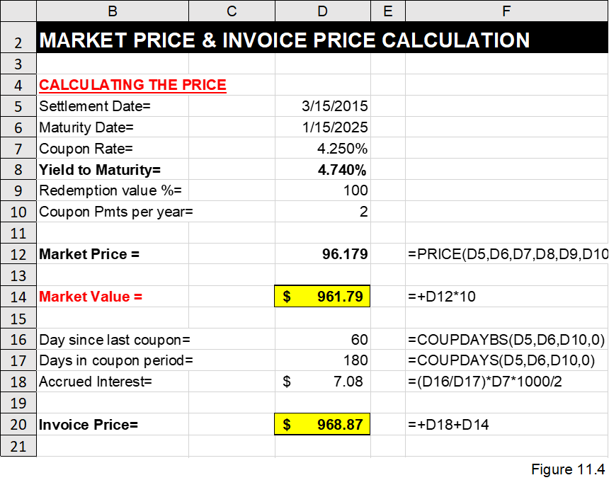
Market Value and Invoice Price using Excel (given the yield)

Slide 15
Bond Interest % and Yields % Concepts
2. INTEREST RATE
Nominal yield (coupon rate)
Accrued interest
Yield to maturity (YTM)
Yield to call (YTC)
Yield to worst (YTW)
Current yield (CY)

Slide 16

Calculating Yield to Maturity (using Formulas)
$$\frac{Annual coupon or interest payment ±[ \frac{Discount or premium}{Years to maturity} ]}{Average price of bonds}$$
For example, assuming a 7-year Bond with a Coupon Rate of 4.25% that is trading at 96.179 and a redemption price a 100.
The annual coupon payment is $42.50 (4.25% x $1000); the discount is $38.21 (1,000 – 961.79); at 7 years until maturity with current price of the bonds is between $1,000 and $961.79 since issuance. Then, the rule of thumb yield to maturity is calculated as follows:
$$\frac{42.50+[ \frac{38.21}{7} ]}{(961.79+1,000)/2}=\frac{42.50+5.46}{980.90}=0.04889=4.9\%$$

Slide 17
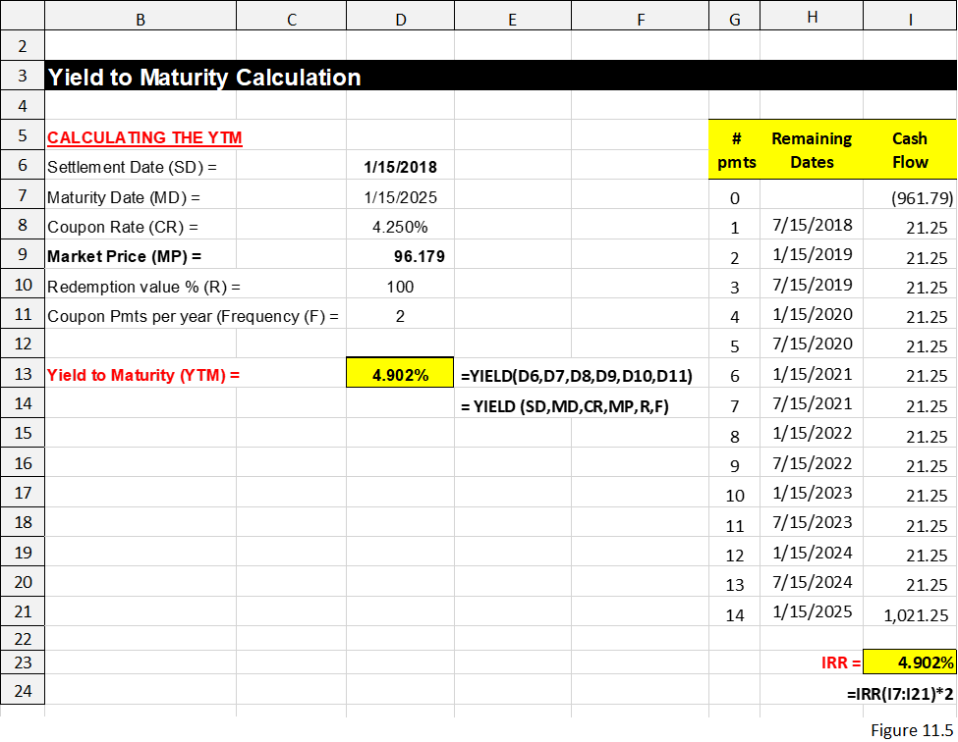
Calculating Yield to Maturity (using Excel)

Slide 18
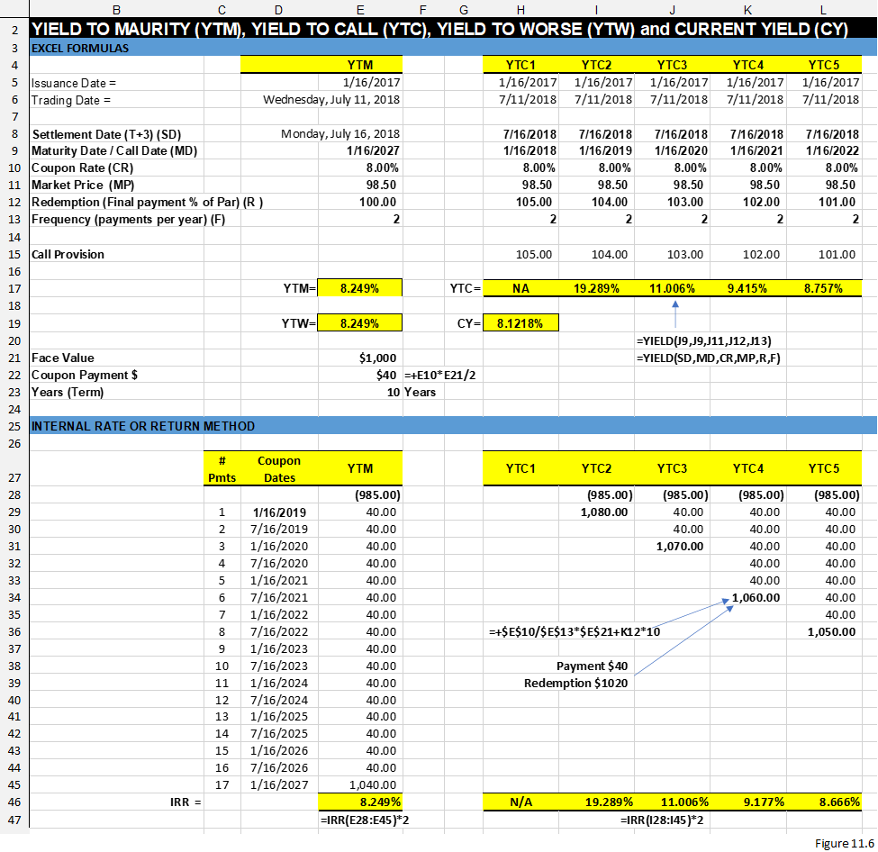
Calculating Yield to Call (YTC) and Yield to Worse (YTW)

Slide 19

Calculating Current Yield (Quick & Dirty)
Current yield (CY): This measures a quick annual rate of return for the investor who is planning to buy the bond in the secondary market.
$$Current bond yield= \frac{Annual coupon or interest payment}{Market price}$$
Example: A $1,000 bond that is selling for $985 and paying an 8% coupon rate. The current yield is calculated as follows:
$$Current bond yield= \frac{\$80.00}{\$985.00}=0.08122=8.122\%$$

Slide 20
Bond Dates and General Timing Concepts
3. Maturities/Time
Issuance date
Maturity date
Coupon dates
Call dates
Trading day
Settlement day (T+3)
Day-count basis

Slide 21
Bond Payment Concepts
4. Bond Payments
Coupon payments
Frequency of payments
Principal payments
  Term bond, the most popular, refers to the bond that pays all its principal amount at maturity. For example, for a 5-year bond the principal payments for years 1–5 are 0, 0, 0, 0, 1000.
  Serial bond refers to the bond that pays all its principal amount equally across maturity. For example, for a 5-year bond the principal payments for years 1–5 are 200, 200, 200, 200, 200.
  Bullet bond refers to the bond that pays a partial amount of the principal upfront and the balance at maturity. For example, for a 5-year bond the principal payments for years 1–5 are 50, 50, 50, 50, 800.

Slide 22
Bond Investment Valuation

Slide 23
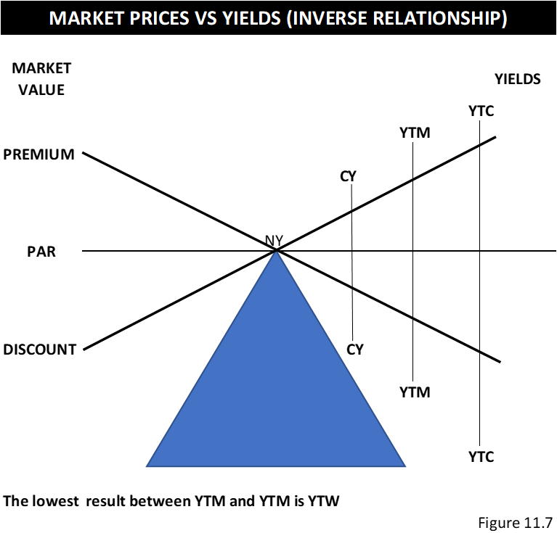
Bond Investment Valuation Concepts
Bond analysis lives by the fundamental concept that the value of the bonds in the secondary market go up and down based on the return expectation for the investor looking to buy these bonds.

Slide 24
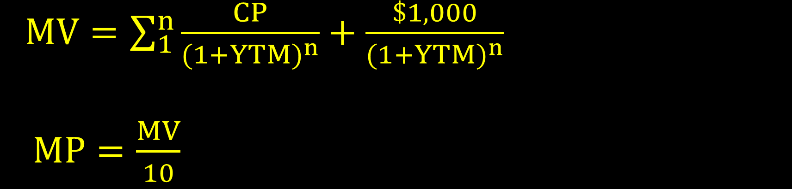
Bond Price
  $MV=\sum_{1}^{n}{\frac{CP}{{(1+YTM)}^{n}}}+\frac{\$1,000}{{(1+YTM)}^{n}}$
  $MP=\frac{MV}{10}$

Slide 25

Duration (D)
This is a measurement the price sensitivity of the bond and/or bond funds to changes with interest rates. They are two types of duration measurement
Macaulay Duration (expressed in years): identifies how many years it will take to recover the initial investment (market value) by calculating the weighted average of each present value of future coupon payments using the yield as a discount rate times the payment year.
Dm = sum of (PV of each periodic Cash Flow / Price of Bond) * time ) / frequency
D$m=[\frac{\sum_{1}^{n}{\frac{CF}{{(1+y/f)}^{t}}}}{MV}$. t ] / f
Modified Duration: (expressed in percentages): Measures the average percentage of movement of the bond price for every 1% movement of the interest rate. For example, the price of a bond with a duration of 5 would be expected to move 5% for every 1% move in interest rates.
$Modified D=\frac{Dm}{1+\frac{y}{n}}$

Slide 26

Convexity (C)
Like the modified duration, convexity is a further measurement of the relationship between the value of the bond and a movement of interest rates. It also measures the sensitivity of the bond price to 1% movement of the interest rates, but it’s calculated on non-linear relationships. Duration can be a good measure of how bond prices may be affected due to sudden fluctuations in interest rates. Nevertheless, the relationship between bond prices and yields has more of a sloped or convex relationship. It is represented as a derivative to the duration.
The formula for calculating the convexity is as follows:
$$Convexity=\frac{\frac{1}{{(1+y)}^{2}} .\sum_{1}^{n}{[\frac{CF}{{\left(1+\frac{y}{f}\right)}^{t}} \left(t^{2}+t\right)]}}{MV . f^{2}}$$
Where $y$ is the periodic yield, t is the time period, CF is the cash flow payment or the coupon payment, n is the number is periods, and$f$ is the frequency of payments per year.

Slide 27
Calculating Price, Duration and Convexity

