Slide 1
Debt Markets: issuing
Corporate Bonds
144As
Private Placements
Chapter 7
“An Analytical Approach to Investments, Finance and Credit”
Professor C. droussiotis

Slide 2
Issuer (Who raises bonds)
Government
Sovereign
Corporate

Slide 3
Corporate Debt: An Overview
Corporate debt is by far one of the most prefer
Raising debt ,in general, do not need to give up ownership and instead they signed a contract.
The contract, called bond indenture or loan agreement, requires the company to pay back such debt in the future plus pre-determined interest payment which represents the cost of borrowing.
Though debt is the preferred source of capital, is not always available.
Debt holders are betting that the company has relatively strong income and cash flows to meet their debt obligations which include both interest and principal payments.
In a bankruptcy, debt is viewed higher in the capital structure than stock

Slide 4
Parties Involved
Investor
Rating Agency
Issuer
Underwriter/Agent.

Slide 5
Investor
Institutional (Primary & Secondary markets)
Retail (secondary markets)

Slide 6
Corporate Bonds
In general, investing in bonds is safer than investing in stocks.
The return is expected to be fixed assuming the investor holds the bonds until the contractual maturity, thus the risk is estimated to be lower than the equity’s investment risk.
What gets a little complicated with holding corporate bonds is that the market value of these bonds could fluctuate due to many factors such as
  interest rates
  credit risk
  market liquidity
  refinancing

Slide 7
Secondary Bond Markets: An Overview
The secondary market for publicly traded bonds takes place in over-the-counter transactions.
Bonds need to register with the SEC and report all secondary trading activities in a centralized reporting platform called TRACE (trade reporting and compliance engine).
The bonds are rated, as required by the SEC, by two independent rating agencies before they are issued. As a precaution, they continue to be monitored for upgrades or downgrades. The rating that is assigned to the bond security is an estimation on the probability of default.
Bonds are basically traded in two separate markets: investment grade and non-investment grade (high yield).

Slide 8
Rating Agency
Standard & Poor’s
Moody’s
Fitch

Slide 9
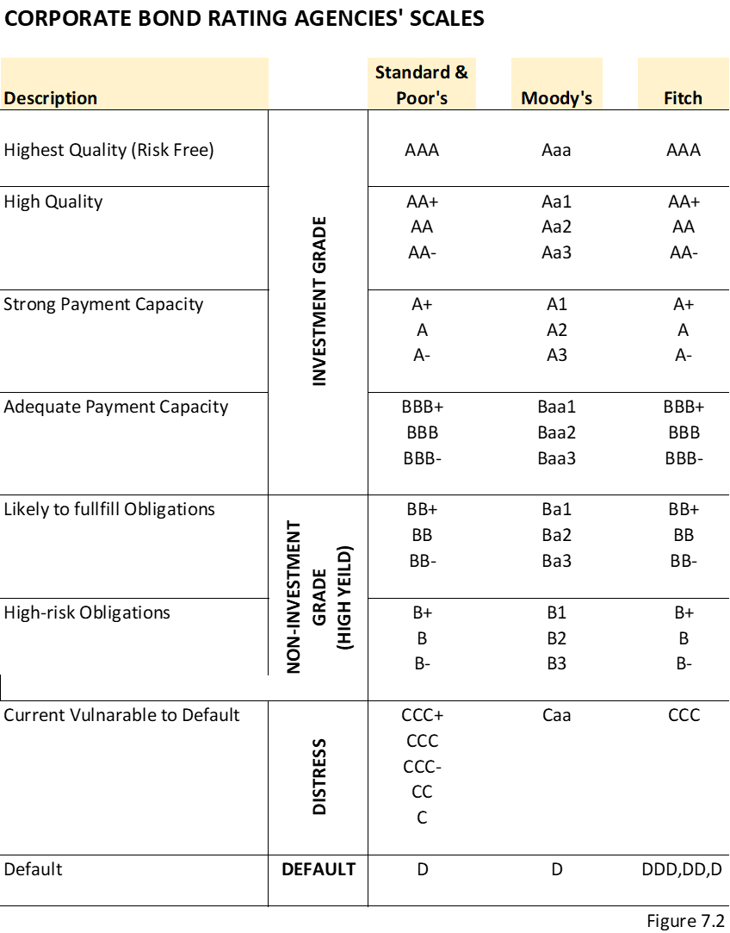
Raising / Issuing Corporate Bonds
The companies issuing bonds in the public markets are required by the Securities and Exchange Commission (SEC) to be independently rated by at least two rating agencies before they are issued Secured Bonds

Slide 10
Rating Agency Methodology
Industry Risk
Company-Specific Business Risks
Management Factor
Financial Risk Analysis
  Loan-to-value or debt capitalization ratio
  Leverage ratio of debt to EBITDA
  Coverage ratios, including EBITDA/interest and cash flow to debt service
  Cash Flow Forecasting and Modeling

Slide 11
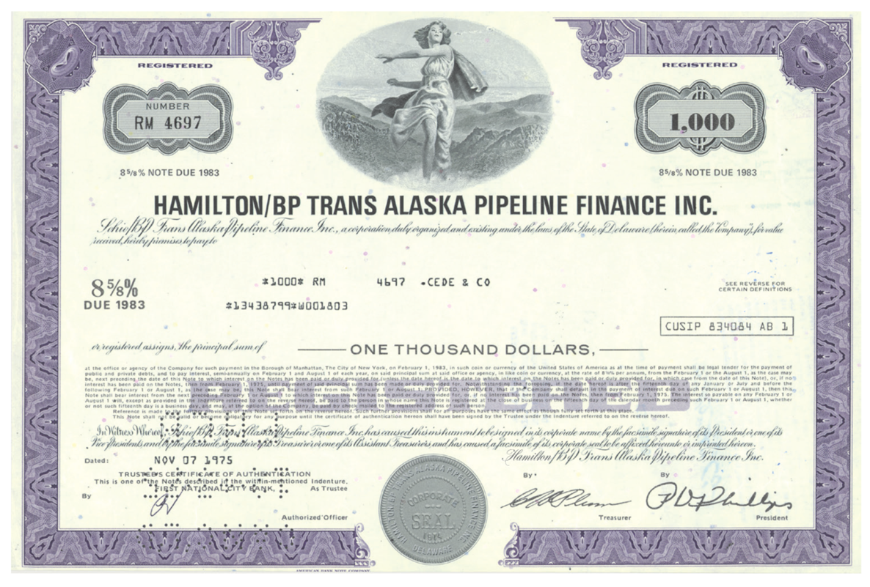
Corporate Issuer

Slide 12
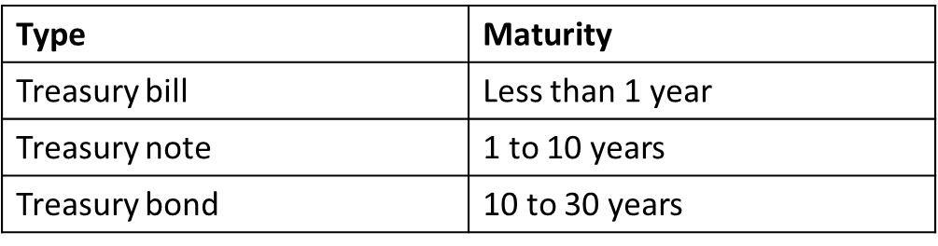
Treasury Notes and Bonds
The U.S. Treasury issues notes and bonds to finance its operations.
The table (12.1) summarizes the maturity differences among the various Treasury securities.

Slide 13
Treasury Bonds: Recent Innovation
Treasury Inflation-Indexed Securities: the principal amount is tied to the current rate of inflation to protect investor purchasing power
Treasury STRIPS: the coupon and principal payments are “stripped” from a T-Bond and sold as individual zero-coupon bonds.

Slide 14
Municipal Bonds
Issued by local, county, and state governments
Used to finance public interest projects
Tax-free municipal interest rate = taxable interest rate × (1 − marginal tax rate)
Two types
  General obligation bonds
  Revenue bonds
NOT default-free (e.g., Orange County California)
  Defaults in 1990 amounted to $1.4 billion in this market

Slide 15
Municipal Bonds: Example
Suppose the rate on a corporate bond is 5% and the rate on a municipal bond is 3.5%. Which should you choose? Your marginal tax rate is 28%.
Find the equivalent tax-free rate (ETFR):
ETFR = 5% × (1 − MTR) = 5% × (1 − 0.28)
The ETFR = 3.6%. If the actual muni-rate is above this , choose the muni. If the actual muni-rate is below this, choose the corporate bond. In this case, we choose corporate bond.

Slide 16

Types of Corporate Bonds
Unsecured Bonds
Secured Bonds
  Mortgage bonds
  Collateral trust bonds
  Equipment trust obligations
  Guarantee bonds
Convertible Bonds
  $Conversion ratio=\frac{Par value}{Conversion price}$,
Zero Coupon Bonds
Paid-In-Kind (PIK) Bonds

Slide 17
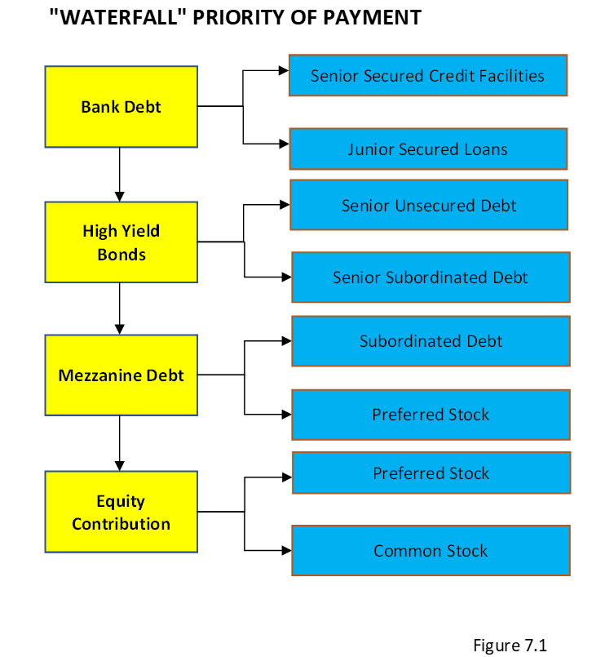
Corporate Debt: An Overview
“The Waterfall” or priority of payment, in a bankruptcy, bonds are viewed higher in the capital structure than stock.

Slide 18
Going to Market to Raise Corporate Bonds
Step I: Select the Investment Company/Underwriter
  Firm Commitment
  Best-Effort Commitment
Step II: Preparing the Documents for the Bond Offering
Step III: SEC Registration and Approval though debt is the preferred source of capital, is not always available.
Step IV: Marketing the Bond Offering
.Step V: Indication of Interest
Step VI: Closing, Funding, and Free to Trade

Slide 19
Terms of the Bonds
Money Terms
  Amount
  Interest
  Maturity/Term
  Principal Payment
Non-Money
  Financial Covenants
  Negative Covenants
  Affirmative Covenants

Slide 20
Money Terms - Primary
Amount Concepts
  Face Value (Book Value) $1,000 per Bond – PAR AMOUNT 100
  Redemption
    Maturity 100
    Earlier than Maturity (Call/Non-Call) at different prices
Interest Rate / Coupon Rate
  Fixed or Floating
  Semi-Annual Payment (i.e. 8.0% Coupon pay $80 per year or $40 every six months)
Maturity (anniversary of issuance)
Principal Payments
  Term Bond (0,0,0,0,100)
  Serial Bond (20,20,20,20,20)
  Balloon Bond (10,10,10,10, 60)

Slide 21

Pricing Bonds
The initial pricing of bonds is guided primarily by demand and supply based on the rating. In setting up the coupon rate, which is the interest rate of cost of borrowing for the issuer, the investment advisor considers the following factors:
  Risk Free Rate or AAA rated bonds which are used as the base
  Inflation Price
  Maturity Rate Price
  Default Rate based on rating
  Liquidity
  $$Coupon Rate= Rfr+IP+MRP+DRP+LP$$

Slide 22
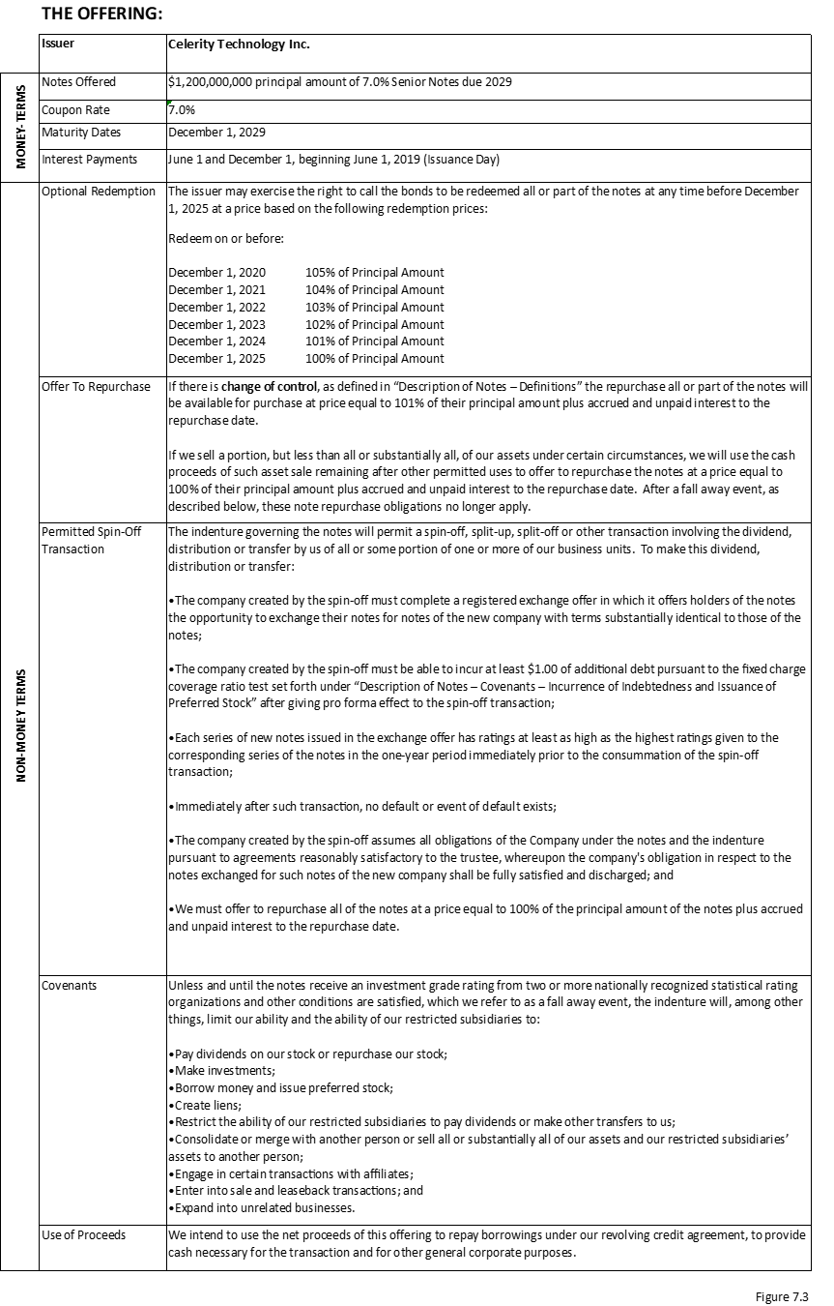
Term Sheet

Slide 23
Market Information
Q2 2022

Slide 24
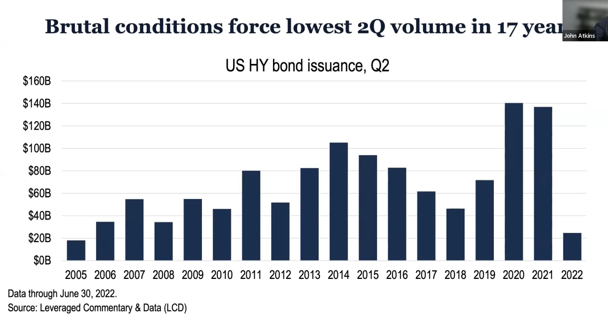

Slide 25
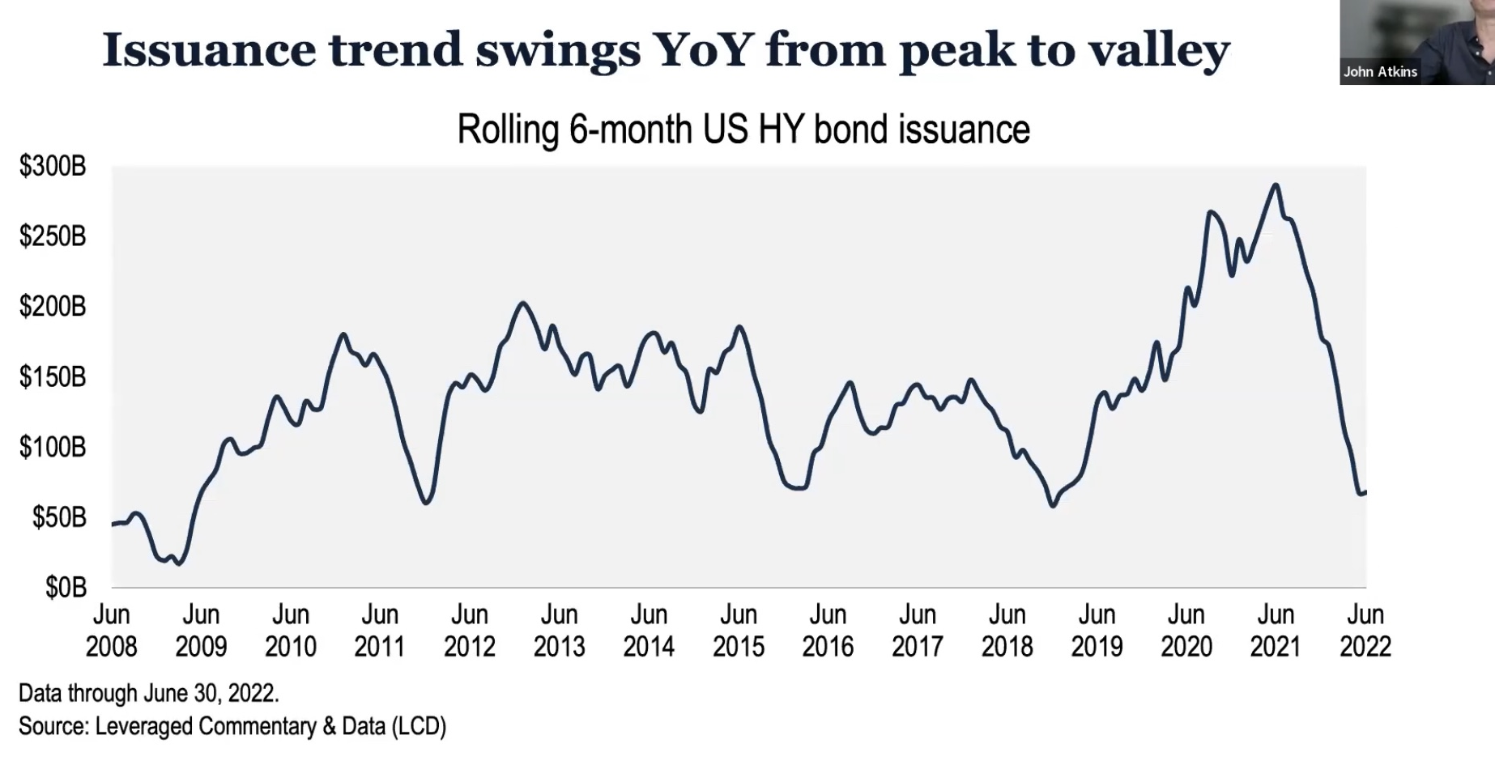

Slide 26
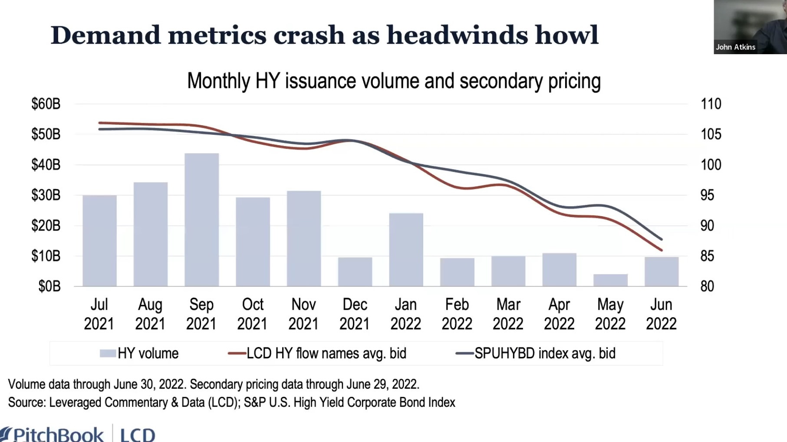

Slide 27
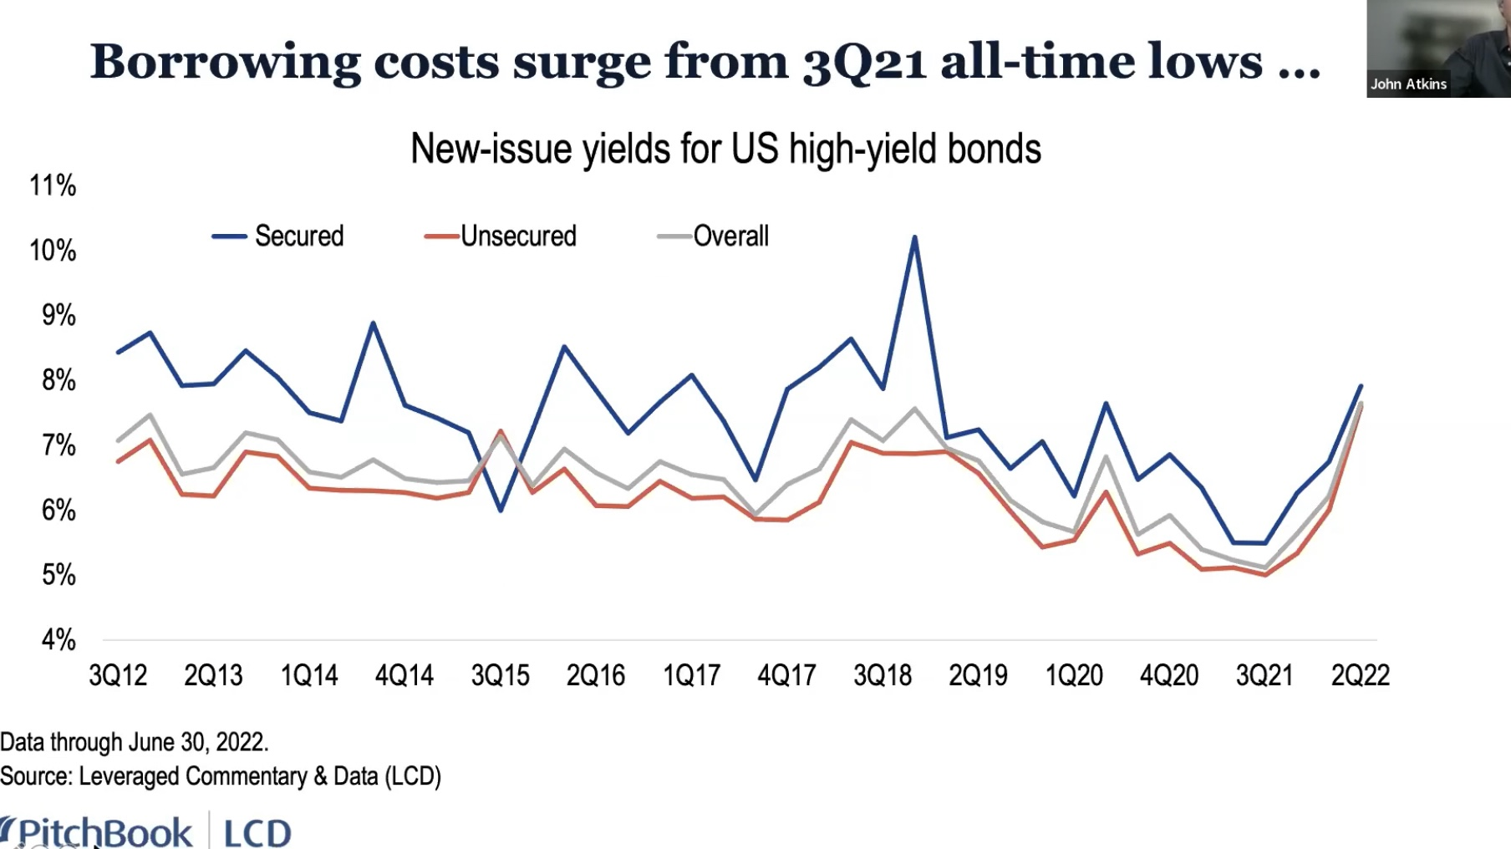

Slide 28
