Slide 1
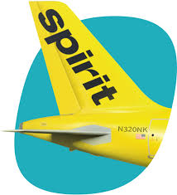
Spirit Airlines
Case 1
The Acquisition of
https://www.youtube.com/watch?v=qjgVSWNlLw4

Slide 2
Agenda
Introduction
Building confidence
Engaging the audience
Visual aids
Final tips & takeaways

Slide 3
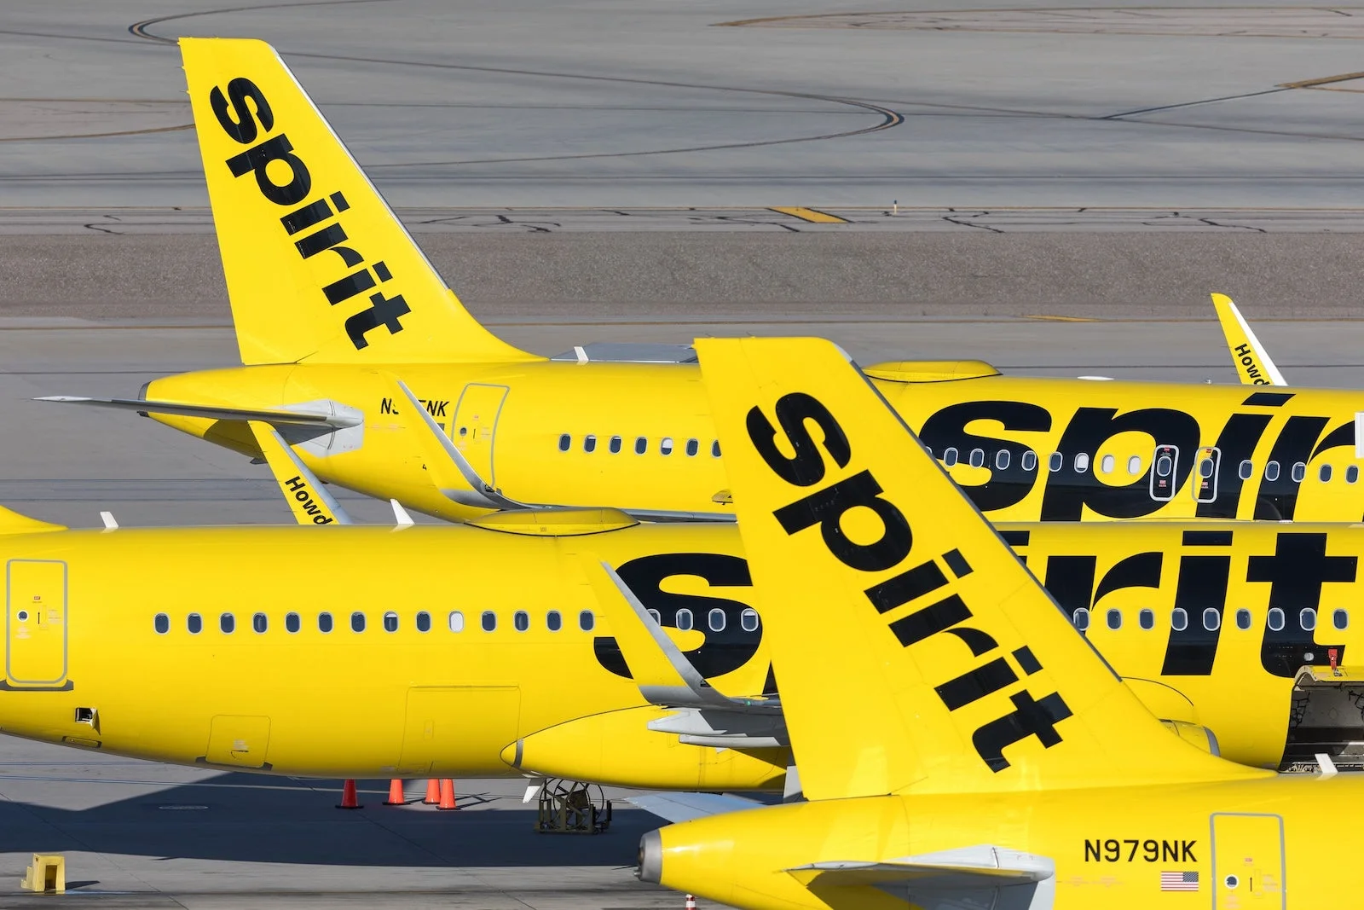
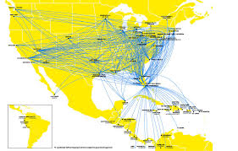
TARGET: Spirit Airlines, Inc.
(SAVE)
Spirit Airlines, Inc. provides airline services. It serves 85 destinations in 16 countries in the United States, Latin America, and the Caribbean. As of December 31, 2021, the company had a fleet of 173 Airbus single-aisle aircraft. It sells tickets through its call centers and airport ticket counters, as well as online through spirit.com; and through various third parties, including online, traditional travel agents, and electronic global distribution systems. The company was formerly known as Clippert Trucking Company and changed its name to Spirit Airlines, Inc. in 1992. Spirit Airlines, Inc. was founded in 1964 and is headquartered in Miramar, Florida.

Slide 4
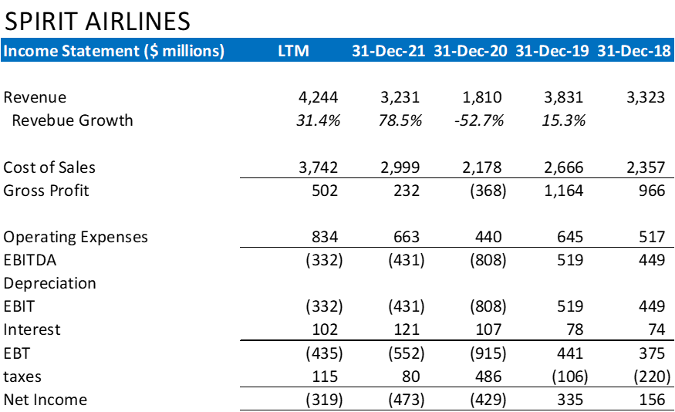
TARGET: Spirit Airlines, Inc.
(SAVE)

Slide 5
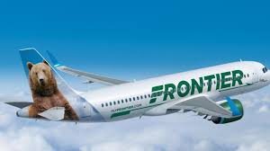
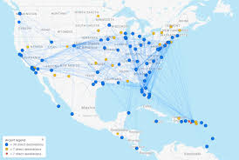
FRIEDLY ACQUIRER:
Frontier Group Holdings
Inc. (ULCC)
Frontier Group Holdings, Inc., a low-fare airline company, provides air transportation for passengers. The company operates an airline that serves approximately 120 airports throughout the United States and international destinations in the Americas. It offers its services through direct distribution channels, including its website, mobile app, and call center. As of December 31, 2021, the company had a fleet of 110 Airbus single-aisle aircraft comprising, 16 A320ceos, 73 A320neos, and 21 A321ceos. Frontier Group Holdings, Inc. was incorporated in 2013 and is headquartered in Denver, Colorado.

Slide 6

FRIEDLY ACQUIRER: Frontier Group Holdings Inc. (ULCC)

Slide 7
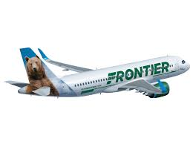
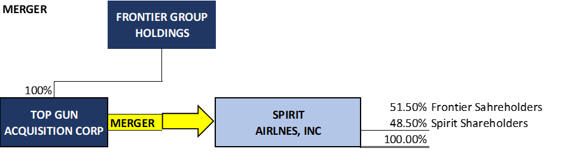
MERGER BETWEEN FRONTIER GROUP AND SPIRIT AIRLINES

Slide 8
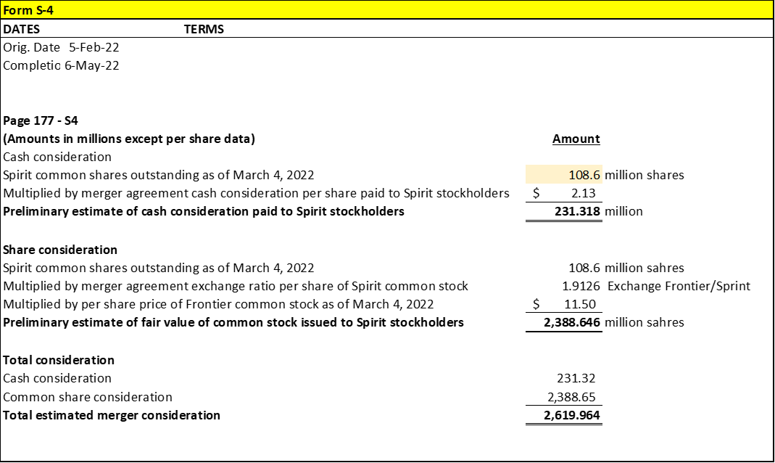
MERGER BETWEEN FRONTIER GROUP AND SPIRIT AIRLINES

Slide 9
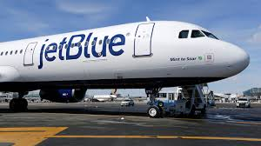
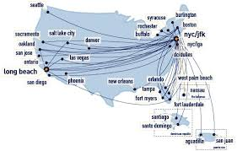
HOSTILE ACQUIRER:
JetBlue Airways
Corporation (JBLU)
JetBlue Airways Corporation provides air passenger transportation services. As of December 31, 2021, the company operated a fleet of 63 Airbus A321 aircraft, 8 Airbus A220 aircraft, 21 Airbus A321neo aircraft, 130 Airbus A320 aircraft, and 60 Embraer E190 aircraft. It also served 107 destinations in the 31 states in the United States, the District of Columbia, the Commonwealth of Puerto Rico, the U.S. Virgin Islands, and 24 countries in the Caribbean and Latin America. JetBlue Airways Corporation has a strategic partnership with American Airlines Group Inc. to create connectivity for travelers in the Northeast. The company was incorporated in 1998 and is based in Long Island City, New York.

Slide 10

HOSTILE ACQUIRER: JetBlue Airways Corporation (JBLU)

Slide 11
HOSTILE ACQUIRER: JetBlue Airways Corporation (JBLU)

Slide 12
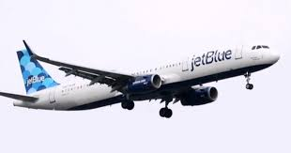
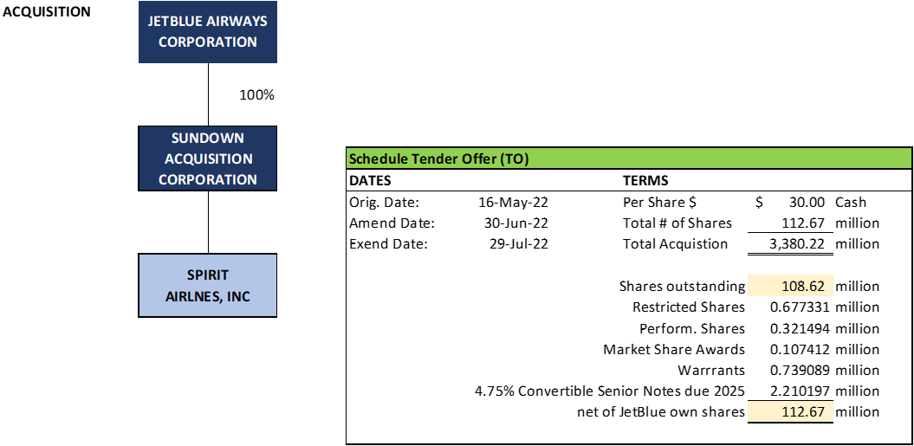
ACQUISITION OF SPIRIT AIRLINES BY JETBLUE AIRWAYS

Slide 13
History
SAVE Stock
$25.46
Up from $21.73
February 7, 2022
Frontier Airlines offered to buy Spirit for $2.9 billion or $25.83 per share
File S-4
https://www.sec.gov/Archives/edgar/data/1670076/000119312522143980/d300541ds4a.htm

Slide 14
History
SAVE Stock
$27.27
February 10, 2022
Spirit Board Agreed to the Merger. The two companies are closely linked and had been discussing a combination for years. Subject to shareholder vote, Spirit entered into a merger agreement with Frontier. 425 - Filed 8K
https://d18rn0p25nwr6d.cloudfront.net/CIK-0001498710/e70695f1-9577-41b7-9b5d-37590f44cbda.pdf
Under which Spirit and Frontier would combine in a stock and cash transaction. Under the terms of the merger agreement, Spirit equity holders would receive 1.9126 shares of Frontier plus $2.13 in cash for each existing Spirit share they own.

Slide 15
History
March 2022
Mr. Hayes, CEO of JetBlue knew he had to act quickly. He called advisers that day.
JetBlue’s advisers worked through a series of questions. Did Frontier have enough cash to withstand a bidding war? Would the Northeast Alliance, JetBlue’s partnership with American Airlines Group Inc., be an impediment? That arrangement was already being challenged by the Justice Department.
The JetBlue team concluded that making a run at Spirit could work. By agreeing to an acquisition by Frontier in the first place, Spirit’s board had signaled that it was for sale and could be open to a better offer, they reasoned.

Slide 16
History
SAVE Stock
$26.92
Up from $21.50
April 5, 2022
JetBlue officially made an unsolicited offer of $33 per share in cash earlier this week, beating a near $25 per share cash-and-stock bid from Frontier made in February (ULCC.O).
Filed a TO 14D-9
https://www.sec.gov/Archives/edgar/data/1158463/000094787122000441/ss917756 _dfan14a.htm

Slide 17
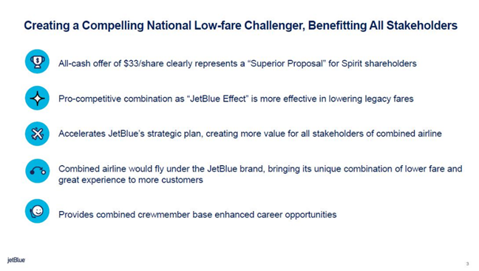
History
April 5, 2022

Slide 18
History
SAVE Stock
$$24.43
April 29, 2022
JetBlue CEO in a letter to Spirit Chairman H. McIntyre Gardner and CEO Christie: “While we would unquestionably prefer to negotiate a transaction with you, if you continue to refuse to constructively engage with us so that we can deliver this value to your stockholders, we are actively considering all other options available to us,”

Slide 19
History
SAVE Stock
$21.50
Down from $25.00
May 2, 2022
Spirit Board rejects JetBlue deal: “Frontier deal had a better chance of passing muster with regulators and would be better for investors in the long run”. Also, the Justice Department is suing JetBlue and American Airlines, seeking to unwind a partnership between those two airlines. A trial is scheduled to begin this fall.

Slide 20
History
May 2, 2022
Robin Hayes
Chief Executive Officer
JetBlue Airways Corporation
27-01 Queens Plaza North
Long Island City, NY 11101
Dear Mr. Hayes:
We have reviewed JetBlue's updated proposal dated April 29, 2022, with Spirit's Board of Directors and its legal and financial advisors. Our Board has unanimously determined that JetBlue's proposal does not constitute a "Superior Proposal" under Spirit's existing merger agreement with Frontier.
As you know, a "Superior Proposal" under the Frontier agreement must, among other requirements, be "reasonably capable of being consummated." Spirit's Board believes JetBlue's proposal falls short of that standard. Our conclusion is based on careful analysis of the competitive implications of a combination of JetBlue, which analysis has been informed by extensive discussions between our respective antitrust advisors and economic consultants over the past four weeks. During that period, Spirit has also discussed projections with your financial advisers and provided voluminous documentary due diligence material through a secure virtual data room.

Slide 21
History
We believe a combination of JetBlue and Spirit has a low probability of receiving antitrust clearance so long as JetBlue's Northeast Alliance (NEA) with American Airlines remains in existence. The U.S. Department of Justice (DOJ), along with Attorneys General in six states and the District of Columbia, have sued to block the NEA, alleging that the alliance "will not only eliminate important competition in [Boston and New York City], but will also harm air travelers across the country by significantly diminishing JetBlue's incentive to compete with American elsewhere, further consolidating an already highly concentrated industry." As you know, Spirit and many other airline and air travel constituencies have publicly opposed the NEA on grounds that it is anticompetitive. We struggle to understand how JetBlue can believe DOJ, or a court, will be persuaded that JetBlue should be allowed to form an anticompetitive alliance that aligns its interests with a legacy carrier and then undertake an acquisition that will eliminate the largest ULCC carrier.
We further believe that your divestiture proposal is unlikely to resolve DOJ's concerns about a combination of Spirit and JetBlue if the NEA continues in existence. DOJ clearly views the NEA as having a broader national effect and Spirit believes DOJ will not place great weight on your proposed remedy, especially because there are reasons to doubt the efficacy of similar divestitures as a remedy in past airline mergers.

Slide 22
History
Moreover, in evaluating a JetBlue-Spirit combination, Spirit believes DOJ—and a court—will be very concerned that a higher-cost/higher fare airline would be eliminating a lower-cost/lower fare airline in a combination that would remove about half of the ULCC capacity in the United States. In addition, the conversion of Spirit aircraft to JetBlue configuration will result in significantly diminished capacity on former Spirit routes, also resulting in higher prices for consumers. Finally, we are skeptical about your claims regarding the so-called "JetBlue Effect." After receiving the summary output of your economic model from your advisers, Spirit's economic consultants identified reasons to doubt that such an effect would significantly exceed any similar "ULCC effect."
In contrast, Spirit believes that merging with Frontier will enable the combined ULCC business to achieve scale, improve operational reliability, have increased relevance to consumers, and do an even better job of delivering ultra-low fares to more consumers and competing more effectively against the Big 4 carriers, as well as against JetBlue. We believe that is a clear, pro-consumer narrative that will resonate more successfully with DOJ than a combination with JetBlue, which would eliminate the largest ULCC and remove significant low-cost/low-fare capacity.

Slide 23
History
Spirit took note of the fact that the JetBlue proposal allocates most of the very substantial deal completion risk to Spirit stockholders. To reduce that risk and achieve a more appropriate balance of the risk between our companies, in our April 25 response Spirit proposed a strong covenant requiring JetBlue to take any action required to obtain regulatory clearance, which specifically included abandoning the NEA at closing. We also proposed a substantial reverse termination fee intended to partially compensate Spirit if the transaction failed to win antitrust clearance. On that score, in the event of a failure or abandonment of a JetBlue-Spirit combination, even a high reverse termination fee will not fully compensate Spirit stockholders for the likely significant business erosion Spirit will face during what will be a protracted approval process.

Slide 24
History
Spirit does not consider JetBlue's April 29 response to be appropriately responsive to Spirit's concerns. Indeed, that response makes clear that JetBlue is unwilling to terminate the NEA – or to agree to any other remedies that might materially decrease the expected benefits to JetBlue from the NEA – to obtain clearance for an acquisition of Spirit. The transaction you describe in your April 29 response not only fails to meet the required standard under the Frontier merger agreement but, by prioritizing the NEA over the steps we believe would be necessary to have any realistic likelihood of obtaining antitrust clearance, it imposes on our stockholders a degree of risk that no responsible board would accept. Given this substantial completion risk, we believe JetBlue's economic offer is illusory, and Spirit's board has not found it necessary to consider it.
Very truly yours,
H. McIntyre Gardner
Chairman of the Board
Edward M. Christie, III
Chief Executive Officer

Slide 25
History
SAVE Stock
$16.81
Down from $21.30
May 2 - 9 Response in the Media
JetBlue had accused Spirit’s board of not looking out for shareholders’ best interests in spurning JetBlue’s offer, while Spirit and Frontier suggested that JetBlue was merely trying to spoil their deal and fend off a potential new rival.
Uncertainty of the any deal getting done
Note: later, JetBlue has agreed to pay Spirit’s shareholders a breakup fee of $400 million if the deal is barred by antitrust authorities, as well as another $70 million to the company. It has also committed to divesting certain assets, including all of Spirit’s holdings at airports where JetBlue and American are working together.

Slide 26
History
May 16, 2022
JetBlue made an official tender offer (Filed an SEC TO) valued at $3.2 billion and said it was willing to pay more if Spirit cooperated with an acquisition.
Note: Sundown Acquisition Corp. (SPV)
JetBlue said Monday that it was taking its offer to acquire Spirit Airlines directly to that carrier’s shareholders, after Spirit’s board rejected a takeover proposal and decided to stick with its plan to merge with Frontier Airlines.
In a statement, JetBlue said it was offering $30 a share to buy all of Spirit’s outstanding stock, a move known as a tender offer. That share price, setting the total purchase price at more than $3.2 billion, was slightly less than it originally offered to Spirit.
After JetBlue announced its tender offer, Spirit said its board would review the proposal and share its position with shareholders within 10 business days. The airline encouraged shareholders to take no action on JetBlue’s tender offer until that review is concluded.
JetBlue said it had filed a “vote no” proxy statement calling for Spirit shareholders to reject the Frontier merger. JetBlue said that its all-cash offer was currently worth 60 percent more than Frontier’s cash-and-stock proposal. Frontier’s share price has fallen by about a third since it announced its merger with Spirit, reducing the value of its bid
SAVE Stock
$19.27
Up from $16.90

Slide 27
History
June 6, 2022
Updated To – 14-9
https://www.sec.gov/Archives/edgar/data/1498710/000119312522170251/d353446dsc14d9a.htm

Slide 28
History
SAVE Stock
$22.80
June 28, 2022
Spirit Airlines, Inc. ("Spirit" or the "Company") (NYSE: SAVE) today reaffirmed its commitment to its merger agreement with Frontier Group Holdings Inc. (“Frontier”) (NASDAQ: ULCC), parent company of Frontier Airlines, Inc., and commented on the most recent revised offer from JetBlue Airways Corporation ("JetBlue") (NASDAQ: JBLU) received on June 27, 2022.
Spirit has scheduled the Special Meeting of Stockholders (the “Special Meeting”) to approve the proposed merger with Frontier for Thursday, June 30, 2022, at 9:00 a.m., Eastern Time. All stockholders of record as of the close of business on May 6, 2022, are entitled to vote at the Special Meeting.
The Spirit Board of Directors strongly recommends you vote FOR the merger on the WHITE proxy card today. If you have already voted, remember that a proxy vote can be changed. For more information on how to vote for the merger, please call the Company’s proxy solicitor, Okapi Partners.

Slide 29
History
SAVE Stock
$22.80
June 30, 2022
Spirit Airlines said it would delay its shareholder vote on buyout offers from Frontier Airlines and JetBlue until July 8. The company had scheduled a vote for Thursday but will now continue to talk with both parties.
Shareholder Reactions:
Spirit shareholder TIG Advisors LLC also informed the carrier’s board of directors that it intends to vote against Frontier’s bid with the low-cost carrier.
Institutional Shareholder Services (ISS) last month said JetBlue’s latest offer to buy Spirit was “more favorable” for the ultra-low-cost airline’s shareholders but maintained its support for the Frontier deal.
Even traditional money managers such as BlackRock and Fidelity were voting against the merger with Frontier.

Slide 30
History
SAVE Stock
$23.46
July 7, 2022
Spirit Airlines Inc said it has postponed a shareholder vote scheduled for Friday on its $2.4 billion sale to Frontier Group Holdings Inc so its board can continue discussions with both Frontier and JetBlue Airways. Spirit said it now plans to hold a special meeting on July 15. The sources said it did not have enough shareholders to back the Frontier deal at the time.
https://d18rn0p25nwr6d.cloudfront.net/CIK-0001498710/cea5edfb-ac53-4b00-a788-3393d8fcd357.html

Slide 31
History
July 11, 2022
SAVE Stock
$24.41
Low-cost carrier Frontier Group Holdings Inc has declined to further raise its bid for takeover target Spirit Airlines Inc, potentially drawing curtains on its months-long bidding war with JetBlue Airways Corp.
July 17, 2022
SAVE Stock
$24.50
Discovery became the second major Spirit shareholder to publicly back a merger with JetBlue, which is vying with Frontier to expand in the United States and create the country’s fifth-largest airline. Discovery owns 1.4% of Spirit..

Slide 32
History
SAVE Stock
$24.30
July 27, 2022
No Deal: Spirit Airlines Terminates Frontier Merger. Spirit Airlines shareholders have rejected the bid to merge with Frontier, opening the door to a possible Spirit-JetBlue deal.
Ted Christie, President and CEO of Spirit Airlines, said,
“While we are disappointed that we had to terminate our proposed merger with Frontier, we are proud of the dedicated work of our Team Members on the transaction over the past many months. Moving forward, the Spirit Board of Directors will continue our ongoing discussions with JetBlue as we pursue the best path forward for Spirit and our stockholders."

Slide 33
History
SAVE Stock
$24.30
July 27, 2022
Bill Franke, chair of Frontier's board and the managing partner of majority shareholder Indigo Partners, commented in a statement,
“While we are disappointed that Spirit Airlines shareholders failed to recognize the value and consumer potential inherent in our proposed combination, the Frontier Board took a disciplined approach throughout the course of its negotiations with Spirit. We were focused on offering the appropriate value for Spirit, while prioritizing consumers and the best interests of Frontier, our employees, and shareholders. As we enter our next chapter, Frontier remains well-positioned to deliver significant value to our shareholders as we serve the growing demand for affordable air travel.”

Slide 34
History
SAVE Stock
$24.30
July 27, 2022
Bill Franke, chair of Frontier's board and the managing partner of majority shareholder Indigo Partners, commented in a statement,
JetBlue statement on the cancelation of the Spirit-Frontier deal
JetBlue provided the following statement regarding today's announcements:
"We are pleased that the merger agreement with Frontier has been terminated and we are engaged in ongoing discussions with Spirit toward a consensual agreement as soon as possible. We remain fully committed to completing this transaction so we can create a compelling national challenger to the dominant airlines with more opportunities for all."
“While we are disappointed that Spirit Airlines shareholders failed to recognize the value and consumer potential inherent in our proposed combination, the Frontier Board took a disciplined approach throughout the course of its negotiations with Spirit. We were focused on offering the appropriate value for Spirit, while prioritizing consumers and the best interests of Frontier, our employees, and shareholders. As we enter our next chapter, Frontier remains well-positioned to deliver significant value to our shareholders as we serve the growing demand for affordable air travel.”

Slide 35
History
SAVE Stock
$26.40
July 28, 2022
JetBlue Airways agreed to buy Spirit Airlines for $33.50 a share in cash. The deal would create the fifth-largest U.S. carrier and comes after a fierce bidding war between JetBlue and Frontier.
Frontier executives said Wednesday that they were disappointed in the outcome but said Frontier was poised to grow as a stand-alone airline. Spirit will have to reimburse Frontier $25 million for costs it incurred related to the failed deal and will be on the hook for another $69 million if it agrees to another acquisition in the next year that ultimately is completed.

Slide 36
History
SAVE Stock
$22.05
September 2, 2022
Regulatory approval for JetBlue's merger with Spirit is not a given, and if that hurdle is cleared the potential integration of the two airlines will be rife with complexities.
Together, the airlines would control 10.2% of the market, behind United Airlines, American Airlines, Delta Air Lines, and Southwest Airlines.
For now, it seems that Frontier stands to benefit the most, as it will be the only ultra-low-cost carrier of scale in the US if JetBlue and Spirit are successful in their plan to merge.

Slide 37

History
November 5, 2024
Spirit Airlines filed for bankruptcy protection in November 2024, the first major U.S. airline to do so since 2011. The iconic budget airline hasn’t had a profitable year since 2019 and it’s lost more than $2 billion since 2020. Faced with mounting losses and looming debt payments, Spirit has furloughed hundreds of pilots and offered salaried workers buyouts. It sold some of its Airbus fleet and cut routes. The airline has struggled with shifting demand, a spike in costs, and a Pratt and Whitney engine recall grounding dozens of its jets, weaker-than-expected sales and a failed acquisition with JetBlue Airways. How did the icon of U.S. budget air travel get here and what’s next for the low cost carrier?
https://www.youtube.com/watch?v=KomDkj5scsg

Slide 38
History
March 2025
First emergence: The company exited this restructuring in March 2025, having converted about $795 million
of its debt into equity and receiving new financing.
https://www.youtube.com/watch?v=IIVhmKFuIiE
August 2025
Second filing: Despite the restructuring, the company continued to struggle with high costs and weak demand. In August 2025, it filed for Chapter 11 bankruptcy for a second time, with plans to make more substantial operational changes, including shrinking its fleet and market presence.
https://www.youtube.com/watch?v=ZTi_t0QEllg
https://www.youtube.com/watch?v=hvHiLoZ1mAA

