Slide 1
Career in finance
Professor Chris droussiotis

Slide 2
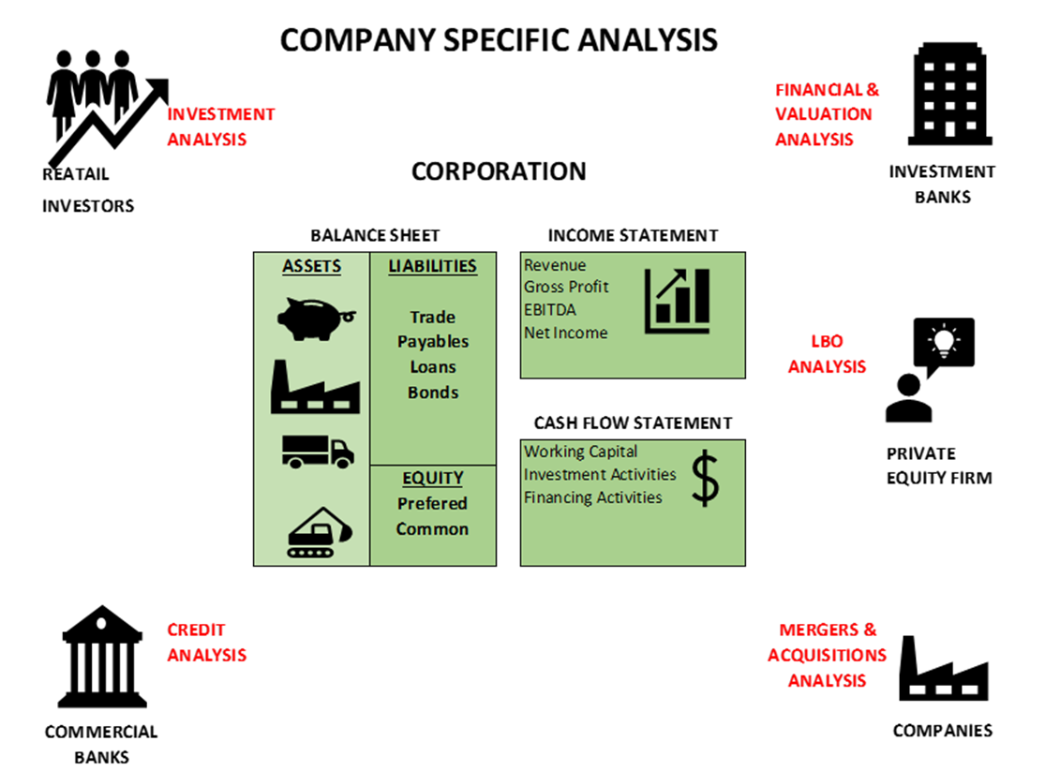
Company Specific Analysis – a 30,000 feet view

Slide 3




Spectrum of career opportunities in finance
CORPORATE FINANCE
CREDIT ANALYSIS
INVESTMENTS
Corporations
Treasury (Budget & Planning)
Controller / Accounting
Commercial Banking
Credit Analysis (Corporate / Project Finance / Asset Finance)
Advisory (Syndications, Distribution, Sales & Trade)
Portfolio Management
Risk Management (Credit & Market)
Operations – Compliance & KYC
Loan Control/Treasury
Merchant Banking (CLOs, BDCs)
Credit Analysis (Bonds/Loans)
Portfolio Management
Investment Banking
Broker/Dealer - Sales & Trade
Advice (M&A, Capital Markets, Economics)
Research
Portfolio Management
Wealth Management
Other Finance Careers
Rating Agencies for Bonds and Loans
Consulting Services (Capital Markets, M&A)
Specialized Finance Services
Private Equity
Equity Analysis
Portfolio Management (Equity)

Slide 4

CORPORATE FINANCE
Analysis:
Understanding Financial Statements
Running Financial Ratios to measure performance based on
  Last year and years before (trend analysis)
  Competitors, industry and market standards (Comparable Analysis)
  Expectation (Vs budget)
  Budgeting and Planning
Budgeting & Planning
Projects / Capital Raising
Corporations
Treasury (Budget & Planning)
Controller / Accounting

Slide 5
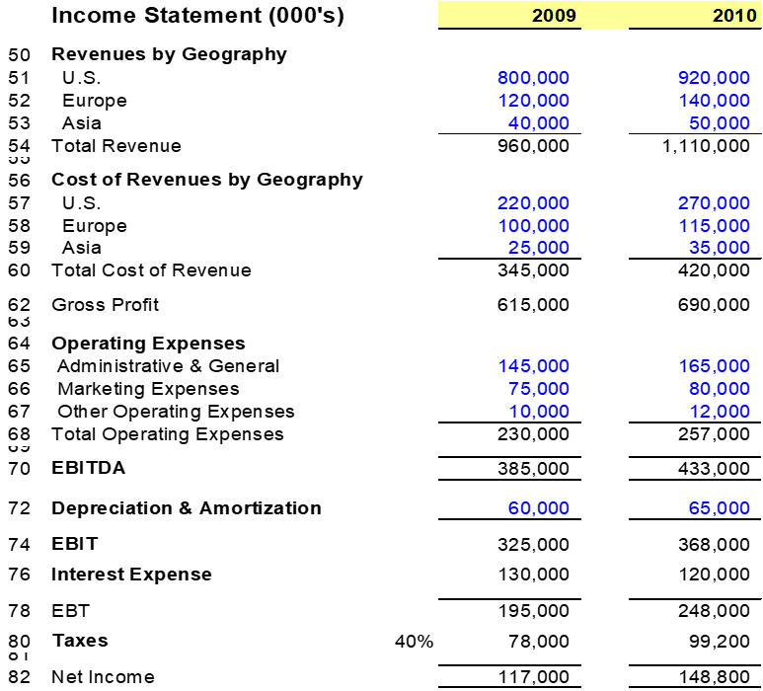
CORPORATE FINANCE
INCOME STATEMENT
Measurement of Profit and Loss over a Period of Time
Top Line to Bottom Line
Revenue (Sales) Less Expenses = Profit or Loss
CASE STUDY

Slide 6
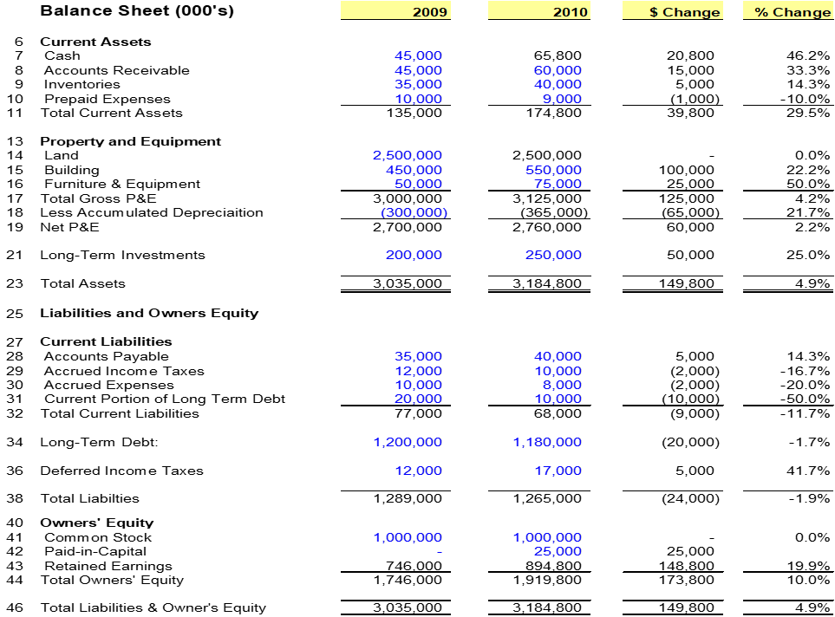
CORPORATE FINANCE
BALANCE SHEET STATEMENT
It shows us on a snap shot the Wealth of the Company
The statement is set-up in Order of Liquidity
CASE STUDY

Slide 7
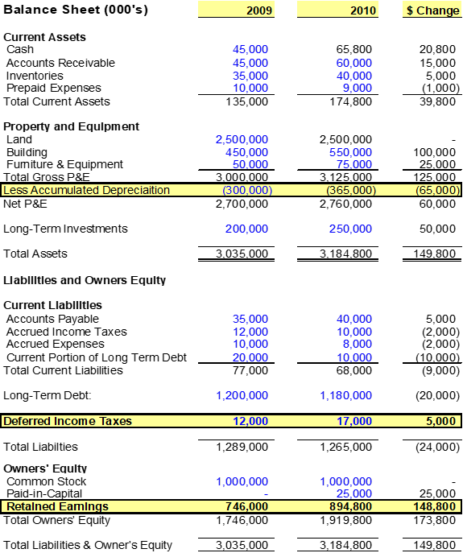
CORPORATE FINANCE
CASH FLOW STATEMENT
It shows the Company’s Cash Inflow and Outflow over a period of time
Differences between Income Statement and Cash Flow Statement
  Timing Differences (Working Capital Activities)
  Capital Expenses Vs Operating Expenses (Investment Activities)
  Financing Expenses not included in the Income Statement (Financing Activities)
Represents the changes from last Year’s Balance Sheet to this Year’s Balance Sheet
  Asset goes Up = Cash Negative
  Asset goes down = Cash Positive
  Liability goes up = Cash Positive
  Liability goes down = Cash Negative
  Owner’s Equity goes up = Cash Positive
  Owner’s Equity goes down = Cash Negative

Slide 8
Financial Analysis
CORPORATE FINANCE
Management Discussion and Analysis (MD&A)
Equity & Bond Research – Wall Street Analysts
The Financial Statements could be used by analysts to project the Company’s performance and valuation
For an effective performance of the Company, you need to ask the three following questions:
  How is the Company doing versus Last Year
  How is the Company doing versus its competitors / piers/ market
  How is the Company doing versus expectations

Slide 9
CORPORATE FINANCE
Financial Analysis
Management Discussion and Analysis (MD&A)
Equity & Bond Research – Wall Street Analysts
The Financial Statements could be used by analysts to project the Company’s performance and valuation
For an effective performance of the Company, you need to ask the three following questions:
  How is the Company doing versus Last Year
  How is the Company doing versus its competitors / piers/ market
  How is the Company doing versus expectations

Slide 10
Financial Ratio Analysis
CORPORATE FINANCE
Trend Analysis
Liquidity Ratio
  How well the Company manages Cash

Slide 11
Financial Ratio Analysis
CORPORATE FINANCE
Solvency Ratio
  How well the Company manages Debt
Activity and Operating Ratios
  It measures productivity and efficiency for running the business
Please note that there are a lot of ratios establish by specialization (i.e. for a Hotel company is Occupancy Rate or for a Cable company is revenue per subscriber)

Slide 12
Financial Ratio Analysis
CORPORATE FINANCE
Profitability Ratio
  How profitable is the company

Slide 13
CREDIT ANALYSIS
FRONT OFFICE
  Customer facing services
    Corporate Finance: Underwrite, Lending / Investing (Primary Market)
    Sales & Trade – (Secondary Market)
    Advisory and Research
MIDDLE OFFICE
  Risk Management
    Market Risk
    Credit Risk
    Operating Risk
    Liquidity Risk
BACK OFFICE
  Operations / IT (Technology) & Compliance
Commercial Banking
Credit Analysis (Corporate / Project Finance / Asset Finance)
Advisory (Syndications, Distribution, Sales & Trade)
Portfolio Management
Risk Management (Credit & Market)
Operations – Compliance & KYC
Loan Control/Treasury

Slide 14
CREDIT ANALYSIS AND PORTFOLIO MANAGEMENT
Investment Management
Leverage Loan/Bond Fund
Equity: $30,000,000
Debt (Loan):
$270,000,000 @ Libor Rate + 2.0% or ($5,400,000)
Portfolio of Investments
(Loans/Bonds)
$300 million
$300 million
Average LIBOR + 5%
$15,000,000
0.50% Management Fee $1,500,000
$2 m
$3 m
Gross Income $15,000,000
Less: Mgmt Fee $5,400,000
Loan $1,500,000
Net Income $8,100,000
$8,100,000 /$30,000,000 = 27.0% Net ¹
$4 m
$5 m
$5 m
$6 m
$4 m
$2 m
$4 m
Merchant Banking (CLOs, BDCs)
Credit Analysis (Bonds/Loans)
Portfolio Management
¹ Return before any assumed losses

Slide 15
CREDIT ANALYSIS AND PORTFOLIO MANAGEMENT
Investment Management
Leverage Loan/Bond Fund
Equity: $30,000,000
Debt (Loan):
$270,000,000 @ Libor Rate + 2.0% or ($5,400,000)
Portfolio of Investments
(Loans/Bonds)
$300 million
$300 million
Average LIBOR + 5.0%
$15,000,000
0.50% Management Fee $1,500,000
$2 m
Gross Income $15,000,000
Less: Mgmt Fee ($5,400,000)
Loan ($1,500,000)
Gross Income $8,100,000
Less Assume 3.0% Loss ($9,000,000)
Plus Recovery 70% $6,300,000
Net Income $5,400,000
$5,400,000 /$30,000,000 = 18.0% Net
$3 m
$4 m
$5 m
$5 m
$6 m
$4 m
$2 m
$4 m
CASE STUDY
Merchant Banking (CLOs, BDCs)
Credit Analysis (Bonds/Loans)
Portfolio Management

Slide 16
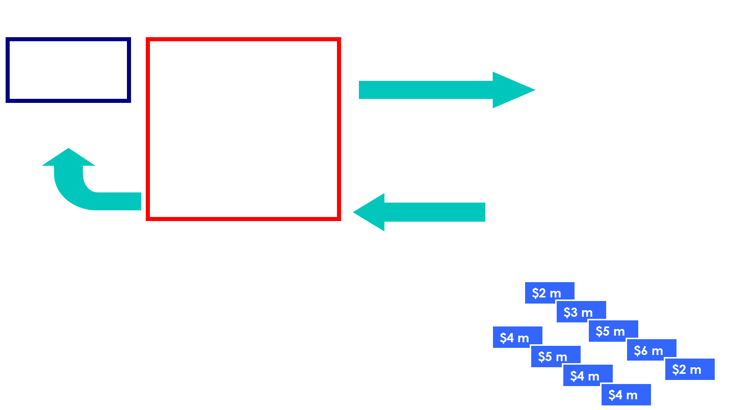
CREDIT ANALYSIS AND PORTFOLIO MANAGEMENT
CASE STUDY
Merchant Banking (CLOs, BDCs)
Credit Analysis (Bonds/Loans)
Portfolio Management

Slide 17
CREDIT ANALYSIS AND PORTFOLIO MANAGEMENT
CASE STUDY
Merchant Banking (CLOs, BDCs)
Credit Analysis (Bonds/Loans)
Portfolio Management

Slide 18
CREDIT ANALYSIS AND PORTFOLIO MANAGEMENT
Merchant Banking (CLOs, BDCs)
Credit Analysis (Bonds/Loans)
Portfolio Management
CASE STUDY

Slide 19
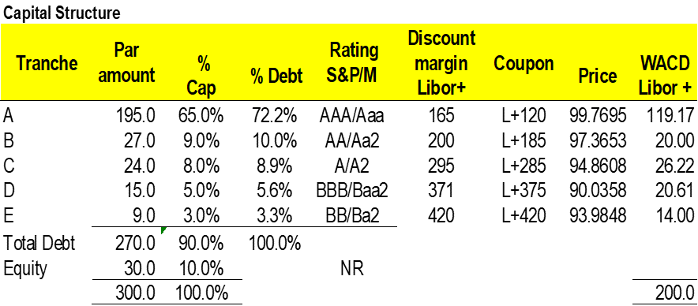

Slide 20

INVESTMENT ANALYSIS
Investment Banking
  Broker/Dealer
    Underwrite Initial Securities – Raising Capital
    Sales and Trade (Stock, Bonds and Derivatives)
  Advice
    Mergers & Acquisitions – Valuation
    Raising Capital
    Research / Recommendations

Slide 21
The Loan Syndication Process
Lead Arranger Bank
Administrative Agent
Issuer /Company
Bookrunner Bank #1
Syndication Agent
Bookrunner Bank #2
Documentation Agent
Bookrunner Bank #3
Documentation Agent
First Tier
Co-Mgr
Bank #1
Co-Mgr
Bank #2
Co-Mgr
Bank #3
Co-Mgr
Bank #4
Co-Mgr
Bank #5
Co-Mgr
Bank #6
Second Tier
Bank or Institution
Bank or Institution
Bank or Institution
Bank or Institution
Bank or Institution
Bank or Institution
Bank or Institution
Bank or Institution
Bank or Institution
Bank or Institution
“Retail” Level
Bank or Institution
Bank or Institution
Bank or Institution
Bank or Institution
Bank or Institution

Slide 22
The Loan Syndication Process
The issuer or Company solicits bids from Arrangers.
Arrangers will outline their syndication strategy and their view on the way the loan will price in market.
Issuer gives the mandate to one or more Arrangers (Co-Arrangers)
The arranger will prepare an information memo (IM) describing the terms of the transactions.
The IM typically will include:
        Executive Summary
        Investment Considerations
        Summary of Terms and Conditions (Term Sheet)
        Transaction Overview
        Company
        Management and Equity Sponsor Overview
        Industry Overview
        Financial Model
        Timing for commitments, closing, as well as fees on level of commitments
Bank meeting is scheduled at which potential lenders hear the management and the Investor group.
A deadline is given for the banks to send their commitment levels subject to final documentation.
Each Bank analyzes the deal’s credit and assess the pricing (RORA). Each Issuer is assigned an internal rating.
The Arranger collects all commitments – different amounts from each Bank.
Allocations are given and Legal Documentation is sent for their final review.
    If the Deal is Oversubscribed, the allocation of each bank will most likely be reduced
    If the Deal is Undersubscribed, depending on the FLEX language, the pricing could be Flexed up.
After Review of Legal Documentation by each lender and signatures are sent, the Deal closes and funds.

Slide 23
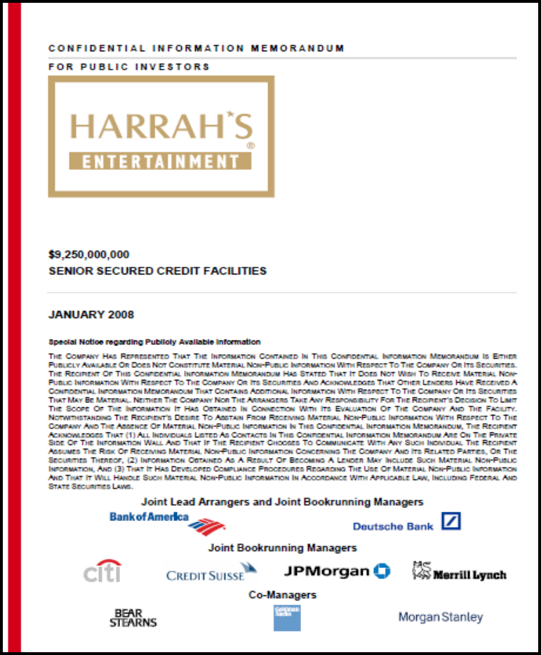
INVESTMENT BANKING

Slide 24
INVESTMENT ANALYSIS
STOCK REPORT EXAMPLE
Stock Analysis
  Stock Reports recommending BUY/HOLD/SELL

Slide 25
INVESTMENT ANALYSIS
Mergers & Acquisitions / IPO
  Corporate Valuation
  Sell / Buy Advice
  Financing Advice

Slide 26
Modes of Mergers & Acquisitions
INVESTMENT ANALYSIS
M&A
Amalgamation
Merger
De-Merger
Acquisition
Asset Purchase
Stock Purchase

Slide 27
Method #1
INVESTMENT ANALYSIS
CASE STUDY
Method #2

Slide 28
Method #3
INVESTMENT ANALYSIS
CASE STUDY

Slide 29
Method #4
INVESTMENT ANALYSIS
CASE STUDY

Slide 30
Method #5
INVESTMENT ANALYSIS
CASE STUDY

Slide 31
Method #5
INVESTMENT ANALYSIS
CASE STUDY

Slide 32
Summary valuation
INVESTMENT ANALYSIS
CASE STUDY

