Slide 1
Chapter 26
Hedge Funds
INVESTMENTS | BODIE, KANE, MARCUS
© McGraw-Hill Education. All rights reserved. Authorized only for instructor use in the classroom. No reproduction or further distribution permitted without the prior written consent of McGraw-Hill Education.

Slide 2
Chapter Overview
Hedge funds vs. mutual funds
Hedge fund strategies
Portable alpha and pure play
Performance measurement for hedge funds
Exposure to omitted risk factors
Fee structure in hedge funds
High water marks
Funds of funds

Slide 3
Hedge Funds versus Mutual Funds
Hedge Fund | Mutual Fund
Transparency: LLP with minimal disclosure of strategy and portfolio composition | Transparency: Regulations require public disclosure of strategy and portfolio composition
Investors: No more than 100 “sophisticated” and wealthy investors | Investors: Number is not limited
Investment Strategies: Very flexible, funds can act opportunistically; make a wide range of investments | Investment Strategies: Predictable, stable strategies, stated in prospectus
Often use shorting, leverage, options | Limited use of shorting, leverage, options
Liquidity: Have lock-up periods, require advance redemption notices | Liquidity: Investments can be moved more easily into and out of a fund
Compensation structure: Management fee of 1-2% of assets and an incentive fee of 20% of profits | Compensation structure: Fees are usually a fixed percentage of assets, typically 0.5% to 1.25%

Slide 4
Hedge Fund Strategies (1 of 2)
Directional
Bets that one sector or another will outperform other sectors
Nondirectional
Exploit temporary misalignments in relative valuation across sectors
Buy one type of security and sell another
Strives to be market neutral

Slide 5
Hedge Fund Strategies (2 of 2)
Statistical Arbitrage
Quantitative systems seek out many temporary and modest misalignments in prices
Trades in hundreds of securities a day with short holding periods
Pairs trading: Pair similar companies with highly correlated returns where one is priced more aggressively
Data mining: Uncovers systematic pricing patterns

Slide 6
Hedge Fund Styles (1 of 2)
Convertible arbitrage | Hedged investing in convertible securities, typically long convertible bonds and short stock.
Dedicated short bias | Net short position, usually in equities, as opposed to pure short exposure.
Emerging markets | Goal is to exploit market inefficiencies in emerging markets. Typically long-only because short-selling is not feasible in many of these markets.
Equity market neutral | Commonly uses long/short hedges. Typically controls for industry, sector, size, and other exposures, and establishes market-neutral positions designed to exploit some market inefficiency. Commonly involves leverage.
Event driven | Attempts to profit from situations such as mergers, acquisitions, restructuring, bankruptcy, or reorganization.
Fixed-income arbitrage | Attempts to profit from price anomalies in related interest rate securities. Includes interest rate swap arbitrage, U.S. versus non-U.S. government bond arbitrage, yield-curve arbitrage, and mortgage-backed arbitrage.

Slide 7
Hedge Fund Styles (2 of 2)
Global macro | Involves long and short positions in capital or derivative markets across the world. Portfolio positions reflect views on broad market conditions and major economic trends.
Long/short equity hedge | Equity- oriented positions on either side of the market (i.e., long or short), depending on outlook. Not meant to be market neutral. May establish a concentrated focus regionally (e.g., U.S. or Europe) or on a specific sector (e.g., tech or health care stocks). Derivatives may be used to hedge positions.
Managed futures | Uses financial, currency, or commodity futures. May make use of technical trading rules or a less structured judgmental approach.
Multistrategy | Opportunistic choice of strategy depending on outlook.
Funds of funds | Fund allocates its cash to several other hedge funds to be managed.

Slide 8
Portable Alpha (1 of 5)
Invest wherever you can find alpha
Hedge systematic risk of the investment → isolates its alpha
Establish exposure to desired market sectors by using passive products such as indexed mutual funds, ETFs, or index futures
Transfer alpha from the sector where you find it to the asset class in which you ultimately establish exposure

Slide 9
Portable Alpha (2 of 5)
Pure Play Example
$2.1 million portfolio
You believe alpha > 0 and that the market is about to fall, < 0
So you establish a pure play on the mispricing
The return on your portfolio is

Slide 10
Portable Alpha (3 of 5)
Pure Play Example (continued)
Suppose
Beta = 1.2
Alpha = 2%
Risk-free rate = 1%
S&P 500 (S₀) = 2,016
You want to capture the 2% alpha per month, but you don’t want the positive beta of the stock because of an expected market decline

Slide 11
Portable Alpha (4 of 5)
Pure Play Example (continued)
Hedge your exposure by selling S&P 500 futures contracts (S&P multiplier = $50)
After 1 month, the value of your portfolio will be:

Slide 12
Portable Alpha (5 of 5)
Pure Play Example (continued)
The dollar proceeds from your futures position
Hedged proceeds = $2,163,000 + $2,100,000 × e
Beta is zero and your monthly return is 3%

Slide 13
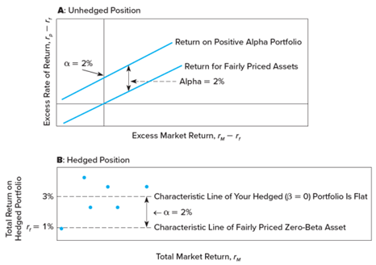
Figure 26.1 A Pure Play

Slide 14
Style Analysis for Hedge Funds
The equity market-neutral funds
Have low and insignificant betas
Dedicated short bias funds
Have substantial negative betas on the S&P index
Distressed-firm funds
Have significant exposure to credit conditions
Global macro funds
Show negative exposure to a stronger U.S. dollar

Slide 15
Performance Measurement for Hedge Funds
Standard index model estimates
Period: October 2011– September 2016
S&P 500 as a market benchmark
Below average performance results
Average alpha was slightly negative
Average Sharpe ratio was less than S&P 500
In earlier periods (particularly before 2010) hedge funds generally substantially outperformed passive indexes.
Regardless of this variability in outcome, several factors make hedge fund performance difficult to evaluate.

Slide 16
Liquidity and Hedge Fund Performance (1 of 2)
Hedge funds tend to hold more illiquid assets than other institutional investors
Aragon: Typical alpha may actually be an equilibrium liquidity premium rather than a sign of stock-picking ability
Hasanhodzic and Lo: Hedge fund returns have serial correlation → liquidity problems, which explains the upward bias in the Sharpe ratios

Slide 17
Liquidity and Hedge Fund Performance (2 of 2)
Sadka: Unexpected declines in market liquidity are an important determinant of average hedge fund returns
Santa effect: Hedge funds report average returns in December that are substantially greater than their average returns in other months
The December spike in returns is stronger for lower-liquidity funds, suggesting that illiquid assets are more generously valued in December

Slide 18
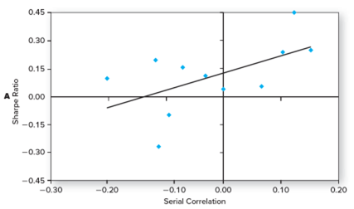
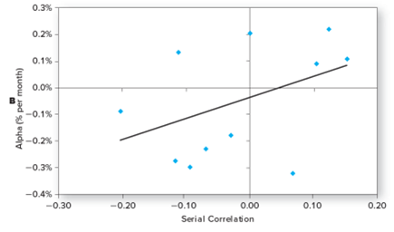
Hedge Funds with Higher Serial Correlation in Returns
Figure 26.2 Hedge funds with higher serial correlation in returns, an indicator of illiquid portfolio holdings, exhibit higher alphas (Panel A) and higher Sharpe ratios (Panel B)
Source: Plotted from data in Table 26.3

Slide 19
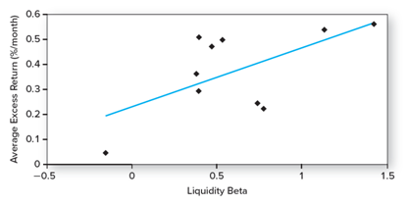
Figure 26.3 Average Hedge Fund Returns as a Function of Liquidity Risk
Source: Plotted from data in Ronnie Sadka, “Liquidity Risk and the Cross-Section of Hedge-Fund Returns,” Journal of Financial Economics 98 (October 2010), pp. 54-71.

Slide 20
Hedge Fund Performance and Survivorship Bias
Backfill bias:
Hedge funds report returns only if they choose to
They may do so only when prior performance is good
Survivorship bias:
Failed funds drop out of the database
Hedge fund attrition rates are more than double those for mutual funds

Slide 21
Hedge Fund Performance and Changing Factor Loadings
Hedge funds are opportunistic and may frequently change their risk profiles
If risk is not constant, alphas will be biased in the standard linear index model
Conclusions
Perfect market timing → nonlinear characteristic line and hence greater sensitivity to the bull market
Funds that write options have greater sensitivity to the market when it is falling than when it is rising
Nonlinear characteristic lines suggest many hedge funds are implicit option writers

Slide 22
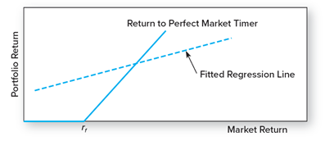
Characteristic Line of a Perfect Market Timer
Figure 26.4 Characteristic line of perfect market timer. The true characteristic line is kinked, with a shape like that of a call option. Fitting a straight line to the relationship will result in misestimated slope and intercept.

Slide 23
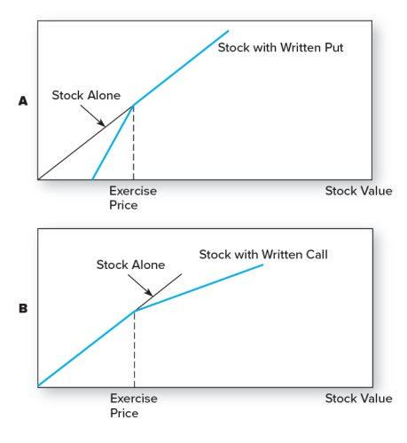
Characteristic Lines of Stock Portfolio with Written Options (1 of 2)

Slide 24
Characteristic Lines of Stock Portfolio with Written Options (2 of 2)
Figure 26.5 Characteristic lines of stock portfolio with written options Panel A, Buy stock, write put. Here, the fund writes fewer puts than the number of shares it holds. Panel B, Buy stock, write calls. Here, the fund writes fewer calls than the number of shares it holds.

Slide 25
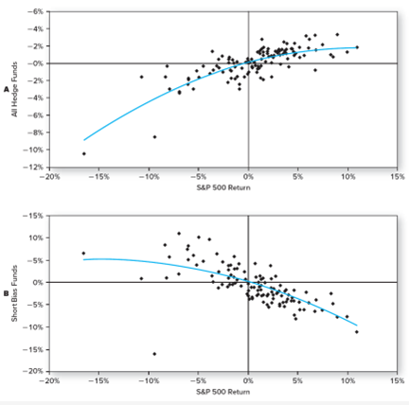
Monthly Return on Hedge Fund Indexes versus Return on the S&P 500 (1 of 2)

Slide 26
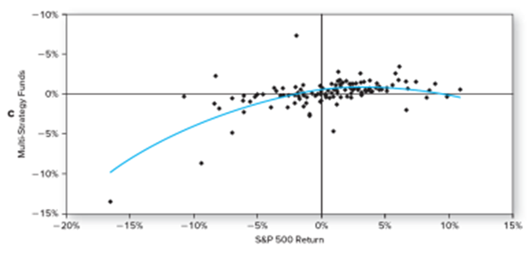
Monthly Return on Hedge Fund Indexes versus Return on the S&P 500 (2 of 2)
Figure 26.6 Monthly return on hedge fund indexes versus return on the S&P 500, 5 years ending September 2016. Panel A, composite hedge fund index. Panel B, short-bias funds. Panel C, multistrategy funds.
Source: Constructed from data downloaded from WWW.hedgeindex.com and finance.yahoo.com.

Slide 27
Tail Events and Hedge Fund Performance
Nassim Taleb:
Many hedge funds rack up fame through strategies that make money most of the time, but expose investors to rare but extreme losses
Examples:
The October 1987 crash
Long term capital management

Slide 28
Fee Structure in Hedge Funds
2% of assets plus an incentive fee equal to 20% of investment profits
Incentive fees are effectively call options on the portfolio with:
X = (Portfolio value) × (1 + Benchmark return)
The manager gets the fee if the portfolio value rises sufficiently, but loses nothing if it falls

Slide 29
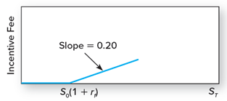
Incentive Fees as a Call Option
Figure 26.7 Incentive fees as a call option. The current value of the portfolio is denoted S₀ and its year-end value is S_{T.} The incentive fee is equivalent to 0.20 call options on the portfolio with exercise price S₀(1+r_{f}).

Slide 30
Fee Structure in Hedge Funds (1 of 3)
High water mark
The fee structure can give incentives to shut down a poorly performing fund
If a fund experiences losses, no incentive fee until it recovers its previous higher value
With deep losses, this may be too difficult so the fund closes

Slide 31
Fee Structure in Hedge Funds (2 of 3)
Funds of funds (feeder funds)
Hedge funds that invest in one or more other funds → diversify across hedge funds
Supposed to provide due diligence in screening funds for investment worthiness
Madoff scandal showed that these advantages are not always realized in practice

Slide 32
Fee Structure in Hedge Funds (3 of 3)
Funds of funds
Pay an incentive fee to each underlying fund that outperforms its benchmark even if the aggregate performance is poor
Diversification can hurt the investor in this case
Spread risk across several different funds, but operate with considerable leverage
If the various hedge funds in which these funds of funds invest have similar investment styles, diversification may be an illusion

Slide 33
Incentive Fees in Funds of Funds (1 of 2)
A fund of funds has $1 million invested in three hedge funds
Hurdle rate for the incentive fee is a zero return
Each fund charges an incentive fee of 20%
The aggregate portfolio of the fund of funds is -5%
Still pays incentive fees of $.12 for every $3 invested

Slide 34
Incentive Fees in Funds of Funds (2 of 2)
 | Fund 1 | Fund 2 | Fund 3 | Fund of Funds
Start of year (millions) | $1.00 | $1.00 | $1.00 | $3.00
End of year (millions) | $1.20 | $1.40 | $0.25 | $2.85
Gross rate of return | 20% | 40% | -75% | -5%
Incentive fee (millions) | $0.04 | $0.08 | $0.00 | $0.12
End of year, net of fee | $1.16 | $1.32 | $0.25 | $2.73
Net rate of return | 16% | 32% | -75% | -9%

Slide 35
End of Presentation

