Slide 1
Chapter 24
Portfolio Performance Evaluation
INVESTMENTS | BODIE, KANE, MARCUS
© McGraw-Hill Education. All rights reserved. Authorized only for instructor use in the classroom. No reproduction or further distribution permitted without the prior written consent of McGraw-Hill Education.

Slide 2
Introduction
If markets are efficient, investors must be able to measure asset management performance
Two common ways to measure average portfolio return:
Time-weighted returns
Dollar-weighted returns
Returns must be adjusted for risk

Slide 3
Dollar- and Time-Weighted Returns (1 of 2)
Time-weighted returns
The geometric average is a time-weighted average
Each period’s return has equal weight

Slide 4
Dollar- and Time-Weighted Returns (2 of 2)
Dollar-weighted returns
Internal rate of return considering the cash flow from or to investment
Returns are weighted by the amount invested in each period:

Slide 5
Example of Multiperiod Returns
Time | Outlay
0 | $50 to purchase first share
1 | $53 to purchase second share a year later
 | Proceeds
1 | $2 dividend from initially purchased share
2 | $4 dividend from the 2 shares held in the second year, plus
 | $108 received from selling both shares at $54 each

Slide 6
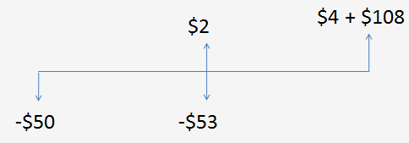
Dollar-Weighted Return (1 of 2)
Dollar-weighted Return (IRR):

Slide 7
Dollar-Weighted Return (2 of 2)
Households should maintain a spreadsheet of time-dated cash flows (in and out) to determine the effective rate of return for any given period
Examples include:
IRA, 401(k), 529

Slide 8
Time-Weighted Return
The dollar-weighted average is less than the time-weighted average in this example because more money is invested in year two, when the return was lower

Slide 9
Adjusting Returns for Risk
The simplest way to adjust for risk is to compare the portfolio’s return with the returns of a comparison universe
The comparison universe is called the benchmark
It is composed of a group of funds or portfolios with similar risk characteristics

Slide 10
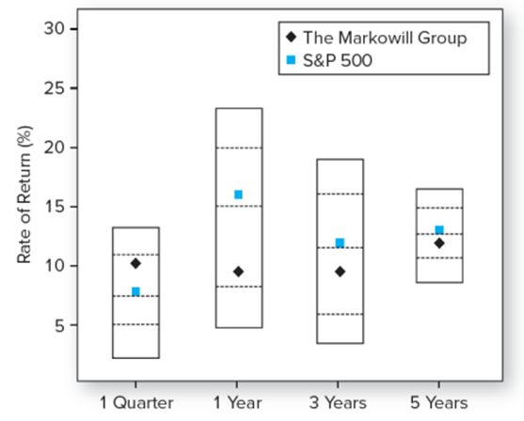
Universe Comparison
Figure 24.1 Universe comparison, periods ending December 31, 2022

Slide 11
Risk Adjusted Performance: Sharpe

Slide 12
Risk Adjusted Performance: Treynor (1 of 3)

Slide 13
Risk Adjusted Performance: Treynor (2 of 3)

Slide 14
Risk Adjusted Performance: Treynor (3 of 3)
The information ratio divides the alpha of the portfolio by the nonsystematic risk
Nonsystematic risk could, in theory, be eliminated by diversification

Slide 15
M² Measure
Developed by Modigliani and Modigliani
Create an adjusted portfolio P* that combines P with Treasury Bills
Set P* to have the same standard deviation as the market index
Now compare market and P* returns:

Slide 16
M² Measure: Example

Slide 17
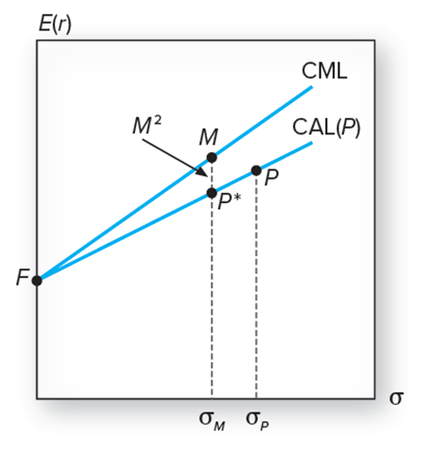
Figure 24.2 M² of Portfolio P

Slide 18
Which Measure is Appropriate? (1 of 2)
It depends on investment assumptions
If P is not diversified, then use the Sharpe measure as it measures reward to risk
If the P is diversified, nonsystematic risk is negligible and the appropriate metric is Treynor’s, measuring excess return to beta

Slide 19
Which Measure is Appropriate? (2 of 2)

Slide 20
Table 24.1 Portfolio Performance
Is Q better than P?

Slide 21
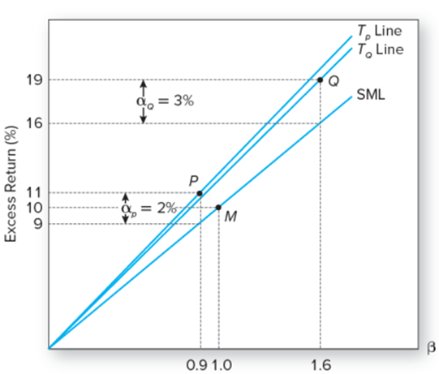
Figure 24.3 Treynor’s Measure

Slide 22
Table 24.3 Performance Statistics
 | Portfolio P | Portfolio Q | Portfolio M
Sharpe ratio | 0.43 | 0.49 | 0.19
M² | 2.16 | 2.66 | 0.00
SCL regression statistics
Alpha | 1.63 | 5.26 | 0.00
Beta | 0.70 | 1.40 | 1.00
Treynor | 3.97 | 5.38 | 1.64
T² | 2.34 | 3.74 | 0.00
σ(e) | 2.02 | 9.81 | 0.00
Information ratio | 0.81 | 0.54 | 0.00
R-square | 0.91 | 0.64 | 1.00

Slide 23
Interpretation of Performance Statistics
If P or Q represents the entire investment, Q is better because of its higher Sharpe measure and better M²
If P and Q are competing for a role as one of a number of subportfolios, Q also dominates because its Treynor measure is higher
If we seek an active portfolio to mix with an index portfolio, P is better due to its higher information ratio

Slide 24
The Role of Alpha in Performance Measures
Table 24.3 Performance Statistics

Slide 25
Performance Measurement for Hedge Funds
When the hedge fund is optimally combined with the baseline portfolio, the improvement in the Sharpe measure will be determined by its information ratio:

Slide 26
Performance Measurement with Changing Portfolio Composition
We need a very long observation period to measure performance with any precision, even if the return distribution is stable with a constant mean and variance
What if the mean and variance are not constant? We need to keep track of portfolio changes

Slide 27
Style Analysis
Introduced by William Sharpe
Regress fund returns on indexes representing a range of asset classes
The regression coefficient on each index measures the fund’s implicit allocation to that “style”
R-square measures return variability due to style or asset allocation
The remainder is due either to security selection or to market timing

Slide 28
Table 24.4 Style Analysis for Fidelity’s Magellan Fund
Style Portfolio | Regression Coefficient
T- bill | 0
Small cap | 0
Medium cap | 35
Large cap | 61
High P/E (growth) | 5
Medium P/E | 0
Low P/E (value) | 0
Total | 100
R-square | 97.5
Source: Authors‘ calculations. Return data for Magellan obtained from finance. yahoo.com/funds and return data for style portfolios obtained from the Web page of Professor Kenneth French: mba.tuck.dartmouth.edu/pages/faculty/Ken.french/data _library.html.

Slide 29
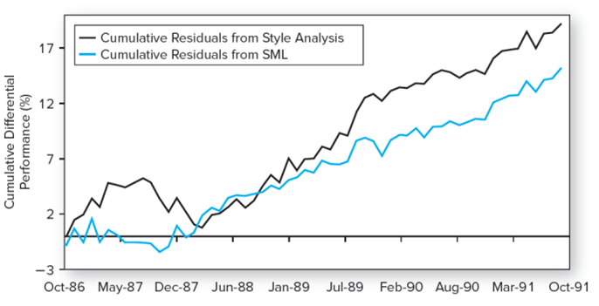
Fidelity Magellan Fund Cumulative Return Difference
Figure 24.4 Fidelity Magellan Fund cumulative return difference: Fund versus style benchmark and fund versus SML benchmark
Source: Authors' calculations.

Slide 30
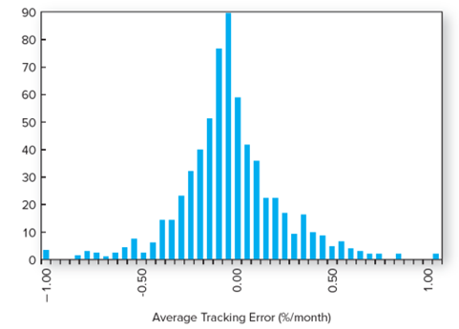
Figure 24.5 Average Tracking Error for 636 Mutual Funds, 1985-1989
Source: William F. Sharpe, “Asset Allocation: Management Style and Performance Evaluation,“ Journal of Portfolio Management, Winter 1992, pp. 7-19.

Slide 31
Performance Manipulation and the MRAR
Assumption: Rates of return are independent and drawn from same distribution
Managers may employ strategies to improve performance at the loss of investors
Ingersoll, Spiegel, Goetzmann, and Welch study leads to MPPM
Using leverage to increase potential returns
MRAR fulfills requirements of the MPPM

Slide 32
Morningstar Risk Adjusted Return

Slide 33
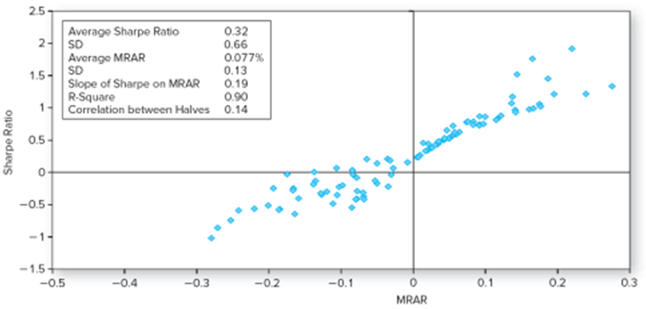
MRAR Scores with and without Manipulation (1 of 2)
A: No Manipulation: Sharpe versus MRAR

Slide 34
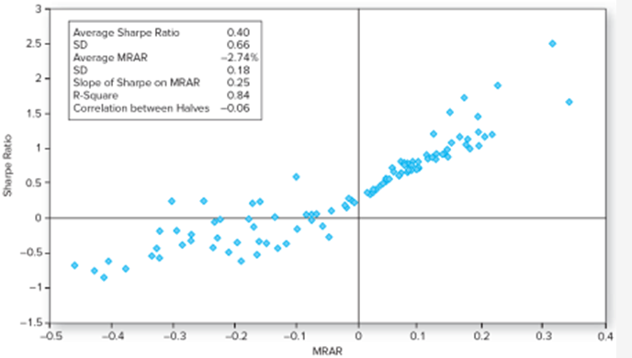
MRAR Scores with and without Manipulation (2 of 2)
B: Manipulation: Sharpe versus MRAR

Slide 35
Market Timing
In its pure form, market timing involves shifting funds between a market-index portfolio and a safe asset
Treynor and Mazuy:
Henriksson and Merton:

Slide 36
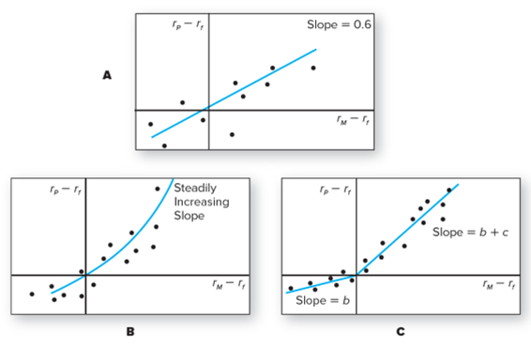
Market Timing — Characteristic Lines
Figure 24.8 Characteristic lines. Panel A: No market timing, beta is constant.
Panel B: Market timing, beta increases with expected market excess return.
Panel C: Market timing with only two values of beta.

Slide 37
Rate of Return of a Perfect Market Timer (1 of 2)
Table 24.5 Performance of bills, equities, and perfect (annual) market timers. Initial investment = $1.
Strategy | Bills | Equities | Perfect Timer
Terminal value | $20 | $3,997 | $534,649
Arithmetic average | 3.47% | 11.53% | 16.54%
Standard deviation | 3.15% | 20.27% | 13.56%
Geometric average | 3.42% | 9.77% | 15.97%
Maximum | 14.71% | 57.35% | 57.35%
Minimum† | -0.02% | -44.04% | 0.00%
Skew | 1.00 | -0.40 | 0.74
Kurtosis | 0.93 | 0.03 | -0.12
LPSD | 0.00% | 13.28% | 0.00%
†A negative rate on "bills“ was observed in 1940. The Treasury security used in the data series in these early years was actually not a T-bill but a T-bond with 30 days to maturity.

Slide 38
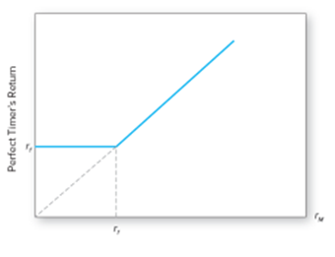
Rate of Return of a Perfect Market Timer (2 of 2)
Figure 24.9 Rate of return of a perfect market timer as a function of the rate of return on the market index.

Slide 39
Valuing Market Timing as a Call Option

Slide 40
Performance Attribution Procedures (1 of 3)
A common attribution system decomposes performance into three components:
Allocation choices across broad asset classes
Industry or sector choice within each market
Security choice within each sector

Slide 41
Performance Attribution Procedures (2 of 3)
Set up a ‘Benchmark’ or ‘Bogey’ portfolio:
Select a benchmark index portfolio for each asset class
Choose weights based on market expectations
Choose a portfolio of securities within each class by security analysis

Slide 42
Performance Attribution Procedures (3 of 3)
Calculate the return on the ‘Bogey’ and on the managed portfolio
Explain the difference in return based on component weights or selection
Summarize the performance differences into appropriate categories

Slide 43
Formulas for Attribution
Where B is the bogey portfolio and p is the managed portfolio

Slide 44
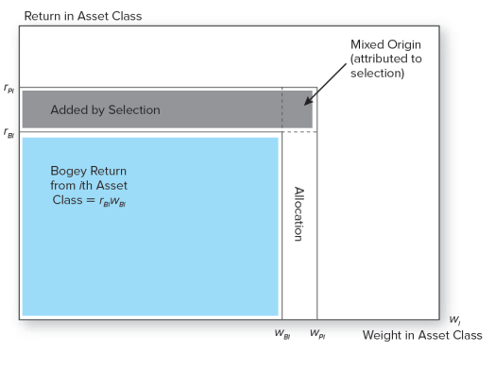
Performance Attribution of ith Asset Class
Figure 24.10 Performance attribution of ith asset class. Enclosed area indicates total rate of return.

Slide 45
Performance Attribution
Superior performance is achieved by:
Overweighting assets in markets that perform well
Underweighting assets in poorly performing markets

Slide 46
Performance Attribution: Example (1 of 3)
Table 24.6 Performance of the managed portfolio
Component | Bogey Performance and Excess Return: Benchmark Weight | Bogey Performance and Excess Return: Return of Index during Month (%)
Equity (S&P 500) | 0.60 | 5.81
Bonds (Barclays Aggregate Index) | 0.30 | 1.45
Cash (money market) | 0.10 | 0.48
Bogey= (0.60 × 5.81) + (0.30 × 1.45) + (0.10 × 0.48) = 3.97%
Return of managed portfolio | 5.37%
-Return of bogey portfolio | 3.97%
Excess return of managed portfolio | 1.37%

Slide 47
Performance Attribution: Example (2 of 3)
A. Contribution of Asset Allocation to Performance
 | (1) | (2) | (3) | (4) | (5) = (3)×(4)
Market | Actual Weight in Market | Benchmark Weight in Market | Active or Excess Weight | Index Return (%) | Contribution to Performance (%)
Equity | 0.70 | 0.60 | 0.10 | 5.81 | 0.5810
Fixed-income | 0.07 | 0.30 | -0.23 | 1.45 | -0.3335
Cash | 0.23 | 0.10 | 0.13 | 0.48 | 0.0624
Contribution of asset allocation |  |  |  |  | 0.3099

Slide 48
Performance Attribution: Example (3 of 3)
B. Contribution of Selection to Total Performance
 | (1) | (2) | (3) | (4) | (5) = (3)×(4)
Market | Portfolio Performance (%) | Index Performance (%) | Excess Performance (%) | Portfolio Weight | Contribution (%)
Equity | 7.28 | 5.81 | 1.47 | 0.70 | 1.03
Fixed-income | 1.89 | 1.45 | 0.44 | 0.07 | 0.03
Contribution of selection within markets |  |  |  |  | 1.06

Slide 49
Table 24.7 Performance Attribution Summary (1 of 2)
 |  | Contribution (basis points)
1. Asset allocation |  | 31
2. Selection
a. Equity excess return (basis points)
i. Sector allocation | 129
ii. Security selection | 18
 | 147 × 0.70 (portfolio weight)= | 102.9
b. Fixed-income excess return | 44 × 0.07 (portfolio weight)= | 3.1
Total excess return of portfolio |  | 137.0

Slide 50
Performance Attribution Summary (2 of 2)
Good performance (a positive contribution) derives from overweighting high-performing sectors
Good performance also derives from underweighting poorly performing sectors

Slide 51
End of Presentation

