Slide 1
Chapter 19
Financial Statement Analysis
INVESTMENTS | BODIE, KANE, MARCUS
© McGraw-Hill Education. All rights reserved. Authorized only for instructor use in the classroom. No reproduction or further distribution permitted without the prior written consent of McGraw-Hill Education.

Slide 2
Financial Statement Analysis
Financial statement analysis can be used to discover mispriced securities
Financial accounting data are widely available
Accounting earnings and economic earnings are not always the same thing

Slide 3
Financial Statements
Income Statement:
  Profitability over time
Balance Sheet:
  Financial condition at a point in time
Statement of Cash Flows:
  Tracks the cash implications of transactions

Slide 4
Accounting Versus Economic Earnings
Economic earnings
  Sustainable cash flow that can be paid to stockholders without impairing productive capacity of the firm
Accounting earnings
  Affected by conventions regarding the valuation of assets

Slide 5
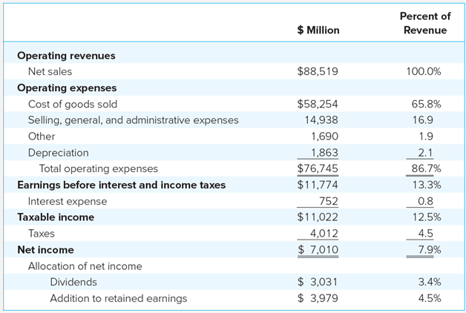
Consolidated Statement of Income for Home Depot, 2016
Table 19.1 Consolidated statement of Income for Home Depot
Note: Sums subject to rounding error.
Source: Home Depot Annual Report, year ending January 2016.

Slide 6
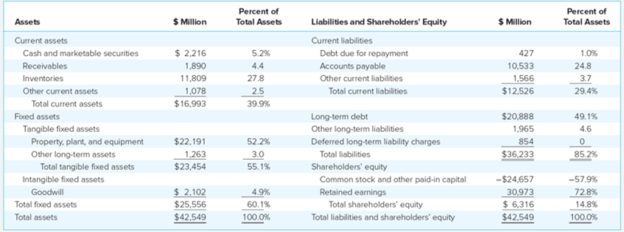
Consolidated Balance Sheet for Home Depot, 2016
Table 19.2 Consolidated Balance sheet for Home Depot
Note: Column sums subject to rounding error.
Source: Home Depot Annual Report, year ending January 2016.

Slide 7
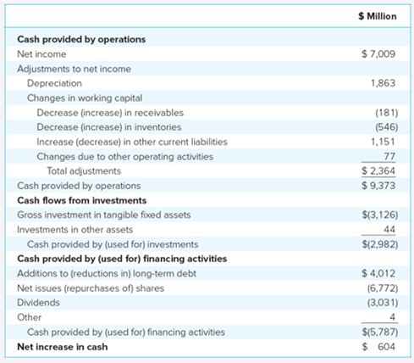
Statement of Cash Flows for Home Depot, 2016
Table 19.3 Statement of Cash Flows for Home Depot
Source: Home Depot Annual Report, year ending January 2016.

Slide 8
Measuring Firm Performance (1 of 4)
Manager responsibilities:
  Investment decisions
  Financing decisions
Ratios show efficiency/profitability of these decisions:
Notes:
ROA: income earned per dollar deployed
ROC: income earned per dollar invested (long term)
ROE: net income realized by shareholders per dollar invested

Slide 9
Measuring Firm Performance (2 of 4)
ROE is a key determinant of earnings growth
Past profitability does not guarantee future profitability
Security values are based on future profits
Expectations of future dividends determine today’s stock value

Slide 10
Measuring Firm Performance (3 of 4)
Figure 19.1 Important financial questions and some ratios that help answer them
What is the probability of investments in real assets?
Return on assets
Return on equity
Return on capital
Economic value added
  Are assets used efficiently?
    Turnover ratios
  Profitability of sales?
    Profit margins

Slide 11
Measuring Firm Performance (4 of 4)
      Are financing decisions prudent?
      Is leverage excessive?
  Debt ratios
  Coverage ratios
      Is there sufficient liquidity?
  Current, quick, cash ratios
  Net working capital

Slide 12
Financial Leverage and ROE (1 of 2)
Leverage allows ROE to differ from ROA
Leverage makes ROE more volatile
  t = tax rate
  r = interest rate

Slide 13
Financial Leverage and ROE (2 of 2)
No debt or ROA = r → ROE = ROA(1 - t)
If ROA > r, the firm earns more than it pays out to creditors and ROE increases
If ROA < r, ROE will decline as a function of the debt-to-equity ratio

Slide 14
Impact of Financial Leverage on ROE
Table19.5 Impact of financial leverage on ROE
Scenario | EBIT ($ millions) | Nodett: Net profits ($ millions) | Nodett: ROE (%) | Somdett: Net profits *($ millions) | Somdett: ROE† (%)
Bad year | 5 | 3 | 3 | 1.08 | 1.8
Normal year | 10 | 6 | 6 | 4.08 | 6.8
Good year | 5 | 9 | 9 | 7.08 | 11.8
*Somdett’s after-tax profits are given by .6(EBIT – $3.2 million).
*ROE =net profit/equity. Somdett’s equity is only $60 million

Slide 15
Economic Value Added
EVA is the difference between return on assets (ROA) and the opportunity cost of capital (k), multiplied by the capital invested in the firma
EVA is also called residual income
If ROA > k, value is added to the firm

Slide 16
Example: Home Depot
Home Depot:
  Cost of capital = 7.7%
  ROC = 17.50%
  Capital base = $27.15 billion
Home Depot’s EVA =
(0.1750-0.077) × $27.15 billion = $2.66 billion

Slide 17
Decomposition of ROE DuPont Method
Tax Burden
Interest Burden
Margin
Turnover
Leverage

Slide 18
Decomposition of ROE (1 of 2)
ROA = EBIT/Sales × Sales/Assets
= margin × turnover
Margin and turnover are unaffected by leverage
ROA reflects soundness of firm’s operations, regardless of financing

Slide 19
Decomposition of ROE (2 of 2)
ROE = Tax burden × ROA × Compound leverage factor
Tax burden is not affected by leverage
Compound leverage factor = Interest burden × Leverage

Slide 20
Ratio Decomposition Analysis for Nodett and Somdett
 | ROE | (1) Net Profits/ Pretax Profits | (2) Pretax Profits/EBIT | (3) EBIT Sales (Margin) | (4) Sales/Assets (Turnover) | (5) Assets/Equity | (6) Compound Leverage Factor (2) × (5)
Bad year
Nodett | 0.030 | 0.6 | 1.000 | 0.0625 | 0.800 | 1.000 | 1.000
Somdett | 0.018 | 0.6 | 0.360 | 0.0625 | 0.800 | 1.667 | 0.600
Normal year
Nodett | 0.060 | 0.6 | 1.000 | 0.1000 | 1.000 | 1.000 | 1.000
Somdett | 0.068 | 0.6 | 0.680 | 0.1000 | 1.000 | 1.667 | 1.134
Good year
Nodett | 0.090 | 0.6 | 1.000 | 0.1250 | 1.200 | 1.000 | 1.000
Somdett | 0.118 | 0.6 | 0.787 | 0.1250 | 1.200 | 1.667 | 1.311
Table 19.7 Ratio decomposition analysis for Nodett and Somdett

Slide 21
Choosing a Benchmark
Compare the company’s ratios across time
Compare ratios of firms in the same industry
Cross-industry comparisons can be misleading

Slide 22
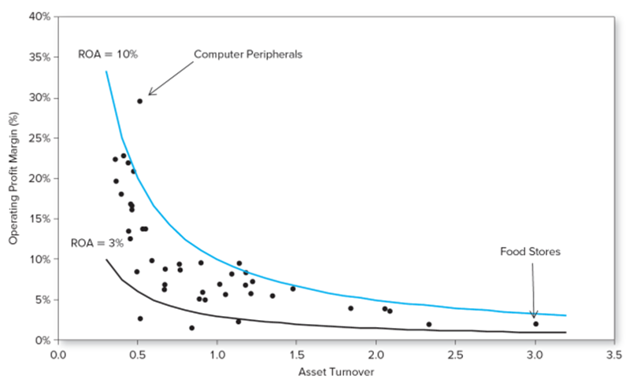
Differences between Profit Margin and Asset Turnover across Industries
Figure 19.2 Operating profit margin, and assets turnover of 45 industries, 2015
Source: U.S. Census Bureau, Quarterly Report for Manufacturing and Trade Corporations, Second Quarter 2015 (www.census.gov/econ/qfr). This is an updated version of a figure that first appeared in Thomas I. Selling and Clyde P. Stickney, “The Effects of Business Environments and Strategy on a Firm’s Rate of Return on Assets,” Financial Analysts Journal, January-February 1989, pp.43-52

Slide 23
Summary of Key Financial Ratios (1 of 5)

Slide 24
Summary of Key Financial Ratios (2 of 5)

Slide 25
Summary of Key Financial Ratios (3 of 5)

Slide 26
Summary of Key Financial Ratios (4 of 5)

Slide 27
Summary of Key Financial Ratios (5 of 5)

Slide 28
Comparability Problems
Accounting Differences
  Inventory Valuation
  Depreciation
Inflation and Interest Expense
Fair Value Accounting
Quality of Earnings
International Accounting Conventions

Slide 29
International Accounting Differences
Reserves — many other countries allow more flexibility in use of reserves
Depreciation — US allows separate tax and reporting presentations
Intangibles — treatment varies widely

Slide 30
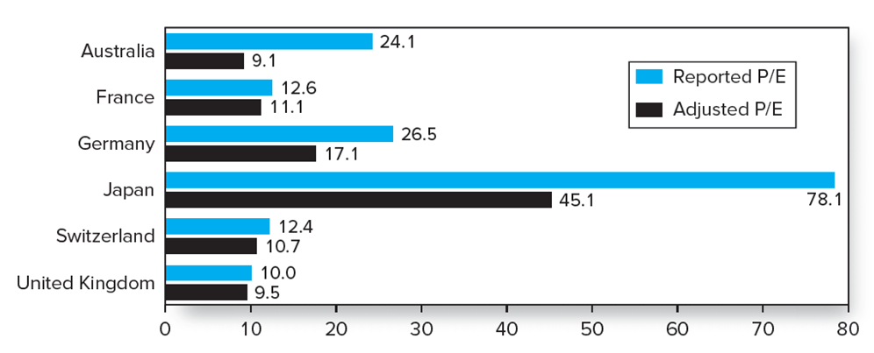
Figure 19.4 Adjusted Versus Reported Price-Earnings Ratios
Source: “Figure J: Adjusted versus Reported Price/Earning Ratio” from Lawrence S. Speidell and Vinod Bavishi, “GAAP Arbitrage: Valuation Opportunities in International Accounting Standards,” Financial Analysts Journal, November-December 1992, pp. 58-66. Copyright 1992, CFA Institute. Reproduced from the Financial Analysts Journal with permission from the CFA Institute.

Slide 31
The Graham Technique
Rules for stock selection:
  Purchase common stocks at less than their working-capital value
  Give no weight to plant or other fixed assets
  Deduct all liabilities in full from assets

Slide 32
End of Presentation

