Slide 1
Chapter 18
Equity Valuation Models
INVESTMENTS | BODIE, KANE, MARCUS
© McGraw-Hill Education. All rights reserved. Authorized only for instructor use in the classroom. No reproduction or further distribution permitted without the prior written consent of McGraw-Hill Education.

Slide 2
Valuation: Fundamental Analysis
Fundamental analysis models base value on current and future profitability
It identifies mispriced stocks relative to some measure of “true” value derived from financial data

Slide 3
Models of Equity Valuation
Balance Sheet Models
Dividend Discount Models (DDM)
Price/Earnings Ratios
Free Cash Flow Models

Slide 4
Valuation by Comparables
Compare valuation ratios of firm to industry averages
Ratios like price/sales are useful for valuing start-ups that have yet to generate positive earnings

Slide 5
Limitations of Book Value
Book values are based on historical cost, not actual market values
It is possible, but uncommon, for market value to be less than book value

Slide 6
Liquidation Value and Tobin’s Q
Liquidation Value:
“Floor” or minimum value is the liquidation value per share
Replacement Cost:
Tobin’s q: ratio of market price to replacement cost
Tobin’s q trends towards 1
Notes:
Liquidation Value: Amount of Money that could be realized by breaking up the firm, selling its assets, repaying its debt, and distributing the remainder to the shareholders
Replacement Cost: Reproduction cost of Assets minus Liabilities

Slide 7
Financial Highlights of Microsoft (1 of 2)
Price per share | $ 49.71
Common shares outstanding (billion) | 7.86
Market capitalization ($ billion) | $ 391
Latest 12 months
Sales ($ billion) | $ 86.90
EBITDA ($ billion) | $ 29.20
Net income ($ billion) | $ 10.50
Earnings per share | $ 1.33

Slide 8
Financial Highlights of Microsoft (2 of 2)
Valuation | Microsoft | Industry Average
Price/Earnings | 17.2 | 29.1
Price/Book | 5.3 | 8.7
Price/Sales | 4.5
PEG | 2.3 | 1.5
Profitability
ROE (%) | 12.7 | 16.1
ROA (%) | 8.2
Operating profit margin (%) | 27.0 | 23.5
Net profit margin (%) | 12.1 | 13.8
Source: Complied from data available at finance.yahoo.com, June 14, 2016.

Slide 9
Intrinsic Value vs. Market Price
The return on a stock is composed of dividends and capital gains or losses
The expected HPR may be more or less than the required rate of return
Variation based on the stock’s risk

Slide 10
Required Return
CAPM gives the required return, k:
If the stock is priced correctly, k = expected return
k is the market capitalization rate

Slide 11
Intrinsic Value and Market Price
The intrinsic value (IV) is the “true” value, according to a model
The market value (MV) is the consensus value of all market participants
Trading Signal:
IV > MV Buy
IV < MV Sell or Short Sell
IV = MV Hold or Fairly Priced

Slide 12
Dividend Discount Models (DDM)
V₀ = current value
D_{t} = dividend at time t
k = required rate of return
DDM says V₀ = the present value of all expected future dividends into perpetuity

Slide 13
Constant Growth DDM (1 of 2)
V₀ = current value
D_{t} = dividend at time t
k = appropriate risk-adjusted interest rate
g = dividend growth rate

Slide 14
Constant Growth DDM (2 of 2)
A stock just paid an annual dividend of $3/share
Dividend is expected to grow at 8% indefinitely
Market capitalization rate is 14%

Slide 15
Preferred Stock and the DDM
No growth case (fixed dividends)
Value a preferred stock paying a fixed dividend of $2 per share when the discount rate is 8%:

Slide 16
DDM Implications
The constant-growth rate DDM implies that a stock’s value will be greater:
The larger its expected dividend per share
The lower the market capitalization rate, k
The higher the expected growth rate of dividends
The stock price is expected to grow at the same rate as dividends

Slide 17
Estimating Dividend Growth Rates
g = growth rate in dividends
ROE = Return on Equity
b = plowback or retention rate (1 - dividend payout rate)

Slide 18
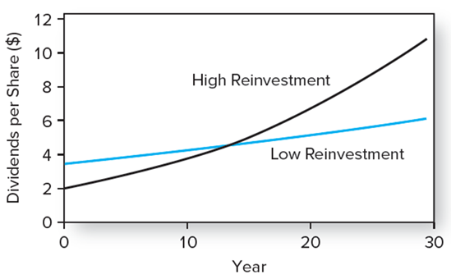
Dividend Growth for Two Earnings Reinvestment Policies
Figure 18.1 Dividend growth for two earnings reinvestment policies

Slide 19
Present Value of Growth Opportunities (1 of 2)
The value of the firm equals:
The value of the assets already in place
No-growth value of the firm
Plus the NPV of its future investments
Present value of growth opportunities or PVGO

Slide 20
Present Value of Growth Opportunities (2 of 2)
Price = No-growth value per share + PVGO

Slide 21
Growth Opportunities (1 of 2)
Firm reinvests 60% of its earnings
Projects generate ROE of 10%
Capitalization rate is 15%
Expected year-end dividend is $2/share
Earnings of $5/share
g = ROE × b = 10% × .6 = 6%

Slide 22
Growth Opportunities (2 of 2)
PVGO = Price per share - no-growth value per share

Slide 23
Life Cycles and Multistage Growth Models (1 of 3)
Firms typically pass through life cycles
Early Years | Later Years
Ample opportunities for profitable reinvestment in the company | Attractive opportunities for reinvestment may become harder to find.
Competitors may have not entered the market. | Competitors enter the market
Payout ratios are low | Payout ratios are high
Growth is correspondingly rapid. | Dividend growth slows because the company has fewer investment opportunities.

Slide 24
Life Cycles and Multistage Growth Models (2 of 3)
Table 18.2 Financial ratios in two industries
 | Ticker | Return on capital (%) | Payout Ratio (%) | Growth Rate 2017-2020
Computer software
Adobe systems | ADBE | 14.5% | 0.0% | 20.4%
Citrix | CTXS | 20.0 | 0.0 | 7.2
Cognizant | CTSH | 18.5 | 0.0 | 22.2
Computer Associates | CA | 13.0 | 38.0 | 12.4
Intuit | INTU | 30.5 | 24.0 | 14.3
Microsoft | MSFT | 23.0 | 52.0 | 11.5
Oracle | ORCL | 15.0 | 20.0 | 8.4
Red Hat | RHT | 14.5 | 0.0 | 15.3
Symantec | SYMC | 13.5 | 25.0 | 9.0
SAP | SAP | 13.5 | 36.0 | 7.3
Median |  | 14.8% | 22.0% | 12.0%

Slide 25
Life Cycles and Multistage Growth Models (3 of 3)
 | Ticker | Return on capital (%) | Payout Ratio (%) | Growth Rate 2017-2020
Electric utilities (East Coast)
Dominion Resources | D | 8.5% | 73.0% | 10.1%
Consolidated Edison | ED | 5.5 | 69.0 | 1.6
Duke Energy | DUK | 5.0 | 75.0 | 3.8
Eversource | ES | 6.0 | 58.0 | 6.0
FirstEnergy | FE | 5.5 | 48.0 | 4.5
Nextera Energy | NEE | 7.5 | 69.0 | 6.3
Public service Enterprise | PEG | 7.0 | 56.0 | 6.3
South Carolina E & G | SCG | 6.0 | 60.0 | 4.7
Southern Company | SO | 6.5 | 75.0 | 4.6
Tampa Electric | TE | 6.5 | 66.0 | 3.9
Median |  | 6.3% | 67.5% | 4.6%
Source: Value Line investment Survey, April 2016, Reprinted with permission of Value Line investment survey.
© 2016 Value Line Publishing. Inc. All rights reserved.

Slide 26
GE Example (1 of 3)
Expected dividends for GE:
2017 | $1.04 | 2019 | $1.41
2018 | $1.22 | 2020 | $1.60
Dividend payout ratio = 53%
ROE = 19.5%

Slide 27
GE Example (2 of 3)
GE’s β = 1.10
r_{f} = 2.5%
Market risk premium = 8%, then k is:
Therefore:

Slide 28
GE Example (3 of 3)
Finally,
In 2016, one share of GE Stock was worth $53.40

Slide 29
Price-Earnings Ratio and Growth (1 of 3)
The ratio of PVGO to E/k is the ratio of firm value due to growth opportunities to value due to assets already in place (no-growth)

Slide 30
Price-Earnings Ratio and Growth (2 of 3)
When PVGO = 0, P₀ = E₁/k. The stock is valued like a nongrowing perpetuity
P/E rises dramatically with PVGO
High P/E indicates that the firm has ample growth opportunities

Slide 31
Price-Earnings Ratio and Growth (3 of 3)
P/E increases:
As ROE increases
As plowback increases, if ROE > k
As plowback decreases, if ROE < k
As k decreases

Slide 32
Effect of ROE and Plowback on Growth and the P/E Ratio
Table 18.3 Effect of ROE and plowback on growth and the P/E ratio
 | Plowback Ratio (b) | Plowback Ratio (b) | Plowback Ratio (b) | Plowback Ratio (b)
 | 0 | 0.25 | 0.50 | 0.75
ROE |  | A. Growth Rate, g | A. Growth Rate, g | A. Growth Rate, g
10% | 0 | 2.5% | 5.0% | 7.5%
12 | 0 | 3.0 | 6.0 | 9.0
14 | 0 | 3.5 | 7.0 | 10.5
ROE |  | B. P/E Ratio | B. P/E Ratio | B. P/E Ratio
10% | 8.33 | 7.89 | 7.14 | 5.56
12 | 8.33 | 8.33 | 8.33 | 8.33
14 | 8.33 | 8.82 | 10.00 | 16.67
Assumption: k= 12% per year.

Slide 33
P/E and Growth Rate
Wall Street: The growth rate is roughly equal to the P/E ratio
“If the P/E ratio of Coca Cola is 15, you’d expect the company to be growing at about 15% per year, etc. But if the P/E ratio is less than the growth rate, you may have found yourself a bargain.”
Quote from Peter Lynch in One Up on Wall Street

Slide 34
P/E Ratios and Stock Risk
When risk is higher, k is higher; therefore, P/E is lower

Slide 35
Pitfalls in P/E Analysis
Use of accounting earnings
Earnings Management
Choices on GAAP
Inflation
Reported earnings fluctuate around the business cycle

Slide 36
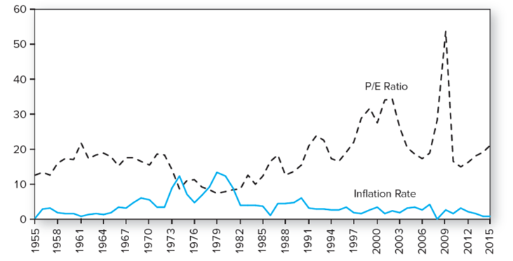
P/E Ratios of the S&P 500 Index and Inflation
Figure 18.3 P/E ratios of the S&P 500 index inflation

Slide 37
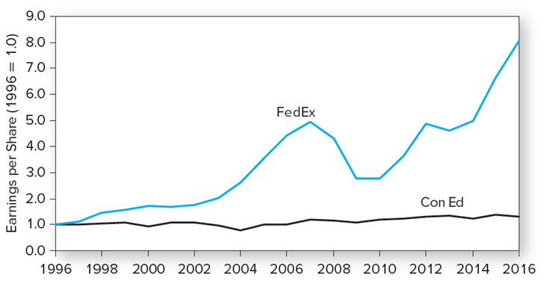
Earnings Growth for Two Companies
Figure 18.4 Earnings growth for two companies

Slide 38
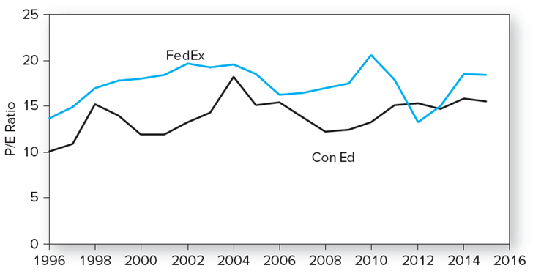
P/E Ratios for Two Companies
Figure 18.5 Price-earnings ratios

Slide 39
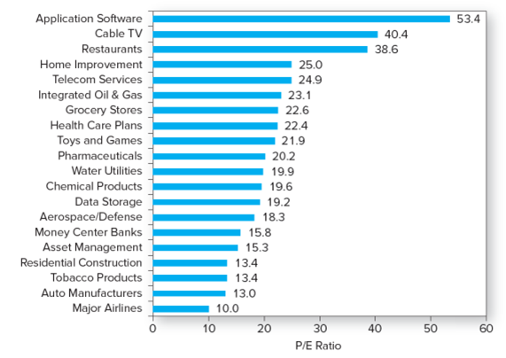
P/E Ratios for Different Industries, 2016
Figure 18.6 P/E ratios for different industries
Source: Yahoo! Finance, finance.yahoo.com, June 4, 2016.

Slide 40
Other Comparative Value Approaches
Price-to-book ratio
Price-to-cash-flow ratio
Price-to-sales ratio

Slide 41
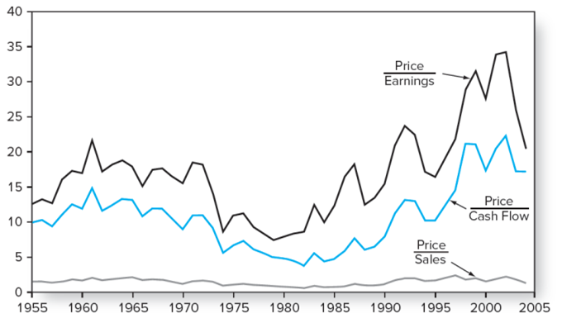
Market Valuation Statistics
Figure 18.7 Market valuation statistics

Slide 42
Free Cash Flow To the Firm Approach (1 of 2)
Value the firm by discounting free cash flow at WACC
Free cash flow to the firm, FCFF, equals:
After tax EBIT
Plus depreciation
Minus capital expenditures
Minus increase in net working capital

Slide 43
Free Cash Flow To the Firm Approach (2 of 2)
Value of the Firm:
Where

Slide 44
Free Cash Flow to Equity Approach (1 of 2)
Free cash flow to equity, FCFE, equals:
FCFF
Minus after tax interest
Plus increase in debt

Slide 45
Free Cash Flow to Equity Approach (2 of 2)
Intrinsic Value of Equity:
Where

Slide 46
Comparing the Valuation Models
In practice
Values from these models may differ
Analysts are always forced to make simplifying assumptions
Problems with DCF
Calculations are sensitive to small changes in inputs
Growth opportunities and growth rates are hard to pin down

Slide 47
Comparing the Valuation Models, GE
Model | Intrinsic Value
Two-stage dividend discount model | $53.40
DDM with earnings multiple terminal value | 33.31
Three-stage DDM | 35.70
Free cash flow to firm | 24.82
Free cash flow to equity | 27.52
Market price (from Value Line) | 30.98

Slide 48
The Aggregate Stock Market
Use of earnings multiplier approach at aggregate level
Some analysts use aggregate version of DDM
S&P 500 taken as leading economic indicator

Slide 49
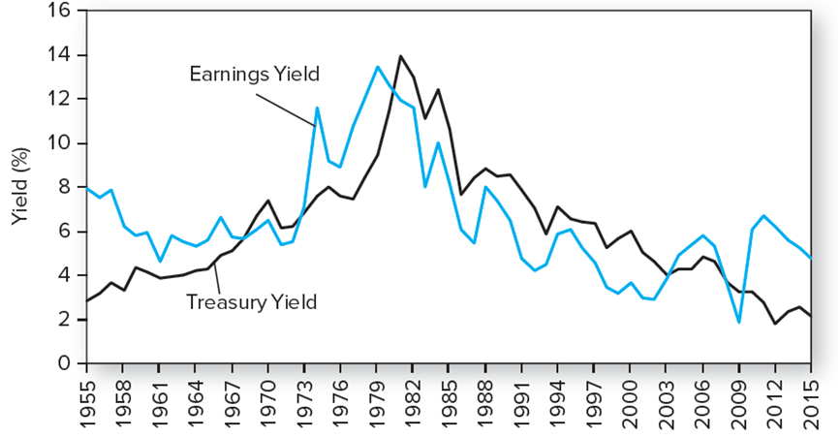
Earnings Yield, S&P 500 vs. 10-Year Treasury Bond
Figure 18.8 Earnings yield of S&P 500 versus 10-year Treasury-bond yield

Slide 50
S&P 500 Price Forecasts Under Various Scenarios
Table 18.4 S&P 500 index forecasts under various interest-rate scenarios
 | Pessimistic Scenario | Most likely Scenario | Optimistic Scenario
Treasury bond yield | 3.0% | 2.5% | 2.0%
Earnings yield | 5.6% | 5.1% | 4.6%
Resulting P/E ratio | 17.86 | 19.61 | 21.74
EPS forecast | 118 | 118 | 118
Forecast for S&P 500 | 2,107 | 2,314 | 2,565
Forecast for the earnings yield on the S&P 500 equals Treasury bond yield plus 2.6%. The P/E ratio is the reciprocal of the forecast earnings yield.

Slide 51
End of Presentation

