Slide 1
Chapter 16
Managing Bond Portfolios
INVESTMENTS | BODIE, KANE, MARCUS
© McGraw-Hill Education. All rights reserved. Authorized only for instructor use in the classroom. No reproduction or further distribution permitted without the prior written consent of McGraw-Hill Education.

Slide 2
Chapter Overview
Interest rate risk
Interest rate sensitivity of bond prices
Duration and its determinants
Convexity
Passive and active management strategies

Slide 3
Characteristics of Interest Rate Sensitivity
Bond prices and yields are inversely related
An increase in a bond’s yield to maturity → smaller price change than a decrease of equal magnitude
Long-term bonds tend to be more price sensitive than short-term bonds
As maturity increases, price sensitivity increases at a decreasing rate
Interest rate risk is inversely related to the bond’s coupon rate
Price sensitivity is inversely related to the yield to maturity at which the bond is selling

Slide 4
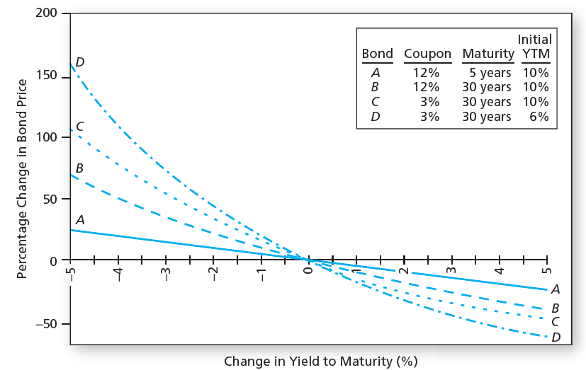
Change in Bond Price as a Function of Change in Yield to Maturity

Slide 5
Prices of 8% Coupon Bond (Coupons Paid Semiannually)
Yield to Maturity (ARP) | T=1 Year | T=10 Year | T=20 Years
8% | 1,000.00 | 1,000.00 | 1,000.00
9% | 990.64 | 934.96 | 907.99
Fall in price (%)* | 0.94% | 6.50% | 9.20%
*Equals value of bond at a 9% yield to maturity divided by value of bond at (the original) 8%yield, minus 1.

Slide 6
Prices of Zero-Coupon Bond (Semiannual Compounding)
Yield to Maturity (ARP) | T=1 Year | T=10 Year | T=20 Years
8% | 924.56 | 456.39 | 208.29
9% | 915.73 | 414.64 | 171.93
Fall in price (%)* | 0.96% | 9.15% | 17.46%
*Equals value of bond at a 9% yield to maturity divided by value of bond at (the original) 8%yield, minus 1.

Slide 7
Duration
A measure of the effective maturity of a bond
The weighted average of the times until each payment is received
The weights are proportional to the present value of the payment
Duration = Maturity for zero coupon bonds
Duration < Maturity for coupon bonds

Slide 8
Duration Calculation
Duration calculation:
CF_{t}= Cash Flow at Time t
P = Price of Bond
y= Yield to Maturity

Slide 9
Interest Rate Risk
Duration-Price Relationship
Price change is proportional to duration
D* = Modified duration

Slide 10
Duration and Interest Rate Risk (1 of 3)
Two bonds have duration of 1.8852 years
Bond A: 2-year, 8% coupon bond with YTM = 10%
Bond B: Zero coupon bond maturing in 1.8852 years
Duration of both bonds is 1.8852 × 2 = 3.7704 semiannual periods
Modified D = 3.7704/1 + 0.05 = 3.591 periods

Slide 11
Duration and Interest Rate Risk (2 of 3)
Suppose the semiannual interest rate increases by 0.01%. Bond prices fall by
Bonds with equal D → same interest rate sensitivity

Slide 12
Duration and Interest Rate Risk (3 of 3)

Slide 13
Duration Rules (1 of 2)
Rule 1
The duration of a zero-coupon bond equals its time to maturity
Rule 2
Holding maturity constant, a bond’s duration is higher when the coupon rate is lower
Rule 3
Holding the coupon rate constant, a bond’s duration generally increases with its time to maturity

Slide 14
Duration Rules (2 of 2)
Rule 4
Holding other factors constant, the duration of a coupon bond is higher when the bond’s yield to maturity is lower
Rule 5
The duration of a level perpetuity is equal to:

Slide 15
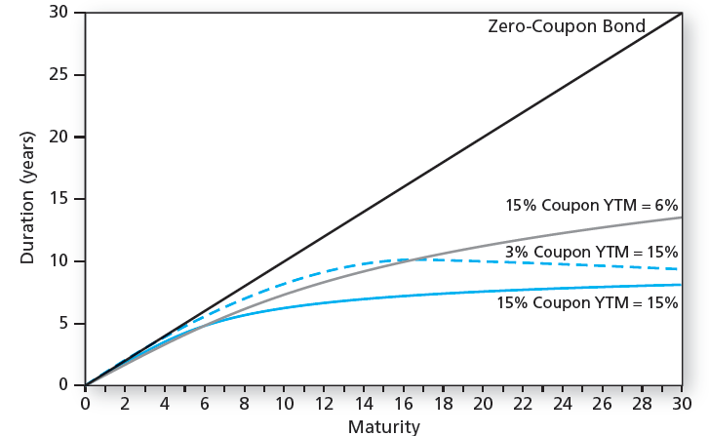
Bond Duration versus Bond Maturity

Slide 16
Bond Durations (Yield to Maturity = 8% APR; Semiannual Coupons)
Years to Maturity | 6% Coupon Rates (per year) | 8% Coupon Rates (per year) | 10% Coupon Rates (per year) | 12% Coupon Rates (per year)
1 | 0.985 | 0.981 | 0.976 | 0.972
5 | 4.361 | 4.218 | 4.095 | 3.990
10 | 7.454 | 7.067 | 6.772 | 6.541
20 | 10.922 | 10.292 | 9.870 | 9.568
Infinite (perpetuity) | 13.000 | 13.000 | 13.000 | 13.000

Slide 17
Convexity (1 of 2)
The relationship between bond prices and yields is not linear
Duration rule is a good approximation for only small changes in bond yields
Bonds with greater convexity have more curvature in the price-yield relationship

Slide 18
Convexity (2 of 2)
Correction for Convexity:

Slide 19
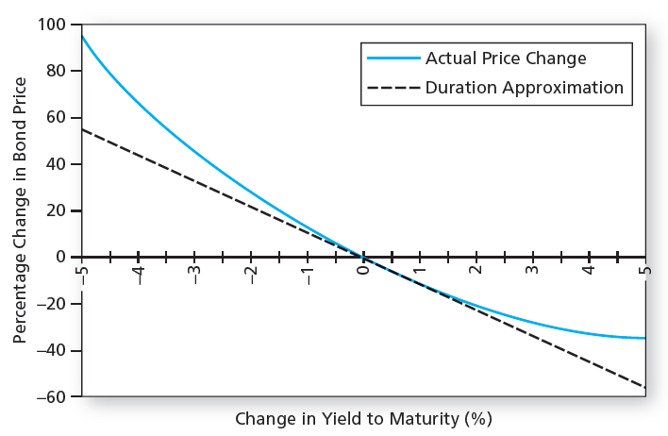
Bond Price Convexity (30-Year Maturity, 8% Coupon; Initial YTM = 8%)

Slide 20
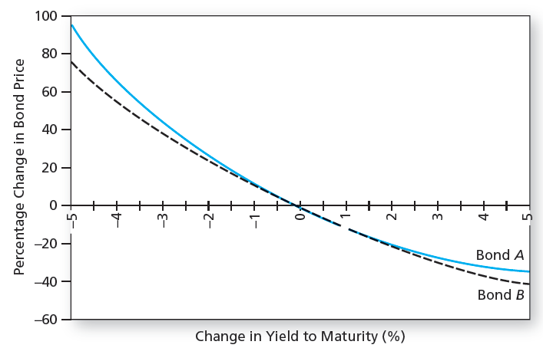
Convexity of Two Bonds

Slide 21
Why Do Investors Like Convexity?
Higher Convexity → Bigger price increases when yields fall than loses when yields rise
The more volatile interest rates, the more attractive this asymmetry
Bonds with greater convexity → higher prices and/or lower yields, all else equal

Slide 22
Duration and Convexity
Callable Bonds
As rates fall, there is a ceiling on the bond’s market price, which cannot rise above the call price
Negative convexity
Use effective duration:

Slide 23
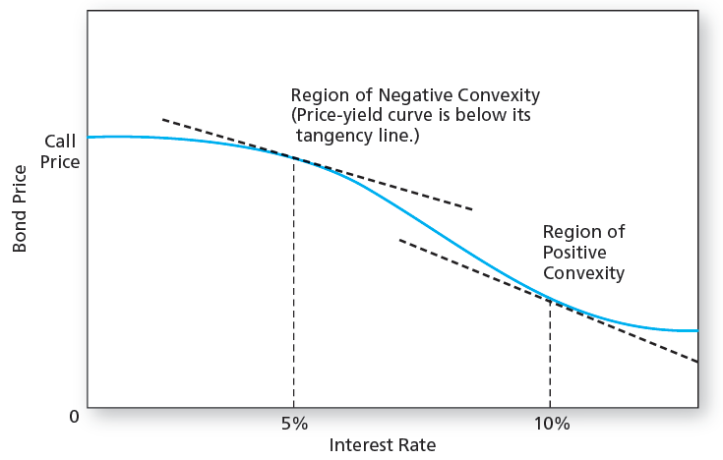
Price–Yield Curve for a Callable Bond

Slide 24
Duration and Convexity: MBS (1 of 2)
Mortgage-Backed Securities (MBS)
Though the number of outstanding callable corporate bonds has declined, the MBS market has grown rapidly
MBS are a portfolio of callable amortizing loans
Homeowners may repay their loans at any time
MBS have negative convexity

Slide 25
Duration and Convexity: MBS (2 of 2)
Mortgage-Backed Securities (MBS)
Often sell for more than their principal balance
Homeowners do not refinance as soon as rates drop, so implicit call price is not a firm ceiling on MBS value

Slide 26
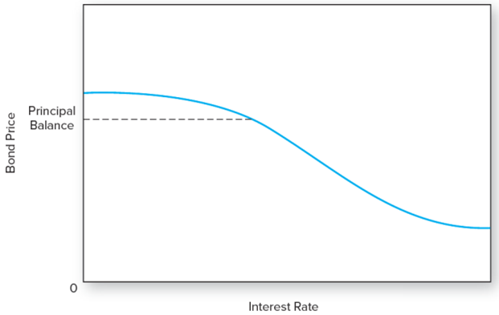
Price-Yield Curve for a Mortgage-Backed Security
Figure 16.6 Price-yield curve for a mortgage-backed security

Slide 27
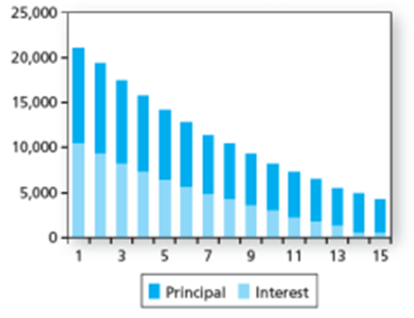
Cash Flows to Whole Mortgage Pool; Cash Flows to Three Tranches (1 of 3)
Tranches — the underlying mortgage pool is divided into a set of derivative securities
A:Whole Mortgage

Slide 28
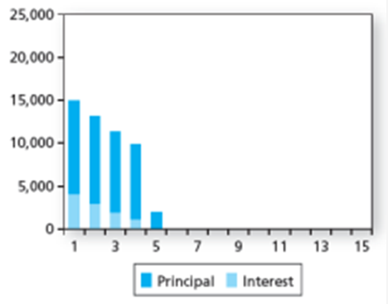
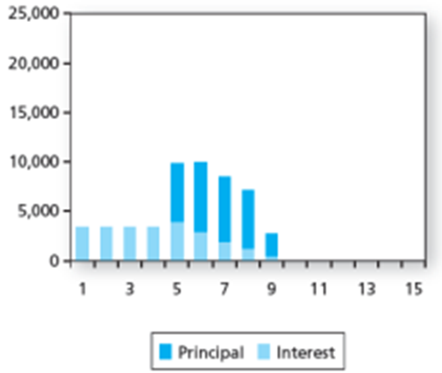
Cash Flows to Whole Mortgage Pool; Cash Flows to Three Tranches (2 of 3)
B: Tranche A
C: Tranche B

Slide 29
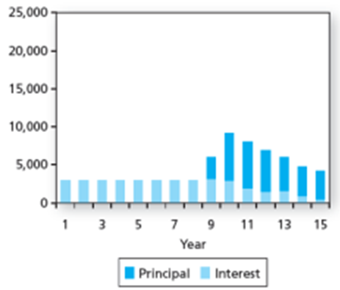
Cash Flows to Whole Mortgage Pool; Cash Flows to Three Tranches (3 of 3)
D: Tranche C
Tranche A= $4 million principal: “Short-pay” tranche
Tranche B= $3 million principal: “Intermediate-pay” tranche
Tranche C= $3 million principal: “Long-pay” tranche

Slide 30
Passive Management
Two passive bond portfolio strategies:
Indexing
Immunization
Both see market prices as being correct
Differ greatly in terms of risk

Slide 31
Passive Management: Indexing
Bond Index Funds
Contains Thousands of Issues, many of which are infrequently traded
Turnover more than stock indexes as the bonds mature
They only hold a representative sample of the bonds in the actual index

Slide 32
Stratification of Bonds into Cells
Term to Maturity/ Sector | Treasury | Agency | Mortgage-backed | Industrial | Finance | Utility | Yankee
<1 year | 12.1%
1-3 years | 5.4%
3-5 years |  |  | 4.1%
5-7 years
7-10 years |  | 0.1%
10-15 years
15-30 years |  |  | 9.2% |  |  | 3.4%
30+ years
Figure 16.8 Stratification of bonds into cells

Slide 33
Passive Management: Immunization
Control interest rate risk
Widely used by pension funds, insurance companies, and banks
The interest rate exposure of assets and liabilities are matched in the portfolio
Match the duration of the assets and liabilities
Price risk and reinvestment rate risk exactly cancel out
Value of assets match liabilities whether rates rise/fall

Slide 34
Terminal value of a Bond Portfolio After 5 Years (1 of 3)

Slide 35
Terminal value of a Bond Portfolio After 5 Years (2 of 3)

Slide 36
Terminal value of a Bond Portfolio After 5 Years (3 of 3)

Slide 37
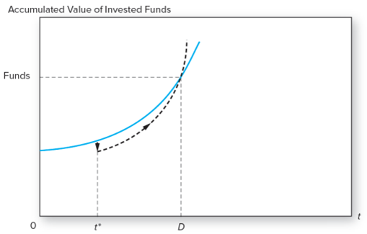
Growth of Invested Funds
Figure 16.9 Growth of invested funds. The solid colored curve represents the growth of portfolio value at the original interest rate. If interest rates increase at time t*, the portfolio value initially falls but increases thereafter at the faster rate represented by the broken curve. At time D (duration), the curve cross.

Slide 38
Table 16.5 Market Value Balance Sheet
Assets | Assets | Liabilities | Liabilities
A. Interest Rate=8%
Bonds | $10,000 | obligation | $10,000
B. Interest Rate=7%
Bonds | $10,476.65 | obligation | $10,476.11
C. Interest Rate=9%
Bonds | $9,551.41 | obligation | $9,549.62
Notes:
Value of bonds = 800 × Annuity factor (r, 6) + 10,000 × PV factor (r, 6)

Slide 39
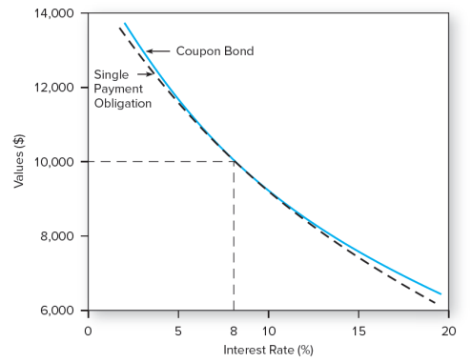
Immunization
Figure 16.10 Immunization. The coupon bond fully funds the obligation at an interest rate of 8%. Moreover, the present value curves are tangent at 8%, so the obligation will remain fully funded even if rates change by a small amount.

Slide 40
Cash Flow Matching
Cash Flow Matching and Dedication
Cash flow matching = Automatic immunization
Cash flow matching is a dedication strategy
Not widely used because of constraints associated with bond choices

Slide 41
Active Management (1 of 3)
Swapping Strategies
Substitution swap
Intermarket spread swap
Rate anticipation swap
Pure yield pickup swap
Tax swap

Slide 42
Active Management (2 of 3)
Horizon Analysis
Select a particular holding period and predict the yield curve at end of period
Given a bond’s time to maturity at the end of the holding period its yield can be read from the predicted yield curve and the end-of-period price can be calculated

Slide 43
End of Presentation

