Slide 1
Chapter 15
The Term Structure of Interest Rates
INVESTMENTS | BODIE, KANE, MARCUS
© McGraw-Hill Education. All rights reserved. Authorized only for instructor use in the classroom. No reproduction or further distribution permitted without the prior written consent of McGraw-Hill Education.

Slide 2
Chapter Overview
The yield curve
Interest rates under certainty
Interest rates under uncertainty
Theories of the term structure
  The expectation hypothesis
  Liquidity preference
Interpreting the term structure
Forward rates and contracts

Slide 3
The Yield Curve
The yield curve displays the relationship between YTM and time to maturity
Information on expected future short-term rates can be implied from the yield curve

Slide 4
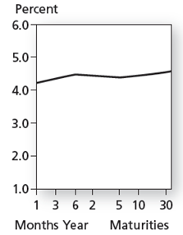
Treasury Yield Curves (1 of 4)
Treasury Yield Curve Yields as of 4:30 P.M. Eastern time
A. (January 2006) Flat Yield Curve

Slide 5
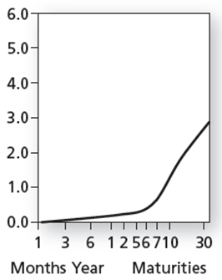
Treasury Yield Curves (2 of 4)
Treasury Yield Curve Yields as of 4:30 P.M. Eastern time
B. (December 2012) Rising Yield Curve

Slide 6
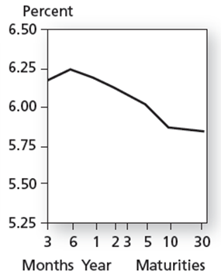
Treasury Yield Curves (3 of 4)
Treasury Yield Curve Yields as of 4:30 P.M. Eastern time
C. (September 11, 2000) Inverted Yield Curve

Slide 7
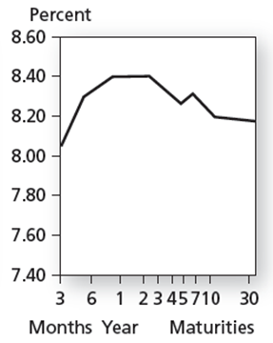
Treasury Yield Curves (4 of 4)
Treasury Yield Curve Yields as of 4:30 P.M. Eastern time
D. (October 4, 1989) Hump-Shaped Yield Curve

Slide 8
Yield Curve: Bond Pricing
Yields on different maturity bonds are not all equal
Consider each bond cash flow as a stand-alone zero-coupon bond
Bond stripping and bond reconstitution offer opportunities for arbitrage
The value of the bond should be the sum of the values of its parts

Slide 9
Prices and Yields to Maturities on
Zero-Coupon Bonds ($1,000 Face Value)

Slide 10
Valuing Coupon Bonds
Value a 3 year, 10% coupon bond using discount rates from Table 15.1:
  Price = $1082.17 and YTM = 6.88%
  6.88% is less than the 3-year rate of 7%

Slide 11
Bond Pricing:
Two Types of Yield Curves
Pure Yield Curve | On-the-Run Yield Curve
Uses stripped or zero coupon Treasuries | Uses recently-issued coupon bonds selling at or near par
May differ significantly from the on-the-run yield curve | The one typically published by the financial press

Slide 12
The Yield Curve and
Future Interest Rates (1 of 5)
Yield Curve Under Certainty
  Suppose you want to invest for 2 years
    Buy and hold a 2-year zero
    or
    Rollover a series of 1-year bonds
  Equilibrium requires that both strategies provide the same return

Slide 13
The Yield Curve and
Future Interest Rates (2 of 5)
Yield Curve Under Certainty
  Buy and hold vs. rollover:
  (r₂) is just enough to make rolling over a series of 1-year bonds equal to investing in the 2-year bond

Slide 14
The Yield Curve and
Future Interest Rates (3 of 5)
Yield Curve Under Certainty
  Spot rate
    The rate that prevails today for a given maturity
  Short rate
    The rate for a given maturity (e.g., one year) at different points in time
  A spot rate is the geometric average of its component short rates

Slide 15
The Yield Curve and
Future Interest Rates (4 of 5)
Short Rates and Yield Curve Slope
When next year’s short rate, r2 > r1, the yield curve slopes up | When next year’s short rate, r2 < r1, the yield curve slopes down
May indicate rates are expected to rise | May indicate rates are expected to fall

Slide 16
The Yield Curve and
Future Interest Rates (5 of 5)
Forward rates
  f_{n} = One-year forward rate for period n
  y_{n} = Yield for a security with a maturity of n

Slide 17
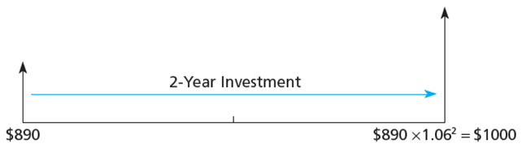
Two 2-Year Investment Programs (1 of 2)
Time Line
Alternative 1: Buy and hold 2-year zero

Slide 18
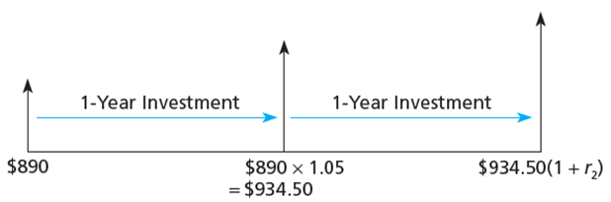
Two 2-Year Investment Programs (2 of 2)
Alternative 2: Buy a 1-year zero, and reinvest proceeds in another 1-year zero

Slide 19
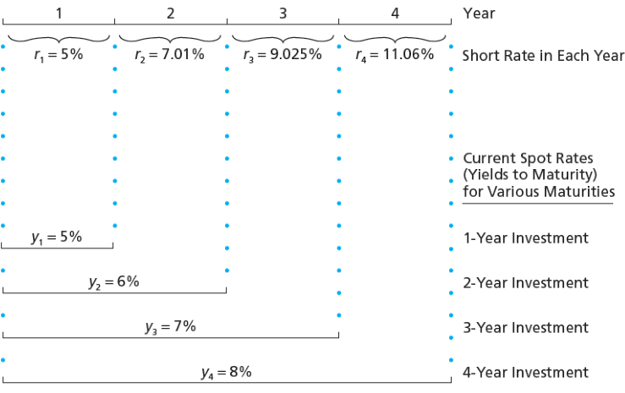
Short Rates versus Spot Rates

Slide 20
Forward Rates
The forward interest rate is a forecast of a future short rate
Rate for 4-year maturity = 8%
Rate for 3-year maturity = 7%

Slide 21
Interest Rate Uncertainty and
Forward Rates (1 of 3)
Suppose that today’s rate is 5% and the expected short rate for the following year is E(r₂) = 6%. The value of a 2-year zero is:
The value of a 1-year zero is:

Slide 22
Interest Rate Uncertainty and
Forward Rates (2 of 3)
The investor wants to invest for 1 year
  Buy the 2-year bond today and plan to sell it at the end of the first year for $1000/1.06 = $943.40
  or
  Buy the 1-year bond today and hold to maturity
What if next year’s interest rate differs from 6%?
  The actual return on the 2-year bond is uncertain!

Slide 23
Interest Rate Uncertainty and
Forward Rates (3 of 3)
Investors require a risk premium to hold a longer-term bond
This liquidity premium compensates short-term investors for the uncertainty about future prices

Slide 24
Theories of Term Structure
(1 of 2)
The Expectations Hypothesis Theory
  Observed long-term rate is a function of today’s short-term rate and expected future short-term rates
  f_{n} = E(r_{n}) and liquidity premiums are zero

Slide 25
Theories of Term Structure
(2 of 2)
Liquidity Preference Theory
  Long-term bonds are more risky→ f_{n} > E(r_{n})
  The excess of f_{n} over E(r_{n}) is the liquidity premium
  The yield curve has an upward bias built into the long-term rates because of the liquidity premium

Slide 26
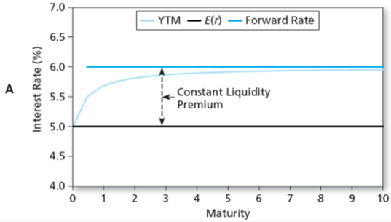
Yield Curve Examples
(1 of 4)
Panel A:
Constant Expected Short Rate
Constant Liquidity Premium

Slide 27
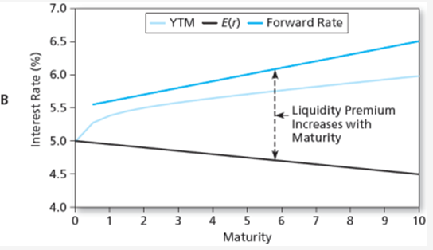
Yield Curve Examples
(2 of 4)
Panel B:
Declining Expected Short Rate
Increasing Liquidity Premiums

Slide 28
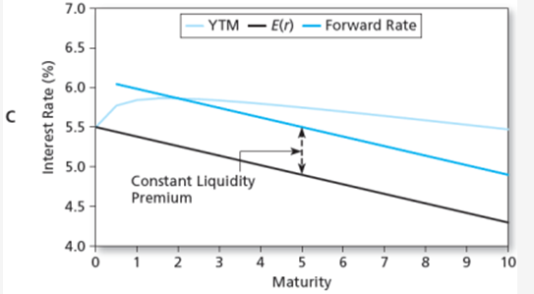
Yield Curve Examples
(3 of 4)
Panel C:
Declining Expected Short Rate
Constant Liquidity Premiums

Slide 29
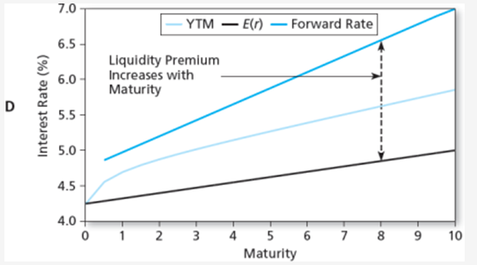
Yield Curve Examples
(4 of 4)
Panel D:
Increasing Expected Short Rates
Increasing Liquidity Premiums

Slide 30
Interpreting the Term Structure
(1 of 2)
The yield curve reflects expectations of future interest rates
The forecasts are clouded by liquidity premiums
An upward sloping curve could indicate:
  Rates are expected to rise
  and/or
  Investors require large liquidity premiums to hold long term bonds

Slide 31
Interpreting the Term Structure
(2 of 2)
The yield curve is a good predictor of the business cycle
  Long term rates tend to rise in anticipation of economic expansion
  Inverted yield curve may indicate that interest rates are expected to fall and signal a recession

Slide 32
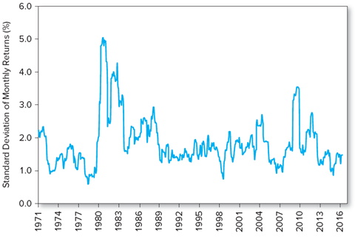
Price Volatility of Long-Term
Treasury Bonds

Slide 33
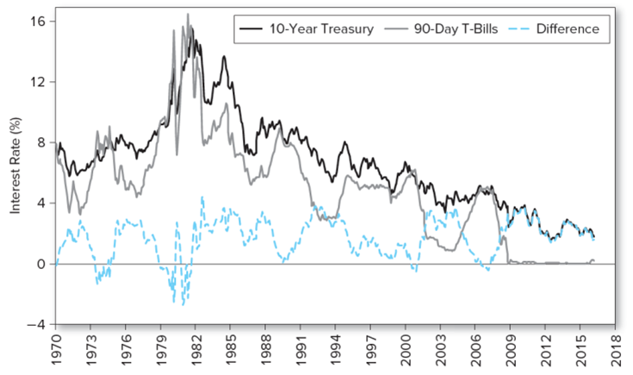
Term Spread: Yields on 10-year vs. 90-day Treasury Securities

Slide 34
Forward Rates as Forward Contracts
In general, forward rates will not equal the eventually realized short rate
  Still an important consideration when trying to make decisions
    Locking in loan rates

Slide 35
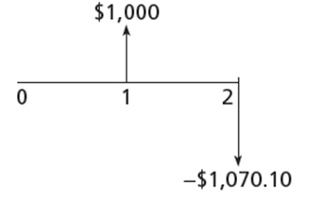
Engineering a Synthetic Forward Loan (1 of 2)
A: Forward Rate: 7.01%

Slide 36
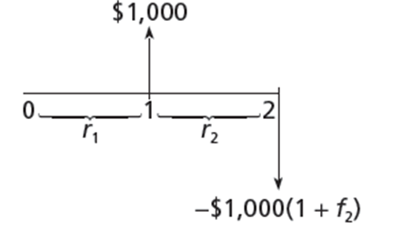
Engineering a Synthetic Forward Loan (2 of 2)
B. For a General Forward Rate. The short rates in the two periods are r₁ (which is observable today) and r₂ (which is not). The rate that can be locked in for a one-period-ahead loan is f₂.

Slide 37
End of Presentation

