Slide 1
Chapter 14
Bond Prices and Yields
INVESTMENTS | BODIE, KANE, MARCUS
© McGraw-Hill Education. All rights reserved. Authorized only for instructor use in the classroom. No reproduction or further distribution permitted without the prior written consent of McGraw-Hill Education.

Slide 2
Overview
Debt (Fixed-Income) securities characteristics
  Types of bonds
Bond pricing
  Prices and yield
  Prices over time
Impact of default and credit risk on bond pricing
  Credit default swaps
  Collateralized debt obligations

Slide 3
Bond Characteristics
Bonds are debt that obligate issuers (borrowers) to bondholders (creditors)
  Face value:
    Typically $1000
  Coupon rate:
  Indenture:
Notes:
Face or par value is the principal repaid at maturity
The coupon rate determines the interest payment (“coupon payments”) paid semiannually
The indenture is the contract between the issuer and the bondholder that specifies the coupon rate, maturity date, and par value

Slide 4
U.S. Treasury Bonds
Bonds and notes may be purchased directly from the Treasury
  Note maturity: 1-10 years
  Bond maturity: 10-30 years
Denomination
  As small as $100
  $1,000 is more common

Slide 5
Corporate Bonds
Callable bonds:
Convertible bonds:
Puttable Bonds:
Floating-rate bonds:
Notes:
Callable bonds: Can be repurchased before the maturity date
Convertible bonds: Can be exchanged for shares of the firm’s common stock
Puttable Bonds: Give the holder an option to retire or extend the bond
Floating-rate bonds: Have adjustable coupon rate

Slide 6
Preferred Stock
Shares characteristics of fixed income and equity
  Like Fixed Income
    Payments are typically Fixed
    Preferred dividends are paid before common
  Like Equity
    Dividends are paid in perpetuity
    Nonpayment does not mean bankruptcy
    No tax break

Slide 7
International Bonds
Foreign Bonds:
  Eurodollar:
  Euroyen:
  Eurosterling:
Eurobonds:
  Yankee Bonds:
  Samurai Bonds:
  Bulldog Bonds:
Notes:
Foreign Bonds: Issued by a borrower from a country other than the one in which the bond is sold.
Eurobond: Denominated in one currently, usually that of the issue, but sold in other national markets.

Slide 8
Innovation in the Bond Market
Inverse Floaters
Asset-Backed Bonds
Catastrophe Bonds
Indexed Bonds
  Treasury Inflation Protected Securities (TIPS)

Slide 9
Principal and Interest Payments for TIPS
Time | Inflation in year Just Ended | Par Value | Coupon Payment | + | Principal Repayment | = | Total Payment
0 |  | $1,000.00
1 | 2% | 1,020.00 | $40.80 |  | $ 0 |  | $ 40.80
2 | 3 | 1,050.60 | 42.02 |  | 0 |  | 42.02
3 | 1 | 1,061.11 | 42.44 |  | 1,061.11 |  | 1,103.55

Slide 10
Bond Pricing (1 of 2)
P_{B} = Price of the bond
C_{t} = Interest or coupon payments
T = Number of periods to maturity
r = Semi-annual discount rate or the semi-annual yield to maturity

Slide 11
Bond Pricing (2 of 2)
Price of a 30 year, 8% coupon bond. Market rate of interest is 10%

Slide 12
Bond Prices and Yields
Prices and yields have an inverse relationship
The bond price curve is convex
The longer the maturity → the more sensitive the bond’s price to changes in market interest rates

Slide 13
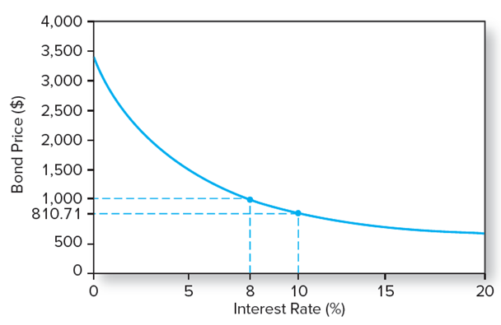
The Inverse Relationship Between Bond Prices and Yields
Figure 14.3 The inverse relationship bond prices and yields. Price of an 8% coupon bond with 30-year maturity making semiannual payments

Slide 14
Table 14.2 Bond Prices at Different Interest Rates
Time to Maturity | Bond Price at Given Market Interest Rate: 2% | Bond Price at Given Market Interest Rate: 4% | Bond Price at Given Market Interest Rate: 6% | Bond Price at Given Market Interest Rate: 8% | Bond Price at Given Market Interest Rate: 10%
1 year | 1,059.11 | 1,038.83 | 1,019.13 | 1,000.00 | 981.41
10 years | 1,541.37 | 1,327.03 | 1,148.77 | 1,000.00 | 875.35
20 years | 1,985.04 | 1,547.11 | 1,231.15 | 1,000.00 | 828.41
30 years | 2,348.65 | 1,695.22 | 1,276.76 | 1,000.00 | 810.71
Bond prices at different interest rates (8 % coupon bond, Coupon paid semiannually)

Slide 15
Bond Yields: Yield to Maturity
Yield To Maturity:
Solve the bond formula for r:
Notes:
Yield to Maturity: Interest rate that makes the present value of the bond’s payments equal to its price.

Slide 16
Yield to Maturity Example
Suppose an 8% coupon, 30 year bond is selling for $1276.76. What is its average rate of return?
  r = 3% per half year
  Bond equivalent yield = 6%
  EAR = ((1.03)²) - 1 = 6.09%

Slide 17
Bond Yields: YTM Versus Current Yield (1 of 2)
Yield to Maturity
  Bond’s internal rate of return
  The interest rate → PV of a bond’s payments equal to its price
  Assumes that all bond coupons can be reinvested at the YTM
Notes:
Yield to Maturity: Bond’s internal rate of return
Current Yield: Bond’s annual coupon payment divided by the bond price

Slide 18
Bond Yields: YTM Versus Current Yield (2 of 2)
Current Yield:
  Bond’s annual coupon payment divided by the bond price
Premium Bonds: Coupon rate > Current yield > YTM
Discount Bonds: Coupon rate < Current yield < YTM

Slide 19
Bond Yields: Yield to Call
Low Interest Rates: The price of the callable bond is flat since the risk of repurchase or call is high
High Interest Rates: The price of the callable bond converges to that of a normal bond since the risk of call is negligible

Slide 20
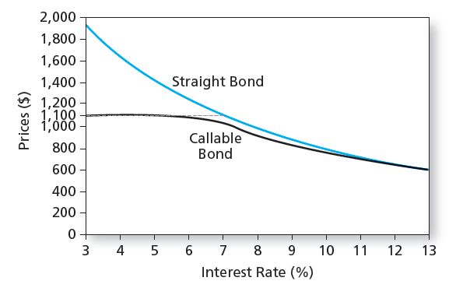
Bond Prices: Callable and Straight Debt

Slide 21
Bond Yields: Realized Yield versus YTM
Reinvestment Assumptions
Holding Period Return
  Changes in rates affect returns
  Reinvestment of coupon payments
  Change in price of the bond

Slide 22
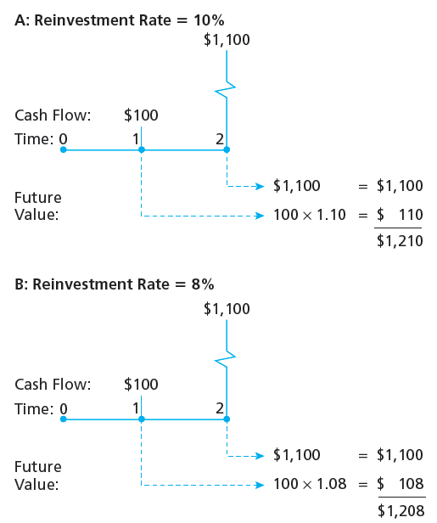
Growth of Invested Funds

Slide 23
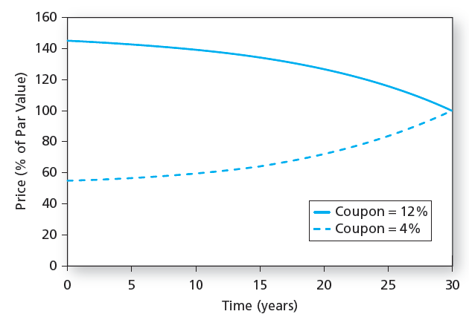
Prices over Time of 30-Year Maturity Bonds

Slide 24
Bond Prices Over Time: YTM versus HPR
YTM | HPR
It is the average return if the bond is held to maturity | It is the rate of return over a particular investment period
Depends on coupon rate, maturity, and par value | Depends on the bond’s price at the end of the holding period, an unknown future value
All of these are readily observable | Can only be forecasted

Slide 25
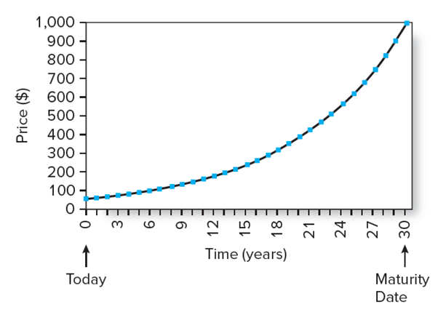
The Price of a 30-Year Zero-Coupon Bond over Time
Figure 14.7 The price of a 30-year zero-coupon bond over time at a yield to maturity of 10%. Price equals 1,000/(1.10)^{T}, where T is time until maturity.

Slide 26
Default Risk and Bond Pricing (1 of 2)
Rating companies
  Moody’s Investor Service, Standard & Poor’s, Fitch
Rating Categories
  Highest rating is AAA or Aaa
  Investment grade bonds: Rated BBB/Baa and above
  Speculative grade/junk bonds: Ratings below BBB or Baa

Slide 27
Default Risk and Bond Pricing (2 of 2)
Determinants of bond Safety
  Coverage ratios
  Leverage ratios, debt-to-equity ratio
  Liquidity ratios
  Profitability ratios
  Cash flow-to-debt ratio

Slide 28
Financial Ratios and Default Risk by Rating Class, Long-Term Debt (1 of 2)
 | Aaa | Aa | A | Baa | Ba | B | C
EBITA/Assets (%) | 20.9% | 15.6% | 13.8% | 10.9% | 9.1% | 7.1% | 4.0%
Operating profit margin (%) | 22.0% | 17.1% | 17.6% | 14.1% | 11.2% | 8.9% | 4.1%
EBITA to interest coverage (multiple) | 28.9% | 15.1% | 9.7 | 5.9 | 3.5 | 1.7 | 0.6
Debt/EBITDA (multiple) | 0.58 | 2.03 | 1.83 | 2.58 | 3.41 | 5.26 | 8.35
Debt/(Debt + Equity) | 19.3% | 50.2% | 38.6% | 46.2% | 51.7% | 72.0% | 98.0%
Funds from operations/Total debt (multiple) | 1.335 | 0.385 | 0.425 | 0.296 | 0.206 | 0.120 | 0.031
Retained cash flow/Net debt (multiple) | 1.3 | 0.3 | 0.4 | 0.3 | 0.2 | 0.1 | 0.0

Slide 29
Financial Ratios and Default Risk by Rating Class, Long-Term Debt (2 of 2)
Table 14.3 Financial ratios by rating class
Note: EBITA is earnings before interest, taxes, and amortization. EBITDA is earnings before interest, taxes, depreciation, and amortization.
Source: Moody's Financial Metrics, Key Ratios by Rating and Industry for Global Non-Financial Corporations, December 2013.

Slide 30
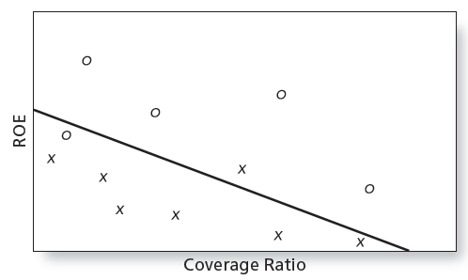
Discriminant Analysis

Slide 31
Default Risk and Bond Pricing:
Bond Indentures
Sinking funds: A way to call bonds early
Subordination of future debt: Restrict additional borrowing
Dividend restrictions: Force firm to retain assets rather than paying them out to shareholders
Collateral: A particular asset bondholders receive if the firm defaults

Slide 32
YTM and Default Risk
The risk structure of interest rates refers to the pattern of default premiums
There is a difference between the yields based on expected cash flows and promised cash flows
Default risk premium: the difference between the expected YTM and the promised YTM

Slide 33
Altman Z-Score and Default Risk
Z < 1.23 → Vulnerability to Bankruptcy
Z > 2.90 → Considered Safe

Slide 34
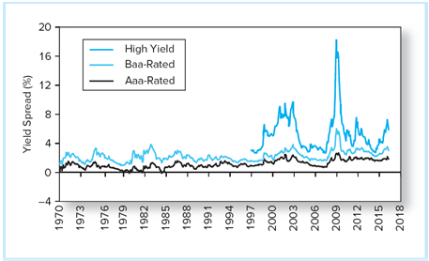
Yield Spreads
Figure 14.11 Yield spreads between corporate and 10-year Treasury bonds
Source: Federal Reserve Bank of St. Louis

Slide 35
Default Risk and CDS (1 of 2)
Credit Default Swaps (CDS)
  Institutional bondholders used CDS to enhance creditworthiness of their loan portfolios, to manufacture AAA debt
  Can also be used to speculate that bond prices will fall
    This means there can be more CDS outstanding than there are bonds to insure

Slide 36
Default Risk and CDS (2 of 2)
Collateralized Debt Obligations (CDOs)
  Major mechanism to reallocate credit risk in the fixed-income markets
  Structured Investment Vehicle (SIV) often used to create the CDO
  Loans are pooled together and split into tranches with different levels of default risk
  Mortgage-backed CDOs were an investment disaster in 2007-2009

Slide 37
Figure 14.13 Collateralized Debt Obligations
 |  | Senior-Subordinated Trench. Structure | Typical Terms
 |  | Senior tranche | 70-90% of notional principal, coupon similar to Aa-Aaa rated bonds
 |  | Mezzanine 1 | 5-15% of principal, investment-grade rating
Bank | Structured investment vehicle, SIV
 |  | Mezzanine 2 | 5-15% of principal, higher-quality junk rating
 |  | Equity/first loss/ residual tranche | <2%, unrated, coupon rate with 20% credit spread

Slide 38
End of Presentation

