Slide 1
Cross-border
Mergers & acquisitions
Chris Droussiotis
December 2018

Slide 2


Course outline
Course Outline

Slide 3
Day three
Mergers & acquisitions – process (first round & second)
Accretion ABD dilution analysis
Worksheet:
  Valuation Workshop: (5 methods of Valuation)
  Due Diligence process and Case studies of choosing the right acquisition candidate.

Slide 4
Merging with a publicly traded company first round process (SEC driven)
Contact Prospective Buyers
Negotiate and Execute Confidentiality Agreements with Interested Parties
Distribute Confidential Information Memorandum and Initial Bid Procedures Letter
Prepare Management Presentation
Set up Data Room
Prepare Stapled Financing Package (if applicable)
Receive Initial Bids and Select Buyers to Proceed to Second Round

Slide 5
Merging with a publicly traded company second round process (SEC driven)
Contact Management Presentations
Facilitate Site Visits
Provide Data Room Access
Distribute Final Bid Procedures Letter and Draft Definitive Agreement
Receive Final Bids

Slide 6
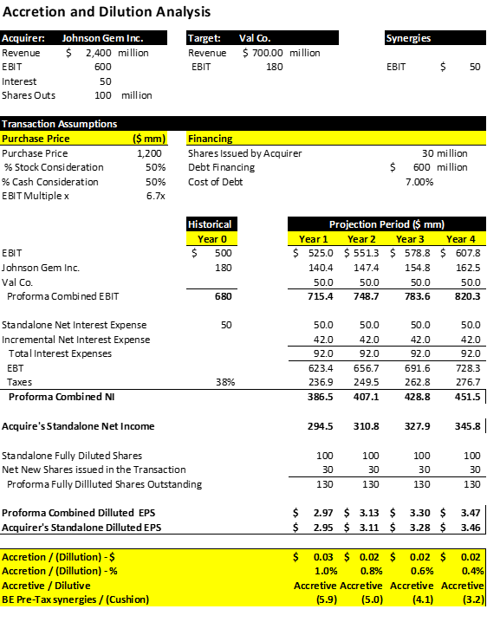
Merging
with a publicly traded company
Accretion & Dilution Analysis

Slide 7
WORKSHOP (MEET AT THE COMPUTER LAB)
THE INSTRUCTOR WILL PROVIDE CASE STUDIES FOR VALUATION AND DUE DILLIGENCE REVIEW
THE STUDENTS WILL HAVE A CHANCE TO REVIEW THE COMPANY AND PERFORM VALUATIONS

